Slide 1
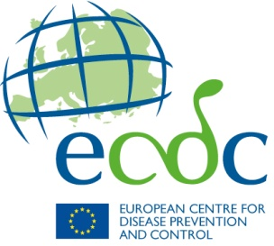
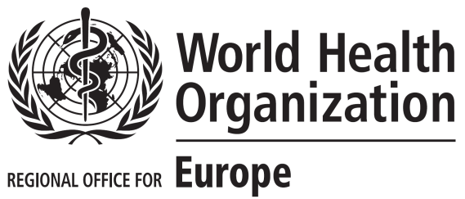
2014
HIV/AIDS Surveillance in the European Union and European Economic Area (EU/EEA)
European Centre for Disease Prevention and Control, Stockholm
WHO Regional Office for Europe, Copenhagen

Slide 2
HIV diagnoses in the EU/EEA, 2014
Reporting countries/Number of countries | 31/31
Number of HIV diagnoses | 29 992
Rate per 100 000 population (adjusted rate*) | 5.9 (6.4)
Percentage age 15-24 years | 11.1
Male-to-female ratio | 3.3
Transmission mode (%)
Sex between men | 42
Heterosexual | 33
Injecting drug use | 4
Mother to child transmission | <1
Unknown | 20
* Rate adjusted for reporting delay for the most recent year of reporting due to the lag in cases being reported to European level in some countries
Source: ECDC/WHO (2015). HIV/AIDS Surveillance in Europe, 2014

Slide 3
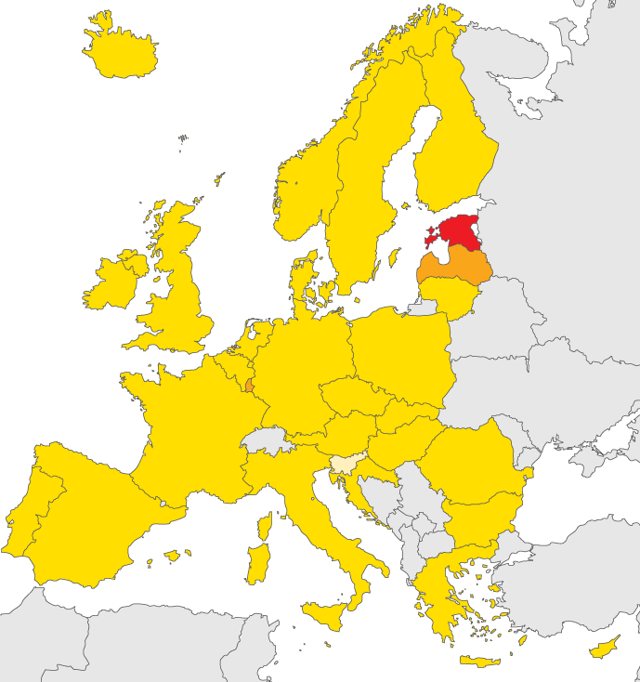
New HIV diagnoses, 2014, EU/EEA
Rate per 100 000 population
< 2
2 to <10
10 to <20
> 20
Not included or
not reporting
EU/EEA rate 5.9 per 100 000*
Non-visible countries
Liechtenstein
Luxembourg
Malta
Source: ECDC/WHO (2015). HIV/AIDS Surveillance in Europe, 2014
* EU rate adjusted for reporting delay is 6.4 per 100 000

Slide 4
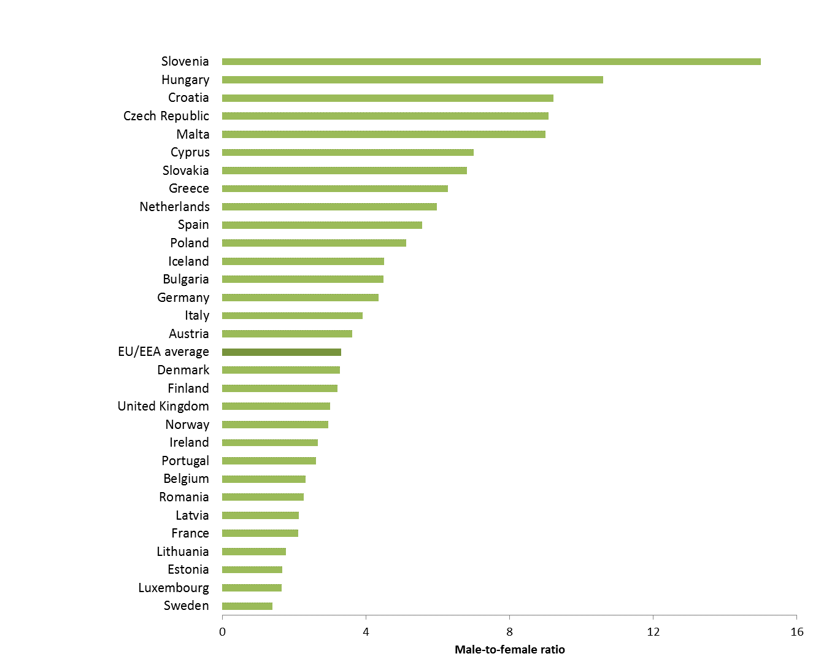
Male-to-female ratio, new HIV diagnoses, by country, EU/EEA, 2014 (n= 29 912)
Source: ECDC/WHO (2015). HIV/AIDS Surveillance in Europe, 2014

Slide 5
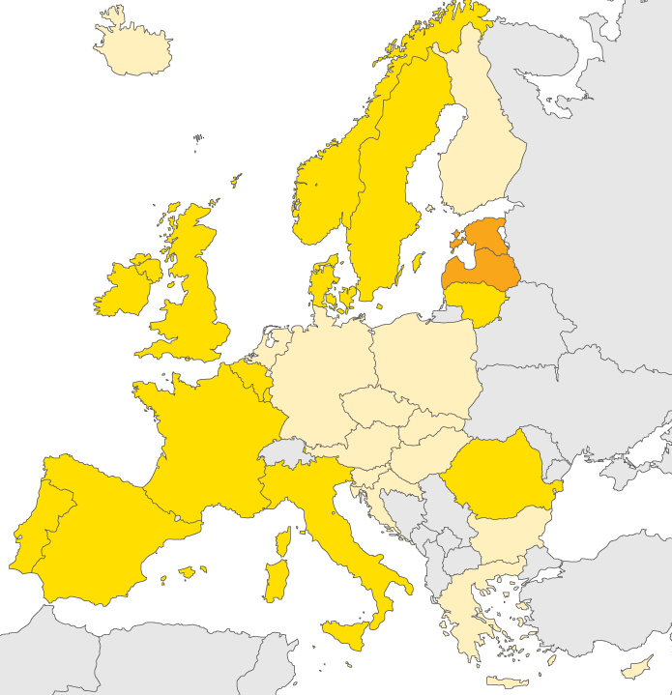
HIV diagnoses in women, 2014, EU/EEA
Rate per 100 000 female population
< 2
2 to <10
10 to <20
> 20
Not included or
not reporting
EU/EEA rate 2.6 per 100 000
Non-visible countries
Liechtenstein
Luxembourg
Malta
Source: ECDC/WHO (2015). HIV/AIDS Surveillance in Europe, 2014

Slide 6
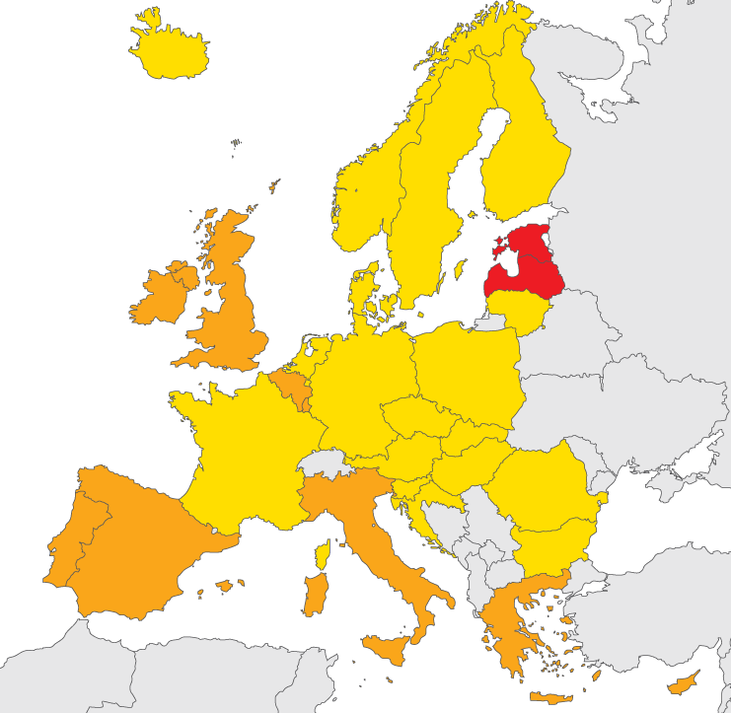
HIV diagnoses in men, 2014, EU/EEA
Rate per 100 000 male population
< 2
2 to <10
10 to <20
> 20
Not included or
not reporting
EU/EEA rate 9.2 per 100 000
Non-visible countries
Liechtenstein
Luxembourg
Malta
Source: ECDC/WHO (2015). HIV/AIDS Surveillance in Europe, 2014

Slide 7
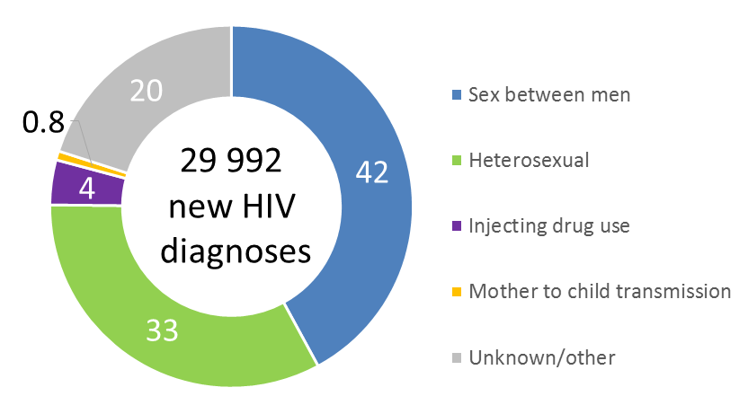
Percentage of HIV diagnoses, by route of transmission, 2014, EU/EEA
Source: ECDC/WHO (2015). HIV/AIDS Surveillance in Europe, 2014

Slide 8
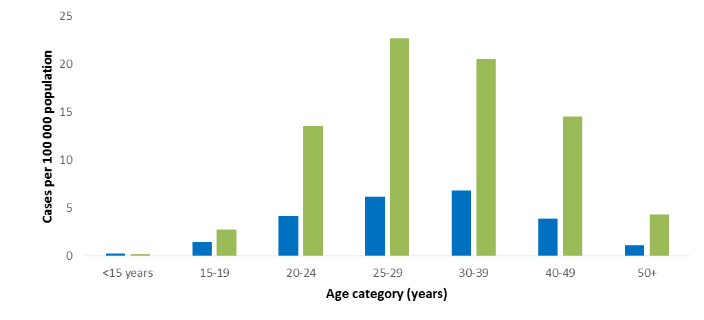
Age- and gender-specific rates of new HIV diagnoses, EU/EEA, 2014 (n=29 923)
Women
Men
Source: ECDC/WHO (2015). HIV/AIDS Surveillance in Europe, 2014

Slide 9
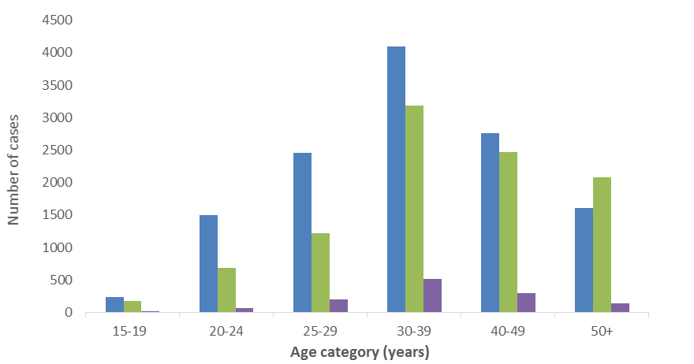
Number of new HIV diagnoses, by age group and transmission mode, EU/EEA,
2014 (n=23 747)
Sex between men
Heterosexual
Injecting drug use
Data from people <15, other/unknown transmission, mother-to-child transmission, transfusion-related transmission, and nosocomial transmission not shown here.
Source: ECDC/WHO (2015). HIV/AIDS Surveillance in Europe, 2014

Slide 10
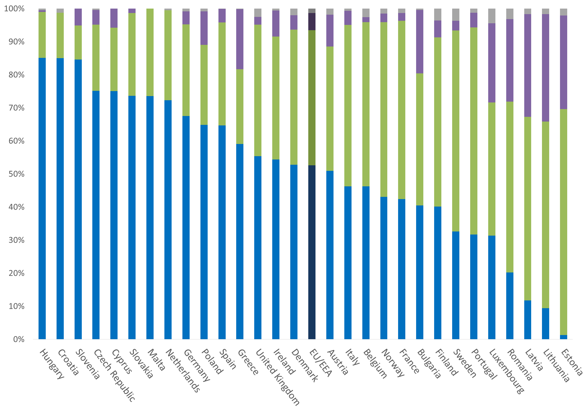
Percentage of new HIV diagnoses with known mode of transmission, EU/EEA, 2014 (n= 24 083)
Other
Injecting drug use
Heterosexual
Sex between men
Unknown mode of transmission is excluded from proportions presented here. Countries reporting only one case in 2014 (Liechtenstein and Iceland) are not presented here.
Source: ECDC/WHO (2015). HIV/AIDS Surveillance in Europe, 2014

Slide 11
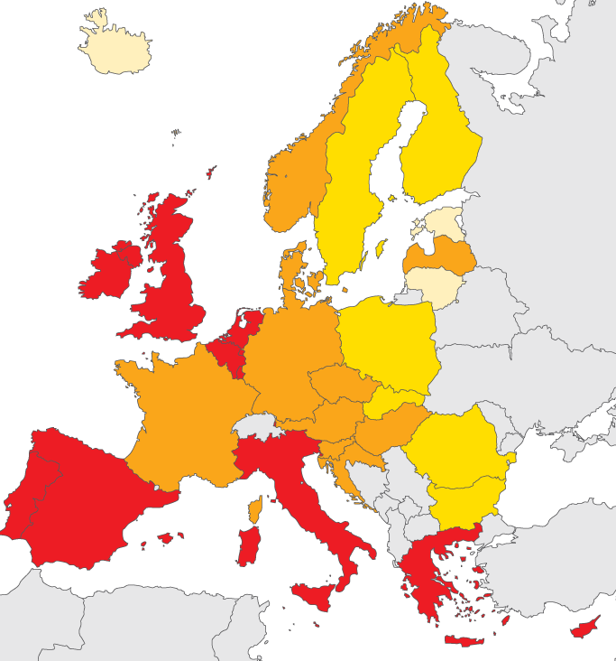
HIV diagnoses attributed to sex between men, 2014, EU/EEA
Rate per 100 000 male population
< 1
1 to <3
3 to <5
> 5
Not included or
not reporting
Non-visible countries
Liechtenstein
Luxembourg
Malta
Source: ECDC/WHO (2015). HIV/AIDS Surveillance in Europe, 2014

Slide 12
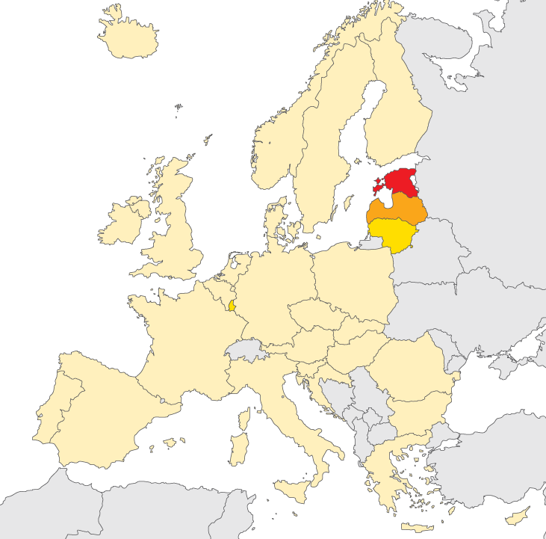
HIV diagnoses acquired through injecting drug use, 2014, EU/EEA
Rate per 100 000 population
< 1
1 to <3
3 to <5
> 5
Not included or
not reporting
Non-visible countries
Liechtenstein
Luxembourg
Malta
Source: ECDC/WHO (2015). HIV/AIDS Surveillance in Europe, 2014

Slide 13
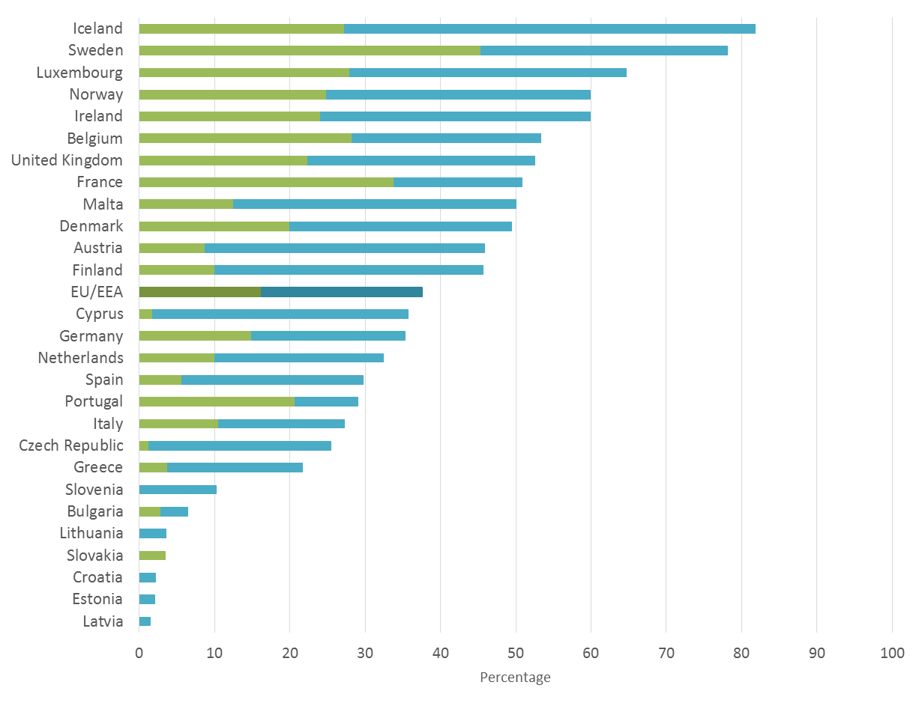
Proportion HIV diagnoses among migrants* by country of report, EU/EEA, 2014 (n= 25 525)
New diagnoses in people originating from countries with generalised HIV epidemics
New diagnoses in people originating from other countries
* Migrants are all persons born outside of the country in which the diagnosis was made. Data presented here are among cases with known region of origin; There were no cases reported among migrants in Hungary, Liechtenstein, Poland or Romania
Source: ECDC/WHO (2015). HIV/AIDS Surveillance in Europe, 2014

Slide 14
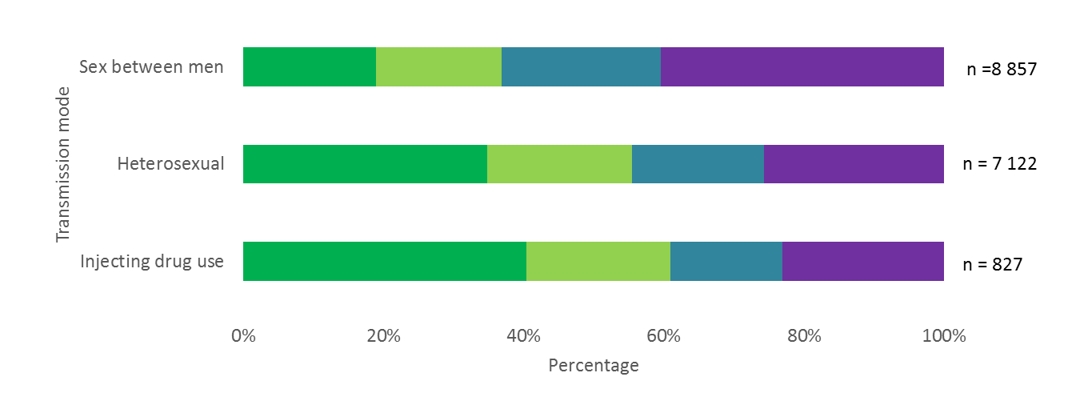
New HIV diagnoses, by CD4 cell count per mm³ at diagnosis and transmission mode, EU/EEA, 2014
< 200 cells/mm³
200 to <350 cells/mm³
350 to <500 cells/mm³
>500 cells/mm³
Source: ECDC/WHO (2015). HIV/AIDS Surveillance in Europe, 2014

Slide 15
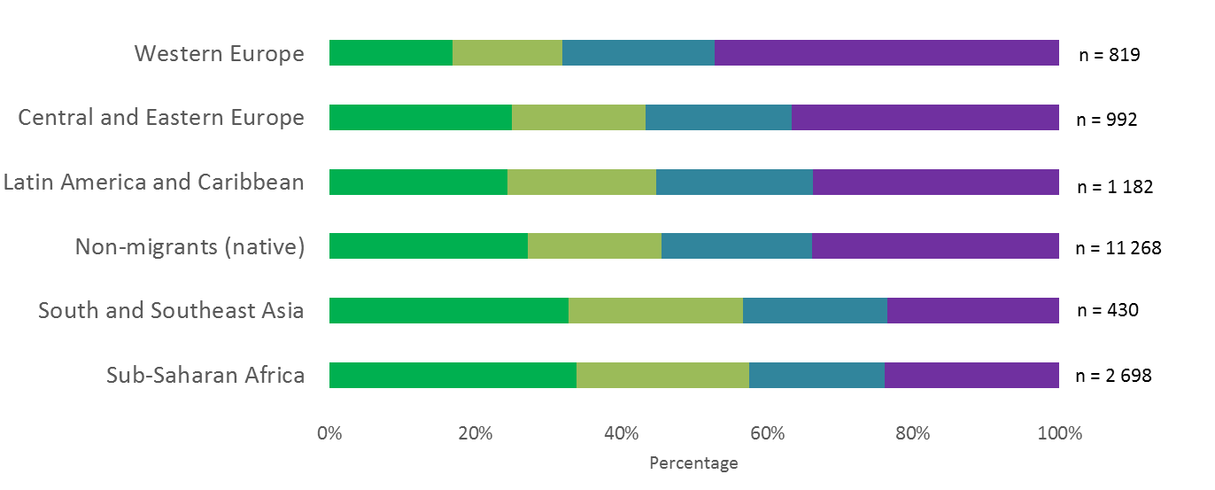
New HIV diagnoses, by CD4 cell count per mm³ at diagnosis and region of origin of the case, EU/EEA, 2014
< 200 cells/mm³
200 to <350 cells/mm³
350 to <500 cells/mm³
>500 cells/mm³
Source: ECDC/WHO (2015). HIV/AIDS Surveillance in Europe, 2014

Slide 16
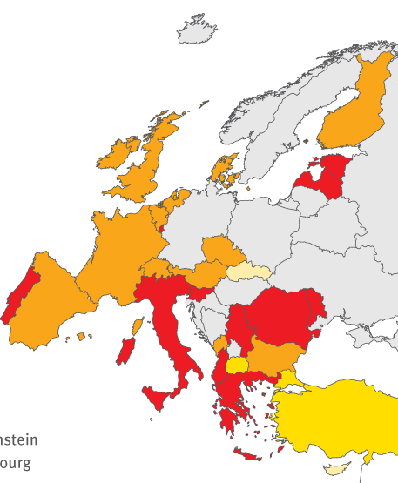
Proportion of HIV cases diagnosed late (CD4<350 cells/mm³), 2014, EU/EEA
< 30%
30 to <40%
40 to 50%
> 50%
Not included or
not reporting
Non-visible countries
Liechtenstein
Luxembourg
Malta
Source: ECDC/WHO (2015). HIV/AIDS Surveillance in Europe, 2014
*Among cases with CD4 count at diagnosis reported

Slide 17
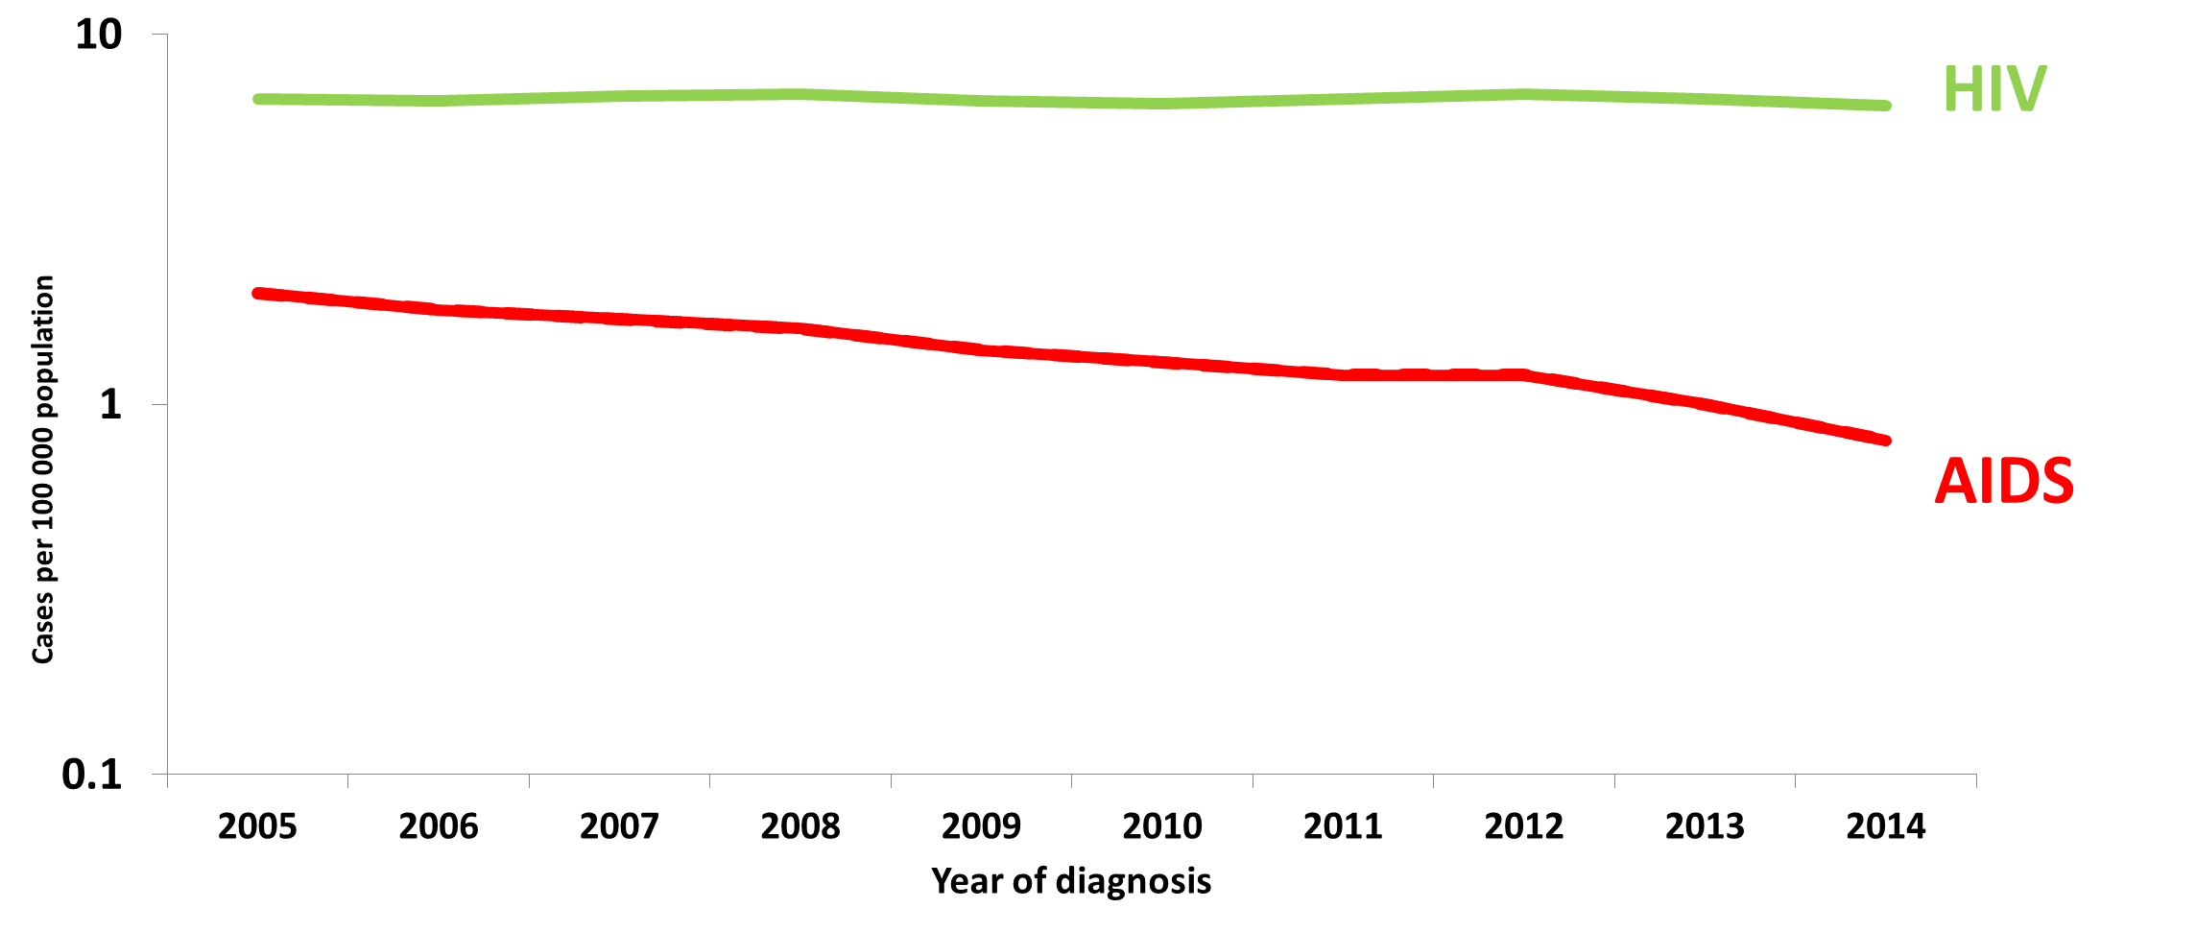
New HIV and AIDS diagnoses per 100 000, 2005-2014, EU/EEA
Source: ECDC/WHO (2015). HIV/AIDS Surveillance in Europe, 2014

Slide 18
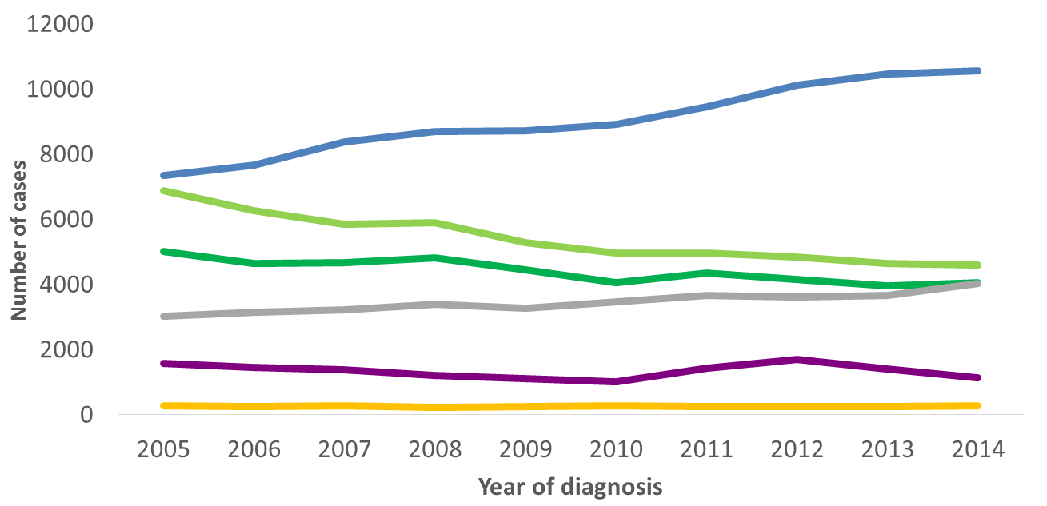
HIV diagnoses, by mode of transmission,
2005-2014, EU/EEA
Sex between men
Heterosexual (women)
Heterosexual (Men)
Other/
undetermined
Injecting drug use
Mother-to-child transmission
Data is adjusted for reporting delay. Cases from Estonia and Poland excluded due to incomplete reporting on transmission mode during the period; cases from Italy and Spain excluded due to increasing national coverage over the period.
Source: ECDC/WHO (2015). HIV/AIDS Surveillance in Europe, 2014

Slide 19
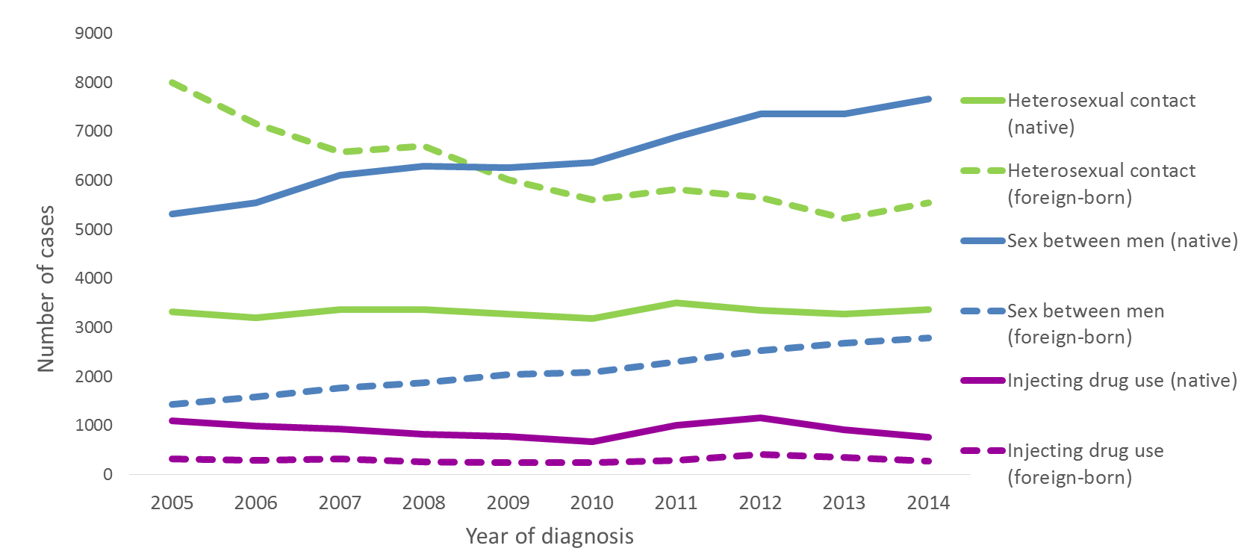
HIV diagnoses, by mode of transmission,
2005-2014, EU/EEA
Data is adjusted for reporting delay. Cases from Estonia and Poland excluded due to incomplete reporting on transmission mode during the period; cases from Italy and Spain excluded due to increasing national coverage over the period.
Source: ECDC/WHO (2015). HIV/AIDS Surveillance in Europe, 2014

Slide 20
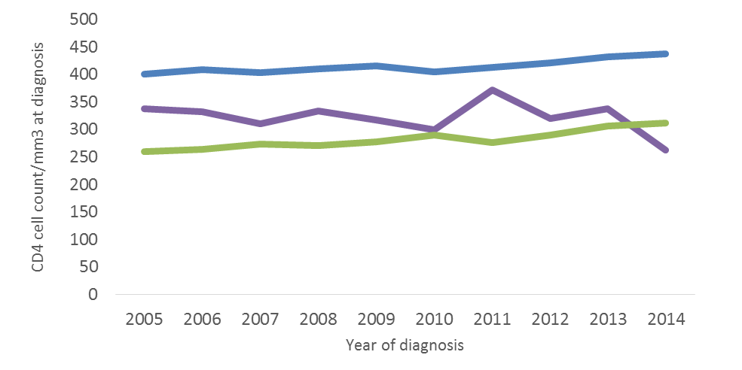
Median CD4 cell count per mm³, by transmission group, EU/EEA, 2005-2014
Heterosexual
Sex between men
Injecting drug use
Excludes countries with >60% incomplete data on CD4 cell count during any year over the period (Belgium, Bulgaria, Croatia, Estonia, Finland, France, Germany, Greece, Hungary, Ireland, Latvia, Lithuania, Malta, Norway, Poland, Portugal, Slovak Republic, Sweden)
Source: ECDC/WHO (2015). HIV/AIDS Surveillance in Europe, 2014

Slide 21
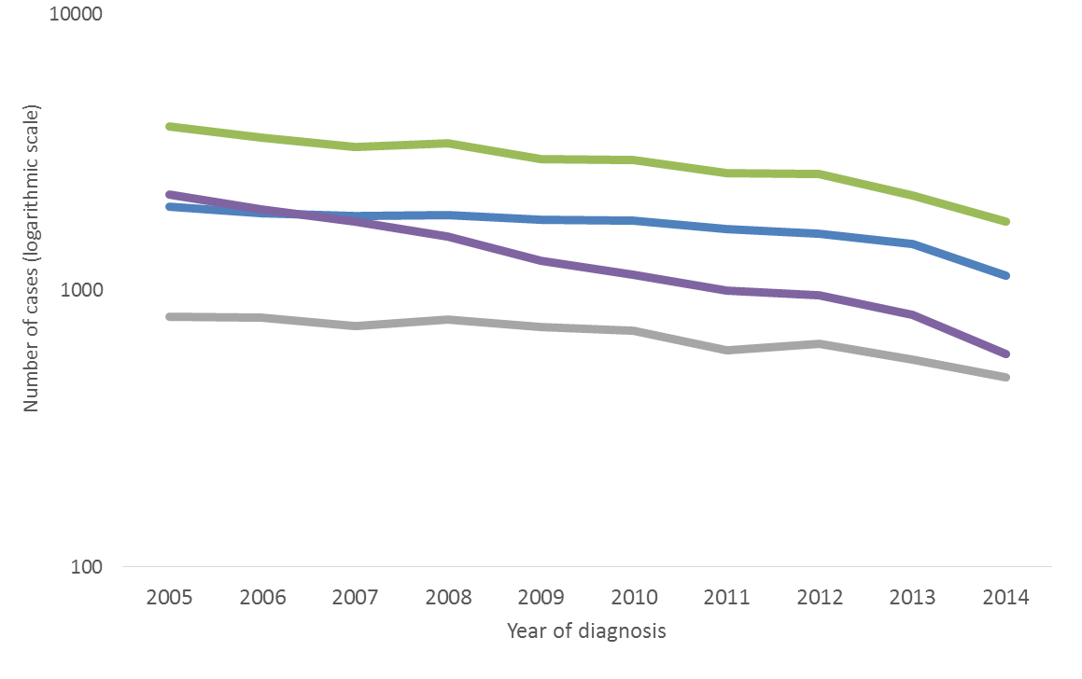
AIDS diagnoses, by transmission mode, EU/EEA, 2005-2014
Heterosexual
Sex between men
Injecting drug use
Other/
undetermined
Cases from Sweden excluded due to inconsistent reporting during the period
Source: ECDC/WHO (2015). HIV/AIDS Surveillance in Europe, 2014

Slide 22
Conclusions (1)
HIV infection is of major public health importance in the EU/EEA, with no clear signs of overall decrease.
During the past decade (2005-2014) there have been important epidemiological changes in HIV diagnoses in the EU/EEA:
  Sex between men accounted for the majority of cases diagnosed in 2014 (42%) and is increasing
  Heterosexual cases declined, driven by a decline among those from countries with generalised HIV epidemics
  Still, 37% of HIV diagnoses in 2014 were among people originating from outside the reporting country
  HIV cases attributed to injecting drug use declined over the last decade, despite the increase in two countries due to localised outbreaks
Nearly half (47%) of persons diagnosed had a CD4 cell count of <350/mm³ at diagnosis.

Slide 23
Conclusions (2)
Evidence-based HIV prevention interventions tailored to the local epidemiological context and targeted at those most at risk should be sustained and scaled-up.
Programmes for men who have sex with men should be a cornerstone of HIV prevention in all EU/EEA countries
Given the high proportion of HIV cases among migrants in many EU/EEA countries, and evidence of post-migration HIV-acquisition, migrant-sensitive prevention services are crucial
Keeping harm reduction levels high will continue to prevent HIV among people who inject drugs
Expansion of HIV counselling and testing will ensure early diagnosis and access to treatment; this will reduce the number of late presenters and improve treatment outcomes.

Slide 24
Full report and tables and can be
downloaded at:
www.ecdc.europa.eu

