Slide 1
Let’s talk about protection
Childhood Vaccination
Presentation for healthcare practitioners and other
professionals involved in immunisation services
European Centre for Disease Prevention and Control (ECDC)
Notes:
Facilitator notes
The following material addresses healthcare practitioners (doctors, nurses), health mediators and other professionals involved in immunisation services, as well as medical students. It can be used during conferences, training initiatives and meetings in order to raise awareness on the importance of immunisation and discuss vaccination related issues.
Each country can adapt the information here provided depending on national strategies and initiatives, country needs and cultural considerations.

Slide 2
Content overview
Why do we vaccinate children?
How do vaccines work?
Vaccine safety
Resources
Notes:
Facilitator notes
First, we’ll look at why we immunise, and the success of vaccines in recent decades.
Next, we’ll discuss how vaccines work in preventing diseases such as measles, pertussis, and other examples.
Next we’ll focus on the approval process before introduction of new vaccines and evaluation of their quality, safety and efficacy.
Finally, we’ll recommend some resources for more information.

Slide 3
Content overview
Why do we vaccinate children?
How do vaccines work?
Vaccine safety
Resources
1. Why do we vaccinate children?
Notes:
Facilitator notes
First, we’ll look at why we immunise and the success of vaccines in recent decades.

Slide 4
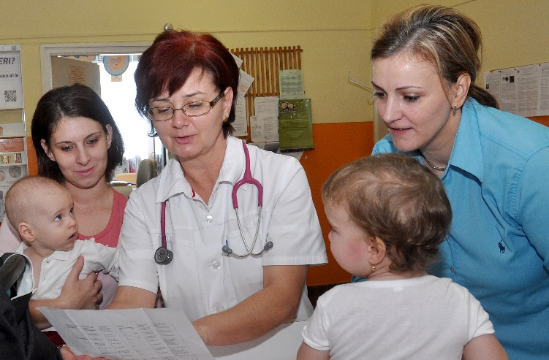
1. Why do we vaccinate children?
Vaccination: One of the great public health achievements of the 20th century
  Smallpox eradicated worldwide since 1979
  Polio eliminated from most parts of the world
High vaccination rates = low disease rates
‘Over half of the (30%) drop in child
mortality since 1990 is attributable
to immunization’.
Dr Margaret Chan,
Director-General,
World Health Organization
Photo: ECDC/Tibor Bujdos
1. Why do we vaccinate children?
Notes:
Facilitator notes
Vaccines are responsible for some of the greatest public health success stories of our time.
All vaccine-preventable diseases have declined significantly in countries with successful immunisation programs.
Paralytic polio eliminated from most of the world. In 2015, only 2 countries (Afghanistan and Pakistan) remained polio-endemic, down from more than 125 in 1988.
Vaccination brought several other diseases under control. But Europeans are still at risk of infection as long as these diseases exist somewhere in the world.

Slide 5
Vaccines save lives and reduce suffering
Vaccines prevent childhood diseases that can cause permanent disability or even death.
Vaccines are safe, while many of the
diseases they prevent have no effective treatments
and …
  90 out of 100 babies born to mothers who had rubella shortly before getting pregnant or while pregnant will suffer from congenital rubella syndrome.
  Diphtheria kills 1 in every 10 people who get it, even with treatment.
  30 out of
  100 persons
  with measles develop
  one or more
  complications.
  Meningococcal disease kills 1 in 10 people, even with prompt diagnosis and treatment.
1. Why do we vaccinate children?

Slide 6
…vaccines protect
Decrease in average number of cases per year (during different decades) of vaccine preventable diseases (example Hungary)
1. Why do we vaccinate children?
Notes:
Facilitator notes
Thanks to vaccines, deaths from many serious childhood diseases have been virtually eliminated and the number of cases of infection dramatically reduced.
Here data is presented for Hungary – similar data could be inserted for other countries.
Presenters can highlight a few examples from the Table, such as:
There were 800 cases of paralytic polio in Hungary before vaccination. Today, there are none.
Before measles vaccine was introduced in 1980s, almost every child got measles. Since 1992, there have been less than 20 cases a year—a 99.9% reduction! Before the vaccine, measles killed children and left others with brain damage (from encephalitis and subacute sclerosing panencephalitis [SSPE]). Today, there are no measles-related deaths in Hungary.
Measles can still be brought into Hungary and spread to unvaccinated people.
Diseases 1952–1961 1962–1971 1972–1981 1982–1991 1992–2001 2002–2011°
Diphtheria 938 41 6 1 – –
Tetanus 313 102 59 28 14 5
Poliomyelitis 808 4 2 1 – –
Pertussis 15176 1216 57 14 2 25
Measles 40014 36169 12273 2087 10 1
Rubella • • 40945 20990 321 36
Mumps • • 42683 34929 5067 45

Slide 7
Vaccines protect everyone – Example Measles
Directly
the baby/child
vaccinated
Indirectly
other babies, children and adults who are vulnerable to disease, e.g. the elderly, those with weak immune systems, those that due to medical reasons cannot be vaccinated.
1. Why do we vaccinate children?
Notes:
Facilitator notes
Examples for other vaccine-preventable diseases:
Giving pertussis or influenza vaccines to parents and caregivers prevents the spread of infection to infants.
Giving pneumococcal vaccine to children prevents the spread of infection to grandparents.

Slide 8
Community immunity
When enough people (blue dots) in a community are immune to an infectious disease (through vaccination and/or prior illness), they can protect those who are not yet vaccinated (yellow dots) from those who are infectious (red dots).
When groups of unvaccinated people build up and are in close proximity, community immunity doesn’t work and the disease spreads.
Community immunity is also referred to as ‘herd immunity’.
1. Why do we vaccinate children?
Notes:
Facilitator notes
Even those who cannot be vaccinated because they are too young, are allergic to vaccine components, or vaccination is contraindicated for them, are offered some protection because the disease cannot easily spread in the community and infect them.

Slide 9
Content overview
Why do we vaccinate children?
How do vaccines work?
Vaccine safety
Resources
Notes:
Facilitator notes
Next, we’ll discuss how vaccines work in preventing diseases such as measles, pertussis, and other examples.

Slide 10
Vaccines
Vaccines contain either a very weakened form of the
virus or bacterium that causes a disease, or a small
part of it.
When the body detects the contents of the vaccine,
its immune system will produce the antibodies
required to fight off infection and eliminate the
disease-causing virus/bacterium.
Later if a person comes into contact with the virus/bacterium, her/his immune system will
recognise it and protect the person by
producing the right antibodies.
2. How do vaccines work?
Notes:
Facilitator notes
Each germ triggers a unique response in the immune system involving a specific set of T-cells, B-cells and memory cells.
Immunity usually lasts for many years, often for a lifetime.
The problem with natural infection – e.g. exposure to measles – is that the virus causes illness before an immune response has developed. In severe cases, infection can cause death or permanent disability before immunity can be established.
Immunity through vaccination protects not only the immunised individual but also unvaccinated people in the community, such as infants that are too young to be vaccinated. Immunity through the disease exposes other unvaccinated people to the risk of the disease before and during the time of infection, and comes with the risk of severe complications.
A vaccine stimulates antibodies and lymphocytes, creating immune memory without causing disease.

Slide 11
There are two types of vaccines
Live attenuated
Produced in a laboratory by modifying a disease-producing bacteria or virus.
Able to replicate and produce immunity but without causing illness, e.g. MMR, yellow fever, and varicella vaccines.
Inactivated
Inactivated vaccines are composed of either whole bacteria or viruses, or a fraction of either with a protein or polysaccharide base. e.g. influenza, pertussis.
Protein-based vaccines contain toxoids (inactivated bacterial toxins) such as tetanus.
Polysaccharide-based vaccines are composed of pure cell-wall polysaccharide from a bacteria., e.g. pneumococcal, meningococcal.
Conjugate polysaccharide vaccines (chemically linked to a protein) are more potent, e.g. Haemophilus influenza type b (Hib).
2. How do vaccines work?

Slide 12
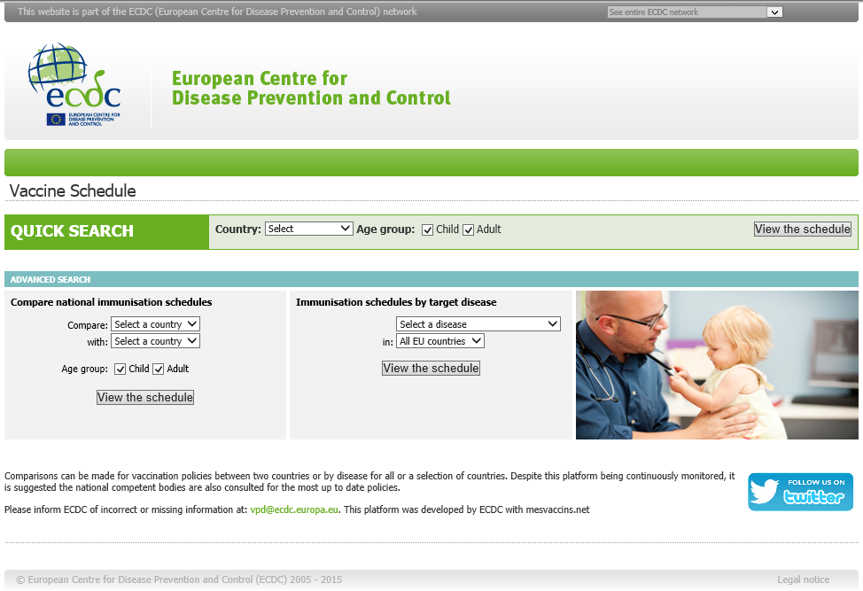
Vaccine schedules
Country specific schedules available on ECDC website
2. How do vaccines work?
Notes:
Facilitator notes
The ECDC Vaccine Schedule is an interactive platform of vaccination schedules for individual European countries and specific age groups. See at: http://vaccine-schedule.ecdc.europa.eu/Pages/Scheduler.aspx.

Slide 13
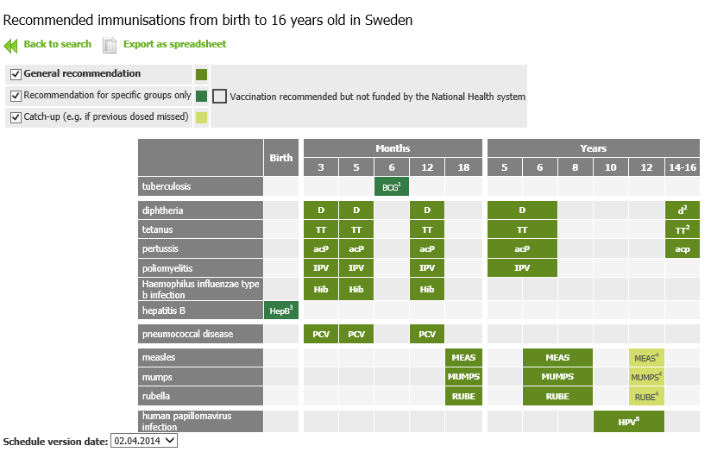
Example – Swedish vaccine schedule for children
2. How do vaccines work?
Notes:
Facilitator notes
Example of a country’s schedule of routine childhood vaccines (April 2014).

Slide 14
Diseases versus side effects of vaccination
(examples)
Disease | Effects of the disease | Possible side effects of the vaccine
Diphtheria | Severe sore throat, marked weakness, nerve damage, heart failure. Death in 10% of cases. | DTaP vaccine: 20% of infants have local redness, pain; less than 5% have fever; more redness and swelling occurs with booster at 4–6 years of age.
Tetanus | Toxin affects nerve endings leading to painful muscle spasms and seizures. | See above as for DTaP. Local redness and pain common with adult booster.
Pertussis | Severe spasms of cough lasting 3–6 weeks, pneumonia, convulsions. Brain damage or death in 1 of every 400 infants. | See above as for DTaP. The risk of brain damage after pertussis vaccine is too small, if any, to be measured.
Polio | Muscle paralysis in 1 out of 200 persons infected with polio. Death in severe cases. | IPV: No risk of disease from vaccine.
Hib | Meningitis kills in 5% of cases and leads to brain damage and deafness in 10–15% of survivors. | Given in combination with DTaP/IPV: see above for side effects.
Measles | Severe bronchitis, high fever, rash for 7–14 days; death in 1 per 1000 cases; encephalitis in 1 per 1000 cases. | Given combined with mumps and rubella vaccines (MMR) 5–10% have fever with or without rash 8–10 days after vaccine. No risk of disease from vaccine. Risk of encephalitis 1 case per 1 million doses.
Mumps | Fever, swollen salivary glands. No visible illness in more than 50% of cases; encephalitis in 1 per 200 cases; deafness in 5 per 100000 cases. | See MMR above.
2. How do vaccines work?
Notes:
Facilitator notes
Some opponents of immunisation claim that vaccines carry unnecessary risk.
The table in the slide compares the specific effects of each disease with the side effects of each vaccine. What you can see even at a glance is that the benefits of vaccines far outweigh the risks of disease.
Presenters can highlight a few examples from the table, such as:
Pertussis is a very serious disease, especially in infants. It can cause coughing spells for 3 to 6 weeks, pneumonia and convulsions. Canadian data shows that 1 of every 400 infants with pertussis will suffer brain damage or die.
With the vaccine, on the other hand, about 20% of infants will have redness and pain at the injection site. Less than 5% will have fever. The risk of brain damage after pertussis vaccine, if any, is too small to be measured.

Slide 15
Example – Measles – A serious disease
Measles is highly infectious and can be severe.
30% of cases develop complications.
Complications from measles infection
7 to 9 out of 100 children develop ear infection, which can result in hearing loss.
8 out of 100 patients report diarrhoea.
1 to 6 out of every 100 patients suffer from pneumonia. This is the most common cause of death from measles in young children.
1 in every 1 000 patients develop acute encephalitis (swelling of the brain). This can lead to convulsions and leave a child deaf or with mental disability.
Eye disorders, such as destruction of the cornea (outer layer of eyeball) may lead to blindness. This condition affects, in particular, malnourished children and is linked to vitamin A deficiency.
A rare but fatal brain complication known as subacute sclerosing panencephalitis (SSPE), can occur several years after measles.
1 out of 4 people who
get measles will need
hospitalization.
Up to 1 in 1 000 measles patients die as a result of the disease.
2. How do vaccines work?
Notes:
Facilitator notes
Measles virus spreads easily from person to person. An infected person may cough or sneeze, spreading small droplets containing many virus particles. They survive in the air for several hours, carried on air currents.
An unvaccinated person who is exposed to measles has a 90 % probability of becoming sick.
1 person with measles can infect an average of 12 to 18 unprotected people.
Because measles is so contagious, populations with even small numbers of unimmunised or inadequately immunised individuals are at risk of measles outbreaks.
Symptoms usually appear 10 to 12 days after infection, initially resembling a cold, with a runny nose, cough and a slight fever. The eyes become red and sensitive to light. As the illness progresses, and usually on the third to seventh day, the temperature may reach 39 to 41°C, and a red rash appears that lasts four to seven days.
These range from ear infections, diarrhoea and dehydration, to pneumonia and can involve lifelong consequences such as blindness and brain damage from encephalitis. Most measles-related deaths are due to complications of measles.
Before vaccine: Large epidemics occurred every 2 to 3 years. Most children had measles, usually by 18 years of age.

Slide 16
Measles vaccines
The vaccine
Live, but weakened virus
Given with mumps and rubella vaccines as MMR or with varicella in addition as MMR-V
2 doses required, since about 5%
of vaccinated children remain unprotected after first dose
Side effects
Mild side effects: fever (in 5–10% of children) or rash (in 2% of children)
Severe adverse events rare: risk of encephalitis is less than 1 case per
one million doses
No evidence of links to other diseases/disorders (such as autism, developmental delay, Crohn’s disease, ulcerative colitis)
Contraindications
Allergic reaction to neomycin, gelatin,
or a previous dose of the vaccine
Certain immune system disorders
Pregnancy
Precautions
Delay vaccine for moderate to severe illness
Delay vaccine for 3 months or more
for anyone who has received blood products, as the vaccine may not work
2. How do vaccines work?
Notes:
Facilitator notes
The vaccine is a live virus that multiplies in the body after it is given by injection. It is weakened (attenuated) compared with the “wild” (pre-vaccine) strain, and usually does not cause illness in healthy people.
There may be traces of gelatin or neomycin (an antibiotic) in the vaccine.
The most common side effect of the vaccine is fever, usually occurring 8-10 days after the vaccine and lasting 24 to 48 hours.
Because encephalitis after measles vaccine has been observed so rarely, it is still not known whether the vaccine can cause encephalitis. It is also not known whether the vaccine can cause SSPE. Since SSPE has disappeared in countries with effective vaccination programs, like Canada and the U.S., it seems unlikely that it does.

Slide 17
When to avoid vaccines
A history of anaphylactic or other serious allergic reaction after receiving a vaccine is a contraindication to further doses of that vaccine
People with certain immune system disorders should not be given live vaccines (e.g. measles, mumps, rubella, varicella, oral typhoid)
Avoid live vaccines during pregnancy, except when expected benefits to mother and baby outweigh risk.
2. How do vaccines work?
Notes:
Facilitator notes
Anaphylaxis is a rapid, extreme allergic reaction which can cause shock, swelling and difficulty breathing. It usually occurs within minutes of exposure to the source of the allergy.
A person who experiences an anaphylactic or other serious allergic reaction following a certain vaccine should not be given that vaccine again until the cause of the reaction determined.
Certain immune system disorders (e.g. congenital immune deficiencies), or medical treatments (e.g., chemotherapy, a bone marrow or other organ transplant, or high doses of steroids) are contraindications for live vaccines.
Every effort should be made to see that women receive all routinely recommended vaccines before they reach child-bearing age. There is concern that a live vaccine given in pregnancy may affect the foetus but so far, damage has only been reported with smallpox vaccine.

Slide 18
Content overview
Why do we vaccinate children?
How do vaccines work?
Vaccine safety
Resources
Notes:
Facilitator notes
Next we’ll focus on the approval process before introduction of new vaccines and evaluation of their quality, safety and efficacy.

Slide 19
How are vaccines approved for use in EU Member States?
Rigorous procedures before a new vaccine is approved and marketed
Marketing authorisation only after evaluation during product development and clinical trials
  Quality
  Safety
  Efficacy
Procedures for registration or licencing of pharmaceutical products
  Centralised: By European Medicines Agency (EMA)
  Mutual recognition procedure: Collection of national marketing authorisations
  National procedures: For products licensed in one single country
3. Vaccine safety
Notes:
Facilitator notes
Vaccines have to obtain a marketing authorisation before being sold after an evaluation of the data collected during product development and clinical trials taking into account quality, safety and efficacy. Compliance with good practices in the areas of manufacturing and clinical or laboratory testing is also verified by regulatory agencies prior to approval of a marketing authorisation.
Registration or licensing of pharmaceutical products in Europe can be done by different procedures:
Centralised Procedure that is undertaken by the European Medicines Agency (EMA) where the single application is evaluated by EMA’s Committee for Medicinal Products for Human Use (CHMP). EMA is the EU agency responsible for the scientific evaluation, supervision and safety monitoring of medicines developed by pharmaceutical companies for use in the EU. The final decision is made by the European Commission that issues a marketing authorisation valid throughout the EU, Iceland, Liechtenstein and Norway.
Mutual Recognition Procedure (MRP) that is applicable for the majority of conventional medicinal products. This procedure results in a collection of national marketing authorisations.
National Procedures for products that are only licensed in one single country.
Once a marketing authorisation is obtained, each batch of vaccines must still be assessed for quality before release for use. This is done by both the manufacturer and an official European control laboratory.

Slide 20
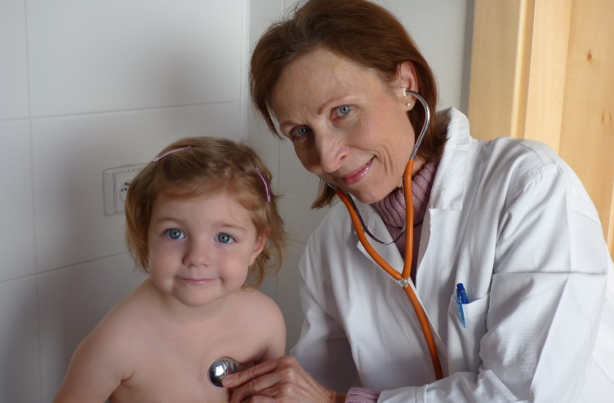
Monitoring vaccine safety
Vaccines are monitored after release for adverse events
Adverse events: Negative health effects occurring after immunisation that may or may not be related to the vaccine.
  Mild adverse events, such as fever and swelling at the injection site, are common. More serious reactions are rare.
Post-marketing surveillance of adverse events: The system for reporting and reviewing adverse events once a vaccine has been approved for use.
  Information reaches the regulatory authorities and
  Public Health Agency of the country through
  doctors and nurses reporting to health officials.
Photo: ECDC/Darja Stundlova
3. Vaccine safety
Notes:
Facilitator notes
All vaccines and pharmaceuticals are monitored after release onto the market for adverse events. This surveillance function is strengthened at European level with the establishment of the European Centre for Disease Prevention and Control (ECDC).
Through surveillance, medical experts at a designated Member State agency are made aware of unusual post-vaccine events.

Slide 21
Content overview
Why do we vaccinate children?
How do vaccines work?
Vaccine safety
Resources
Notes:
Facilitator notes
Finally, we’ll discuss some issues to be aware of when searching for information on vaccination on the internet, and then we’ll recommend some resources for more information.

Slide 22

Assessing vaccine information on the Internet
When looking at health-related information on the internet, it can be difficult to judge the quality and accuracy of information found. Check that the website:
  Informs about ownership, purpose, authors, and organisations that support it.
  Is transparent about the sources of funding and informs about data protection.
  Provides information based on scientific research and mention sources of information (including references and links).
  Directs you to additional information sources
  and refers to well-recognised public health
  organisations and professional bodies.
  Credible websites usually present both the
  benefits and risks of vaccination.
4. Resources
Notes:
Facilitator notes
Websites offering credible information are transparent with the way they work. They usually have a section where they inform visitors if they are commercial or non-profit, independent or affiliated. A website should clearly state who is responsible for its content. It should also identify the organisation(s) behind it (e.g. ‘about us’) and provide contact information.
HON is a Swiss not-for-profit organization that helps users find reliable online medical information. It has a set of guidelines and a code of conduct for sites that meet HON criteria.

Slide 23

Web resources
  ECDC webpage with information on immunisation
  ecdc.europa.eu/en/healthtopics/immunisation/pages/index.aspx
  World Health Organization (WHO)
  www.who.int/topics/immunization/en
  World Health Organisation (WHO) –
  Lists of reviewed vaccination websites
  that meet good information practices criteria
  www.who.int/vaccine_safety/initiative/
  communication/network/approved_
  vaccine_safety_website/en
4. Resources
Notes:
Facilitator notes
The WHO Global Advisory Committee on Vaccine Safety (GACVS) developed four categories of criteria for good information practices – credibility, content, accessibility and design – to which websites providing information on vaccine safety should adhere. See: ‘Good information practices for vaccine safety websites’, at www.who.int/vaccine_safety/good_vs_sites/en.
Countries can add other relevant links in this slide.

Slide 24
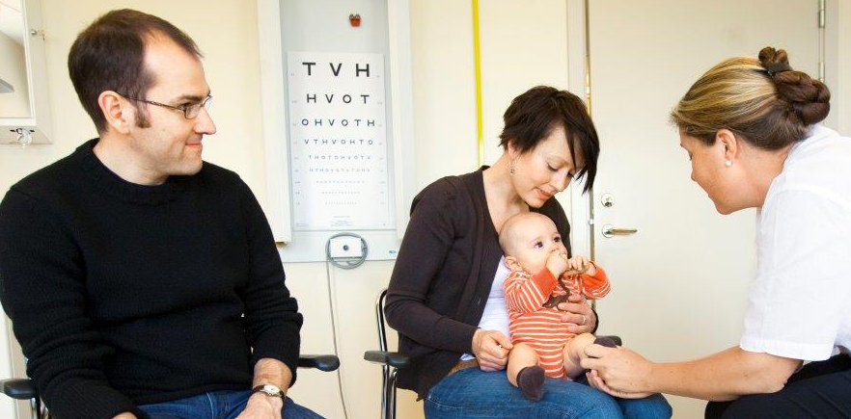
Thank you!
For more information: www.ecdc.europa.eu

