Slide 1
World Tuberculosis Day 2016
TB situation in the EU/EEA, in 2014
Findings from the joint TB surveillance and monitoring report by ECDC and WHO Regional Office for Europe
ECDC TB Team European Centre for Disease Prevention and Control
Stockholm, 24 March 2016

Slide 2
TB Surveillance data, EU/EEA, 2014

Slide 3
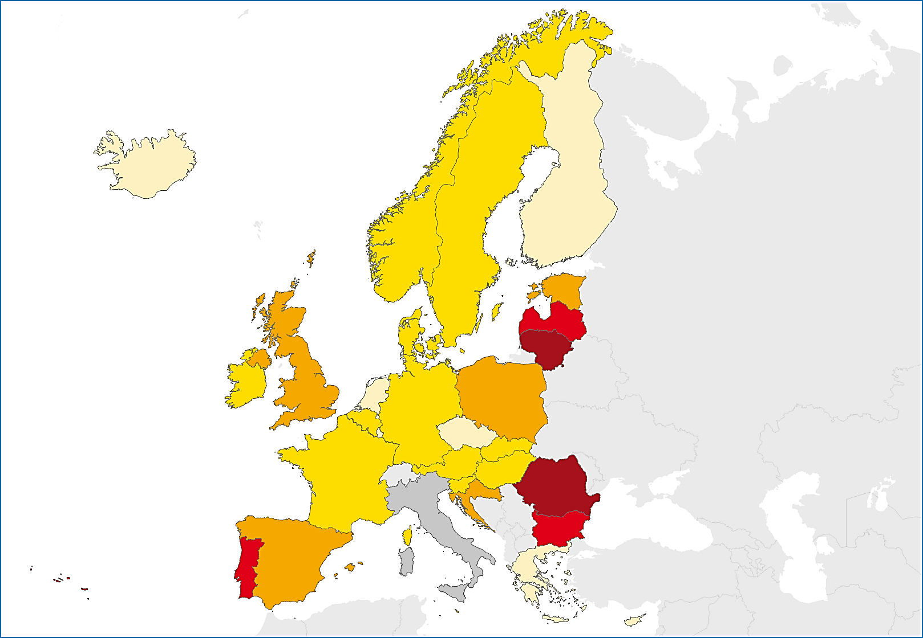
TB notifications, EU/EEA, 2014
58 008 TB cases notified in 29 EU/EEA countries
Notification rate of 12.8 per 100 000 population
(range 2.5–79.7)
< 5 per 100 000
5 to 9 per 100 000
10 to 19 per 100 000
20 to 49 per 100 000
≥ 50 per 100 000
Not reporting
Source: European Centre for Disease Prevention and Control.
TB surveillance and monitoring in Europe, 2016.

Slide 4
Reported TB cases, EU/EEA, 2005 – 2014
Steady decline between 2005 and 2014:
number of TB cases decreased by 35%
notification rate decreased by 36%
Source: European Centre for Disease Prevention and Control.
TB surveillance and monitoring in Europe, 2016.

Slide 5
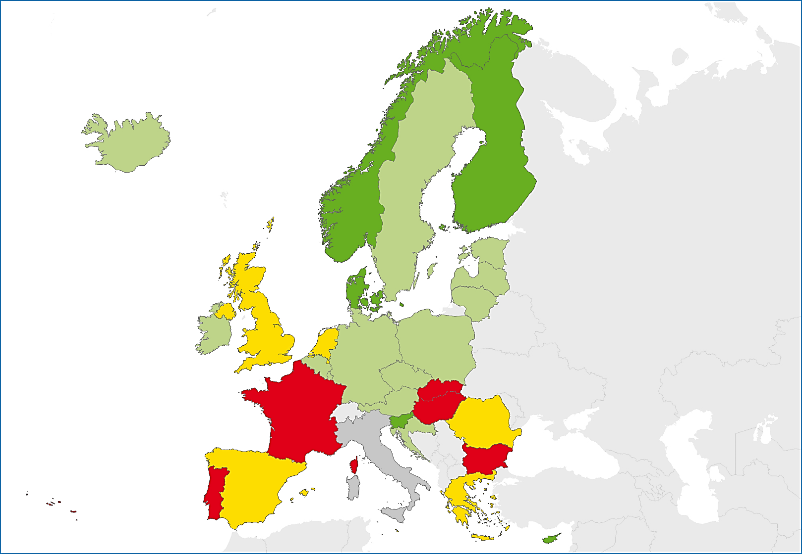
Confirmed TB cases*, EU/EEA, 2014
65.3% of the reported TB cases were laboratory confirmed (range 39.2–88.2%)
< 60%
60 to 69%
70 to 79%
≥ 80%
Not reporting
Source: European Centre for Disease Prevention and Control.
TB surveillance and monitoring in Europe, 2016.
* Confirmation identified by culture or by both sputum microscopy and Mycobacterium tuberculosis nucleic acid amplification test

Slide 6
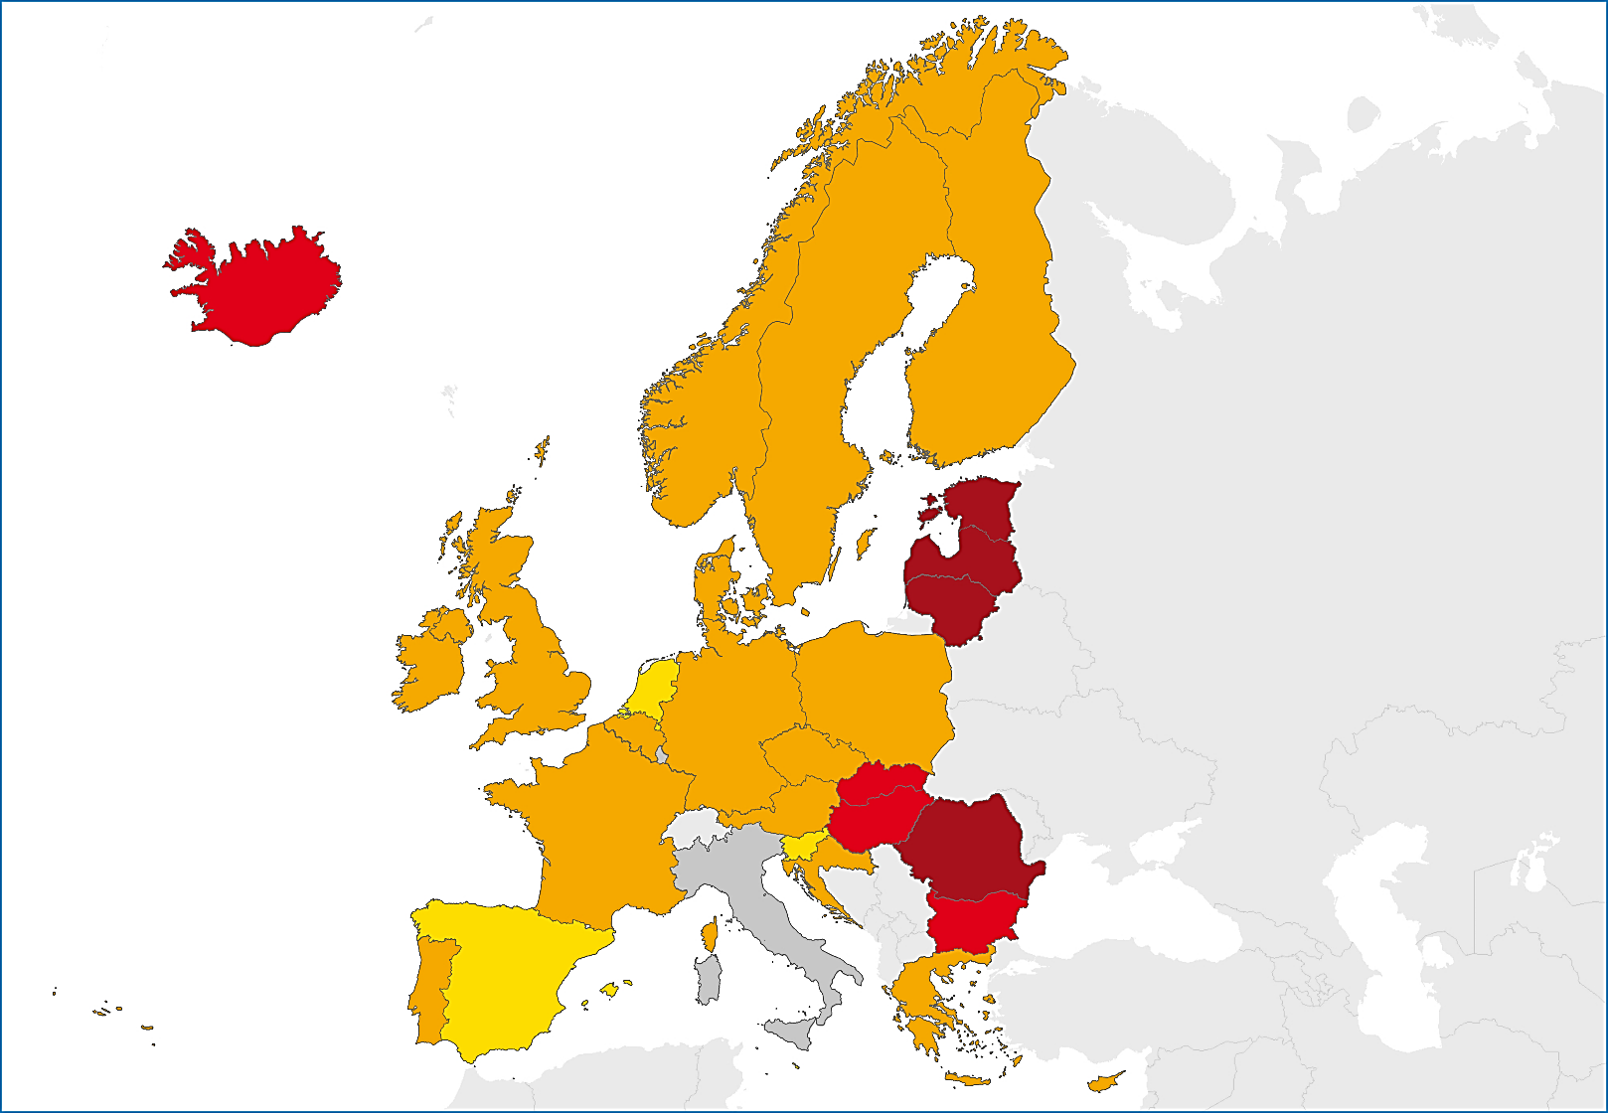
Notified previously treated TB cases, EU/EEA, 2014
11.5% of reported cases had been previously treated (range 2.2–21.4%)
< 5%
5 to 9.9%
10 to 14.9%
≥ 15%
Not reporting
Source: European Centre for Disease Prevention and Control.
TB surveillance and monitoring in Europe, 2016.

Slide 7
TB notification rate by age group, EU/EEA, 2005 – 2014
Decreased by > 25% in all age groups over the period
Source: European Centre for Disease Prevention and Control.
TB surveillance and monitoring in Europe, 2016.

Slide 8
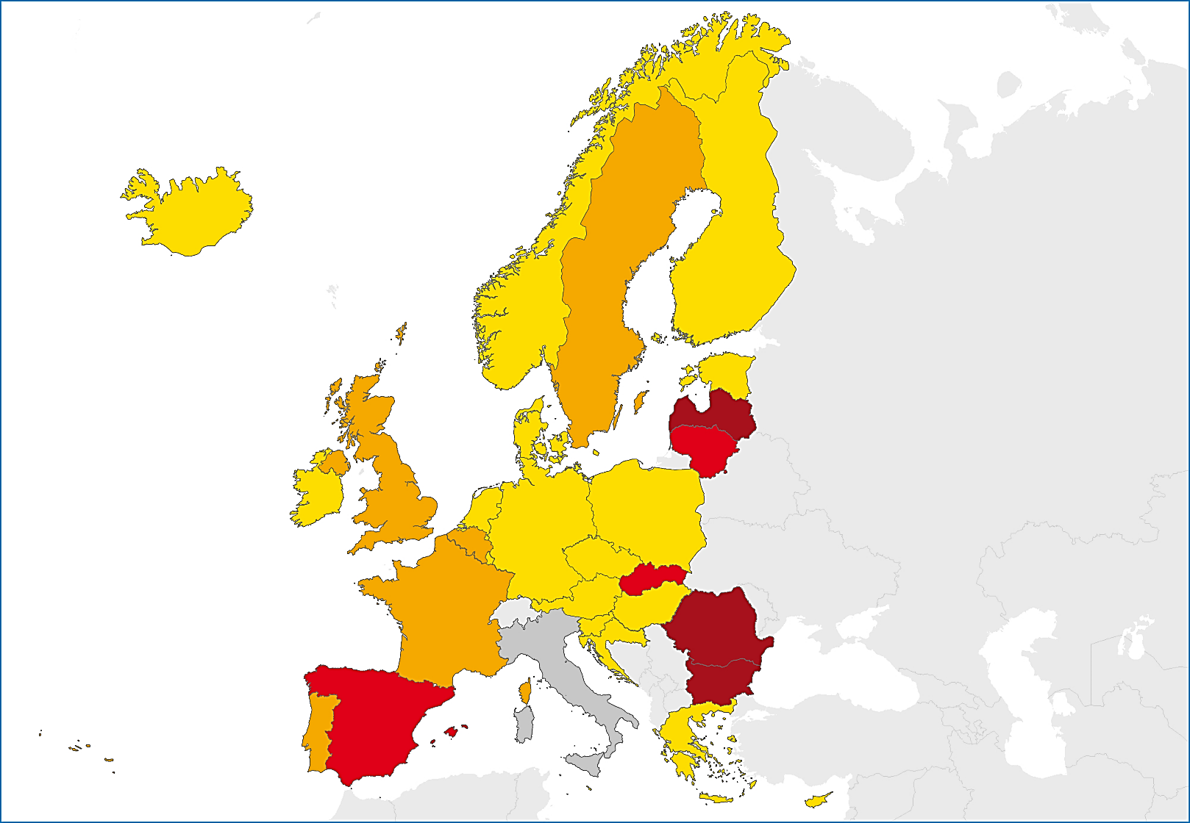
Notified TB in children under 15, EU/EEA, 2014
2 258 TB cases reported in children under 15 years. That is 3.9% of all TB cases (range 0-13.7%) and
2.8 notifications per 100 000 child population (range 0–20.7).
< 2 per 100 000 child population
2 to 3.9 per 100 000 child population
4 to 9.9 per 100 000 child population
≥ 10 per 100 000 child population
Not reporting
Source: European Centre for Disease Prevention and Control.
TB surveillance and monitoring in Europe, 2016.

Slide 9
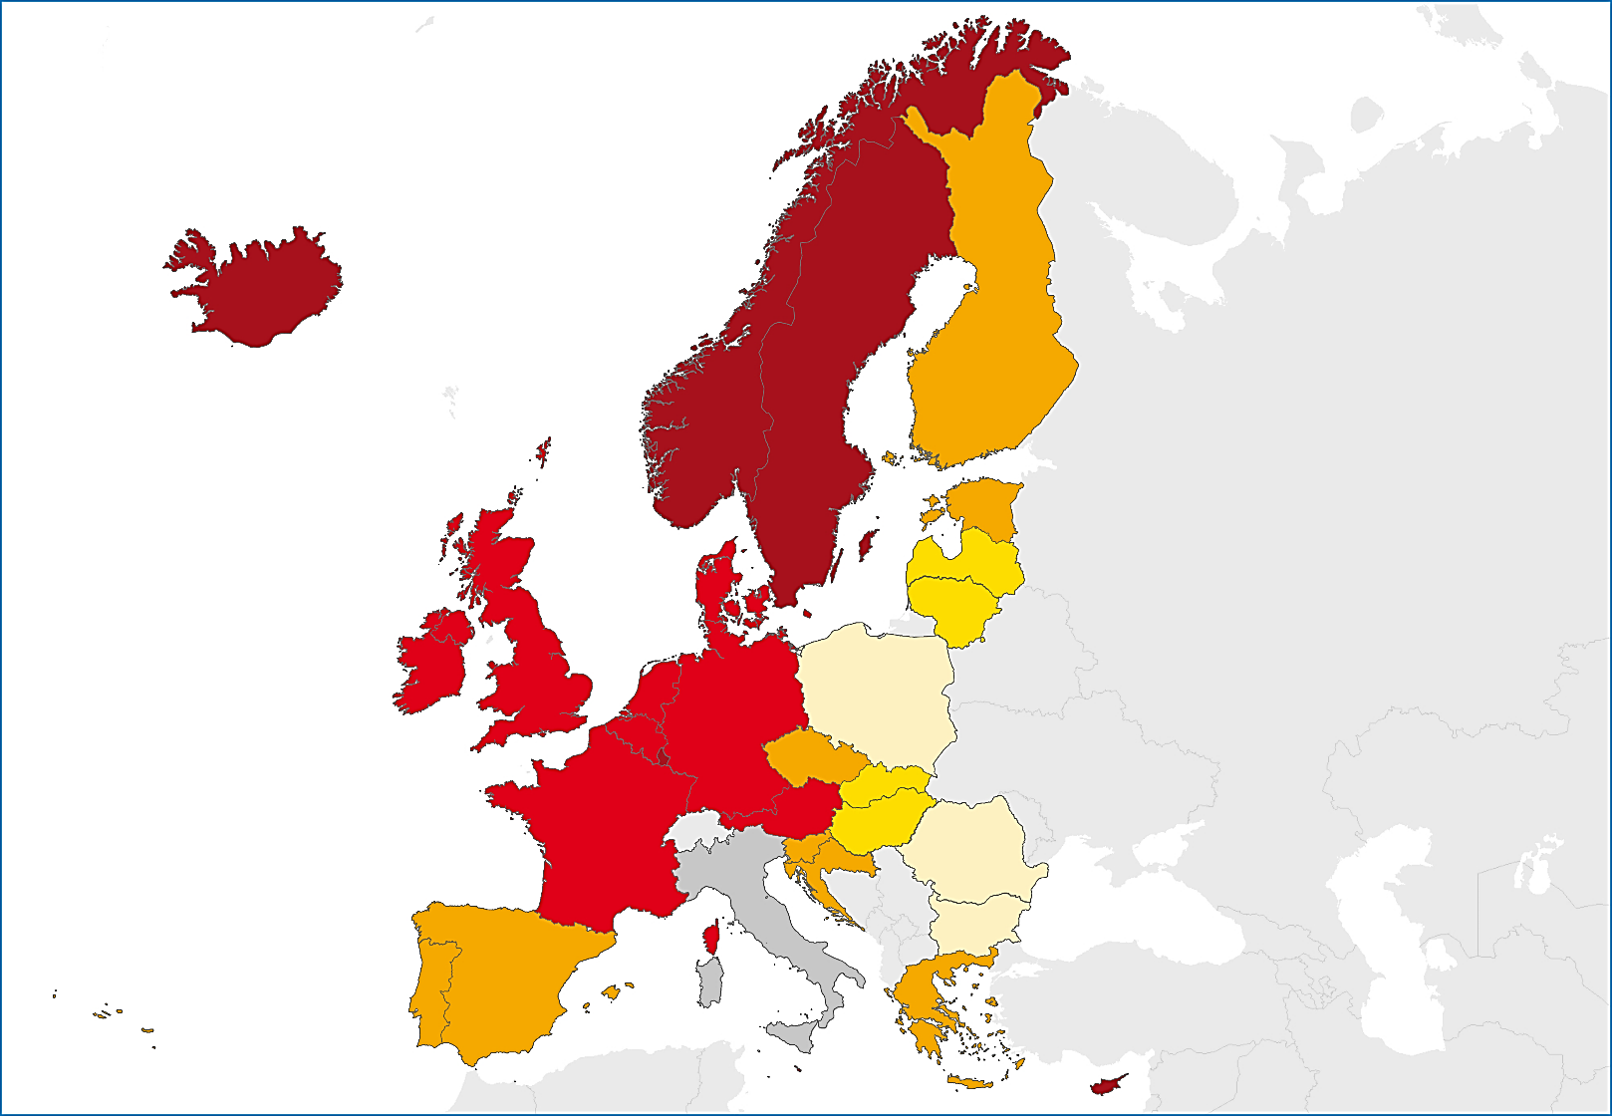
Notified TB cases in persons of foreign origin, EU/EEA, 2014
26.8% of TB cases occurred in persons of foreign origin (range 0.3–100.0%)
< 1%
1 to 9.9%
10 to 39.9%
40 to 74.9%
≥ 75%
Not reporting
Source: European Centre for Disease Prevention and Control.
TB surveillance and monitoring in Europe, 2016.

Slide 10
Notified TB cases in persons of foreign origin, EU/EEA, 2005 – 2014
Percentage of cases in persons of foreign origin increased from 19% in 2005 to 27% in 2014.
Rate per 100 000 total population stable* between 3.4 and 3.8
Source: European Centre for Disease Prevention and Control.
TB surveillance and monitoring in Europe, 2016.
* Slight decrease in the proportion of cases in persons of foreign-origin in 2014, probably due to missing data from Italy

Slide 11
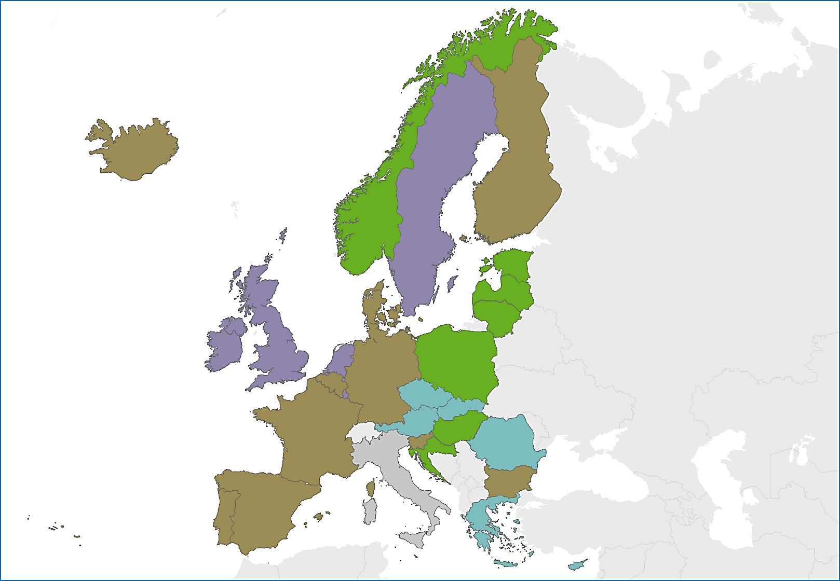
Notified extrapulmonary TB cases, EU/EEA, 2014
21.8% of TB cases were extrapulmonary TB (range 3.2–46.0%)
0 to 9.9%
10 to 19.9%
20 to 29.9%
≥ 30%
Not reporting
Source: European Centre for Disease Prevention and Control.
TB surveillance and monitoring in Europe, 2016.

Slide 12
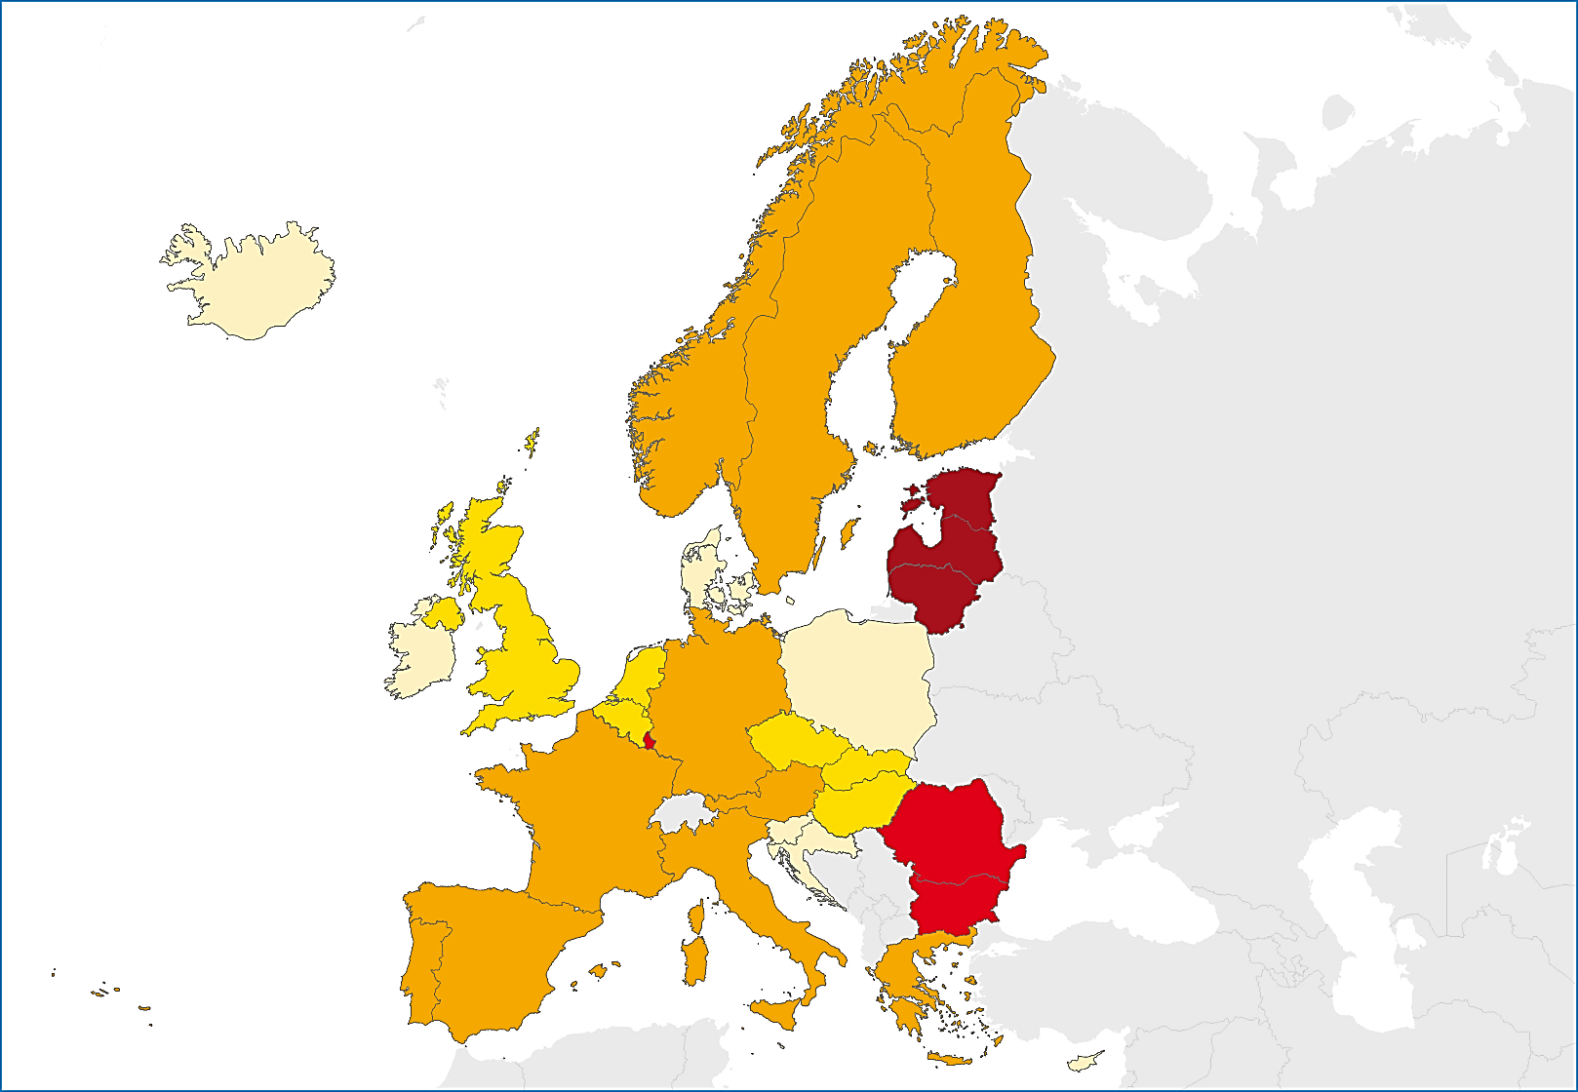
Multidrug-resistant TB, EU/EEA, 2014
4.0% of TB cases with DST* results were multidrug-resistant (range 0–25.8%)
< 1%
1 to 1.9%
2 to 4.9%
5 to 9.9%
≥ 10%
Not reporting
Source: European Centre for Disease Prevention and Control.
TB surveillance and monitoring in Europe, 2016.
* DST – drug susceptibility results reported for at least isoniazid and rifampicin

Slide 13
Multidrug-resistant TB notification rate, EU/EEA, 2010 – 2014
Rate was stable at 0.3 per 100 000 population between 2010 and 2014
Source: European Centre for Disease Prevention and Control.
TB surveillance and monitoring in Europe, 2016.

Slide 14
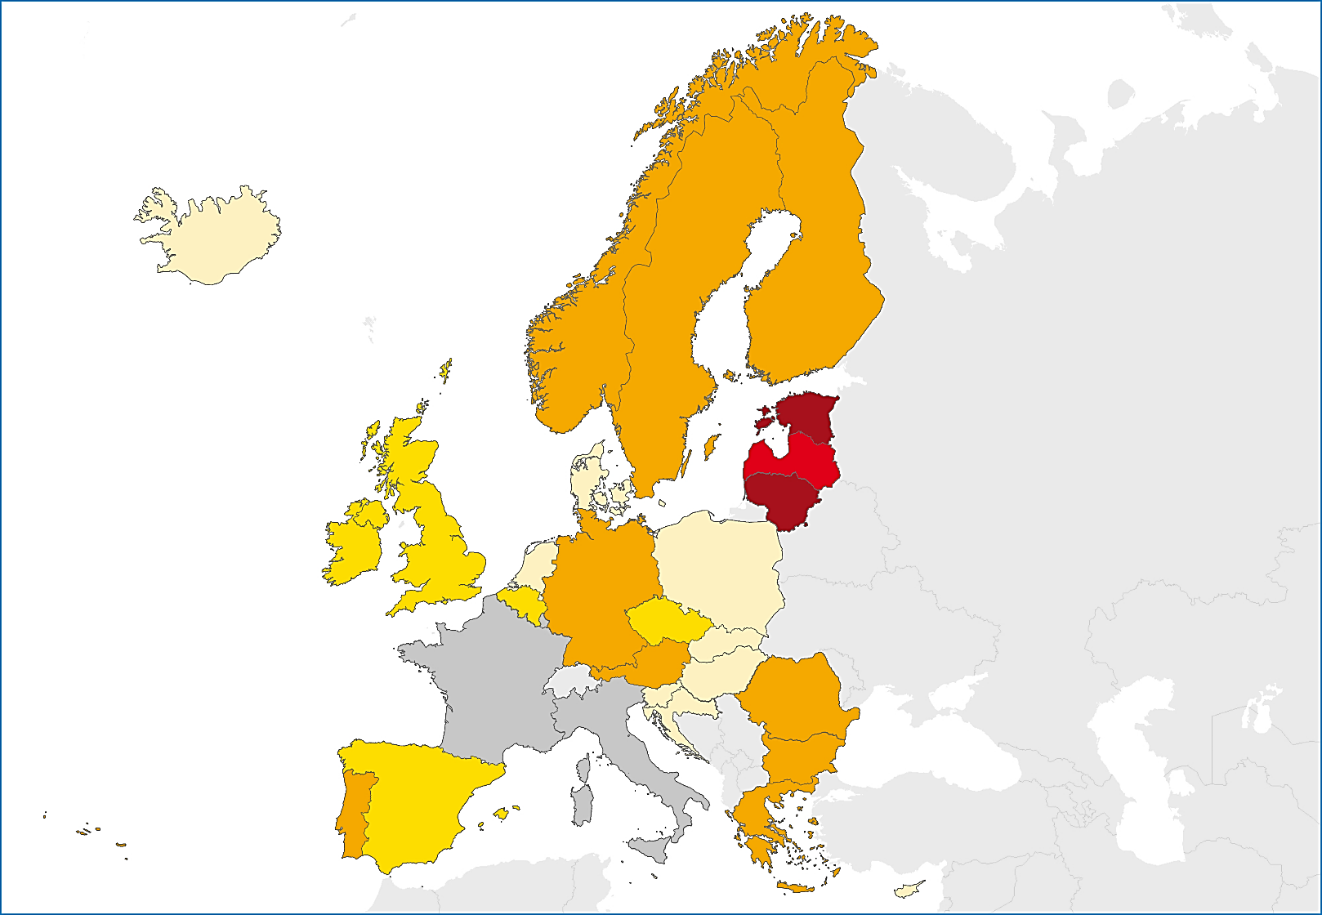
Multidrug resistance among new pulmonary TB cases, EU/EEA, 2014
2.4% of new pulmonary TB cases with DST* results had multidrug-resistant TB (range 0–19.5%)
< 1%
1 to 1.9%
2 to 4.9%
5 to 9.9%
≥ 10%
Not reporting
Source: European Centre for Disease Prevention and Control.
TB surveillance and monitoring in Europe, 2016.
DST – drug susceptibility test. (Results reported for at least isoniazid and rifampicin)

Slide 15
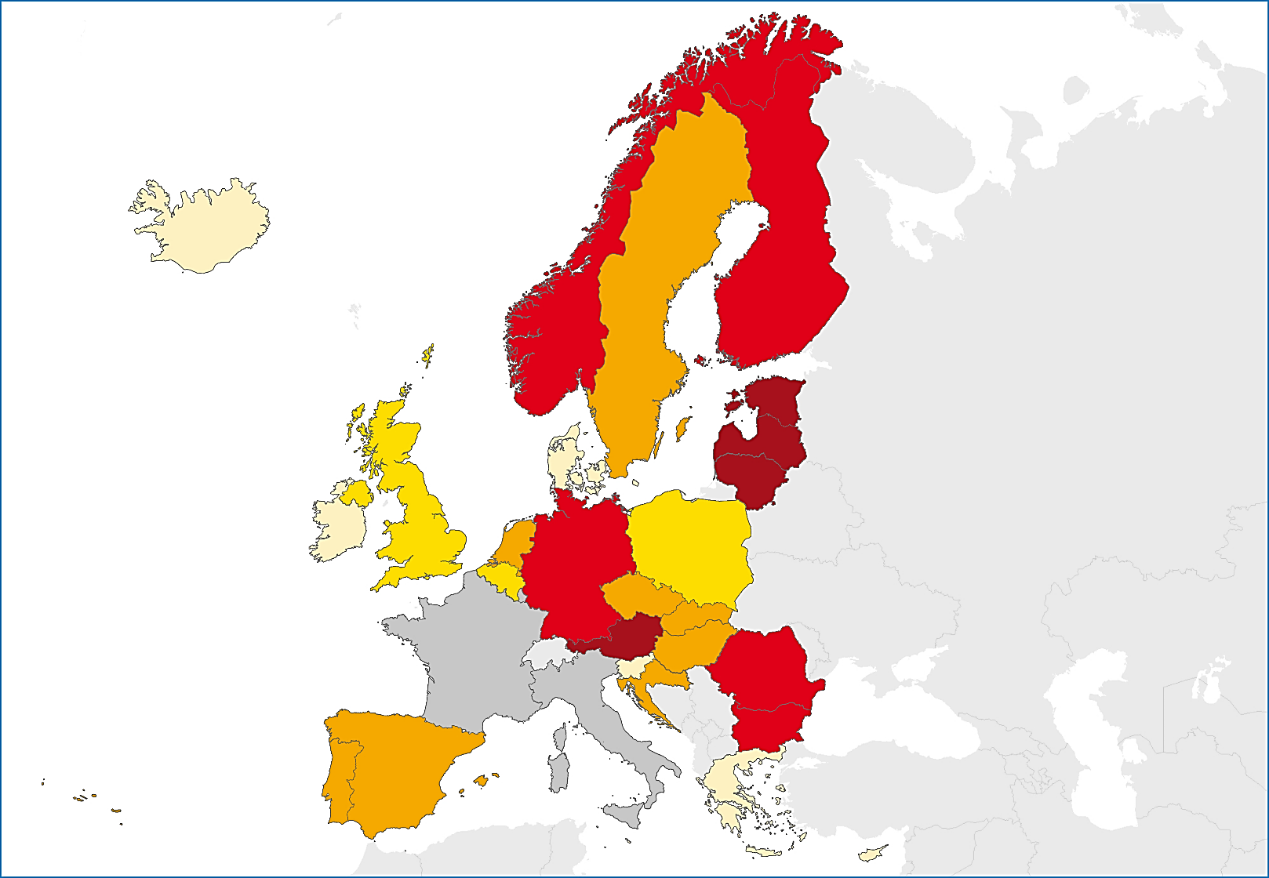
Multidrug resistance among previously treated pulmonary TB cases, EU/EEA, 2014
17.7% (range 0–62.1%) of previously treated pulmonary TB cases with DST* results had multidrug-resistant TB
< 1%
1 to 4.9%
5 to 14.9%
15 to 24.9%
≥ 25%
Not reporting
Source: European Centre for Disease Prevention and Control.
TB surveillance and monitoring in Europe, 2016.
* DST – drug susceptibility test results for isoniazid and rifampicin

Slide 16
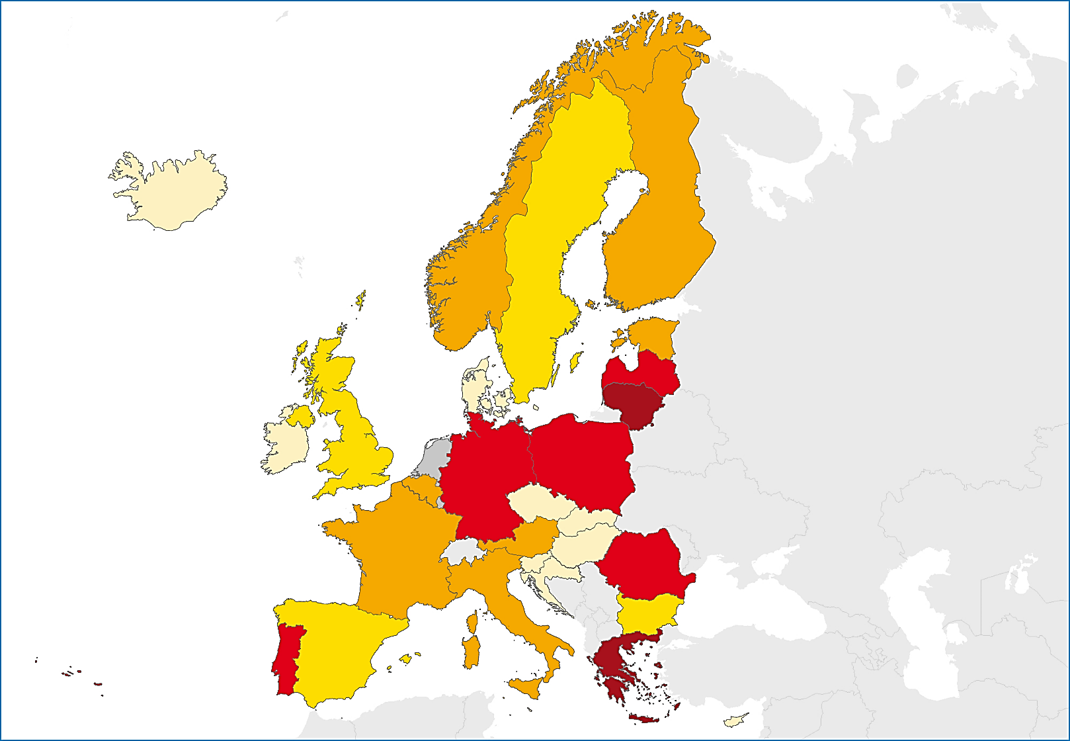
Extensively drug-resistant TB (XDR TB), EU/EEA, 2014
17.5% of MDR TB cases with 2nd line DST* were extensively drug-resistant (range 0–50.0% and 5.7–26.1% for countries reporting more than one case)
< 1%
1 to 9.9%
10 to 14.9%
15 to 24.9%
≥ 25%
Not reporting
Source: European Centre for Disease Prevention and Control.
TB surveillance and monitoring in Europe, 2016.
* DST – drug susceptibility test

Slide 17
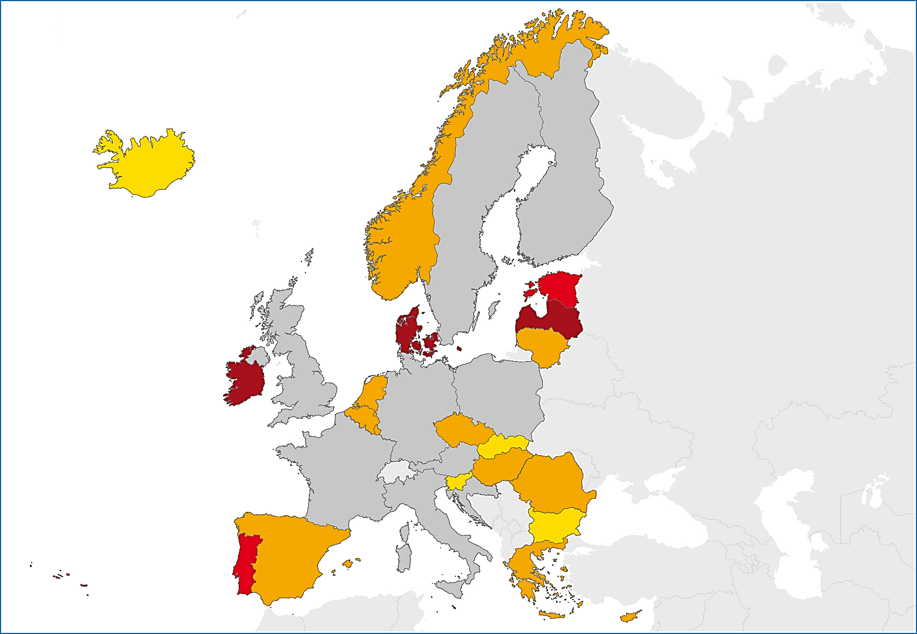
Notified TB/HIV co-infection, EU/EEA, 2014
4.9% of TB cases with known HIV status* were HIV positive (range 0–22.6%)
< 1%
1 to 9.9%
10 to 14.9%
≥ 15%
Not reporting
Source: European Centre for Disease Prevention and Control.
TB surveillance and monitoring in Europe, 2016.
* Among countries with at least 50% reporting completeness for HIV status

Slide 18
Treatment success of all TB cases, EU/EEA, 2014
74.0% of all TB cases* had a successful treatment outcome after 12 months (range 0.0–92.8%)
Source: European Centre for Disease Prevention and Control.
TB surveillance and monitoring in Europe, 2016.
* Four EU/EEA Member States did not report treatment outcome data

Slide 19
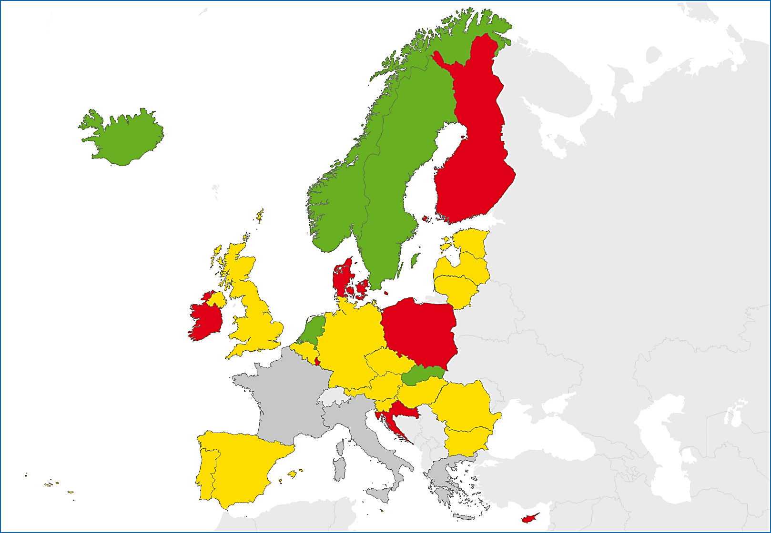
Treatment success, EU/EEA, 2014
Treatment success rate for all TB cases has been stable at 75% over the past five years
< 60%
60 to 84.9%
≥ 85%
Not reporting
Source: European Centre for Disease Prevention and Control.
TB surveillance and monitoring in Europe, 2016.
* Four EU/EEA Member States did not report treatment outcome data

Slide 20
Treatment success in new confirmed pulmonary TB cases and relapses, started on treatment in 2013*, EU/EEA, 2014
77.6% of new confirmed pulmonary cases and relapses had a successful treatment outcome (range 50.0–100.0%)
Source: European Centre for Disease Prevention and Control.
TB surveillance and monitoring in Europe, 2016.
* Cases started on second line treatment are excluded

Slide 21
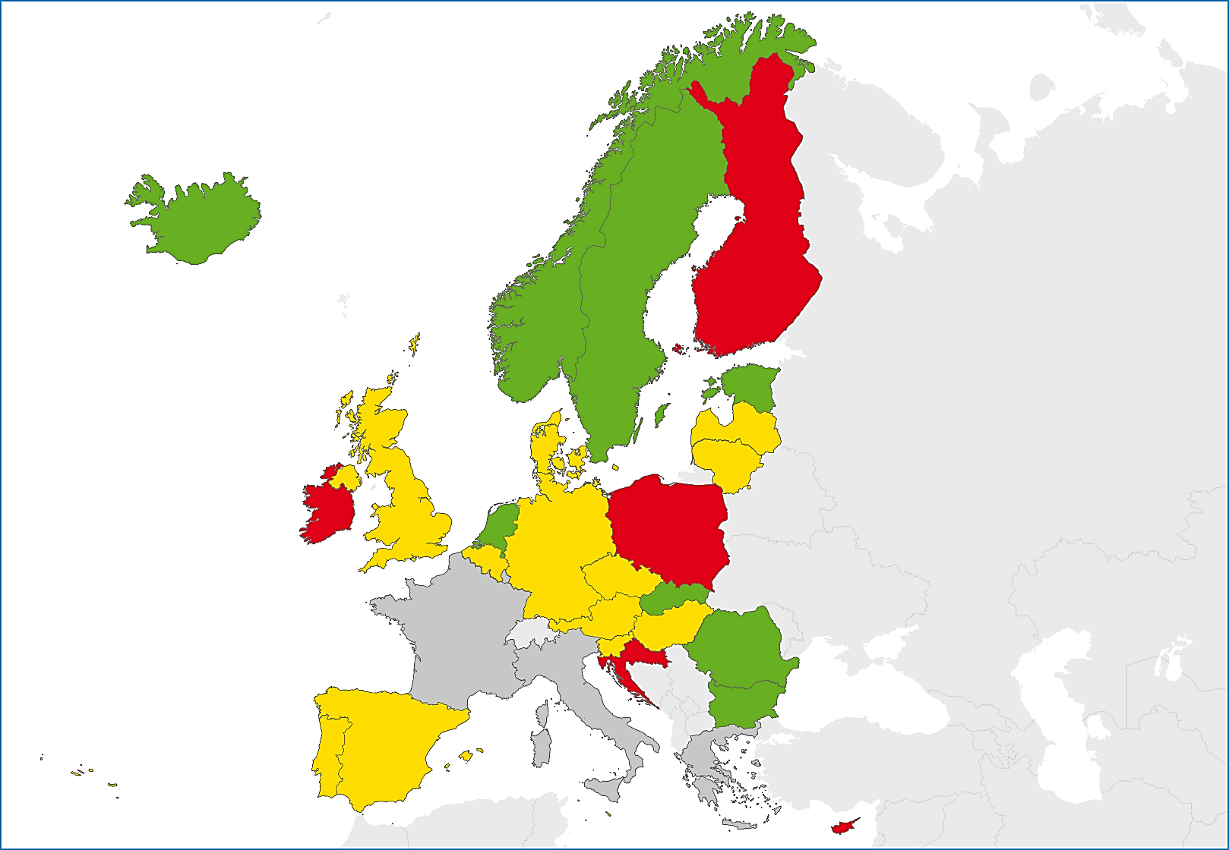
Treatment success in new confirmed pulmonary TB cases and relapses started on treatment in 2013*, EU/EEA, 2014
77.6% of new confirmed pulmonary TB cases and relapses had a successful treatment outcome (range 50.0-100.0%).
< 60%
60 to 84.9%
≥ 85%
Not reporting
Source: European Centre for Disease Prevention and Control.
TB surveillance and monitoring in Europe, 2016.
* Four EU/EEA Member States did not report treatment outcome data

Slide 22
Treatment success in multidrug-resistant TB*, EU/EEA, 2014
40.3% was the success rate for all multidrug-resistant TB cases notified in 2012 (range 0–85.7%)
Source: European Centre for Disease Prevention and Control.
TB surveillance and monitoring in Europe, 2016.
* Cyprus, Luxembourg, Malta and Slovenia reported zero MDR TB cases in 2012, nine Member States did not report treatment outcome data for MDR TB cases

Slide 23
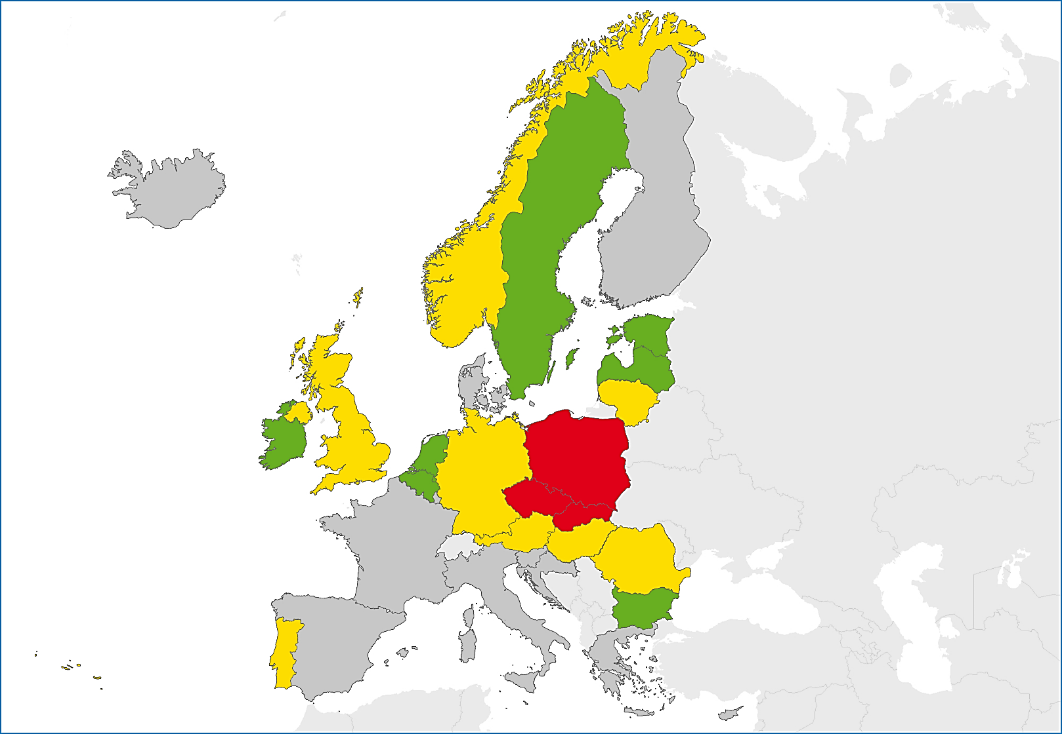
Treatment success in all cases with multidrug-resistant TB*, EU/EEA, 2014
40.3% was the success rate for all multidrug-resistant TB cases notified in 2012 (range 0–85.7%)
< 40%
40 to 69.9%
≥ 70%
Not reporting
Source: European Centre for Disease Prevention and Control.
TB surveillance and monitoring in Europe, 2016.
* Cyprus, Luxembourg, Malta and Slovenia reported zero MDR TB cases in 2012. Nine Member States did not report treatment outcome data for MDR TB cases.

Slide 24
Treatment outcomes in MDR TB notified in 2010-2012, EU/EEA, 2014
Treatment success rates increased from 32% to 40% in the 2010, 2011 and 2012 cohorts
Source: European Centre for Disease Prevention and Control.
TB surveillance and monitoring in Europe, 2016.

Slide 25
Treatment success in extensively drug-resistant TB (XDR TB) cases, EU/EEA, 2014
33.8% was the success rate in extensively drug-resistant TB cases notified in 2011 (range 0–100.0%)
Source: European Centre for Disease Prevention and Control.
TB surveillance and monitoring in Europe, 2016.
* Bulgaria, Cyprus, Denmark, Slovakia and Slovenia reported zero XDR TB cases in 2011. 13 countries did not report second line drug susceptibility testing results or XDR TB treatment outcome data.
25

