Slide 1
World Tuberculosis Day 2016
Monitoring the implementation of the Framework Action Plan to Fight Tuberculosis in the European Union – Situation in 2014
ECDC TB Team European Centre for Disease Prevention and Control
Stockholm, 24 March 2016

Slide 2
Monitoring Four epidemiological indicators Eight core indicators

Slide 3
Epidemiological indicators

Slide 4
Indicator 1: Trends in case notification rate 2010−2014*
Target: Mean declining trend over the previous five years
Status 2014: 27 countries met the target
Source: European Centre for Disease Prevention and Control.
TB surveillance and monitoring in Europe, 2016.
* Estimated data for Italy for 2014

Slide 5
Indicator 2: Trends in multidrug-resistant TB case notification rate, 2010-2014
Target: Mean declining trend over the previous five years
Status 2014: 17 countries met the target
Source: European Centre for Disease Prevention and Control.
TB surveillance and monitoring in Europe, 2016.

Slide 6
Indicator 3: Trends in child-to-adult notification ratio
Target: Mean declining 10-year trend in child-to-adult notification ratio
Status 2014: Thirteen countries met the target
Source: European Centre for Disease Prevention and Control.
TB surveillance and monitoring in Europe, 2016.

Slide 7
Indicator 4: Trends in mean age of TB cases
Target: Increasing 10-year trend
Status 2014: Twelve countries met the target
Source: European Centre for Disease Prevention and Control.
TB surveillance and monitoring in Europe, 2016.

Slide 8
Epidemiological indicators Summary, EU/EEA, 2014:
Trend in TB notification rate:
Target: decreasing 5-year trend.
EU/EEA status: Mean annual change, 2010 to 2014 was – 5.6%
Trend in MDR TB notification rate:
Target: decreasing 5-year trend.
EU/EEA status: Mean annual change, 2010 to 2014 was – 1.8%
Trend in ratio of notification rate in children to adults*:
Target: decreasing 5-year trend, met by 13 countries.
EU/EEA status: Mean annual change, 2010 to 2014 was 1.0%
Trend in mean age of TB cases*:
Target: increasing 10-year trend, met by 12 countries.
EU/EEA status: Mean annual change, 2005 to 2014 was 0.2%
Source: European Centre for Disease Prevention and Control.
TB surveillance and monitoring in Europe, 2016.
* Member States’ level indicator. Not applicable for EU level.

Slide 9
Core indicators

Slide 10
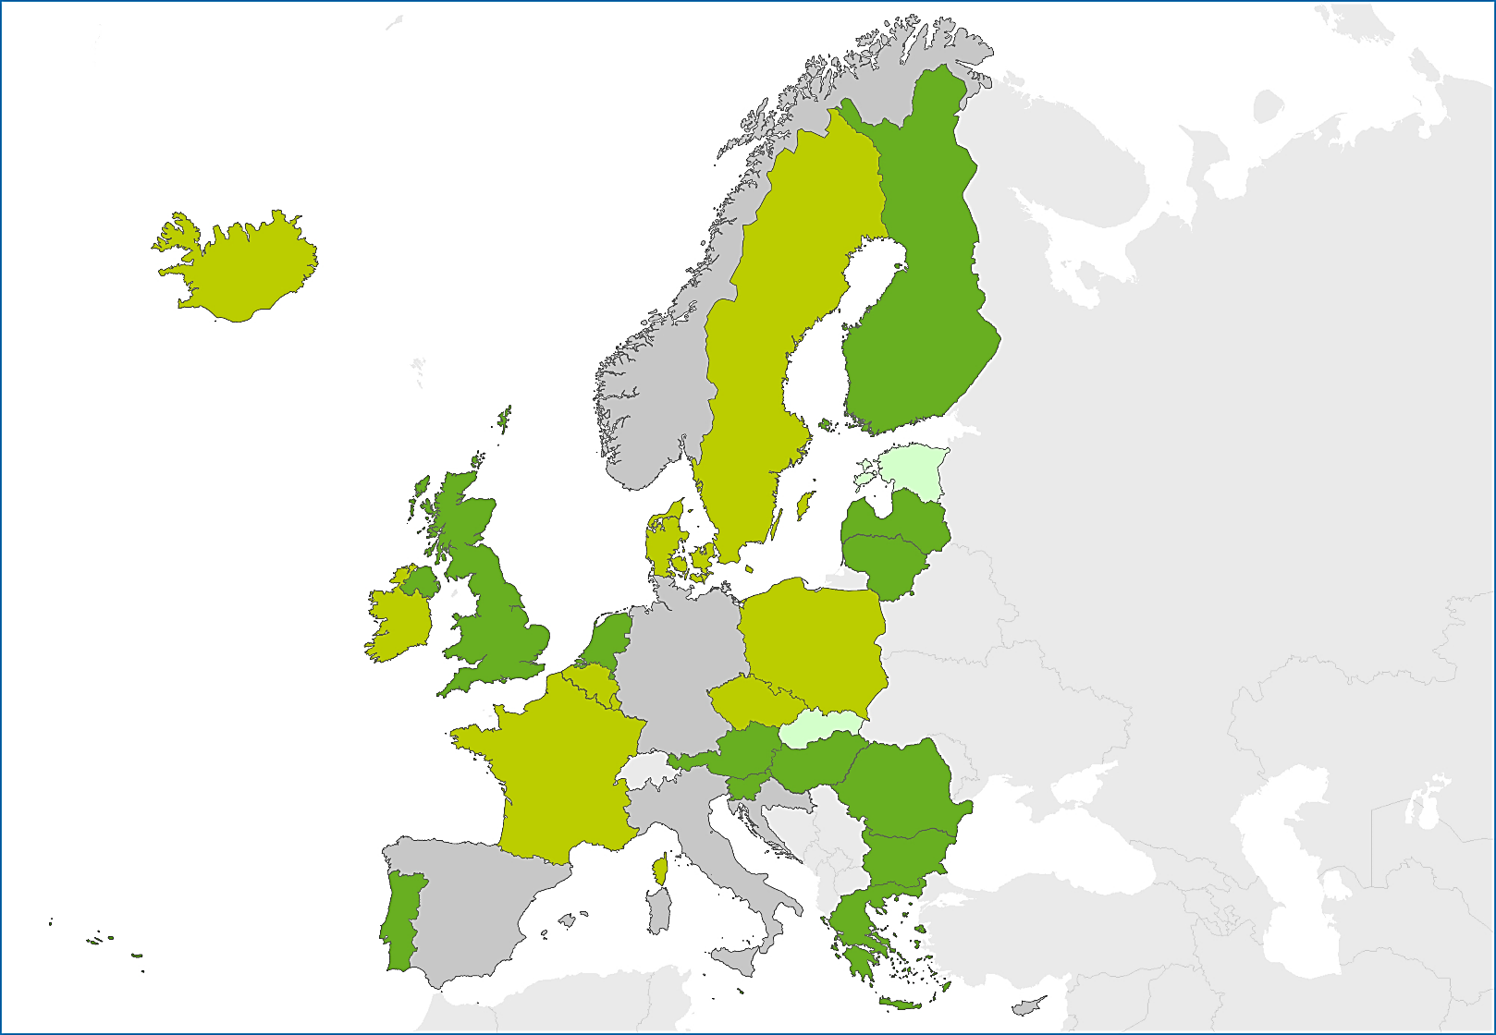
Indicator 1 and 2: Availability of national TB control plan and implementation guidelines*
Target: All countries have national TB control plans available and implementing guidelines
Status 2014: 15 countries have a national TB control plan, 13 countries have a plan with guidelines for implementation
National TB control plan available with implementation guidelines
National TB control plan available without implementation guidelines
National TB control plan not available
Information not available
Source: European Centre for Disease Prevention and Control.
TB surveillance and monitoring in Europe, 2016.
* Data obtained from ECDC questionnaire survey

Slide 11
Indicator 3: Percentage of national TB reference laboratories achieving adequate performance in the external quality assessment (EQA) scheme
Target: 100% of national TB reference laboratories achieving ≥ 80% performance (smear, culture, first- and second-line drug susceptibility testing).
Status 2014*: Nine national reference laboratories from nine country participated in the EQA for all four diagnostic methods and all (100%) laboratories achieved a performance of ≥ 80% for all four methods.
Source: European Centre for Disease Prevention and Control.
TB surveillance and monitoring in Europe, 2016.
* Results for 2014 report obtained from European Reference Laboratory Network for Tuberculosis (ERLTB-Net). No country-specific data are available.

Slide 12
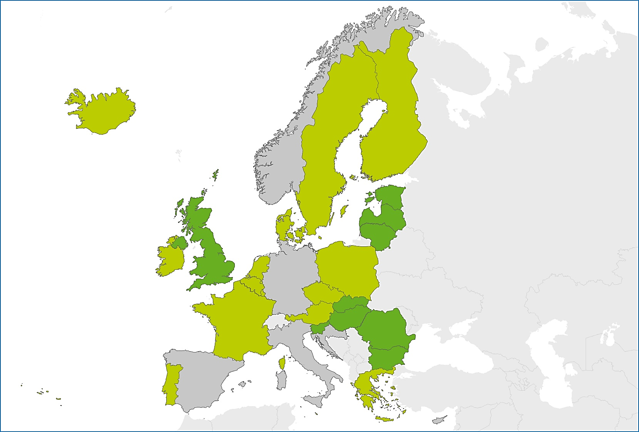
Indicator 4: Availability of a strategy for introducing and implementing new tools for TB control*
Target: All Member States (100%) have a strategy within the national TB programme supporting the introduction and implementation of new tools for TB control
Status 2014: Nine (37.5%) countries have a strategy in place
Strategy for new tools for TB control available
Strategy for new tools for TB control not available
Information not available or country not reporting
Source: European Centre for Disease Prevention and Control.
TB surveillance and monitoring in Europe, 2016.
* Data obtained from ECDC questionnaire survey

Slide 13
Indicator 5: Percentage of new pulmonary TB cases confirmed by culture
Target: 80% of new pulmonary TB cases are culture confirmed
Status 2014: 72.7% of new pulmonary TB cases were culture confirmed, 12 countries met the target
Source: European Centre for Disease Prevention and Control.
TB surveillance and monitoring in Europe, 2016.

Slide 14
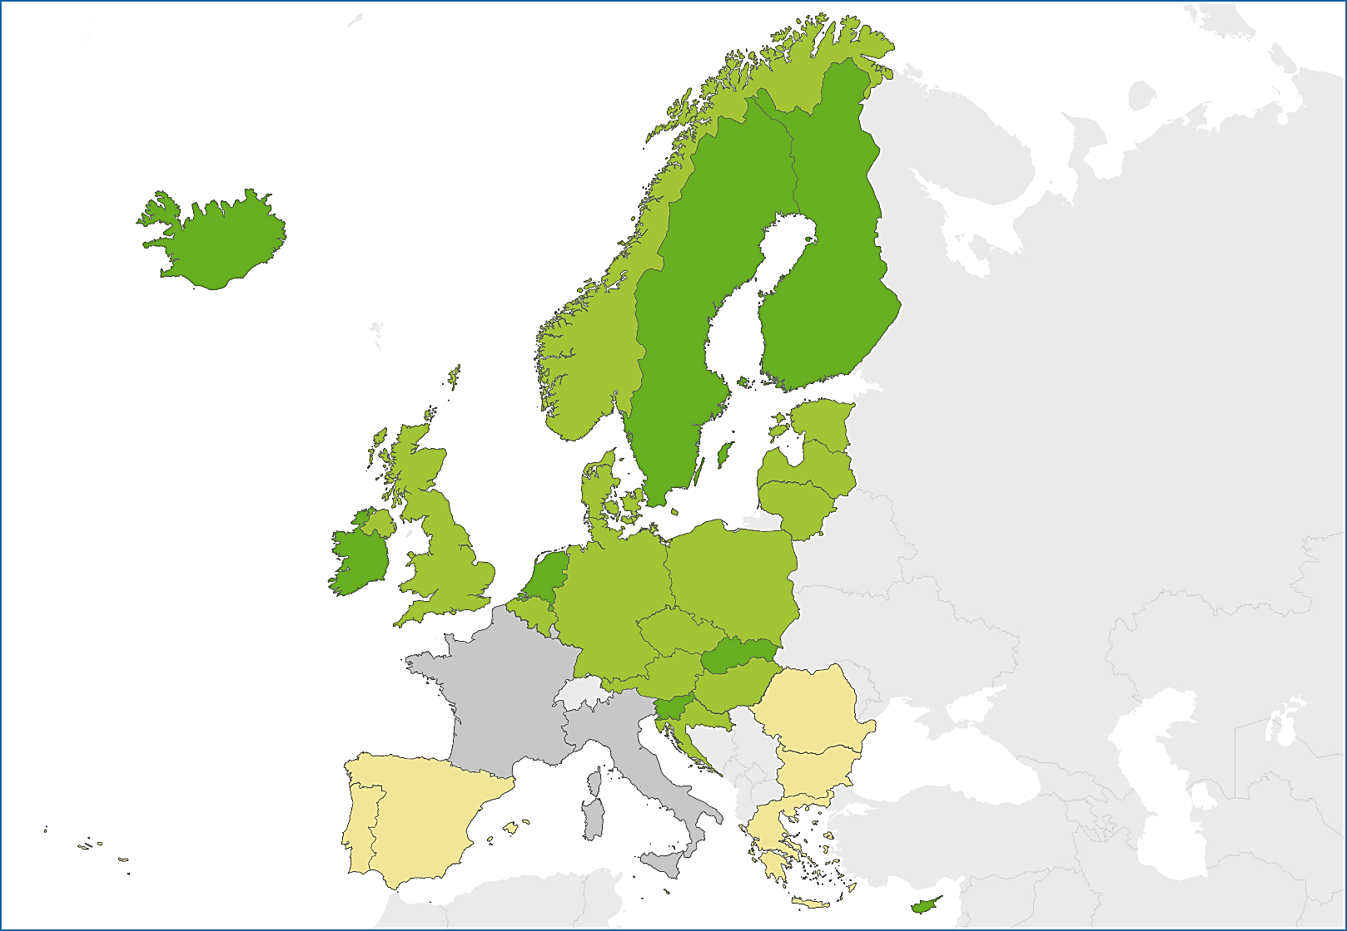
Indicator 5: Percentage of new pulmonary TB cases tested by DST for first-line drugs
Target: 100% of TB cases tested for susceptibility to first-line drugs (isoniazid and rifampicin) among new pulmonary TB cases
Status 2014: For 72.7% of culture-confirmed TB cases DST was reported, eight countries met the target
0 to 84.9%
85 to 99.9%
100%
Not reporting
Source: European Centre for Disease Prevention and Control.
TB surveillance and monitoring in Europe, 2016.

Slide 15
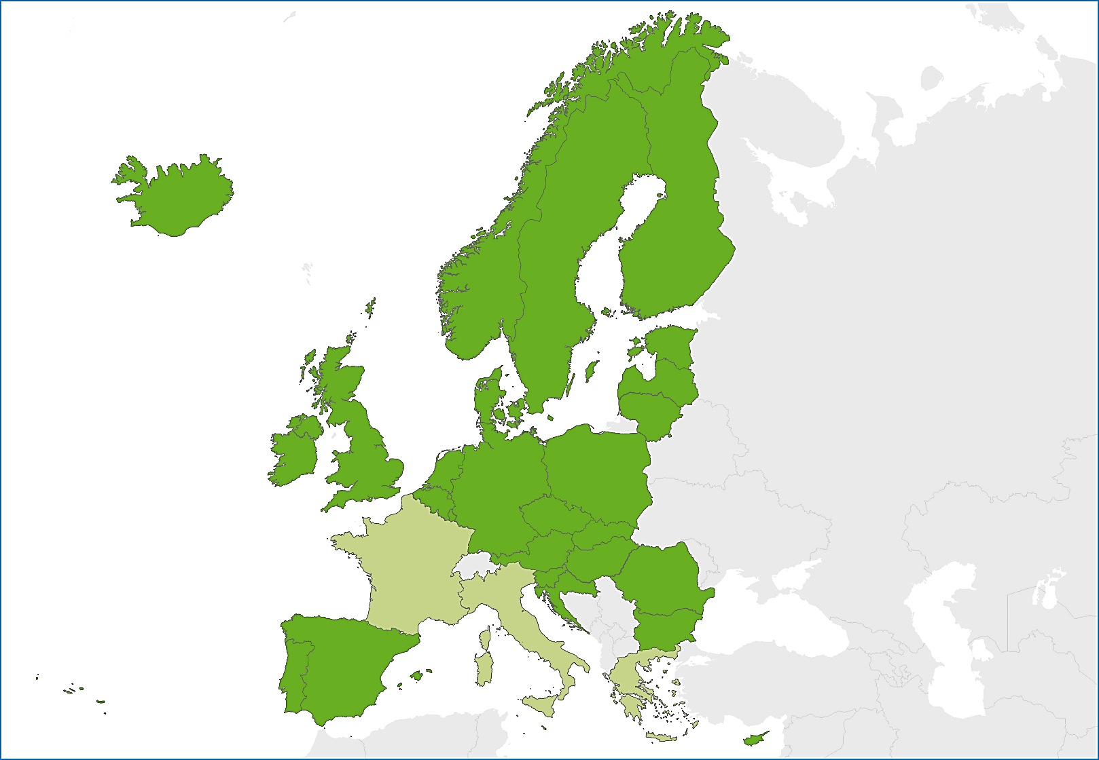
Indicator 6: Percentage of Member States reporting treatment success rate
Target: All Member States (100%) report treatment outcome monitoring to ECDC
Status 2014: 27 EU/EEA Member States reported treatment outcome for TB cases notified in 2013
Treatment outcome reported
Treatment outcome not reported
Source: European Centre for Disease Prevention and Control.
TB surveillance and monitoring in Europe, 2016.

Slide 16
Indicator 7: Treatment success rate
Target: Treatment success rate of at least 85% for new pulmonary culture-confirmed TB cases
Status 2014: Treatment success rate for EU/EEA was 75.9% (range: 0–100.0%), target met by five countries
Source: European Centre for Disease Prevention and Control.
TB surveillance and monitoring in Europe, 2016.

Slide 17
Indicator 7: Treatment success rate new pulmonary culture positive MDR TB cases*
Target: Treatment success of 70% for new pulmonary culture-positive MDR TB cases
Status 2014: Success rate in EU/EEA was 55.6% (range 0–100.0%), target met by 6 countries
Source: European Centre for Disease Prevention and Control.
TB surveillance and monitoring in Europe, 2016.
* Luxembourg reported ‘zero’ cases; France, Greece, and Italy did not report treatment outcome results.

Slide 18
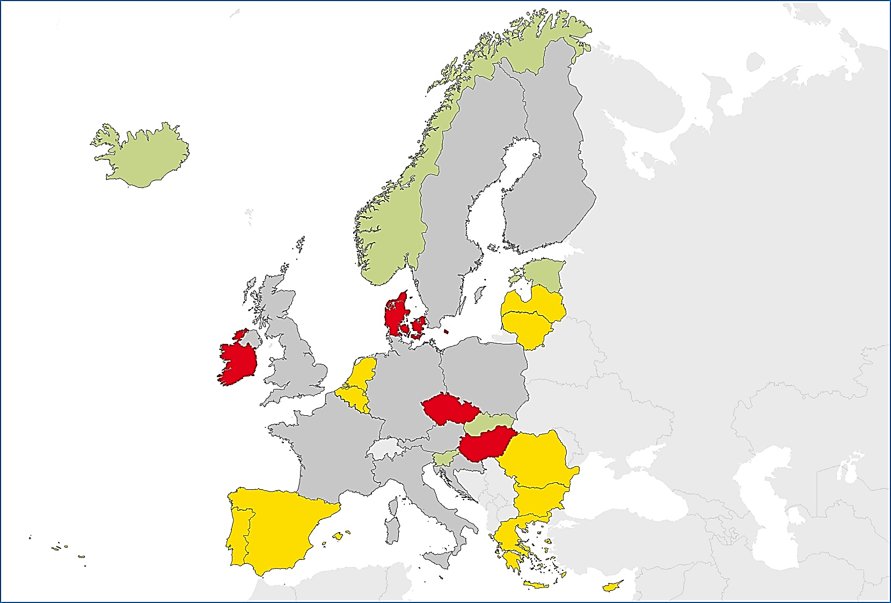
Indicator 8: Percentage of TB patients for whom HIV status is known
Target: HIV status is known for 100% of notified TB cases
Status 2014: 21 countries reported HIV test results for 36.6% of all reported cases, the 100% target was not met
< 50%
50 to 74.9%
75 to 99.9%
100%
Not included or not reporting
Source: European Centre for Disease Prevention and Control.
TB surveillance and monitoring in Europe, 2016.
* Finland and Poland reported HIV-positive cases, but not the number of tested cases for HIV, therefore excluded

Slide 19
Core indicators 1 - 4 Summary, EU/EEA, 2014:
National TB plan availability*:
Target: TB plan available, met by 15 countries.
EU/EEA status: not met
Availability of guidelines for implementing the national TB control plan*:
Target: TB guidelines available, met by 13 countries.
EU/EEA status: not met
Laboratory EQA performance:
Target: 100% of reference lab’s achieving 80% of performance (culture, smear and DST), met by 9 laboratories (100% of reporting).
EU/EEA status: met
Availability of a New Tool strategy*:
Target: New Tool strategy available, met by 9 countries.
EU/EEA status: not met
Source: European Centre for Disease Prevention and Control.
TB surveillance and monitoring in Europe, 2016.
* Member States’ level indicator. Not applicable for EU level.

Slide 20
Core indicators 5 - 8 Summary, EU/EEA, 2014:
Culture-confirmation:
Target: 80% of culture confirmation in new pulmonary TB cases.
EU/EEA status: 72.7%
Drug susceptibility testing,
Target: 100% of culture-confirmed cases tested for first-line drugs.
EU/EEA status: 85.2%
Treatment success reporting:
Target: 100% of EU/EEA Member States are reporting treatment success.
EU/EEA status: 90.0%
Treatment success rate:
Target a: 85% of new pulmonary TB cases treated successfully in 12 months.
EU/EEA status: 75.9%
Target b: 70% of new pulmonary MDR TB cases treated successfully in 24 months.
EU/EEA status: 55.6%
Known HIV status:
Target: Known HIV status for 100% of notified TB cases.
EU/EEA status: 36.6%
Source: European Centre for Disease Prevention and Control.
TB surveillance and monitoring in Europe, 2016.

Slide 21
Progressing towards TB elimination: how’s the EU doing?
INDICATORS | MET √ / NOT MET ⊗ at EU LEVEL
Epidemiological Indicators reflect both trends in disease burden and in the level of transmission
Trends in TB case notification rate | √
Trends in MDR-TB case notification rate | √
Trends in child-to-adult ratio of notification rates | ⊗
Trends in mean age of TB cases | ⊗
Core Indicators are related to the 8 strategic areas of the Framework Action Plan
Availability of a national TB control plan | ⊗
Availability of guidelines for implementing the national TB control plan | ⊗
Percentage of National TB reference laboratories achieving adequate performance in the external quality assurance scheme | √
Availability of a strategy for introducing and implementing new tools for TB control | ⊗
Percentage of new pulmonary TB cases confirmed by culture and percentage of new cases tested by DST for first-line drugs | ⊗
Percentage of Member States reporting treatment success rate | ⊗
Treatment success rate | ⊗
Percentage of TB patients for whom HIV-status is known | ⊗

