Slide 1
Vaccine Effectiveness Burden and Impact Studies (VEBIS), Primary Care
Latest update September 2024

Slide 2
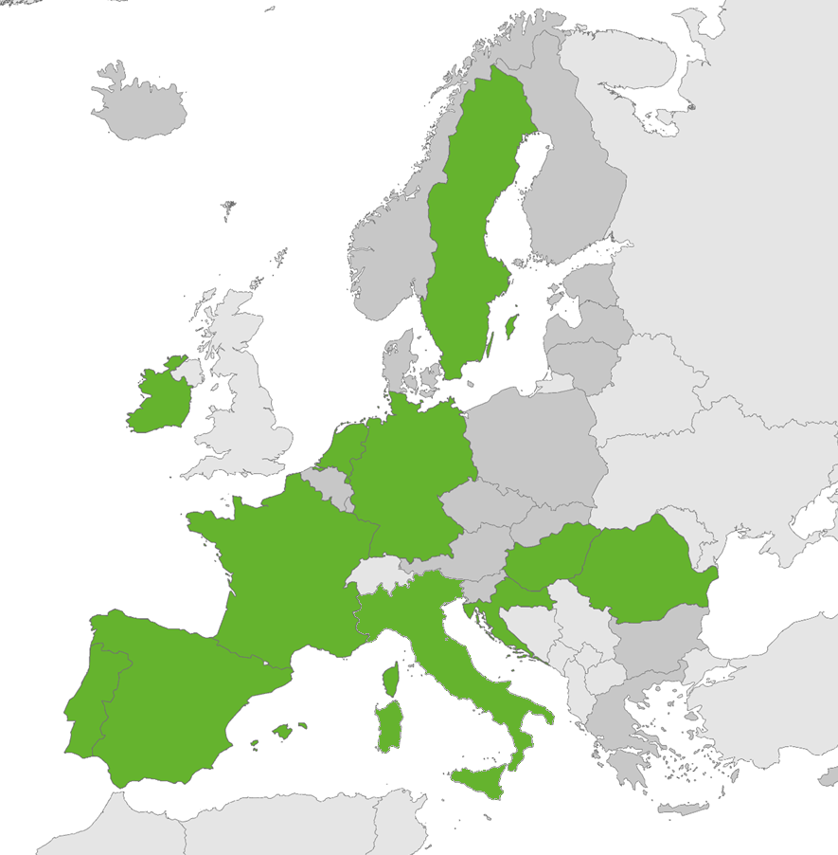
Participating countries in the VEBIS primary care study. A total of 11 countries:
Croatia
France
Hungary
Ireland
Italy
Netherlands
Germany
Portugal
Romania
Spain
Navarra (Spain)
Sweden

Slide 3
Participating sites
Croatia
Croatian Institute of Public Health, Zagreb
France
INSERM, Sorbonne Université, Institut Pierre Louis d'épidémiologie et de Santé Publique (IPLESP UMRS 1136), Paris, France
Institut Pasteur, Paris, France
Germany
Robert Koch Institute, Berlin, Germany
Hungary
National Laboratory for Health Security, Epidemiology and Surveillance Centre, Semmelweis University, Budapest, Hungary
Ireland
Health Service Executive- Health Protection Surveillance Centre, Dublin, Ireland
Italy
Istituto Superiore di Sanità, Rome, Italy
Navarra
Instituto de Salud Pública y Laboral de Navarra, IdiSNA, Pamplona, Spain
Netherlands
Nivel, Utrecht, the Netherlands
National Institute for Public Health and the Environment (RIVM), Bilthoven, the Netherlands
Portugal
Instituto Nacional de Saúde Dr. Ricardo Jorge, Lisbon, Portugal
Romania
Cantacuzino National Military-Medical Institute for Research and Development, Bucharest, Romania
Spain
Institute of Health Carlos III, Madrid, Spain
Sweden
Public Health Agency of Sweden, Stockholm, Sweden

