Slide 1
Vaccine Effectiveness Burden and Impact Studies (VEBIS), SARI, hospital study
Latest update December 2025

Slide 2
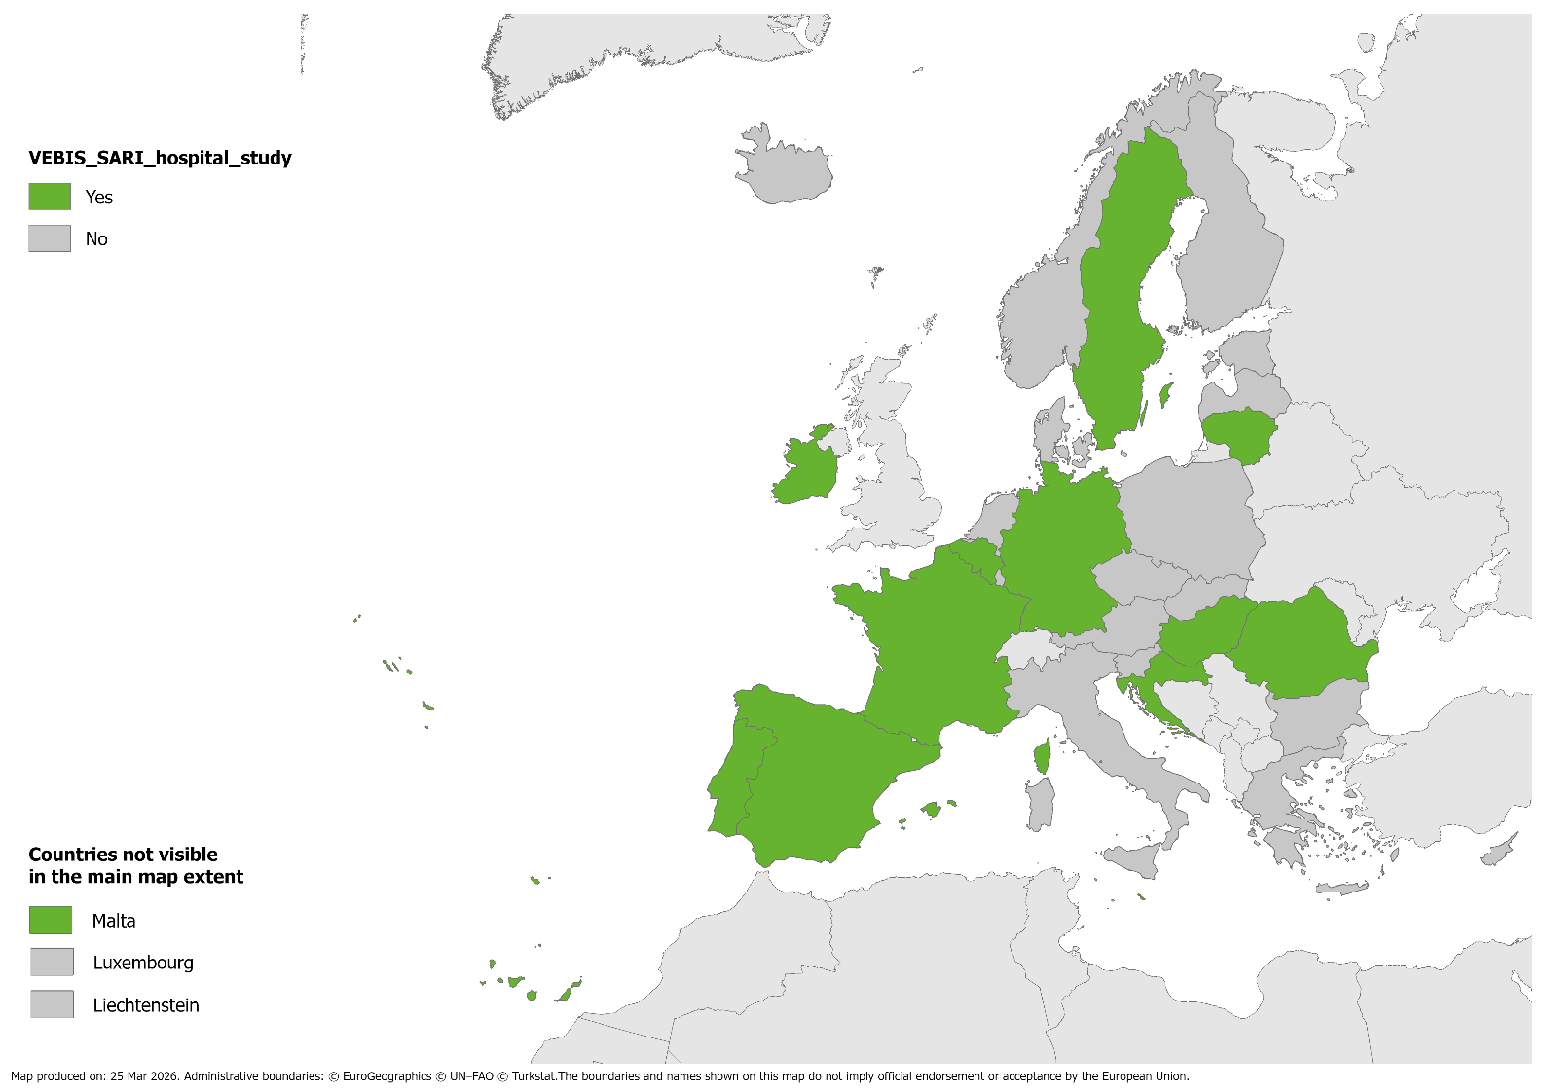
Participating countries in the VEBIS SARI hospital study, season 2025-2026. A total of 12 countries:
Belgium
Croatia
France
Germany
Hungary
Ireland
Lithuania
Malta
Portugal
Romania
Spain (incl. Navarra)
Sweden

Slide 3
Participating sites season 2025-2026
Belgium:
AZ Sint Jan Brugge
Centre Hospitalier de Wallonie Picarde
Grand Hôpital de Charleroi
Jessa Ziekenhuis Hasselt
UCL Namur (Mont Godinne)
Universitair Ziekenhuis Antwerpen
Universitair Ziekenhuis Brussel
CHU St Pierre Bruxelles
Universitair Ziekenhuis Gent
Ziekenhuisnetwerk Antwerpen
Croatia:
Clinical Hospital Centre Split
France
University hospital Strasbourg
University hospital Toulouse
Germany
Helios Klinikum Emil von Behring
Helios Kliniken Schwerin
Helios Hanseklinikum Stralsund
Helios Klinikum Gifhorn
Helios St. Marienberg Klinik Helmstedt
Helios Klinikum Hildesheim
Helios Klinikum Pirna
Helios Klinikum Erfurt
Helios Klinikum Pforzheim
Helios St. Johannes Klinik Duisburg
Helios Universitätsklinikum Wuppertal
Helios Klinikum Krefeld
Helios Klinikum Siegburg
Helios Klinikum Bonn/Rhein-Sieg
Hungary:
Petz Aladar Hospital, Győr
Ireland:
Saint Vincent's University Hospital

Slide 4
Hospital Clinic Barcelona
Hospital Sant Joan de Deu
Complejo Hospitalario de Badajoz
Complejo Hospitalario de Cáceres
Complejo Hospital Universitario Doctor Negrín
Hospital General Universitario de Elche
Hospital de Melilla
Hospital de Ceuta
Hospital Burgos
Hospital Juan Ramón Jiménez de Huelva
Hospital de Jerez de la Frontera
Hospital Regional de Málaga
Hospital Virgen de la Macarena
Hospital Universitario Central de Oviedo
Hospital Virgen del Rocío
Hospital Virgen de la Victoria
Hospital Universitario de La Ribera
Hospital Universitario de La Plana
Hospital Clínico Universitario Virgen de la Arrixaca
Complejo Hospitalario de Albacete
Complexo Hospitalarario Santiago
H. U. Germans Trias i Pujol de Badalona
Hospital Universitari Vall d'Hebron
Hospital Univ. Joan XXIII de Tarragona
Hospital de Valdecilla
Hospital U. Arnau de Vilanova de Lleida
Hospital de Tortosa Verge de la Cinta
Hospital Universitari de Bellvitge
Lithuania:
Vilnius University Santaros Clinics
Kaunas Hospital of the Lithuanian University of health Sciences
Malta:
Mater Dei Hospital
Portugal:
Centro Hospitalar Universitário de São João
Centro Hospitalar e Universitário de Lisboa Norte
Romania
Victor Babes Hospital, Bucharest
Sf Parascheva Hospital, Iasi
Spain – Navarra region
Hospital Universitario de Navarra
Hospital Reina Sofía de Tudela
Hospital Garcia Orcoyen de Estella
Spain – Other regions
Hospital Clínico Valladolid
Hospital General Universitario Gregorio Marañón
Hospital Universitario Ramón y Cajal

Slide 5
Hospital Virgen de las Nieves
Hospital U de Girona Doctor Josep Trueta
Hospital Son Espases
Complexo Hospitalarario Santiago
Hospital Miguel Servet
Hospital Universitario La Paz
Sweden
Uppsala Hospital

