Slide 1
Tuberculosis situation in the EU/EEA, 2021
Tuberculosis situation in the EU/EEA, 2024
h
Findings from the joint report Tuberculosis surveillance and monitoring in Europe by ECDC and WHO Regional Office for Europe
Stockholm, 24 March 2026

Slide 2
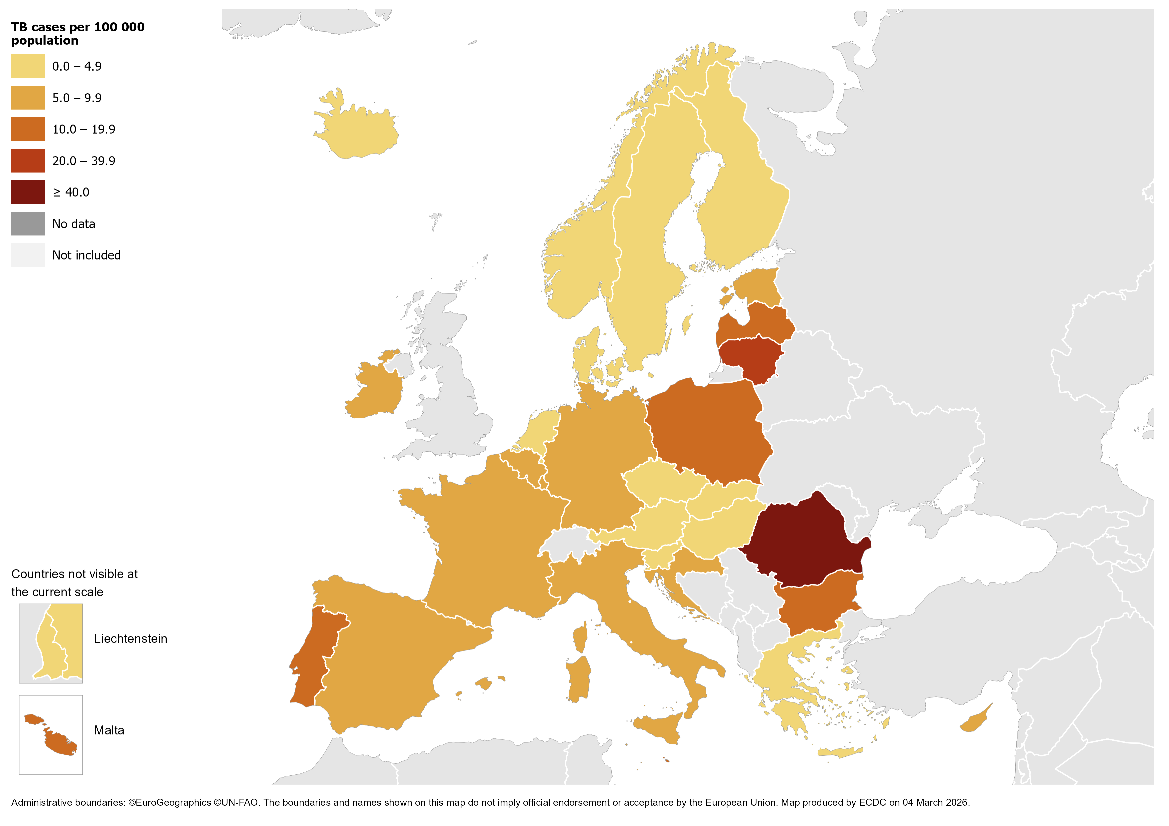
TB notifications, EU/EEA, 2024
38 249 TB cases notified in all EU/EEA countries
Notification rate 8.4 per 100 000 population (range 2.1 – 46.3)
.
Source: ECDC/WHO (2025). Tuberculosis surveillance and monitoring in Europe 2026–2024 data
2

Slide 3
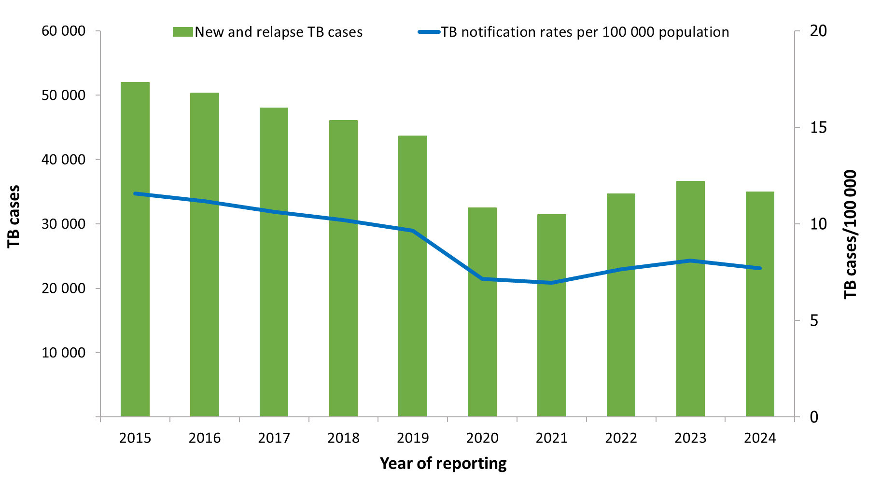
Notified TB cases, EU/EEA*, 2015–2024
The recovery of cases after the COVID-19 pandemic halted in 2024.
Despite the increases in recent years, the overall trend continues to decline between 2015 and 2024:
Number of TB cases decreased by 32.8%
Notification rate decreased by 33.6%
* Liechtenstein did not report data for 2019.
Source: ECDC/WHO (2026). Tuberculosis surveillance and monitoring in Europe 2026–2024 data

Slide 4
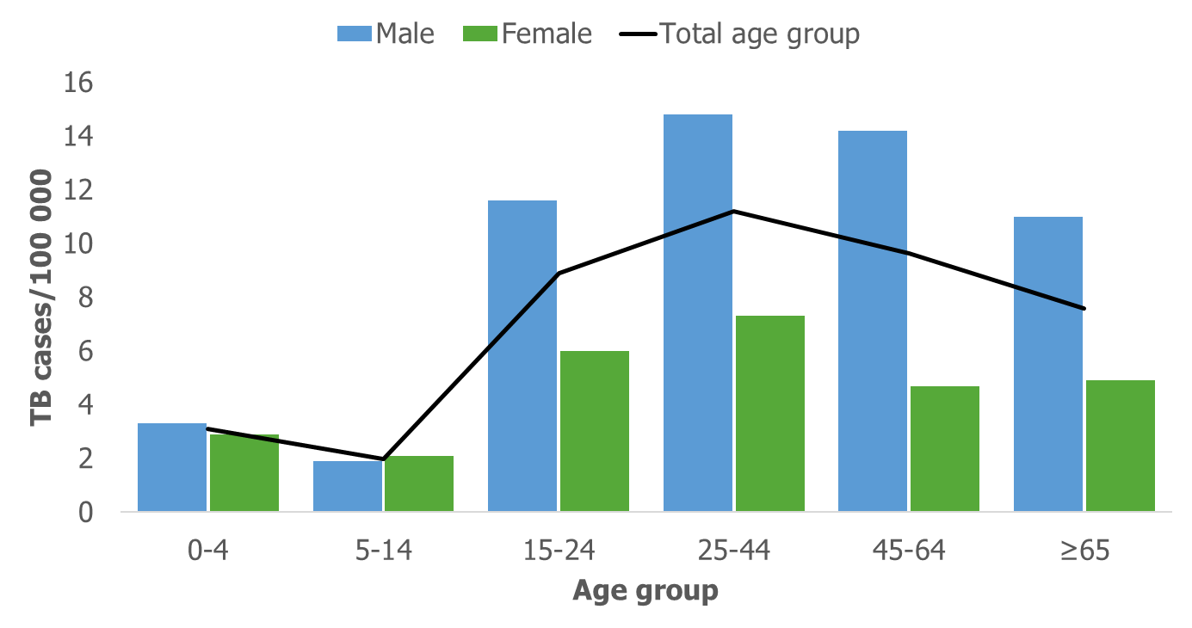
TB notification rate by sex and age group, EU/EEA, 2024
The highest notification rate was observed in the age group 25–44 years (14.8 per 100 000)
Males were over-represented in all age groups over 14 years.
Source: ECDC/WHO (2026). Tuberculosis surveillance and monitoring in Europe 2026–2024 data

Slide 5
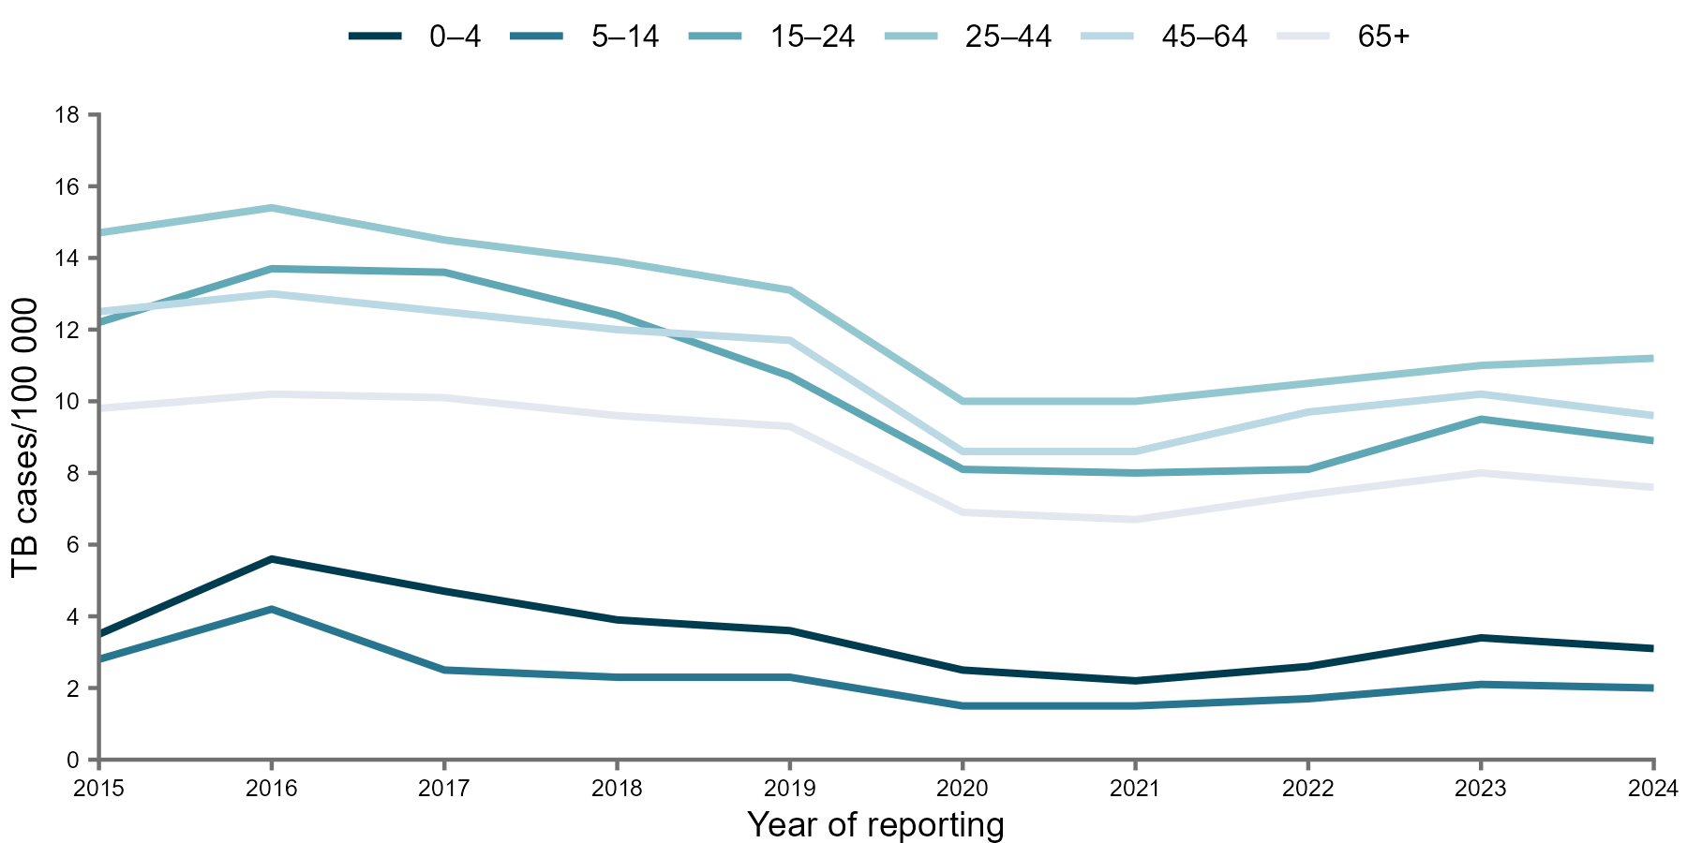
TB notification rate by age group, EU/EEA*,
2015–2024
Annual average decrease of between 2.1 to 5.1% in all age groups
* Liechtenstein did not report data for 2019.
Source: ECDC/WHO (2026). Tuberculosis surveillance and monitoring in Europe 2026–2024 data

Slide 6
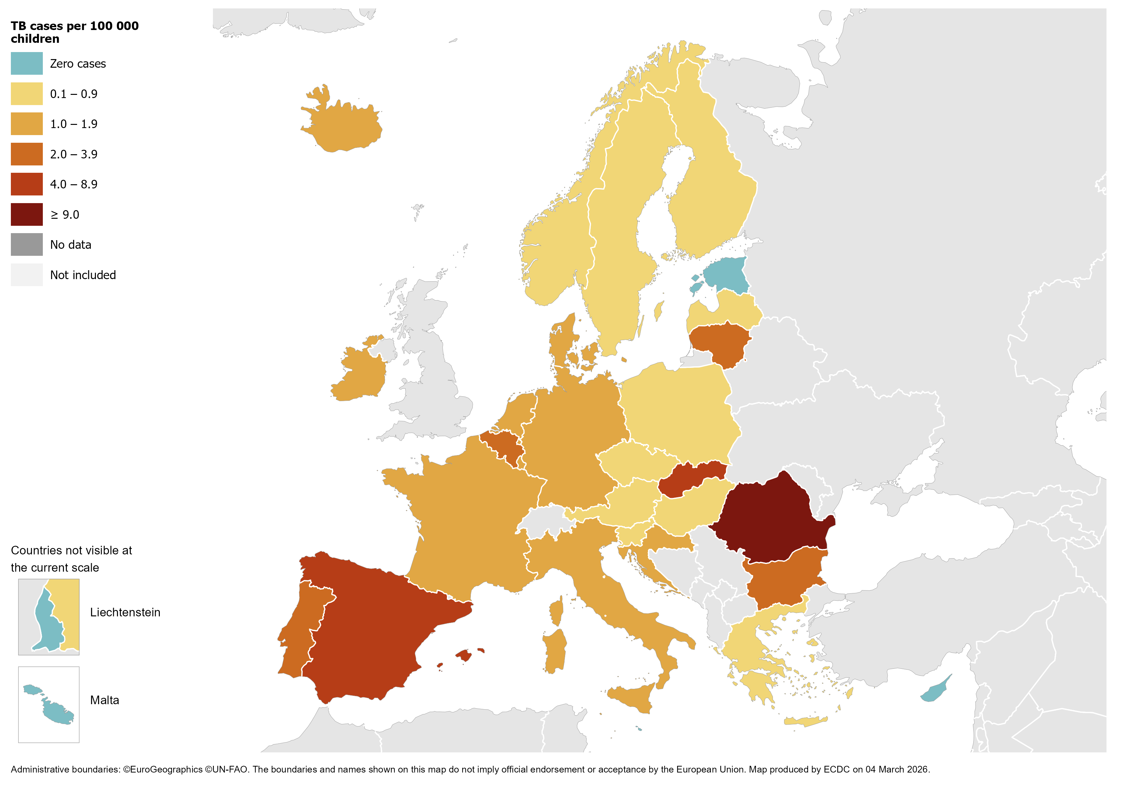
TB in children under 15 years, EU/EEA, 2024
1 612 TB cases notified in children under 15 years (new and relapse cases accounted for 1 457)
4.2% of all TB cases
(range 0.0–34.1%)
2.4 per 100 000 child population
(range 0.0–11.0)
Source: ECDC/WHO (2026). Tuberculosis surveillance and monitoring in Europe 2026–2024 data

Slide 7
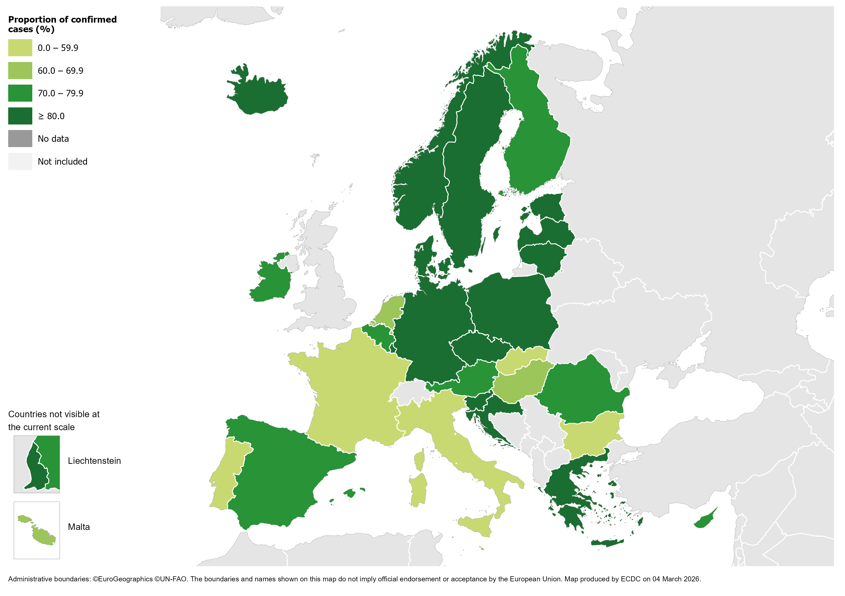
Confirmed TB cases*, EU/EEA, 2024
26 500 TB cases were confirmed
69.3% of all TB cases
(range 44-100%)
* Confirmation by culture, or by microscopy and Mycobacterium tuberculosis nucleic acid amplification test.
Source: ECDC/WHO (2026). Tuberculosis surveillance and monitoring in Europe 2026–2024 data

Slide 8
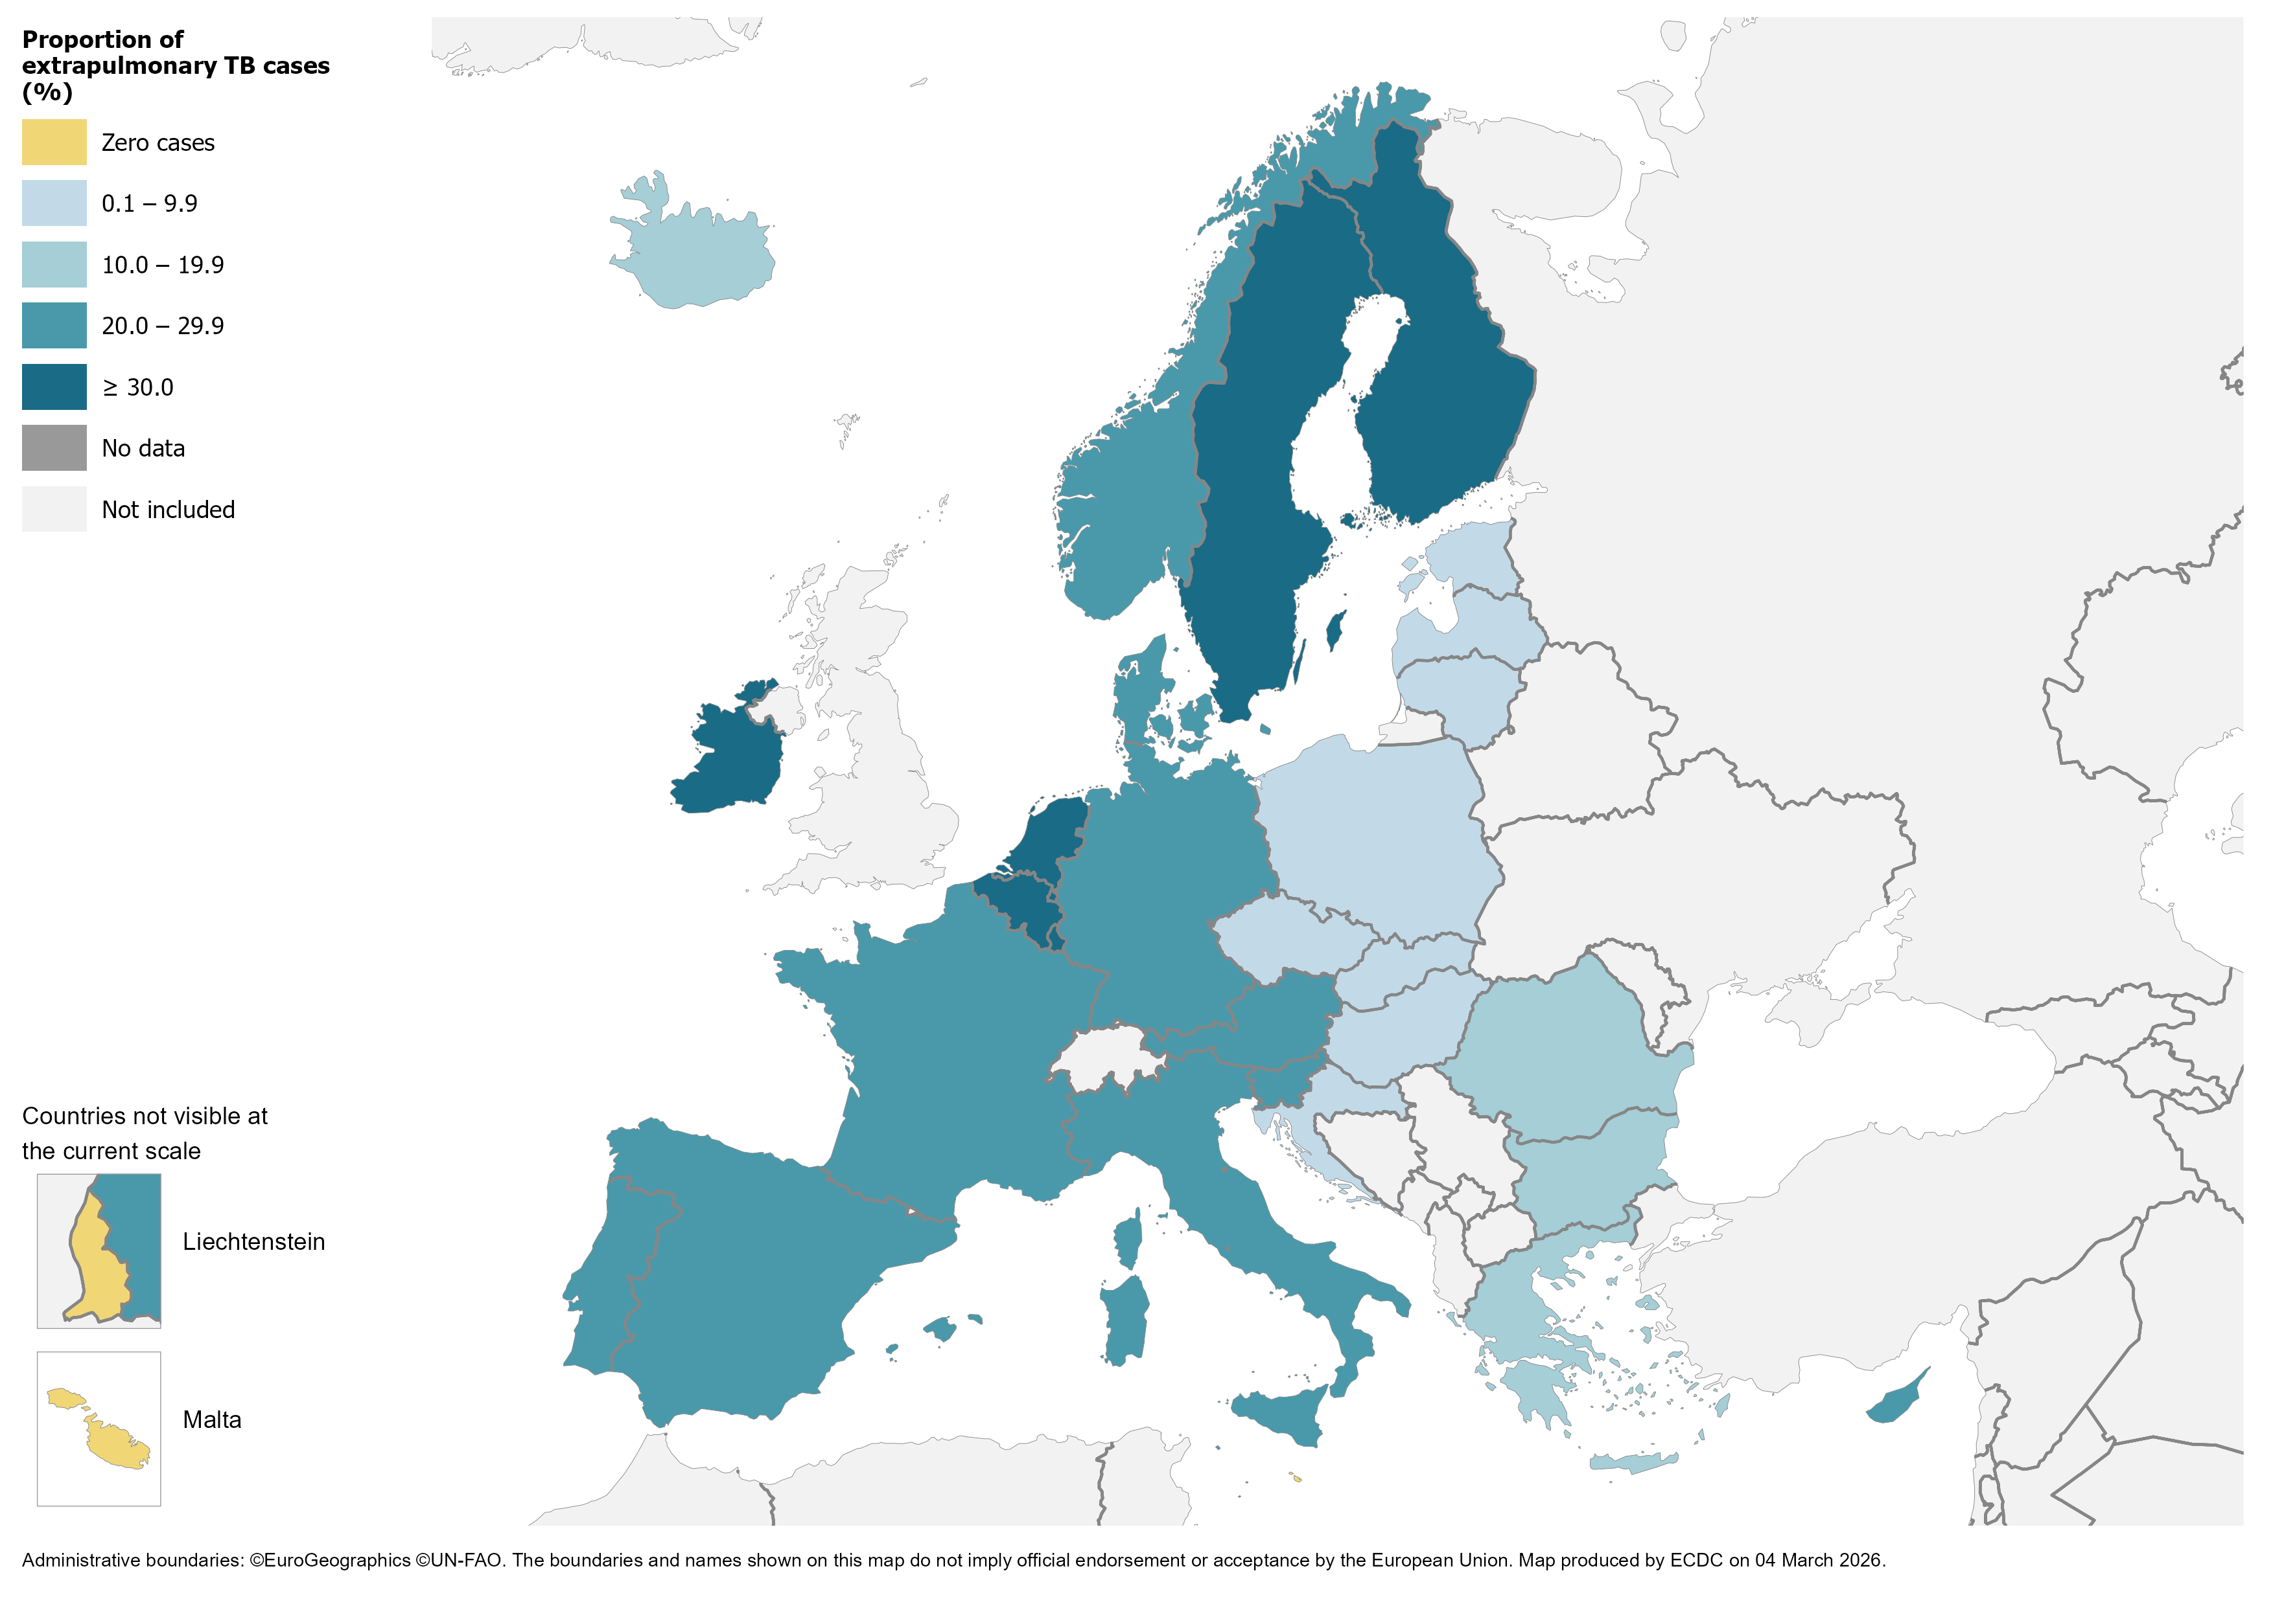
Extrapulmonary TB, EU/EEA, 2024
7 827 notified cases had extrapulmonary TB
20.5% of all TB cases (range 0.0–40.5%)
Source: ECDC/WHO (2026). Tuberculosis surveillance and monitoring in Europe 2026–2024 data

Slide 9
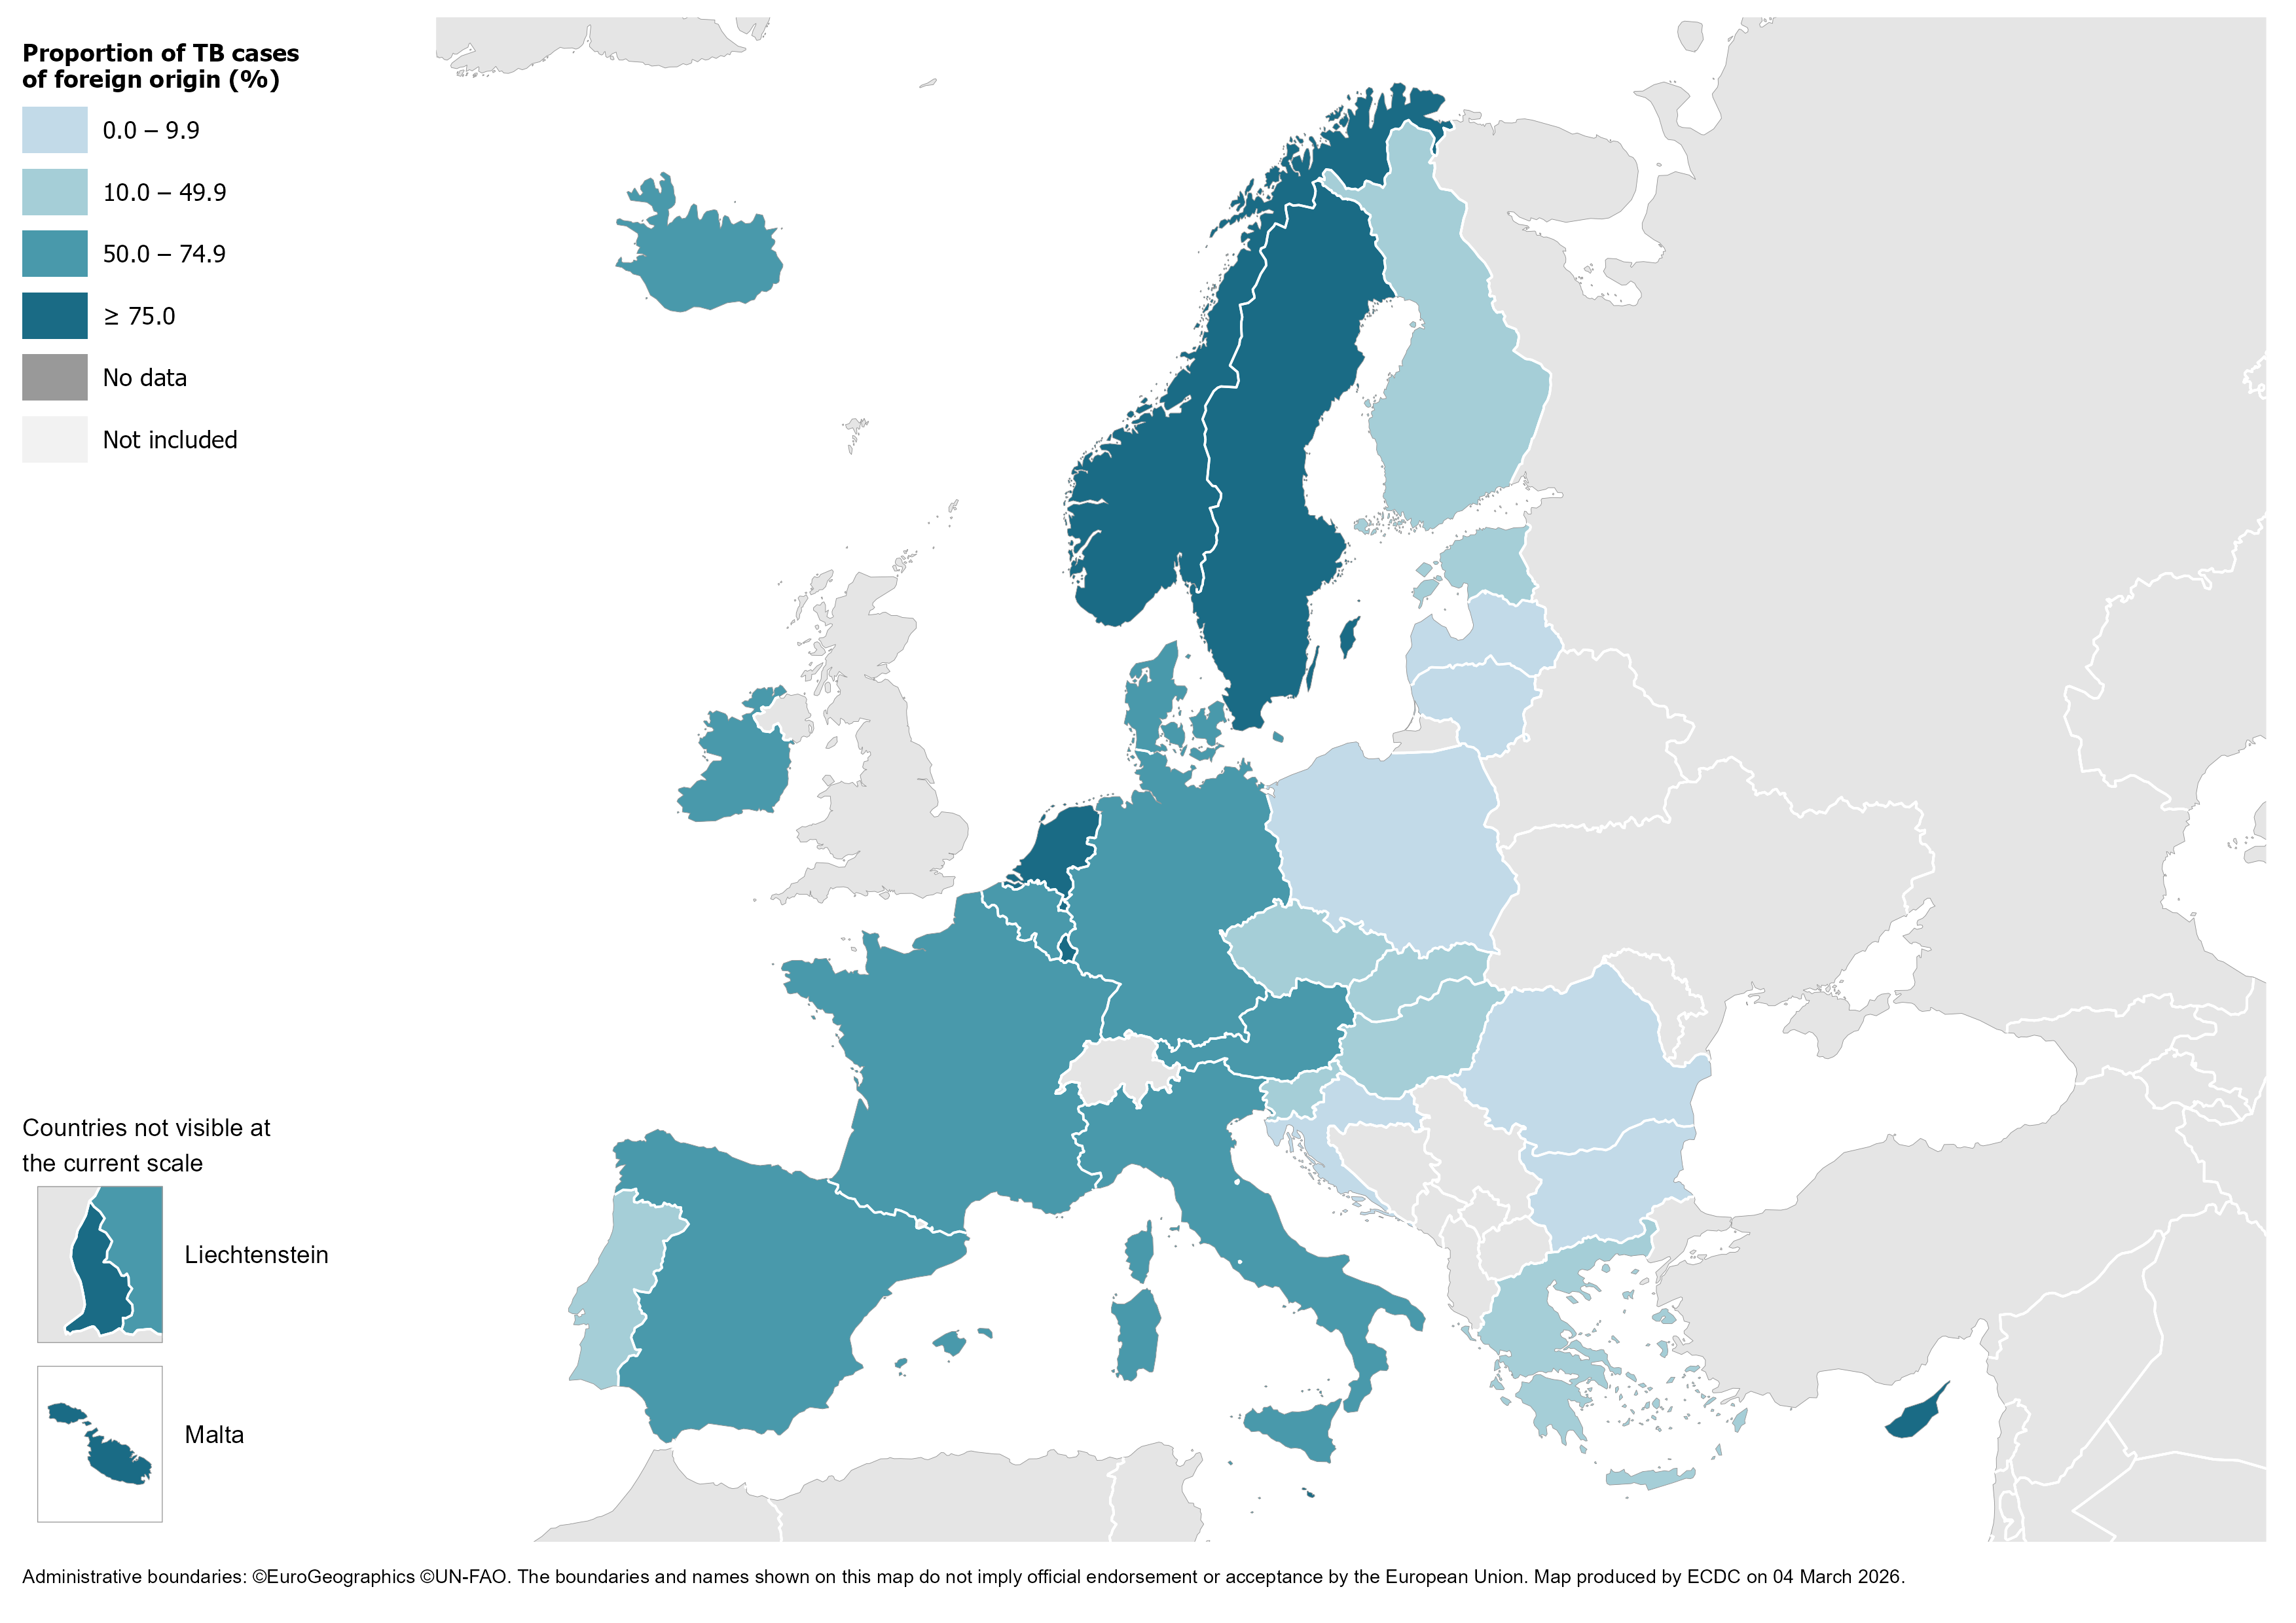
TB in persons of foreign origin*, EU/EEA, 2024
14 400 TB cases of foreign* origin
37.6% of all TB cases (range 0.0–100%)
* Notified in persons originating from other countries than the reporting country. Latvia reported all cases as of unknown origin in 2024.
Source: ECDC/WHO (2026). Tuberculosis surveillance and monitoring in Europe 2026–2024 data

Slide 10
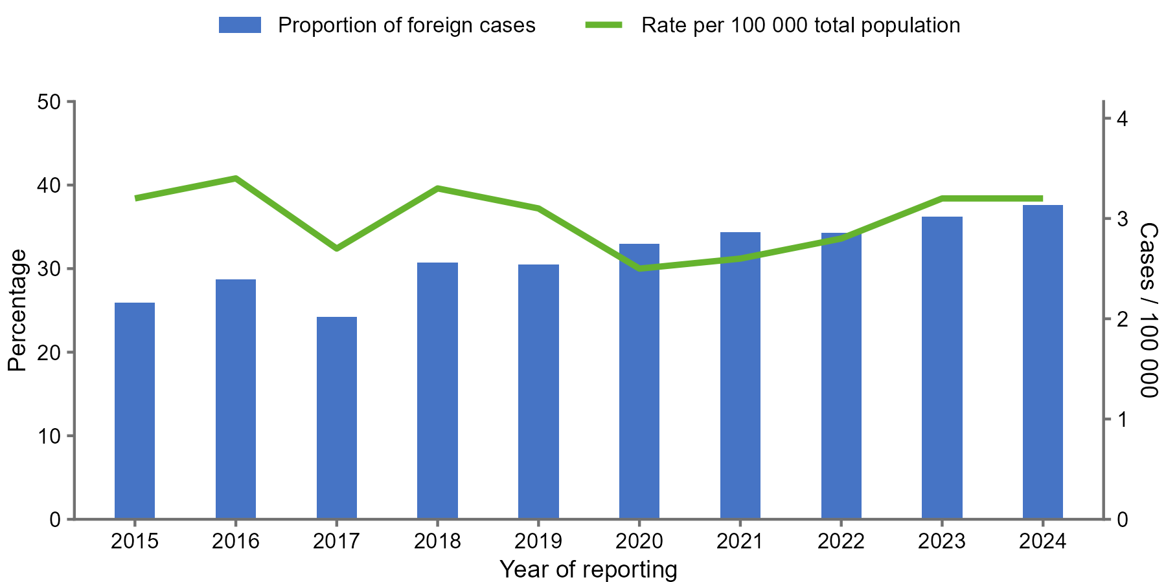
TB cases in persons of foreign origin*, EU/EEA†, 2015–2024
The proportion of cases in persons of foreign origin increased from 25.9% in 2015 to 37.6% in 2024.
The rate of TB cases of foreign origin per 100 000 of the total population varied between 2.5 and 3.4
* Notified in persons originating from other countries than the reporting country.
† Liechtenstein did not report data for 2019.
Source: ECDC/WHO (2026). Tuberculosis surveillance and monitoring in Europe 2026–2024 data

Slide 11
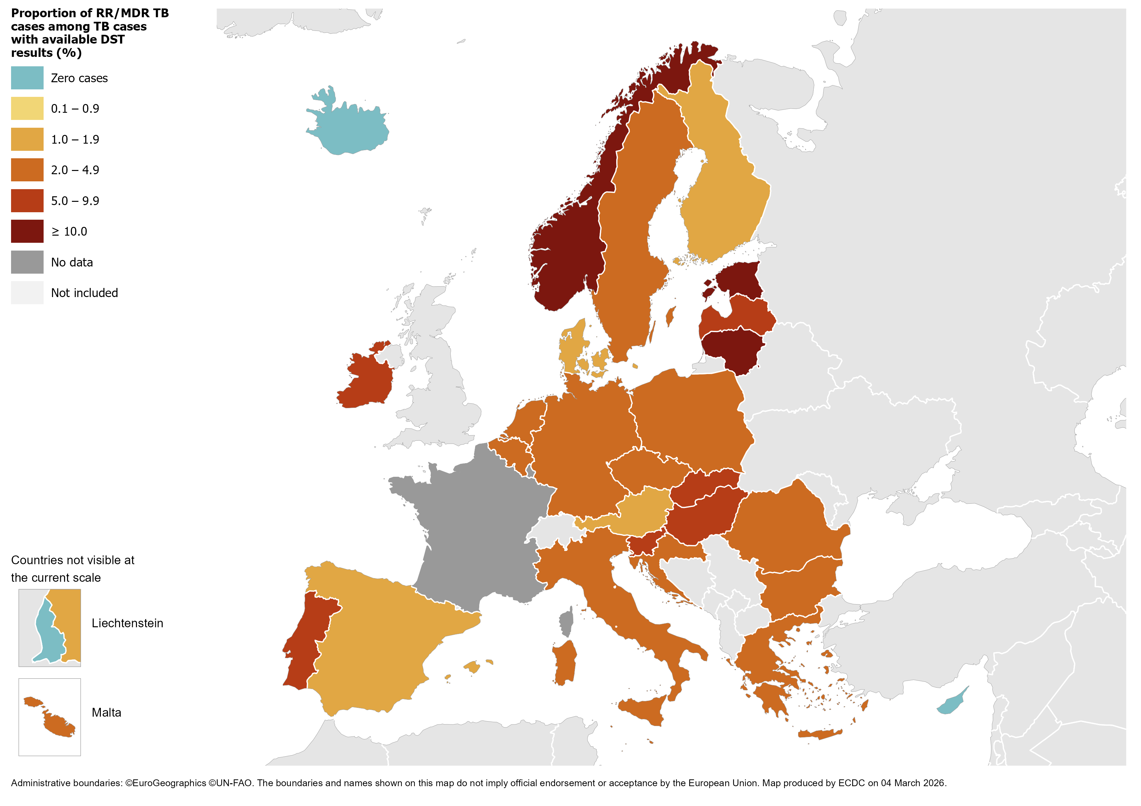
RR/MDR TB# cases with available DST results, EU/EEA*, 2024
817 pulmonary RR/MDR TB cases notified by all EU/EEA countries*
4.3% of all TB cases with available DST† results had RR/MDR TB (range 0.0–17.7%, excluding France)
# RR/MDR TB – Rifampicin resistant or multidrug resistant.
* Data from France included in the total cases notified and percentage, but not included in the range or the map, as DST results are only available for RR/MDR TB cases.
† DST – drug susceptibility test.
Source: ECDC/WHO (2026). Tuberculosis surveillance and monitoring in Europe 2026–2024 data

Slide 12
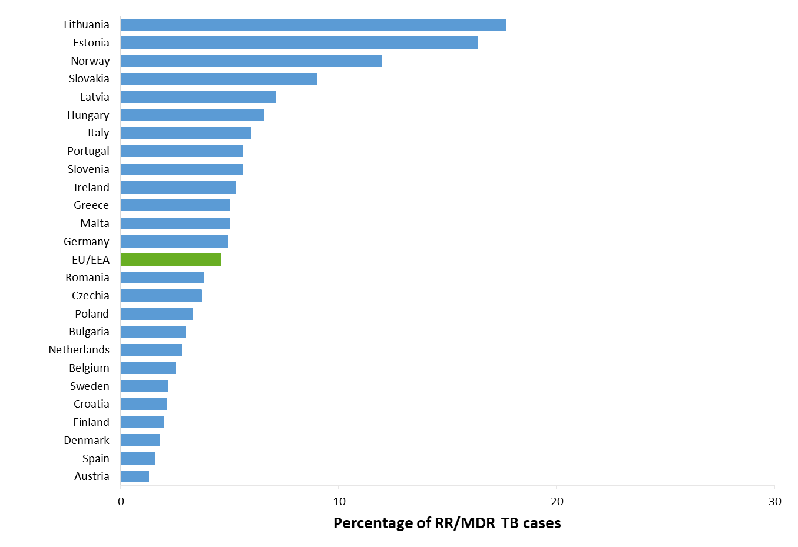
Proportion of RR/MDR TB, EU/EEA*, 2024
817 RR/MDR TB cases notified by all EU/EEA countries
4.3% of all bacteriologically-confirmed TB cases with available DST† results had RR/MDR TB (range 0–17.7%)
* RR/MDR TB data from France is not included in the graph. Cyprus, Iceland, Liechtenstein and Luxembourg reported zero RR/MDR TB cases for 2024.
† DST – drug susceptibility test.
Source: ECDC/WHO (2026). Tuberculosis surveillance and monitoring in Europe 2026–2024 data

Slide 13
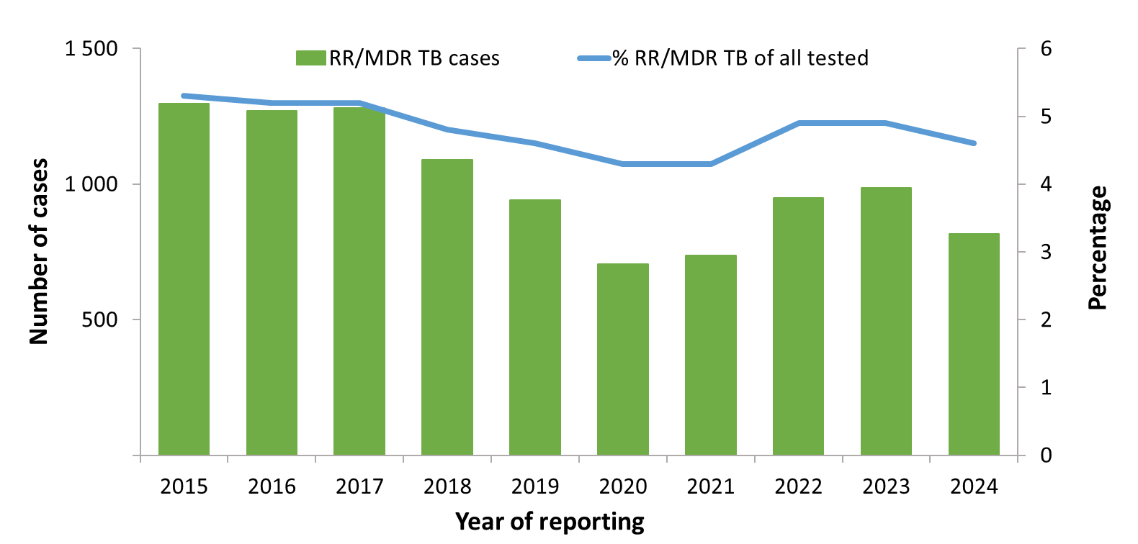
RR/MDR TB cases and proportions of all TB cases tested for drug resistance, EU/EEA*, 2015–2024
The total number of notified RR/MDR TB cases decreased from 1 297 in 2015 to 817 in 2024.
Proportion of RR/MDR TB cases among all TB cases with available DST† results decreased from 5.1% in 2015 to 4.6% in 2024 in the countries where data was available during 2015-2024.
* Countries and the years they are not included due to reporting discrepancies or no data: France (2015) and Liechtenstein (2019-2020).
† DST – drug susceptibility test.
Source: ECDC/WHO (2026). Tuberculosis surveillance and monitoring in Europe 2026–2024 data

Slide 14
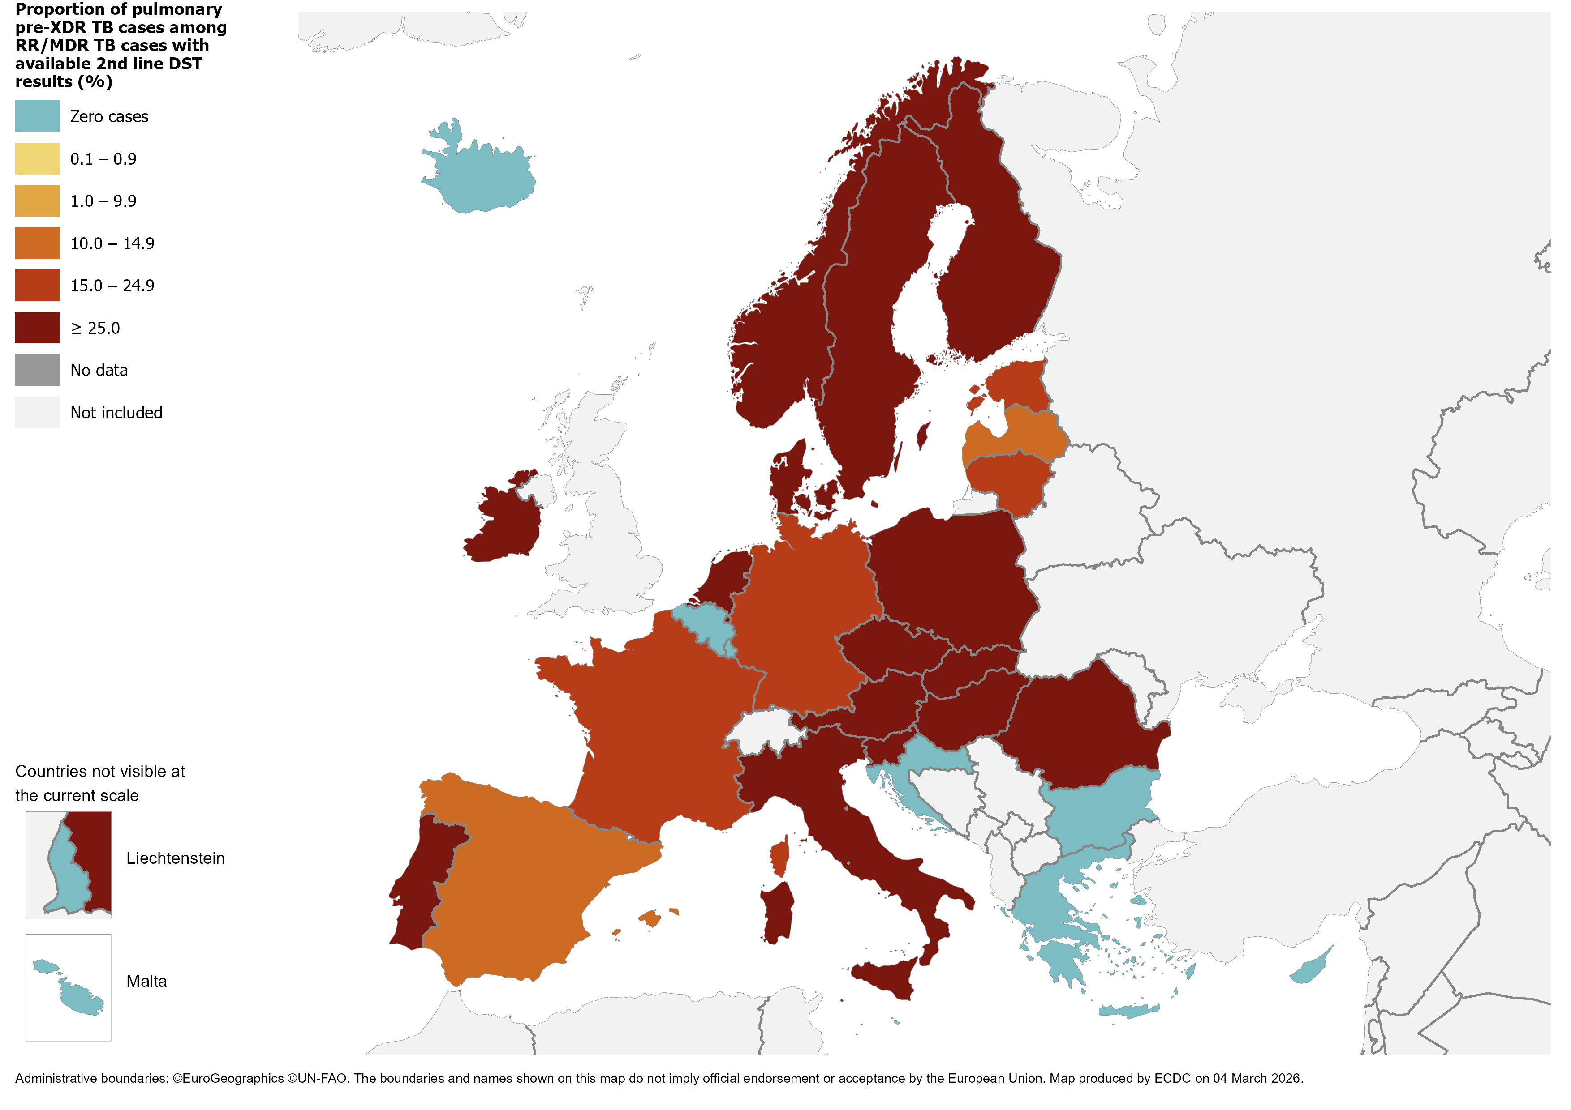
Pulmonary pre-XDR* TB cases, EU/EEA, 2024
145 pre-XDR* TB cases notified in EU/EEA countries
26.4% of RR/MDR TB cases with second-line DST† results met the pre-XDR TB definition
* pre-XDR TB – cases with multidrug resistance and rifampicin-resistance (RR/MDR TB) and which are also resistant to any fluoroquinolone.
† DST – drug susceptibility test.
Source: ECDC/WHO (2026). Tuberculosis surveillance and monitoring in Europe 2026–2024 data

Slide 15
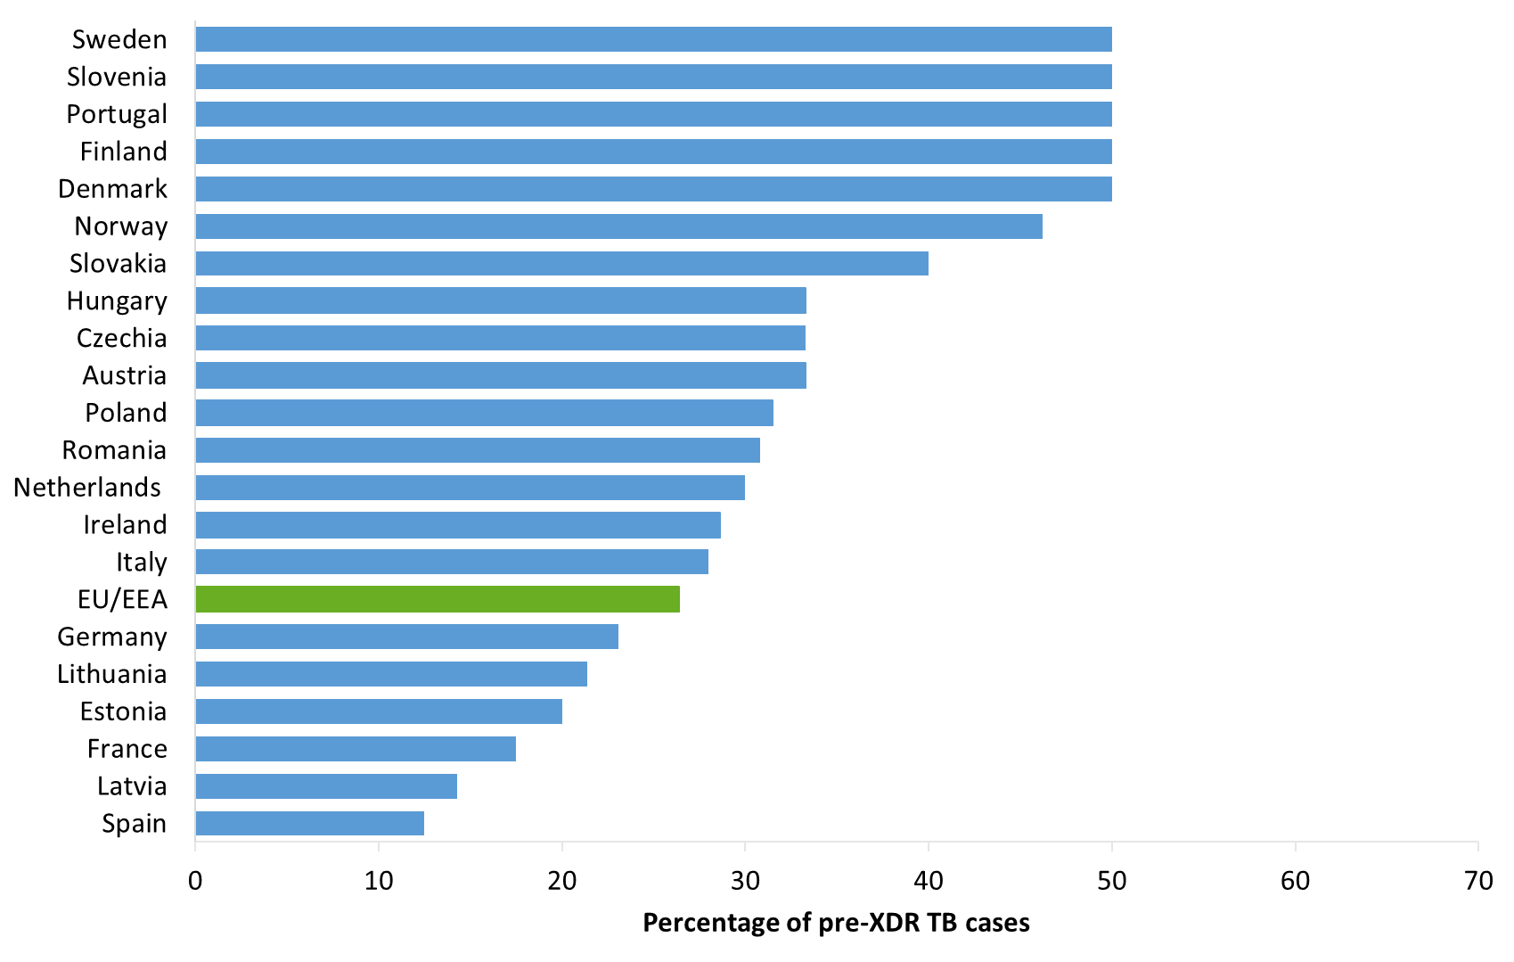
Proportion of pulmonary pre-XDR# TB among RR/MDR TB cases with 2nd line DST results, EU/EEA*, 2024
145 pre-XDR# TB cases notified in 21 EU/EEA countries*
26.4% of all RR/MDR TB cases with second-line DST† results (range 0.0%–50.0%)
# pre-XDR TB – cases with multidrug resistance and rifampicin-resistance (RR/MDR TB) and which are also resistant to any fluoroquinolone.
* The graph shows countries that reported pre-XDR TB. No pre-XDR TB cases were reported by Belgium, Bulgaria, Croatia, Cyprus, Greece, Iceland,
Liechtenstein, Luxembourg and Malta.
† DST – drug susceptibility test.
Source: ECDC/WHO (2026). Tuberculosis surveillance and monitoring in Europe 2026–2024 data

Slide 16
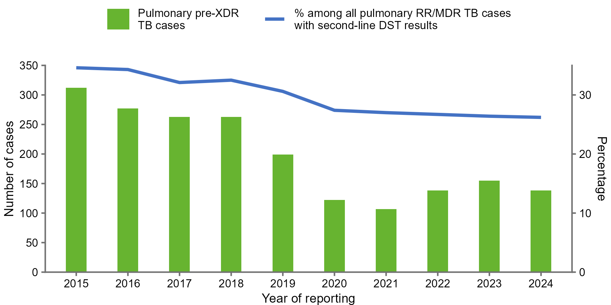
Pulmonary pre-XDR# TB cases and proportion among all pulmonary RR/MDR TB cases with 2nd line DST results, EU/EEA*, 2015–2024
The total number of pulmonary pre-XDR TB cases peaked at 312 in 2015, decreased to 112 in 2021 and was 145 in 2024
The proportion of pre-XDR TB cases among pulmonary RR/MDR TB cases ranged between 27.0% in 2021 to 34.6% in 2015
# Pre-XDR TB – cases with multidrug resistance and rifampicin-resistance (RR/MDR TB) and which are also resistant to any fluoroquinolone.
* Countries and the years for which they are not included due to reporting discrepancies or no data: Liechtenstein (2019).
Source: ECDC/WHO (2026). Tuberculosis surveillance and monitoring in Europe 2026–2024 data

Slide 17
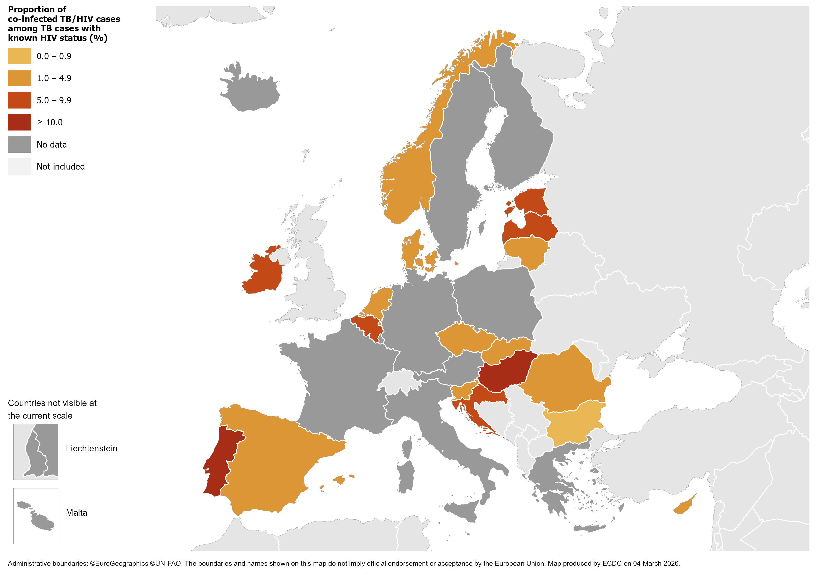
TB/HIV co-infection, EU/EEA*, 2024
567 HIV-positive TB cases were notified by 18 EU/EEA countries in 2024
3.5% of all TB cases with known HIV status were HIV-positive
(range 0.2–17.1%)
* Twelve countries did not report HIV status data: Austria, Finland, France, Germany, Greece, Iceland, Italy, Liechtenstein, Luxembourg, Malta, Poland, Sweden.
Source: ECDC/WHO (2026). Tuberculosis surveillance and monitoring in Europe 2026–2024 data

Slide 18
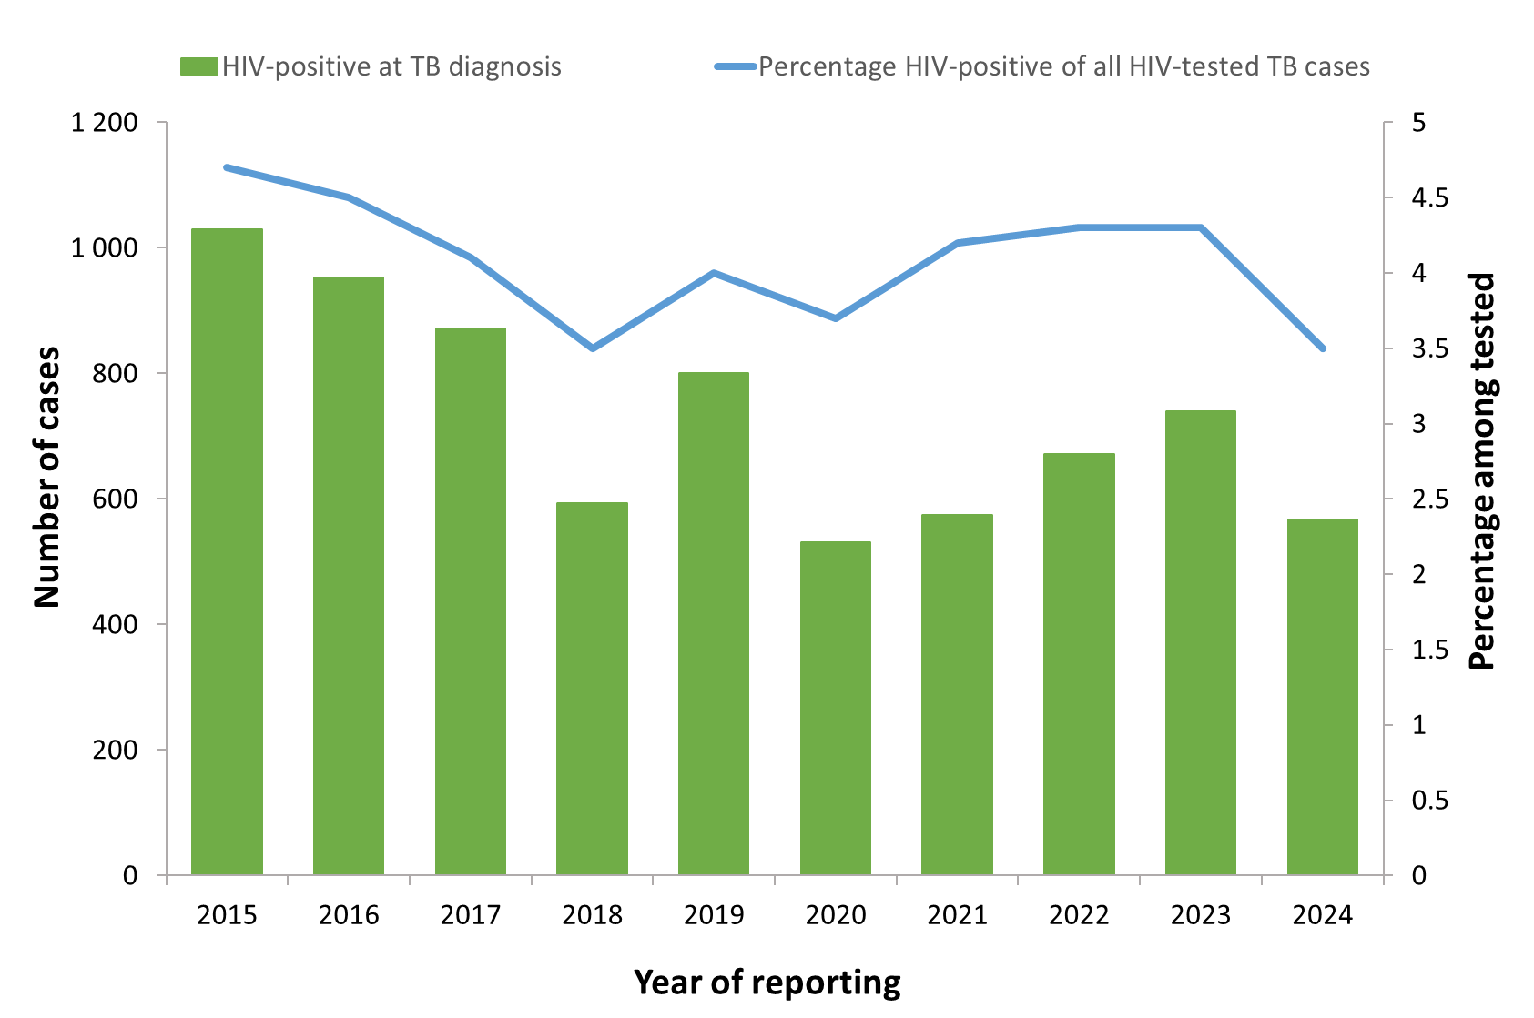
HIV-positive TB cases and proportion among all those tested, EU/EEA, 2015–2024*
The total number of HIV-positive TB cases decreased from 1 030 in 2015 to 531 in 2020 and reached 567 cases in 2024.
The proportion of HIV-positive TB cases among those tested decreased from 4.7% in 2015 to the lowest reported at 3.5% in 2018 and 2024.
* Countries and the years for which they are not included due to reporting discrepancies or no data: Austria (all years), Croatia (2013-2015), Cyprus (2013),
Denmark (2013), Finland (all years), France (all years), Germany (all years), Hungary (2013), Iceland (2020-2023), Italy (all years), Latvia (2018-2019;2023),
Liechtenstein (all years), Malta (2018-2019), Norway (2011-2012), Poland (all years) and Sweden (all years).
Source: ECDC/WHO (2026). Tuberculosis surveillance and monitoring in Europe 2026–2024 data

Slide 19
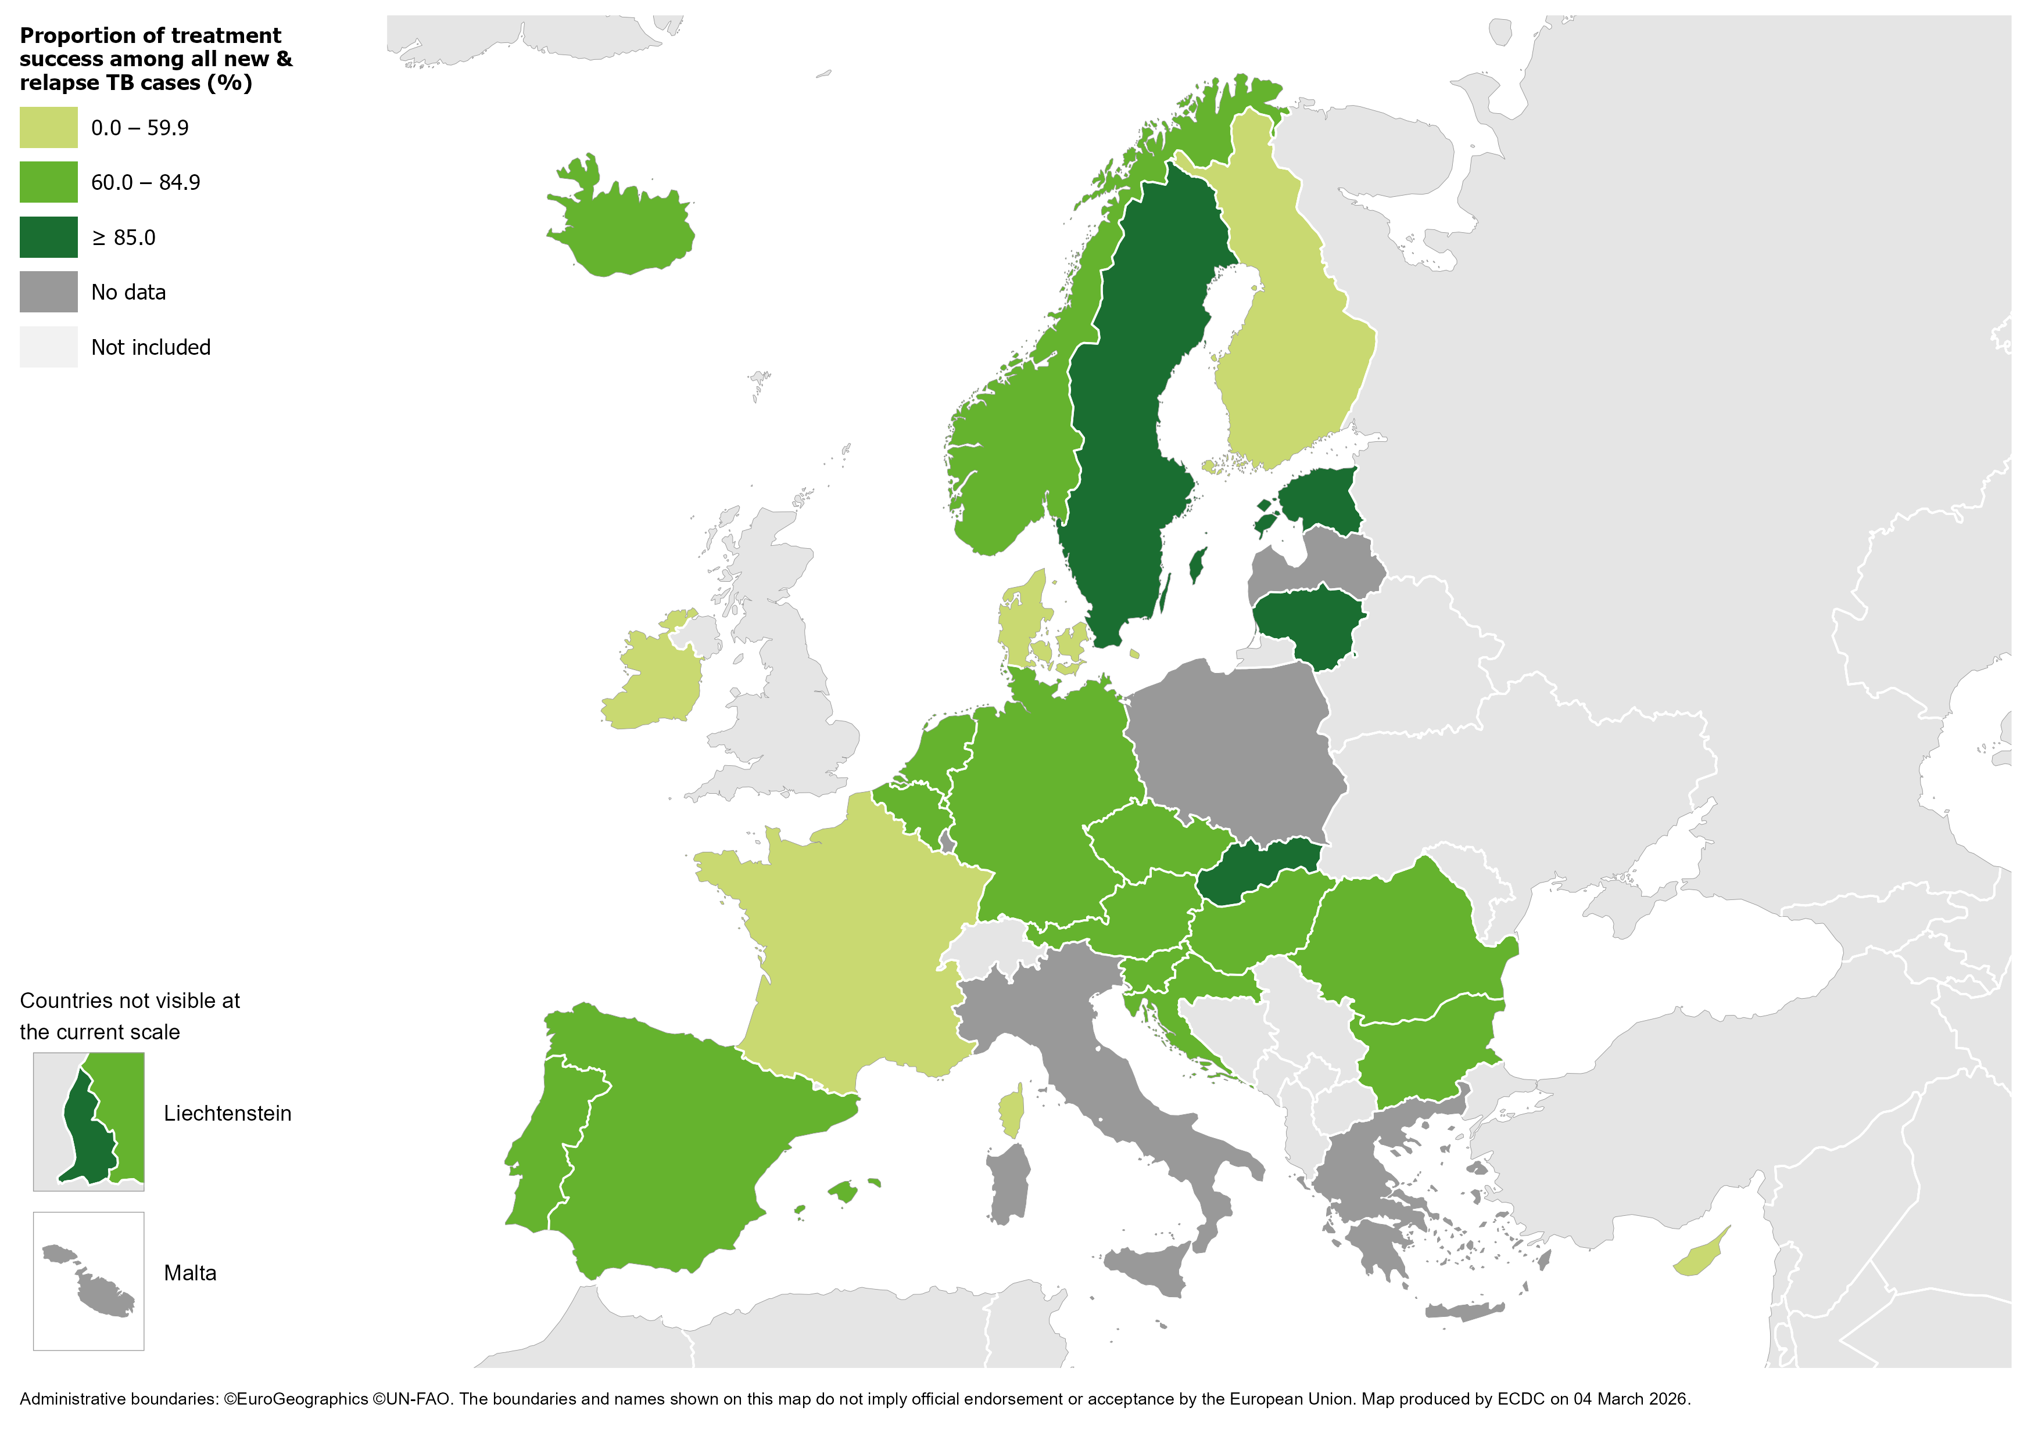
Treatment success after 12 months among new
& relapse TB cases notified in 2023, EU/EEA*, 2024
64.2% of all TB cases
had a successful treatment outcome after 12 months
(range 0.0–100%)
* Five countries did not report treatment outcome data: Greece, Italy, Luxembourg, Malta and Poland. Latvia reported zero cases with a successful treatment outcome.
Source: ECDC/ WHO (2026). Tuberculosis surveillance and monitoring in Europe 2026–2024 data

Slide 20
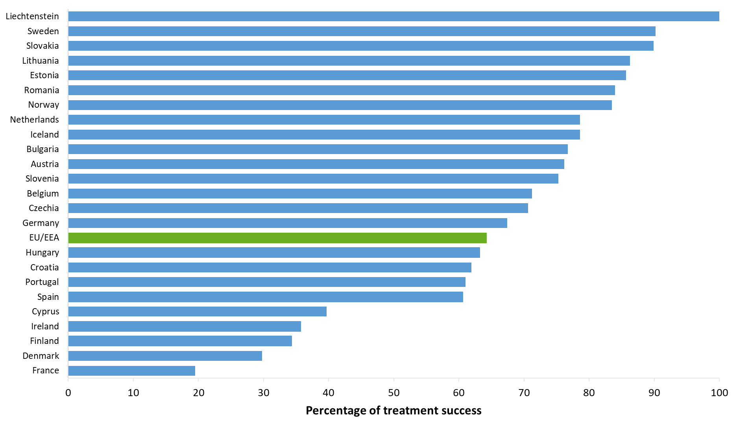
Treatment success after 12 months among new & relapse TB cases notified in 2023, EU/EEA*, 2024
64.2% of new and relapse TB cases had a successful treatment outcome after 12 months in 2024 (range 0.0-100%)
* Five EU/EEA countries did not report treatment outcome data: Greece, Italy, Luxembourg, Malta and Poland.
Latvia reported zero cases with successful treatment outcome.
Source: ECDC/WHO (2026). Tuberculosis surveillance and monitoring in Europe 2026–2024 data

Slide 21
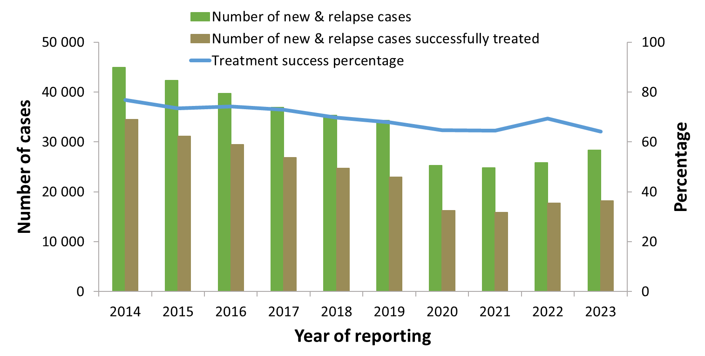
Treatment success after 12 months among new & relapse TB cases notified during 2014–2023, EU/EEA*, 2024
Proportion reported with a successful treatment varied between 76.8% in 2014 and 64.2% in 2023
* Countries and the years for which they are not included due to reporting discrepancies or no data: Croatia (2010-2011), Greece (all years), Italy (all years), Liechtenstein (2010-2014, 2018-2019, 2022), Luxembourg (2010-2018,2022), Malta (2014-2019, 2022), Poland (2017-2022).
Source: ECDC/WHO (2026). Tuberculosis surveillance and monitoring in Europe 2026–2024 data

Slide 22
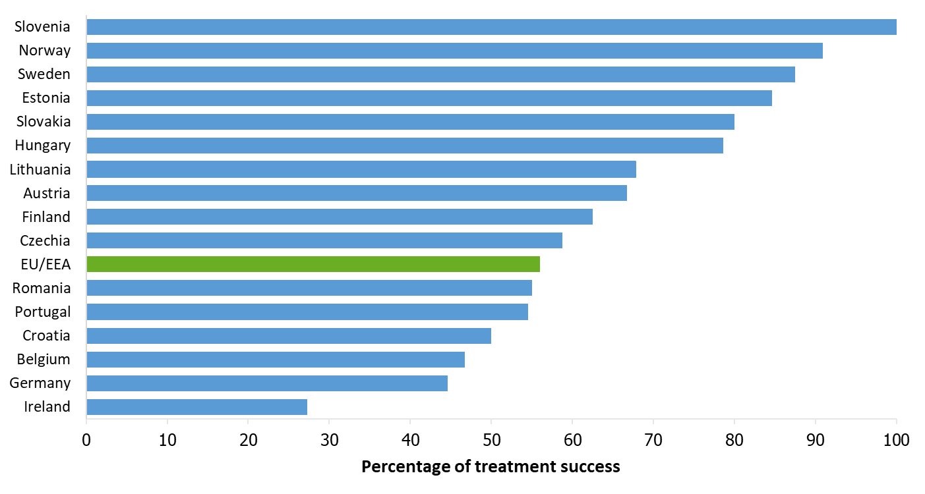
Treatment success after 24 months among RR/MDR TB cases started on second-line treatment in 2022, EU/EEA*, 2024
56.0% of all RR/MDR TB cases started on second-line treatment in 2022 were reported to have treatment success after 24 months
(range 0.0–100%)
* One country did not report any RR/MDR TB cases in 2022: Liechtenstein.
Twelve countries did not report treatment outcome data: Bulgaria, Cyprus, Denmark, France, Greece, Iceland, Italy, Luxembourg, Malta, Netherlands, Poland and Spain.
Latvia did not report any successful treatment outcome for the RR/MDR TB cases.
Source: ECDC/WHO (2026). Tuberculosis surveillance and monitoring in Europe 2026–2024 data

Slide 23
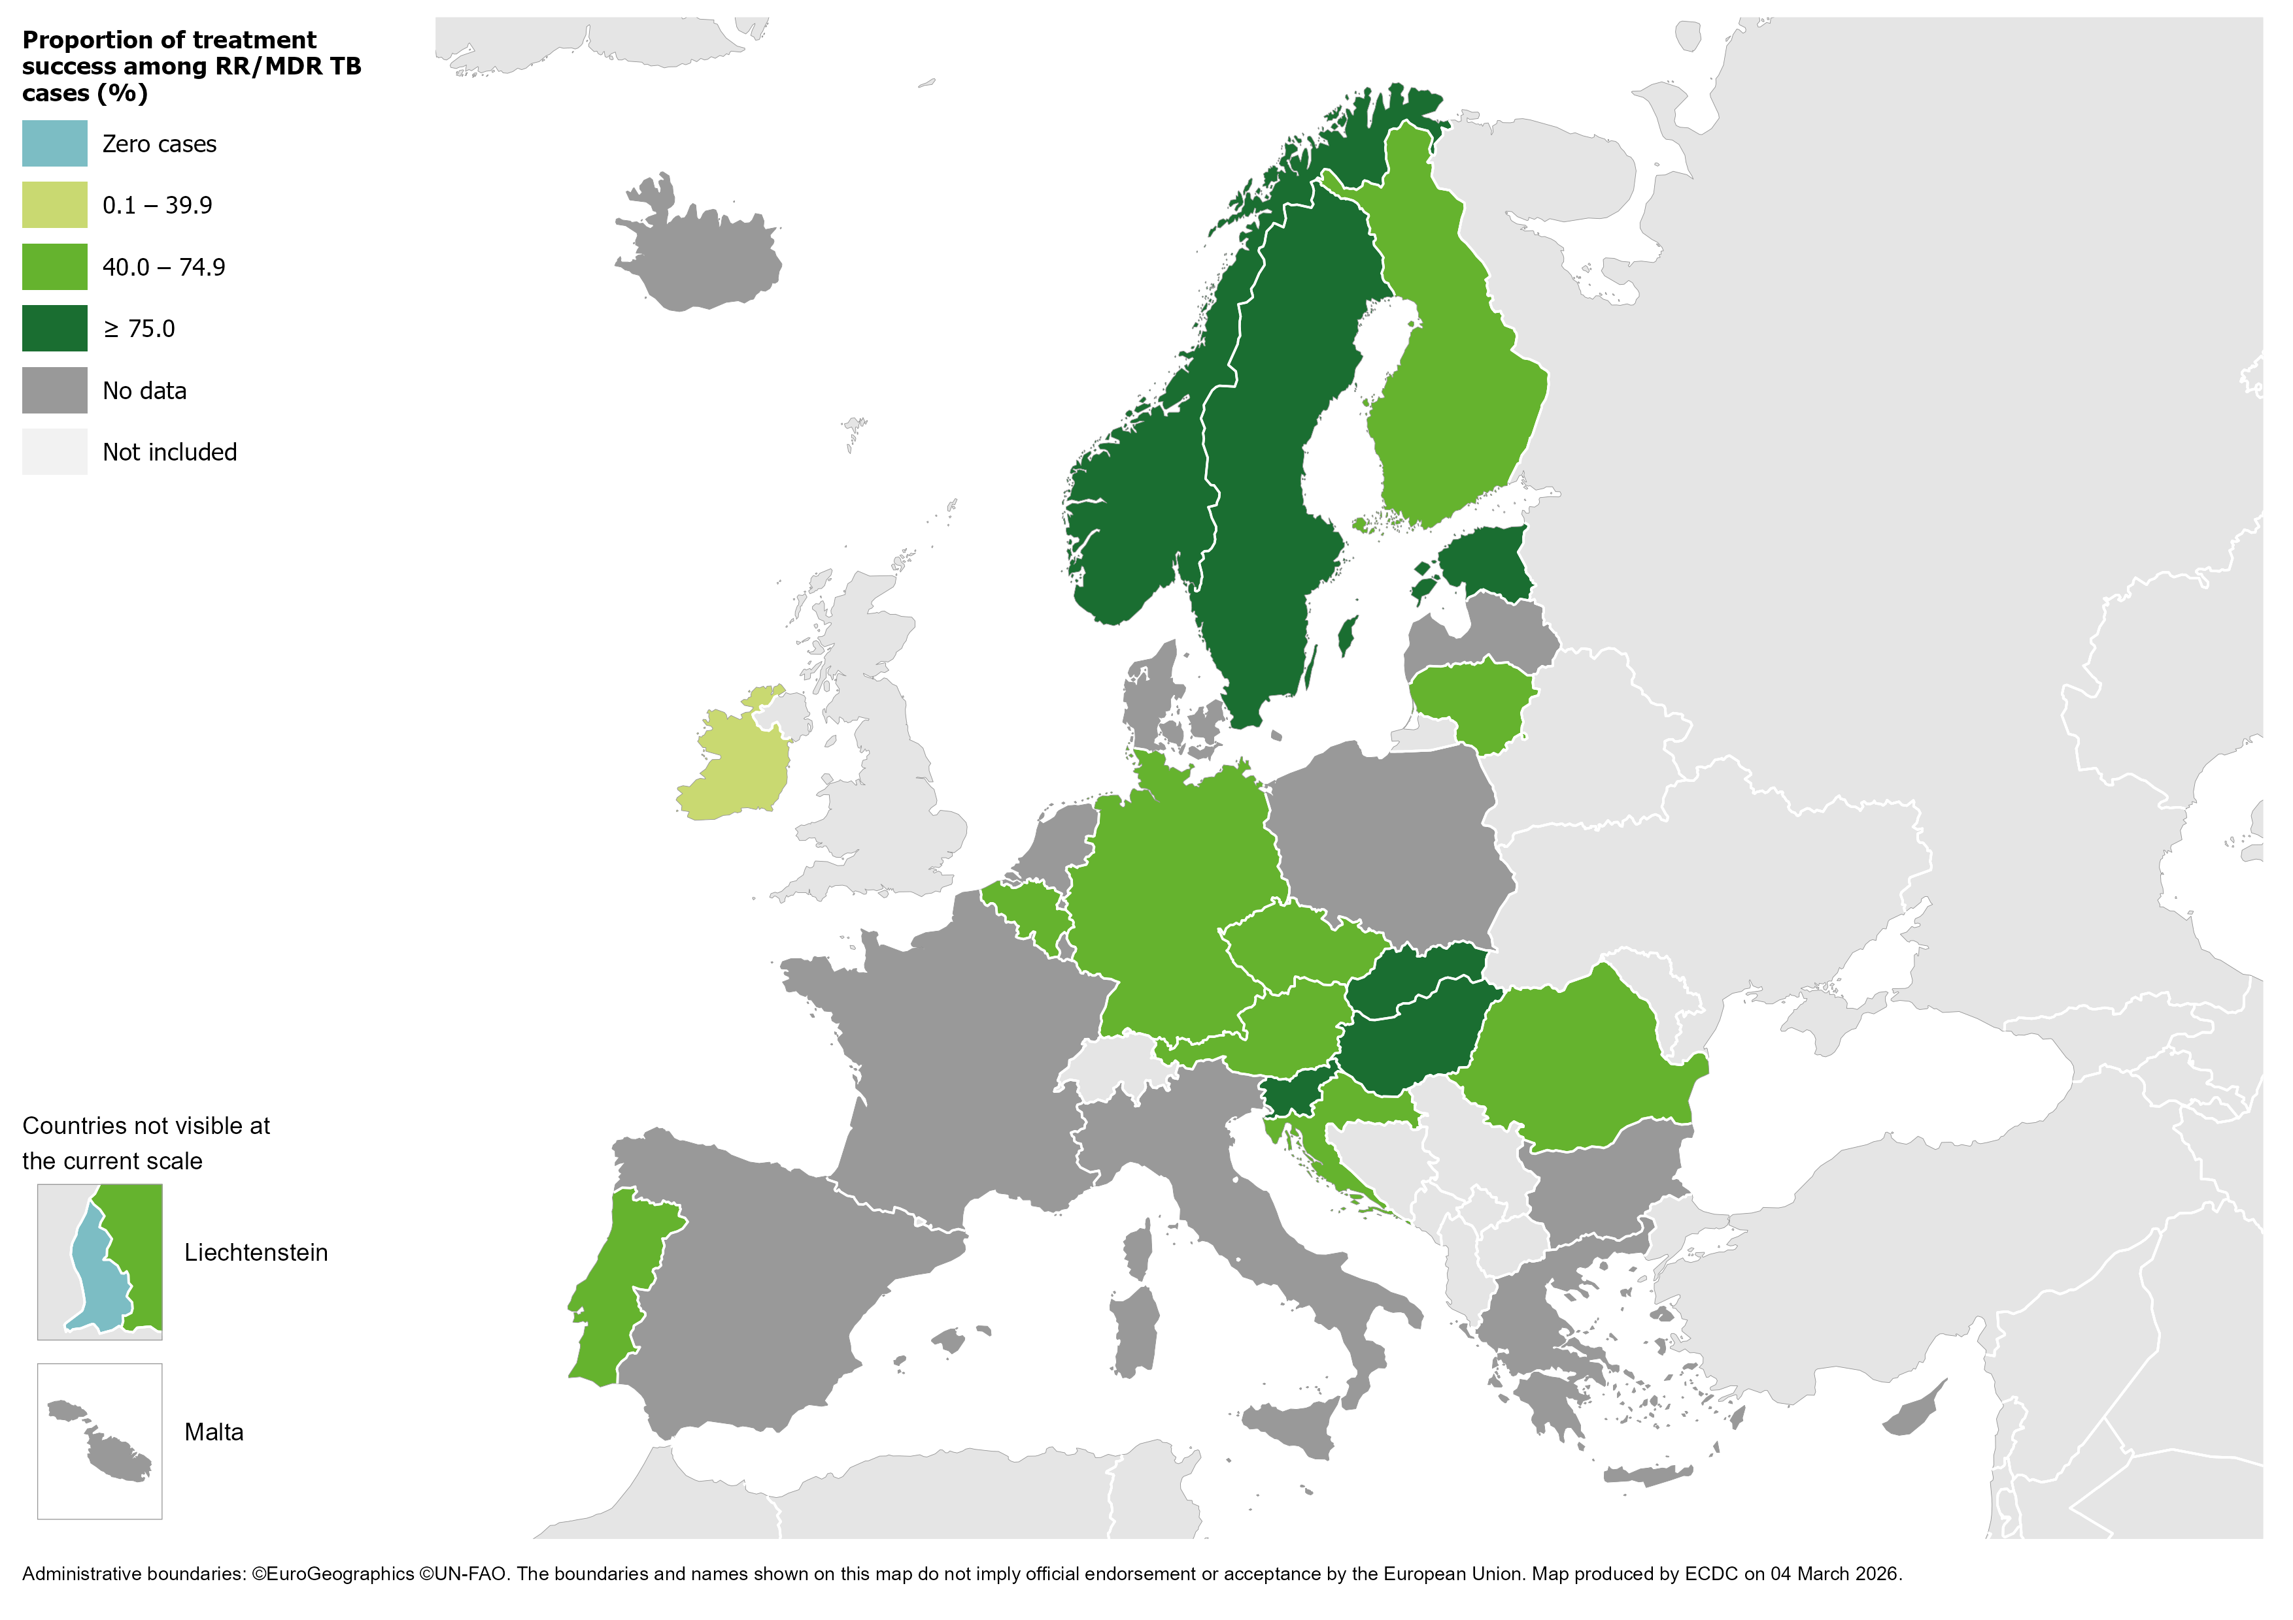
Treatment success after 24 months among RR/MDR TB cases started on second-line treatment in 2022, EU/EEA*, 2024
56.0% of all RR/MDR TB cases started on second-line treatment in 2022 were reported to have treatment success after 24 months (range 0.0–100%)
* One country did not report any RR/MDR TB cases in 2022: Liechtenstein. Twelve countries did not report treatment outcome data: Bulgaria, Cyprus, Denmark, France, Greece, Iceland, Italy, Luxembourg, Malta, Netherlands, Poland and Spain.
Latvia did not report any successful treatment outcome for the RR/MDR TB cases.
Source: ECDC/WHO (2026). Tuberculosis surveillance and monitoring in Europe 2026–2024 data

Slide 24
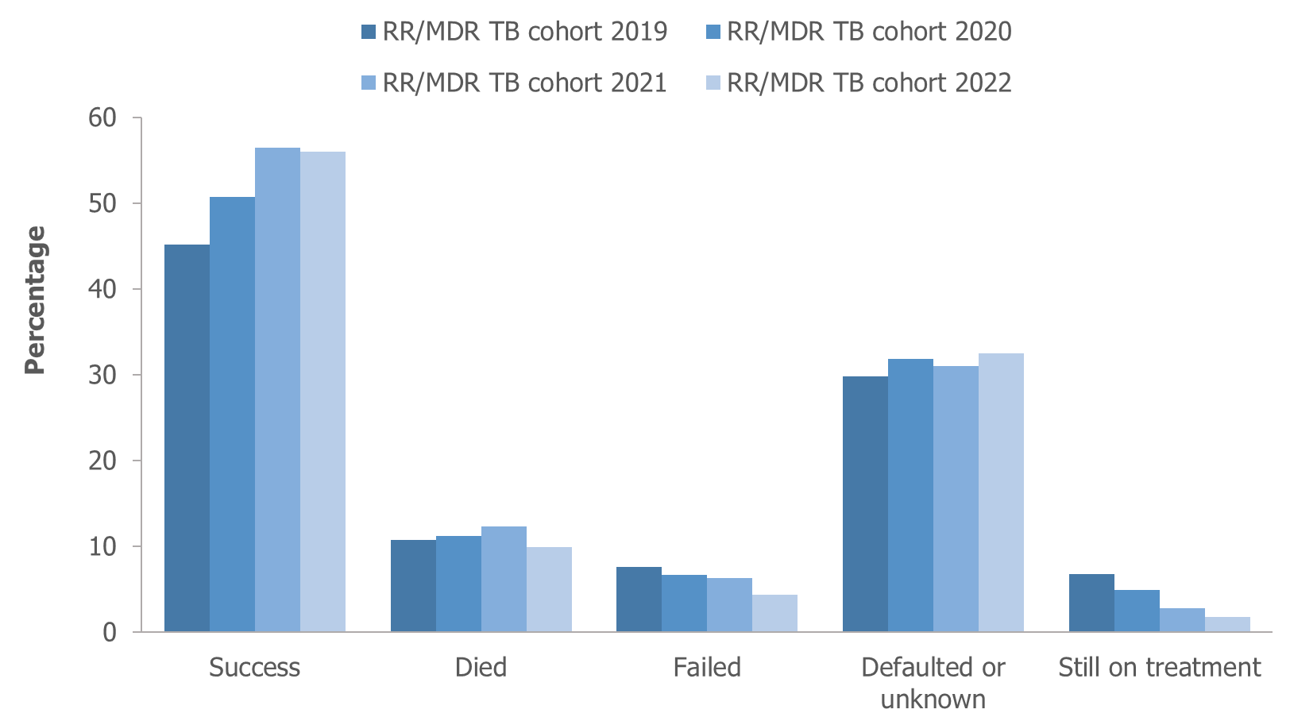
Treatment outcomes among RR/MDR TB cases started on second-line treatment in 2019–2022, EU/EEA†, 2024
Reported treatment success remained below 60% for all RR/MDR TB cohorts between 2019-2022
† Countries and the cohorts for which they are not included due to reporting discrepancies or no data: Croatia (2016-2017, 2021), Cyprus (all years), France (all years), Greece (all years), Iceland (all years) , Italy (all years), Liechtenstein (all years), Luxembourg (all years), Malta (all years), Poland (all years), Slovenia (2018-2019), Spain (all years).
Source: ECDC/WHO (2026). Tuberculosis surveillance and monitoring in Europe 2026–2024 data

Slide 25
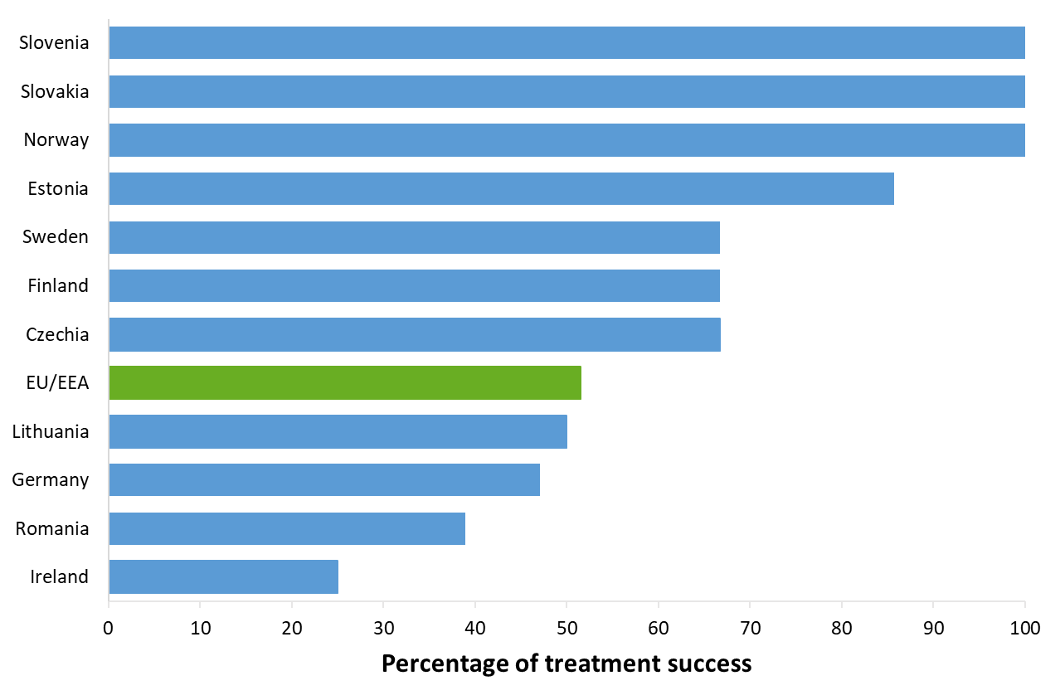
Treatment success after 24 months among pre-XDR TB cases started on second-line treatment in 2022, EU/EEA*, 2024
51.5% of the pre-XDR TB cases started on second-line treatment in 2022 were reported to have treatment success after 24 months (range 0-100%)*
* One country reported zero pre-XDR TB cases in 2022: Croatia.
Sixteen countries did not report treatment outcome data: Belgium, Cyprus, Denmark, France, Greece, Hungary, Iceland, Italy, Latvia, Liechtenstein, Luxembourg, Malta, Netherlands, Poland, Portugal and Spain.
Austria and Bulgaria reported zero cases with a successful treatment outcome.
Source: ECDC/WHO (2026). Tuberculosis surveillance and monitoring in Europe 2026–2024 data

Slide 26
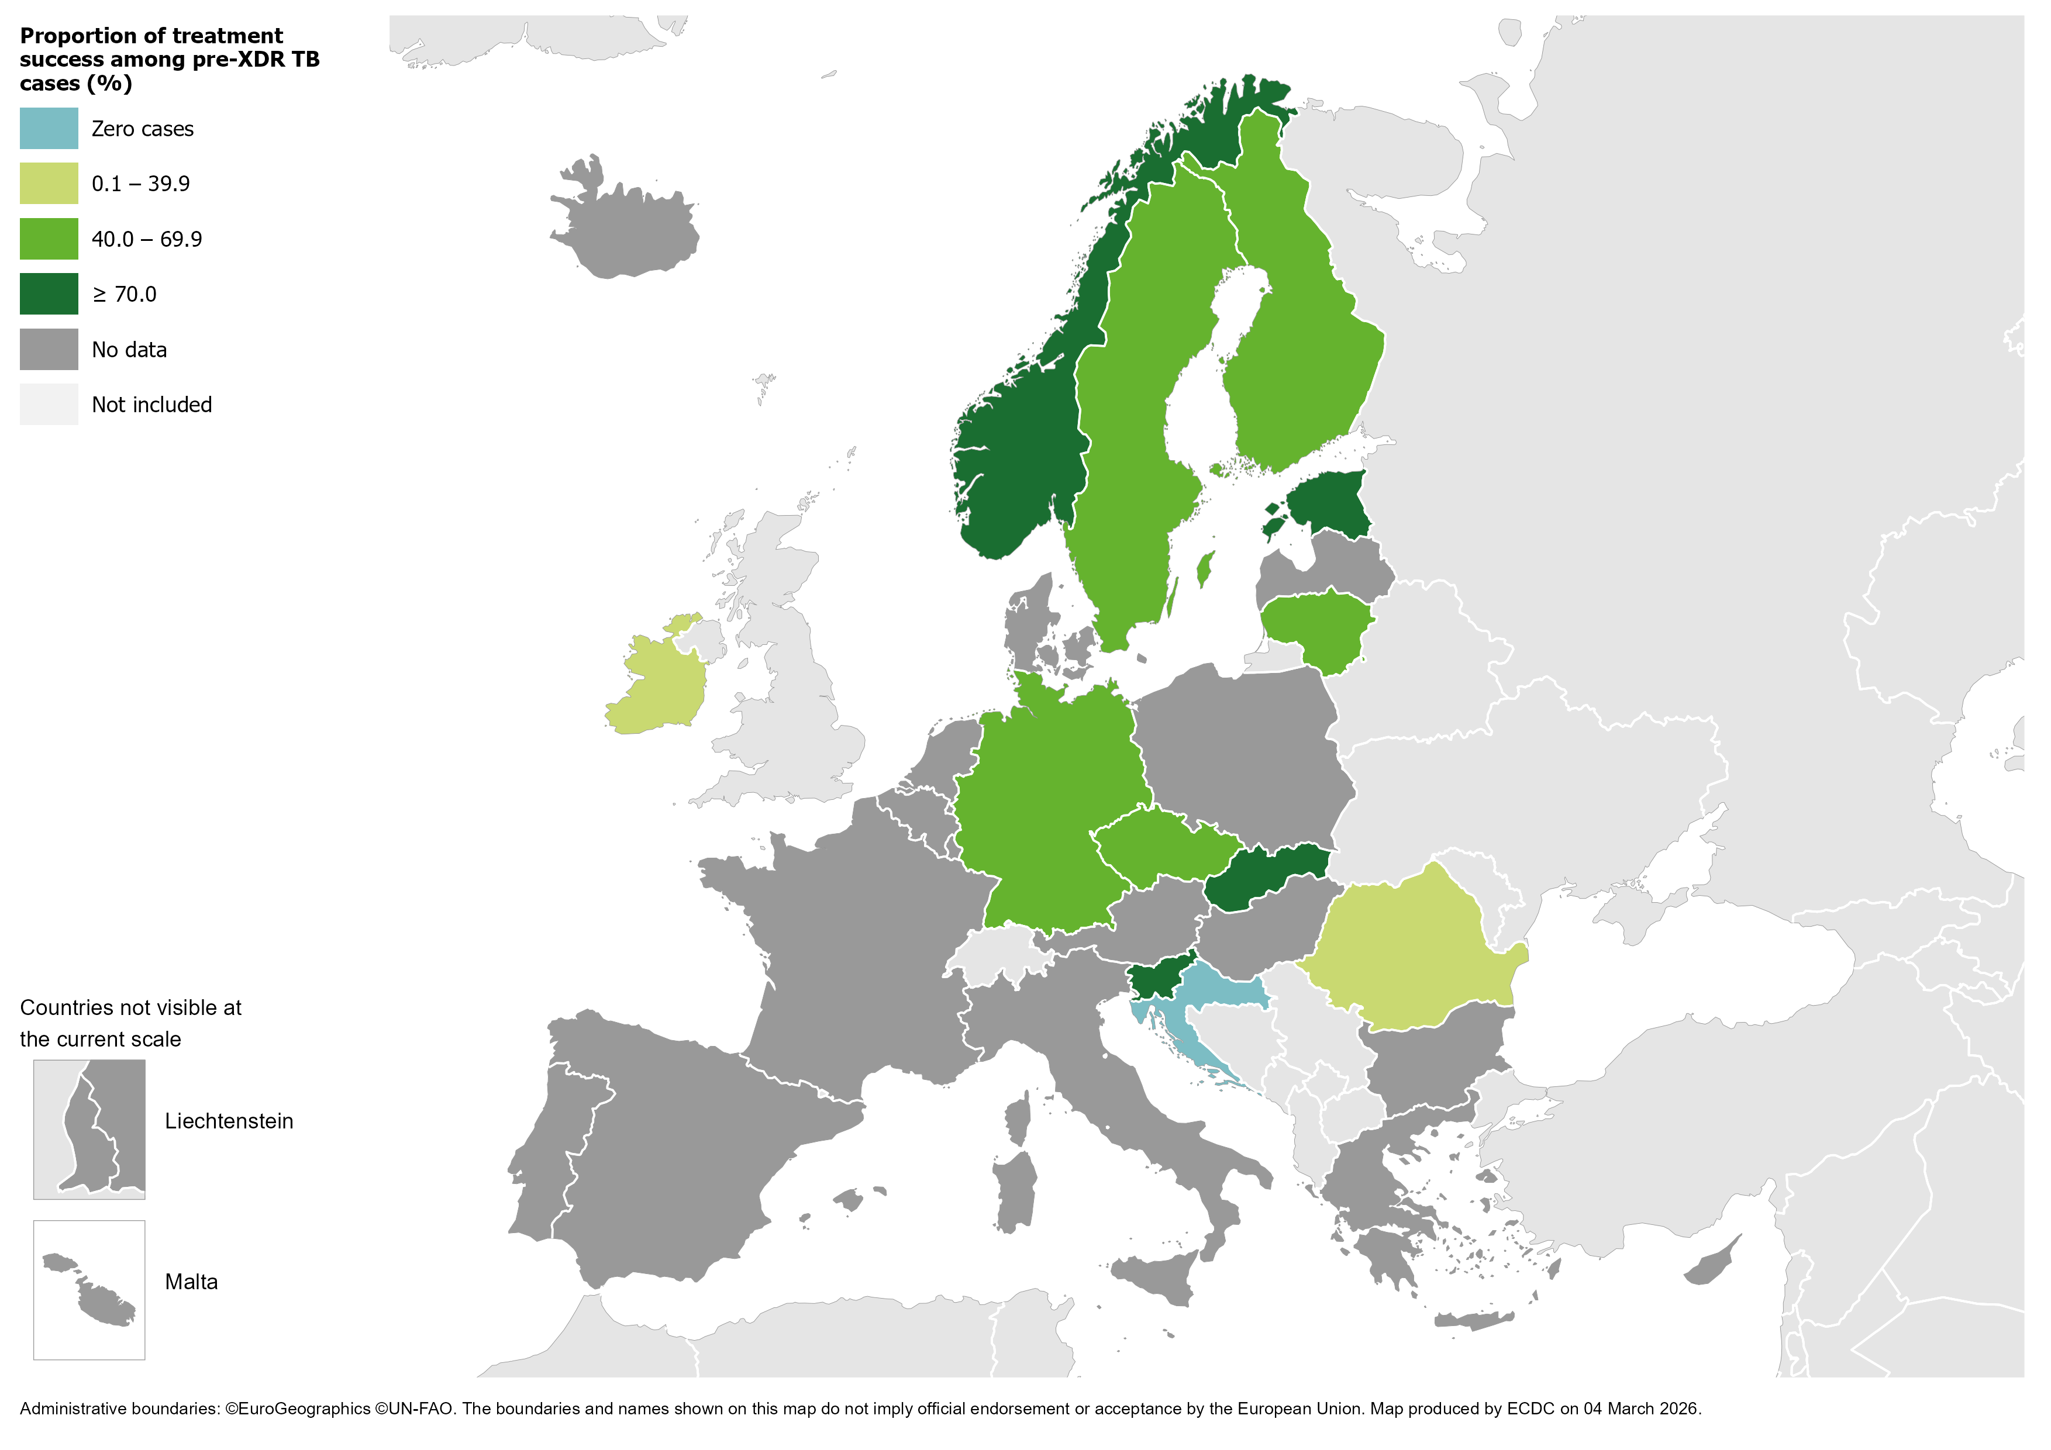
Treatment success after 24 months among pre-XDR TB cases started on second-line treatment in 2022, EU/EEA*, 2024
51.5% of all pre-XDR TB cases started on second-line treatment in 2022 were successfully treated (range 0–100%)
* One country reported zero pre-XDR TB cases in 2022: Croatia.
Sixteen countries did not report treatment outcome data: Belgium, Cyprus, Denmark, France, Greece, Hungary, Iceland, Italy, Latvia, Liechtenstein, Luxembourg, Malta, Netherlands, Poland, Portugal and Spain.
Austria and Bulgaria reported zero cases with a successful treatment outcome.
Source: ECDC/WHO (2026). Tuberculosis surveillance and monitoring in Europe 2026–2024 data

Slide 27
Treatment outcomes new & relapse TB, RR/MDR, pre-XDR, XDR TB cases, EU/EEA*, 2024
 | New & relapse TB, 12 months | RR/MDR, 24 months | Pre-XDR, 24 months | XDR, 36 months
Cases started on treatment | 28 376 | 736 | 103 | 3
Countries reporting cases | 25 | 18 | 14 | 2
Treatment success | 64.2% | 56.0% | 51.5% | 0.0%

