Slide 1
Tuberculosis situation in the EU/EEA, 2021
Tuberculosis situation in the EU/EEA, 2023
h
Findings from the joint report Tuberculosis surveillance and monitoring in Europe by ECDC and WHO Regional Office for Europe
Stockholm, 24 March 2025

Slide 2
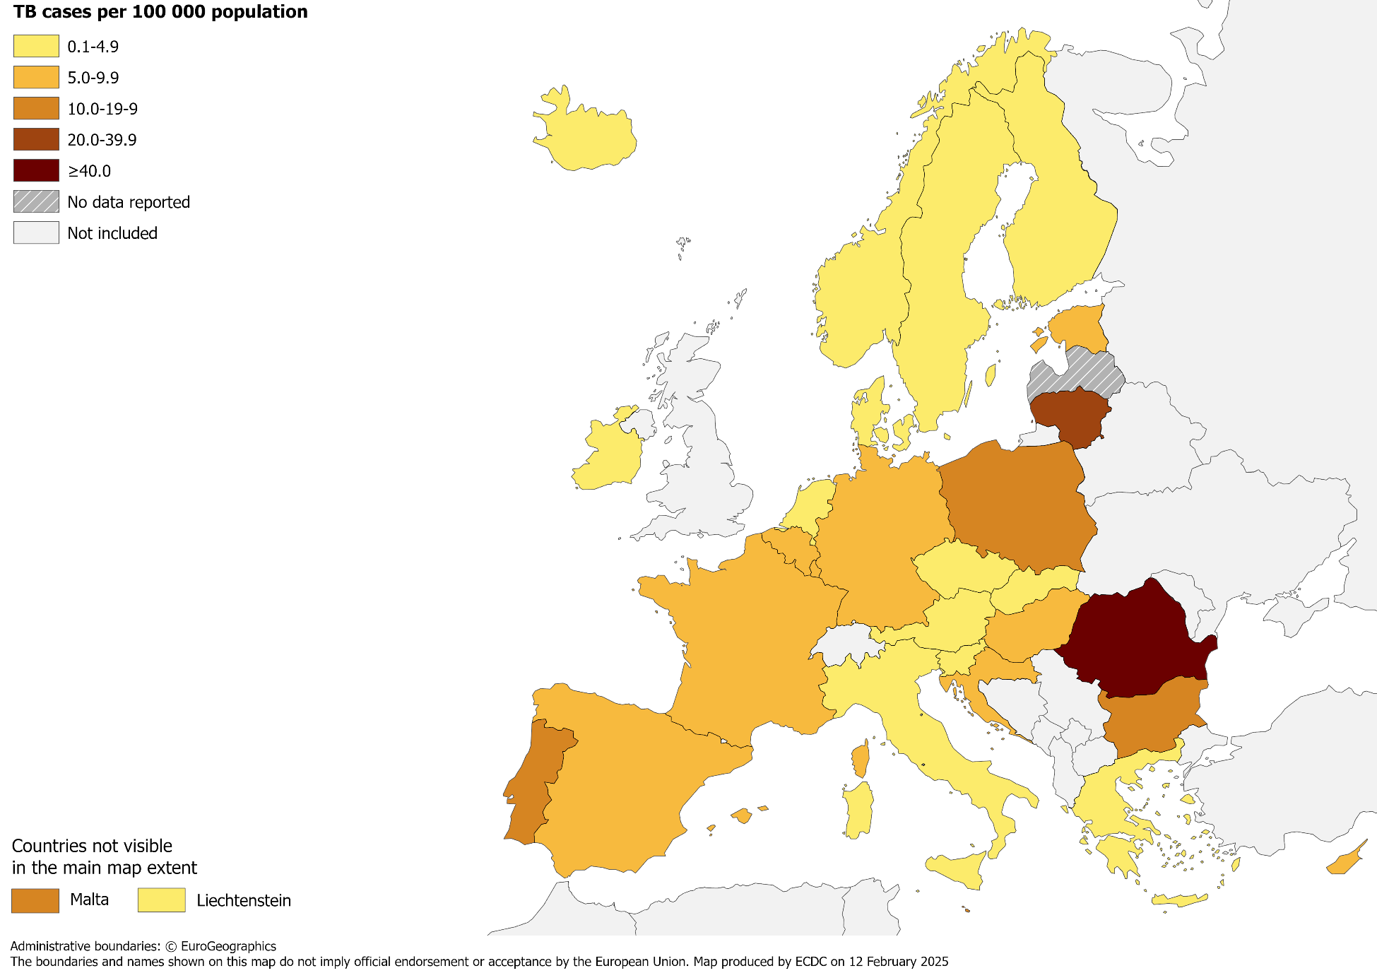
TB notifications, EU/EEA, 2023
38 993 TB cases notified in 29 EU/EEA countries
Notification rate 8.6 per 100 000 population (range 2.5 – 49.9)
.
Source: ECDC/WHO (2025). Tuberculosis surveillance and monitoring in Europe 2025–2023 data
2

Slide 3
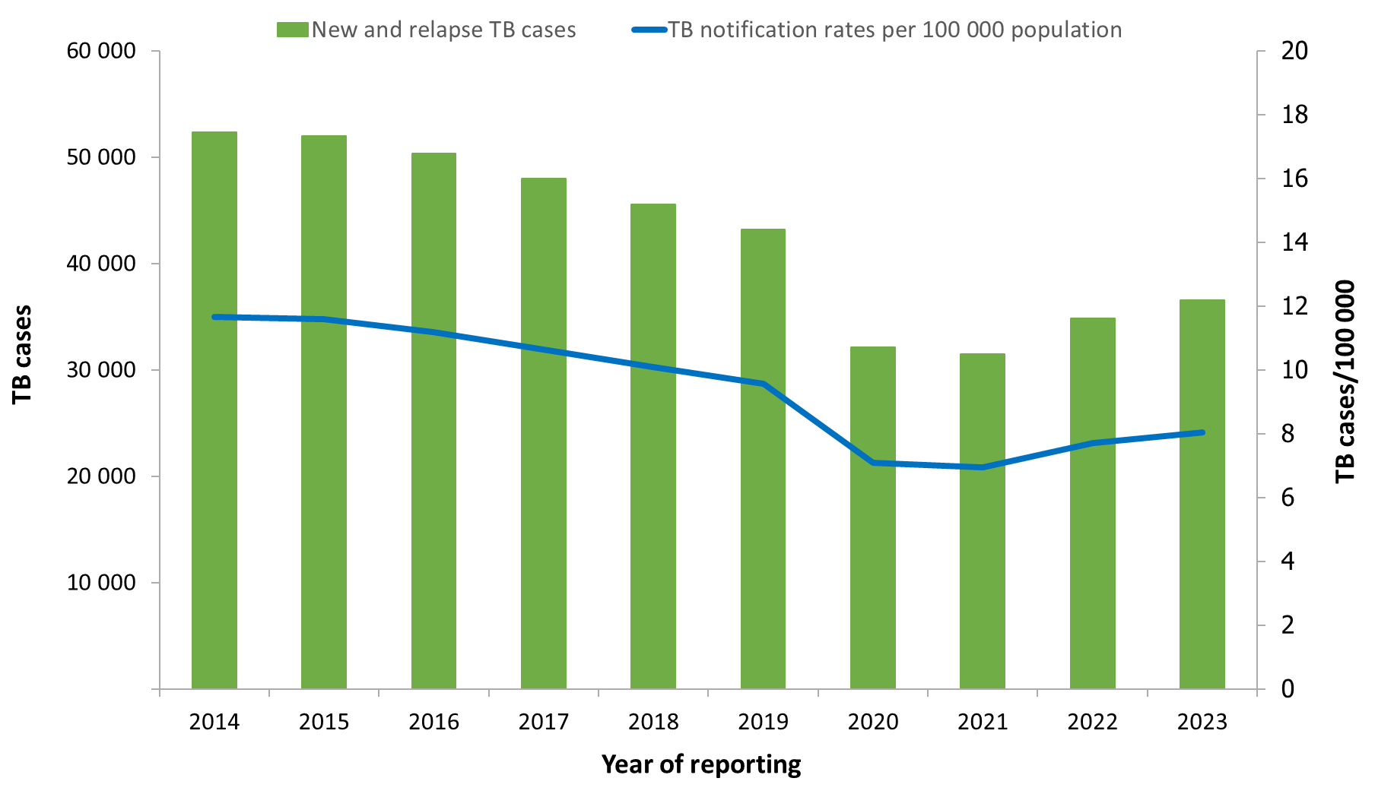
Notified TB cases, EU/EEA*, 2014–2023
The recovery of cases after the COVID-19 pandemic disruptions continued in 2023.
Despite the increases in recent years, the overall trend continues to decline between 2014 and 2023:
Number of TB cases decreased by 30%
Notification rate decreased by 31%
* Latvia did not report data for 2018-2020 and 2023, Liechtenstein did not report data for 2019.
Source: ECDC/WHO (2025). Tuberculosis surveillance and monitoring in Europe 2025–2023 data

Slide 4
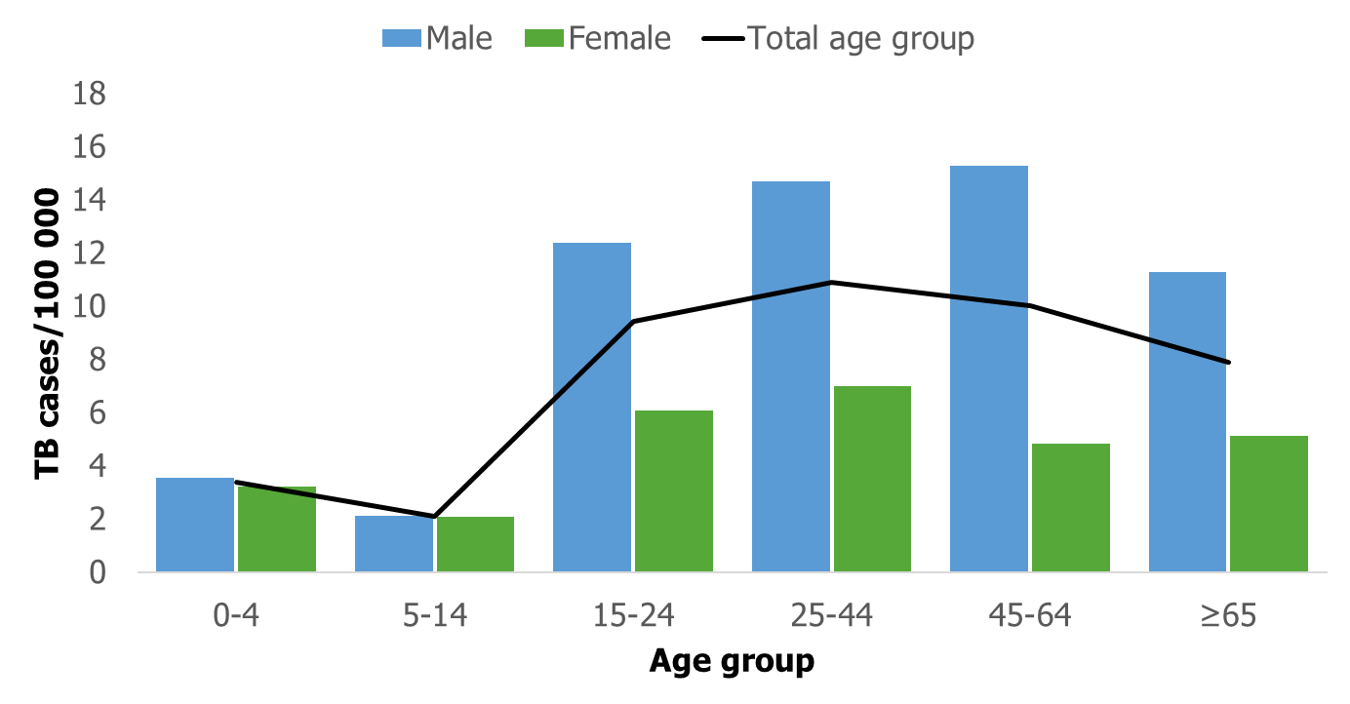
TB notification rate by sex and age group, EU/EEA, 2023
The highest notification rate was observed in the age group 25–44 years (10.2 per 100 000)
Males were over-represented in all age groups over 14 years.
Source: ECDC/WHO (2025). Tuberculosis surveillance and monitoring in Europe 2025–2023 data

Slide 5
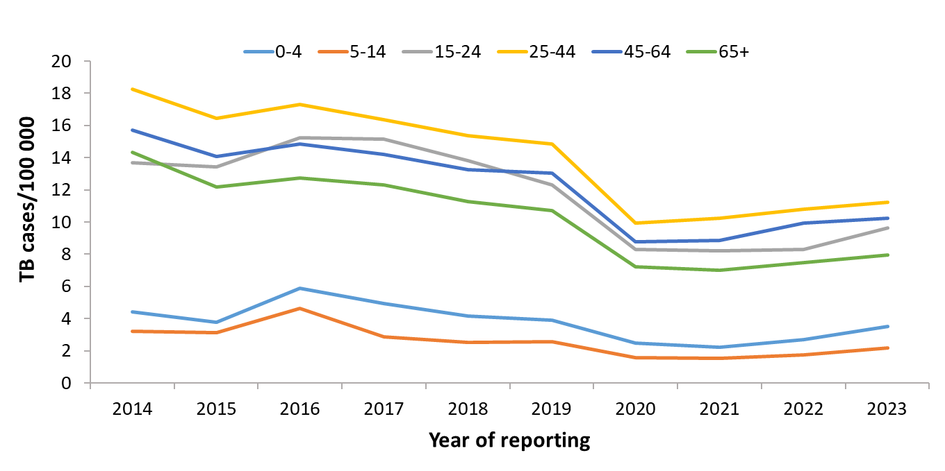
TB notification rate by age group, EU/EEA*, 2014–2023
Annual average decrease of between 2.5 to 6.3% in all age groups
* Latvia did not report data for 2018-2020 and 2023, Liechtenstein did not report data for 2019.
Source: ECDC/WHO (2025). Tuberculosis surveillance and monitoring in Europe 2025–2023 data

Slide 6
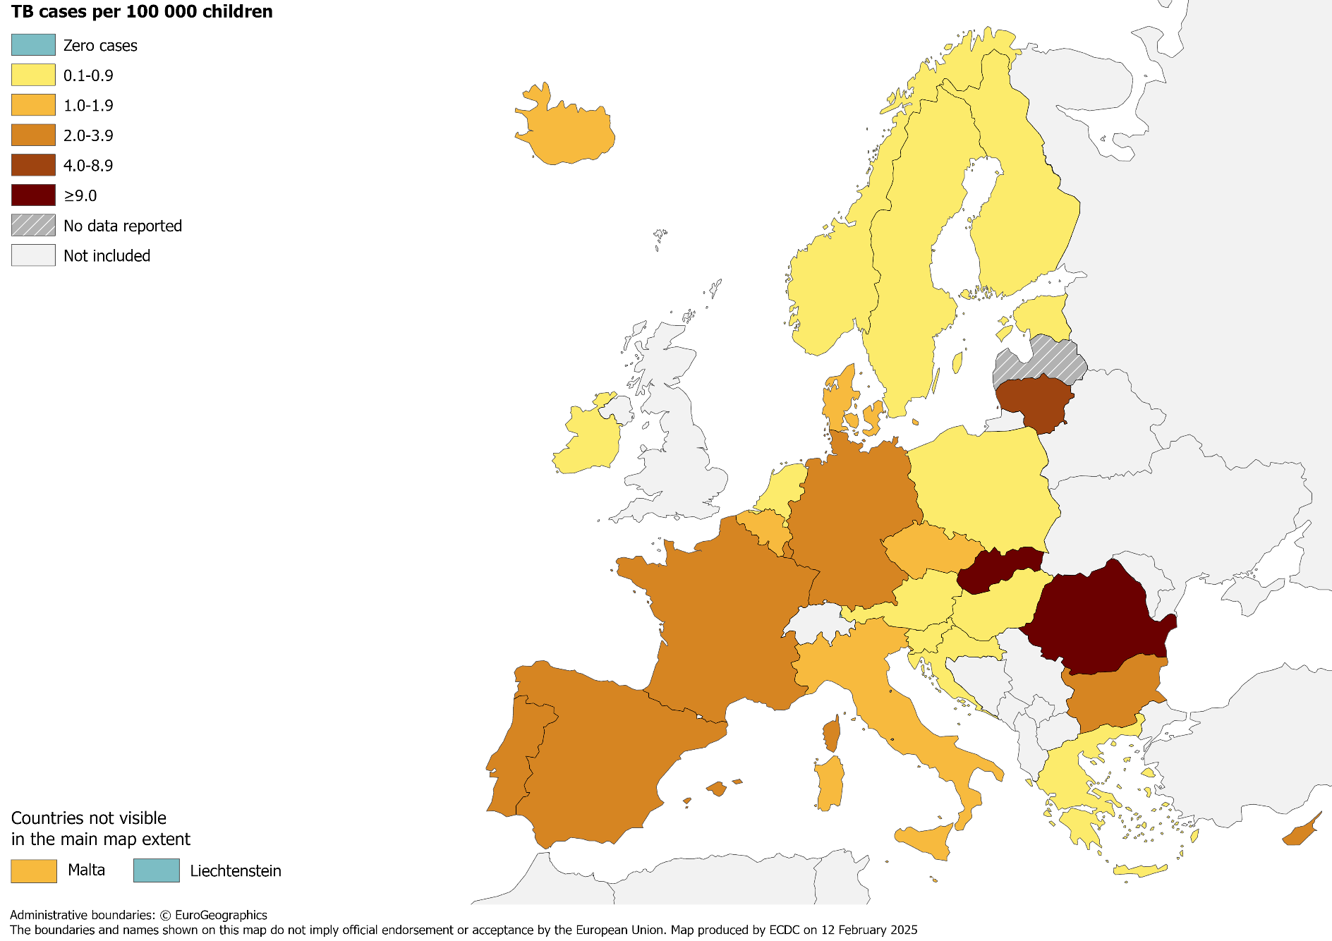
TB in children under 15 years, EU/EEA, 2023
1 689 TB cases notified in children under 15 years (new and relapse cases accounted for 1 644)
4.3% of all TB cases
(range 0.0–36.7%)
2.5 per 100 000 child population (range 0.0–13.8)
Source: ECDC/WHO (2025). Tuberculosis surveillance and monitoring in Europe 2025–2023 data

Slide 7
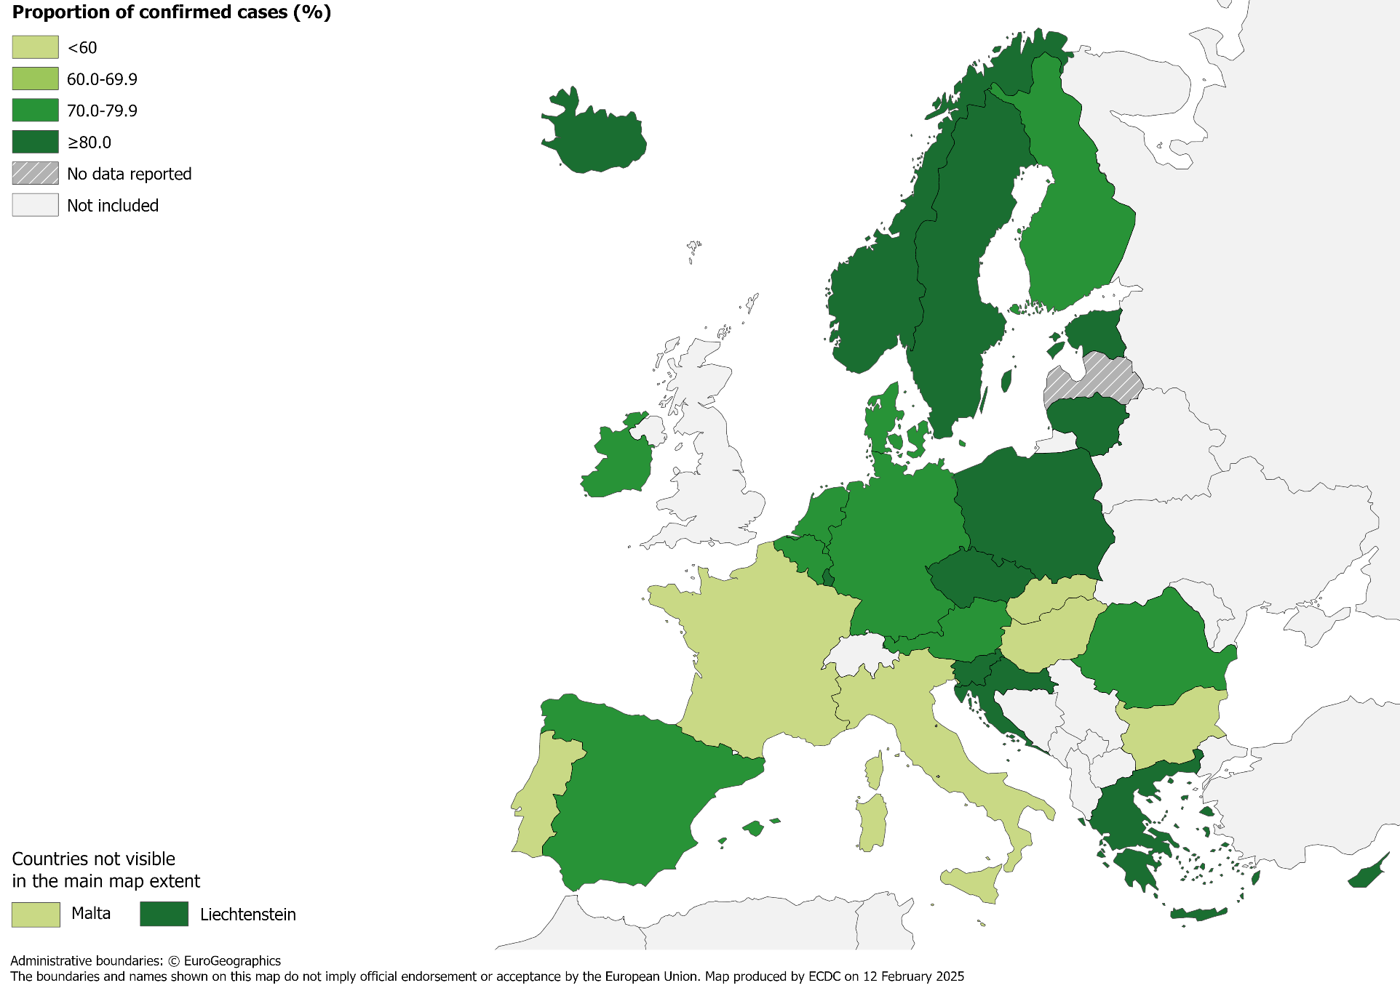
Confirmed TB cases*, EU/EEA, 2023
26 687 TB cases were confirmed
68.4% of all TB cases (range 42.3–100%)
* Confirmation by culture, or by microscopy and Mycobacterium tuberculosis nucleic acid amplification test.
Source: ECDC/WHO (2025). Tuberculosis surveillance and monitoring in Europe 2025–2023 data

Slide 8
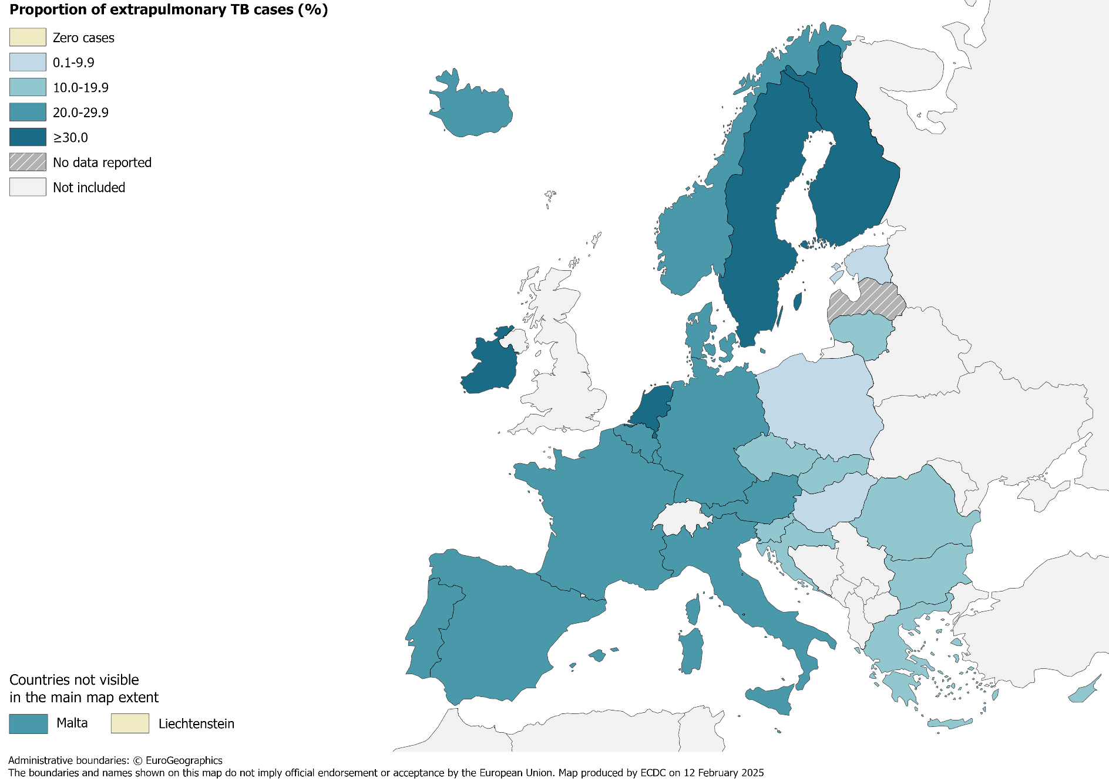
Extrapulmonary TB, EU/EEA, 2023
7 516 notified cases had extrapulmonary TB
19.3% of all TB cases (range 0.0–37.8%)
Source: ECDC/WHO (2025). Tuberculosis surveillance and monitoring in Europe 2025–2023 data

Slide 9
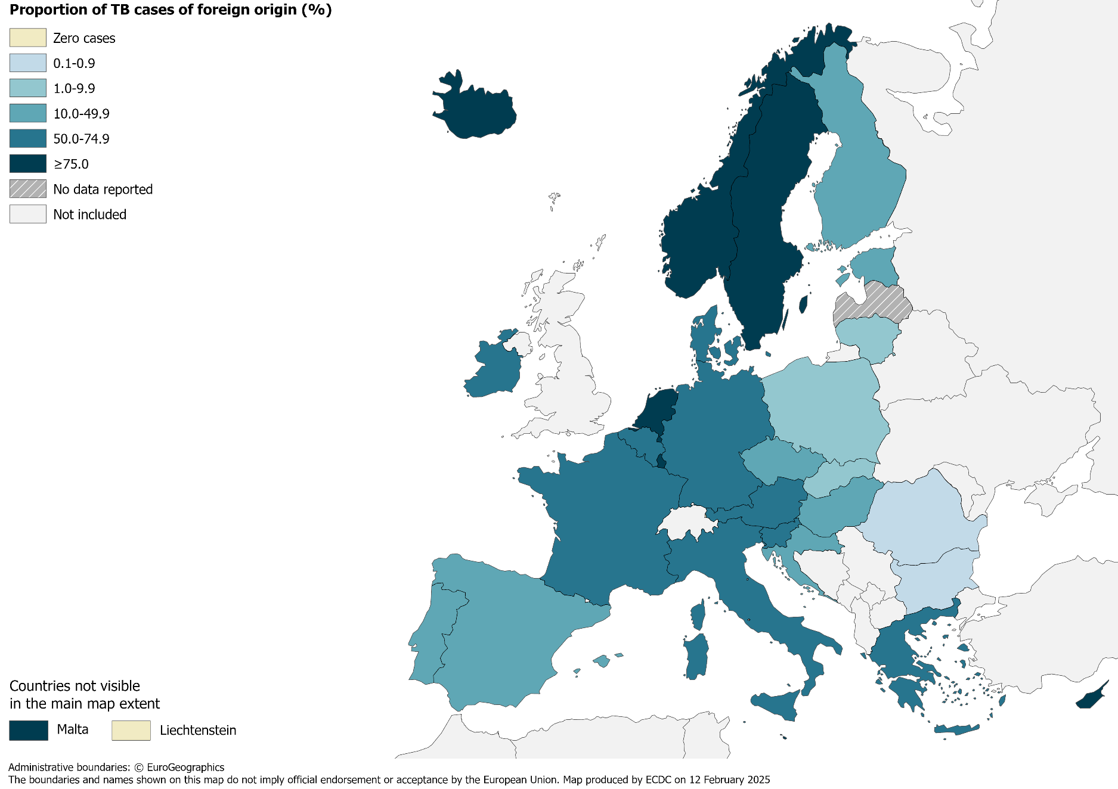
TB in persons of foreign origin*, EU/EEA, 2023
14 050 TB cases of foreign* origin
36.0% of all TB cases (range 0.0–94.1%)
* Notified in persons originating from other countries than the reporting country.
Source: ECDC/WHO (2025). Tuberculosis surveillance and monitoring in Europe 2025–2023 data

Slide 10
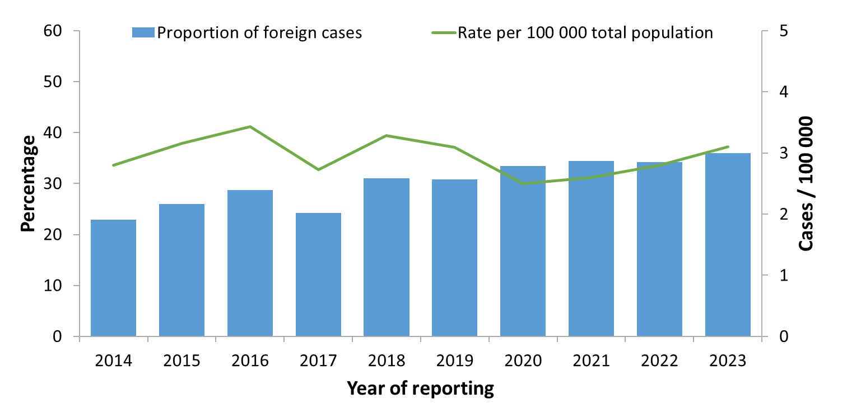
TB cases in persons of foreign origin*, EU/EEA†, 2014–2023
The proportion of cases in persons of foreign origin increased from 22.9% in 2014 to 36.0% in 2023
The rate of TB cases of foreign origin per 100 000 of the total population varied between 2.5 and 3.4
* Notified in persons originating from other countries than the reporting country. † Latvia did not report data for 2018-2020 and 2023. Liechtenstein did not report data for 2019.
Source: ECDC/WHO (2025). Tuberculosis surveillance and monitoring in Europe 2025–2023 data

Slide 11
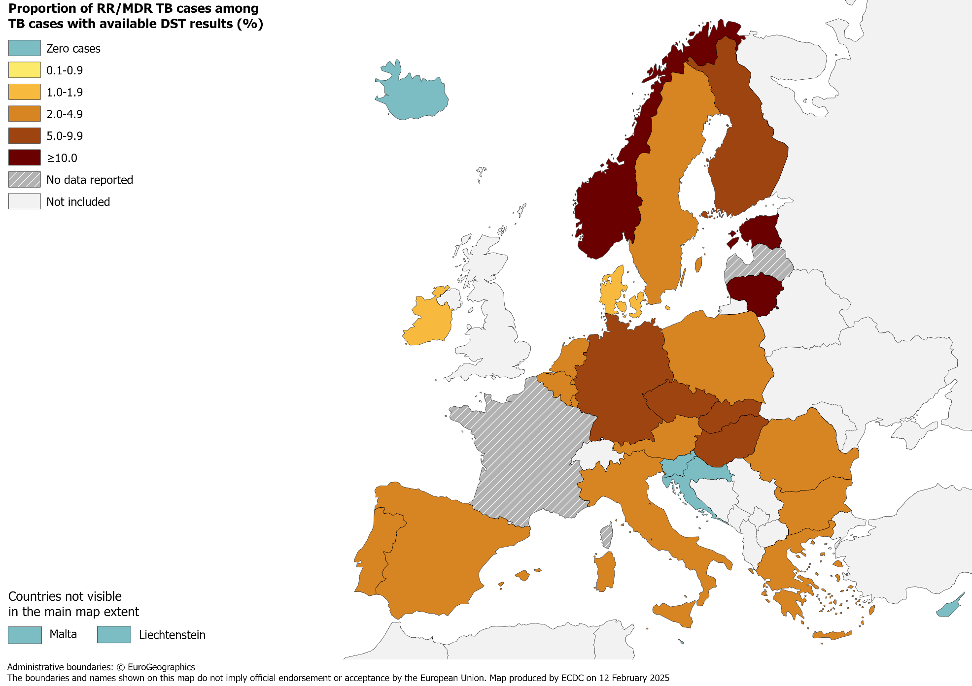
RR/MDR TB cases with available DST results, EU/EEA*, 2023
942 pulmonary RR/MDR TB cases notified by all EU/EEA countries*
5.3% of all TB cases with available DST† results had RR/MDR TB (range 0.0–24.4%, excluding France)
* Data from France included in the total cases notified and percentage, but not included in the range or the map, as DST results are only available for RR/MDR TB cases. † DST – drug susceptibility test.
Source: ECDC/WHO (2025). Tuberculosis surveillance and monitoring in Europe 2025–2023 data

Slide 12
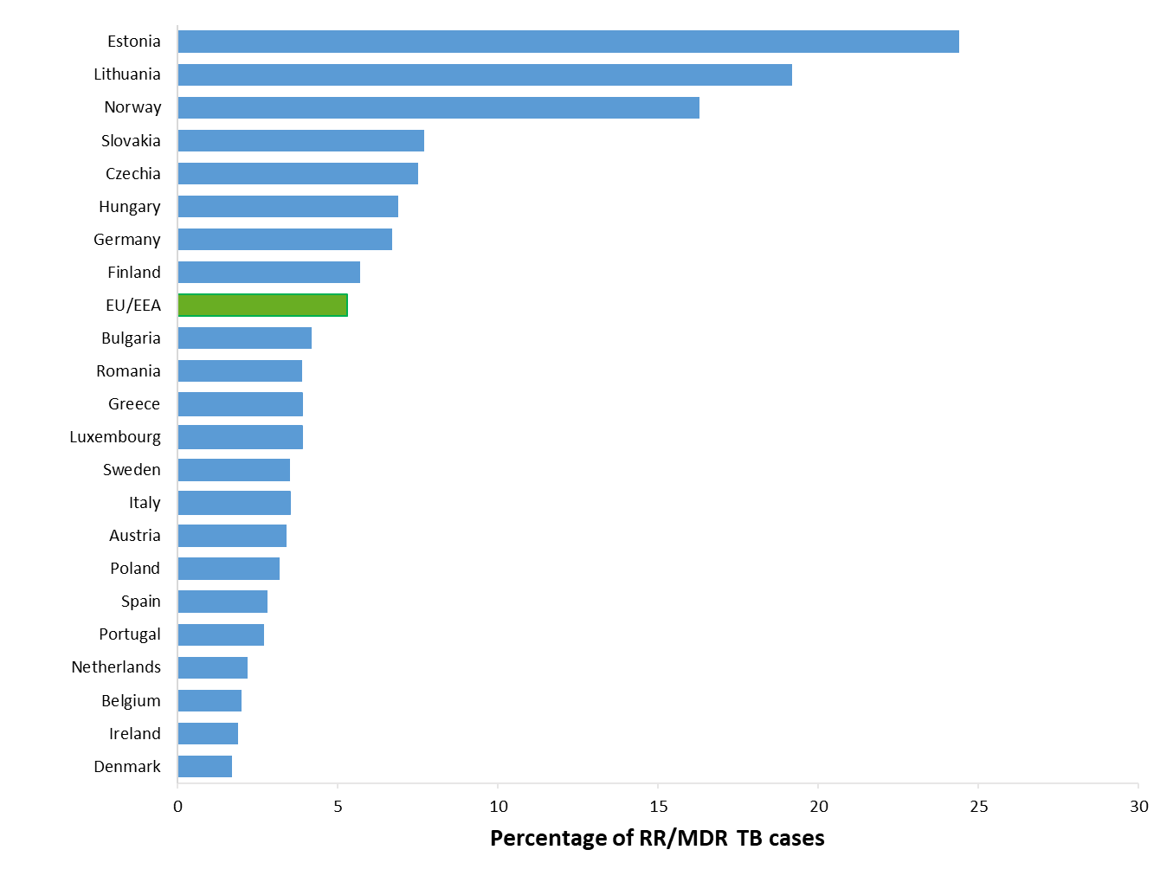
Proportion of RR/MDR TB, EU/EEA*, 2023
942 RR/MDR TB cases notified by all EU/EEA countries
5.3% of all bacteriologically-confirmed TB cases with available DST† results had RR/MDR TB (range 0–24.4%)
* RR/MDR TB data from France is not included in the graph. Croatia, Cyprus, Iceland, Liechtenstein, Malta and Slovenia reported zero RR/MDR TB cases for 2023. Latvia did not report data in 2023. † DST – drug susceptibility test.
Source: ECDC/WHO (2025). Tuberculosis surveillance and monitoring in Europe 2025–2023 data

Slide 13
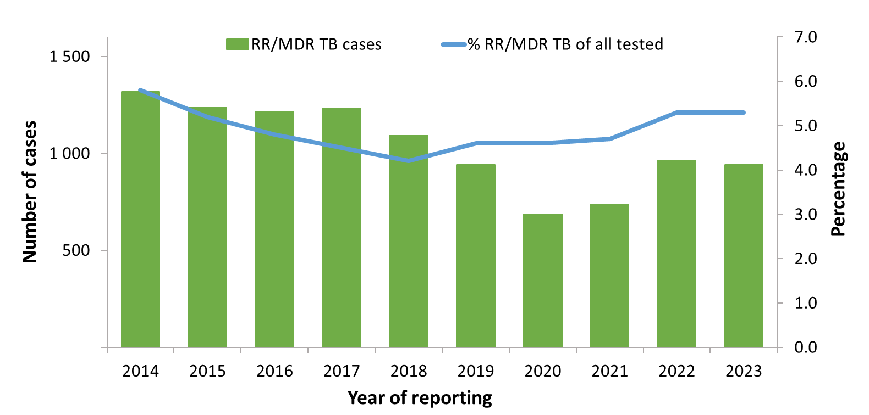
RR/MDR TB cases and proportions of all TB cases tested for drug resistance, EU/EEA*, 2014–2023
The total number of notified RR/MDR TB cases decreased from 1 318 in 2014 to 942 in 2023
Proportion of RR/MDR TB cases among all TB cases with available DST† results decreased from 5.8% in 2014 to 5.3% in 2023
* Countries and the years they are not included due to reporting discrepancies or no data: France (2015), Latvia (2018-2020 and 2023), Liechtenstein (2019-2020), Spain (2014). † DST – drug susceptibility test.
Source: ECDC/WHO (2025). Tuberculosis surveillance and monitoring in Europe 2024–2023 data

Slide 14
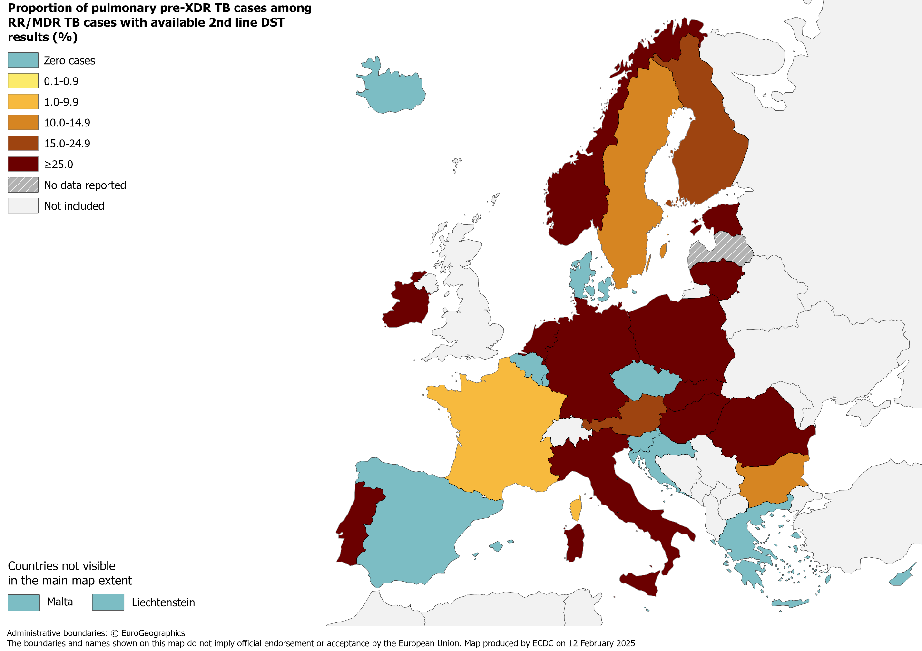
Pulmonary pre-XDR TB cases, EU/EEA, 2023
155 pre-XDR TB cases notified in EU/EEA countries
27.6% of RR/MDR TB cases with second-line DST† results met the pre-XDR TB definition
† DST – drug susceptibility test.
Source: ECDC/WHO (2025). Tuberculosis surveillance and monitoring in Europe 2025–2023 data

Slide 15
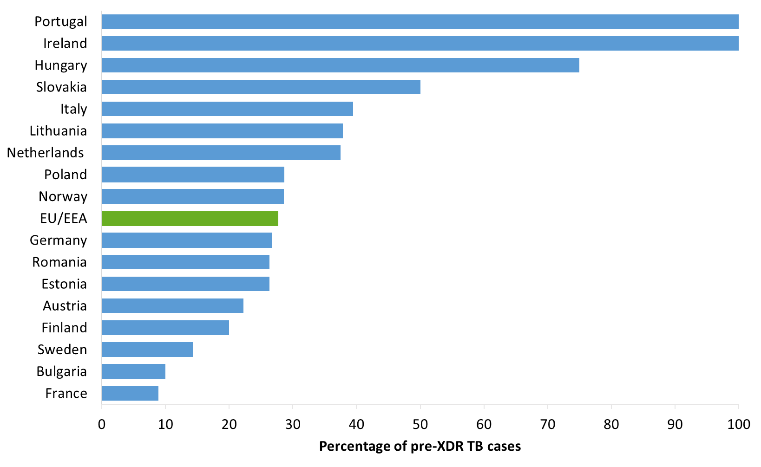
Proportion of pulmonary pre-XDR TB among RR/MDR TB cases with 2nd line DST results, EU/EEA*, 2023
155 pre-XDR TB cases notified in 17 EU/EEA countries*
27.6% of all RR/MDR TB cases with second-line DST† results (range 0.0%–100.0%)
* The graph shows countries that reported pre-XDR TB No pre-XDR TB cases were reported by Belgium, Croatia, Cyprus, Czechia, Denmark, Greece, Iceland, Liechtenstein, Luxembourg, Malta, Slovenia and Spain. Latvia did not report data in 2023. † DST – drug susceptibility test.
Source: ECDC/WHO (2025). Tuberculosis surveillance and monitoring in Europe 2025–2023 data

Slide 16
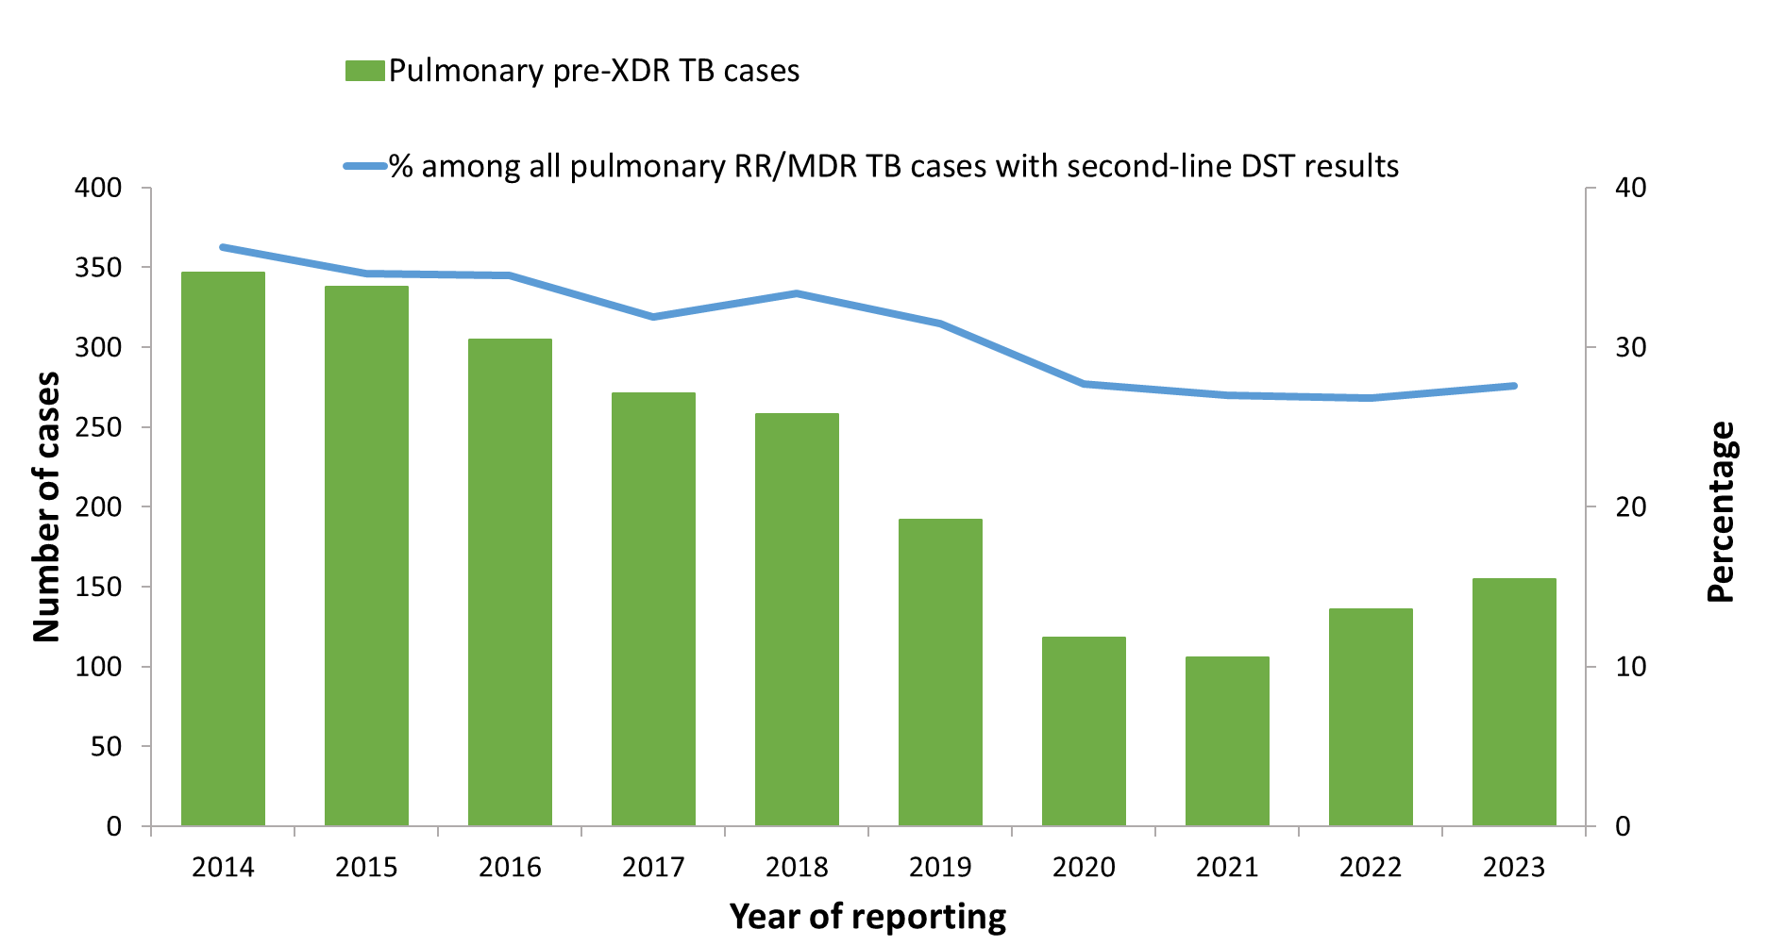
Pulmonary pre-XDR TB cases and proportion among all pulmonary RR/MDR TB cases with 2nd line DST results, EU/EEA*, 2014–2023
The total number of pulmonary pre-XDR TB cases peaked at 347 in 2014, decreased to 106 in 2021 and was 155 in 2023
The proportion of pre-XDR TB cases among pulmonary RR/MDR TB cases ranged between 26.8% in 2022 to 36.3% in 2014
* Countries and the years for which they are not included due to reporting discrepancies or no data: Latvia (2018-2020 and 2023), Liechtenstein (2019).
Source: ECDC/WHO (2025). Tuberculosis surveillance and monitoring in Europe 2025–2023 data

Slide 17
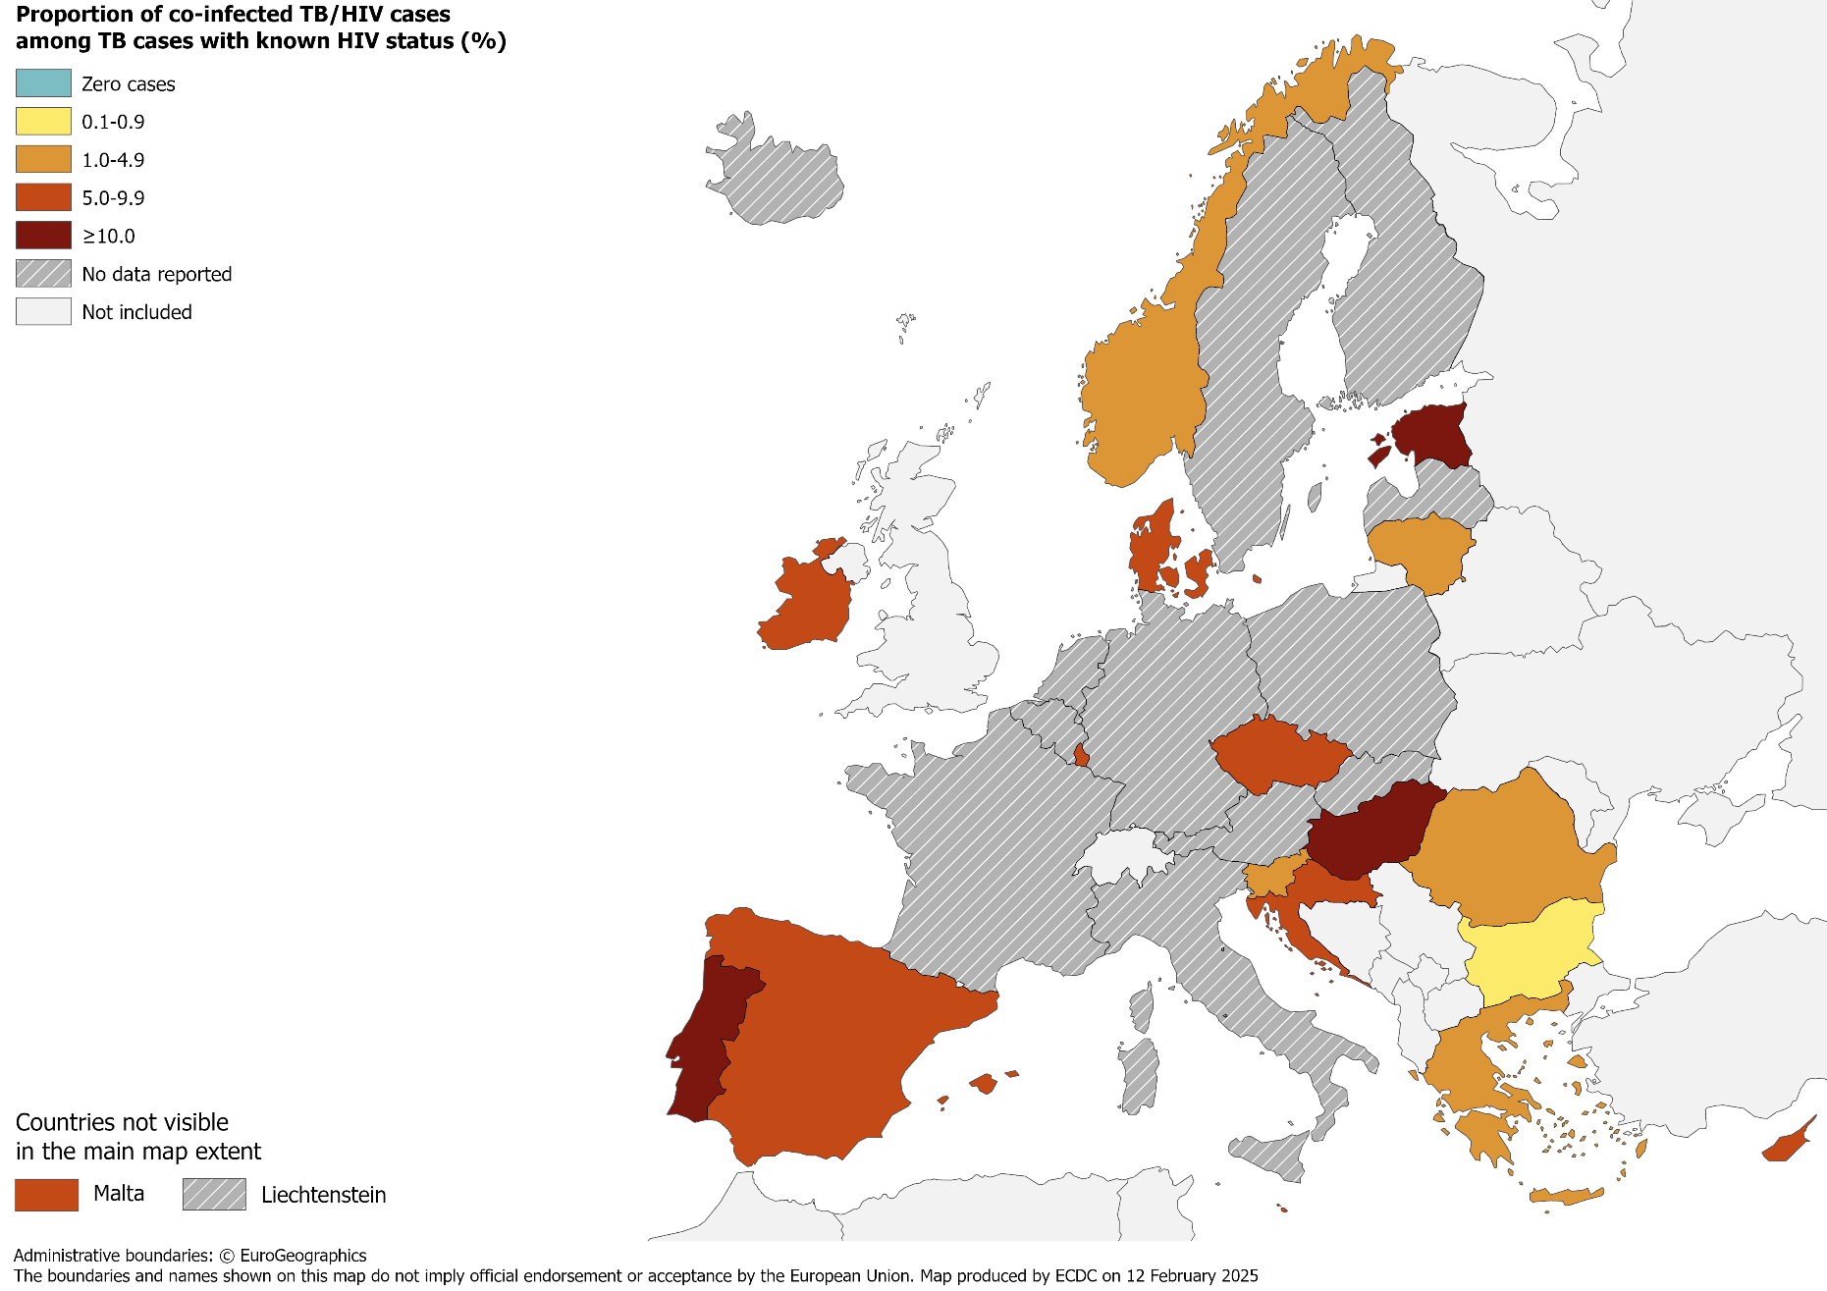
TB/HIV co-infection, EU/EEA*, 2023
680 HIV-positive TB cases were notified by 18 EU/EEA countries in 2023
4.4% of all TB cases with known HIV status were HIV-positive
(range 0.0–16.1%)
* Eleven countries did not report HIV status data: Austria, Belgium, Finland, France, Germany, Iceland, Italy, Liechtenstein, Netherlands, Poland, Sweden. Latvia did not report 2023 data.
Source: ECDC/WHO (2025). Tuberculosis surveillance and monitoring in Europe 2025–2023 data

Slide 18
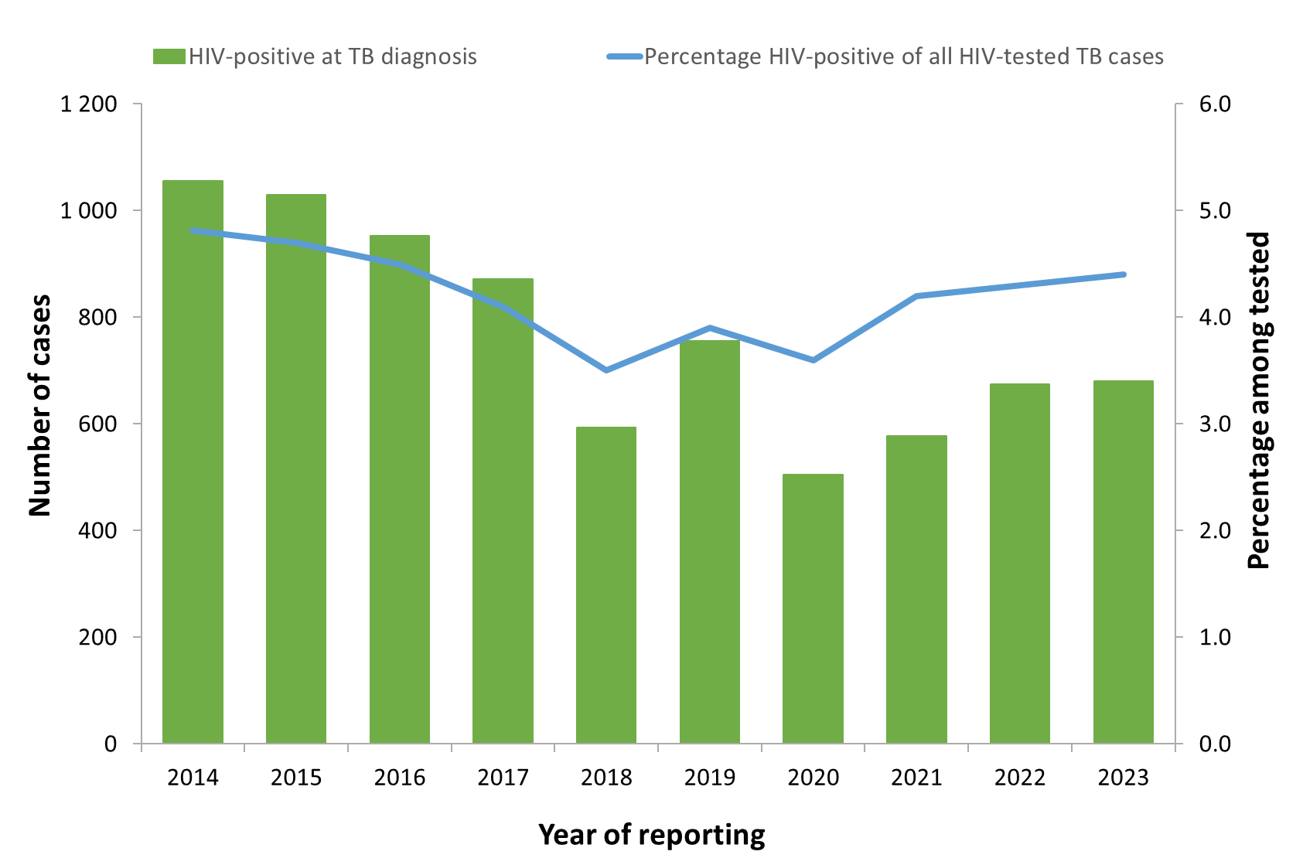
HIV-positive TB cases and proportion among all those tested, EU/EEA, 2014–2023*
The total number of HIV-positive TB cases decreased from 1 056 in 2014 to 505 in 2020 and reached 680 cases in 2023
The proportion of HIV-positive TB cases among those tested decreased from 4.8% in 2014 to the lowest reported at 3.5% in 2018, afterwards increasing between 2019-2023
* Countries and the years for which they are not included due to reporting discrepancies or no data: Austria (all years), Belgium (2023), Croatia (2013-2015), Cyprus (2013), Denmark (2013), Finland (all years), France (all years), Germany (all years), Hungary (2013), Iceland (2020-2023), Italy (all years), Latvia (2018-2020;2023), Liechtenstein (all years), Malta (2018-2021), Netherlands(2023), Norway (2011-2012), Poland (all years) and Sweden (all years).
Source: ECDC/WHO (2025). Tuberculosis surveillance and monitoring in Europe 2025–2023 data

Slide 19
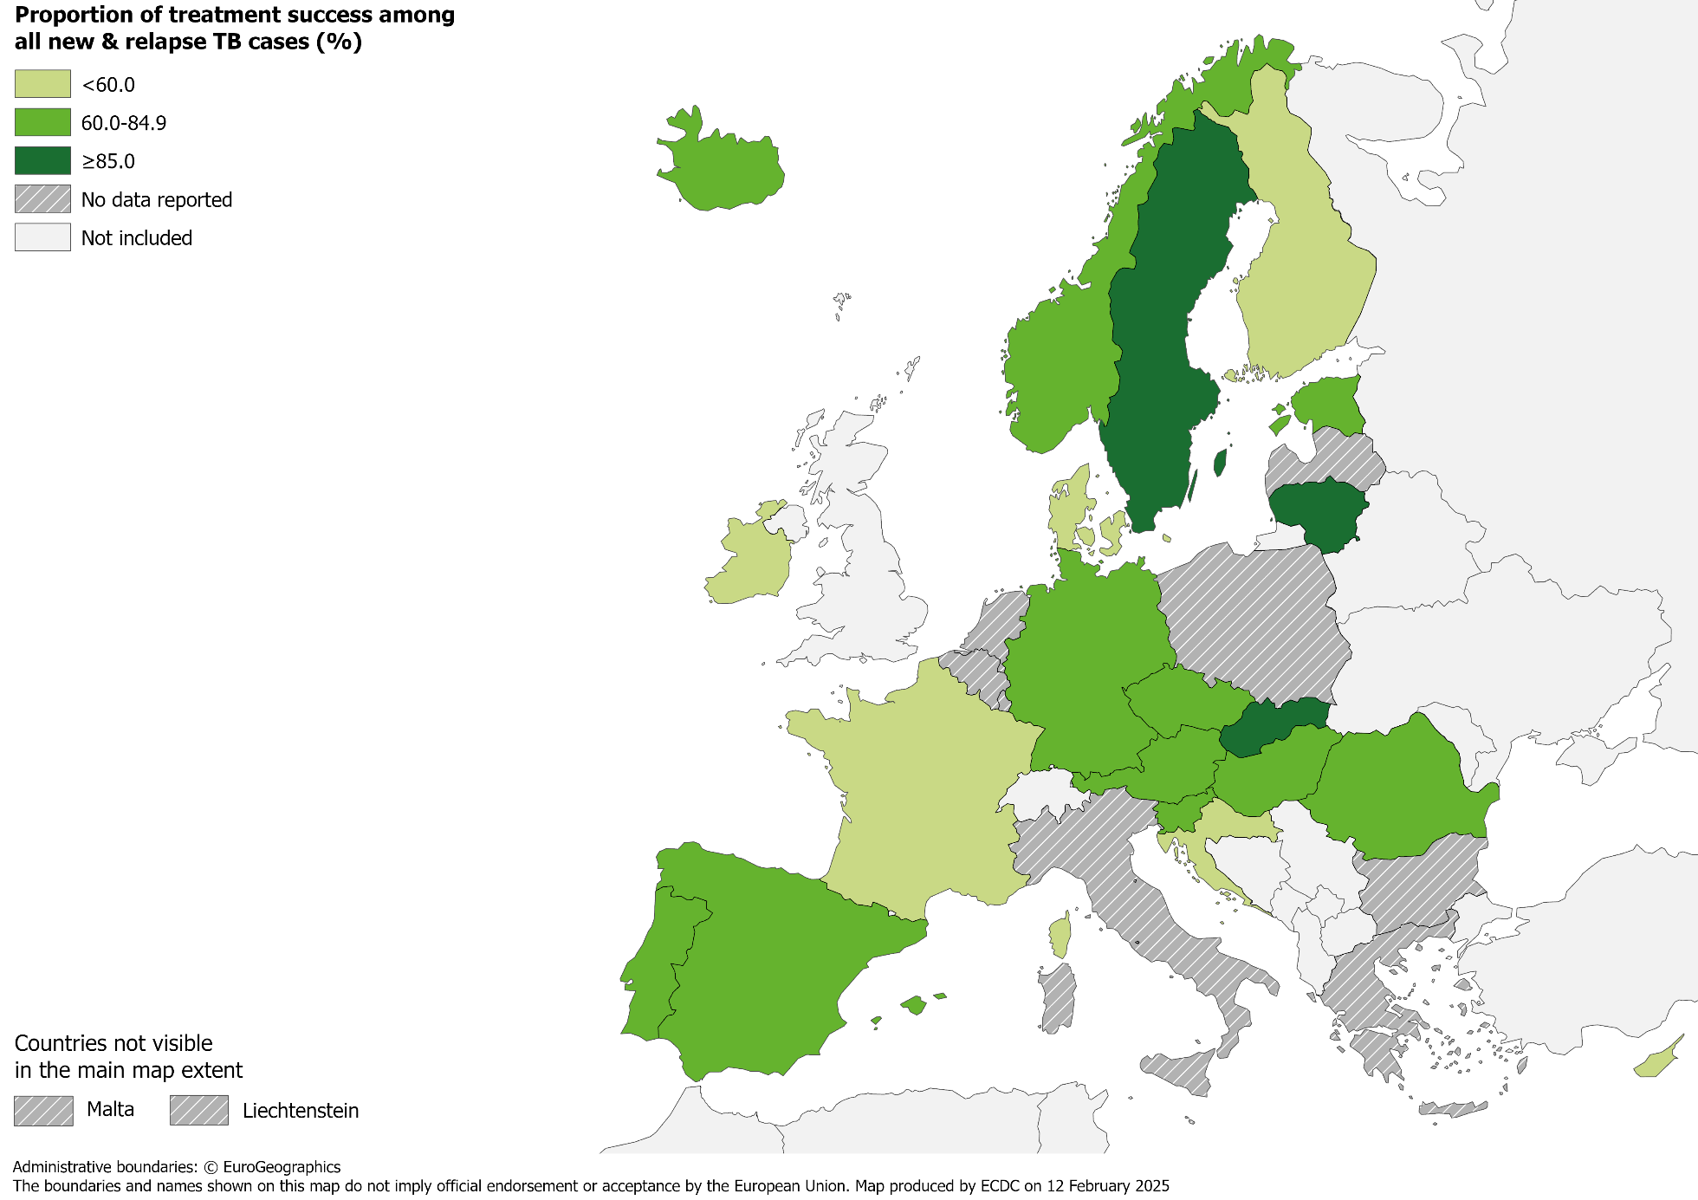
Treatment success after 12 months among new & relapse TB cases notified in 2022, EU/EEA*, 2023
67.9% of all TB cases
had a successful treatment outcome after 12 months
(range 0.6–89.1%)
* Seven countries did not report treatment outcome data: Bulgaria, Greece, Italy, Liechtenstein, Luxembourg, Malta and Poland. Belgium and Netherlands did not report previous treatment history.
Latvia did not report 2023 data.
Source: ECDC/ WHO (2025). Tuberculosis surveillance and monitoring in Europe 2025–2023 data

Slide 20
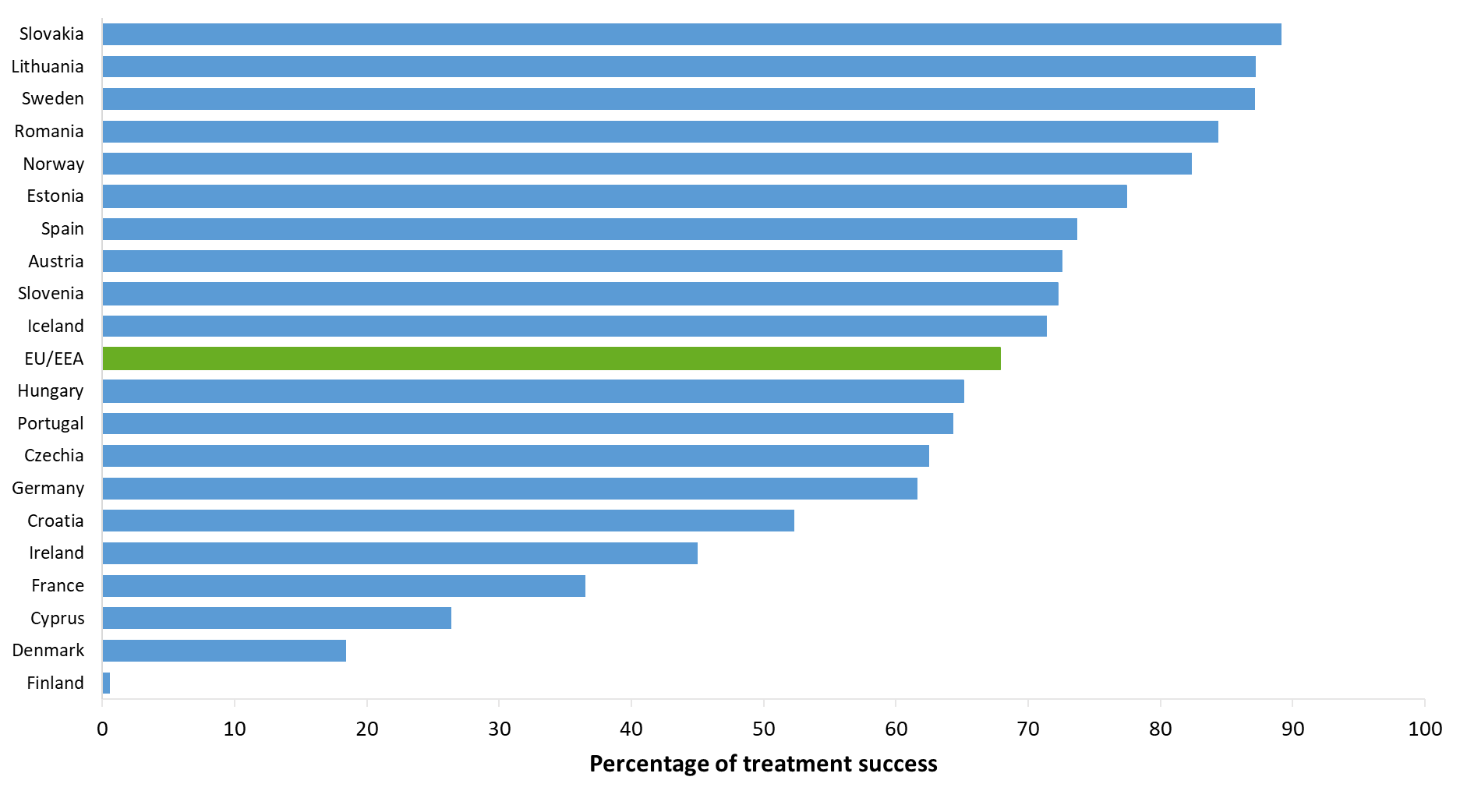
Treatment success after 12 months among new & relapse TB cases notified in 2022, EU/EEA*, 2023
67.9% of new and relapse TB cases after 12 months reported a successful treatment outcome in 2023 (range 0.6–87.1%)
* Seven EU/EEA countries did not report treatment outcome data: Bulgaria, Greece, Italy, Liechtenstein, Luxembourg, Malta and Poland. Belgium and the Netherlands did not report previous treatment history in 2023.
Latvia did not report 2023 data.
Source: ECDC/WHO (2025). Tuberculosis surveillance and monitoring in Europe 2025–2023 data

Slide 21
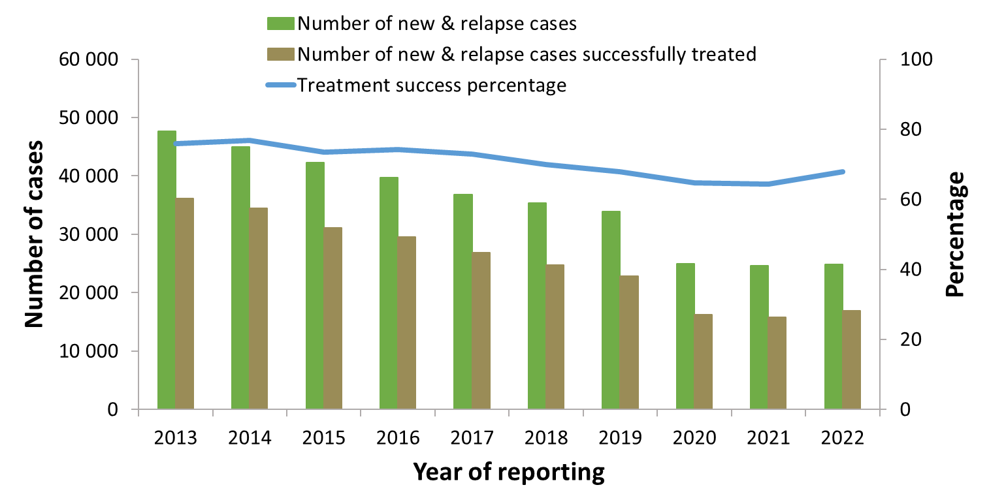
Treatment success after 12 months among new & relapse TB cases notified during 2013–2022, EU/EEA*, 2023
Proportion reported with a successful treatment varied between 76.8% in 2014 to 64.4% in 2021, increasing to 67.9% in 2022
* Countries and the years for which they are not included due to reporting discrepancies or no data: Croatia (2010-2011), Greece (all years), Italy (all years), Latvia (2017-2022), Liechtenstein (2010-2014, 2018-2019, 2022), Luxembourg (2010-2018,2022), Malta (2014-2019, 2022), Poland (2017-2022).
Belgium and the Netherlands did not report previous treatment history in 2023, hence data not included for analysis.
Source: ECDC/WHO (2025). Tuberculosis surveillance and monitoring in Europe 2025–2023 data

Slide 22
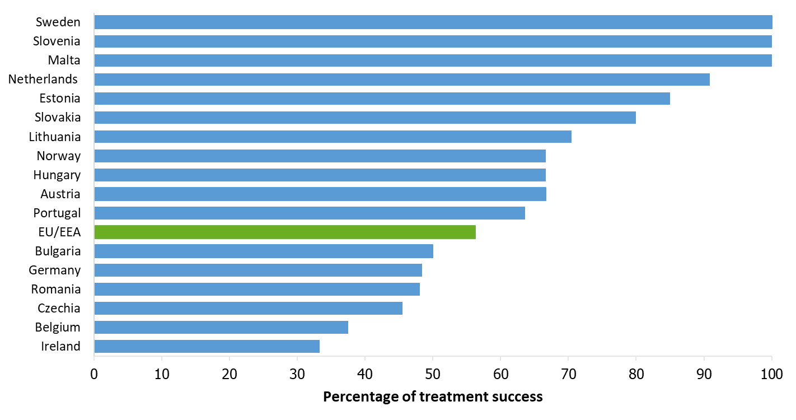
Treatment success after 24 months among RR/MDR TB cases started on second-line treatment in 2021, EU/EEA*, 2023
56.3% of all RR/MDR TB cases started on second-line treatment in 2021 were reported to have treatment success after 24 months
(range 33.3–100%)
* Four countries did not report any RR/MDR TB cases in 2021: Croatia, Iceland, Liechtenstein and Luxembourg. Nine countries did not report treatment outcome data: Cyprus, Denmark, Finland, France, Greece, Italy, Poland and Spain.
Latvia did not report 2023 data.
Source: ECDC/WHO (2025). Tuberculosis surveillance and monitoring in Europe 2025–2023 data

Slide 23
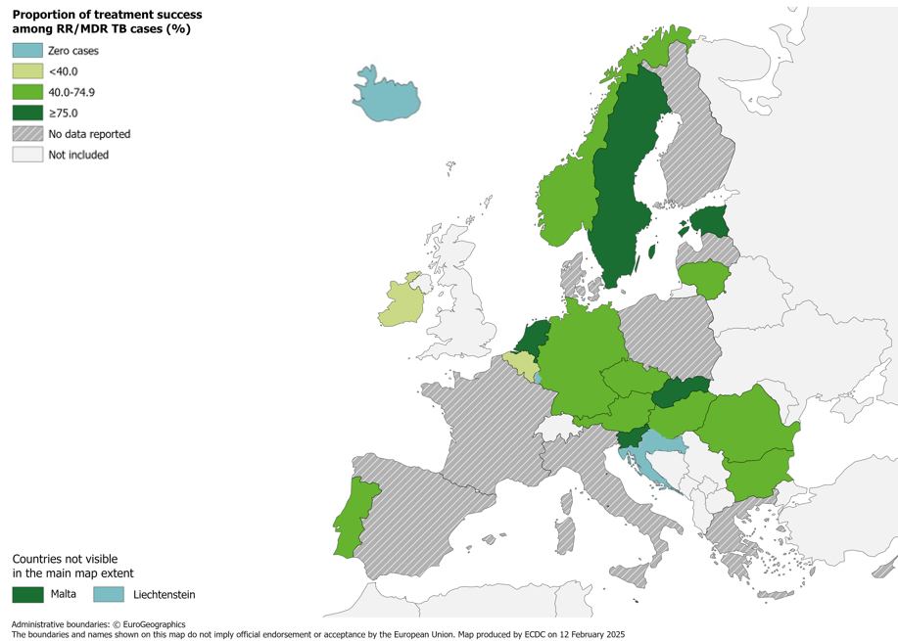
Treatment success after 24 months among RR/MDR TB cases started on second-line treatment in 2021, EU/EEA*, 2023
56.3% of all RR/MDR TB cases started on second-line treatment in 2021 were reported to have treatment success after 24 months (range 33.3–100%)
* Four countries did not report any RR/MDR TB cases in 2021: Croatia, Iceland, Liechtenstein and Luxembourg. Nine countries did not report treatment outcome data: Cyprus, Denmark, Finland, France, Greece, Italy, Poland and Spain.
Latvia did not report 2023 data.
Source: ECDC/WHO (2025). Tuberculosis surveillance and monitoring in Europe 2025–2023 data

Slide 24
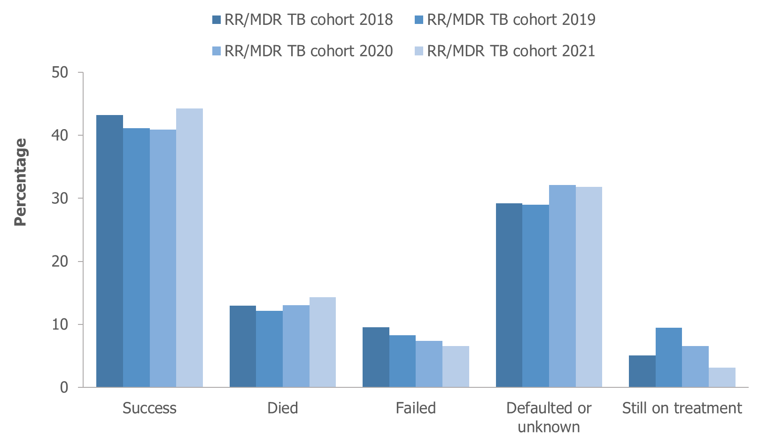
Treatment outcomes among RR/MDR TB cases* started on second-line treatment in 2018–2021, EU/EEA†, 2023
Reported treatment success remained below 50% for all RR/MDR TB cohorts between 2018-2021
* Pre-XDR and XDR TB cases are not included.
† Countries and the cohorts for which they are not included due to reporting discrepancies or no data: Croatia (2016-2017, 2021), Cyprus (all years), France (all years), Greece (all years), Iceland (all years) , Italy (all years), Latvia (all years), Liechtenstein (all years), Luxembourg (all years), Malta (all years), Poland (all years), Slovenia (2018-2019), Spain (all years).
Source: ECDC/WHO (2025). Tuberculosis surveillance and monitoring in Europe 2025–2023 data

Slide 25
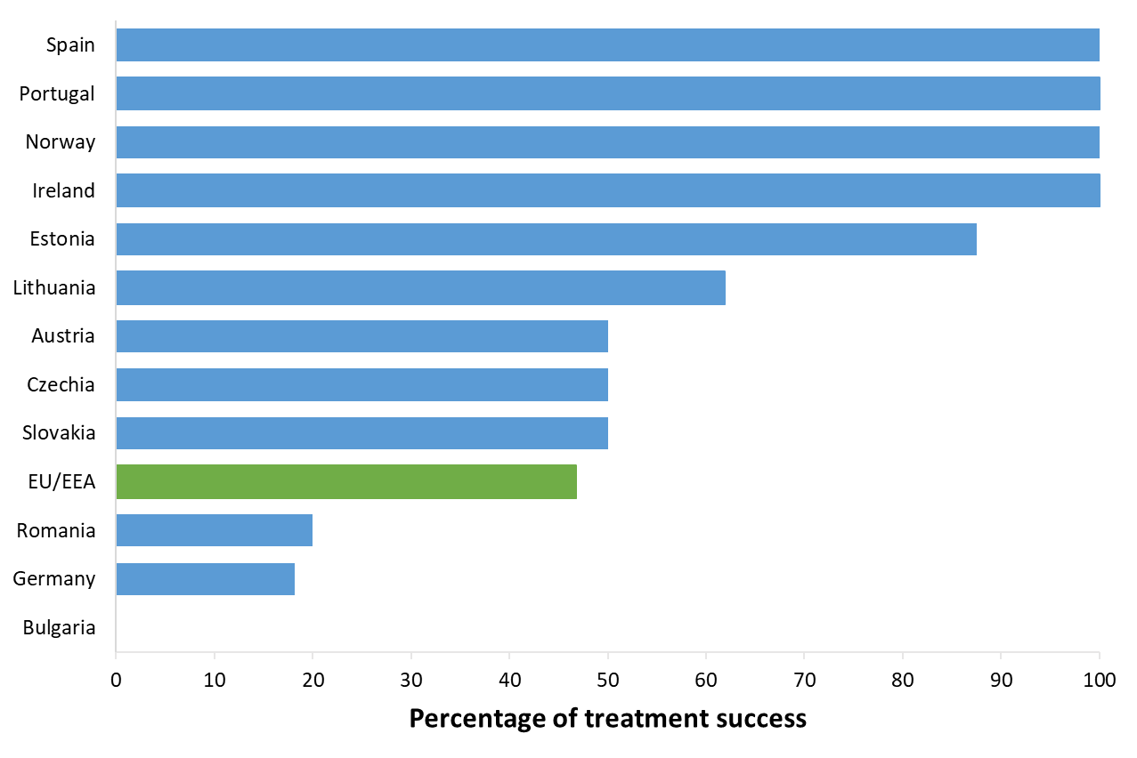
Treatment success after 24 months among pre-XDR TB cases started on second-line treatment in 2021, EU/EEA*, 2023
46.8% of the pre-XDR TB cases started on second-line treatment in 2021 were reported to have treatment success after 24 months (range 0-100%)*
* Three countries reported zero pre-XDR TB cases in 2021: Cyprus, Slovenia and Sweden.
Fourteen countries did not report treatment outcome data: Belgium, Croatia, Denmark, Finland, France, Greece, Hungary, Iceland, Italy, Liechtenstein, Luxembourg, Malta, Netherlands and Poland. Latvia did not report 2023 data.
Source: ECDC/WHO (2025). Tuberculosis surveillance and monitoring in Europe 2025–2023 data

Slide 26
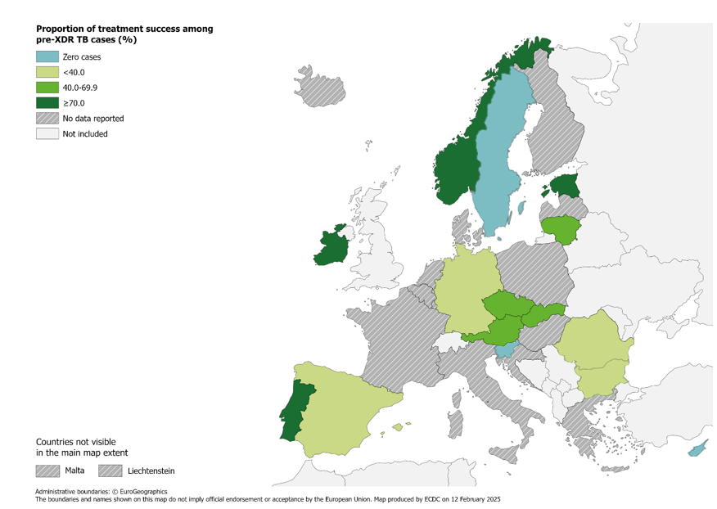
Treatment success after 24 months among pre-XDR TB cases started on second-line treatment in 2021, EU/EEA*, 2023
46.8% of all pre-XDR TB cases started on second-line treatment in 2021 were successfully treated (range 0–100%)
* Three countries reported zero pre-XDR TB cases in 2021: Cyprus, Slovenia and Sweden.
Fourteen countries did not report treatment outcome data: Belgium, Croatia, Denmark, Finland, France, Greece, Hungary, Iceland, Italy, Liechtenstein, Luxembourg, Malta, Netherlands and Poland. Latvia did not report 2023 data.
Source: ECDC/WHO (2025). Tuberculosis surveillance and monitoring in Europe 2025–2023 data

Slide 27
Treatment outcomes new & relapse TB, RR/MDR, pre-XDR, XDR TB cases, EU/EEA*, 2023
 | New & relapse TB, 12 months | RR/MDR, 24 months | Pre-XDR, 24 months | XDR, 36 months
Cases started on treatment | 24 901 | 577 | 79 | 0
Countries reporting cases | 20 | 17 | 12 | 0
Countries reporting 0 cases | 0 | 4 | 3 | 14
Treatment success | 67.9% | 56.3% | 46.8% | NA†
* Latvia did not report data for 2020 and 2023.
† NA: Not applicable.

