Slide 1
Tuberculosis situation in the EU/EEA, 2021
Tuberculosis situation in the EU/EEA, 2022
h
Findings from the joint report Tuberculosis surveillance and monitoring in Europe by ECDC and WHO Regional Office for Europe
Stockholm, 21 March 2024

Slide 2
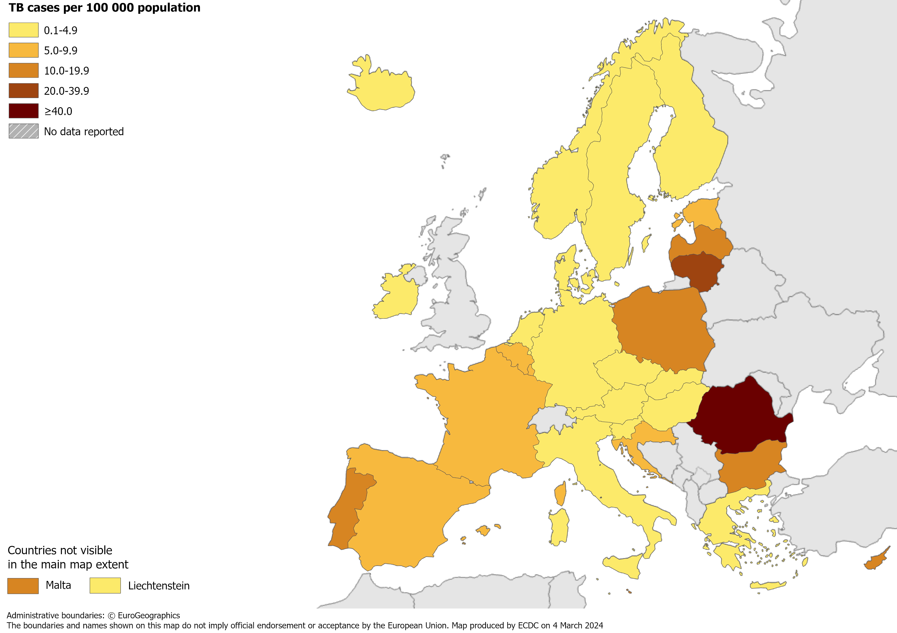
TB notifications, EU/EEA, 2022
36 179 TB cases notified in all EU/EEA countries
Notification rate 8.0 per 100 000 population (range 2.5 – 48.7)
Source: ECDC/WHO (2024). Tuberculosis surveillance and monitoring in Europe 2024–2022 data

Slide 3
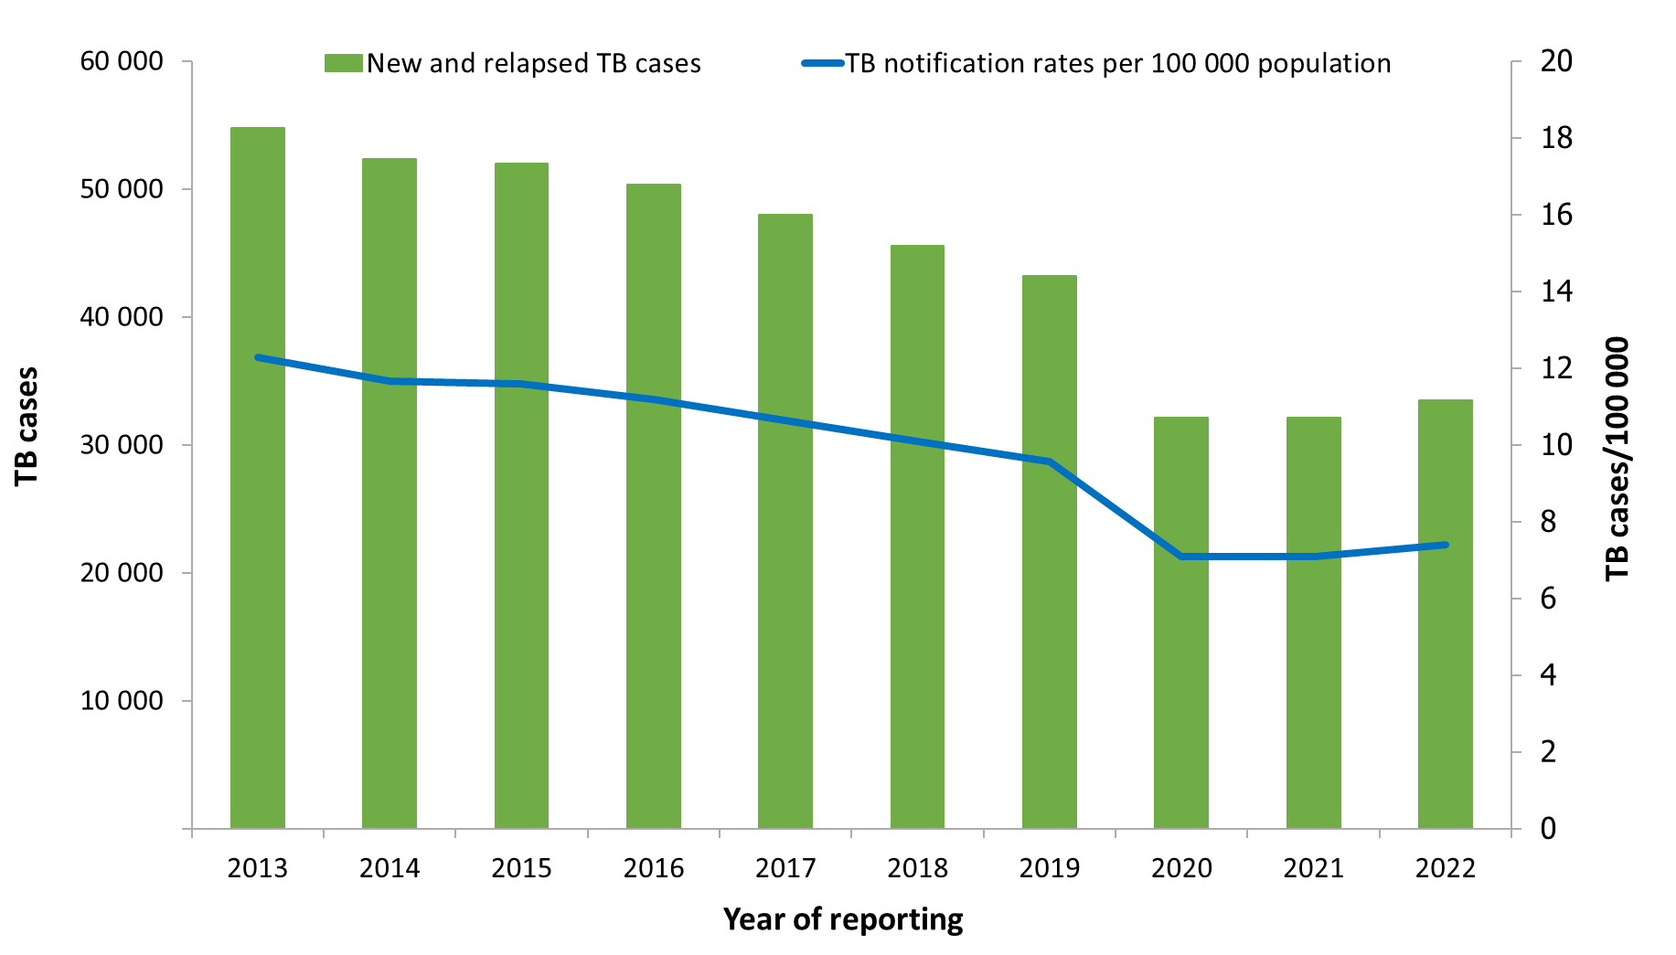
Notified new and relapse TB cases, EU/EEA*, 2013–2022
Slight increase reported in 2022 compared to 2020-2021, but overall, the trend continues to decline between 2013 and 2022:
Number of TB cases decreased by 39%
Notification rate decreased by 40%
* Data not reported and excluded from the trends presented in the figure for Latvia 2018, 2019 or 2020 and Liechtenstein 2019.
Source: ECDC/WHO (2024). Tuberculosis surveillance and monitoring in Europe 2024–2022 data

Slide 4
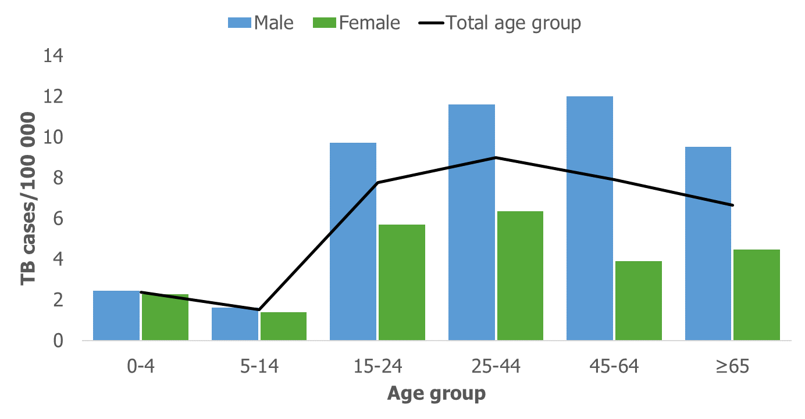
TB notification rate by sex and age group, EU/EEA, 2022
The highest notification rate was observed in the age group 25–44 years (9.5 per 100 000)
Males were over-represented in all age groups over 14 years
Source: ECDC/WHO (2024). Tuberculosis surveillance and monitoring in Europe 2024–2022 data

Slide 5
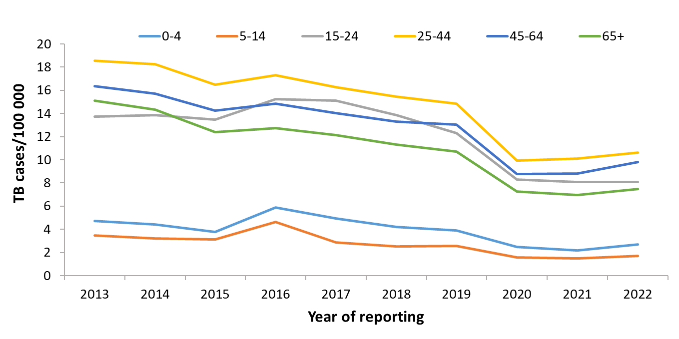
TB notification rate by age group, EU/EEA*, 2013–2022
Annual average decrease of between 5.5 to 7.7% in all age groups
* Data not reported and excluded from the trends presented in the figure for Latvia 2018, 2019 or 2020 and Liechtenstein 2019.
Source: ECDC/WHO (2024). Tuberculosis surveillance and monitoring in Europe 2024–2022 data

Slide 6
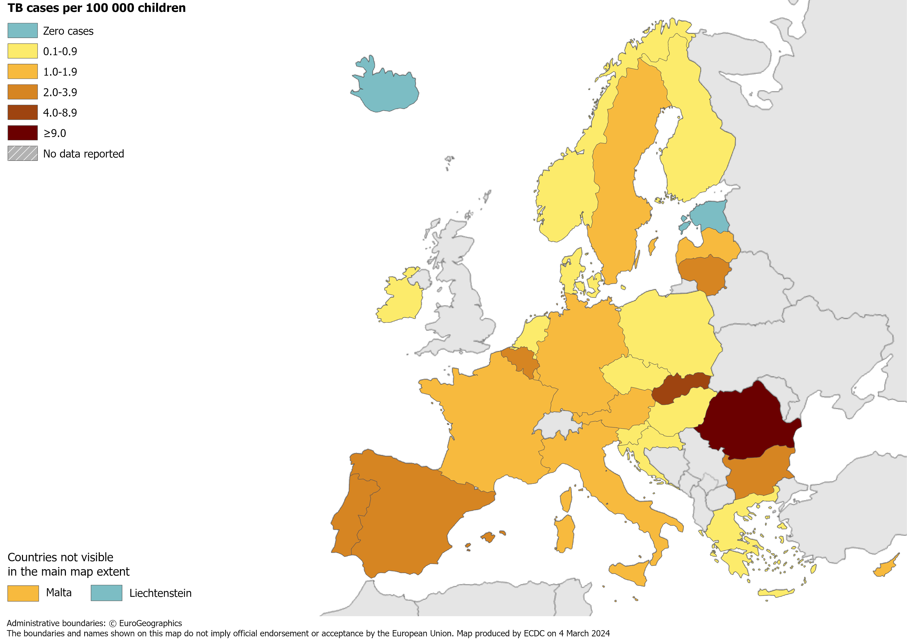
TB in children under 15 years, EU/EEA, 2022
1 214 TB cases notified in children under 15 years
3.6% of all TB cases (range 0.0–18.3%)
1.9 per 100 000 child population (range 0.0–27.7)
Source: ECDC/WHO (2024). Tuberculosis surveillance and monitoring in Europe 2024–2022 data

Slide 7
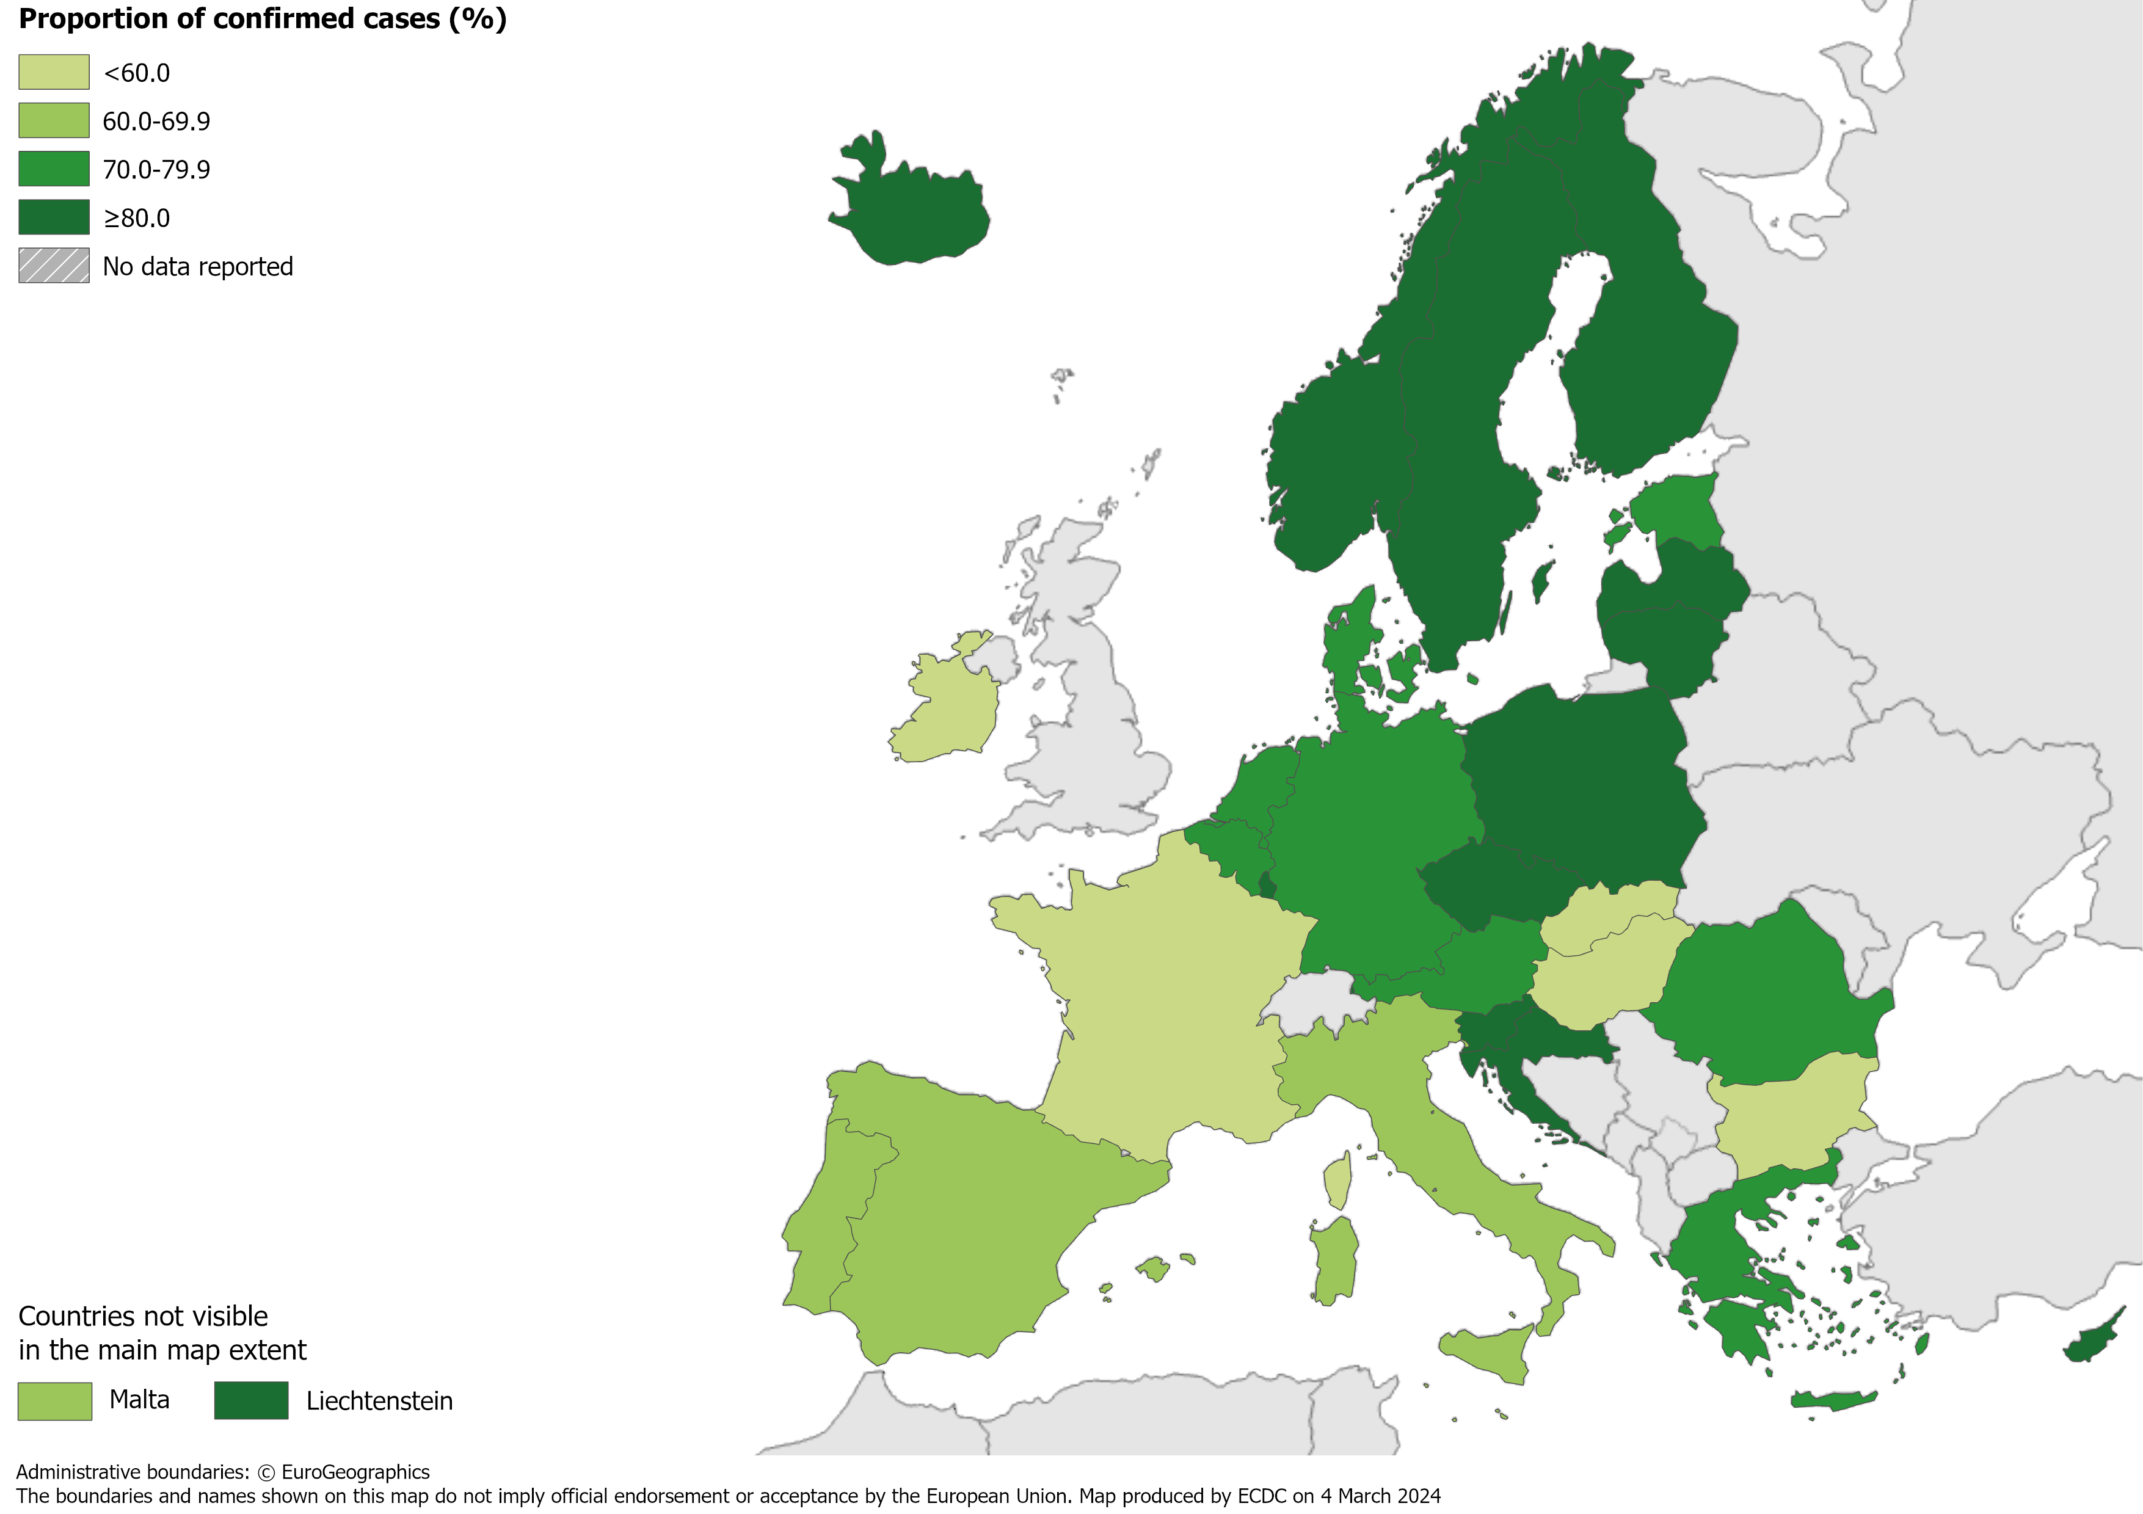
Confirmed TB cases*, EU/EEA, 2022
25 556 TB cases were confirmed
71% of all TB cases (range 39.8–100%)
*Confirmation by culture, or by microscopy and Mycobacterium tuberculosis nucleic acid amplification test.
Source: ECDC/WHO (2024). Tuberculosis surveillance and monitoring in Europe 2024–2022 data

Slide 8
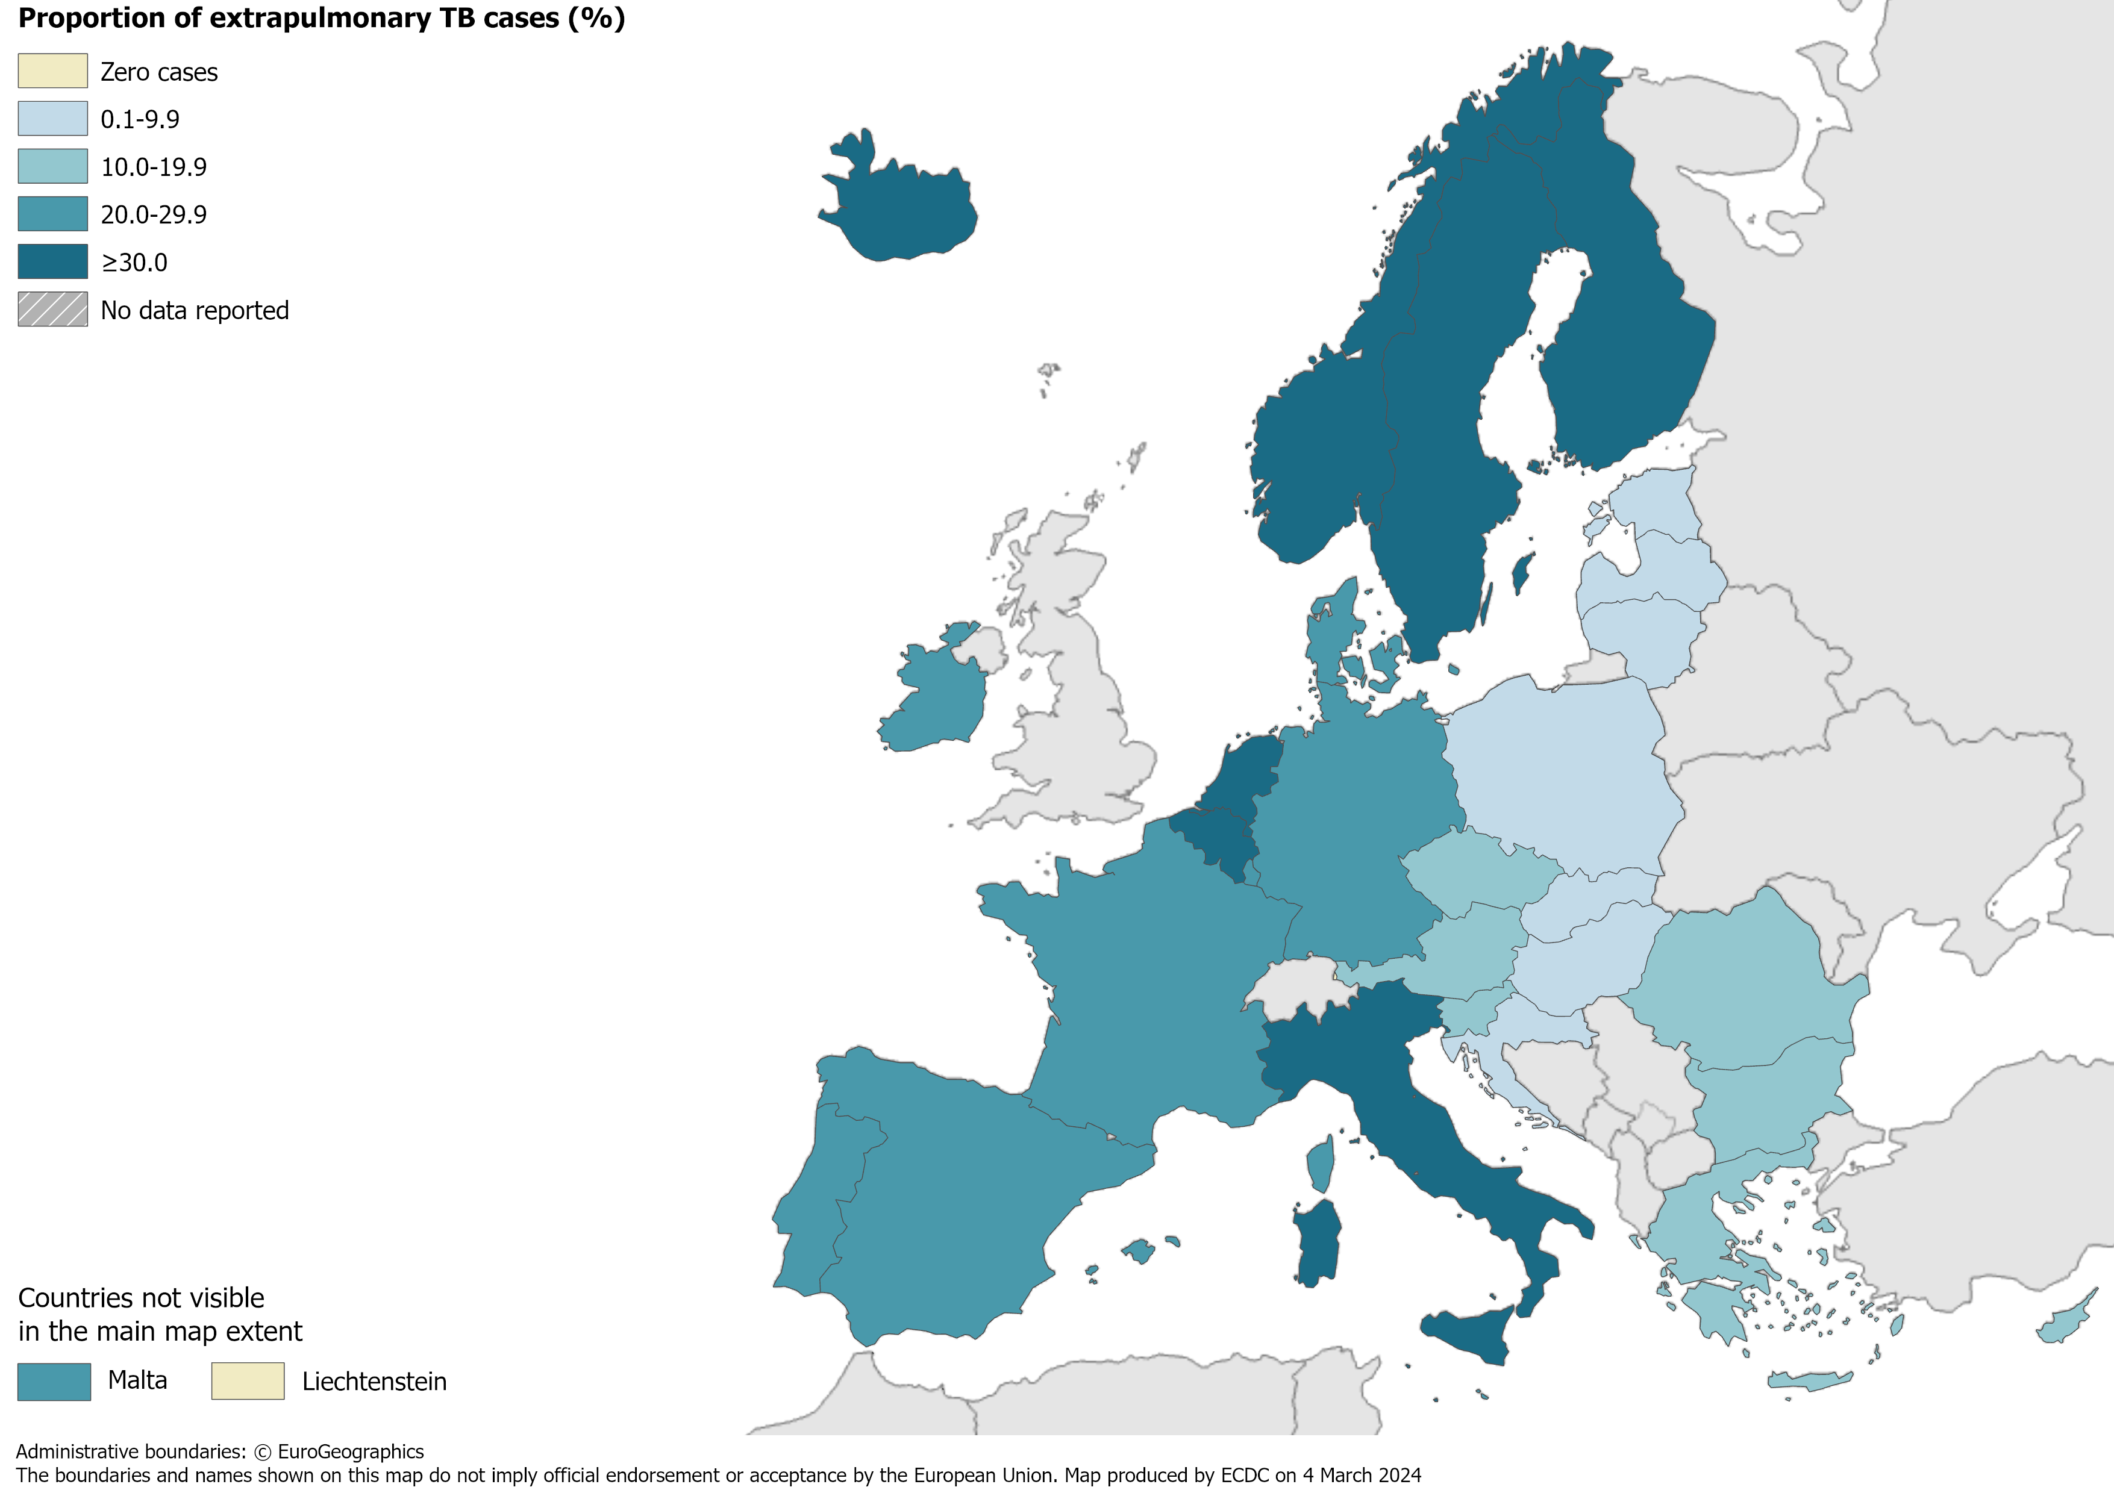
Extrapulmonary TB, EU/EEA, 2022
6 885 notified cases had extrapulmonary TB
19% of all TB cases (range 0.0–40.8%)
Source: ECDC/WHO (2024). Tuberculosis surveillance and monitoring in Europe 2024–2022 data

Slide 9
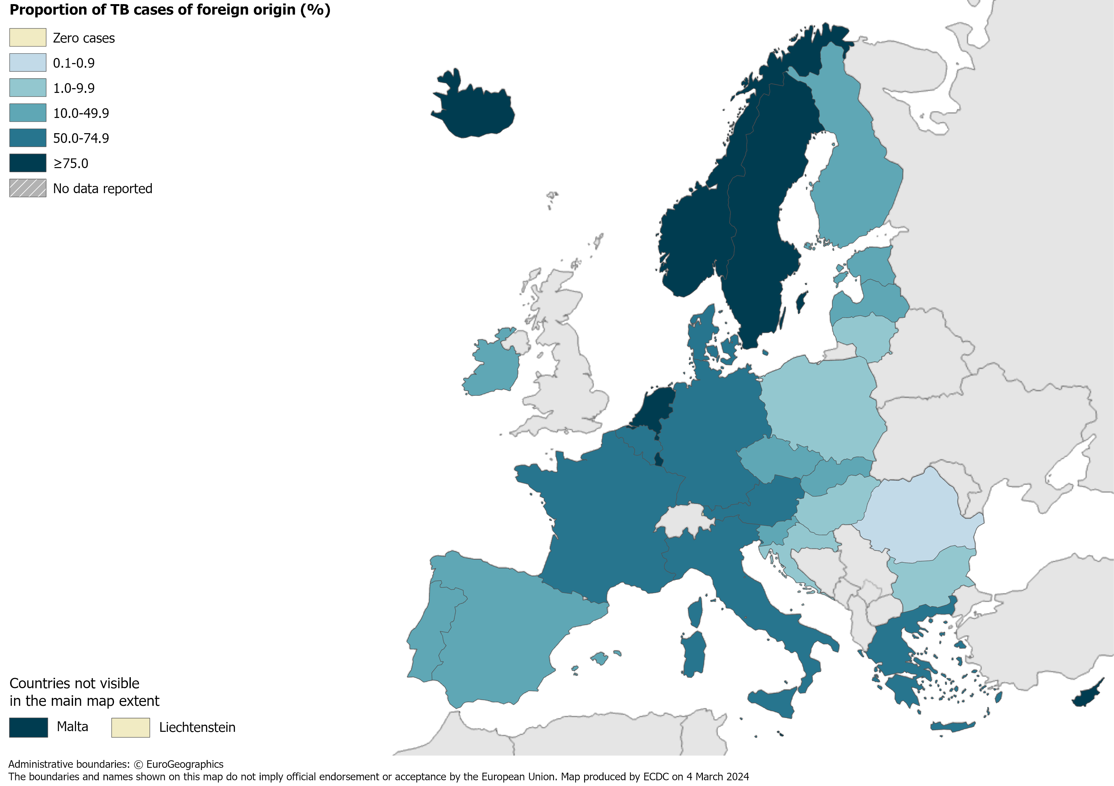
TB in persons of foreign origin*, EU/EEA, 2022
12 051 TB cases of foreign* origin
33.3% of all TB cases (range 0.0–93.8%)
* Notified in persons originating from other countries than the reporting country.
Source: ECDC/WHO (2024). Tuberculosis surveillance and monitoring in Europe 2024–2022 data

Slide 10
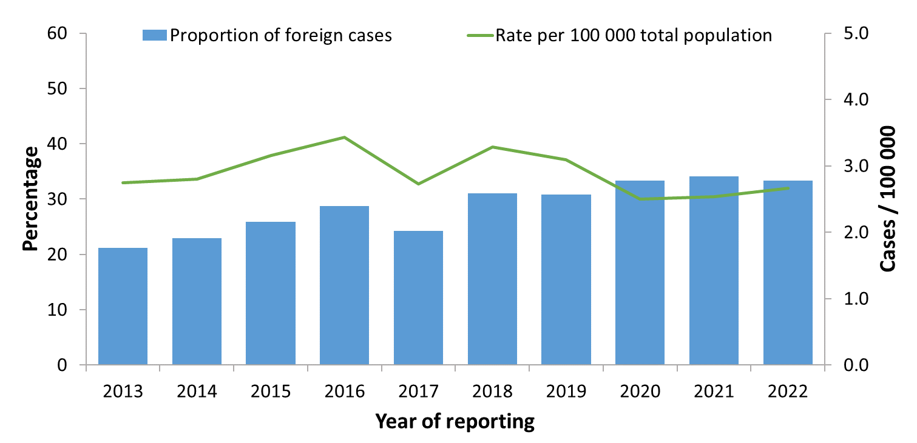
TB cases in persons of foreign origin*, EU/EEA†, 2013–2022
The proportion of cases in persons of foreign origin increased from 21.2% in 2013 to 33.3% in 2022
The rate of TB cases of foreign origin per 100 000 of the total population varied between 2.5 and 3.4
* Notified in persons originating from other countries than the reporting country. † Data not reported and excluded from the trends presented in the figure for Latvia 2018-2020 and Liechtenstein 2019.
Source: ECDC/WHO (2024). Tuberculosis surveillance and monitoring in Europe 2024–2022 data

Slide 11
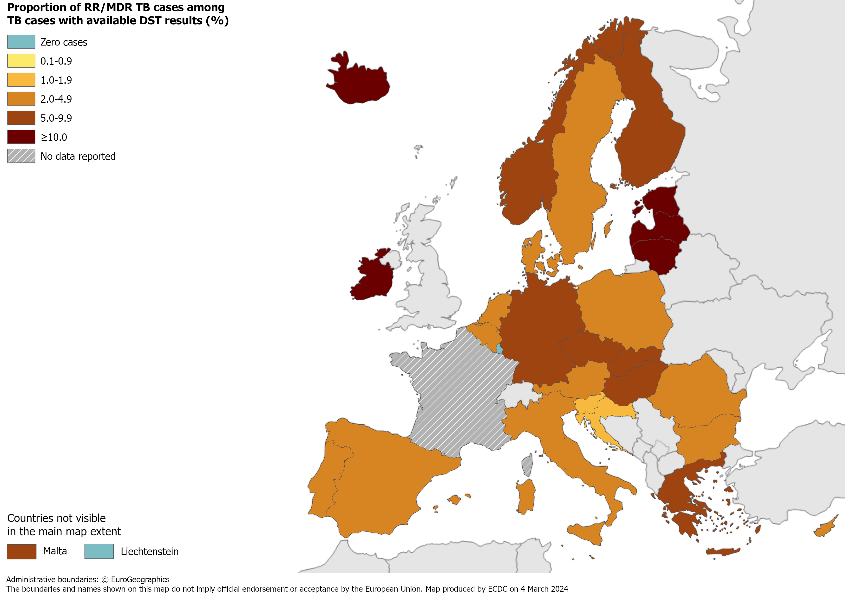
RR/MDR TB cases with available DST results, EU/EEA*, 2022
933 pulmonary RR/MDR TB cases notified by all EU/EEA countries*
5.0% of all TB cases with available DST† results had RR/MDR TB (range 0.0–25.5%, excluding France)
* Data from France included in the total cases notified and percentage, but not included in the range or the map, as DST results are only available for RR/MDR TB cases. † DST – drug susceptibility test.
Source: ECDC/WHO (2024). Tuberculosis surveillance and monitoring in Europe 2024–2022 data

Slide 12
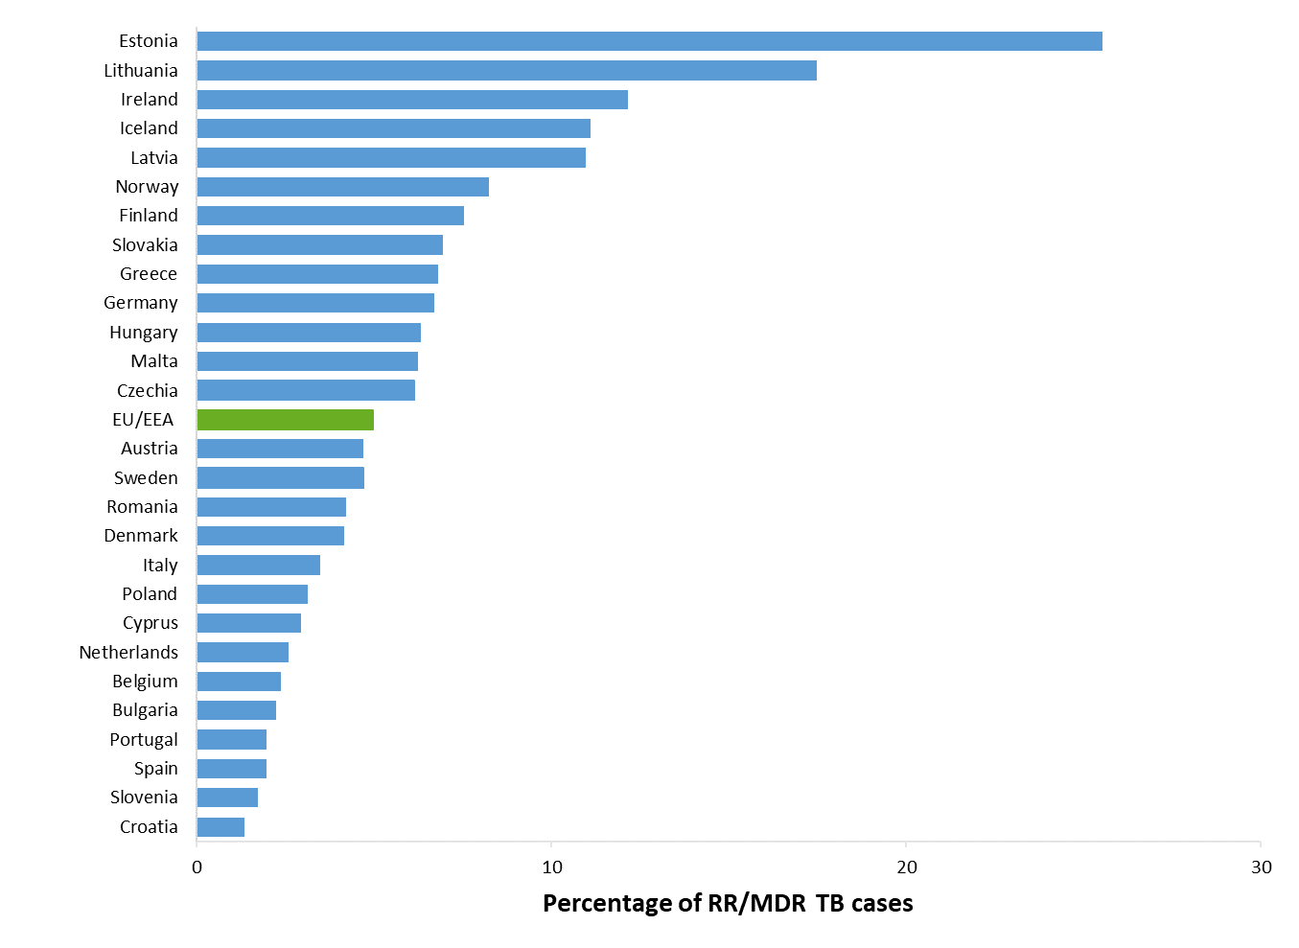
Proportion of RR/MDR TB, EU/EEA*, 2022
933 RR/MDR TB cases notified by all EU/EEA countries
5.0% of all bacteriologically-confirmed TB cases with available DST† results had RR/MDR TB (range 0-25.5%)
* RR/MDR TB data from France are not included in the graph. Liechtenstein and Luxembourg reported zero RR/MDR TB cases for 2022. † DST – drug susceptibility test.
Source: ECDC/WHO (2024). Tuberculosis surveillance and monitoring in Europe 2023–2022 data

Slide 13
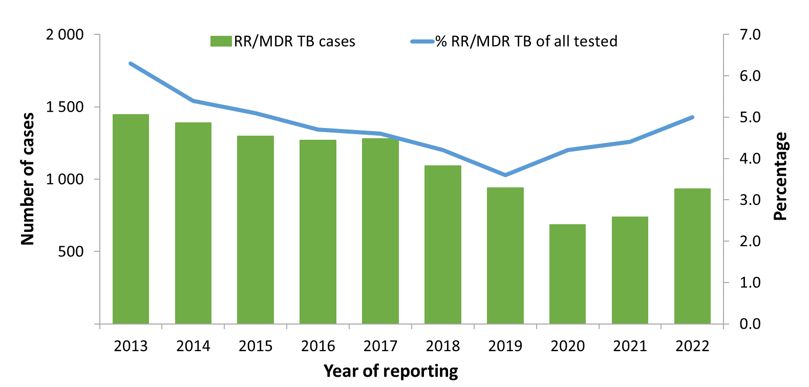
RR/MDR TB cases and proportion of all RR/MDR TB cases tested for drug resistance, EU/EEA*, 2013–2022
The total number of notified RR/MDR TB cases decreased from 1 446 in 2013 to 933 in 2022
Proportion of RR/MDR TB cases among all TB cases with available DST† results decreased from 6.3% in 2013 to 5.0% in 2022
Countries and the years they are not included due to reporting discrepancies or no data: France (2013, 2015), Latvia (2018, 2019, 2020), Liechtenstein (2013, 2019-2020) and Spain (2013-2014). † DST – drug susceptibility test.
Source: ECDC/WHO (2024). Tuberculosis surveillance and monitoring in Europe 2024–2022 data

Slide 14
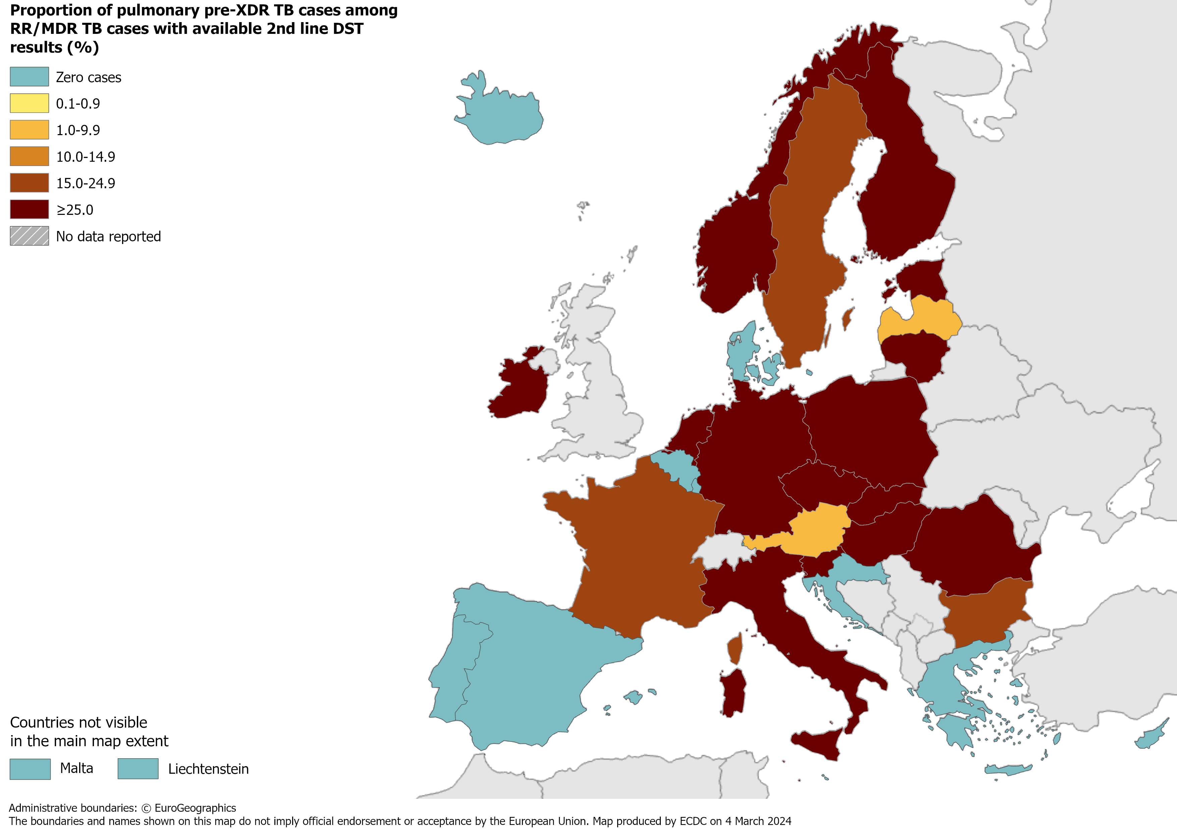
Pulmonary pre-XDR TB cases, EU/EEA, 2022
135 pre-XDR TB cases notified by all EU/EEA countries
26.9% of RR/MDR TB cases with second-line DST† results met the pre-XDR TB definition
† DST – drug susceptibility test.
Source: ECDC/WHO (2024). Tuberculosis surveillance and monitoring in Europe 2024–2022 data

Slide 15
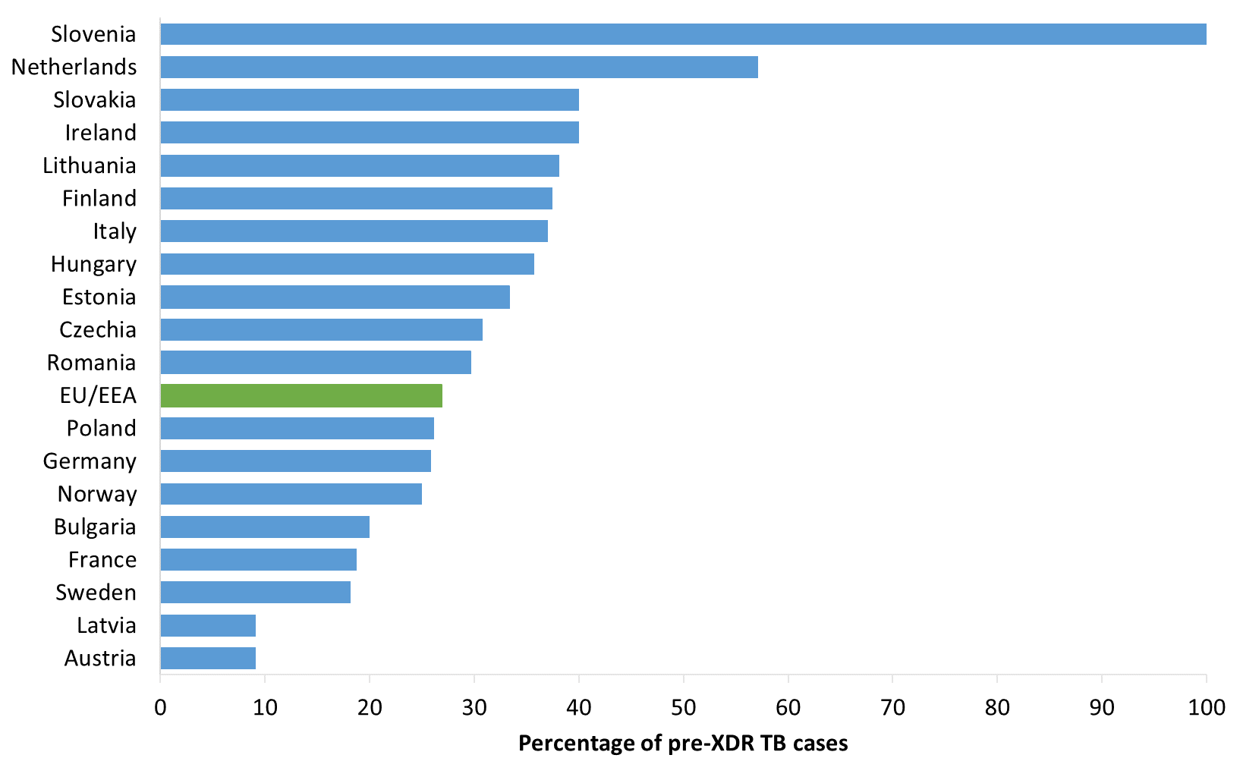
Proportion of pulmonary pre-XDR TB among RR/MDR TB cases with 2nd line DST results, EU/EEA*, 2022
135 pulmonary pre-XDR TB cases notified in 19 EU/EEA countries*
26.9% of all bacteriologically-confirmed RR/MDR TB cases with second-line DST† results (range 0.0–100.0%)
* The graph shows countries that reported pre-XDR TB cases. No pre-XDR TB cases were reported by Belgium, Croatia, Cyprus, Denmark, Greece, Iceland, Liechtenstein, Luxembourg, Malta, Portugal and Spain. † DST – drug susceptibility test.
Source: ECDC/WHO (2024). Tuberculosis surveillance and monitoring in Europe 2024–2022 data

Slide 16
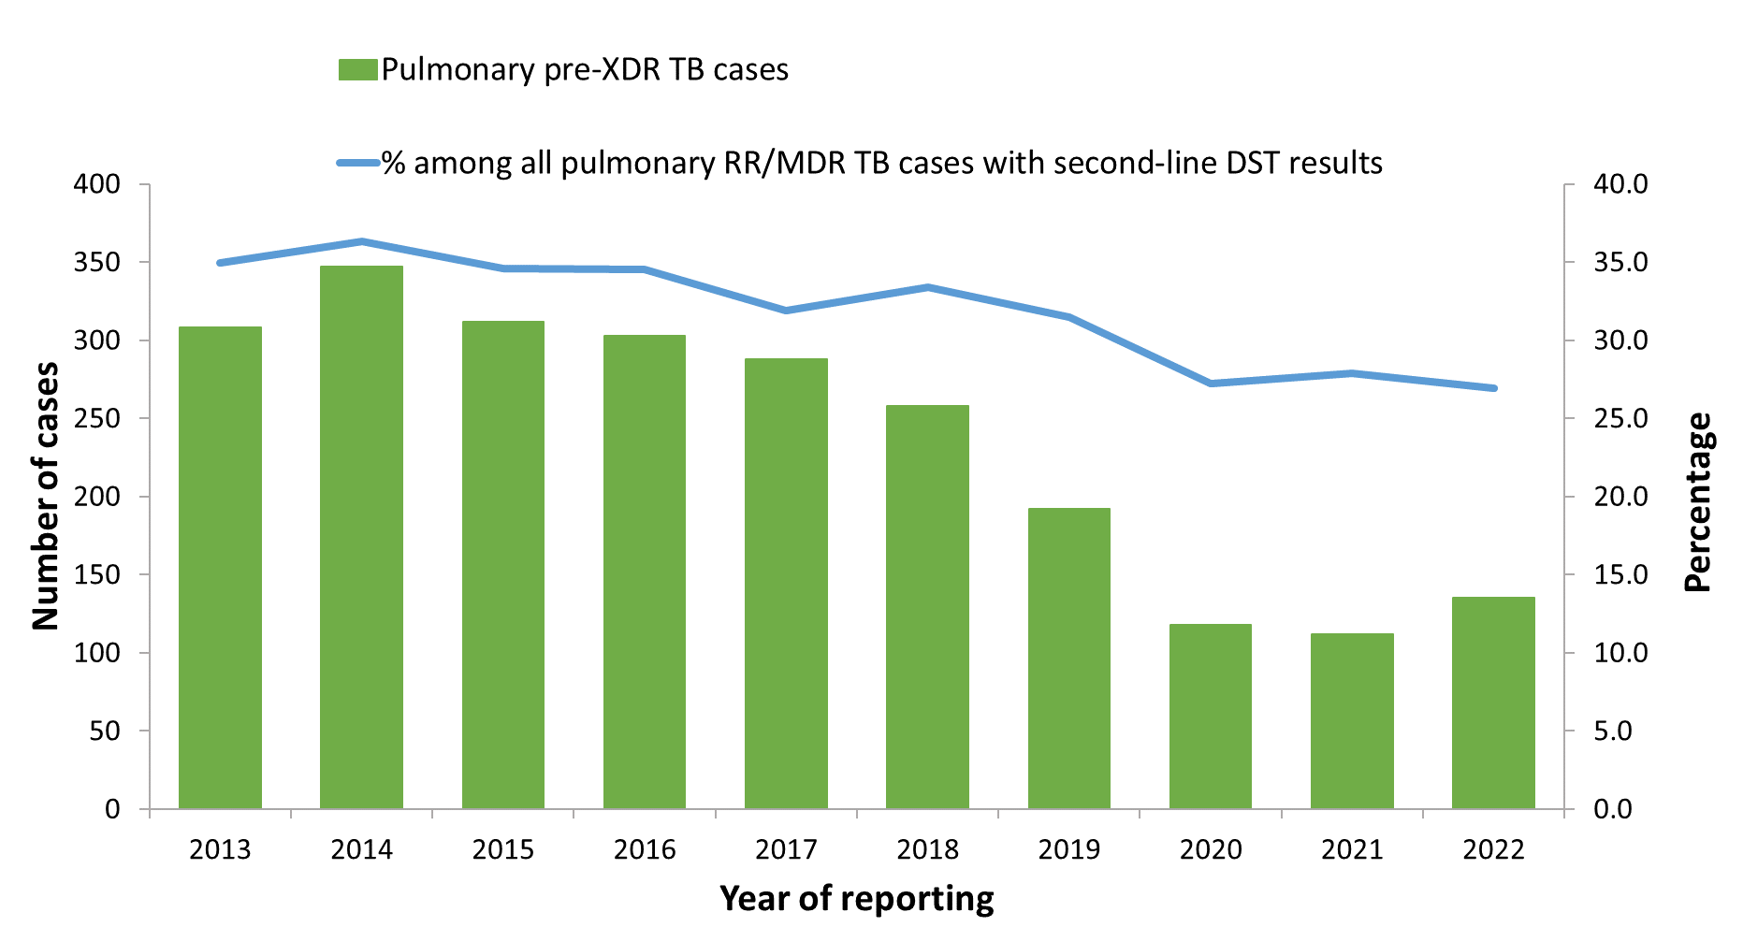
Pulmonary pre-XDR TB cases and proportion among all pulmonary RR/MDR TB cases with 2nd line DST results, EU/EEA*, 2013–2022
The total number of pulmonary pre-XDR TB cases peaked at 347 in 2014 and decreased to 112 in 2021, and was 135 in 2022
The proportion of pre-XDR TB cases among pulmonary RR/MDR TB cases ranged between 26.9% in 2022 to 36.3% in 2014
* Countries and the years for which they are not included due to reporting discrepancies or no data: Latvia (2018-2020), Liechtenstein (2019).
Source: ECDC/WHO (2024). Tuberculosis surveillance and monitoring in Europe 2024–2022 data

Slide 17
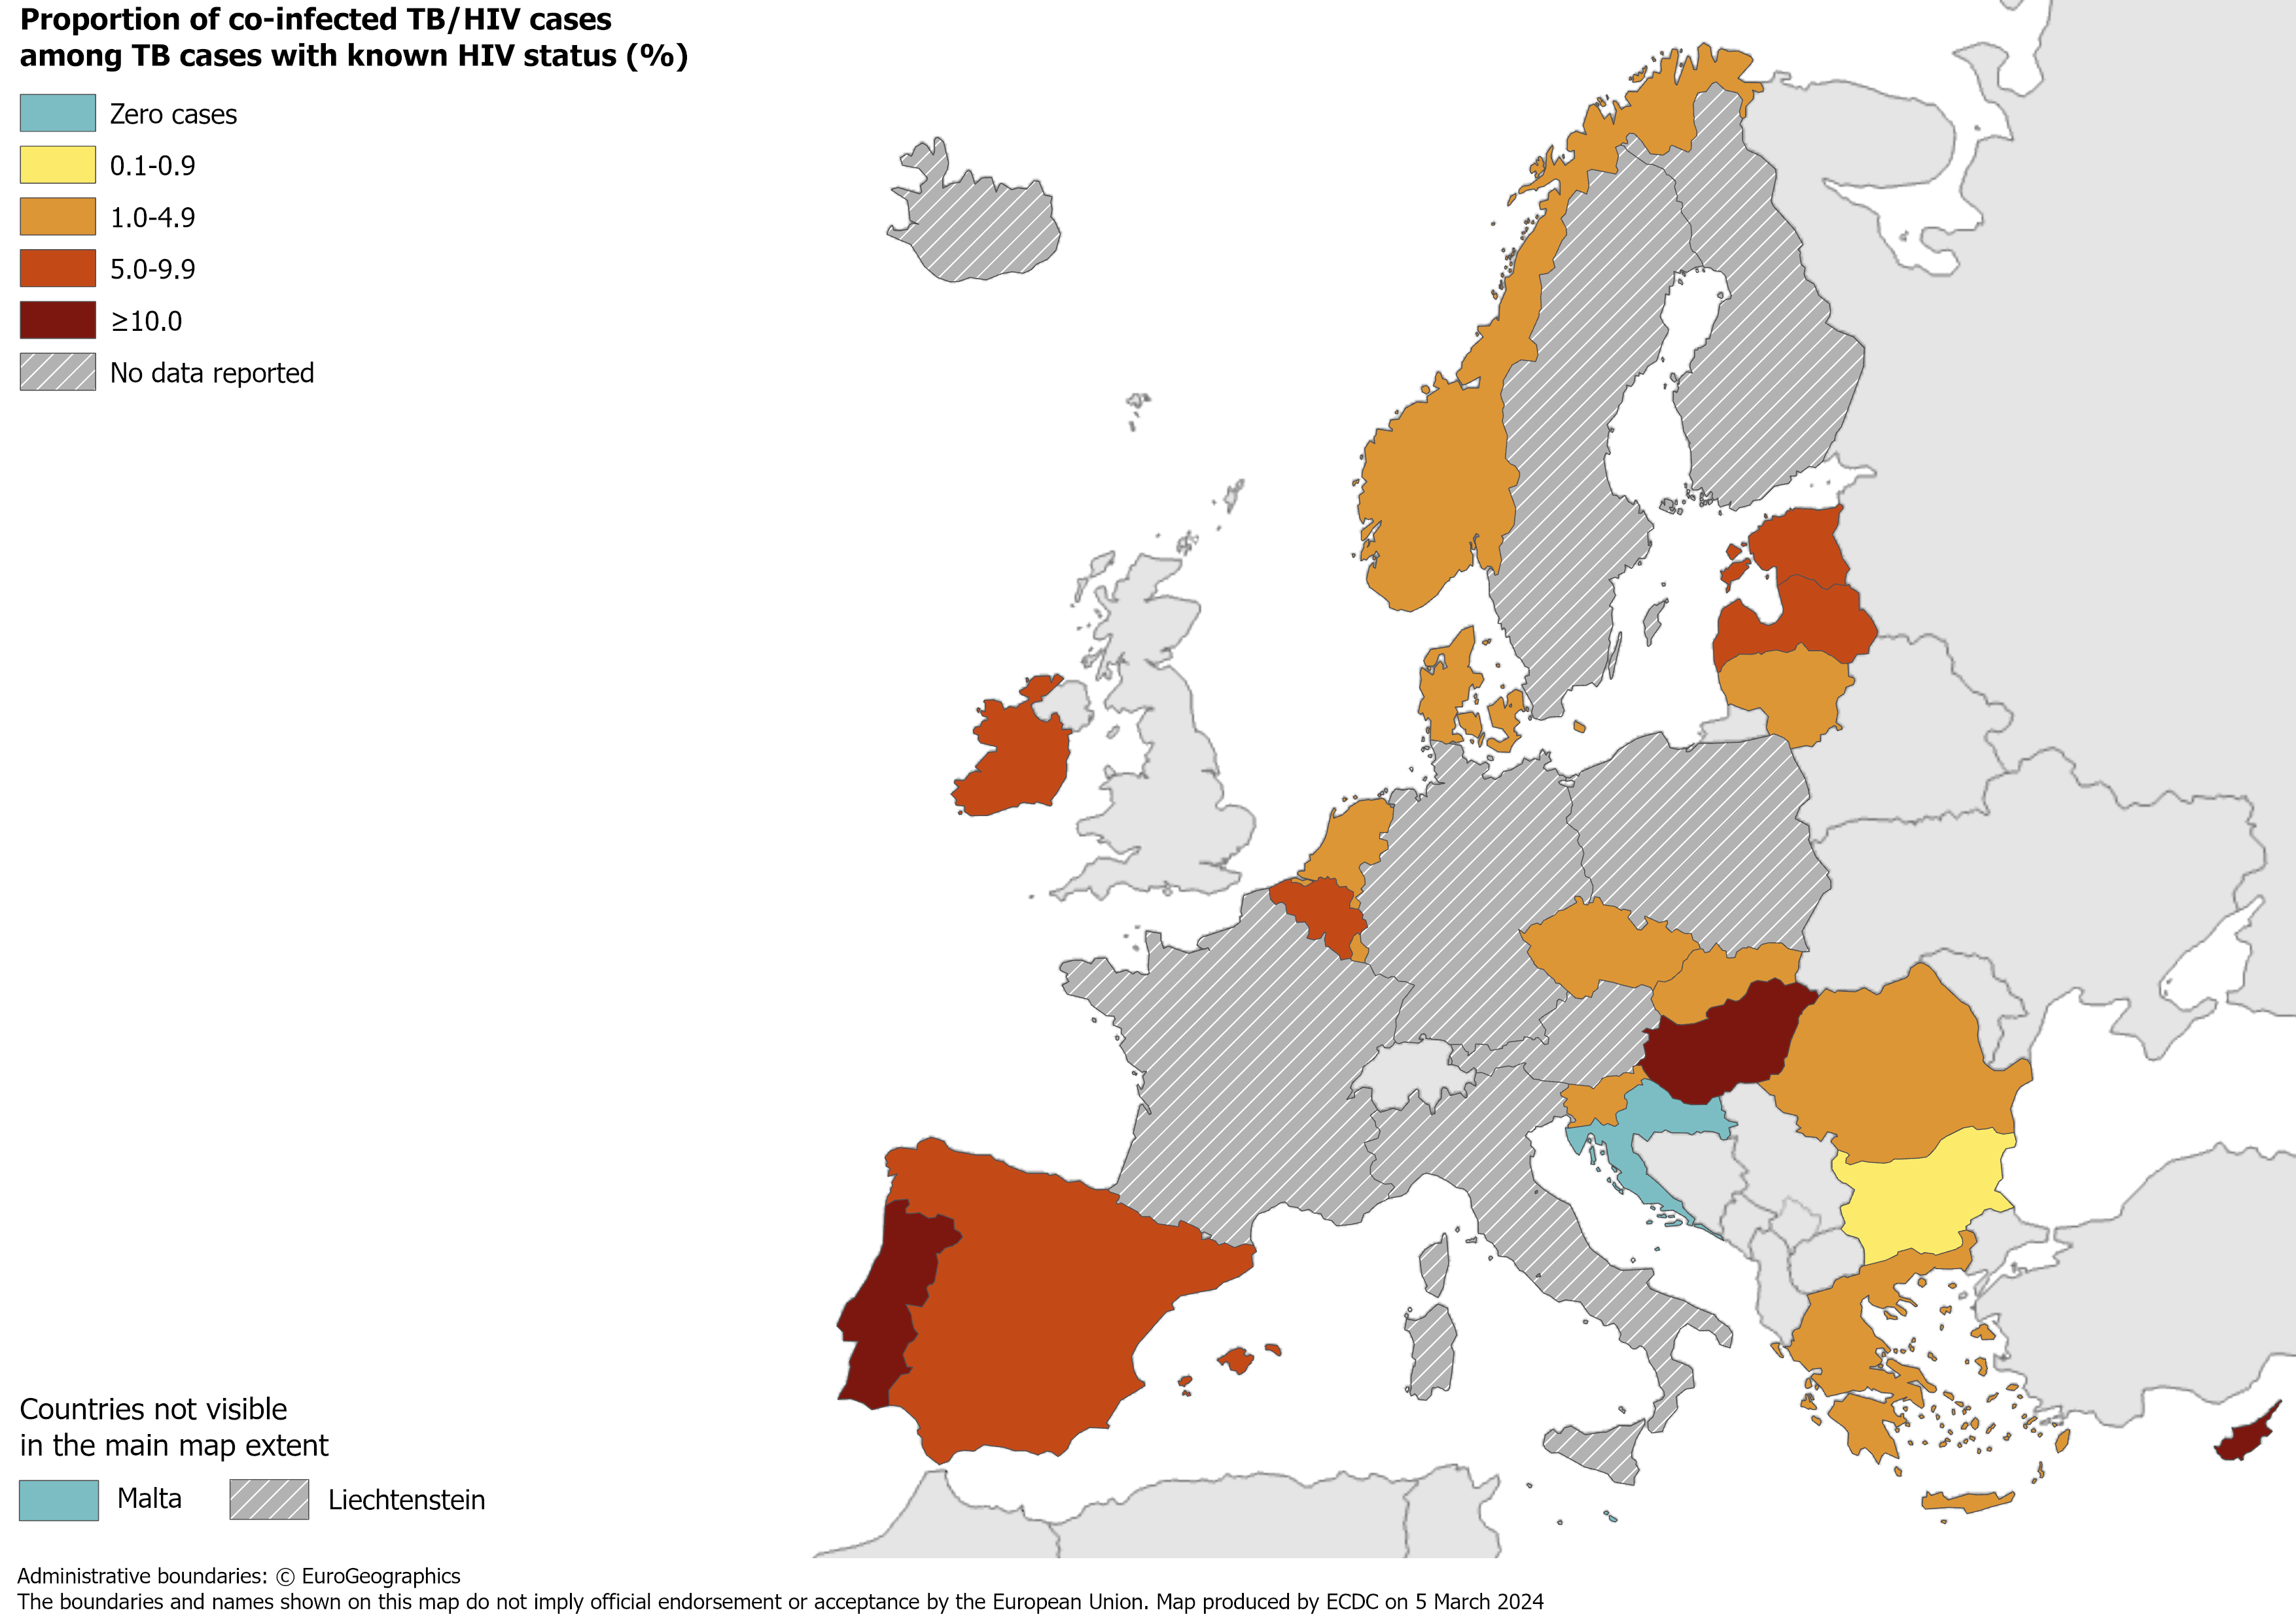
TB/HIV co-infection†, EU/EEA*, 2022
620 HIV-positive TB cases were notified by 21 EU/EEA countries in 2022
4.1% of TB cases with known HIV status were HIV-positive (range 0.0–18.5%)
* Nine countries did not report HIV status data: Austria, Finland, France, Germany, Iceland, Italy, Liechtenstein, Poland and Sweden.
† HIV-positive TB cases only includes new and relapsed cases.
Source: ECDC/WHO (2024). Tuberculosis surveillance and monitoring in Europe 2024–2022 data

Slide 18
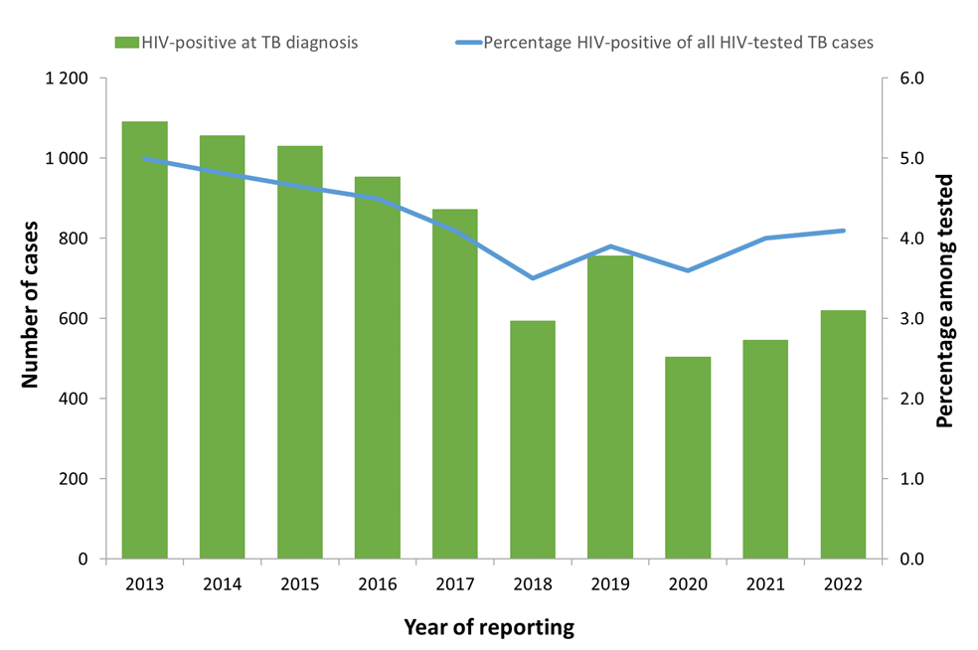
HIV-positive TB cases and proportion among all those tested, EU/EEA, 2013–2022*
The total number of HIV-positive TB cases decreased from 1 090 in 2013 to 504 in 2020 and reached 620 cases in 2022
The proportion of HIV-positive TB cases among those tested decreased from 5.0% in 2013 to 4.1% in 2022
* Countries and the years for which they are not included due to reporting discrepancies or no data: Austria (all years), Croatia (2013-2015), Cyprus (2013), Denmark (2013), Finland (all years), France (all years), Germany (all years), Hungary (2013), Iceland (2020-2022), Italy (all years), Latvia (2018-2020), Liechtenstein (all years), Poland (all years) and Sweden (all years).
Source: ECDC/WHO (2024). Tuberculosis surveillance and monitoring in Europe 2024–2022 data

Slide 19
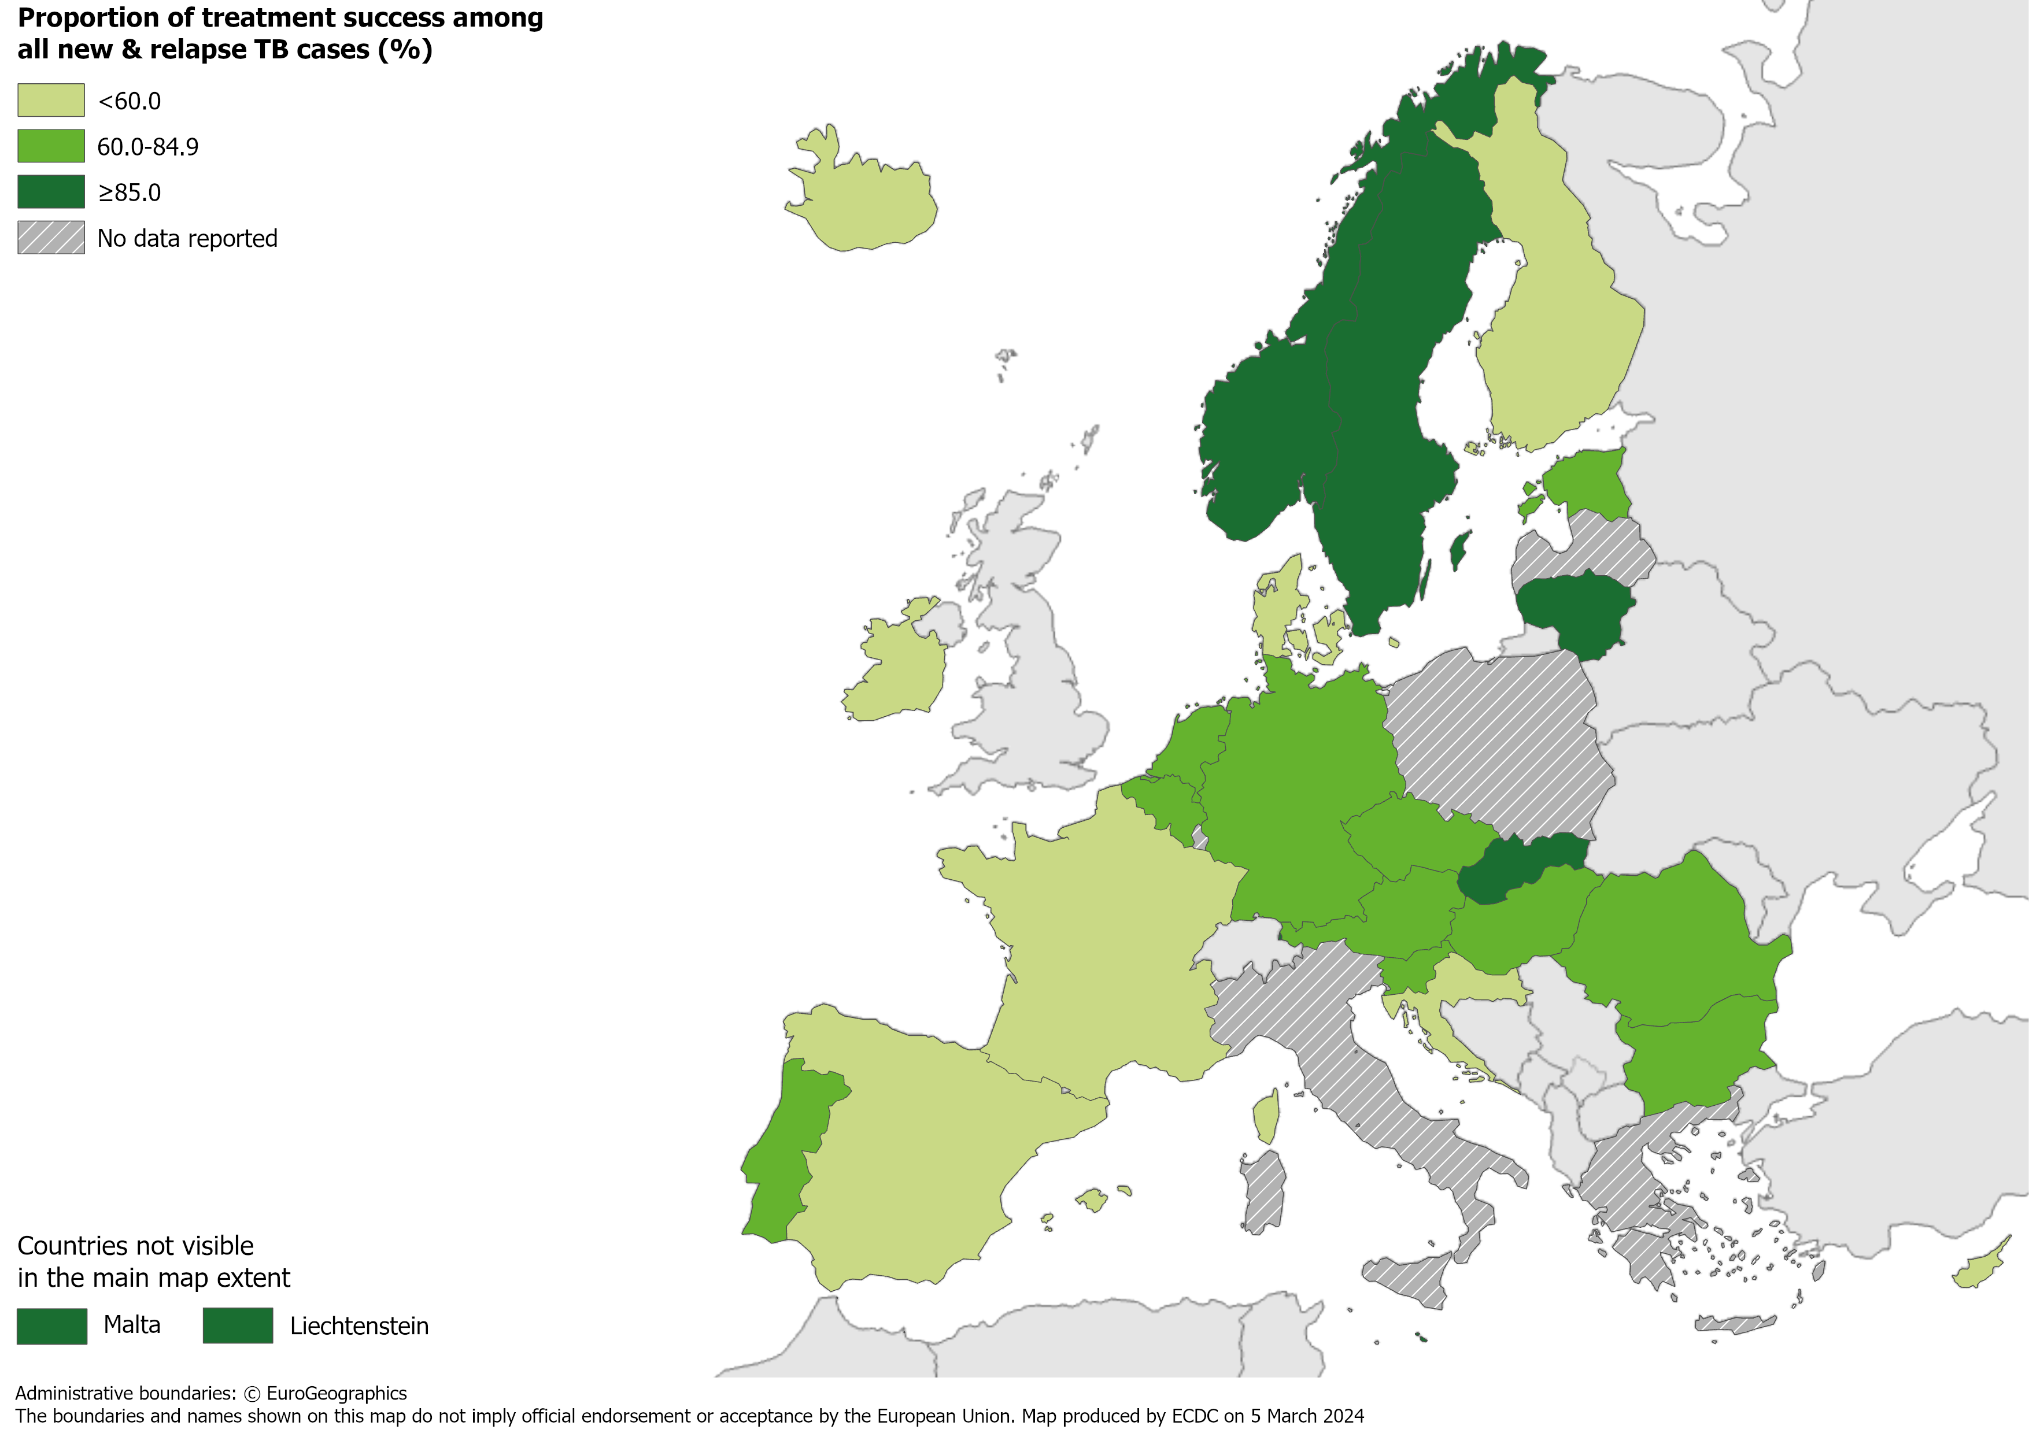
Treatment success after 12 months among new and relapse TB cases notified in 2021, EU/EEA*, 2022
64.0% of all TB cases had a successful treatment outcome after 12 months (range 3.4–100.0%)
* Five countries did not report treatment outcome data: Greece, Italy, Latvia, Luxembourg and Poland.
Source: ECDC/WHO (2024). Tuberculosis surveillance and monitoring in Europe 2024–2022 data

Slide 20
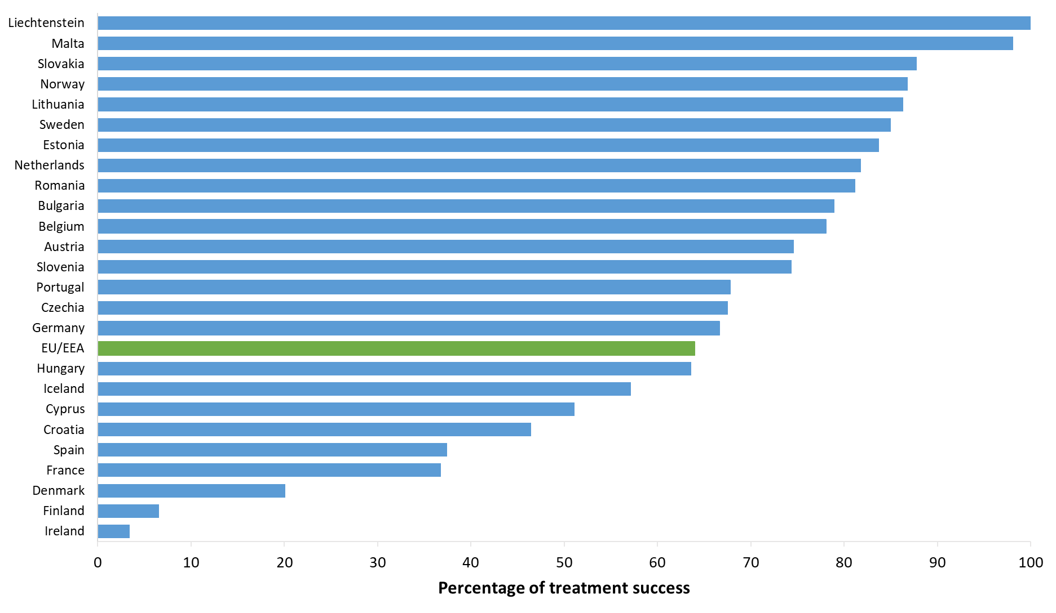
Treatment success after 12 months among new & relapse TB cases notified in 2021, EU/EEA*, 2022
64.0% of new & relapse TB cases had a successful treatment outcome after 12 months (range 3.4–100%)
* Five EU/EEA countries did not report treatment outcome data: Greece, Italy, Latvia, Luxembourg and Poland.
Source: ECDC/WHO (2024). Tuberculosis surveillance and monitoring in Europe 2024–2022 data

Slide 21
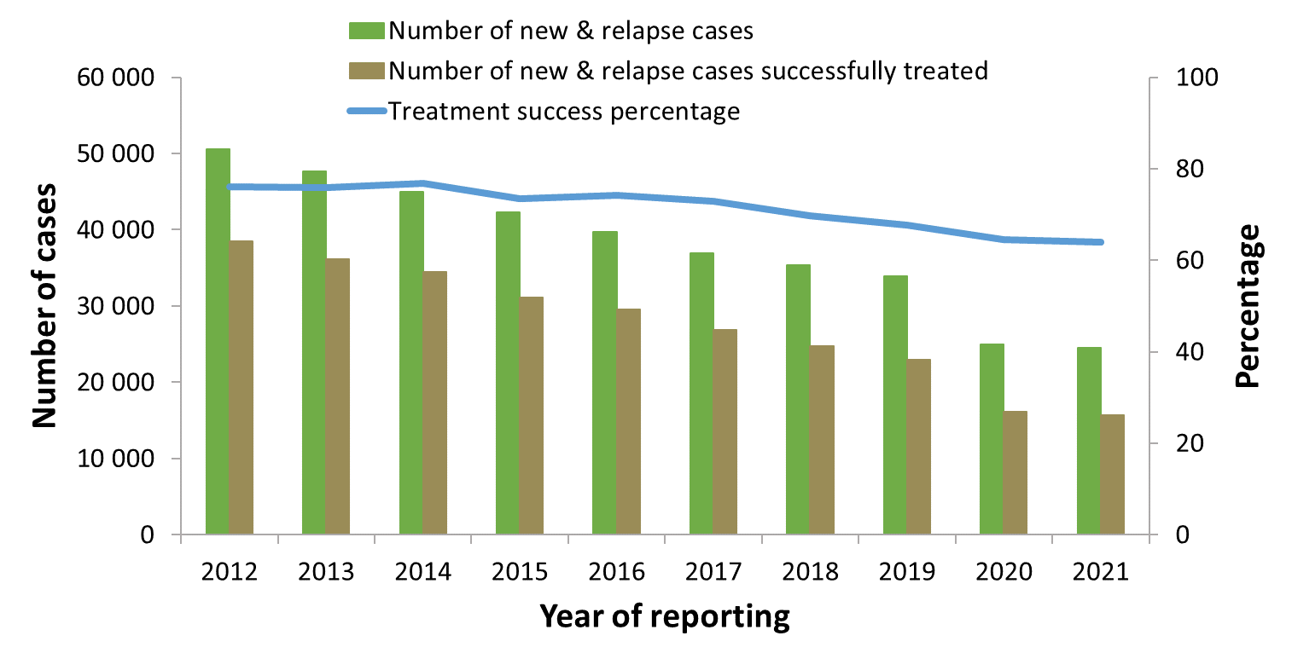
Treatment success after 12 months among new and relapse TB cases notified 2012–2021, EU/EEA*, 2022
Proportion of successfully treated cases decreased between 76.1% in 2012 to 64.0% in 2021
* Countries and the years for which they are not included due to reporting discrepancies or no data: France (all years), Greece (all years), Italy (all years), Latvia (2017-2020), Liechtenstein (2012-2014, 2018-2019), Luxembourg (2012-2018), Malta (2014-2019), Poland (2017-2021).
Source: ECDC/WHO (2024). Tuberculosis surveillance and monitoring in Europe 2024–2022 data

Slide 22
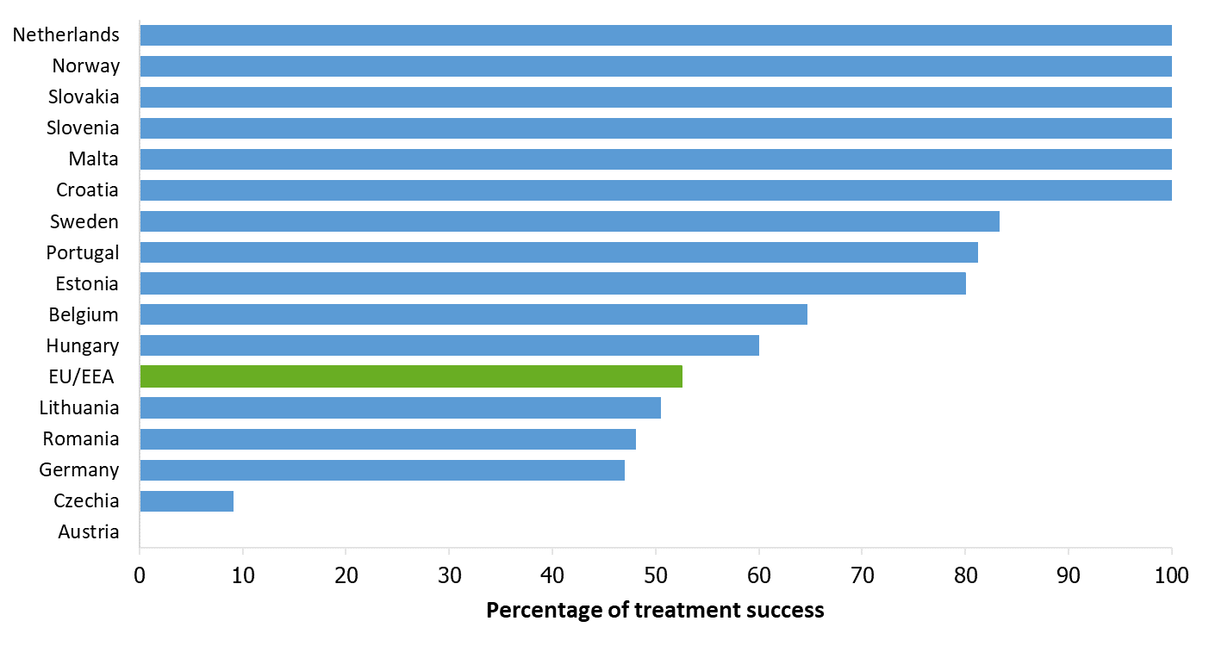
Treatment success after 24 months among RR/MDR TB cases started on second-line treatment in 2020, EU/EEA*, 2022
52.5% of all RR/MDR TB cases started on second-line treatment in 2020 were reported to have treatment success after 24 months (range 0 –100%)
* Three countries reported zero RR/MDR TB cases in 2020: Cyprus, Denmark and Iceland
Eleven countries did not report treatment outcome data: Bulgaria, Finland, France, Greece, Ireland, Italy, Latvia, Liechtenstein, Luxembourg, Poland, Spain.
Source: ECDC/WHO (2024). Tuberculosis surveillance and monitoring in Europe 2023–2022 data

Slide 23
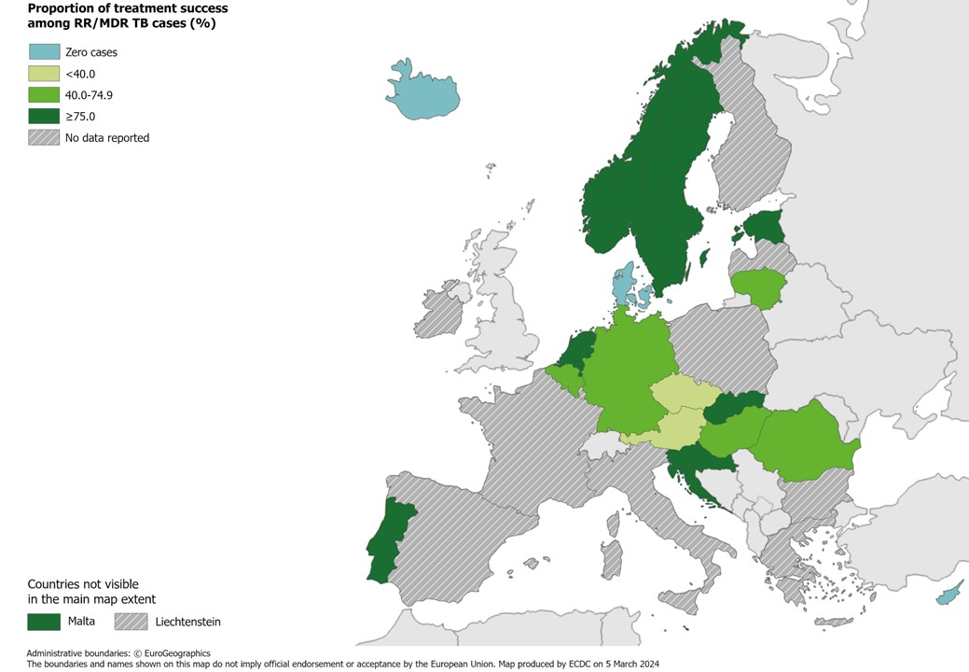
Treatment success after 24 months among RR/MDR TB cases started on second-line treatment in 2020, EU/EEA*, 2022
52.5% of all RR/MDR TB cases started on second-line treatment in 2020 were reported to have treatment success after 24 months (range 0–100%)
* Three countries reported zero RR/MDR TB cases in 2020: Cyprus, Denmark and Iceland
Eleven countries did not report treatment outcome data: Bulgaria, Finland, France, Greece, Ireland, Italy, Latvia, Liechtenstein, Luxembourg, Poland, Spain.
Source: ECDC/WHO (2024). Tuberculosis surveillance and monitoring in Europe 2024–2022 data

Slide 24
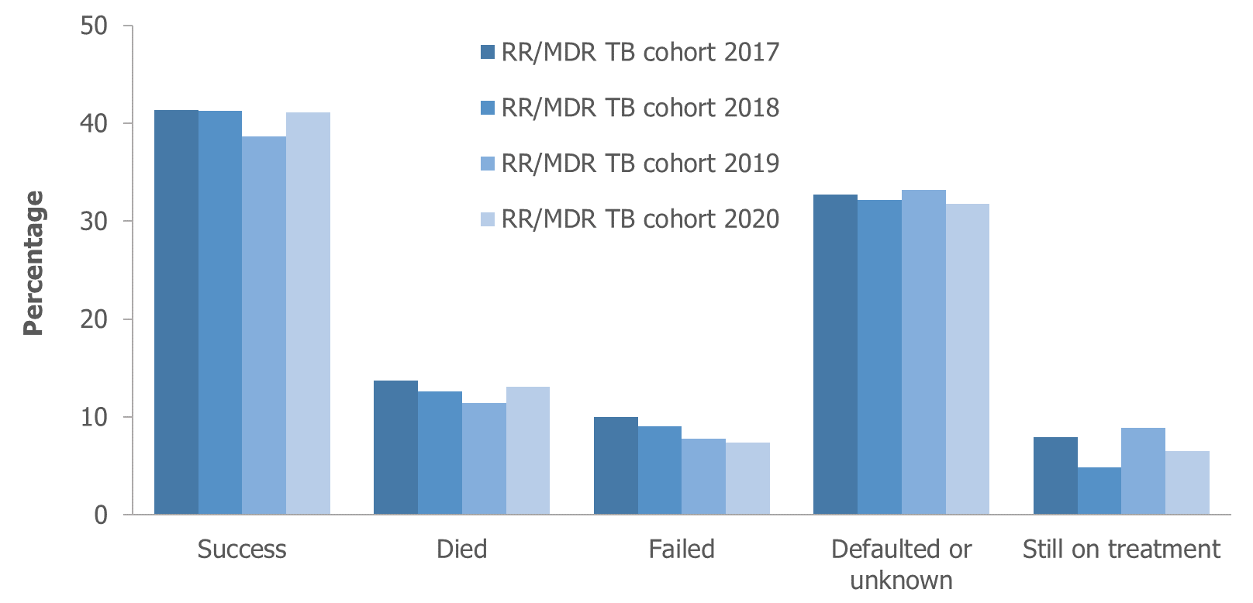
Treatment outcomes among RR/MDR TB cases* started on second-line treatment in 2017–2020, EU/EEA†, 2022
Reported treatment success remained below 50% for all RR/MDR TB cohorts between 2017-2020
* Pre-XDR and XDR TB cases are not included and, thus, treatment outcomes presented here differ from those including pre-XDR and XDR TB cases.
† Countries and the cohorts for which they are not included due to reporting discrepancies or no data: Croatia (2017), Cyprus (all years), Denmark (2020), Finland (2020), France (all years), Greece (all years), Iceland (all years), Ireland (2020), Italy (all years), Latvia (2017-2018), Liechtenstein (all years), Luxembourg (all years), Malta (all years), Poland (2017-2018), Slovenia (2017-2019), Spain (all years).
Source: ECDC/WHO (2024). Tuberculosis surveillance and monitoring in Europe 2024-2022 data

Slide 25
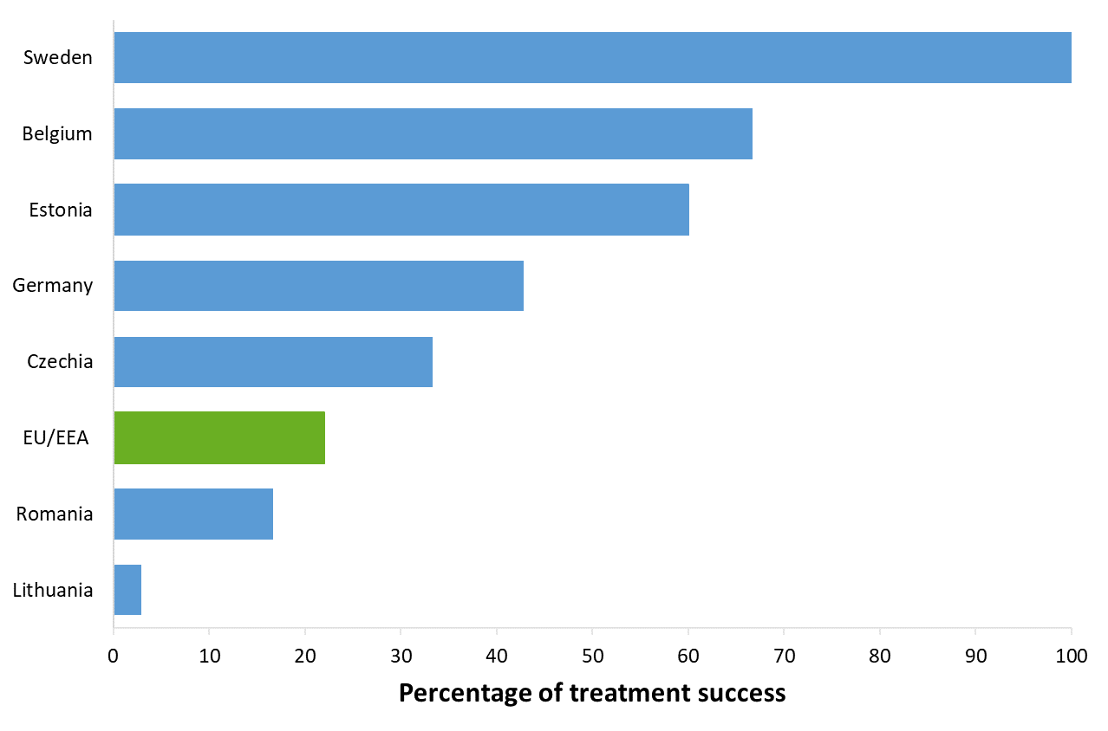
Treatment success after 24 months among pre-XDR TB cases started on second-line treatment in 2020, EU/EEA*, 2022
22.0% of the pre-XDR TB cases started on second-line treatment in 2020 were reported to have treatment success after 24 months (range 2.9-100%)*
* Twelve countries reported zero pre-XDR TB cases in 2020: Austria, Cyprus, Denmark, Finland, Hungary, Iceland, Ireland, Liechtenstein, Netherlands, Portugal, Slovakia, Slovenia.
Ten countries did not report treatment outcome data: Bulgaria, Croatia, France, Greece, Italy, Luxembourg, Malta, Norway, Poland and Spain. Latvia did not report data for 2018-2020.
Source: ECDC/WHO (2024). Tuberculosis surveillance and monitoring in Europe 2024–2022 data

Slide 26
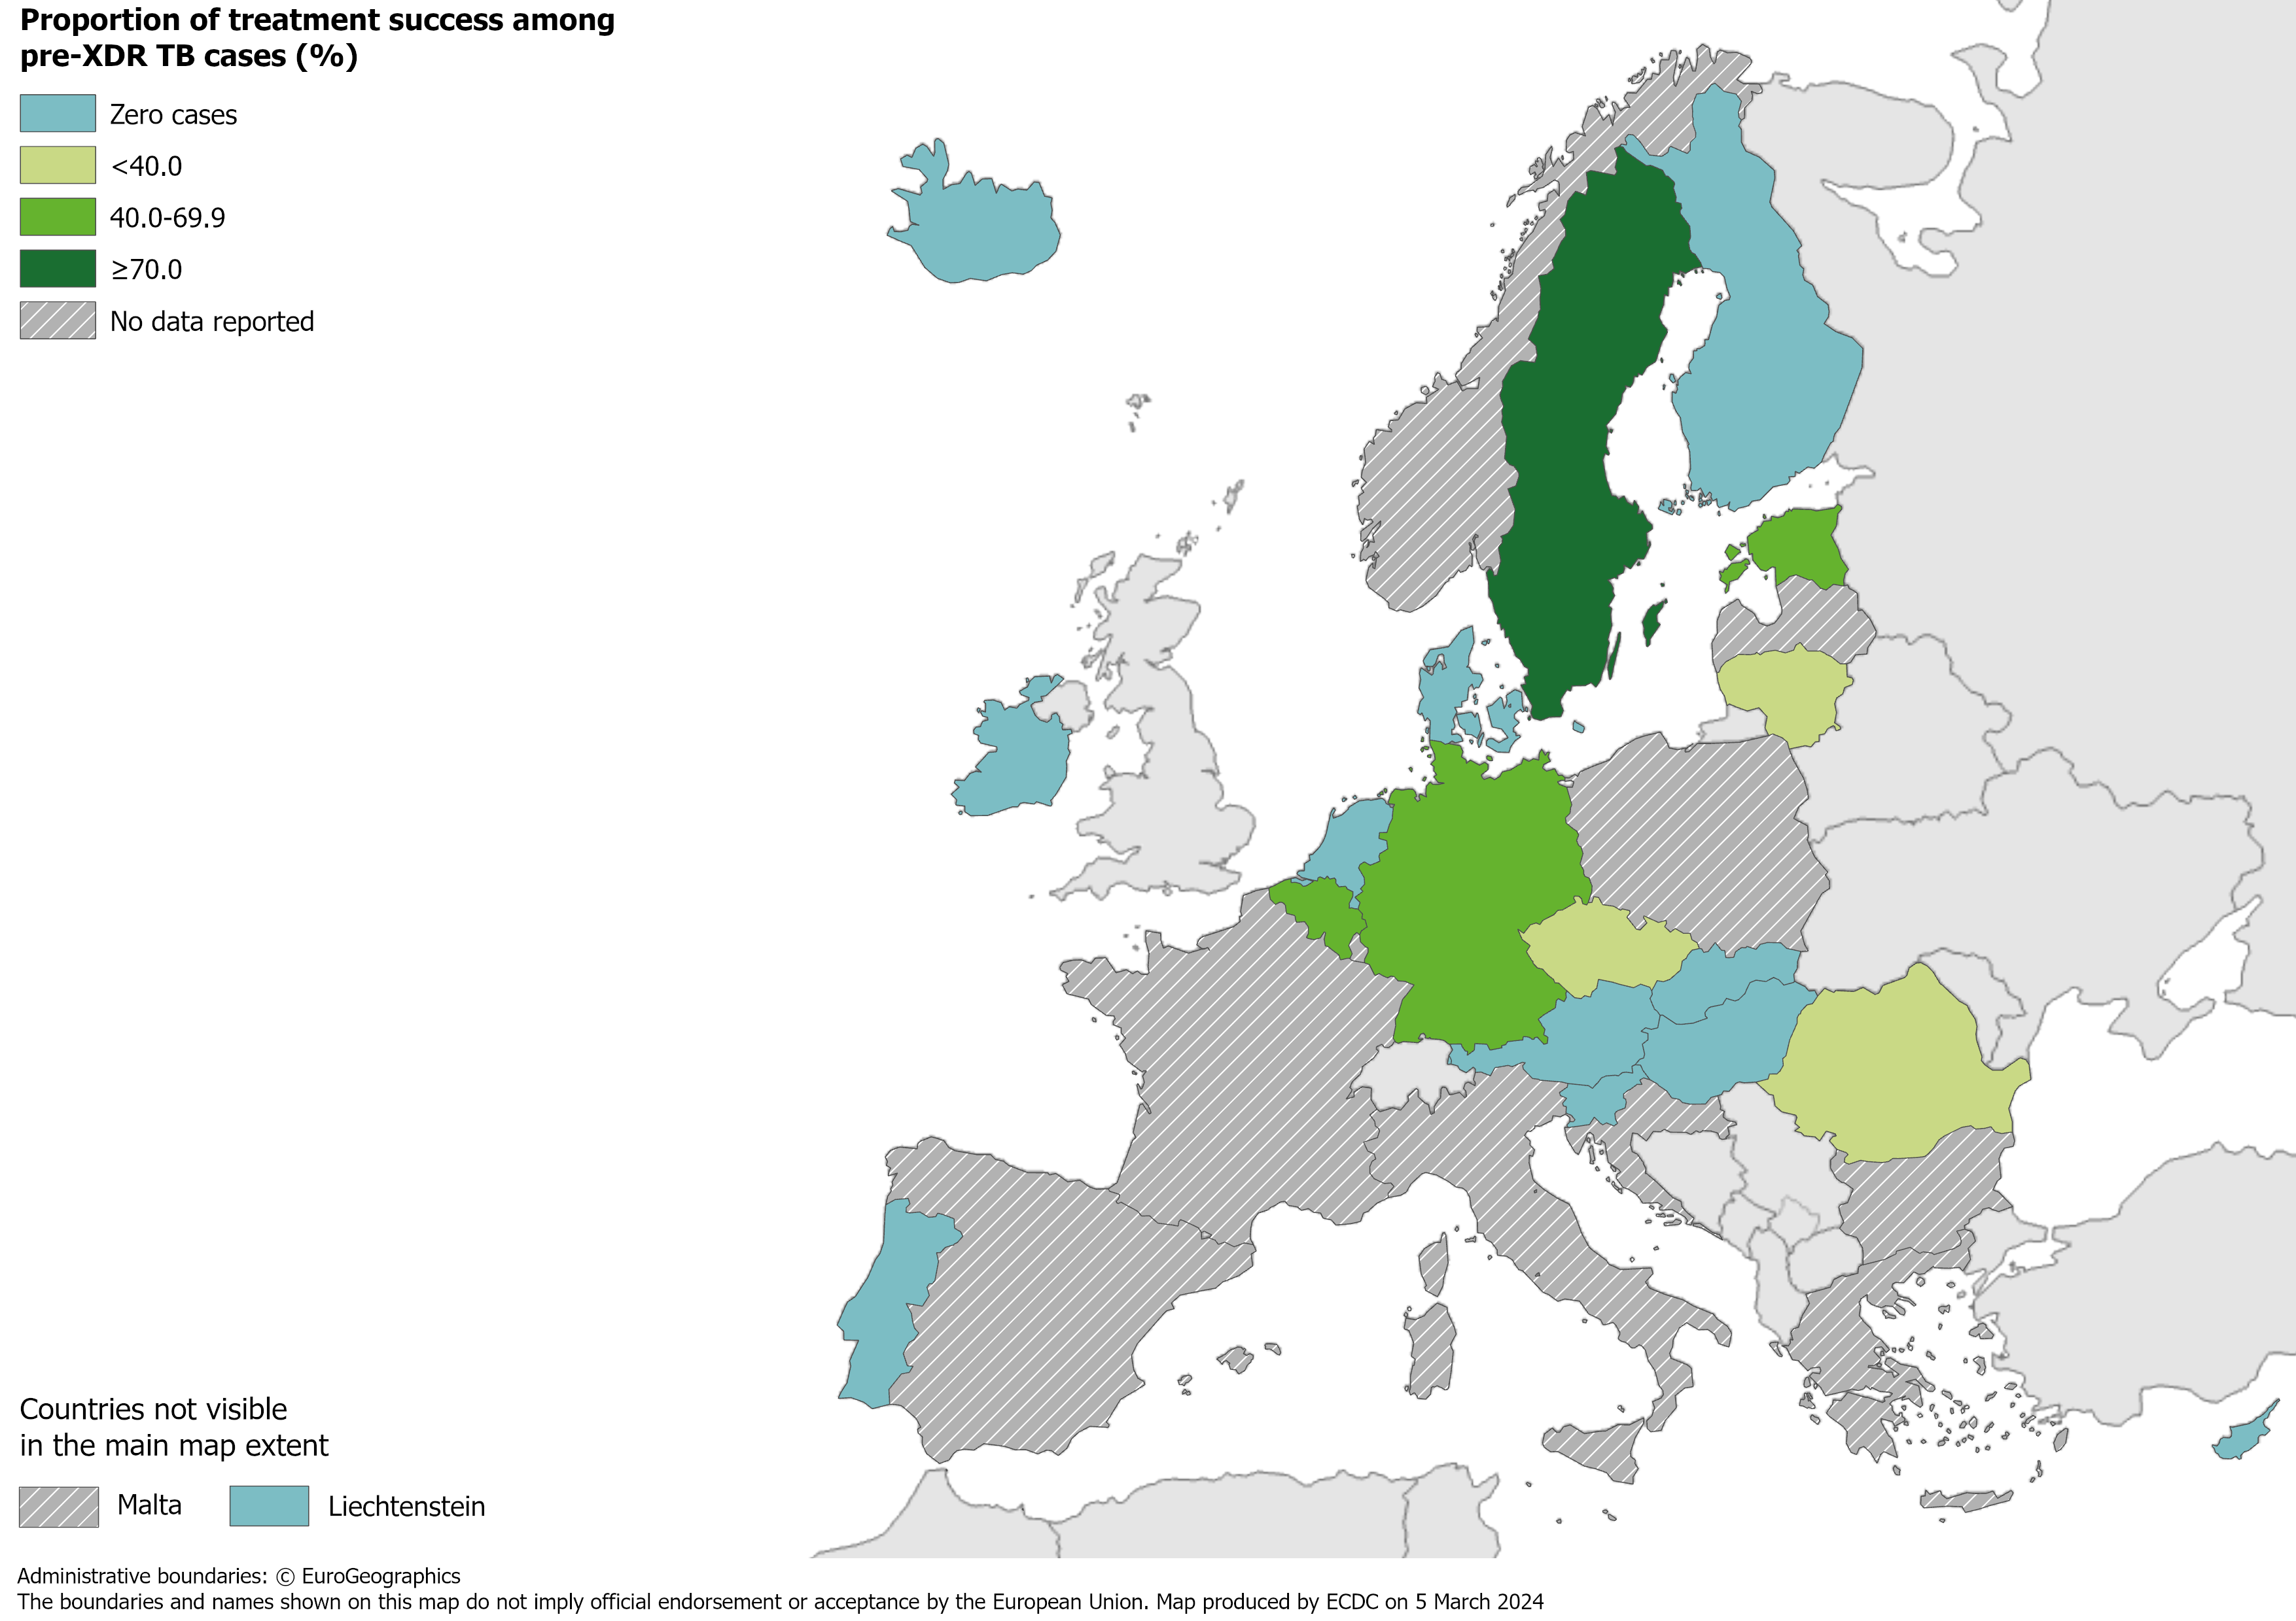
Treatment success after 24 months among pre-XDR TB cases started on second-line treatment in 2020, EU/EEA*, 2022
22.0% of all pre-XDR TB cases started on second-line treatment in 2020 were successfully treated (range 2.9–100%)
* Twelve countries reported zero pre-XDR TB cases in 2020: Austria, Cyprus, Denmark, Finland, Hungary, Iceland, Ireland, Liechtenstein, Netherlands, Portugal, Slovakia, Slovenia.
Ten countries did not report treatment outcome data: Bulgaria, Croatia, France, Greece, Italy, Luxembourg, Malta, Norway, Poland and Spain. Latvia did not report data for 2018-2020.
Source: ECDC/WHO (2024). Tuberculosis surveillance and monitoring in Europe 2024–2022 data

Slide 27
Treatment outcomes new & relapse TB, RR/MDR, pre-XDR, XDR TB cases, EU/EEA*, 2022
 | New & relapse TB, 12 months | RR/MDR TB, 24 months | Pre-XDR TB, 24 months | XDR TB, 36 months
Cases started on treatment | 24 468 | 566 | 91 | 2
Countries reporting cases | 25 | 17 | 7 | 1
Countries reporting 0 cases | 0 | 3 | 12 | 18
Treatment success | 64.0% | 52.5% | 22.0% | 0.0%
* Latvia did not report any data for 2018-2020.

