Slide 1
Tuberculosis situation in the EU/EEA, 2020
Findings from the joint report Tuberculosis surveillance and monitoring in Europe by ECDC and WHO Regional Office for Europe
Stockholm, 23 March 2022

Slide 2
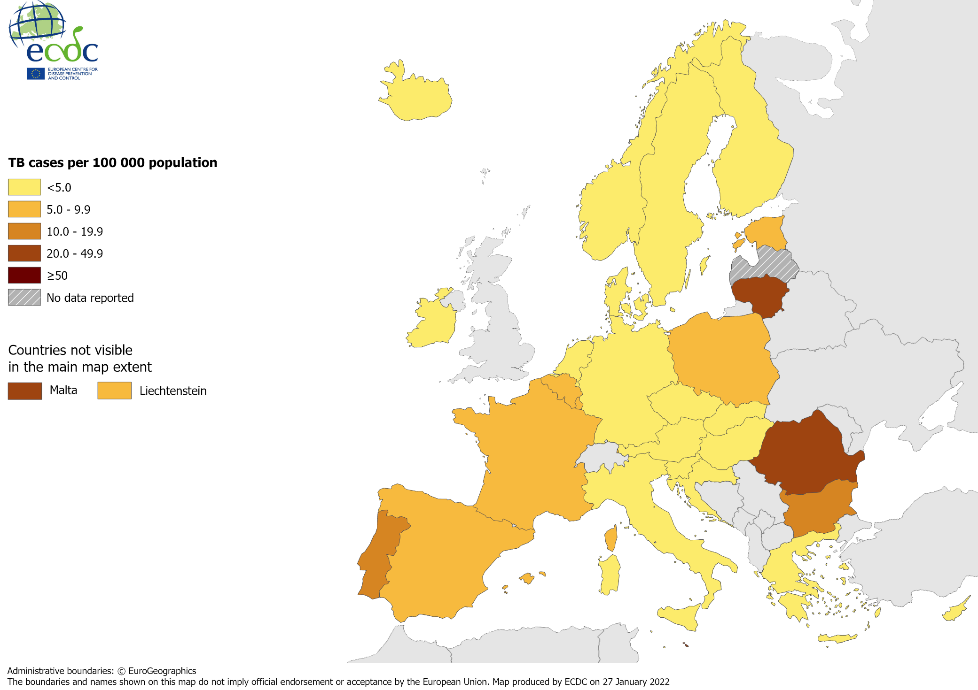
TB notifications, EU/EEA*, 2020
33 148 TB cases notified in 29 EU/EEA countries
Notification rate 7.3 per 100 000 population (range 2.9–39.8)
* Latvia did not report data for 2020.
Source: ECDC/WHO (2022). Tuberculosis surveillance and monitoring in Europe 2022–2020 data

Slide 3
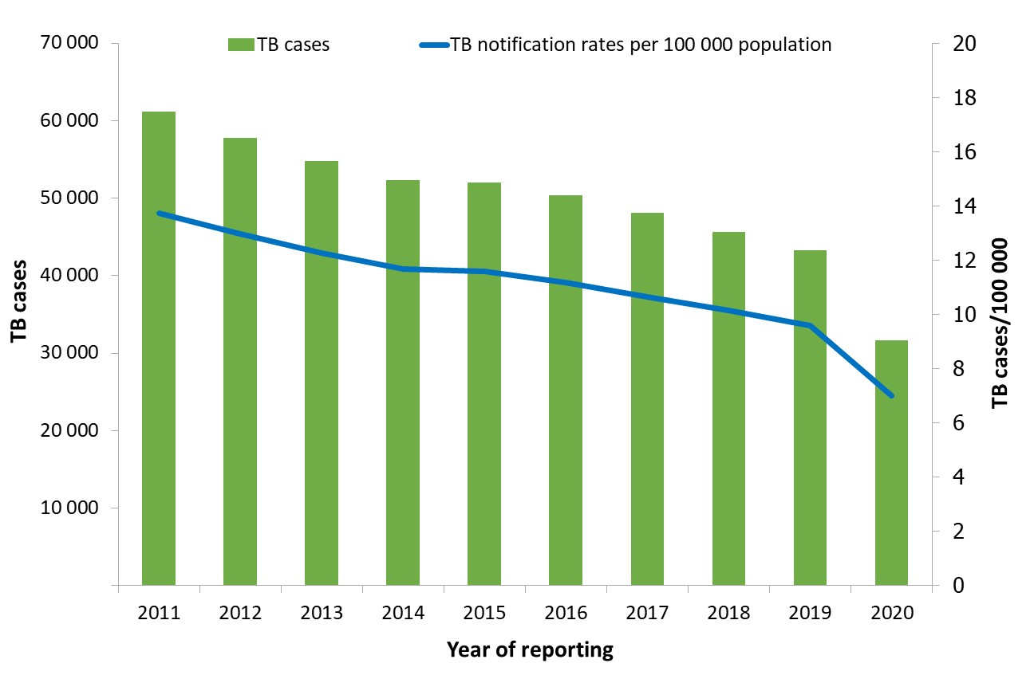
Notified TB cases, EU/EEA*, 2011–2020
Continuous decline between 2011 and 2020:
Number of TB cases decreased by 49%
Notification rate decreased by 49%
* Latvia did not report data for 2018, 2019 or 2020, Liechtenstein did not report data for 2019.
Source: ECDC/WHO (2022). Tuberculosis surveillance and monitoring in Europe 2022–2020 data

Slide 4
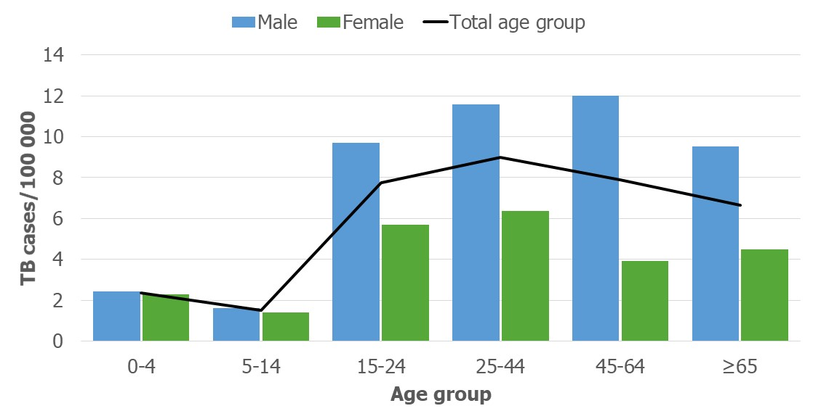
TB notification rate by sex and age group, EU/EEA*, 2020
The highest notification rate was observed in the age group 25–44 years (9.0 per 100 000)
Males were over-represented in all age groups over 14 years
* Latvia did not report data for 2020.
4
Source: ECDC/WHO (2022). Tuberculosis surveillance and monitoring in Europe 2022–2020 data

Slide 5
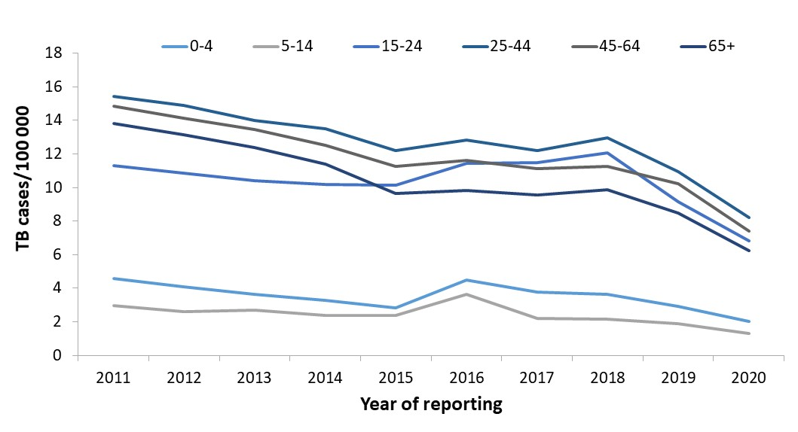
TB notification rate by age group, EU/EEA*, 2011–2020
Annual average decrease of between 5.4 to 8.7% in all age groups
* Latvia did not report data for 2018-2020, Liechtenstein did not report data for 2019.
Source: ECDC/WHO (2022). Tuberculosis surveillance and monitoring in Europe 2022–2020 data

Slide 6
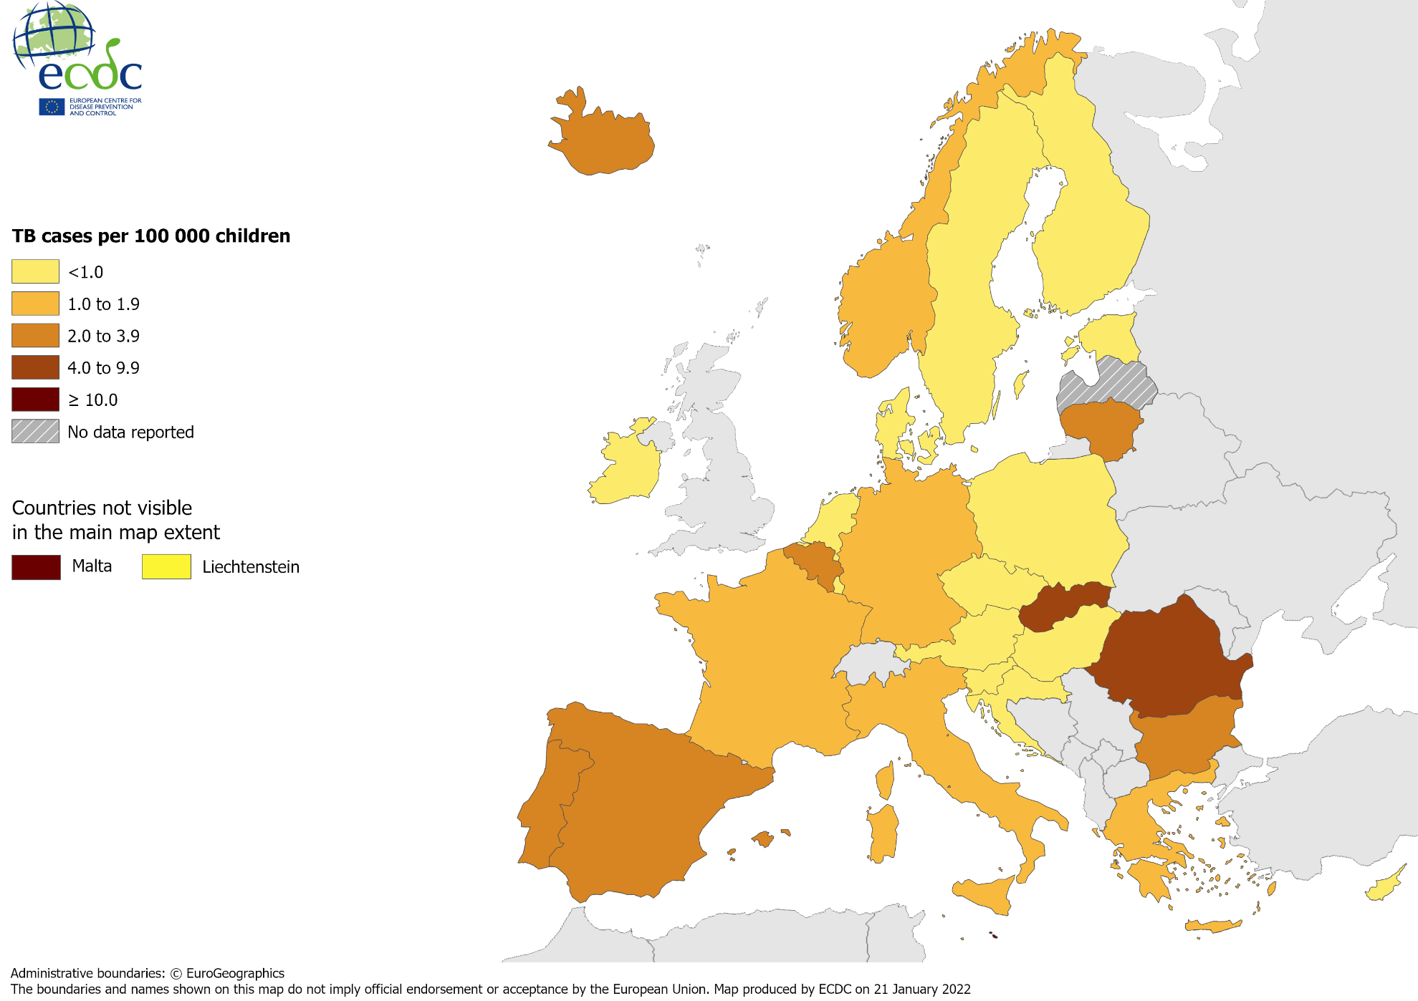
TB in children under 15 years, EU/EEA*, 2020
1 218 TB cases notified in children under 15 years
3.8% of all TB cases (range 0.0–22.9%)
1.5 per 100 000 child population (range 0.0–10.1)
* Latvia did not report data for 2020.
Source: ECDC/WHO (2022). Tuberculosis surveillance and monitoring in Europe 2022–2020 data

Slide 7
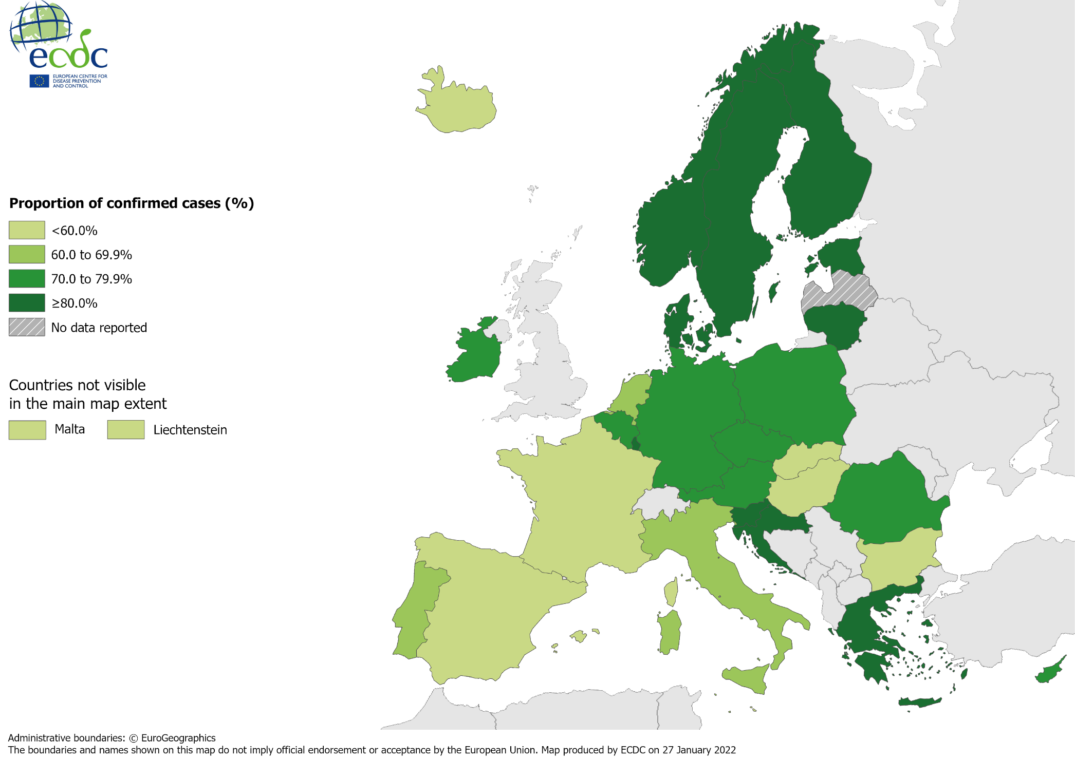
Confirmed TB cases*, EU/EEA†, 2020
22 301 TB cases were confirmed
67.3% of all TB cases (range 30.7–94.8%)
* Confirmation by culture, or by microscopy and Mycobacterium tuberculosis nucleic acid amplification test. † Latvia did not report data for 2020.
Source: ECDC/WHO (2022). Tuberculosis surveillance and monitoring in Europe 2022–2020 data

Slide 8
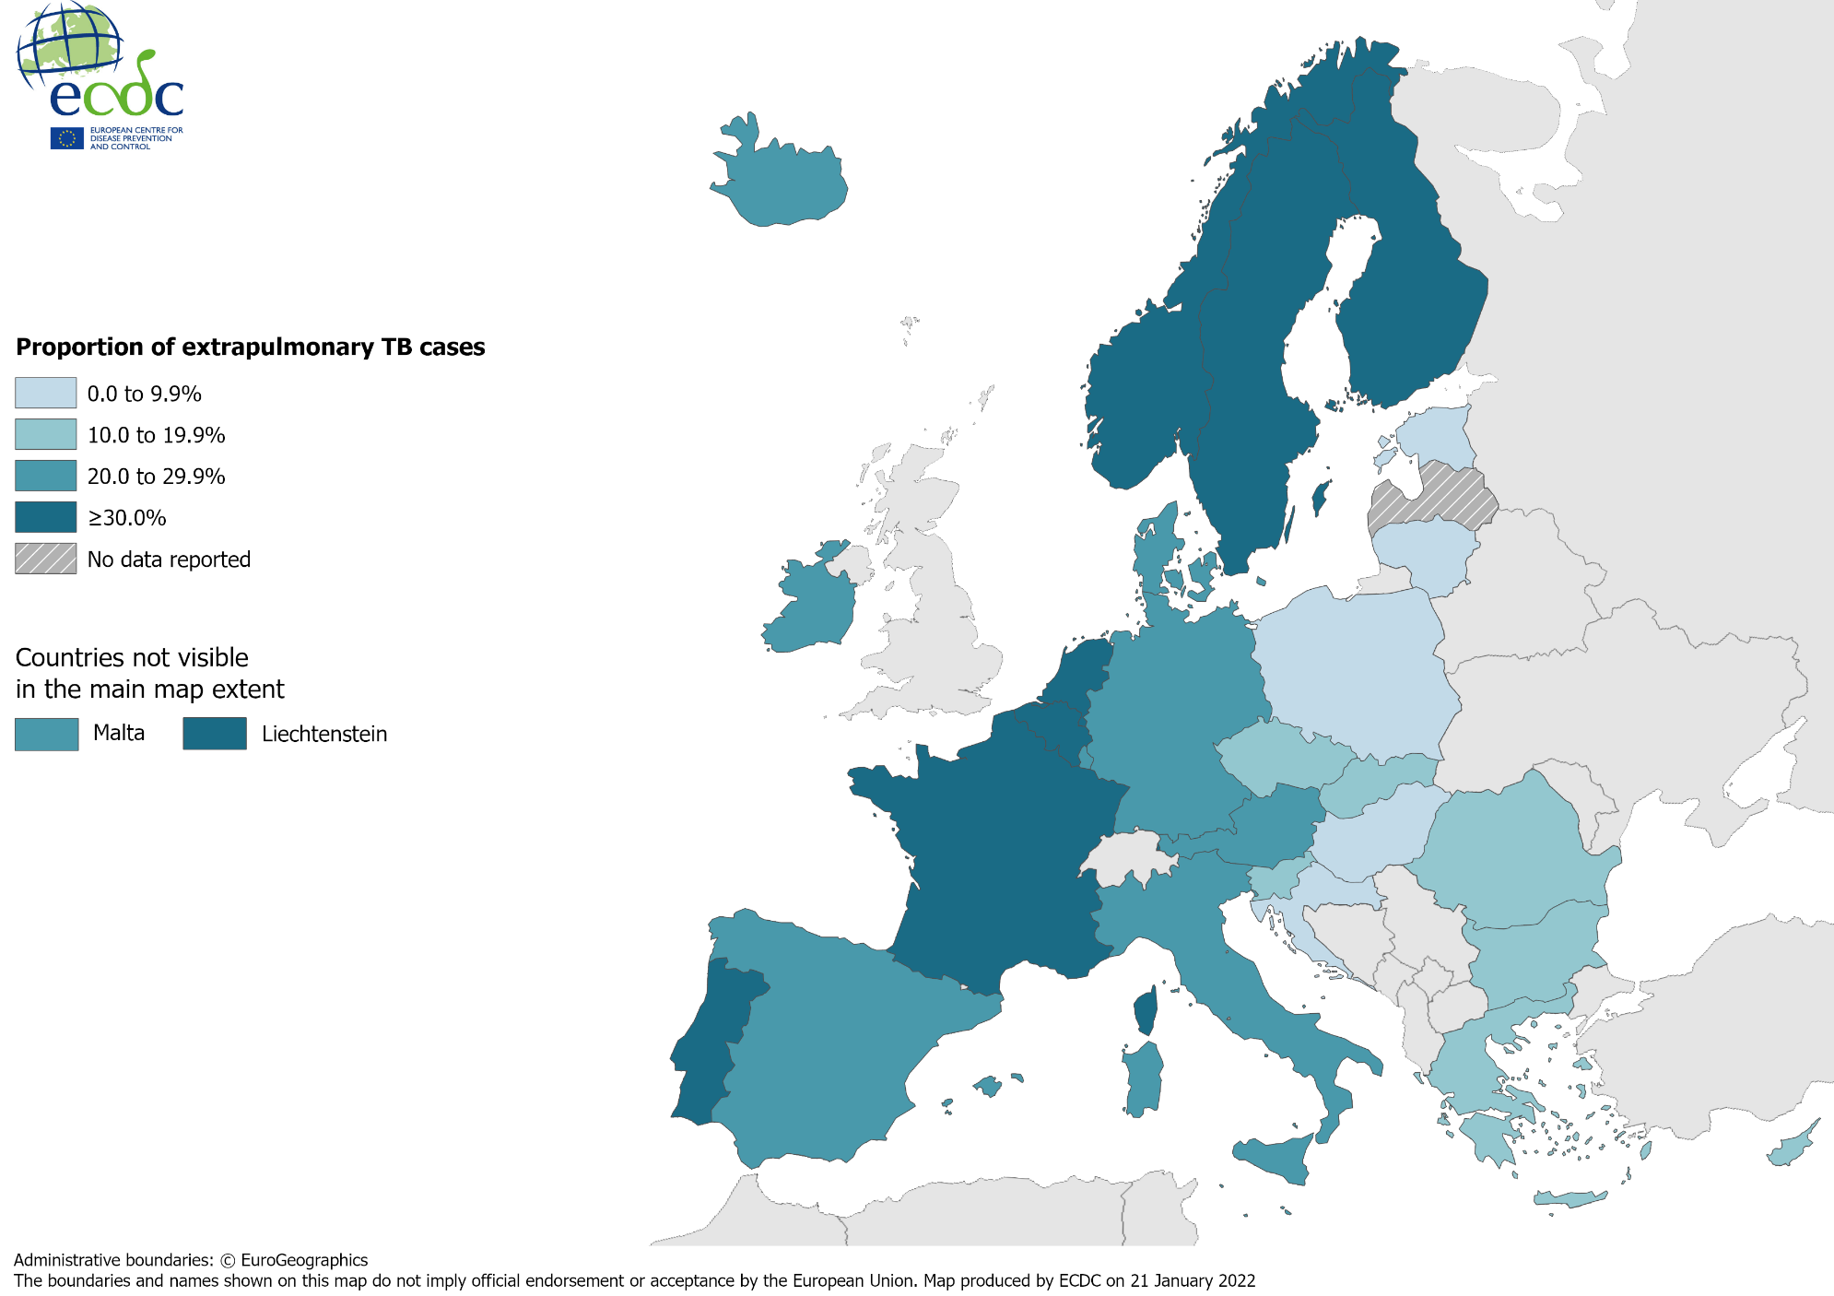
Extrapulmonary TB, EU/EEA*, 2020
7 117 notified cases had extrapulmonary TB
21.5% of all TB cases (range 1.1–100%)
* Latvia did not report data for 2020.
Source: ECDC/WHO (2022). Tuberculosis surveillance and monitoring in Europe 2022–2020 data

Slide 9
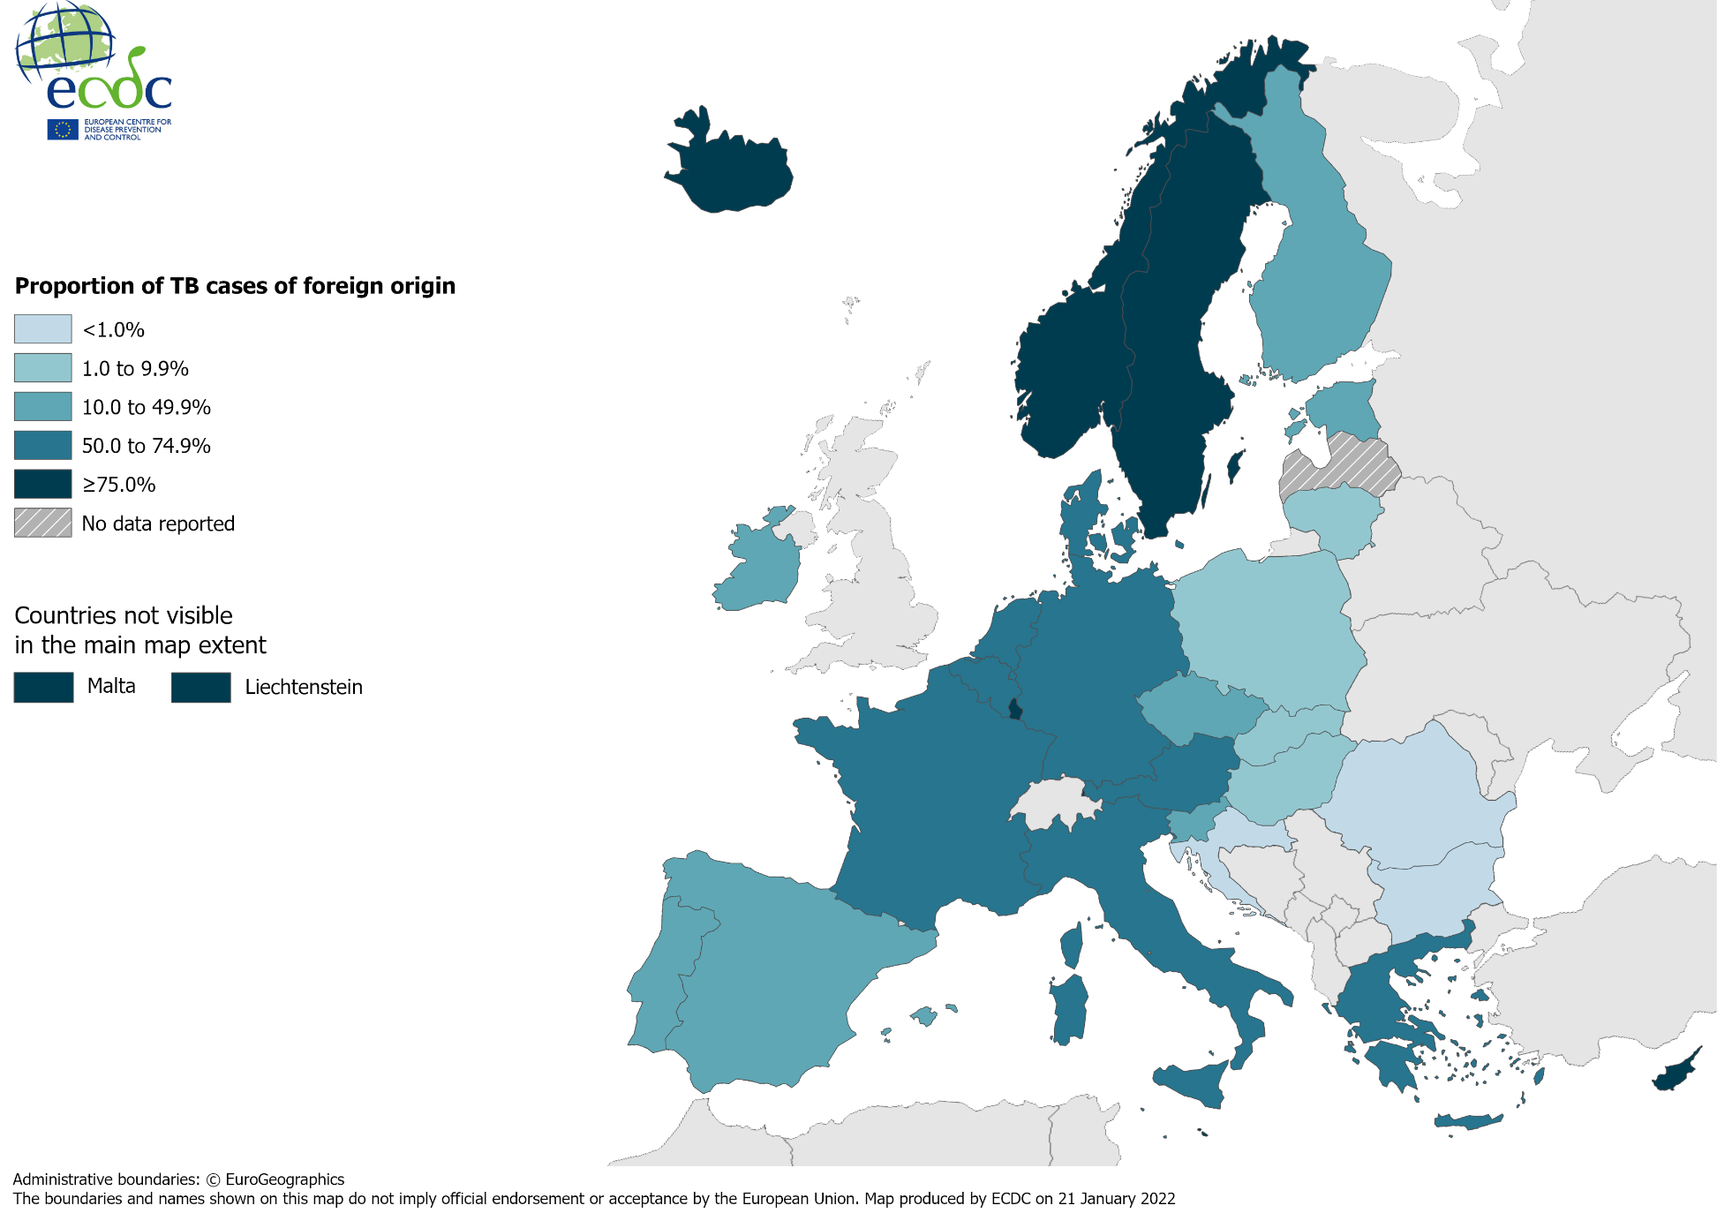
TB in persons of foreign origin*, EU/EEA†, 2020
10 942 TB cases of foreign* origin
33.0% of all TB cases (range 0.0–100%)
* Notified in persons originating from other countries than the reporting country. † Latvia did not report data for 2020.
Source: ECDC/WHO (2022). Tuberculosis surveillance and monitoring in Europe 2022–2020 data

Slide 10
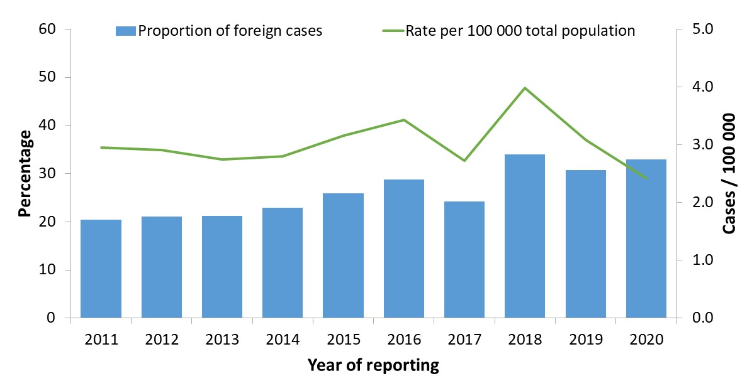
TB cases in persons of foreign origin*, EU/EEA†, 2011–2020
The proportion of cases in persons of foreign origin increased from 20.4% in 2011 to 33.0% in 2020
The rate of TB cases of foreign origin per 100 000 of the total population varied between 2.4 and 4.0
* Notified in persons originating from other countries than the reporting country. † Croatia is not included for 2011. Latvia did not report data for 2018-2020. Liechtenstein did not report data for 2019.
Source: ECDC/WHO (2022). Tuberculosis surveillance and monitoring in Europe 2022–2020 data

Slide 11
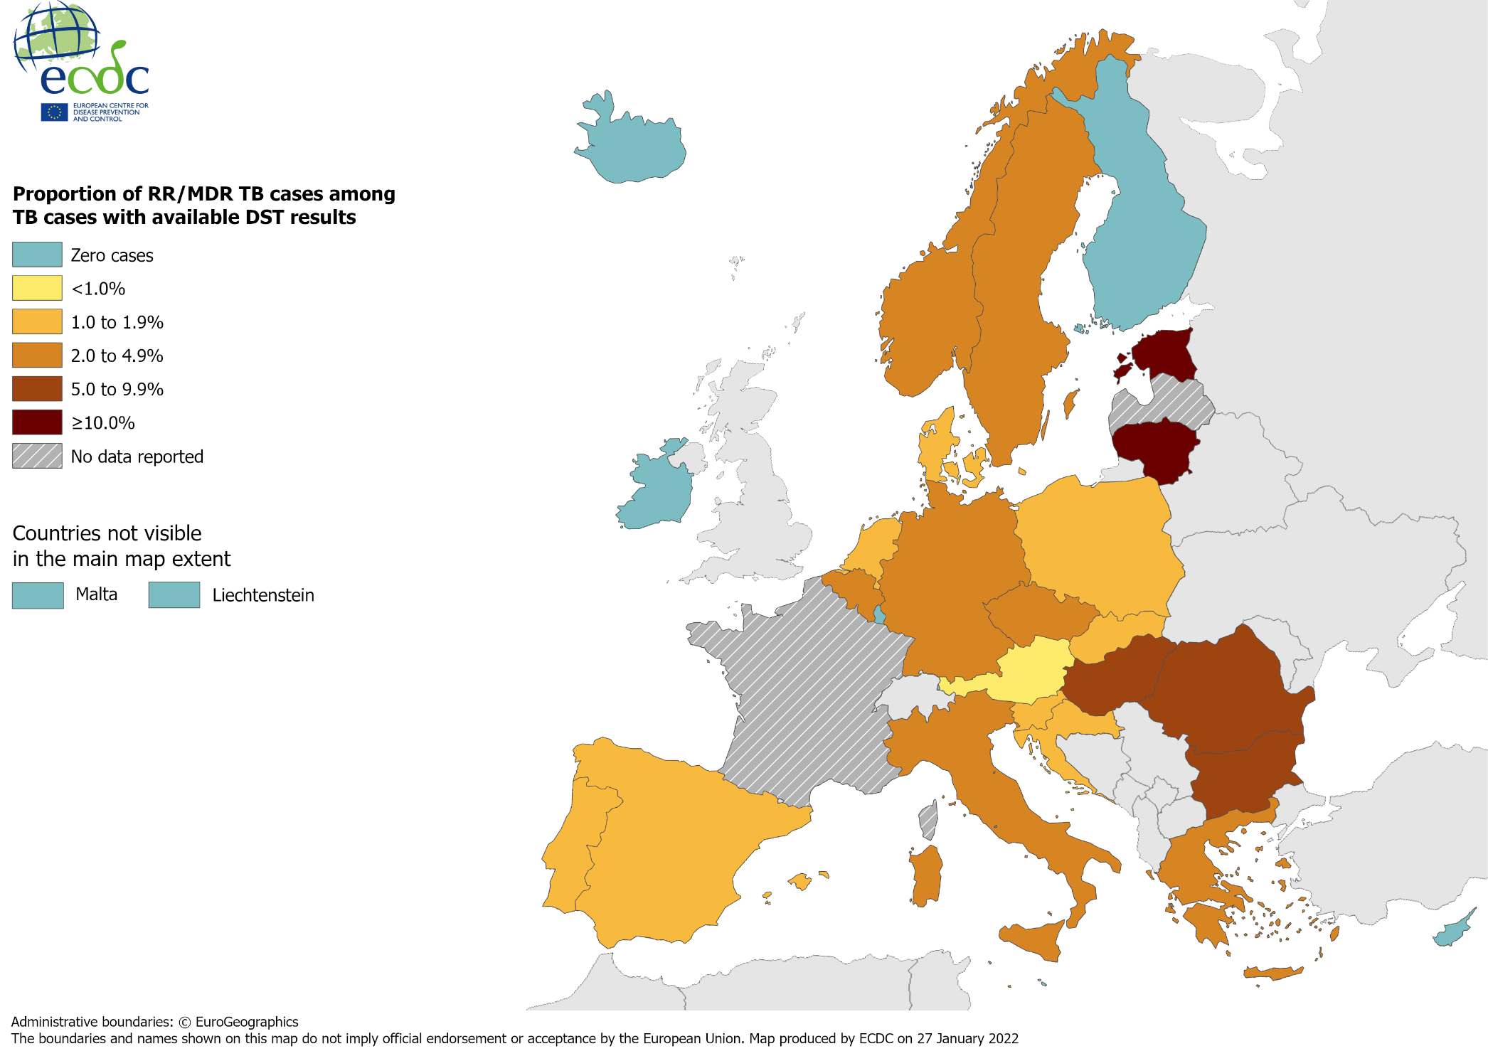
Pulmonary RR/MDR TB cases, EU/EEA*, 2020
649 pulmonary RR/MDR TB cases notified by 29 EU/EEA countries*
4.6% of all TB cases with available DST† results had RR/MDR TB (range 0.0–19.4%, excluding France)
* Data from France included in the total cases notified and percentage, but not included in the range or the map, as DST results are only available for RR/MDR cases. Latvia did not report data for 2020. † DST – drug susceptibility test.
Source: ECDC/WHO (2022). Tuberculosis surveillance and monitoring in Europe 2022–2020 data

Slide 12
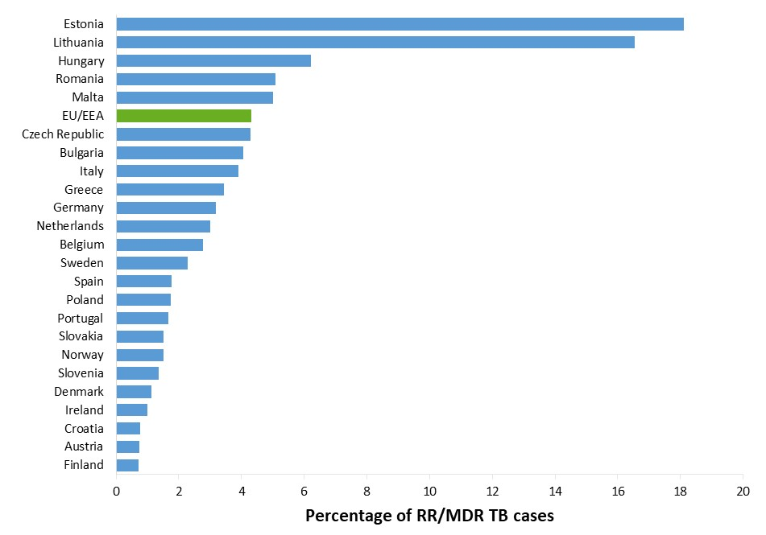
Proportion of RR/MDR TB, EU/EEA*, 2020
731 RR/MDR TB cases notified by 29 EU/EEA countries
4.3% of all bacteriologically-confirmed TB cases with available DST† results had RR/MDR TB (range 0–18.1%)
* RR/MDR TB data from France is not included in the graph. Cyprus, Iceland, Liechtenstein and Luxembourg reported zero RR/MDR TB cases for 2020. Latvia did not report data for 2020. † DST – drug susceptibility test.
Source: ECDC/WHO (2022). Tuberculosis surveillance and monitoring in Europe 2022–2020 data

Slide 13
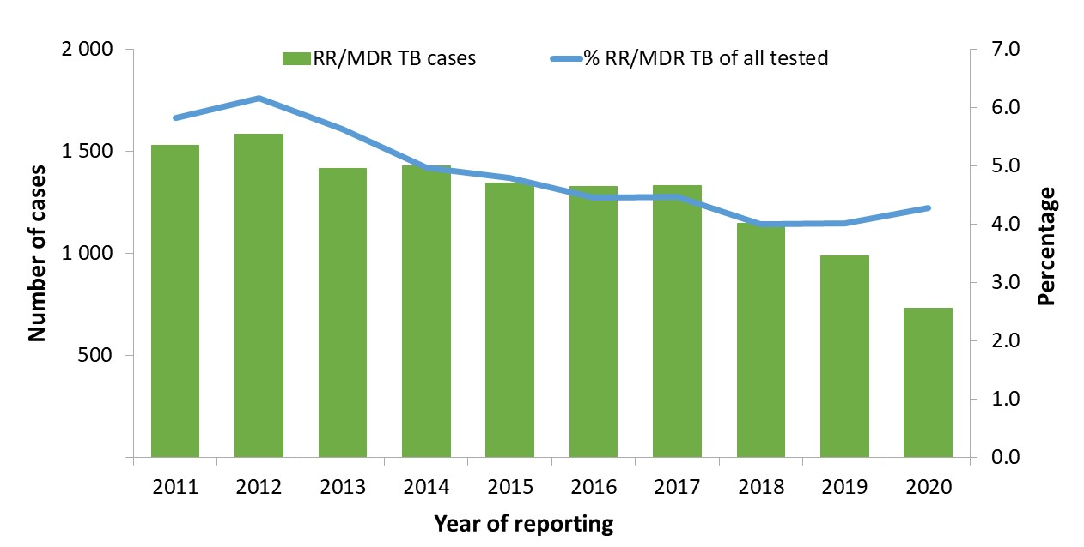
RR/MDR TB cases and proportions of all TB cases tested for drug resistance, EU/EEA*, 2011–2020
The total number of notified RR/MDR TB cases decreased from 1 530 in 2011 to 731 in 2020
Proportion of RR/MDR TB cases among all TB cases with available DST† results decreased from 5.8% in 2011 to 4.3% in 2020
* Countries and the years they are not included due to reporting discrepancies or no data: France (2012, 2013, 2015), Latvia (2018, 2019, 2020), Liechtenstein (2013, 2019-2020), Spain (2011-2014). † DST – drug susceptibility test.
Source: ECDC/WHO (2022). Tuberculosis surveillance and monitoring in Europe 2022–2020 data

Slide 14
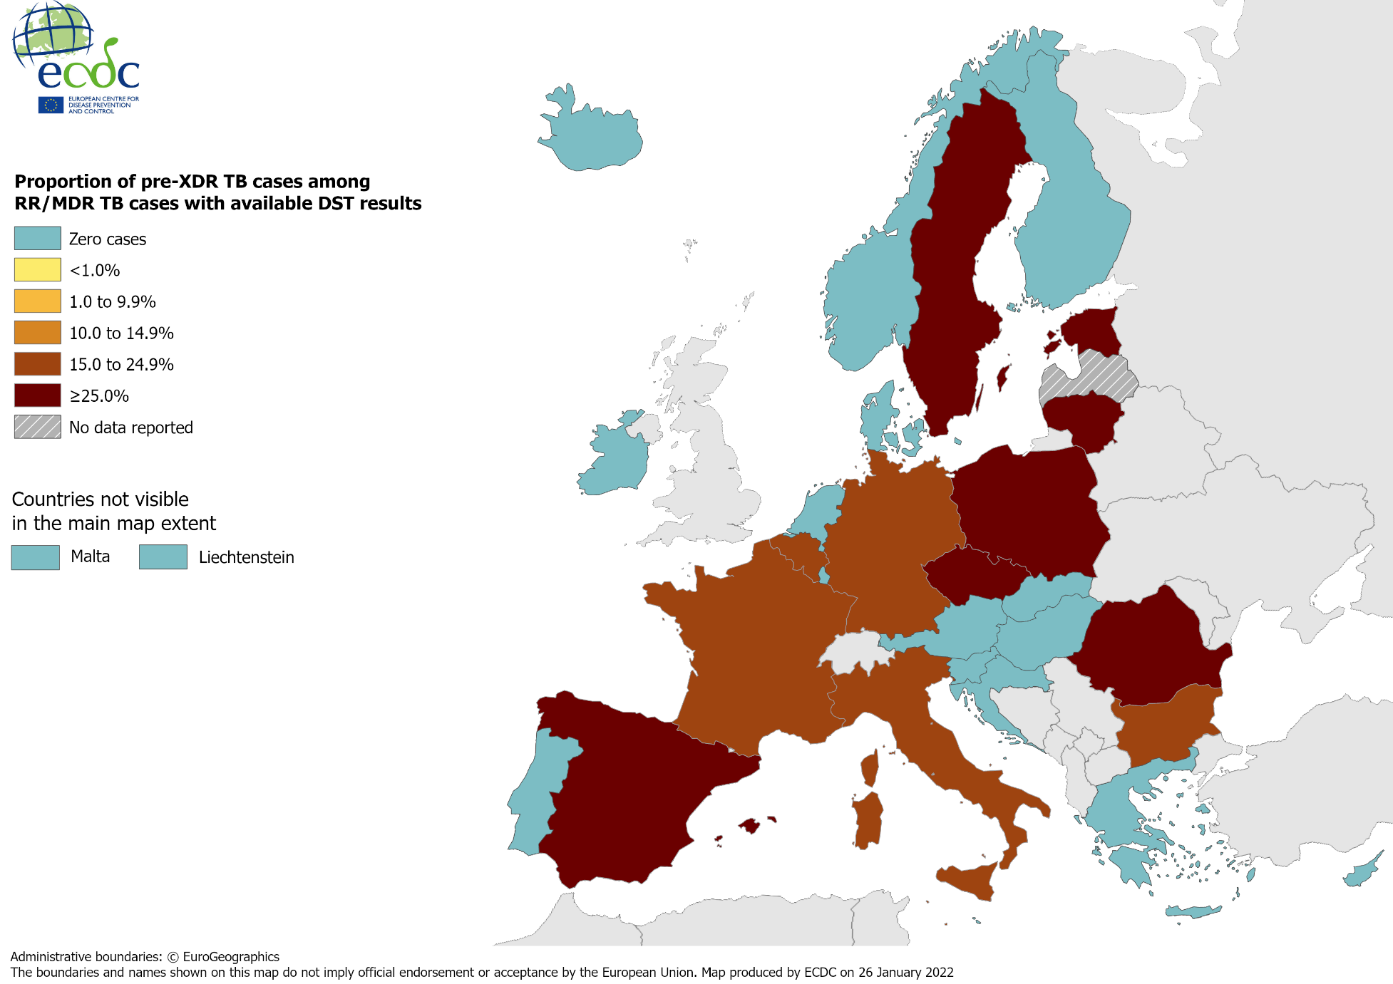
Pulmonary pre-XDR TB cases, EU/EEA*, 2020
115 pre-XDR TB cases notified by 29 EU/EEA countries*
27.6% of RR/MDR TB cases with second-line DST† results met the pre-XDR TB definition
* Latvia did not report data for 2020. † DST – drug susceptibility test.
Source: ECDC/WHO (2022). Tuberculosis surveillance and monitoring in Europe 2022–2020 data

Slide 15
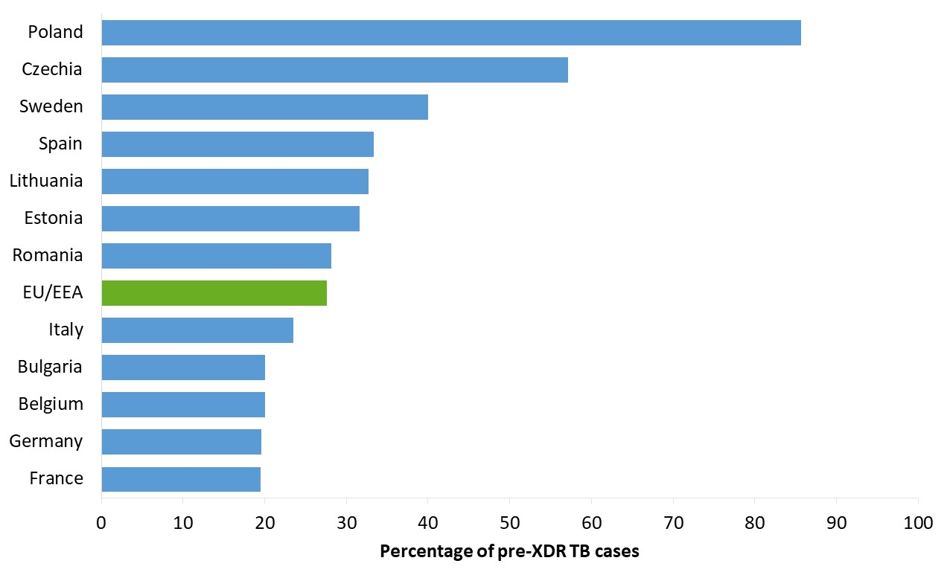
Proportion of pulmonary pre-XDR TB among RR/MDR TB cases with 2nd line DST results, EU/EEA*, 2020
115 pre-XDR TB cases notified in 10 EU/EEA countries*
27.6% of all RR/MDR TB cases with second-line DST† results (range 0.0%–85.7%)
* The graph shows countries that reported pre-XDR TB cases. No pre-XDR TB cases were reported by Austria, Croatia, Cyprus, Denmark, Finland, Greece, Hungary, Iceland, Ireland, Liechtenstein, Luxembourg, Malta, Netherlands, Norway, Portugal, Slovakia and Slovenia. Latvia did not report data for 2020. † DST – drug susceptibility test.
Source: ECDC/WHO (2022). Tuberculosis surveillance and monitoring in Europe 2022–2020 data

Slide 16
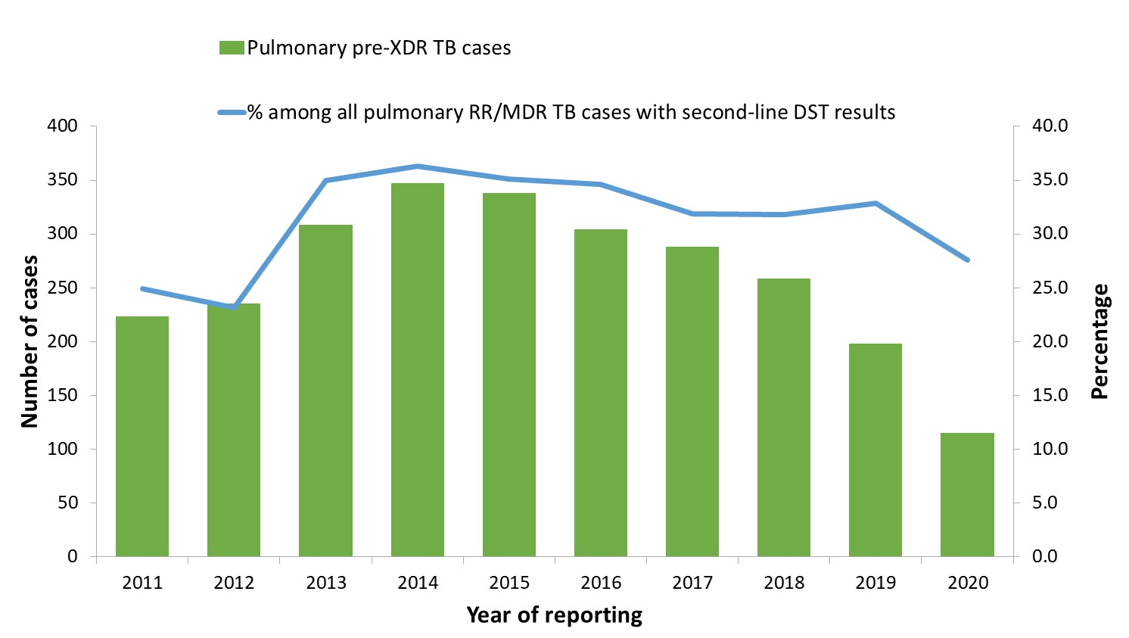
Pulmonary pre-XDR TB cases and proportion among all pulmonary RR/MDR TB cases with 2nd line DST results, EU/EEA*, 2011–2020
The total number of pulmonary pre-XDR TB cases peaked at 347 in 2014 and decreased to 115 in 2020
The proportion of pre-XDR TB cases among pulmonary RR/MDR TB cases ranged between 23.2% in 2012 to 36.3% in 2014, and was 27.6% in 2020
* Countries and the years for which they are not included due to reporting discrepancies or no data: France (2011-2012), Italy (2011), Latvia (2018-2020), Liechtenstein (2019).
Source: ECDC/WHO (2022). Tuberculosis surveillance and monitoring in Europe 2022–2020 data

Slide 17
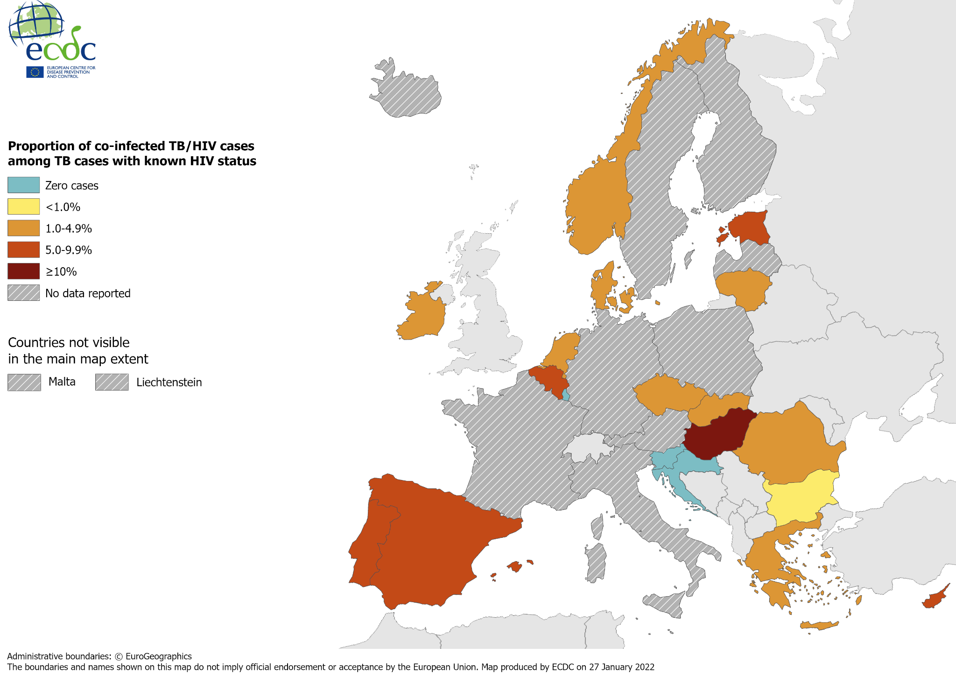
TB/HIV co-infection, EU/EEA*, 2020
515 HIV-positive TB cases were notified by 19 EU/EEA countries in 2020
4.2% of TB cases with known HIV status were HIV-positive (range 0.0–11.8%)
* Ten countries did not report HIV status data: Austria, Finland, France, Germany, Iceland, Italy, Liechtenstein, Malta, Poland, Sweden. Latvia did not report data for 2020.
Source: ECDC/WHO (2022). Tuberculosis surveillance and monitoring in Europe 2022–2020 data

Slide 18
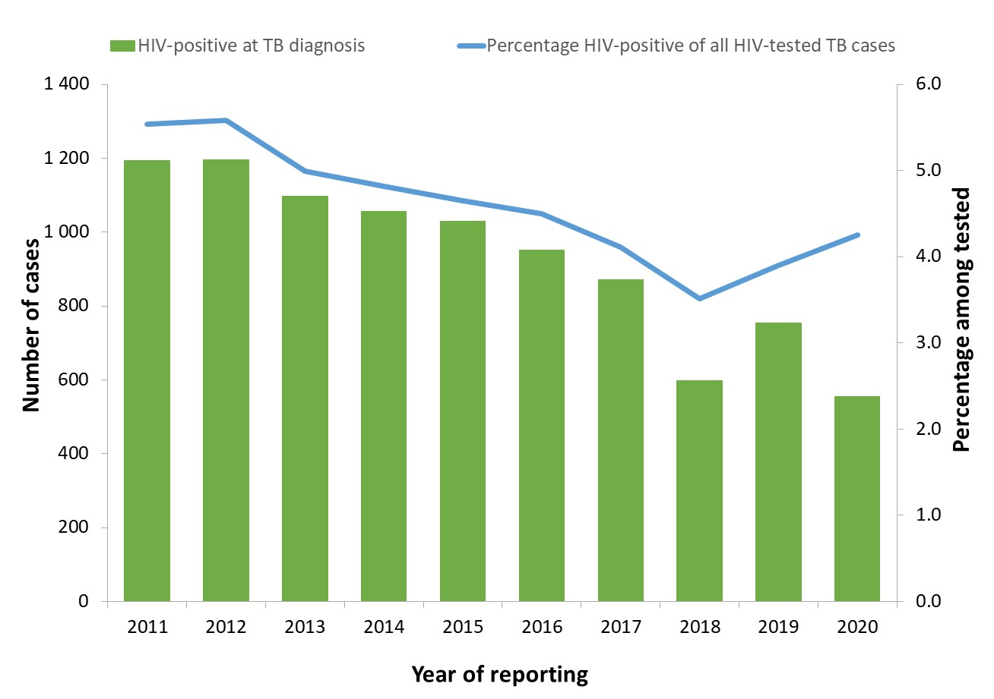
HIV-positive TB cases and proportion among all those tested, EU/EEA, 2011–2020*
The total number of HIV-positive TB cases decreased from 1 193 in 2011 to 554 in 2020
The proportion of HIV-positive TB cases among those tested decreased from 5.6% in 2012 to 4.2% in 2020
* Countries and the years for which they are not included due to reporting discrepancies or no data: Austria (all years), Croatia (2011-2015), Cyprus (2011-2013), Denmark (2011-2013), Finland (all years), France (all years), Germany (all years), Greece (2011-2012), Hungary (2011-2013), Iceland (2020), Italy (all years), Latvia (2018-2020), Liechtenstein (all years), Malta (2018-2020), Norway (2011-2012), Poland (all years) and Sweden (all years).
Source: ECDC/WHO (2022). Tuberculosis surveillance and monitoring in Europe 2022–2020 data

Slide 19
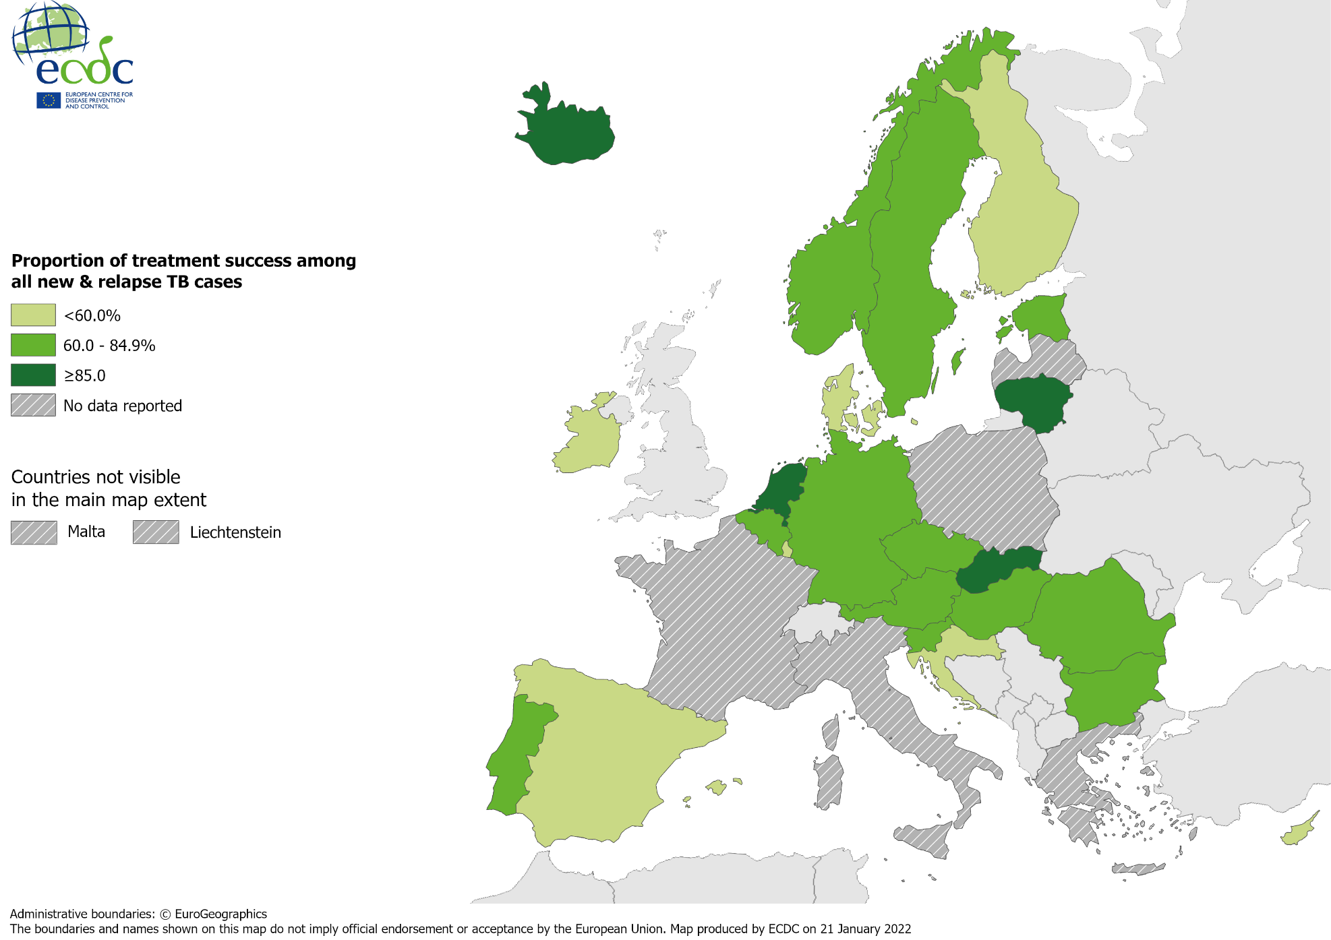
Treatment success after 12 months among new & relapse TB cases notified in 2019, EU/EEA*, 2020
71.8% of all TB cases had a successful treatment outcome after 12 months (range 3.7–100.0%)
* Six countries did not report treatment outcome data: France, Greece, Italy, Liechtenstein, Malta, Poland. Latvia did not report any data for 2020.
Source: ECDC/WHO (2022). Tuberculosis surveillance and monitoring in Europe 2022–2020 data

Slide 20
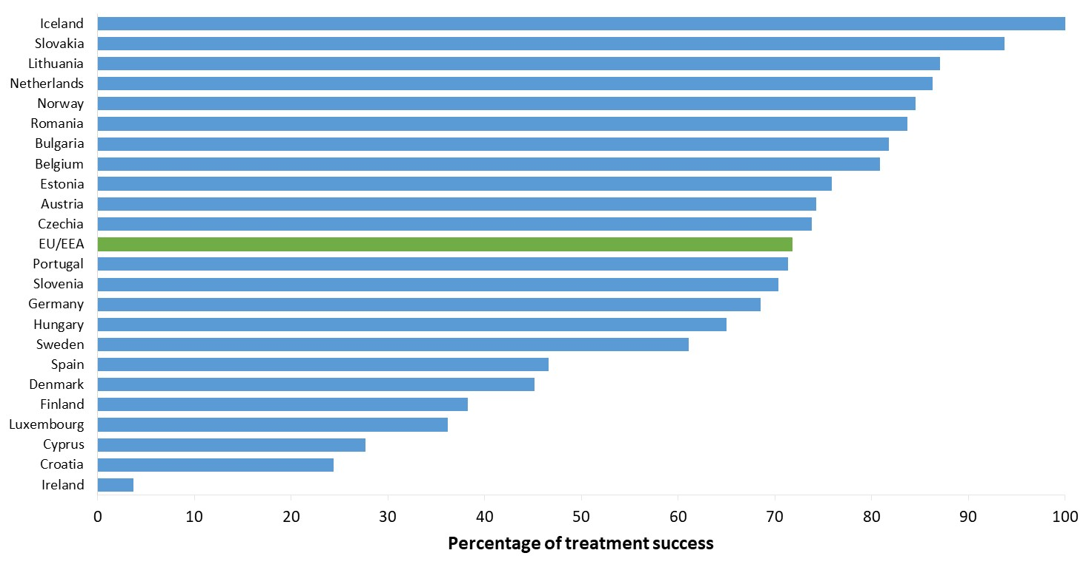
Treatment success after 12 months among new & relapse TB cases notified in 2019, EU/EEA*, 2020
71.8% of new & relapse TB cases had a successful treatment outcome after 12 months (range 3.7–100%)
*Five EU/EEA countries did not report treatment outcome data: France, Greece, Italy, Malta and Poland. Latvia did not report data for 2019 or 2020. Liechtenstein did not report data for 2019.
Source: ECDC/WHO (2022). Tuberculosis surveillance and monitoring in Europe 2022–2020 data

Slide 21
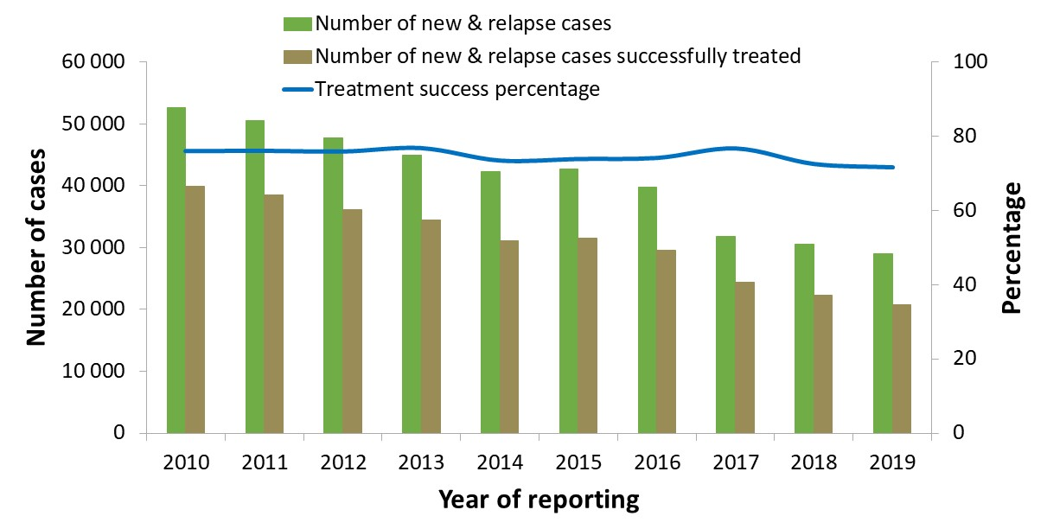
Treatment success after 12 months among new & relapse TB cases notified 2010–2019, EU/EEA, 2020
Proportion of successfully treated cases remained stable between 76.0% in 2010 & 71.8% in 2019*
* Countries and the years for which they are not included due to reporting discrepancies or no data: Croatia (2010-2011), France (all years), Greece (all years), Italy (all years), Latvia (2017-2019), Liechtenstein (2010-2014, 2018-2019), Luxembourg (2010-2018), Malta (2014-2019), Poland (2017-2019).
Source: ECDC/WHO (2022). Tuberculosis surveillance and monitoring in Europe 2022–2020 data

Slide 22
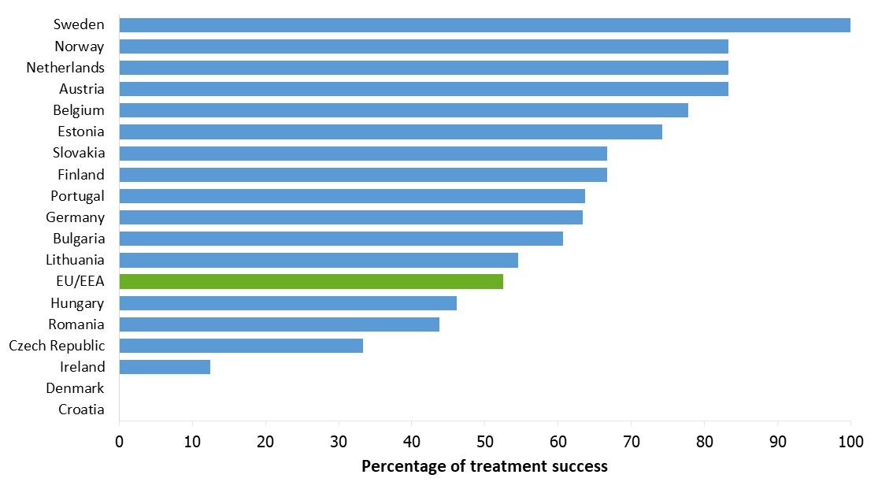
Treatment success after 24 months among RR/MDR TB cases started on second-line treatment in 2018, EU/EEA*, 2020
52.4% of all RR/MDR TB cases started on second-line treatment in 2018 were reported to have treatment success after 24 months (range 0–100%)
* Cyprus, Iceland, Liechtenstein, and Slovenia reported zero RR/MDR TB cases in 2018.
Six countries did not report treatment outcome data: France, Greece, Italy, Luxembourg, Malta, Poland and Spain. Latvia did not report data for 2018-2020.
Source: ECDC/WHO (2022). Tuberculosis surveillance and monitoring in Europe 2022–2020 data

Slide 23
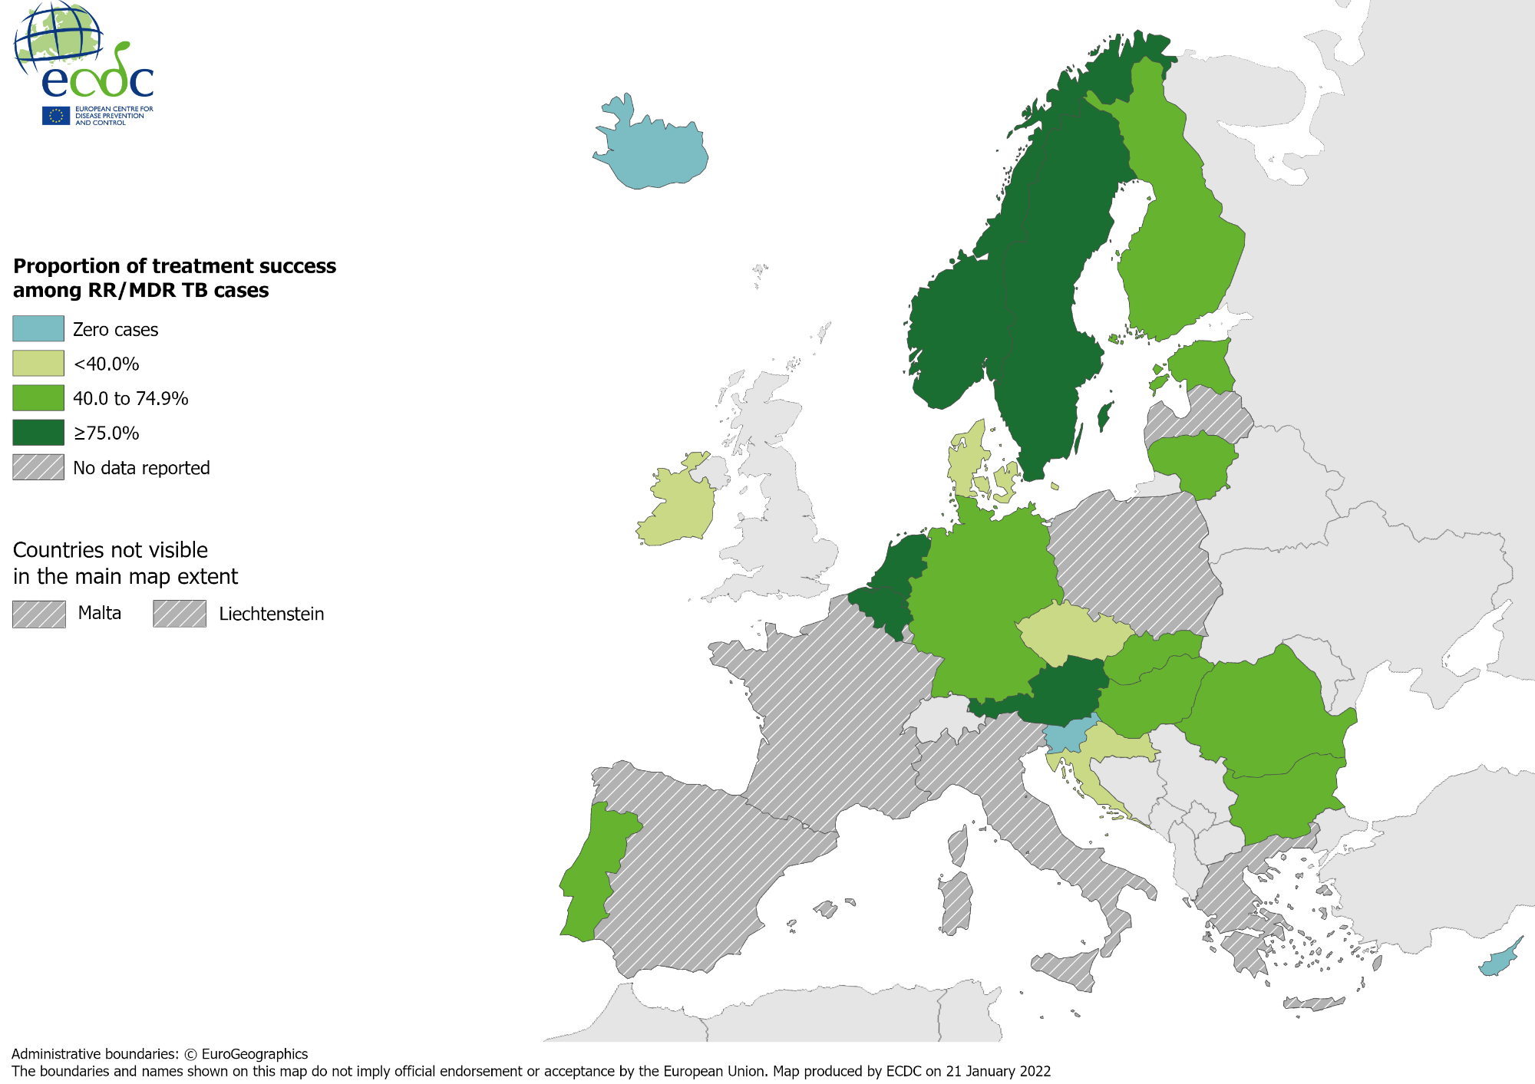
Treatment success after 24 months among RR/MDR TB cases started on second-line treatment in 2018, EU/EEA*, 2020
52.4% of all RR/MDR TB cases started on second-line treatment in 2018 were reported to have treatment success after 24 months (range 0.0–100%)
* Three countries did not report any RR/MDR TB cases in 2018: Cyprus, Iceland, Slovenia. Eight countries did not report treatment outcome data: France, Greece, Italy, Liechtenstein, Luxembourg, Malta, Poland, Spain. Latvia did not report any data for 2020.
Source: ECDC/WHO (2022). Tuberculosis surveillance and monitoring in Europe 2022–2020 data

Slide 24
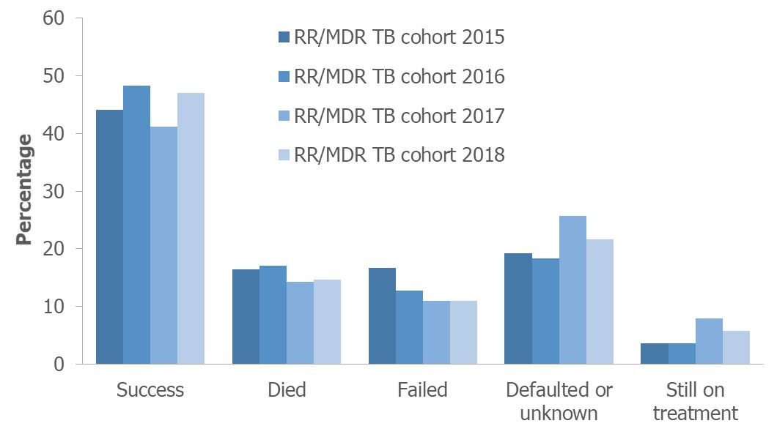
Treatment outcomes among RR/MDR TB cases* started on second-line treatment in 2015–2018, EU/EEA†, 2020
Reported treatment success remained below 50% for all RR/MDR TB cohorts between 2015-2018
* Pre-XDR and XDR TB cases are not included.
† Countries and the cohorts for which they are not included due to reporting discrepancies or no data: Croatia (2016-2017), Cyprus (all years), France (all years), Greece (all years), Iceland (all years) , Italy (all years), Latvia (2016-2018), Liechtenstein (all years), Luxembourg (all years), Malta (all years), Poland (2016-2018), Slovenia (all years), Spain (all years).
Source: ECDC/WHO (2022). Tuberculosis surveillance and monitoring in Europe 2022–2020 data

Slide 25
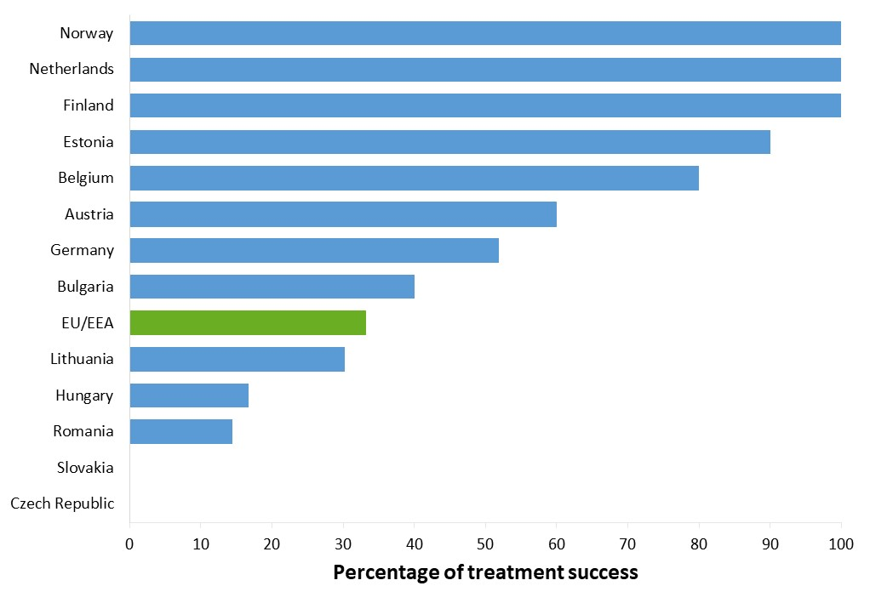
Treatment success after 24 months among pre-XDR TB cases started on second-line treatment in 2018, EU/EEA*, 2020
33.2% of the pre-XDR TB cases started on second-line treatment in 2018 were reported to have treatment success after 24 months (range 0-100%)*
* Eight countries reported zero pre-XDR TB cases in 2018: Croatia, Cyprus, Denmark, Iceland, Ireland, Portugal, Slovenia and Sweden.
Eight countries did not report treatment outcome data: France, Greece, Italy, Liechtenstein, Luxembourg, Malta, Poland and Spain. Latvia did not report any data for 2018-2020.
Source: ECDC/WHO (2022). Tuberculosis surveillance and monitoring in Europe 2022–2020 data

Slide 26
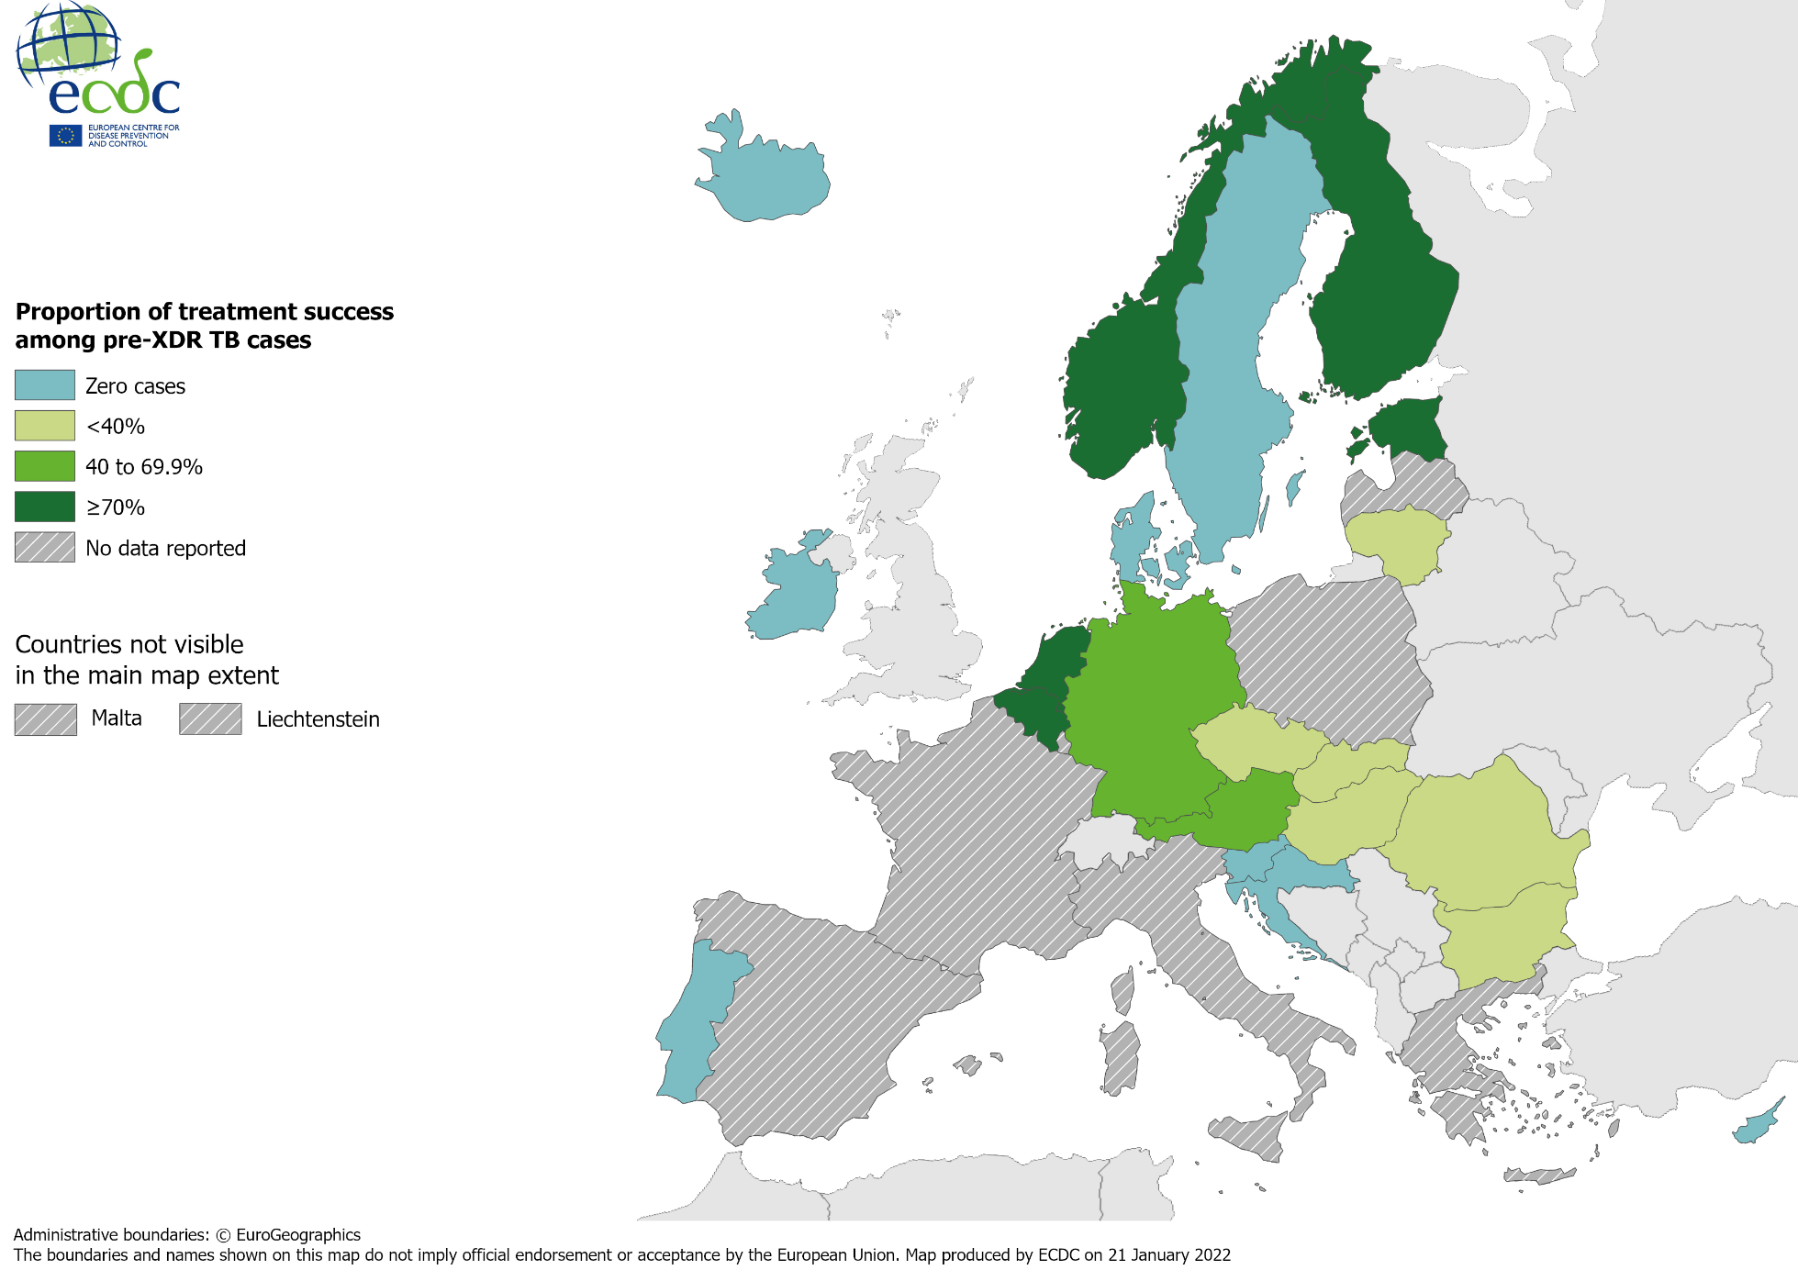
Treatment success after 24 months among pre-XDR TB cases started on second-line treatment in 2018, EU/EEA*, 2020
33.2% of all pre-XDR TB cases started on second-line treatment in 2018 were successfully treated (range 0–100%)
* Eight countries did not report any pre-XDR TB cases in 2018: Croatia, Cyprus, Denmark, Iceland, Ireland, Portugal, Slovenia, Sweden. Eight countries did not report treatment outcome data: France, Greece, Italy, Liechtenstein, Luxembourg, Malta, Poland, Spain.
Latvia did not report any data for 2020.
Source: ECDC/WHO (2022). Tuberculosis surveillance and monitoring in Europe 2022–2020 data

Slide 27
Treatment outcomes new & relapse TB, RR/MDR, pre-XDR, XDR TB cases, EU/EEA*, 2020
 | New & relapse TB, 12 months | RR/MDR, 24 months | Pre-XDR, 24 months | XDR, 36 months
Cases started on treatment | 28 985 | 927 | 211 | 26
Countries reporting cases | 23 | 18 | 13 | 7
Countries reporting 0 cases | 0 | 3 | 8 | 14
Treatment success | 71.8% | 52.4% | 33.2% | 38.5%
* Latvia did not report any data for 2018-2020.

