Slide 1
Tuberculosis situation in the EU/EEA, 2021
Tuberculosis situation in the EU/EEA, 2021
h
Findings from the joint report Tuberculosis surveillance and monitoring in Europe by ECDC and WHO Regional Office for Europe
Stockholm, 24 March 2023

Slide 2
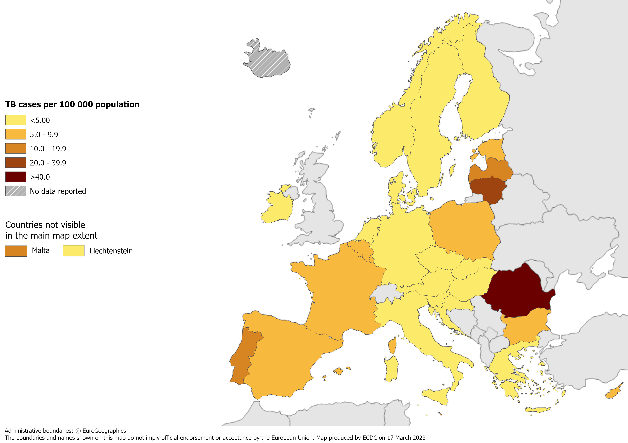
TB notifications, EU/EEA*, 2021
33 520 TB cases notified in 29 EU/EEA countries
Notification rate 7.4 per 100 000 population (range 1.9 – 41.6)
* Iceland did not report data for 2021.
Source: ECDC/WHO (2023). Tuberculosis surveillance and monitoring in Europe 2023–2021 data

Slide 3
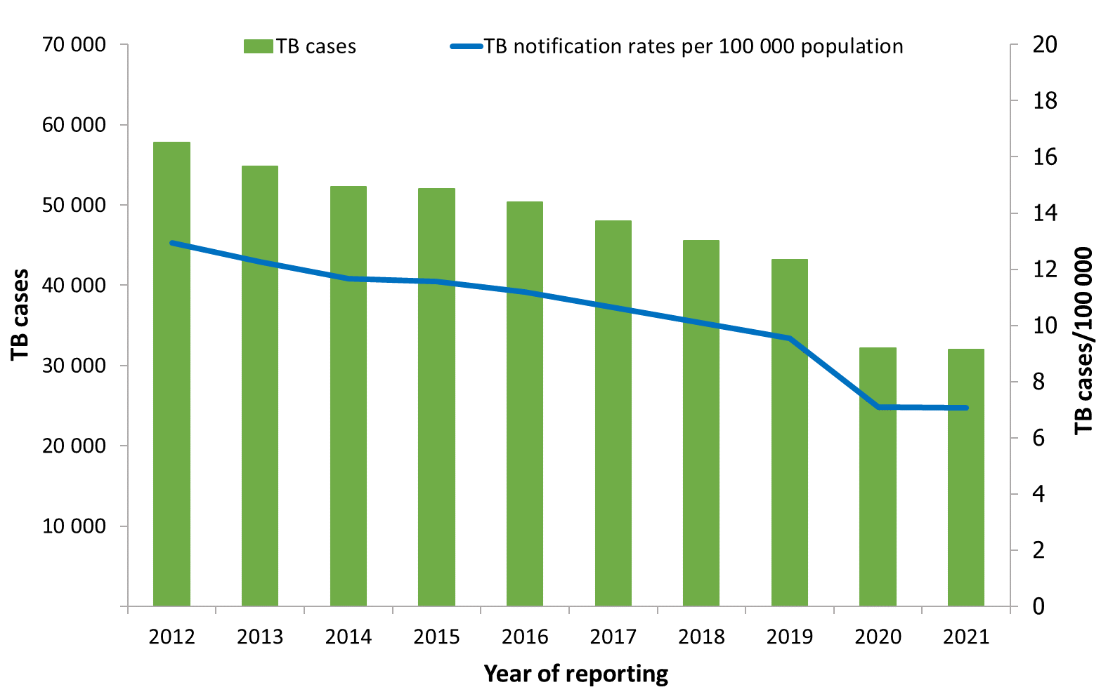
Notified TB cases, EU/EEA*, 2012–2021
Continuous decline between 2012 and 2021:
Number of TB cases decreased by 45%
Notification rate decreased by 45%
* Latvia did not report data for 2018, 2019 and 2020; Liechtenstein did not report data for 2019; and Iceland did not report data for 2021.
Source: ECDC/WHO (2023). Tuberculosis surveillance and monitoring in Europe 2023–2021 data

Slide 4
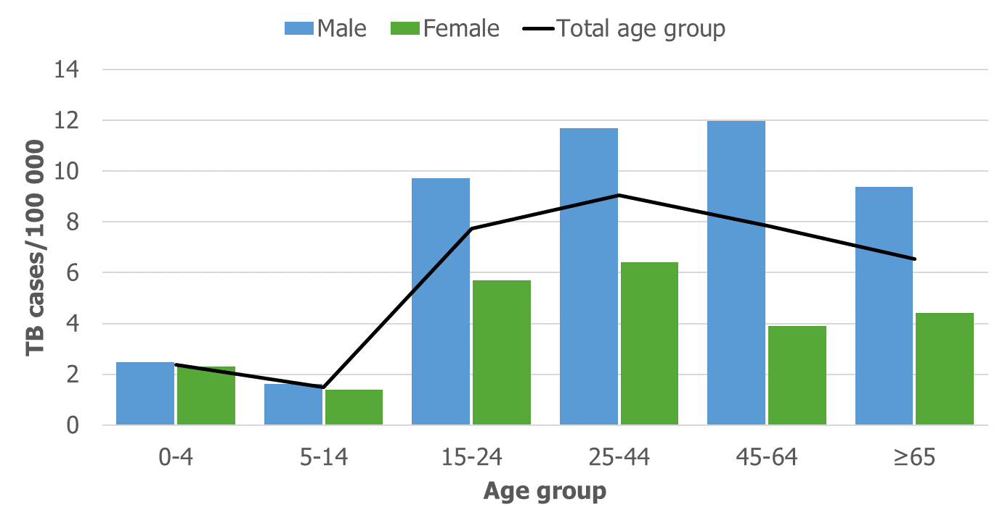
TB notification rate by sex and age group, EU/EEA*, 2021
The highest notification rate was observed in the age group 25–44 years (9.4 per 100 000)
Males were over-represented in all age groups over 14 years
* Iceland did not report data for 2021.
Source: ECDC/WHO (2023). Tuberculosis surveillance and monitoring in Europe 2023–2021 data

Slide 5
TB notification rate by age group, EU/EEA*,
2012–2021
Annual average decrease of between 6.9 to 10.3% in all age groups
* Latvia did not report data for 2018, 2019 and 2020, Liechtenstein did not report data for 2019 and Iceland did not report data for 2021.
Source: ECDC/WHO (2023). Tuberculosis surveillance and monitoring in Europe 2023–2021 data

Slide 6
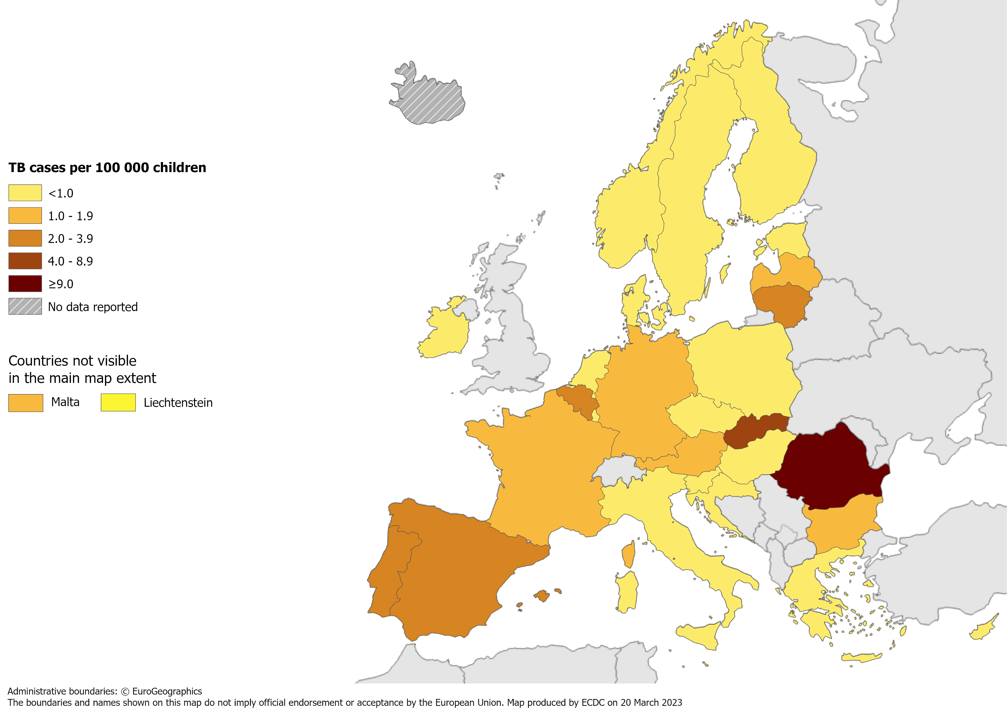
TB in children under 15 years, EU/EEA*, 2021
1 116 TB cases notified in children under 15 years
3.3% of all TB cases (range 0.0–29.9%)
1.6 per 100 000 child population (range 0.0–9.3)
* Iceland did not report data for 2021.
Source: ECDC/WHO (2023). Tuberculosis surveillance and monitoring in Europe 2023–2021 data

Slide 7
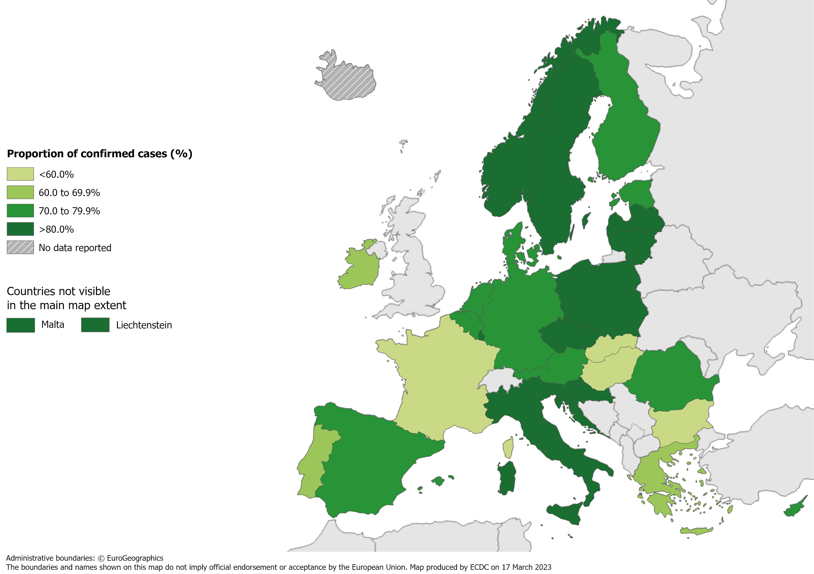
Confirmed TB cases*, EU/EEA†, 2021
24 127 TB cases were confirmed
72% of all TB cases (range 38.7–100%)
* Confirmation by culture, or by microscopy and Mycobacterium tuberculosis nucleic acid amplification test.
† Iceland did not report data for 2021.
Source: ECDC/WHO (2023). Tuberculosis surveillance and monitoring in Europe 2023–2021 data

Slide 8
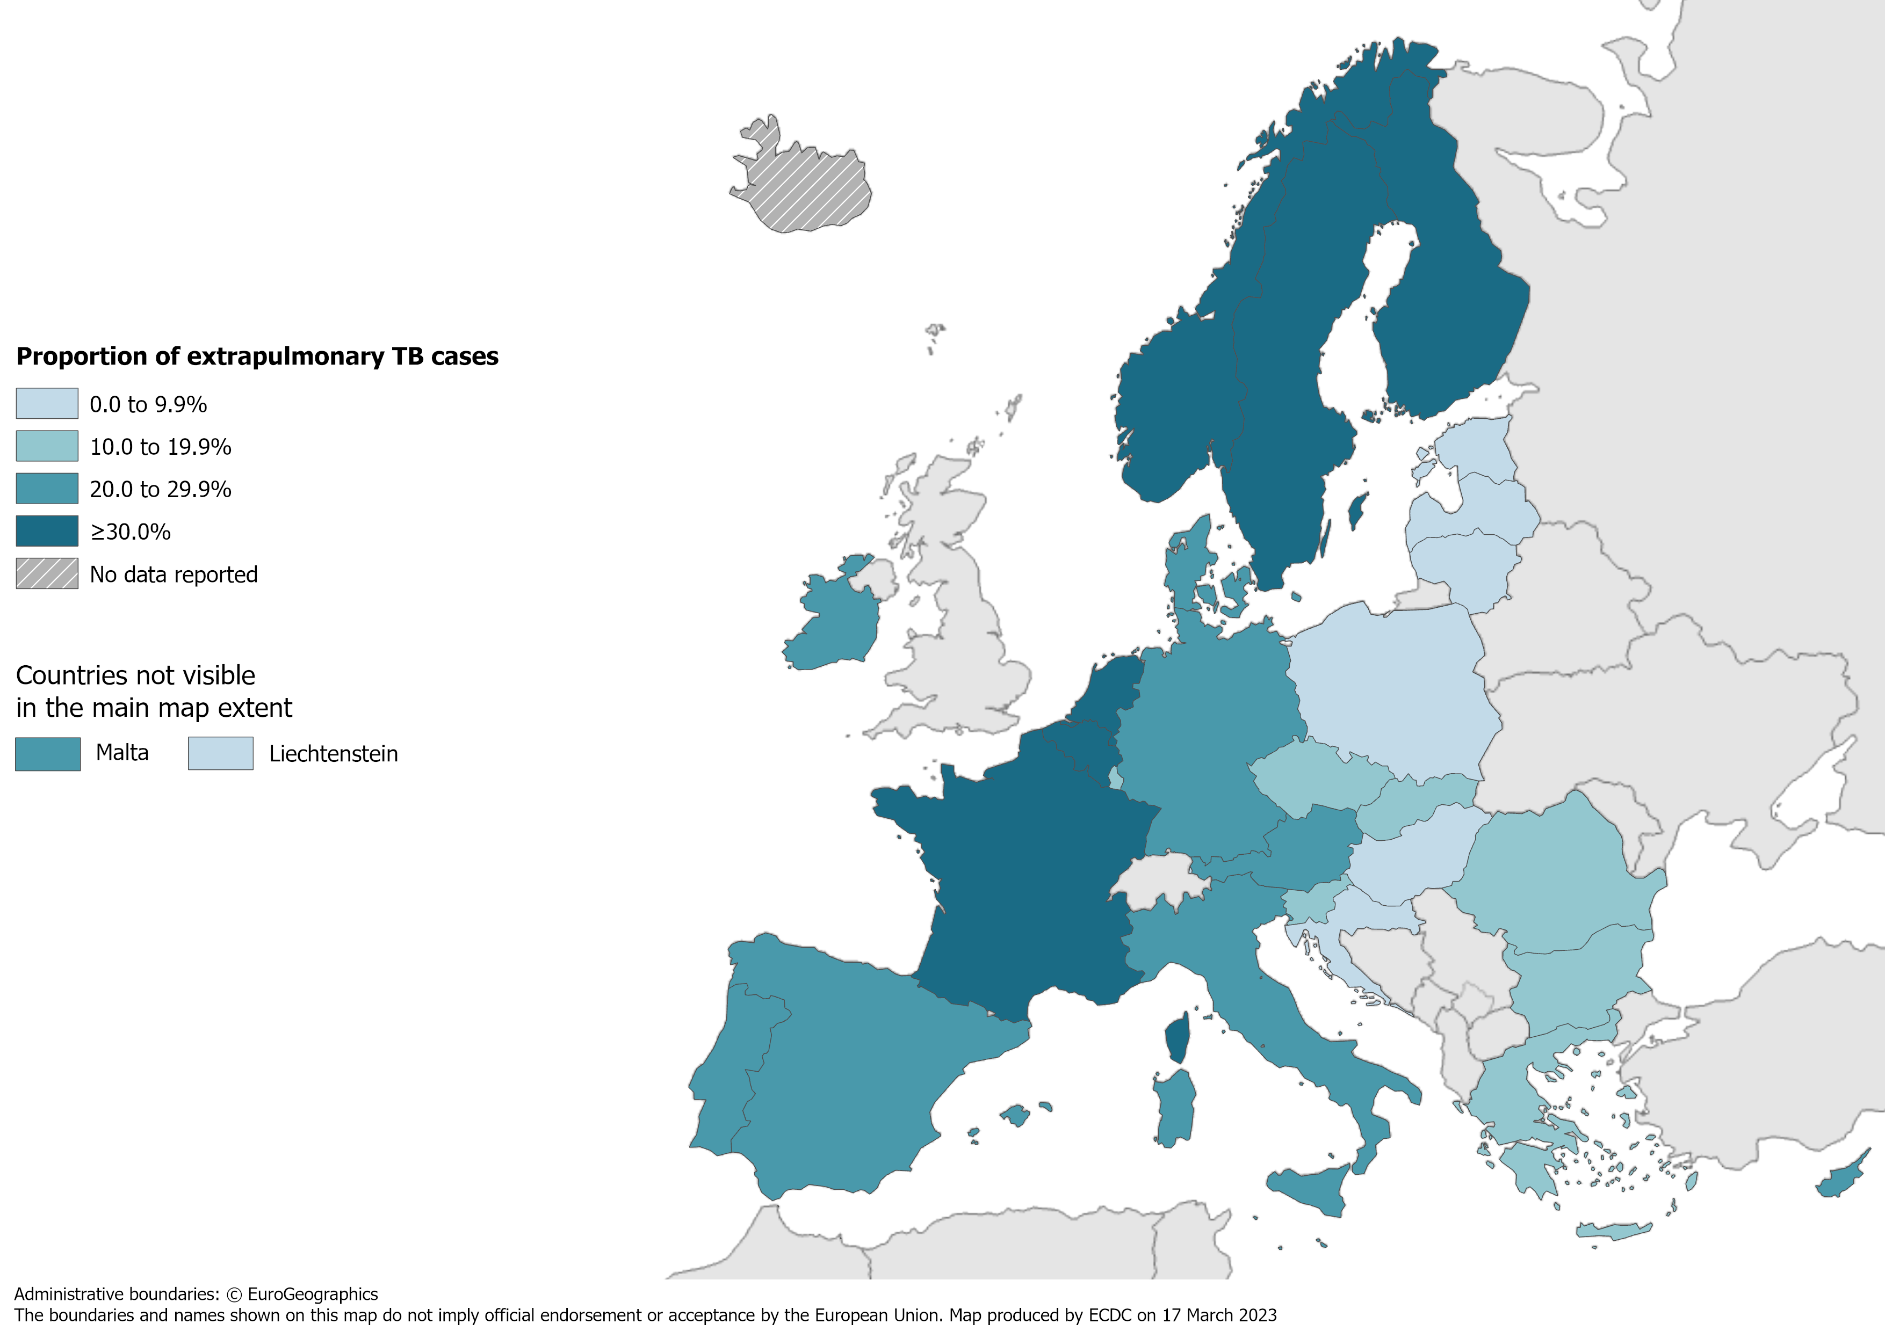
Extrapulmonary TB, EU/EEA*, 2021
7 026 notified cases had extrapulmonary TB
21.0% of all TB cases (range 0.0–45.2%)
* Iceland did not report data for 2021.
Source: ECDC/WHO (2023). Tuberculosis surveillance and monitoring in Europe 2023–2021 data

Slide 9
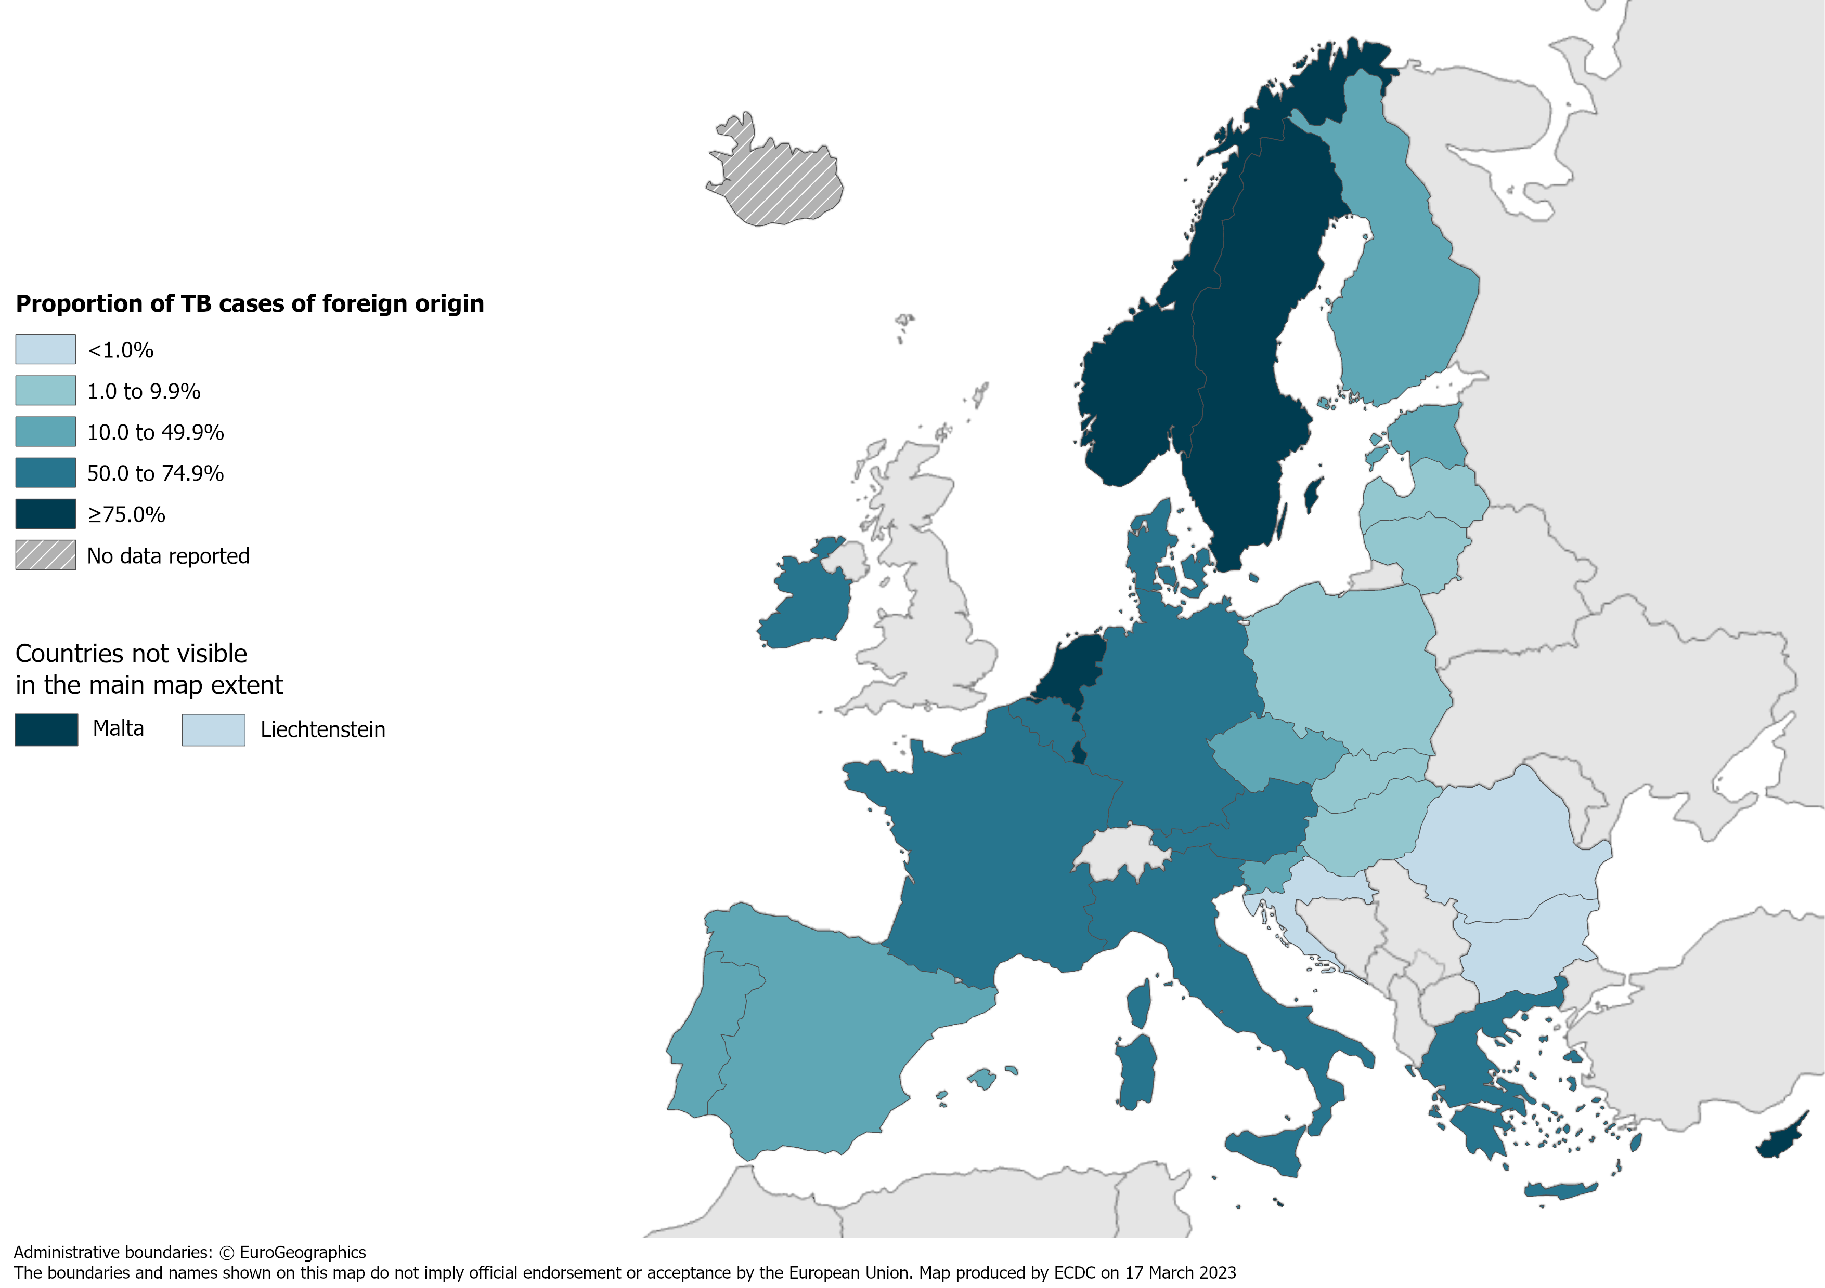
TB in persons of foreign origin*, EU/EEA†, 2021
11 334 TB cases of foreign origin*
33.8% of all TB cases (range 0.0–98.1%)
* Notified in persons originating from other countries than the reporting country.
† Iceland did not report data for 2021.
Source: ECDC/WHO (2023). Tuberculosis surveillance and monitoring in Europe 2023–2021 data

Slide 10
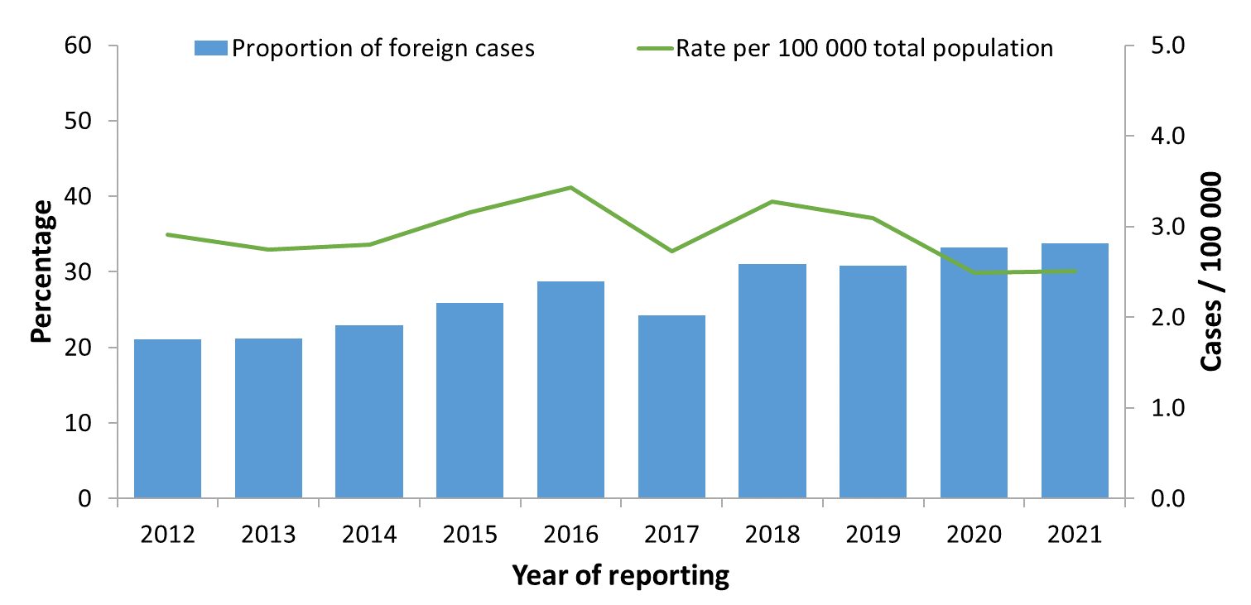
TB cases in persons of foreign origin*, EU/EEA†, 2012–2021
The proportion of cases in persons of foreign origin increased from 21.1% in 2012 to 33.8% in 2021
The rate of TB cases of foreign origin per 100 000 of the total population varied between 2.5 and 3.3
* Notified in persons originating from other countries than the reporting country.
† Croatia is not included for 2011. Latvia did not report data for 2018-2020. Liechtenstein did not report data for 2019. Iceland did not report data for 2021.
Source: ECDC/WHO (2023). Tuberculosis surveillance and monitoring in Europe 2023–2021 data

Slide 11
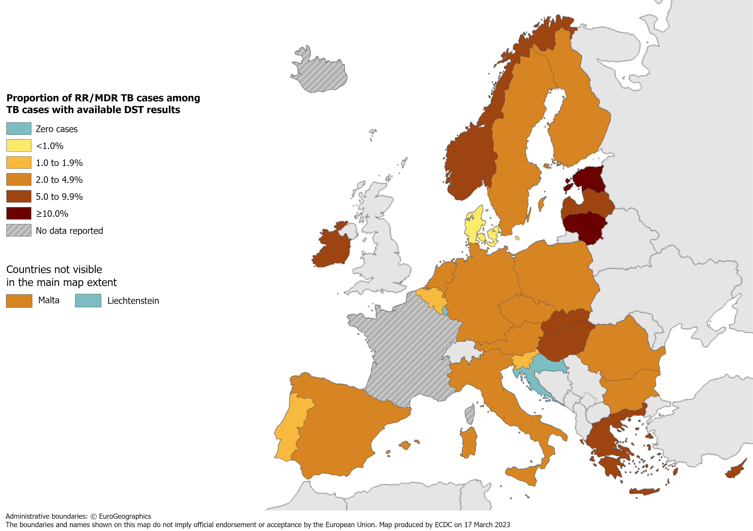
RR/MDR TB cases with available DST results, EU/EEA*, 2021
770 RR/MDR TB cases notified by 29 EU/EEA countries* among cases with available DST results
4.1% of all TB cases with available DST† results had RR/MDR TB (range 0.0–28.0%, excluding France)
* Data from France included in the total cases notified and percentage, but not included in the
range or the map, as DST results are only available for RR/MDR TB cases.
Iceland did not report data for 2021.
† DST – drug susceptibility test.

Slide 12
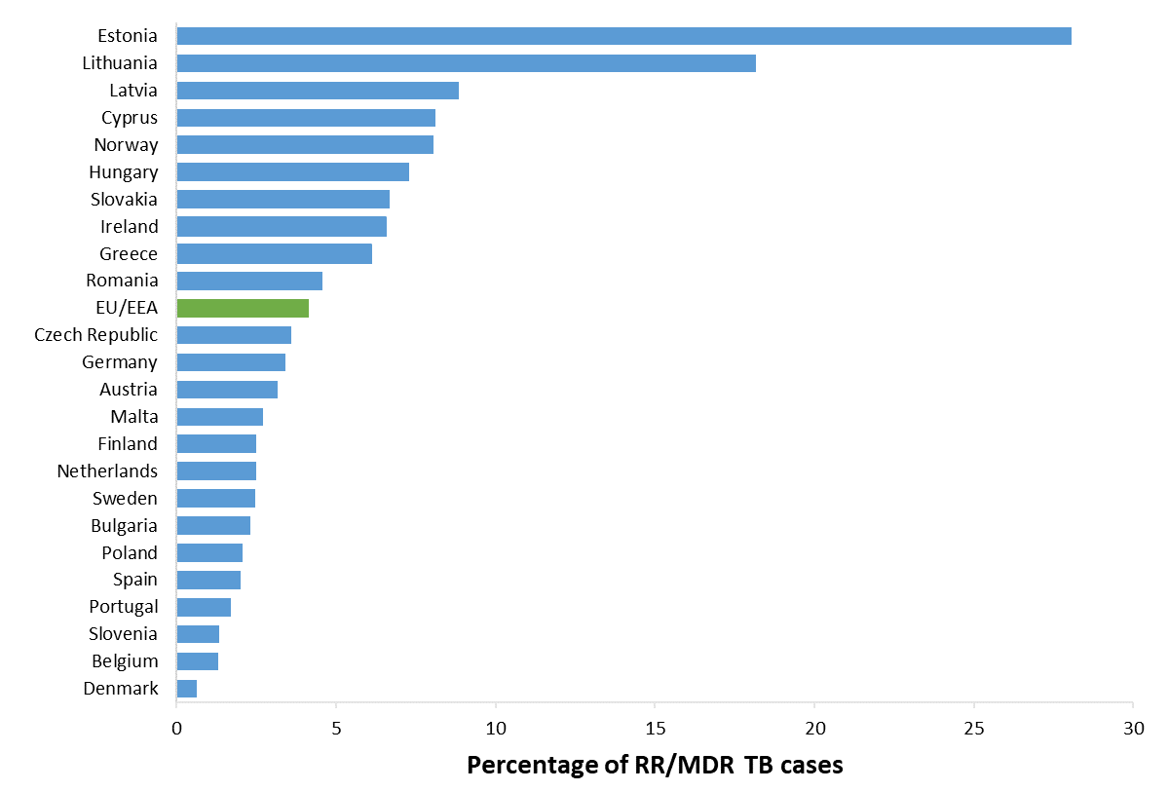
Proportion of RR/MDR TB, EU/EEA*, 2021
770 RR/MDR TB cases notified by 29 EU/EEA countries
4.1% of all bacteriologically-confirmed TB cases with available DST† results had RR/MDR TB
(range 0–28.0%)
* RR/MDR TB data from France are not included in the graph. Cyprus, Liechtenstein and Luxembourg reported zero RR/MDR TB cases for 2021.
Iceland did not report data for 2021.
† DST – drug susceptibility test.
Source: ECDC/WHO (2023). Tuberculosis surveillance and monitoring in Europe 2023–2021 data

Slide 13
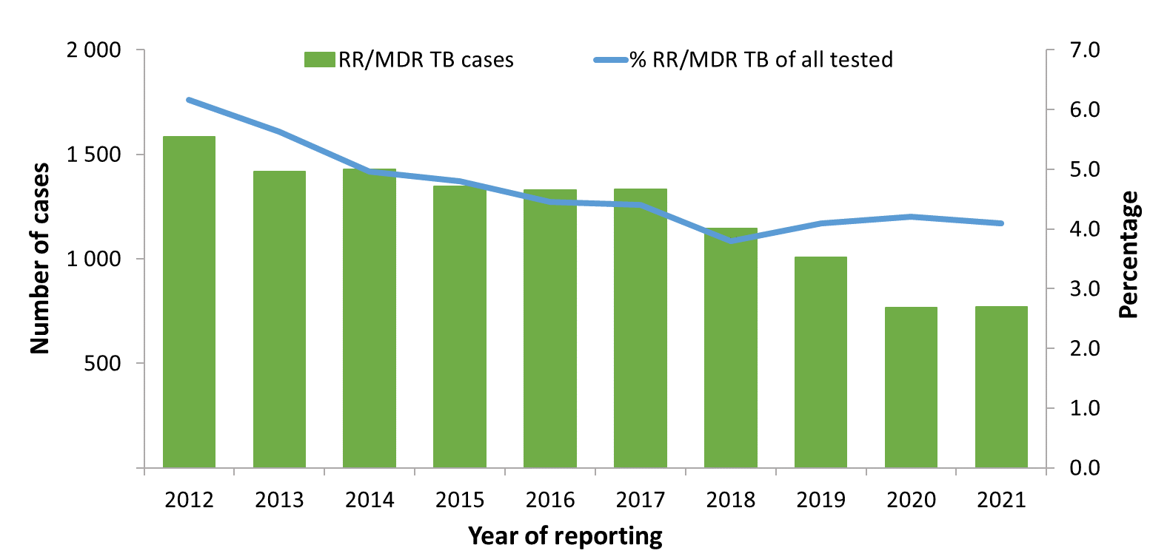
RR/MDR TB cases and proportions of all TB cases tested for drug resistance, EU/EEA*, 2012–2021
The total number of notified RR/MDR TB cases decreased from 1 583 in 2012 to 770 in 2021
Proportion of RR/MDR TB cases among all TB cases with available DST† results decreased from 6.2% in 2012 to 4.1% in 2021
* Countries and the years they are not included due to reporting discrepancies or no data: France (2012, 2013, 2015), Iceland (2021), Latvia (2018, 2019, 2020), Liechtenstein (2013, 2019-2020), Spain (2011-2014).
† DST – drug susceptibility test.
Source: ECDC/WHO (2023). Tuberculosis surveillance and monitoring in Europe 2023–2021 data

Slide 14
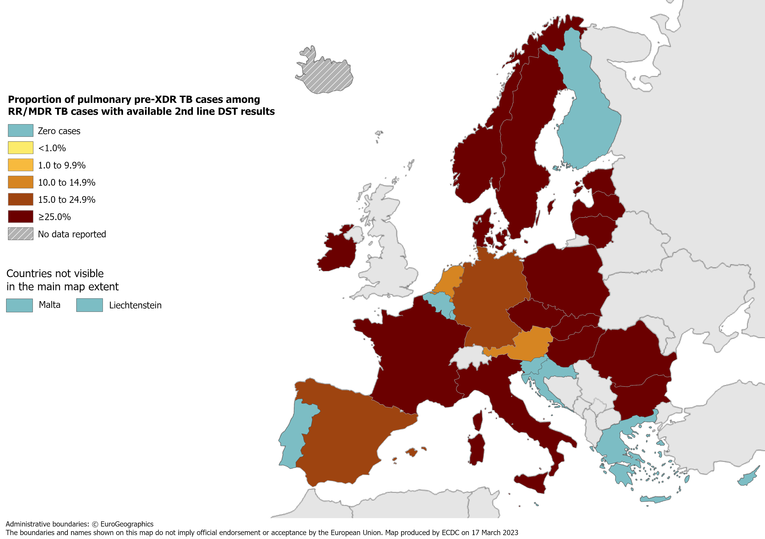
Pulmonary pre-XDR TB cases, EU/EEA*, 2021
115 pre-XDR TB cases notified by 29 EU/EEA countries*
28.5% of RR/MDR TB cases with second-line DST† results met the pre-XDR TB definition
* Iceland did not report data for 2021.
† DST – drug susceptibility test.
Source: ECDC/WHO (2023). Tuberculosis surveillance and monitoring in Europe 2023–2021 data

Slide 15
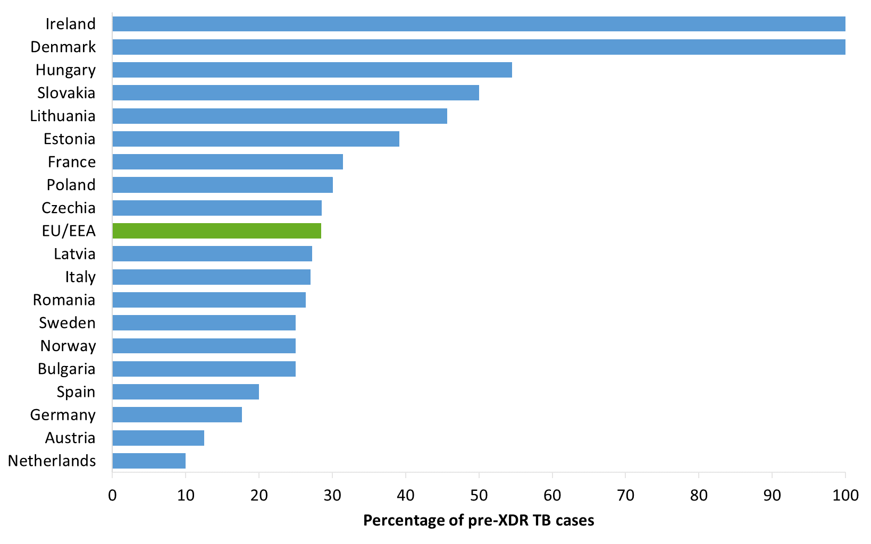
Proportion of pulmonary pre-XDR TB among RR/MDR TB cases with 2nd line DST results, EU/EEA*, 2021
115 pulmonary pre-XDR TB cases notified in 18 EU/EEA countries*
28.5% of all bacteriologically-confirmed RR/MDR TB cases with second-line DST† results (range 0.0–100.0%)
* The graph shows countries that reported pre-XDR TB cases. No pre-XDR TB cases were reported by Belgium, Croatia, Cyprus, Finland, Greece,
Liechtenstein, Luxembourg, Malta, Portugal and Slovenia.
Iceland did not report data for 2021.
† DST – drug susceptibility test.
Source: ECDC/WHO (2023). Tuberculosis surveillance and monitoring in Europe 2023–2021 data

Slide 16
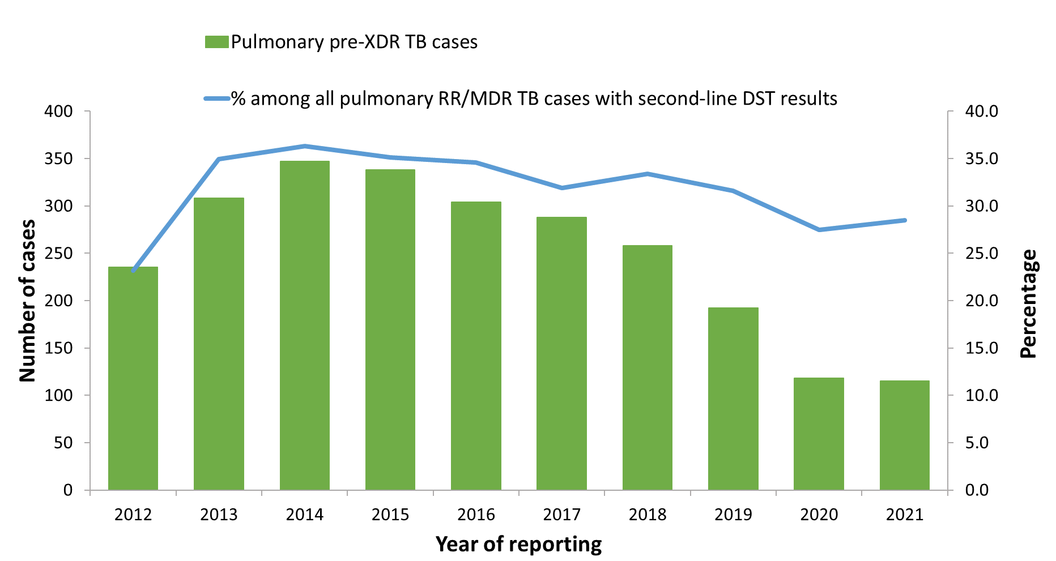
Pulmonary pre-XDR TB cases and proportion among all pulmonary RR/MDR TB cases with 2nd line DST results, EU/EEA*, 2012–2021
The total number of pulmonary pre-XDR TB cases peaked at 347 in 2014 and decreased to 115 in 2021
The proportion of pre-XDR TB cases among pulmonary RR/MDR TB cases ranged between 23.2% in 2013 to 36.3% in 2014, and was 28.5% in 2021
* Countries and the years for which they are not included due to reporting discrepancies or no data: France (2011-2012), Italy (2011), Latvia (2018-2020), Liechtenstein (2019), Iceland (2021).
Source: ECDC/WHO (2023). Tuberculosis surveillance and monitoring in Europe 2023–2021 data

Slide 17
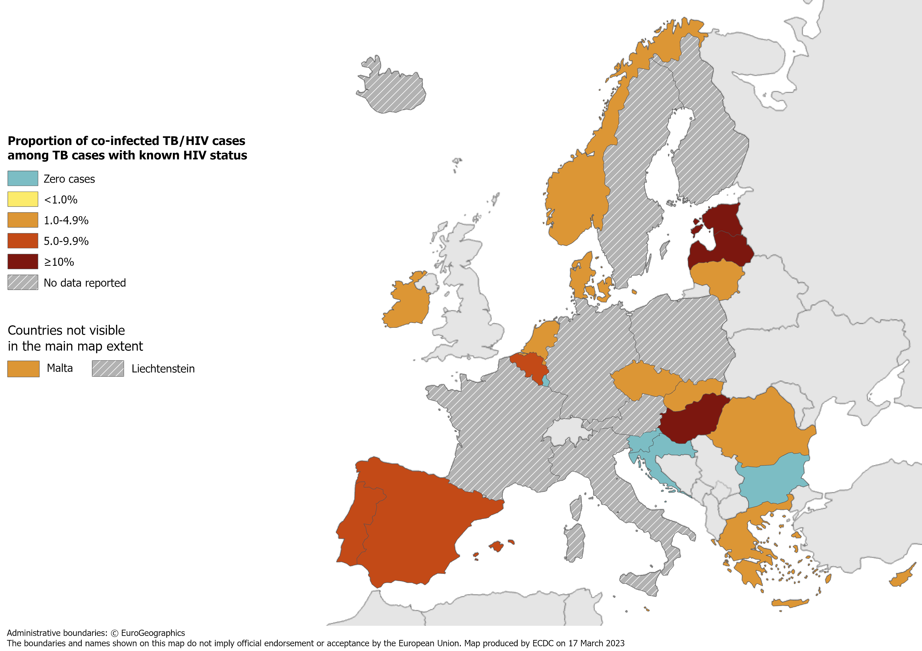
TB/HIV co-infection†, EU/EEA*, 2021
472 HIV-positive TB cases were notified by 21 EU/EEA countries in 2021
3.8% of TB cases with known HIV status were HIV-positive (range 0.0–14.3%)
* Nine countries did not report HIV status data: Austria, Finland, France, Germany, Italy, Liechtenstein, Poland, Sweden. Iceland did not report data for 2021 data.
† HIV-positive TB cases only includes new and relapsed cases.
Source: ECDC/WHO (2023). Tuberculosis surveillance and monitoring in Europe 2023–2021 data

Slide 18
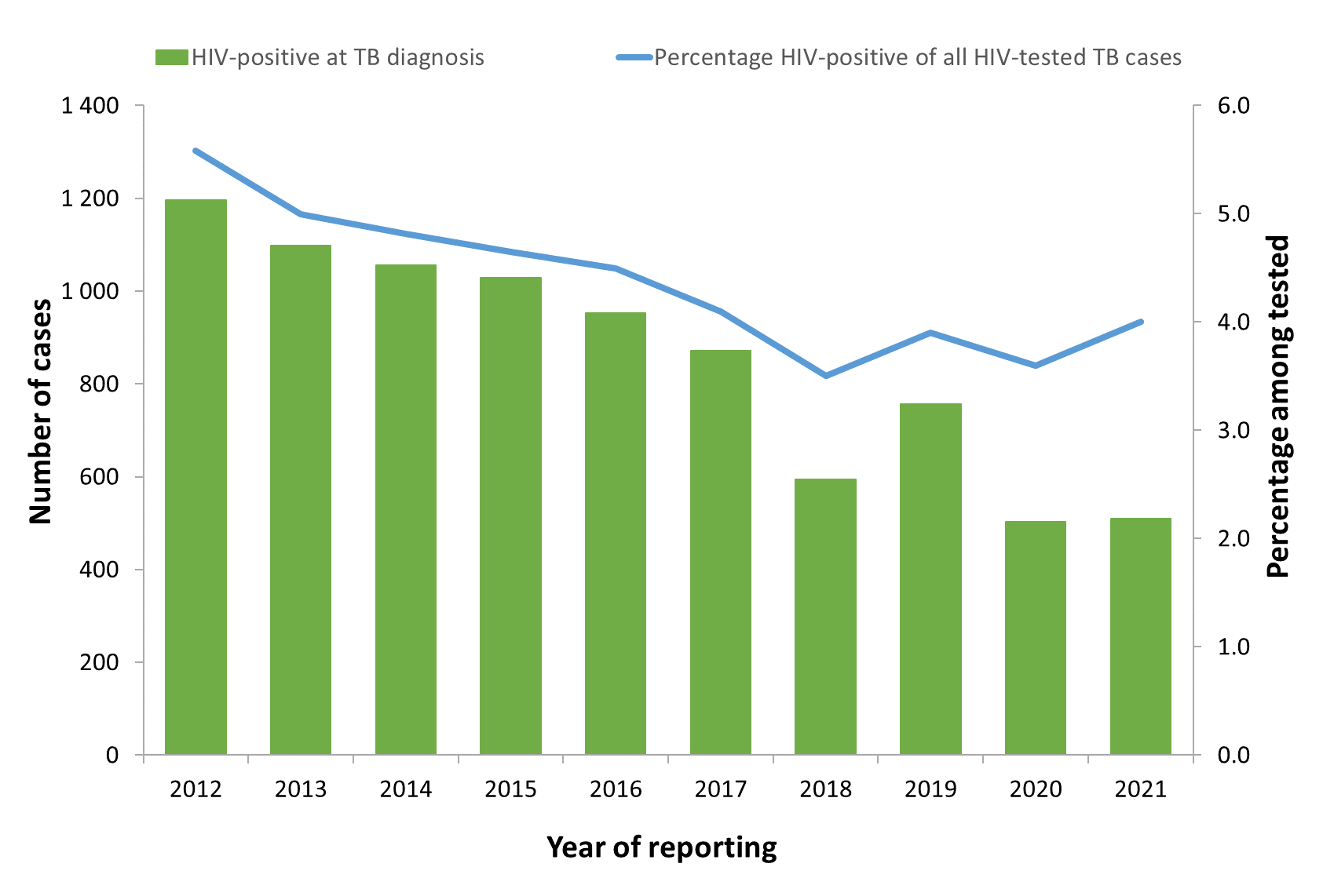
HIV-positive TB cases and proportion among all those tested, EU/EEA, 2012–2021*
The total number of HIV-positive TB cases decreased from 1 196 in 2012 to 510 in 2021
The proportion of HIV-positive TB cases among those tested decreased from 5.6% in 2012 to 4.0% in 2021
* Countries and the years for which they are not included due to reporting discrepancies or no data: Austria (all years), Croatia (2012-2015), Cyprus (2012-2013),
Denmark (2012-2013), Finland (all years), France (all years), Germany (all years), Greece (2012), Hungary (2012-2013), Iceland (2020-2021), Italy (all years), Latvia (2018-2020),
Liechtenstein (all years), Norway (2011-2012), Poland (all years) and Sweden (all years).
Source: ECDC/WHO (2023). Tuberculosis surveillance and monitoring in Europe 2023–2021 data

Slide 19
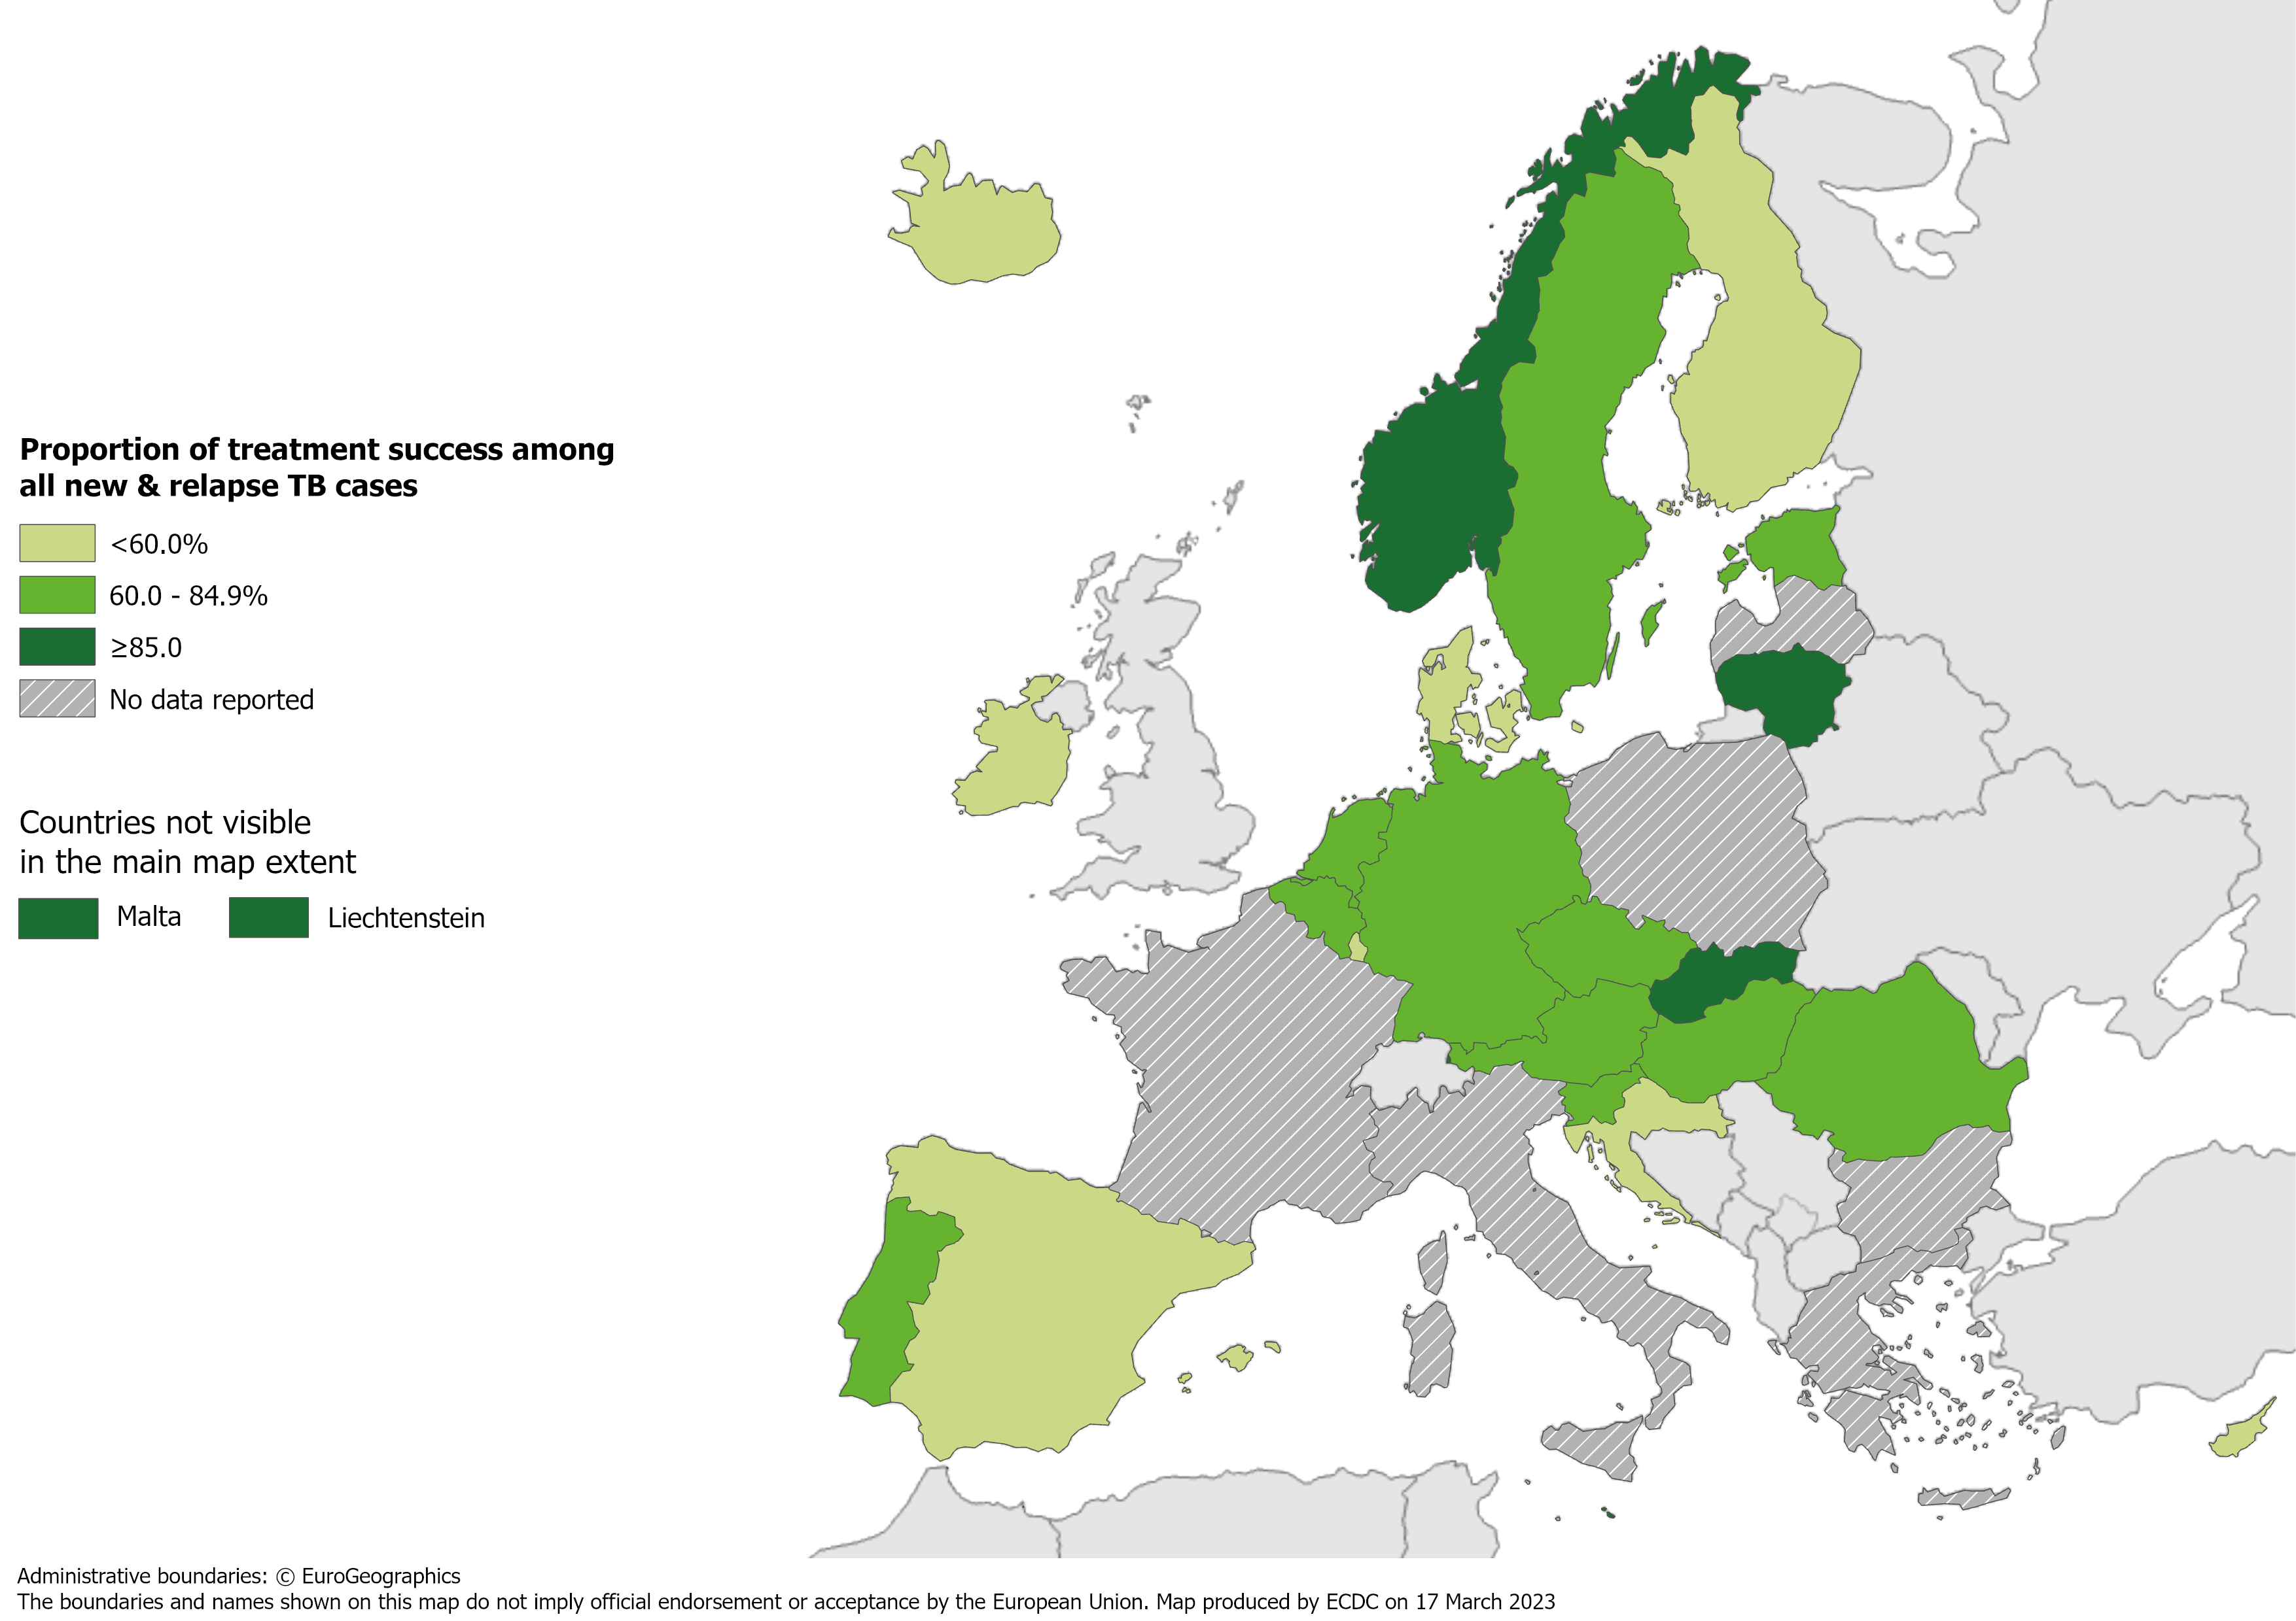
Treatment success after 12 months among new and relapse TB cases notified in 2020, EU/EEA*, 2021
71.7% of all
TB cases had a successful treatment outcome after
12 months (range 6.3–100.0%)
* Six countries did not report treatment outcome data: Bulgaria, France, Greece, Italy, Latvia,
Poland. Iceland did not report any data for 2021.
Source: ECDC/WHO (2023). Tuberculosis surveillance and monitoring in Europe 2023–2021 data

Slide 20
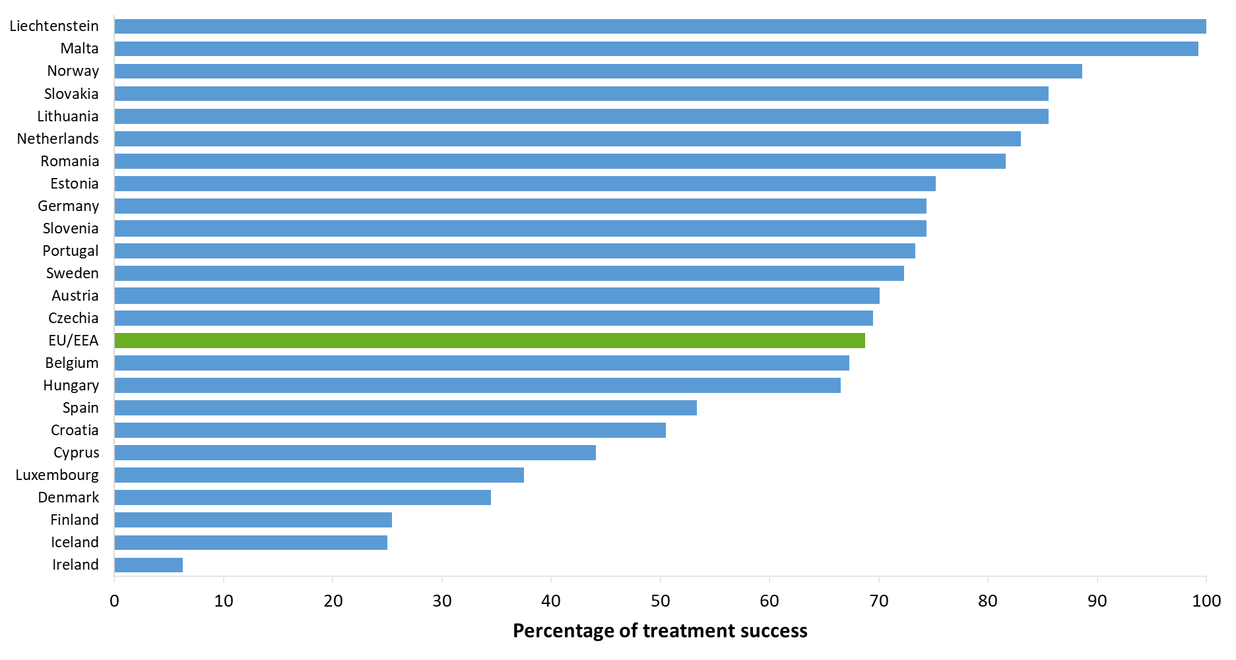
Treatment success after 12 months among new & relapse TB cases notified in 2020, EU/EEA*, 2021
71.7% of new & relapse TB cases had a successful treatment outcome after 12 months (range 6.3–100%)
*Six EU/EEA countries did not report treatment outcome data: Bulgaria, France, Greece, Italy, Latvia, Poland.
Iceland did not report data for 2021; 2020 data contained information on treatment success.
Source: ECDC/WHO (2023). Tuberculosis surveillance and monitoring in Europe 2023–2021 data

Slide 21
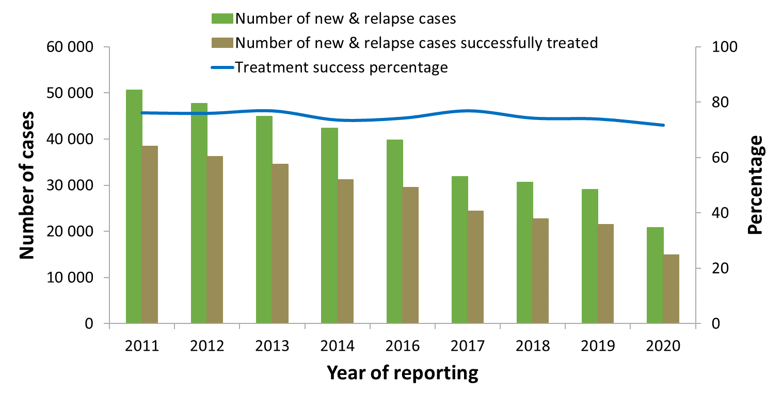
Treatment success after 12 months among new and relapse TB cases notified 2011–2020, EU/EEA, 2021
Proportion of successfully treated cases remained stable between 76.1% in 2011 and 71.7% in 2020*
* Countries and the years for which they are not included due to reporting discrepancies or no data: Croatia (2010-2011), France (all years), Greece (all years), Iceland (2021), Italy (all years), Latvia (2017-2020), Liechtenstein (2010-2014, 2018-2019), Luxembourg (2010-2018), Malta (2014-2019), Poland (2017-2019).
Source: ECDC/WHO (2023). Tuberculosis surveillance and monitoring in Europe 2023–2021 data

Slide 22
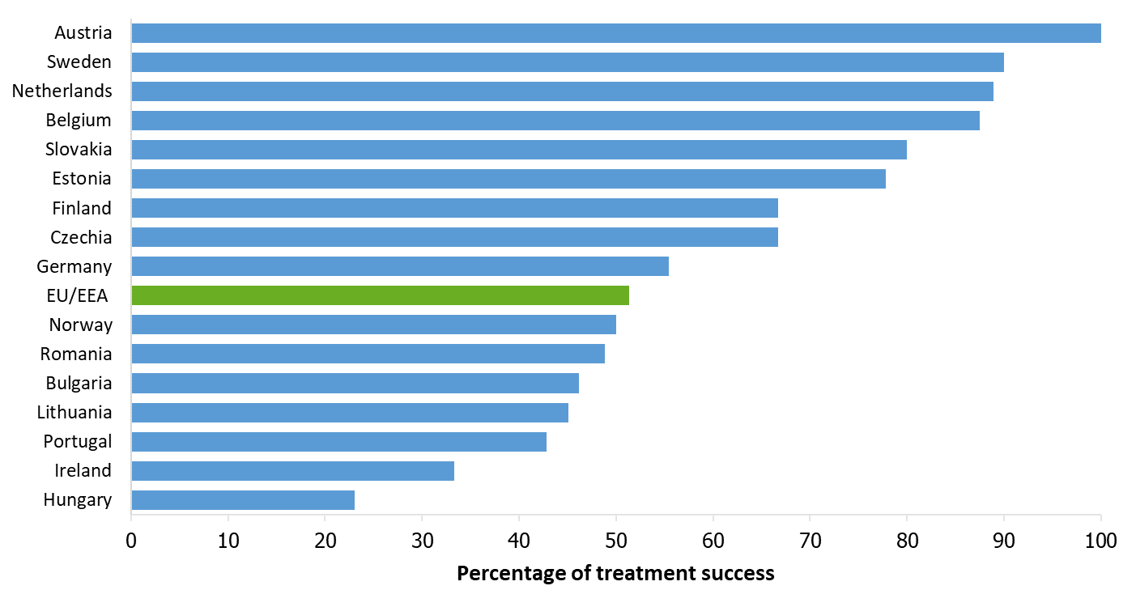
Treatment success after 24 months among RR/MDR TB cases started on second-line treatment in 2019, EU/EEA*, 2021
51.7% of all RR/MDR TB cases started on second-line treatment in 2019 were reported to have treatment success after 24 months (range 23.1–100%)
* Slovenia did not report any RR/MDR TB cases in 2019.
Ten countries did not report treatment outcome data: Cyprus, France, Greece, Italy, Latvia, Liechtenstein, Luxembourg, Malta, Poland, Spain. Iceland did not report any data for 2021.
Source: ECDC/WHO (2022). Tuberculosis surveillance and monitoring in Europe 2022–2020 data

Slide 23
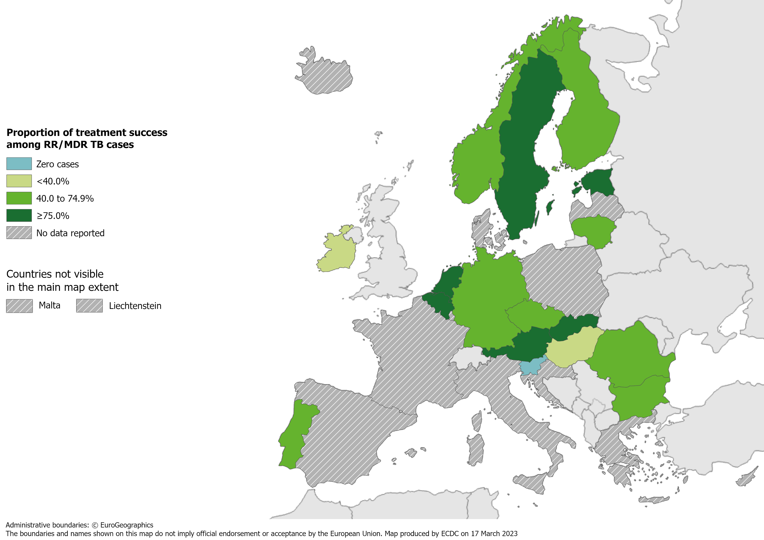
Treatment success after 24 months among RR/MDR TB cases started on second-line treatment in 2019, EU/EEA*, 2021
51.7% of all RR/MDR TB cases started on second-line treatment in 2019 were reported to have treatment success after 24 months (range 23.1–100%)
* Slovenia did not report any RR/MDR TB cases in 2019.
Ten countries did not report treatment outcome data: Cyprus, France, Greece, Italy, Latvia, Liechtenstein, Luxembourg, Malta, Poland, Spain. Iceland did not report any data for 2021.
Source: ECDC/WHO (2023). Tuberculosis surveillance and monitoring in Europe 2023–2021 data

Slide 24
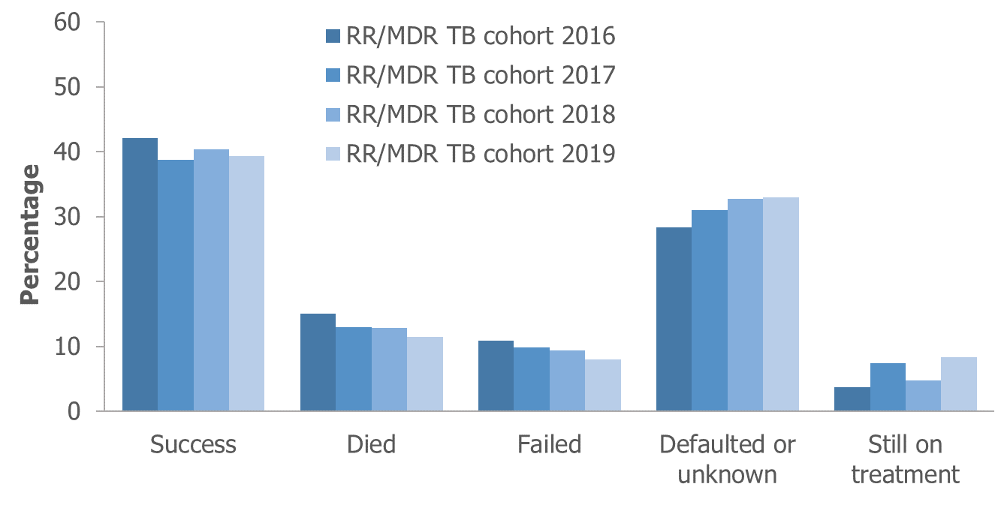
Treatment outcomes among RR/MDR TB cases* started on second-line treatment in 2016–2019, EU/EEA†, 2021
Reported treatment success remained below 50% for all RR/MDR TB cohorts between 2016-2019
* Pre-XDR and XDR TB cases are not included and, thus, treatment outcomes presented here differ from those including pre-XDR and XDR TB cases.
† Countries and the cohorts for which they are not included due to reporting discrepancies or no data: Croatia (2016-2017), Cyprus (all years), France (all years), Greece (all years), Iceland (all years), Italy (all years), Latvia (2016-2018), Liechtenstein (all years), Luxembourg (all years), Malta (all years), Poland (2016-2018), Slovenia (all years), Spain (all years).
Source: ECDC/WHO (2023). Tuberculosis surveillance and monitoring in Europe 2023–2021 data

Slide 25
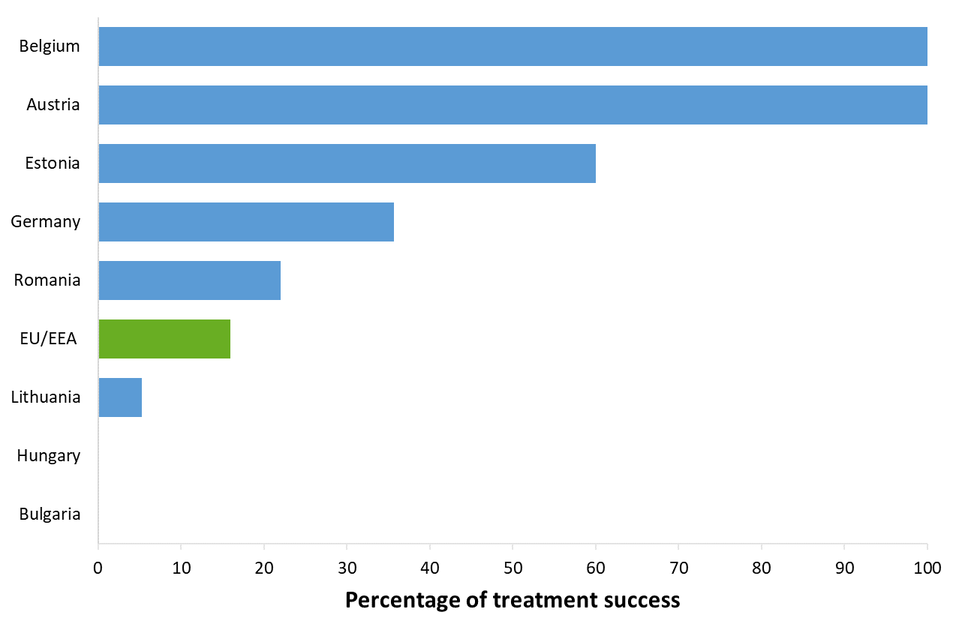
Treatment success after 24 months among pre-XDR TB cases started on second-line treatment in 2019, EU/EEA*, 2021
17.0% of the pre-XDR TB cases started on second-line treatment in 2019 were reported to have treatment success after 24 months (range 0-100%)*
* Eleven countries reported zero pre-XDR TB cases in 2019: Cyprus, Czechia, Denmark, Finland, Ireland, Liechtenstein, Netherlands, Portugal, Slovakia, Slovenia and Sweden.
Nine countries did not report treatment outcome data: Croatia, France, Greece, Italy, Luxembourg, Malta, Norway, Poland and Spain.
Latvia did not report any data for 2018-2020 and Iceland did not report data for 2021.
Source: ECDC/WHO (2023). Tuberculosis surveillance and monitoring in Europe 2023–2021 data

Slide 26
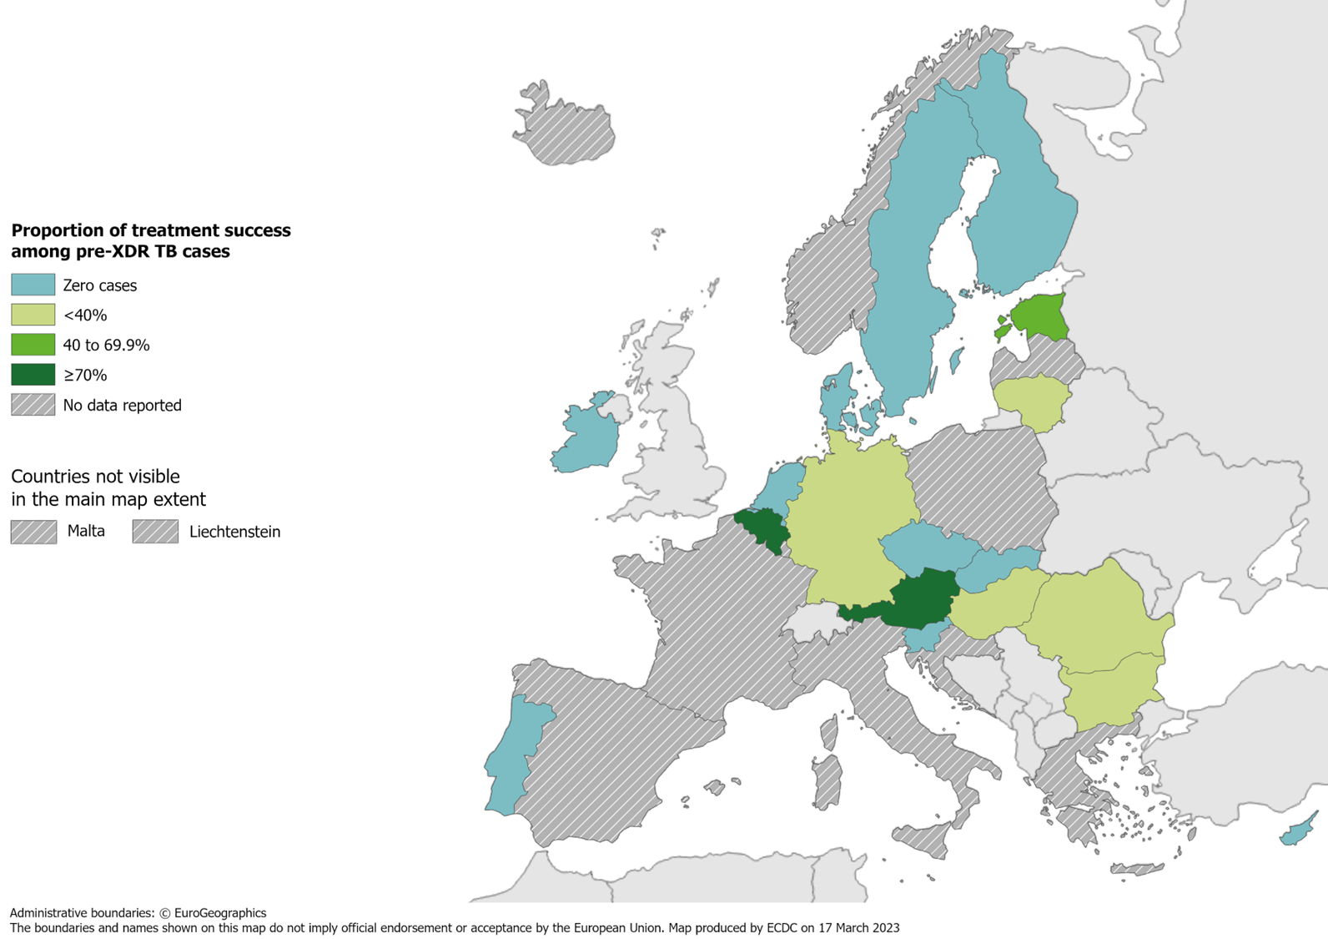
Treatment success after 24 months among pre-XDR TB cases started on second-line treatment in 2019, EU/EEA*, 2021
17% of all pre-XDR TB cases started on second-line treatment in 2019 were successfully treated (range 0–100%)
* Eleven countries did not report any pre-XDR TB cases in 2019: Cyprus, Czechia,
Denmark, Finland, Ireland, Liechtenstein, Netherlands, Portugal, Slovakia, Slovenia and Sweden.
Nine countries did not report treatment outcome data: Croatia, France, Greece, Italy,
Liechtenstein, Luxembourg, Malta, Norway, Poland, Spain.
Latvia did not report any data for 2018-2020 and Iceland did not report any data for 2021.
Source: ECDC/WHO (2023). Tuberculosis surveillance and monitoring in Europe 2023–2021 data

Slide 27
Treatment outcomes new & relapse TB, RR/MDR, pre-XDR, XDR TB cases, EU/EEA*, 2021
 | New & relapse TB, 12 months | RR/MDR TB, 24 months | Pre-XDR TB, 24 months | XDR TB, 36 months
Cases started on treatment | 20 760 | 781 | 159 | 27
Countries reporting cases | 24 | 16 | 8 | 5
Countries reporting 0 cases | 0 | 1 | 11 | 15
Treatment success | 71.7% | 51.7% | 17.0% | 66.7%
* Latvia did not report any data for 2018-2020, Iceland did not report data for 2021.

