Slide 1
Tuberculosis situation in the EU/EEA, 2018
Findings from the joint report Tuberculosis surveillance and monitoring in Europe by ECDC and WHO Regional Office for Europe
Stockholm, 24 March 2020

Slide 2
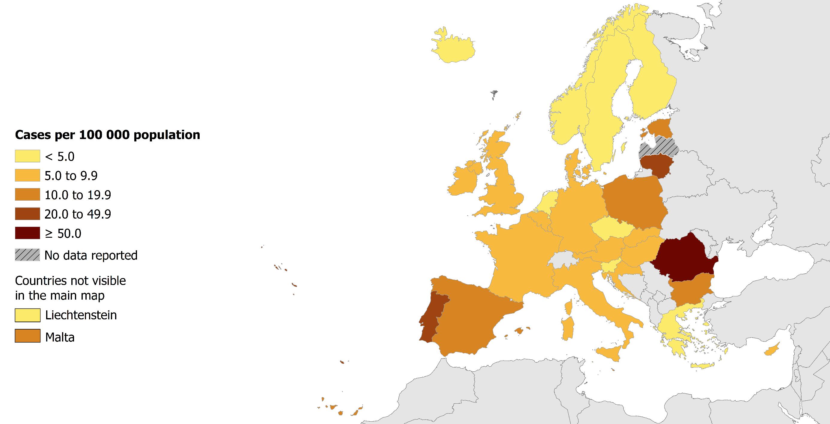
TB notifications, EU/EEA, 2018
52 862 TB cases notified in 30 EU/EEA countries
Notification rate 10.2 per 100 000 population (range 2.3–62.5)
Source: ECDC/WHO (2020). Tuberculosis surveillance and monitoring in Europe 2020–2018 data

Slide 3
Notified TB cases, EU/EEA, 2009–2018*
Continuous decline between 2009 and 2018:
number of TB cases decreased by 34%
notification rate decreased by 35%
* Latvia did not report data for 2018
Source: ECDC/WHO (2020). Tuberculosis surveillance and monitoring in Europe 2020–2018 data
Notes:
Marieke added a note about Latvia on relevant slides.

Slide 4
TB notification rate by sex and age group, EU/EEA, 2018*
The highest notification rate was observed in the age group 25–44 years (8 per 100 000)
Males were over-represented in all age groups over 14 years
* Latvia did not report data for 2018
Source: ECDC/WHO (2020). Tuberculosis surveillance and monitoring in Europe 2020–2018 data

Slide 5
TB notification rate by age group, EU/EEA, 2009–2018*
Annual average decrease by 2–6% in all age groups
* Croatia started reporting data as of 2010 and is not included for the years prior to 2010. Latvia did not report data for 2018
Source: ECDC/WHO (2020). Tuberculosis surveillance and monitoring in Europe 2020–2018 data

Slide 6
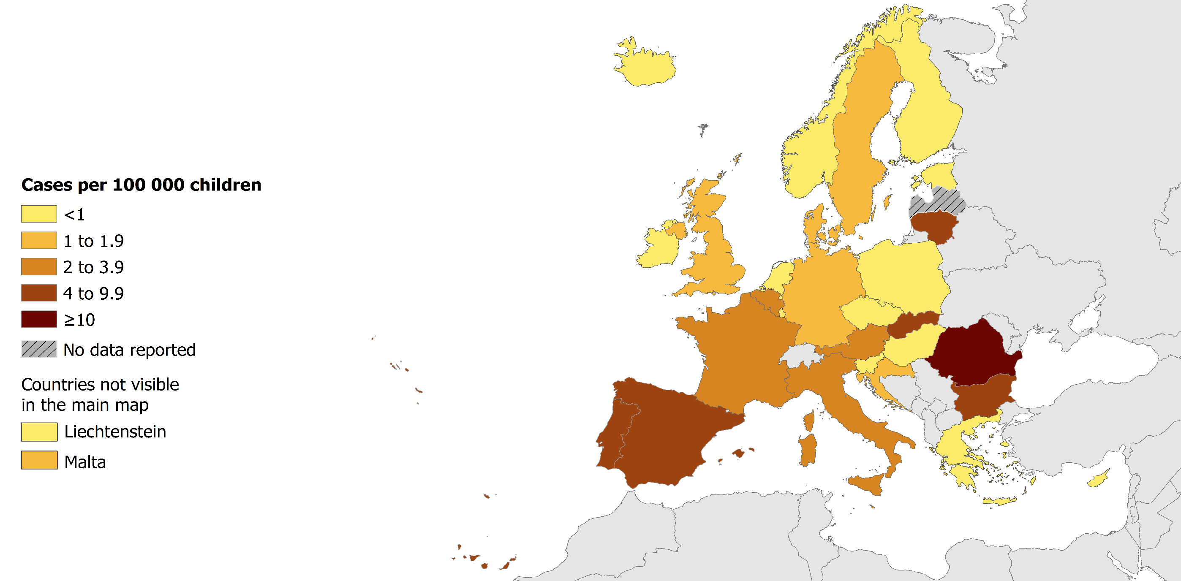
TB in children under 15 years, EU/EEA, 2018
2 060 TB cases notified in children under 15 years
3.9% of all TB cases (range 0–14.2%)
2.6 per 100 000 child population (range 0–17.8)
Source: ECDC/WHO (2020). Tuberculosis surveillance and monitoring in Europe 2020–2018 data

Slide 7
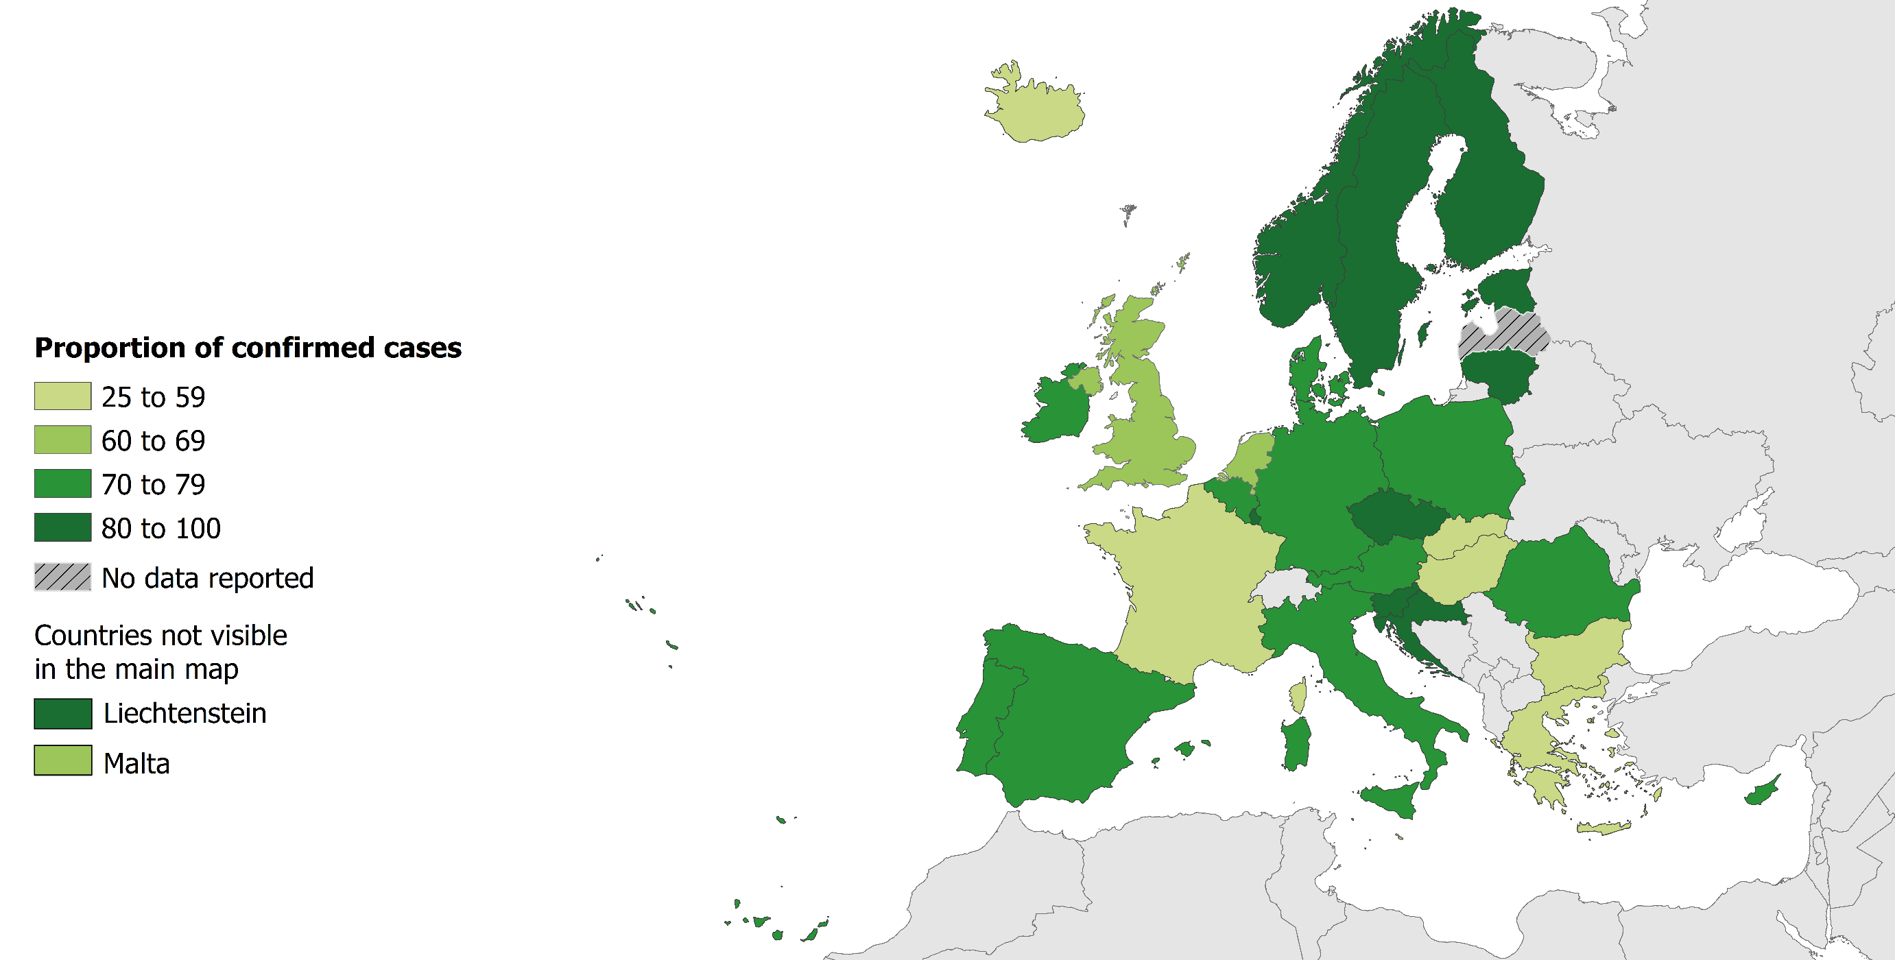
Confirmed TB cases*, EU/EEA, 2018
36 047 TB cases were confirmed
68.2% of all TB cases (range 25–100%)
* Confirmation by culture, or by microscopy and Mycobacterium tuberculosis nucleic acid amplification test
Source: ECDC/WHO (2020). Tuberculosis surveillance and monitoring in Europe 2020–2018 data

Slide 8
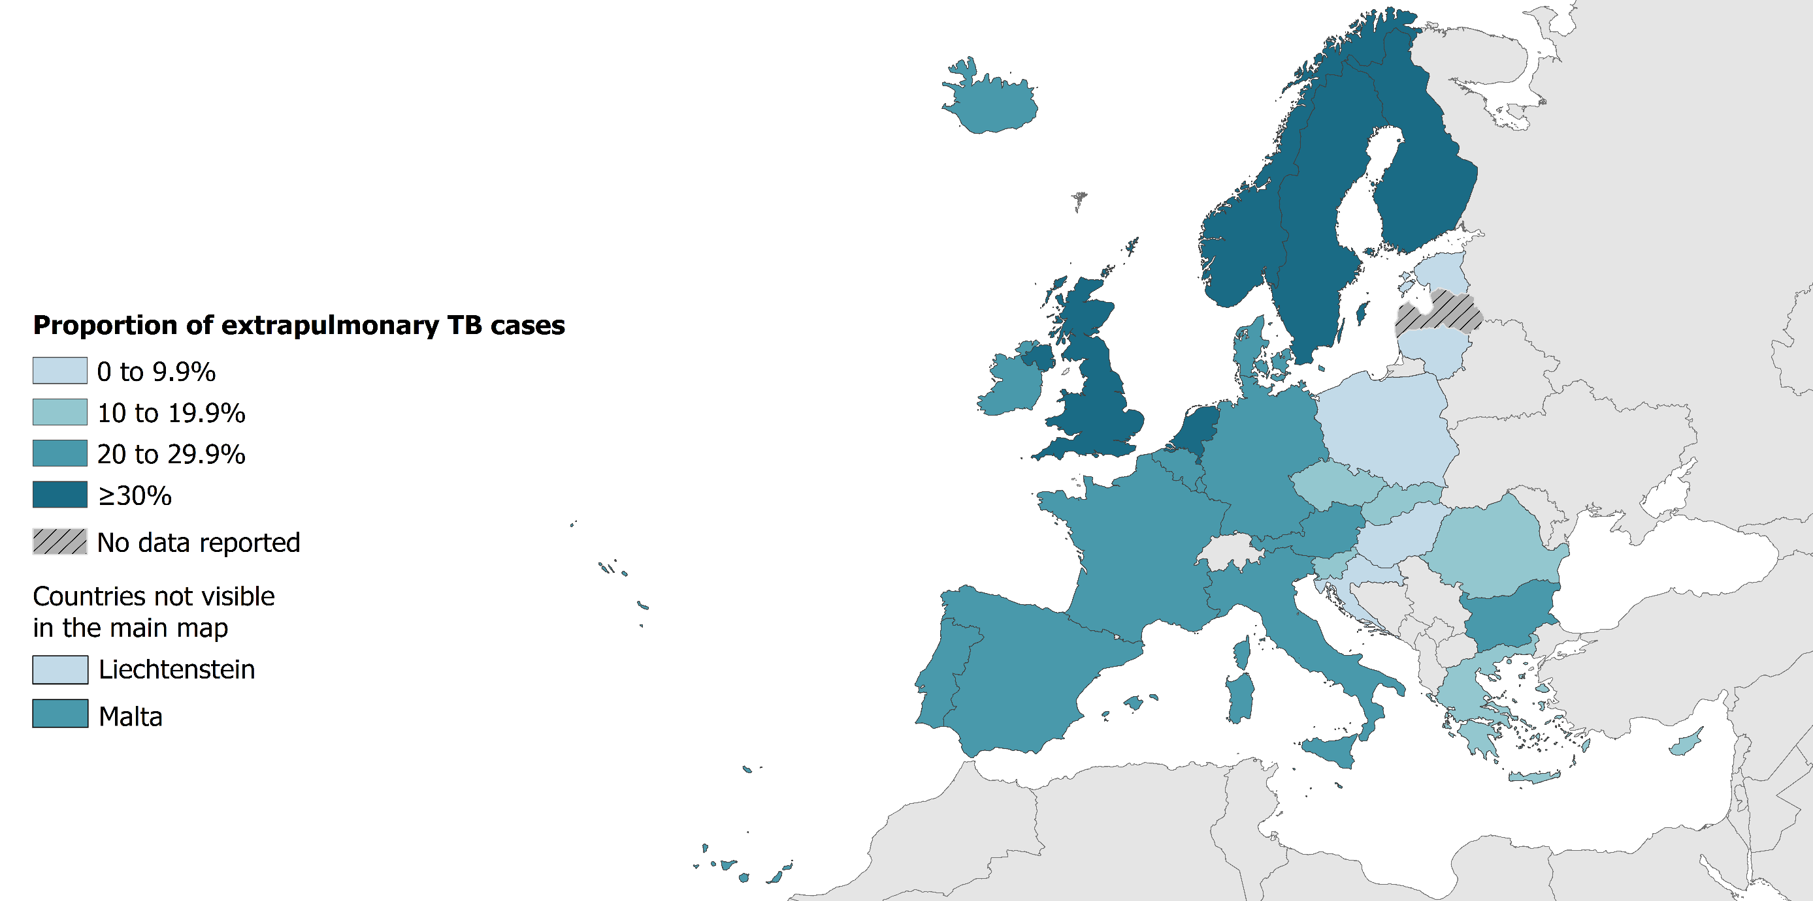
Extrapulmonary TB, EU/EEA, 2018
11 857 notified cases had extrapulmonary TB
22.4% of all TB cases (range 0–42.2%)
Source: ECDC/WHO (2020). Tuberculosis surveillance and monitoring in Europe 2020–2018 data

Slide 9
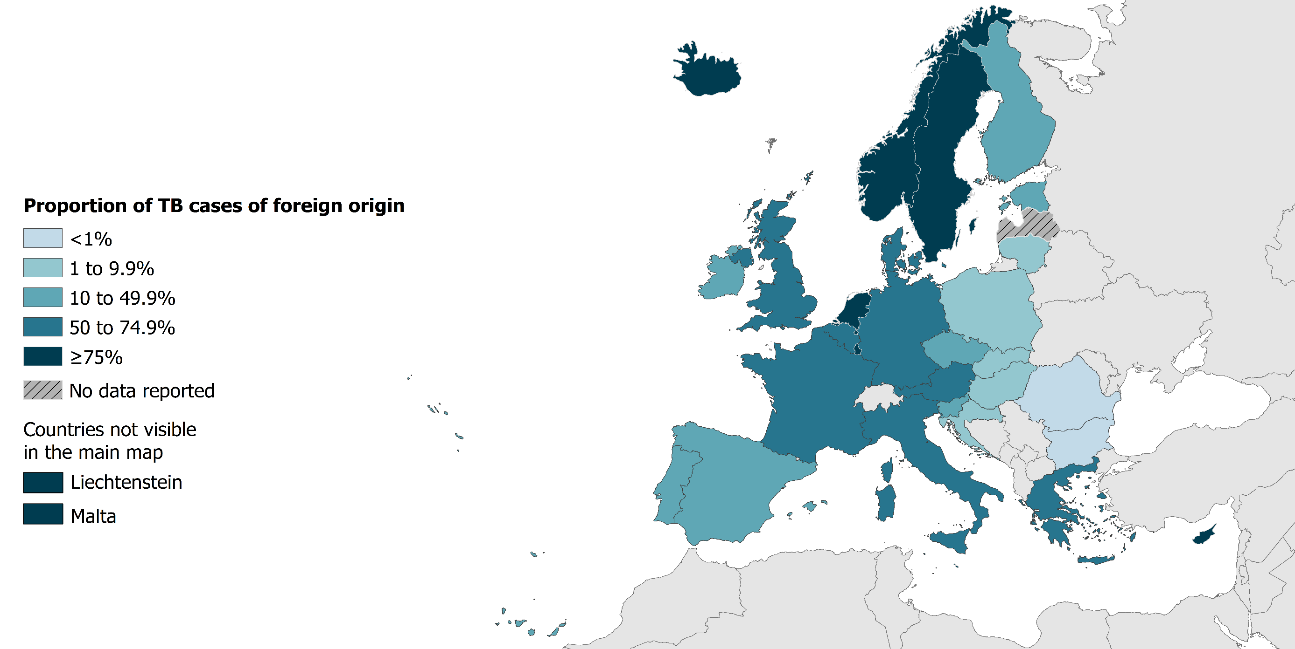
TB in persons of foreign origin, EU/EEA, 2018
18 246 TB cases of foreign* origin
34.5% of all TB cases (range 0.3–100%)
* Notified in persons originating from other countries than the reporting country
Source: ECDC/WHO (2020). Tuberculosis surveillance and monitoring in Europe 2020–2018 data

Slide 10
TB cases in persons of foreign origin, EU/EEA, 2009–2018*
The proportion of cases in persons of foreign origin increased from 23.8% in 2009 to 34.5% in 2018
The rate of TB cases of foreign origin per 100 000 of the total population varied between 3.4 and 3.9
* Croatia started reporting data as of 2010 and is not included for the years prior to 2010. Latvia did not report data in 2018
Source: ECDC/WHO (2020). Tuberculosis surveillance and monitoring in Europe 2020–2018 data

Slide 11
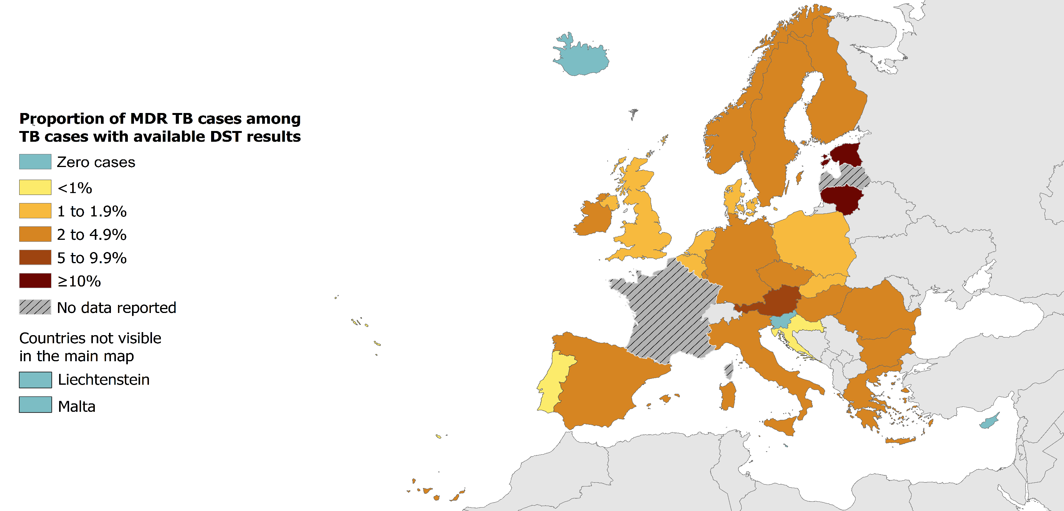
Multidrug-resistant TB (MDR TB), EU/EEA, 2018
1 052 MDR TB cases notified by 30 EU/EEA countries
3.6% of all TB cases with available DST* results had MDR TB (range 0–100%)
* DST – drug susceptibility test
* France only reported data for rifampicin resistant TB cases; MDR TB data from France are not included in the map
Source: ECDC/WHO (2020). Tuberculosis surveillance and monitoring in Europe 2020–2018 data

Slide 12
Proportion of multidrug-resistant TB (MDR TB), EU/EEA, 2018*
1 052 MDR TB cases notified by 30 EU/EEA countries
3.6% of all bacteriologically-confirmed TB cases with available DST results had MDR TB (range 0–24.6%)
* MDR TB data from France are not included in the graph.
* DST – drug susceptibility test
Cyprus, Iceland, Liechtenstein, Malta and Slovenia reported zero MDR TB cases for 2018. Latvia did not report data for 2018.
Source: ECDC/WHO (2020). Tuberculosis surveillance and monitoring in Europe 2020–2018 data

Slide 13
MDR TB cases and proportions of all TB cases tested for drug resistance, EU/EEA, 2009–2018*
The total number of notified MDR TB cases decreased from 1 673 in 2009 to 1 052 in 2018
Proportion of MDR TB cases among all TB cases tested for drug resistance decreased from 4.6% in 2009 to 3.6% in 2018
* Three countries are not included due to reporting discrepancies for the years indicated in brackets: Croatia (2010), France (2012, 2015, 2017), Latvia (2018)
Source: ECDC/WHO (2020). Tuberculosis surveillance and monitoring in Europe 2020–2018 data

Slide 14
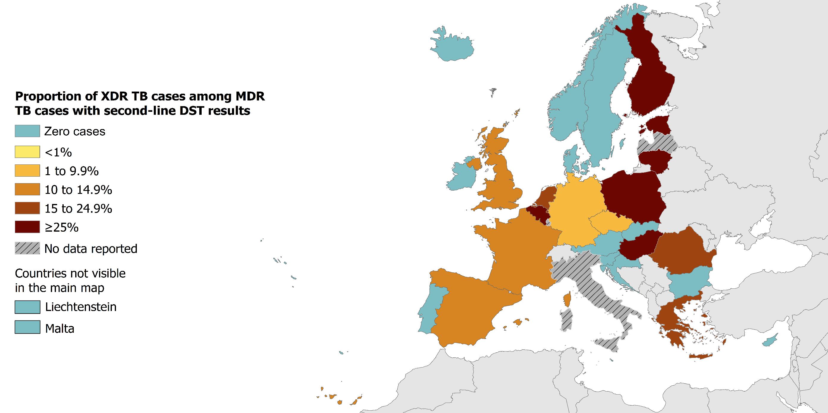
Extensively drug-resistant TB (XDR TB), EU/EEA, 2018
19.6% of MDR TB cases with second-line DST* results were extensively drug-resistant (range 0–42.9% and 8.9–34.1% for countries reporting more than five XDR TB cases)
* DST – drug susceptibility test
Source: ECDC/WHO (2020). Tuberculosis surveillance and monitoring in Europe 2020–2018 data

Slide 15
Proportion of extensively drug-resistant TB (XDR TB), EU/EEA, 2018
158 XDR TB cases notified in 14 EU/EEA countries*
19.6% of all MDR TB cases with second-line drug susceptibility test results (range 0–42.9%)
* The graph shows countries that reported XDR TB cases. Cyprus, Iceland, Liechtenstein, Luxembourg, Malta and Slovenia reported no MDR or XDR cases in 2018. MDR or XDR data was not available for Italy and Latvia.
Source: ECDC/WHO (2020). Tuberculosis surveillance and monitoring in Europe 2020–2018 data

Slide 16
Pulmonary XDR TB cases and proportions of all pulmonary MDR TB cases tested for second-line drug resistance, EU/EEA, 2009–2018*
The total number of pulmonary XDR TB cases increased from 64 in 2009 to 159 in 2018
The proportion of XDR TB cases among pulmonary MDR TB cases was 11.7% in 2009 and 20.4% in 2018
* Countries and the years for which they are not included due to reporting discrepancies or no data: Croatia (2009-2012), France (2009-2012, 2017), Latvia (2018), Luxembourg, Italy (2009-2012), Spain (2009-2012)
Source: ECDC/WHO (2020). Tuberculosis surveillance and monitoring in Europe 2020–2018 data

Slide 17
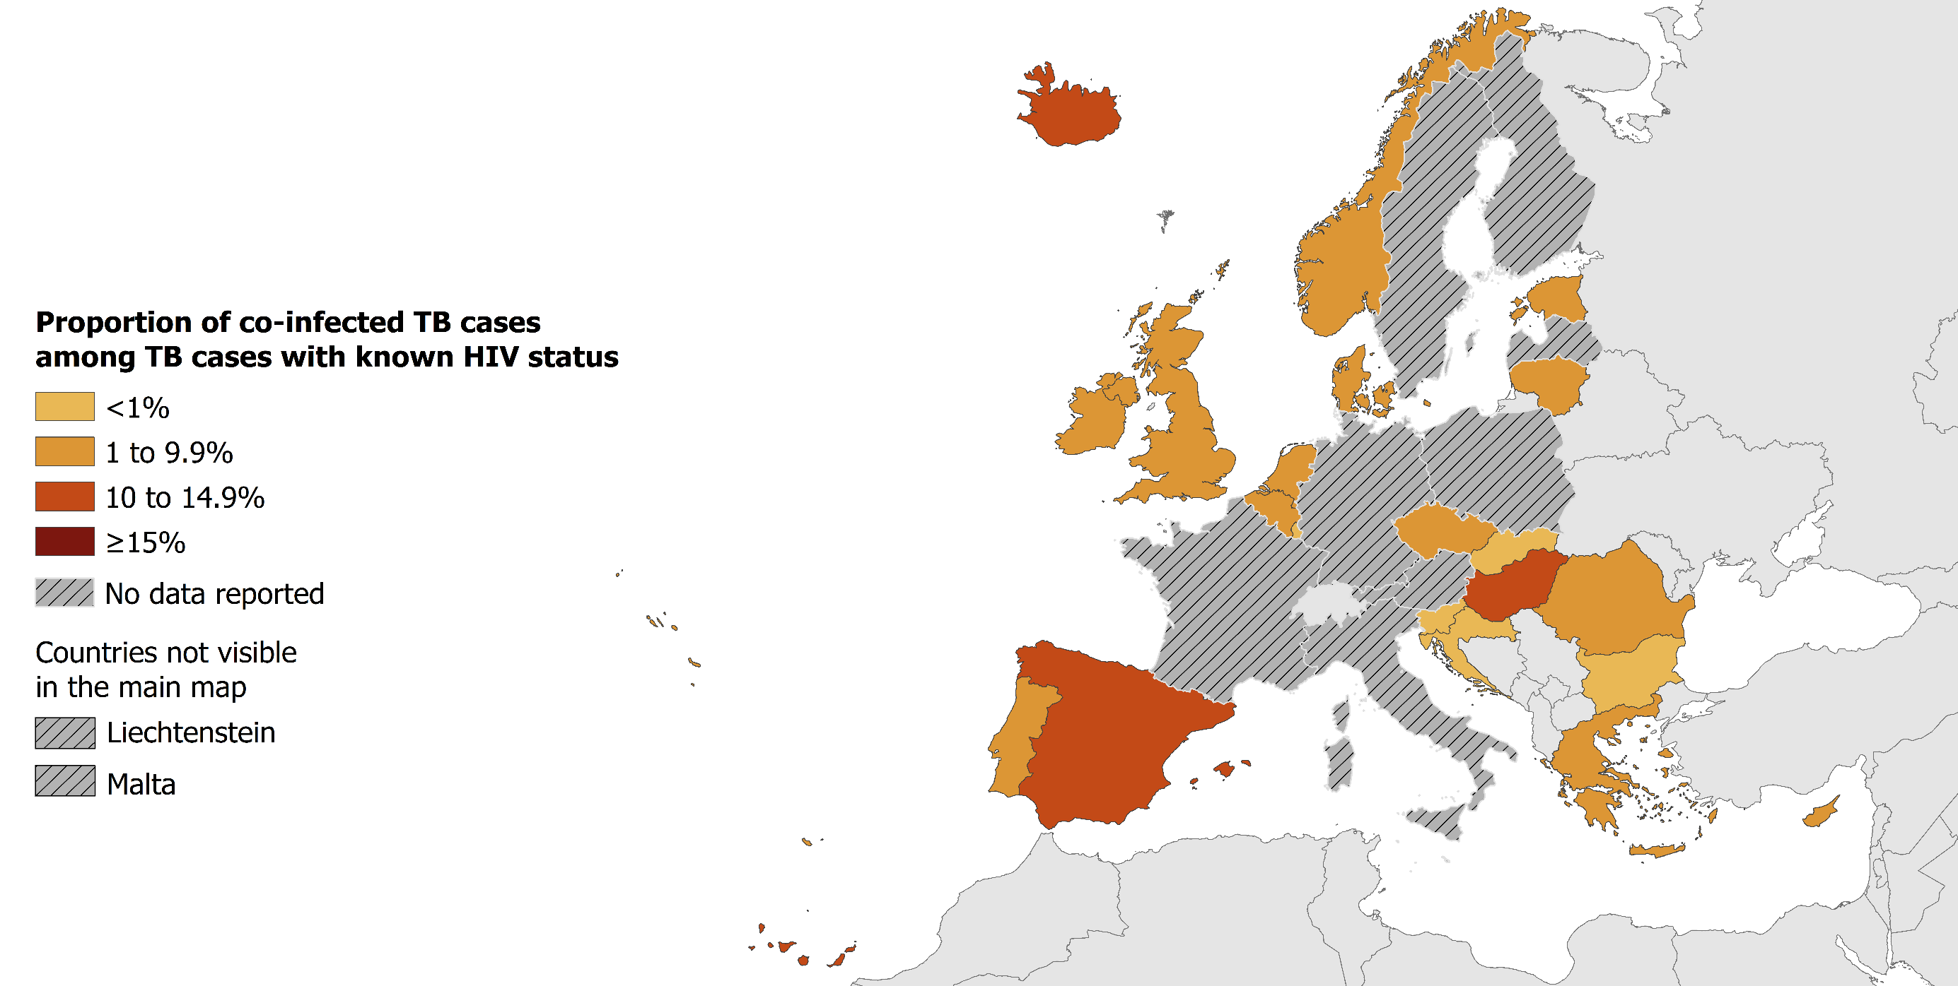
TB/HIV co-infection, EU/EEA, 2018
991 HIV-positive TB cases were notified by 21 EU/EEA countries in 2018
4.2% of TB cases with known HIV status were HIV-positive (range 0–13%)
Source: ECDC/WHO (2020). Tuberculosis surveillance and monitoring in Europe 2020–2018 data

Slide 18
HIV-positive TB cases and proportions among all those tested, EU/EEA, 2009–2018*
The total number of HIV-positive TB cases decreased from 1 287 in 2009 to 991 in 2018
The proportion of HIV-positive TB cases among those tested decreased from 7.4% in 2009 to 4.2% in 2018
* Countries and the years for which they are not included due to reporting discrepancies or no data: Austria (2009-2018), Croatia (2009-2015), Cyprus (2009-2010, 2013), Finland (2009, 2012-2018), France (2009-2012, 2018), Germany (2009-2018), Greece (2009-2012), Hungary (2009, 2012-2013), Italy (2009-2018), Latvia (2018), Liechtenstein (2009-2018), Lithuania (2009), Luxembourg (2009, 2015), Malta (2018), Norway (2009-2011), Poland (2009, 2012-2018), Sweden (2009-2018)
Source: ECDC/WHO (2020). Tuberculosis surveillance and monitoring in Europe 2020–2018 data

Slide 19
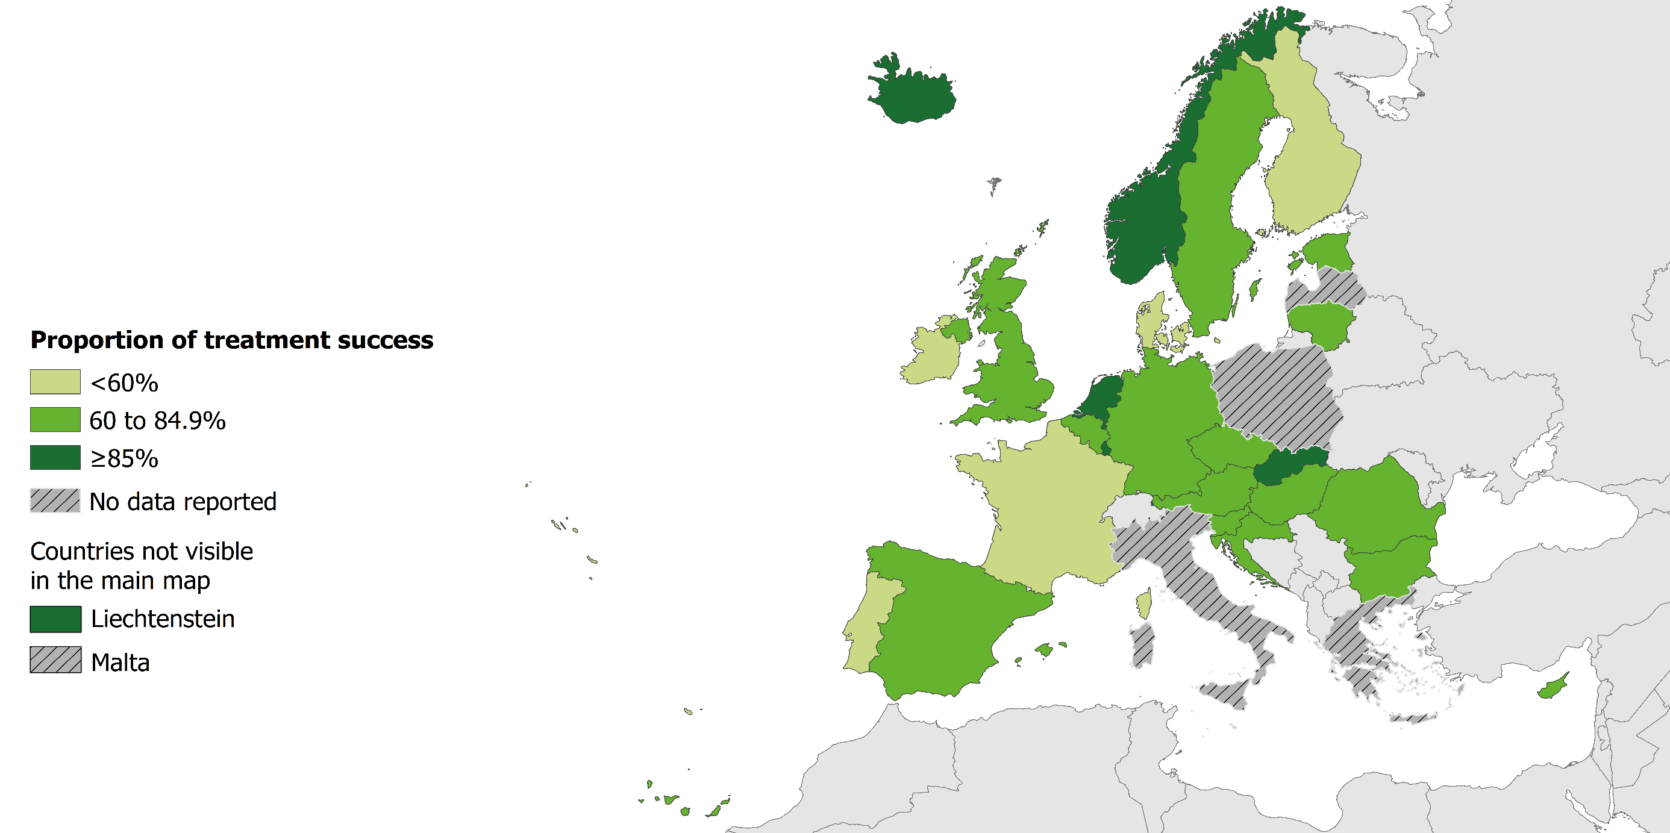
Treatment success as of 2018 in all TB cases notified in 2017, EU/EEA
67.7% of all TB cases* had a successful treatment outcome after 12 months (range 0–100%)
Source: ECDC/WHO (2020). Tuberculosis surveillance and monitoring in Europe 2020–2018 data

Slide 20
Treatment success as of 2018 in all TB cases notified in 2017, EU/EEA
67.6% of all TB cases* had a successful treatment outcome after 12 months (range 0–100%)
* Treatment outcome data not available for Greece, Italy, Latvia, Malta and Poland
Source: ECDC/WHO (2020). Tuberculosis surveillance and monitoring in Europe 2020–2018 data

Slide 21
Treatment success of all notified TB cases after 12 months, EU/EEA, 2008–2017
Proportion of successfully treated cases decreased from 76.3% in 2008 to 67.6% in 2017*
* Over the years the number of countries reporting treatment outcome data varied between 24 and 28
Source: ECDC/WHO (2020). Tuberculosis surveillance and monitoring in Europe 2020–2018 data

Slide 22
Treatment success after 24 months in MDR TB cases*, EU/EEA, 2018
48.1% of all MDR TB cases notified in 2016 were successfully treated (range 20–91%)
* Croatia, Iceland, Liechtenstein, Malta and Slovenia reported zero MDR TB cases in 2016. Treatment outcome and/or DST data were not available for Cyprus, France, Greece, Italy, Latvia, Luxembourg, Poland and Spain.
Source: ECDC/WHO (2020). Tuberculosis surveillance and monitoring in Europe 2020–2018 data

Slide 23
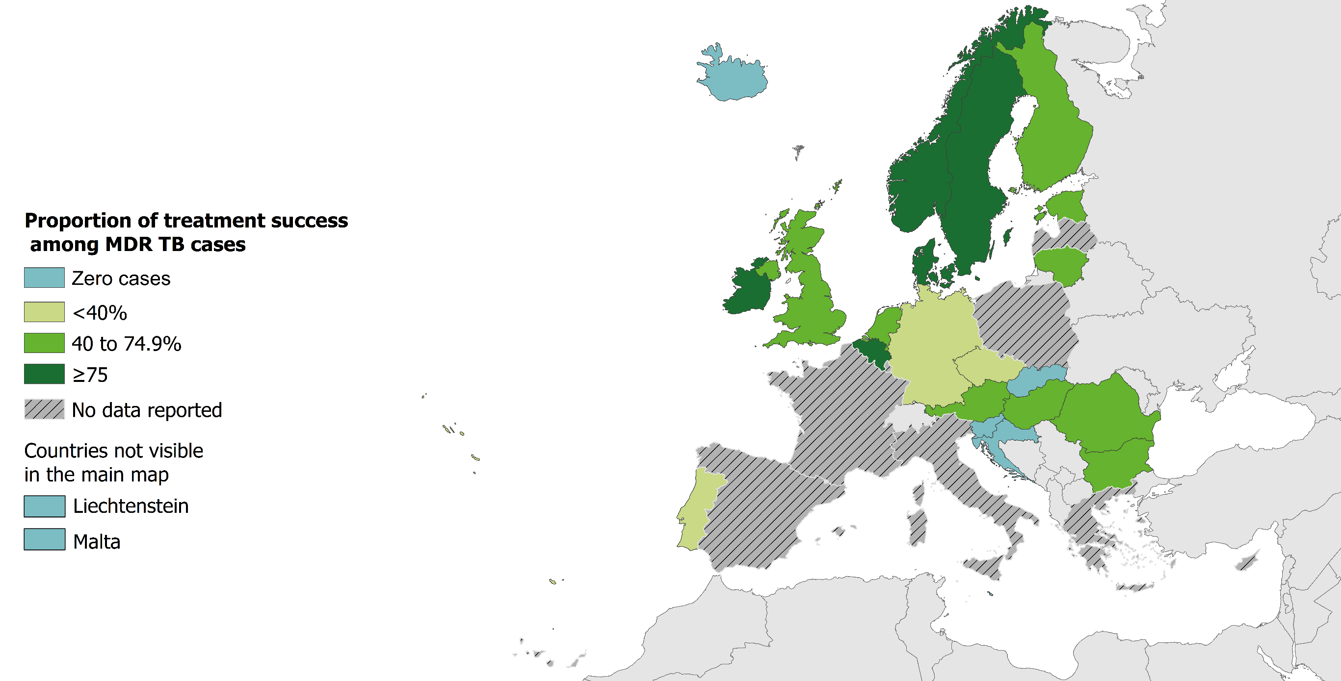
Treatment success as of 2018 in MDR TB cases notified in 2016*, EU/EEA
48.1% of all MDR TB cases notified in 2016 were successfully treated (range 20–91%)
Source: ECDC/WHO (2020). Tuberculosis surveillance and monitoring in Europe 2020–2018 data

Slide 24
Treatment outcomes of MDR TB cases notified in 2013–2016, EU/EEA, 2018
The treatment success rate increased from 44% in 2013 to 53.2% in 2016*
* XDR TB cases are not included
Source: ECDC/WHO (2020). Tuberculosis surveillance and monitoring in Europe 2020–2018 data

Slide 25
Treatment success after 36 months in XDR TB cases, EU/EEA, 2018
37.4% of the XDR TB cases notified in 2015 were treated successfully (range 0–100%)*
* Croatia, Cyprus, Greece, Iceland, Ireland, Liechtenstein, Luxembourg, Malta, Netherlands, Norway, Slovakia, Slovenia and Spain reported zero MDR TB cases in 2015. Treatment outcome data was not available for Finland, France, Italy, Latvia or Poland.
Source: ECDC/WHO (2020). Tuberculosis surveillance and monitoring in Europe 2020–2018 data

Slide 26
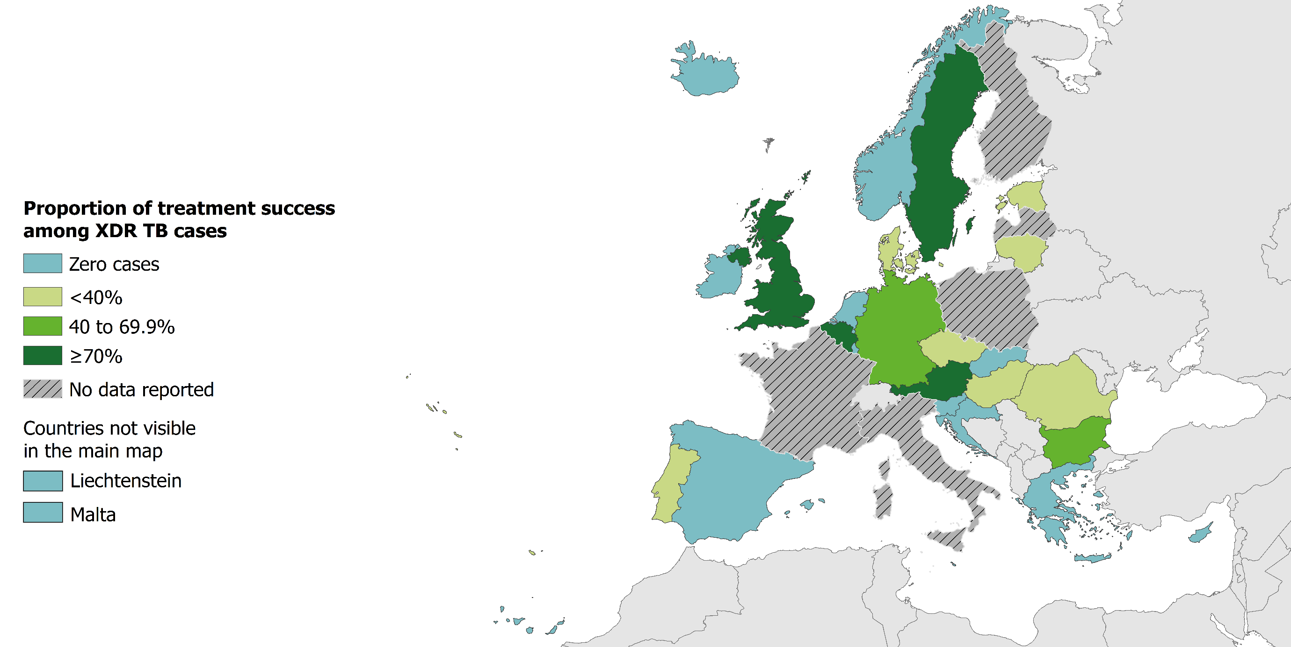
Treatment success as of 2018 in XDR TB cases notified in 2015*, EU/EEA
37.4% of all XDR TB cases notified in 2015 were successfully treated (range 0–100%)
Source: ECDC/WHO (2020). Tuberculosis surveillance and monitoring in Europe 2020–2018 data

