Slide 1

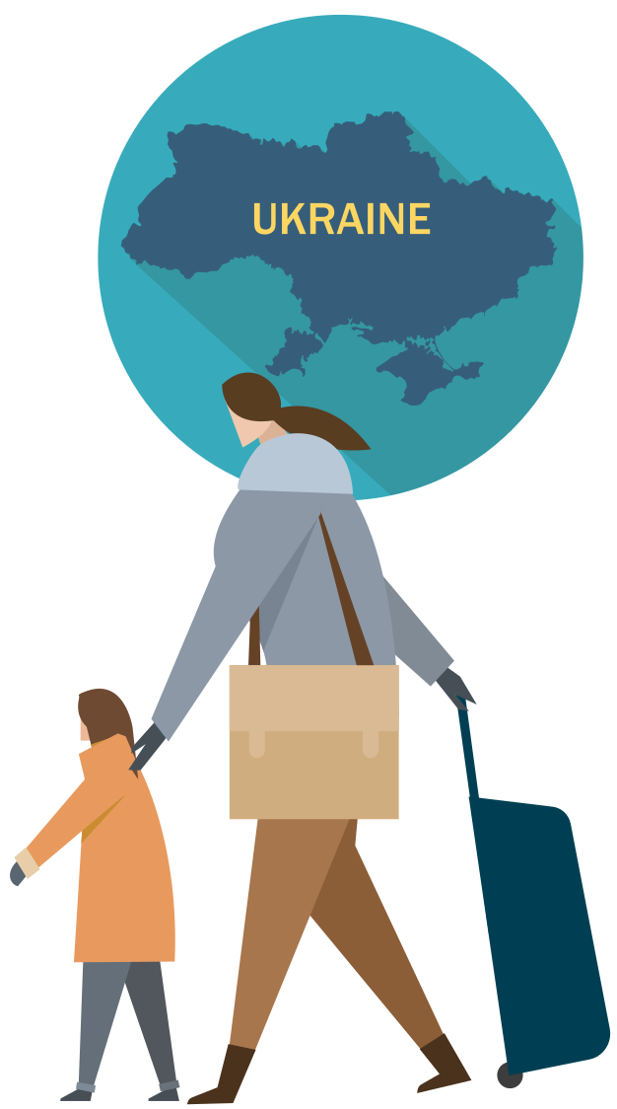
Are you and your family protected from vaccine-preventable diseases?
You and your children can receive for free the same vaccines that are offered to the population of the EU/EEA country that you are now in. These include vaccines against the most common vaccine-preventable diseases such as COVID-19, measles, mumps, rubella, diphtheria, tetanus, pertussis (whooping cough) and poliomyelitis.
Register with the national health system
If you are fleeing Ukraine and receive temporary protection in your host EU country, you will have access to national healthcare services.
Check with staff how to register with the health system.
Are you ill or is someone you care about ill?
Ask healthcare staff for medical advice, including with regard to vaccines.
Call 112 if someone is seriously ill or injured and their life is at risk.

