Slide 1


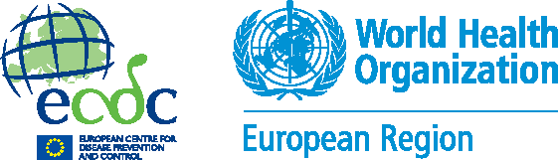
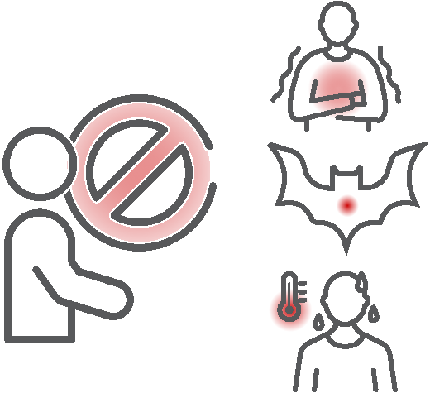
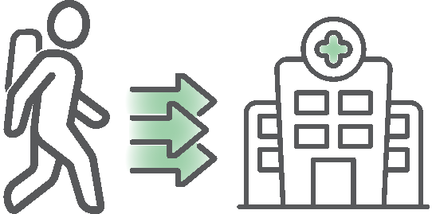
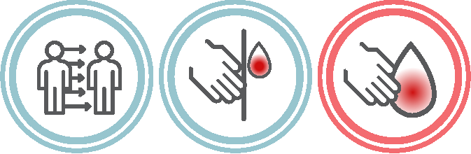
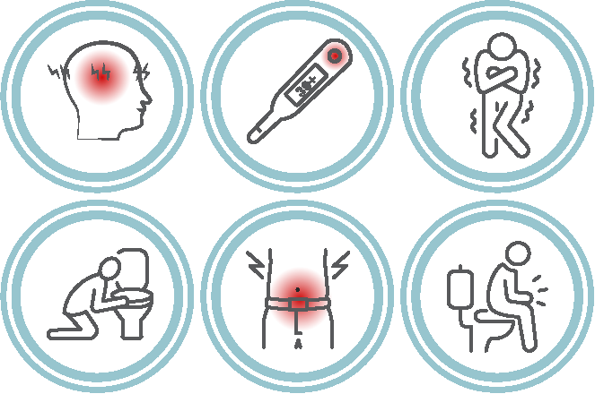


Public health advice for people travelling to or from countries with outbreaks of Marburg Virus Disease (MVD)
An MVD outbreak is currently ongoing in Rwanda. If you are travelling to or returning from Rwanda:
Avoid contact with anyone who shows MVD symptoms (like fever, vomiting, diarrhoea or bleeding) or with materials and surfaces contaminated by their bodily fluids. Keep your distance from infected individuals, including dead bodies. Avoid participating in funerary rituals.
Avoid visiting healthcare facilities in the MVD-affected areas, unless it’s an emergency.
Avoid places where bats may live, such as caves or mines. Avoid close contact with wild animals, including monkeys, forest antelopes, rodents, and bats, both alive and dead. Do not touch or eat any type of bushmeat.
Have you recently come back from Rwanda?
If you've returned from Rwanda within the previous 21 days and experience symptoms like high fever, severe headache, muscle pain, isolate yourself and contact a doctor right away. Tell them about your trip, any risky situations you were in, and people you were close to.
What you need to know about Marburg virus disease
Transmission:
MVD is a severe disease that typically spreads through direct contact with blood or other bodily fluids from infected people or animals.
The virus can also be transmitted through contact with surfaces and materials like clothing, bedding and medical equipment contaminated with infected blood or body fluids.
If proper protective measures are strictly followed, the likelihood of infection is very low.
Symptoms:
Early symptoms of MVD appear between 2- to 21 days after infection and may include high fever, chills, severe headache and severe tiredness, muscle aches and pains.
As infection progresses, patients may experience nausea, vomiting, stomach and or chest pain, rash and diarrhoea which can last around a week. In later stages of the disease, bleeding from various sites such as the gums, nose and anus can occur. Patients can suffer shock, delirium and organ failure.
Early care for MVD can significantly improve chances of survival and reduce the risk of transmission to others.
Get information, advice and guidance on MVD from official sources of information, such as your national and local health authority. Always check the source and analyse the content before sharing it with others.
October 2024

