Slide 1
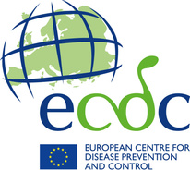
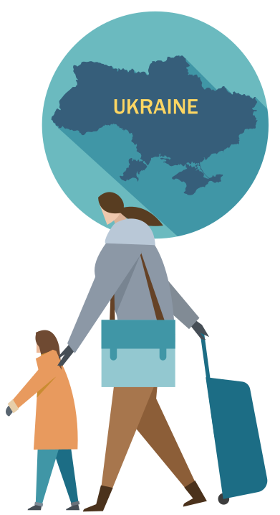
Register with the national health system
Vaccination protects individuals against diseases that could have serious consequences for their health, for example:
Are you and your family protected from vaccine-preventable diseases?
If you are fleeing Ukraine and receive temporary protection in your host EU/EEA country, you will have access to national healthcare services.
You should register even if you are well. You never know when you may need healthcare and the staff can offer preventive services to keep you healthy.
Check with staff how to register.
Measles is highly contagious and can be contracted at any age. Three out of 10 people affected develop complications, which can include ear infection, diarrhoea, pneumonia and encephalitis (inflammation of the brain tissue).
Diphtheria kills one in every 10 people who get it, even with treatment.
Almost nine out of 10 babies born to mothers who had rubella in early pregnancy will suffer from congenital rubella syndrome (with conditions such as deafness, cataracts and learning disabilities).
Are you ill, or is someone you care about ill?
Meningococcal disease kills one in 10 people affected, even with prompt diagnosis and treatment, while problems including neurological or hearing impairment and amputation occur in up to 20% of survivors.
Check with medical staff for advice, including with regard to vaccines.
Call 112 if someone is seriously ill or injured and their life is at risk.
Pertussis (whooping cough) can be particularly serious in infants, causing coughing spells that may recur for up to two months. Complications include pneumonia, encephalopathy (a disease of the brain), seizures and even death.
Follow the QR code for more information on vaccines and how to register with a GP

Slide 2



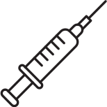

When and what vaccines are routinely given in the EU/EEA countries?
Vaccines prevent diseases that could otherwise cause serious health problems, permanent disability or even death.
Each year, vaccines are given to hundreds of millions of people of all ages to protect against serious diseases.
If you or your family have not been vaccinated, or if the vaccination series is incomplete, you may receive vaccines against the most common vaccine-preventable diseases in the EU/EEA countries.
These usually include COVID-19, measles, mumps, rubella, diphtheria, tetanus, pertussis (whooping cough) and poliomyelitis.
COVID-19 vaccines
Vaccinations are offered to all age group,s although they may slightly differ from country to country. Below are some examples:
People over 60 years and those with underlying health conditions are especially vulnerable to severe COVID-19 disease, however, people of all ages can suffer from severe forms of COVID-19.
It is important that you complete the primary vaccination course, usually 2 doses depending on the vaccine, and then receive a booster dose to be well protected.
If you started the vaccination in Ukraine, you might not be able to get the second dose or the booster with the same vaccine. However, vaccination with another type of vaccine is usually well tolerated, and combinations can induce even better protection against COVID-19.
Babies and toddlers receive vaccines against measles, mumps, rubella, rotavirus, diphtheria, whooping cough, meningitis, polio, tetanus, hepatitis B and tuberculosis.
Pre-school children need booster vaccinations for some of the diseases listed above. This helps to protect children better and for longer.
Teenagers need another vaccination booster to protect them from some of these infectious diseases, including meningitis. The boosters give longer lasting protection into adulthood. They are also offered the human papillomavirus vaccine which can prevent some cancers.
Pregnant women need vaccines to protect themselves and their baby from whooping cough and flu.
Older people need vaccinations to protect them against flu, pneumonia and shingles.
Children above five years and adults can receive COVID-19 vaccines. While vaccinated people can still catch the infection, but the current COVID-19 vaccines are very good at protecting you from serious illness and death.
Protect yourself and your children from vaccine preventable diseases
You and your children can receive for free any of the vaccines that are freely available for the population of the EU/EEA country that you are now in.
Some vaccines need more than one dose. If you started the vaccination course for yourself or for your child in your own country and have not completed it, ask healthcare staff to check if you need a catch-up dose.
Vaccines are very safe. Side effects after getting vaccinated are mostly mild and usually last one to two days. The most common side effects are fever (a temperature over 38.5 °C), and redness, swelling and tenderness around the area where the needle went into the skin.
Discuss with healthcare staff who can advise what vaccines you and your children can receive.

