Slide 1

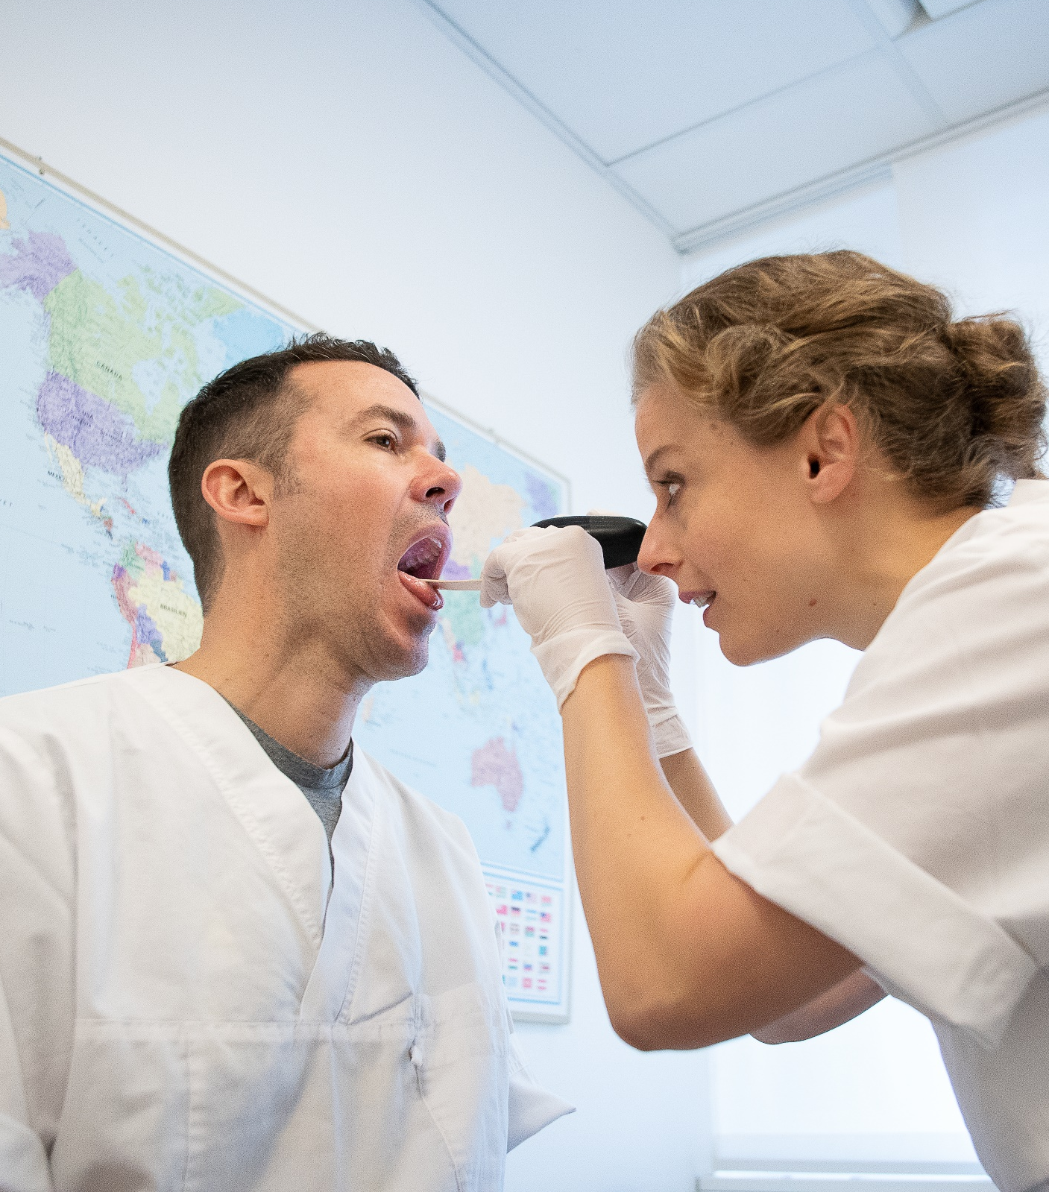
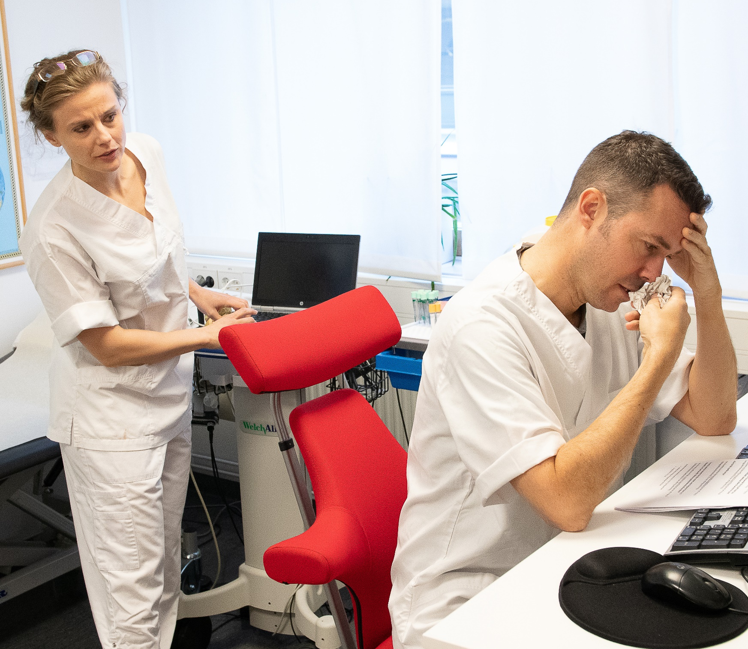
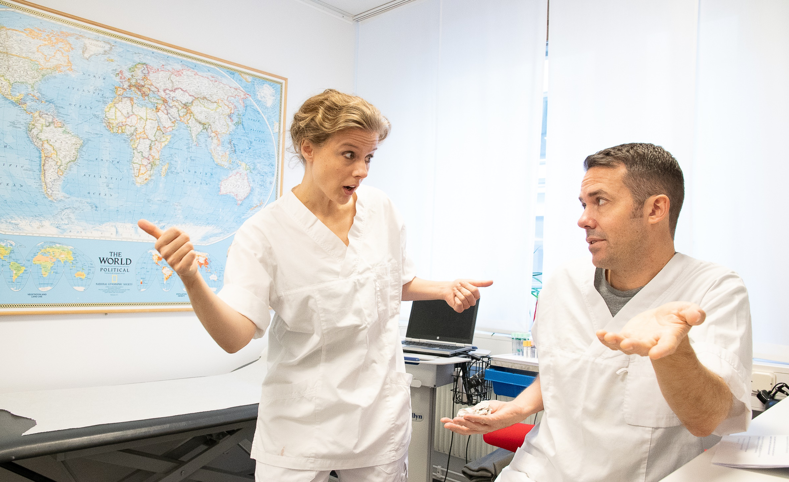
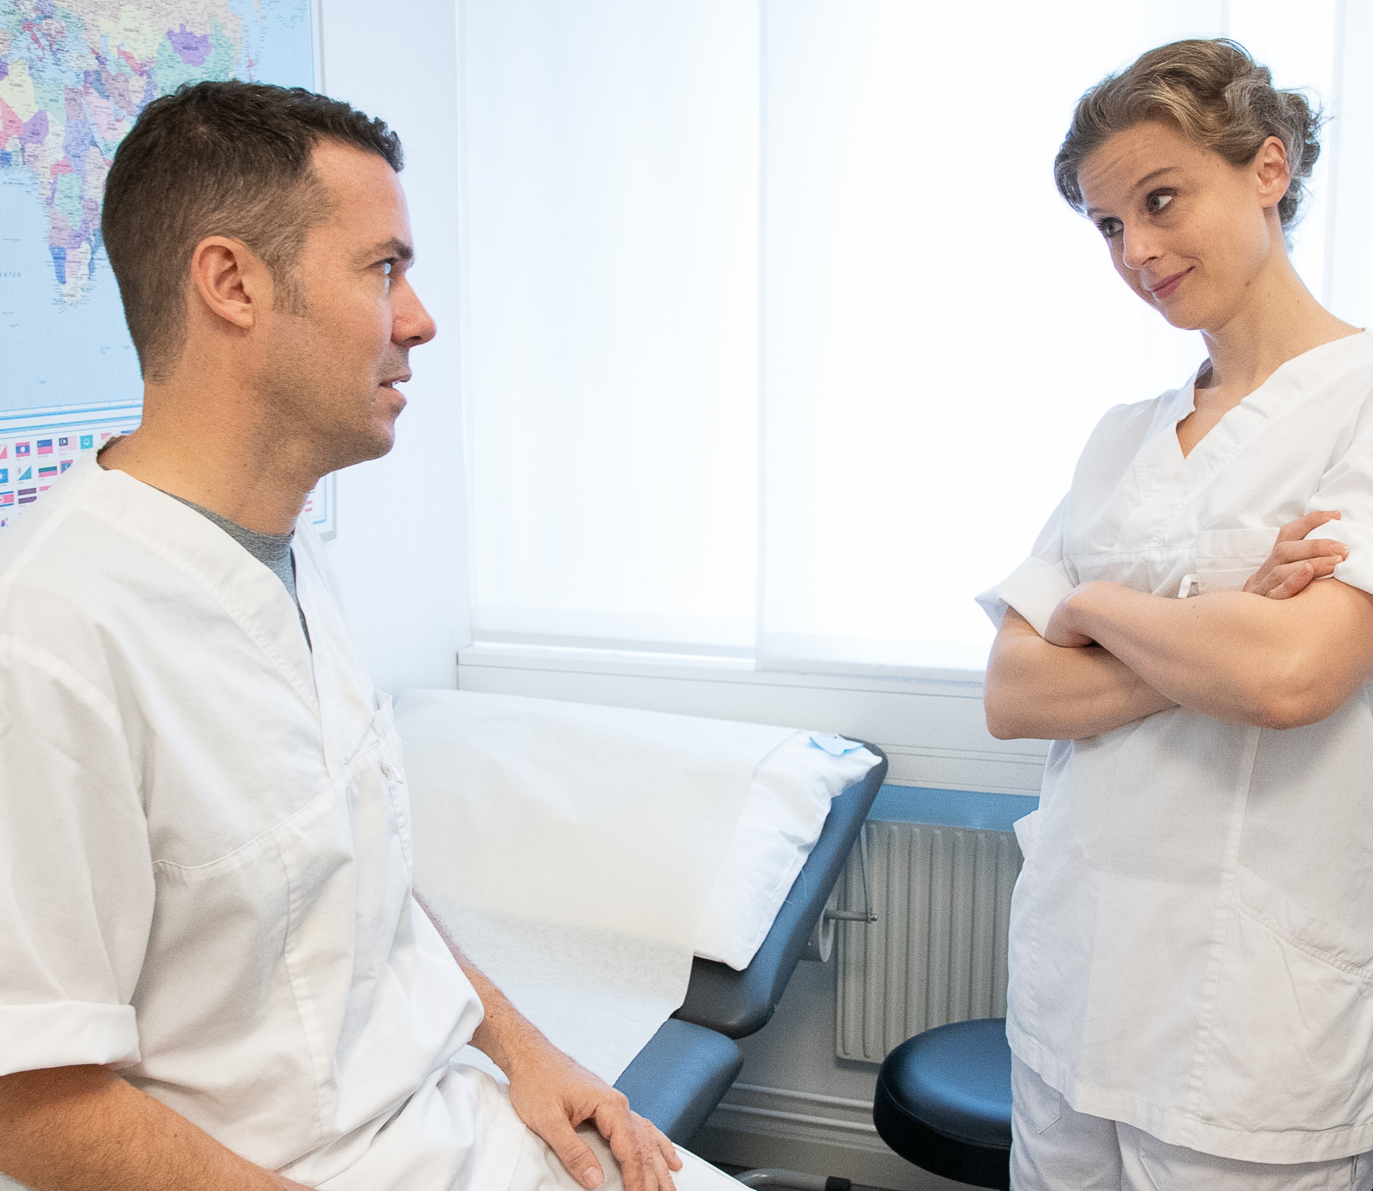
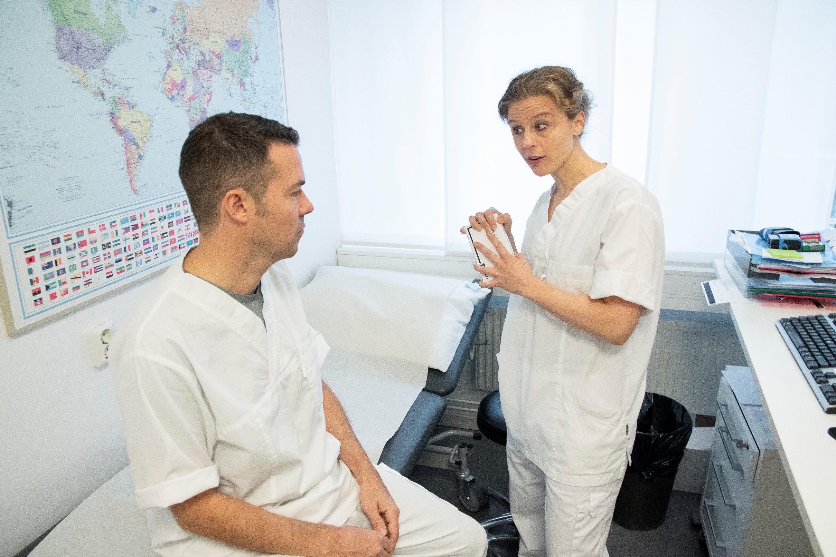
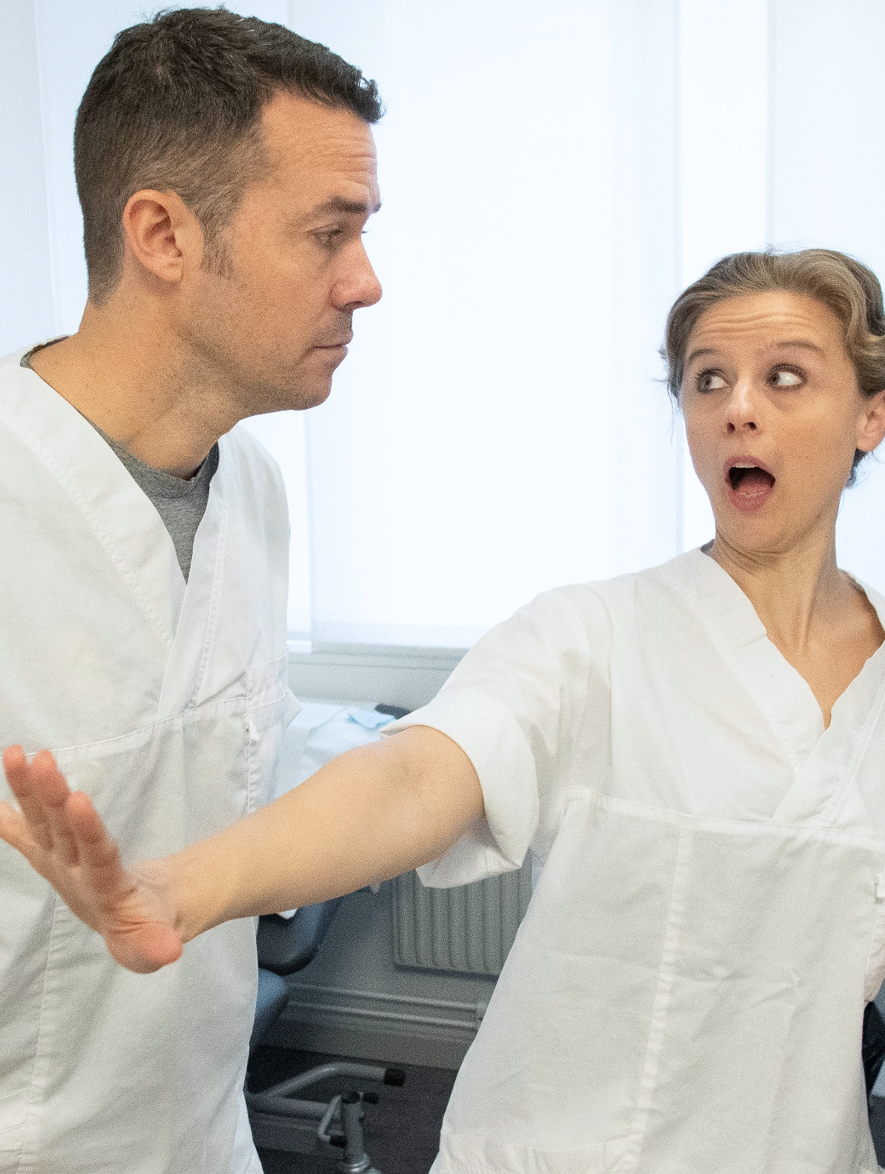
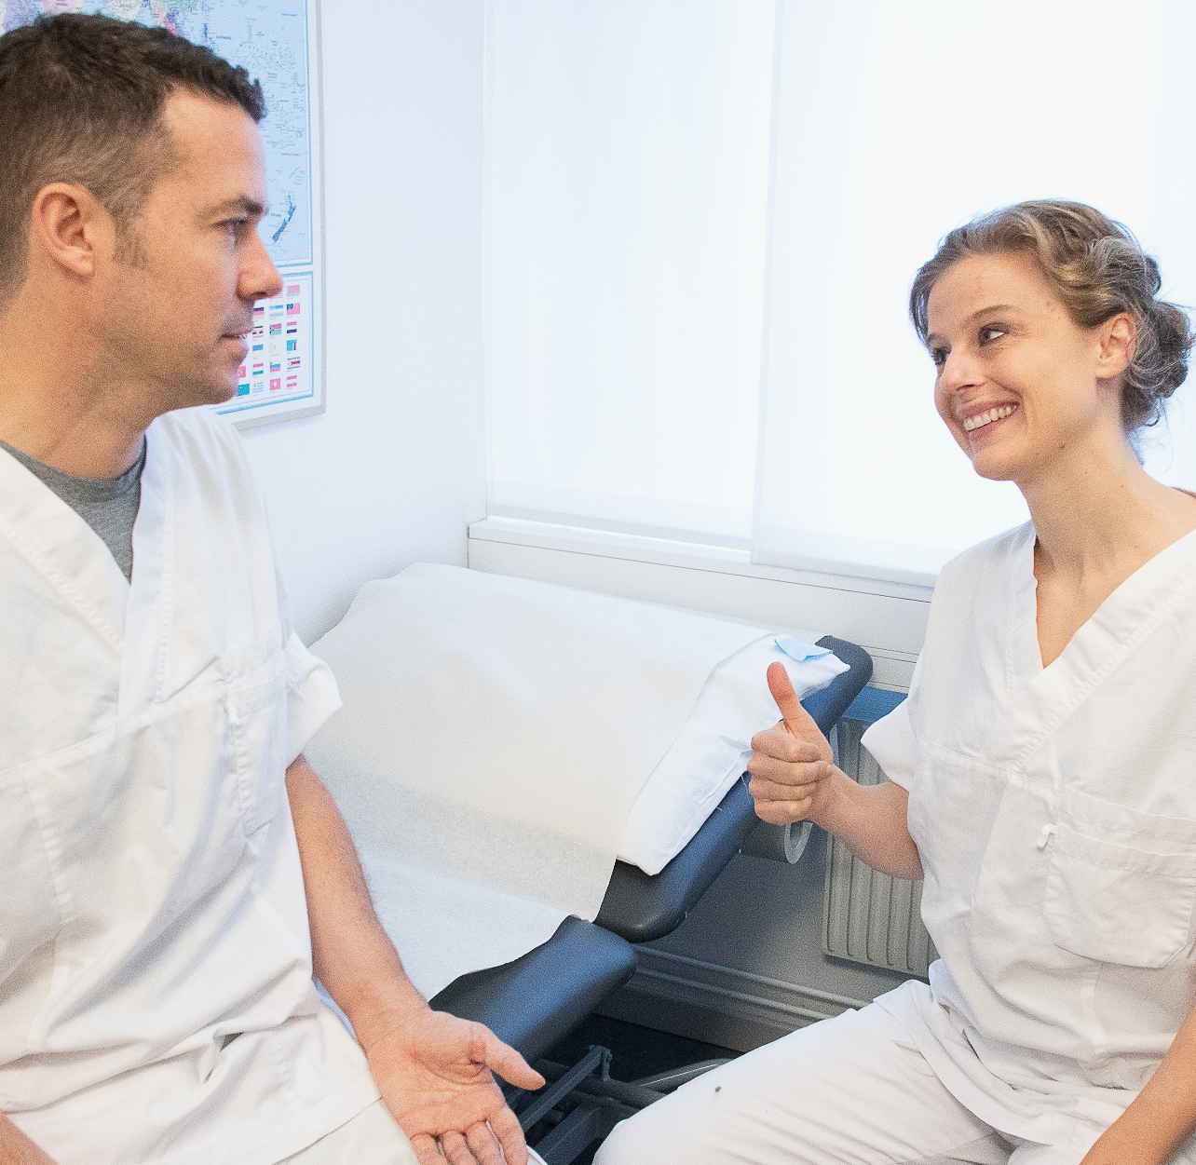
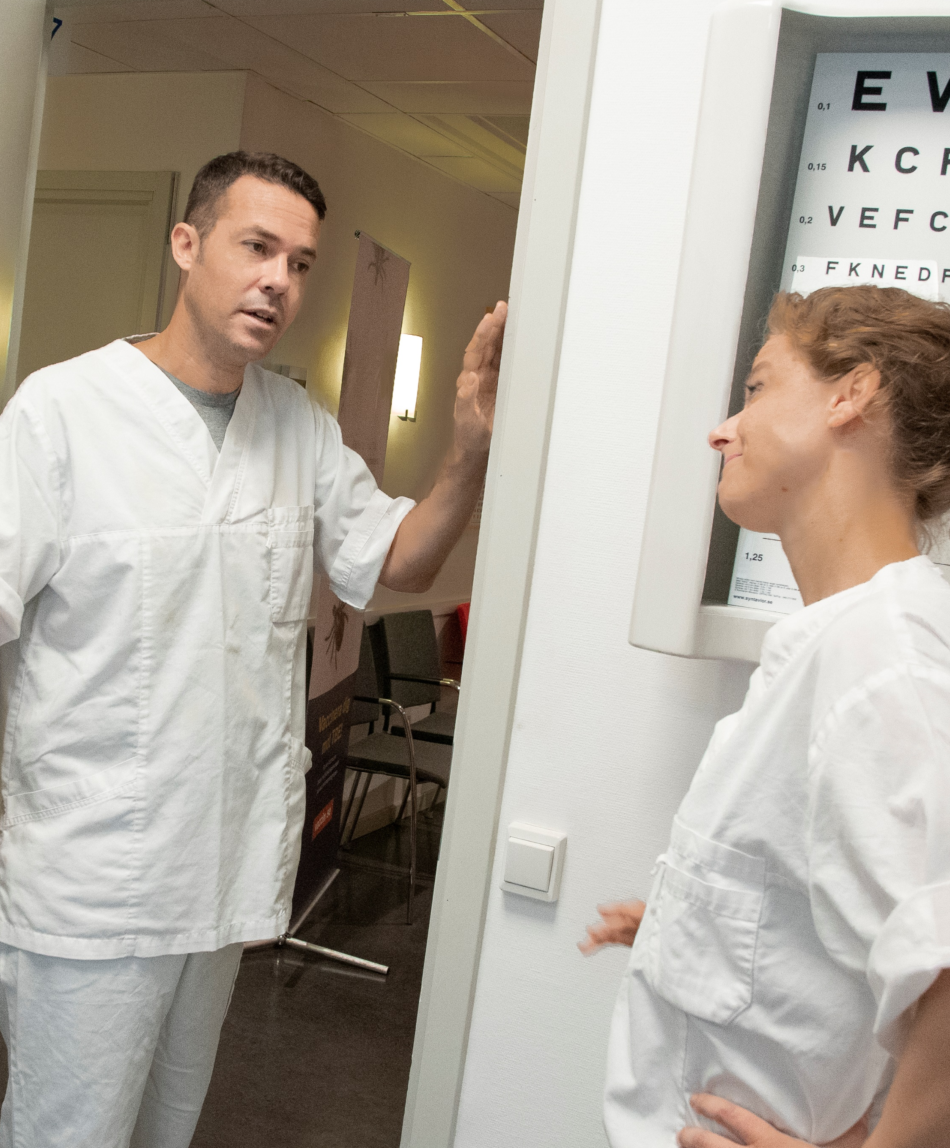
The sick doctor who didn’t want to go home
“I was contagious, but refused to go home.”
Have
you seen the waiting room? There must be 20 people out there waiting to see me.
A few minutes later, both doctors are in an examination room…
Hey Pete,
what’s the matter? You’re looking really weary.
You know what, why don’t you let me do a quick check-up?
Ahhhhh
I really think you should go home and rest.
Yup. I definitely don’t feel great today. I might have the flu.
What are you saying?
I’ve got work to do!
I know, I know, but it will only take a second.
Just what I thought: sore throat and a fever. Looks like you have the flu.
Why don’t we do a rapid test to find out for sure?
You sure know your public health guidelines! But I guess you are right: I should stay away from people – even if this turns out to be nothing but a cold.
Get vaccinated and protect yourself and the people around you.
As a healthcare worker, there’s a lot you can do against the flu:
Get vaccinated each year
Wash your hands
Stay home when sick
Fine. That’ll take about 30 minutes, in the meantime
I’ll take care of
Mrs. Miller…
Thanks.
And about that test… I don’t think I need it. I’ll stay home, no matter what the results.
Stop right there!
Mrs Miller?! The old lady with the bad hip? She’s in her late 70s! People 65 years or older are at increased risk for developing flu-related complications.
I am glad
you agree. The fever must’ve temporarily clouded your mind. Now go home and get some rest. I’ll take care of business.
Get well soon!

