Slide 1
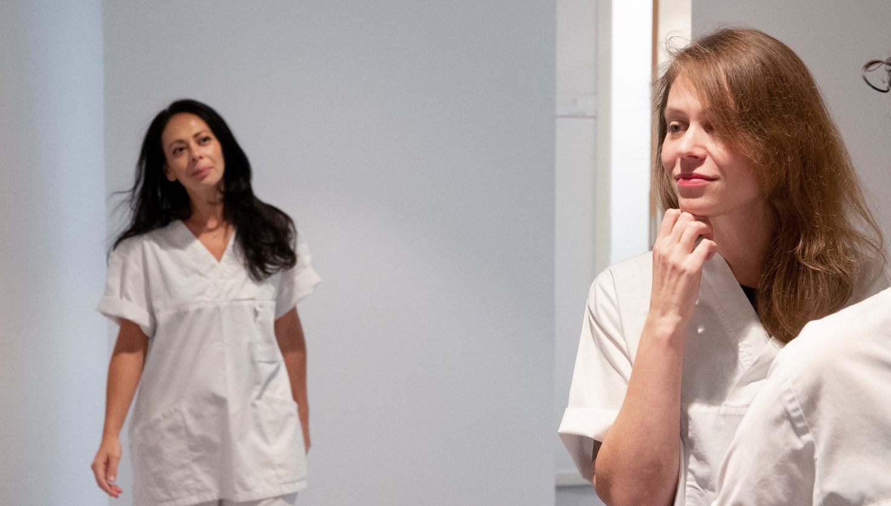
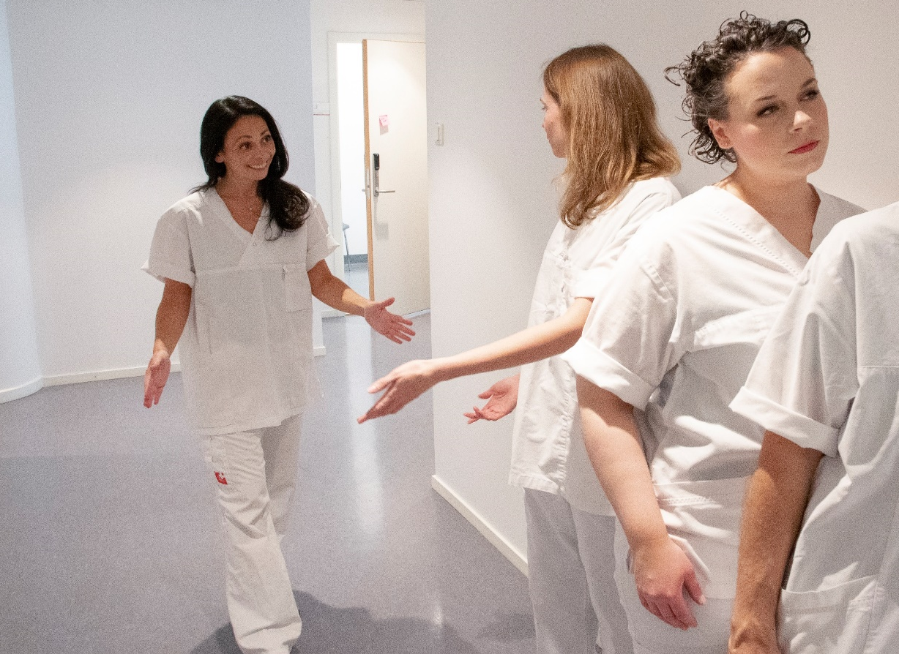
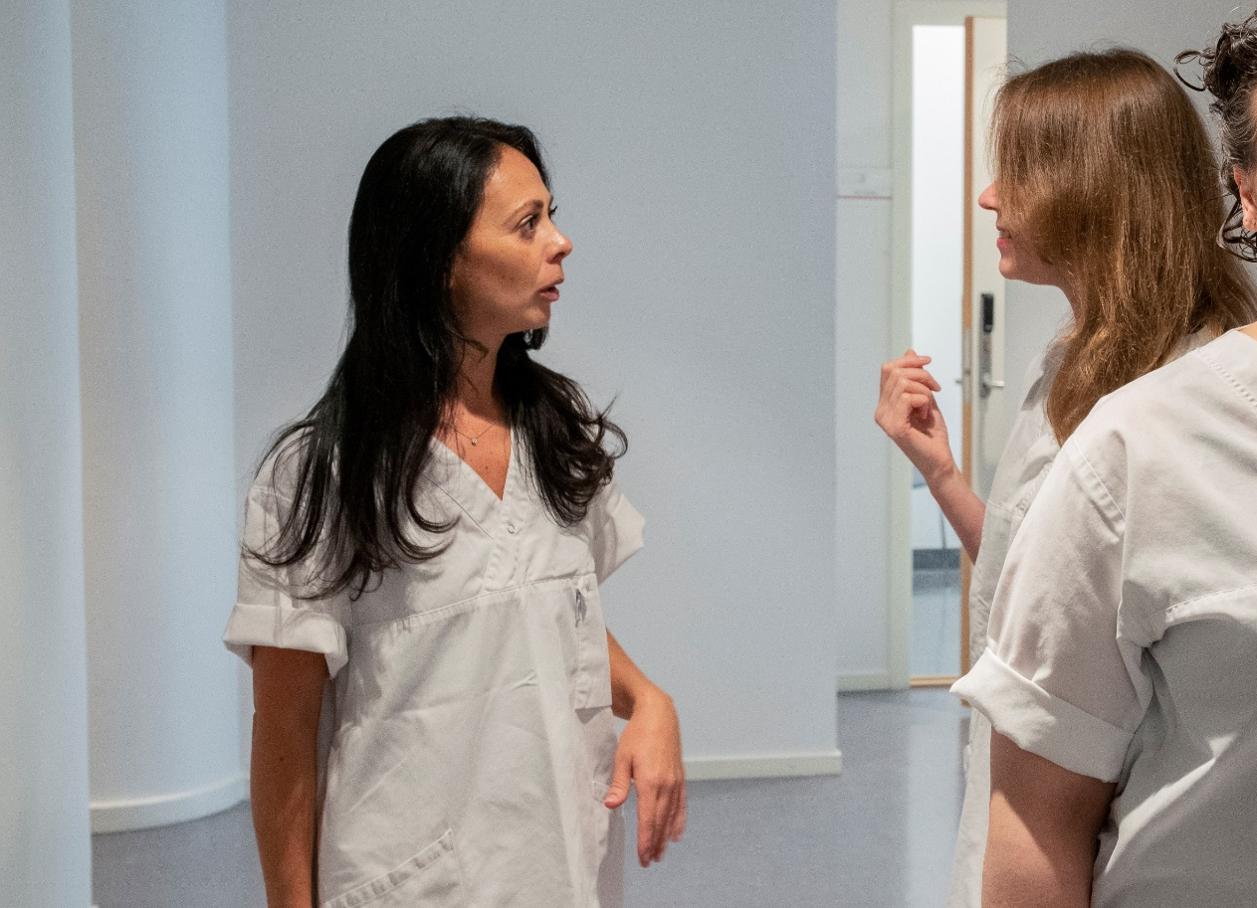
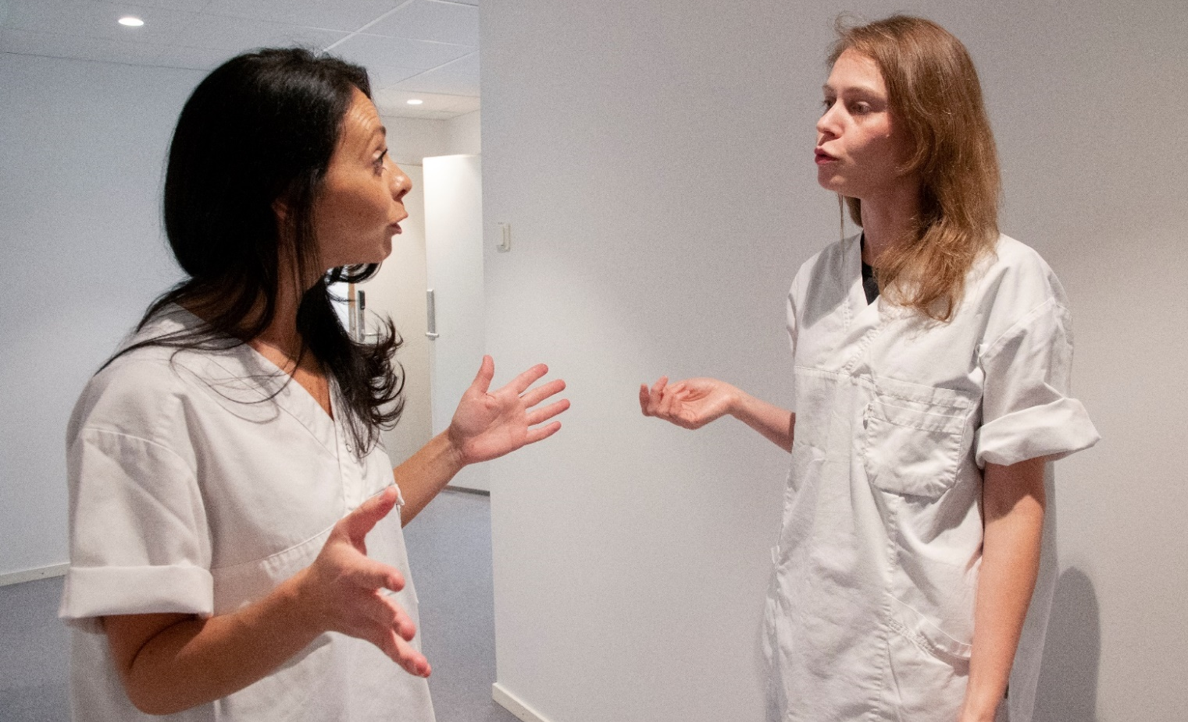
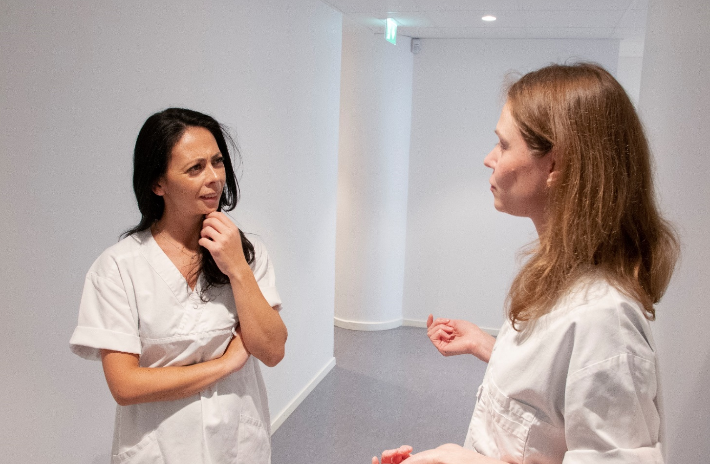
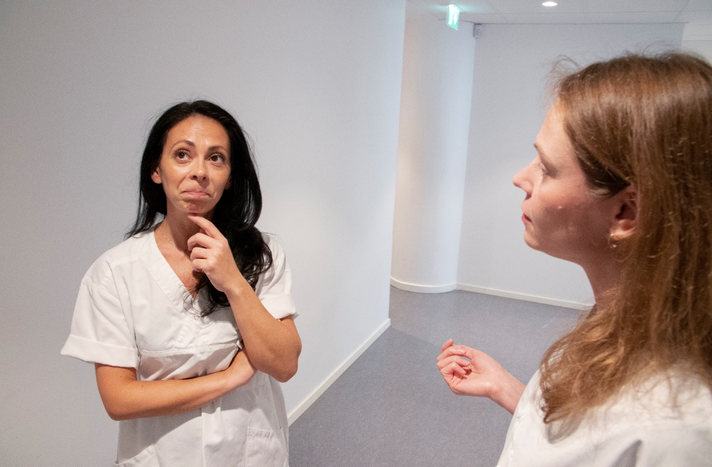
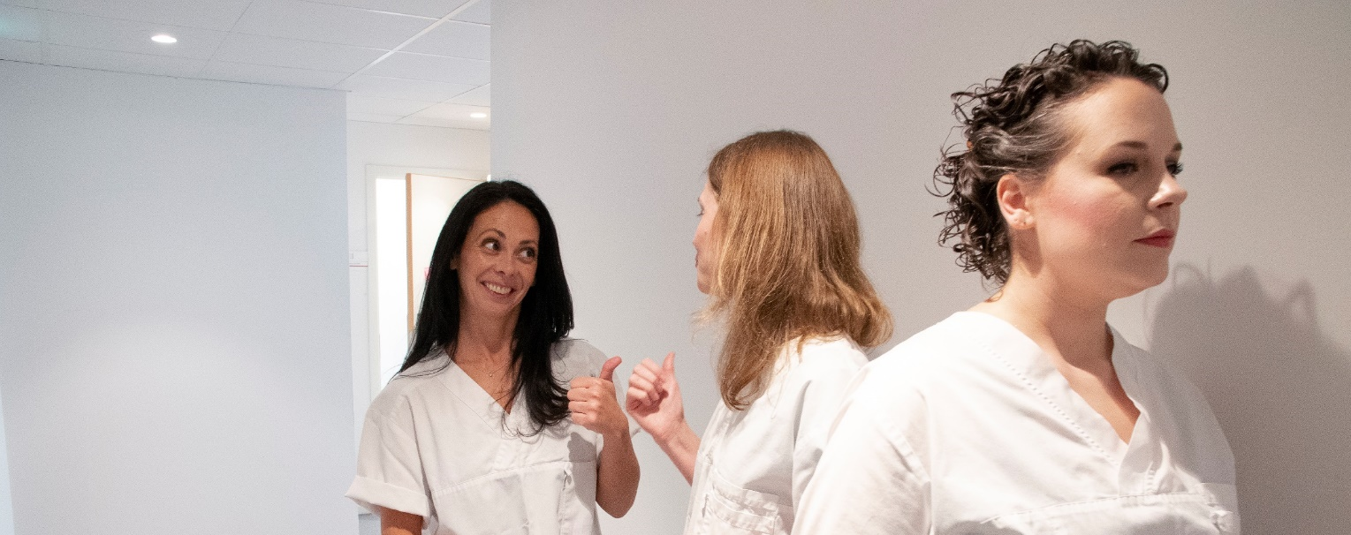
Paediatrician confesses: “I lined up for my shot long before flu season”
“Not perfect, but still the best we got.”
It’s time for the annual flu shot. Nurses and doctors are lining up…
Good thing our hospital manager is letting us have the flu shot for free. I don’t want to end up sick in bed for two weeks, like last year.
Hi Sandy, what are you doing here?
Hi Carmen! I’m queuing up to receive my flu shot. The hospital manager said that everyone should get one.
Did you get vaccinated already?
No, not really.
Seriously, Carmen?! Why not?!
A surprising confession follows...
This may sound funny coming from a person who gives injections all the time…
… but I don’t like having needles put into my body. I don’t like how it feels, I just hate it. I am afraid of the whole thing.
I am listening…
I am actually afraid it will make me sick. And you never know what side effects you might get.
You know as well as me that the vaccine is perfectly safe. The benefits are a thousand times greater than any side effects
Are you telling me I’m being irrational?
Yes! But as a healthcare worker you should do everything you can to stay healthy. Or do you want the babies and young children in this ward to get sick?
Are you kidding?!
Of course not!!
But I heard that the vaccine is not perfect.
Even if the flu vaccination doesn’t provide 100% protection, it substantially reduces the chances of getting ill. Plus it prevents spread: if you stay healthy, so will the kids you take care of.
That’s one way of looking at it.
Yeah. Getting vaccinated against the flu may not be perfect, but it’s still the best shot we got.
He, he. Good one! No pun intended, as they say. OK, I’ll join you in the queue!
Yesss!
Get vaccinated for influenza each year and protect yourself and others around you!

