Slide 1
Smarter Tools, Stronger Healthcare Systems.
www.ecdc.europa.eu/hyfive

Slide 2
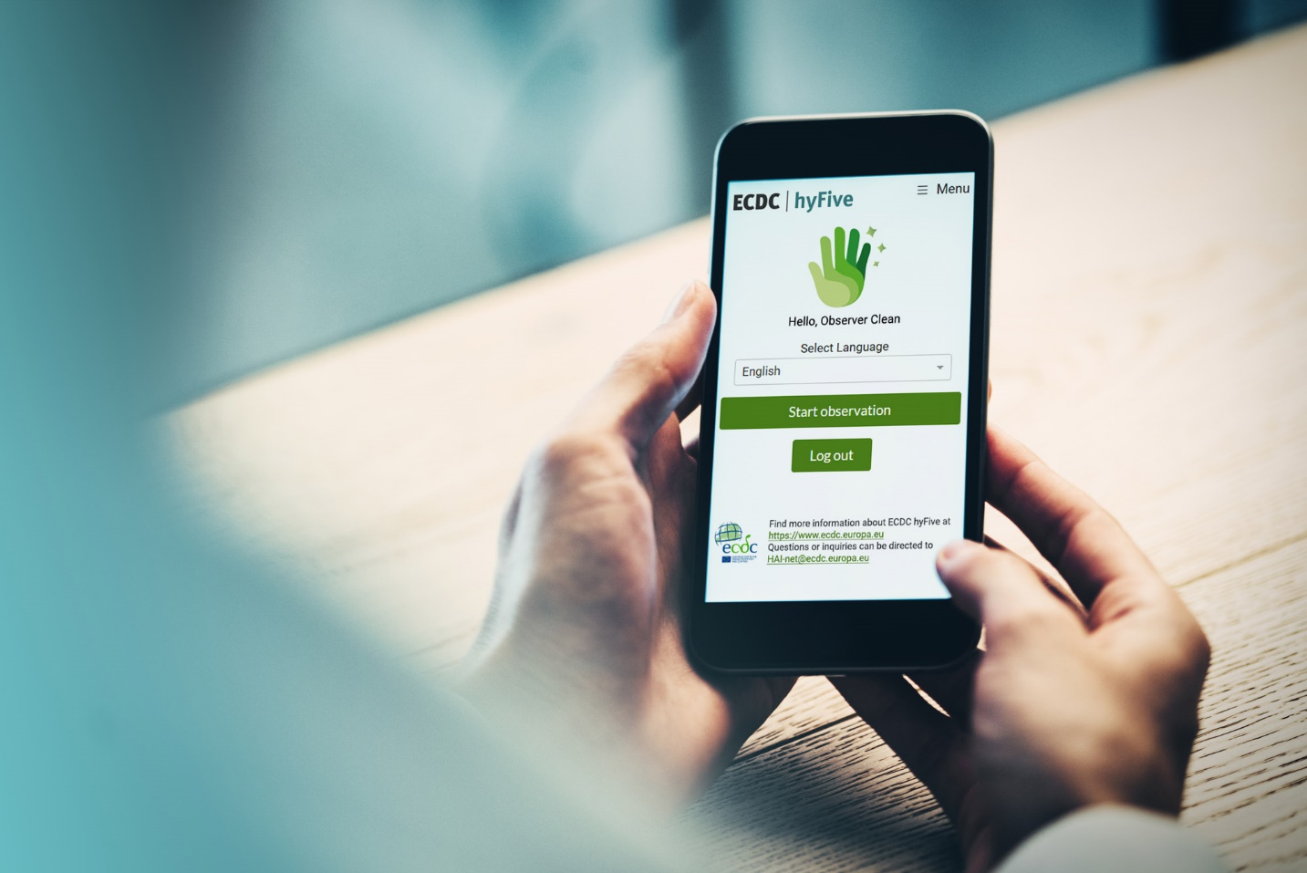
Overview
What the problem is
Why we need a digital tool
What hyFive is
How hyFive works
Advantages of hyFive
www.ecdc.europa.eu/hyfive

Slide 3

Monitoring hand hygiene
is too resource‑intensive
Today, hand hygiene monitoring relies on:
Manual observation
Paper-based recording
Manual data entry
Manual calculation of rates and graphs
Manual feedback to healthcare workers
Manual monitoring requires time and resources that IPC teams often do not have

Slide 4
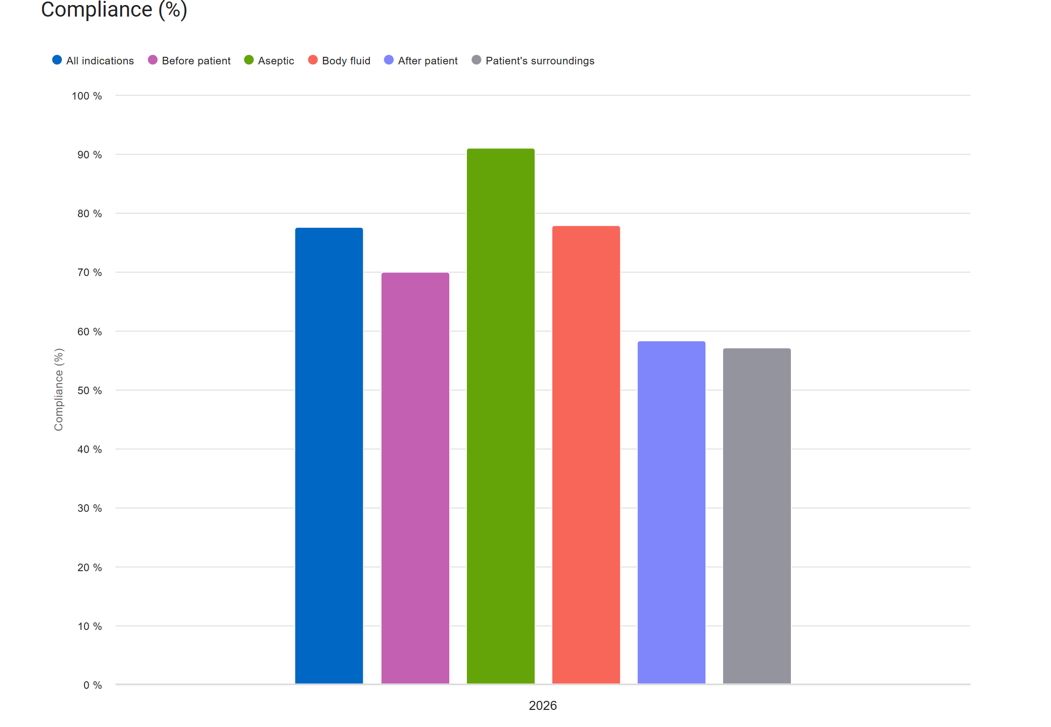
Supporting hand hygiene monitoring through digital solutions
Digital monitoring tools
Faster and standardised data collection
Fewer transcription errors Automatic compliance calculations One-click generation of graphs
Real-time feedback to staff
Easier reporting
Data security and storage
www.ecdc.europa.eu/hyfive

Slide 5
ECDC hyFive digital tool
Progressive Web App (PWA):
Web application using modern web technologies to deliver an app-like experience directly through a web browser
Installable: Can be added to the home screen or desktop with a dedicated icon and standalone window, bypassing traditional app stores
Responsive: Design adjusts to fit any form factor (desktop, mobile, tablet)
Safe: Must be served via HTTPS to ensure security
Works offline
Currently in English language, but it will be translated to all EU languages
Provided free of charge by ECDC
Modules:
Hand hygiene
Gloves
Bare below elbows
www.ecdc.europa.eu/hyfive

Slide 6
How hyFive works
Easy Setup
Installed at the hospital, public health institute, or ministry.
Fast data entry and visualisations
Compliance rates easily shown across units and departments.
National overview
Real-time compliance data at national level.
www.ecdc.europa.eu/hyfive

Slide 7
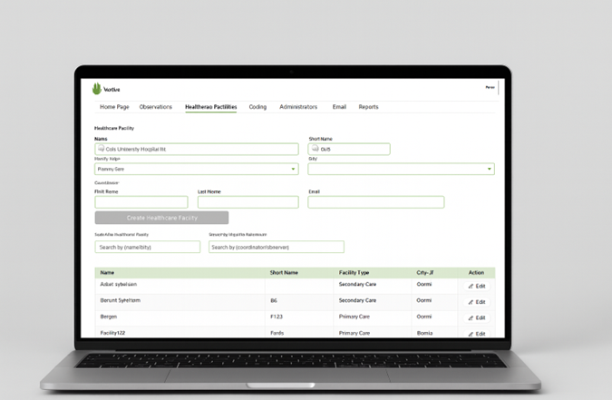
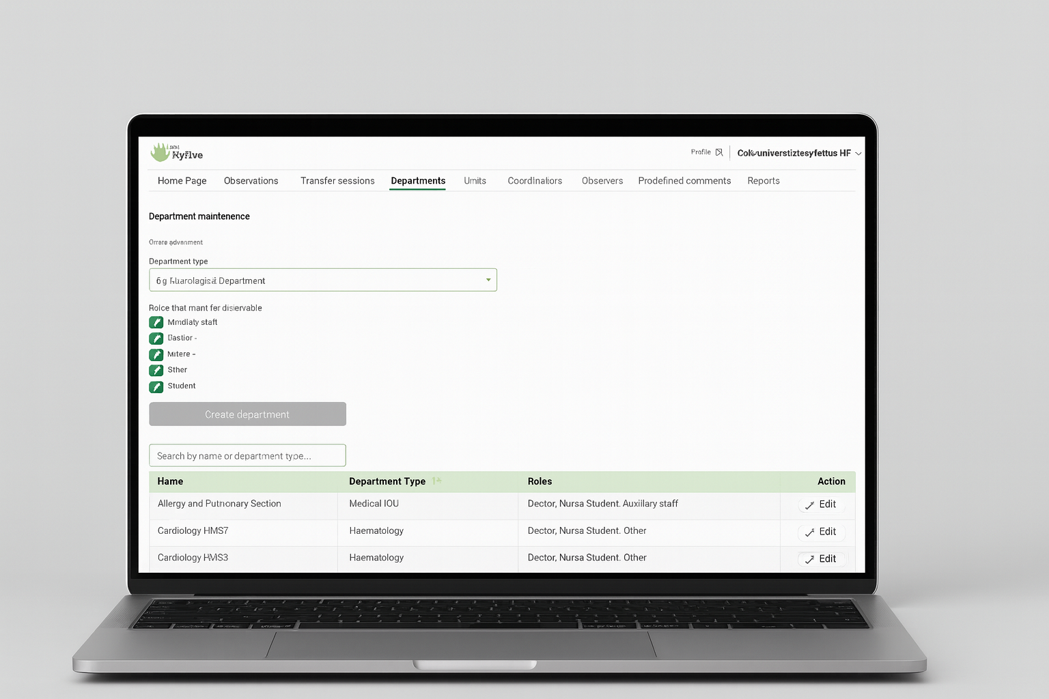
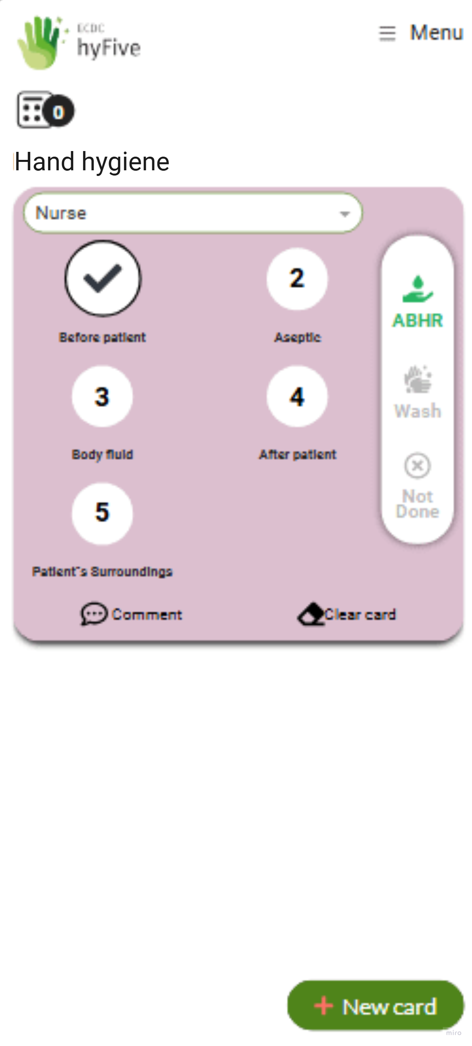
Two user interfaces – Three roles
Administrator
Coordinator
Observer
National level
Healthcare facility level
www.ecdc.europa.eu/hyfive

Slide 8
hyFive at a glance
A standardised system connected to a centralised database
Data can be collected, stored, and analysed in real time. Can be implemented from individual wards to entire hospitals, or across national health networks.
Digital observation
Hand hygiene observations are captured instantly using an intuitive mobile interface – no paper, no duplication, no delays.
Real-time insights
Compliance data are instantly visible at hospital and national levels through dynamic graphs, providing immediate insight into compliance levels.
Faster data-driven decisions
Aggregated data and trends enable faster evidence-based decisions, supporting targeted interventions and effective resource allocation across health systems.
www.ecdc.europa.eu/hyfive

Slide 9
Benefits of hyFive
For National level
Real-time nationwide overview of hand hygiene compliance
Transparent, standardised data across facilities
Access anytime, anywhere
For healthcare facilities
• Supports accreditation, audits, and regulatory requirements
• Enables timely, data-driven safety decisions
For IPC professionals
No paperwork
Faster documentation
Automatic reports and visualisations
www.ecdc.europa.eu/hyfive

Slide 10
Thank you
www.ecdc.europa.eu/hyfive

