Slide 1
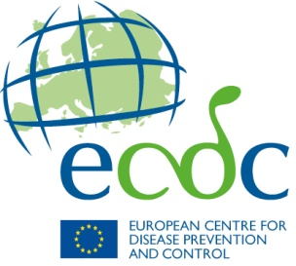
2012
HIV/AIDS surveillance in Europe
European Centre for Disease Prevention and Control, Stockholm
WHO Regional Office for Europe, Copenhagen

Slide 2
European Union and European Economic Area (EU/EEA)

Slide 3
HIV infections diagnosed, 2012
Characteristics of reported cases | EU/EEA
Number of HIV diagnoses | 29 381
Diagnoses per 100 000 population | 5.8
Percentage aged 15–24 years | 10.6%
Male-to-female ratio | 3.2
Transmission mode (percentage)
Heterosexual | 33.8%*
Men who have sex with men | 40.4%
Injecting drug use | 6.1%
Unknown | 18.7%
* Includes individuals (12%) originating from sub-Saharan African countries.
Source: ECDC/WHO. HIV/AIDS Surveillance in Europe, 2012

Slide 4
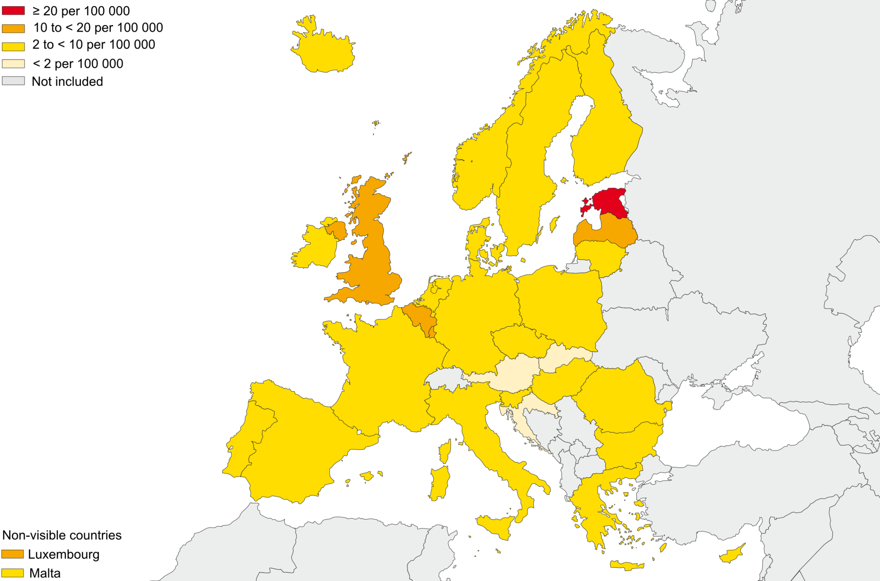
HIV infections diagnosed and reported, 2012 All cases, EU/EEA
Source: ECDC/WHO. HIV/AIDS Surveillance in Europe, 2012

Slide 5
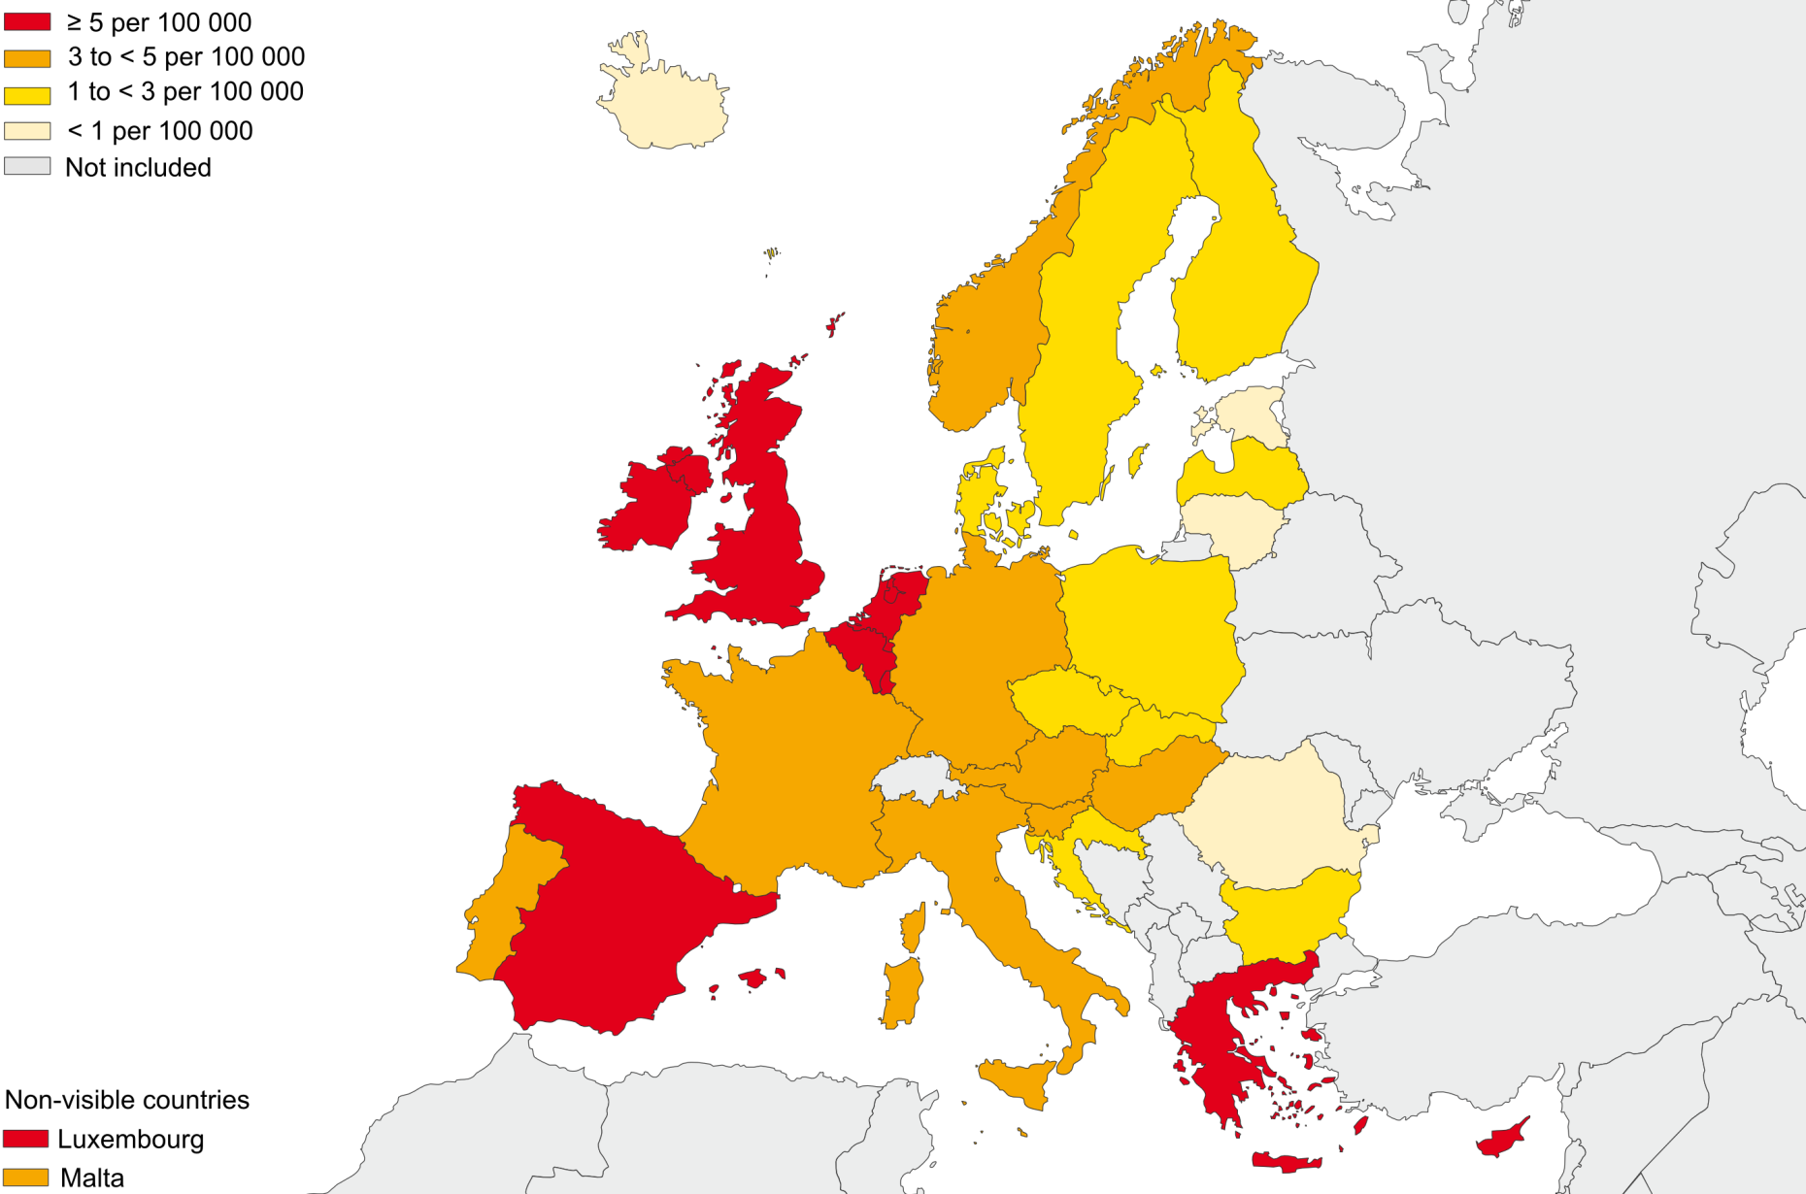
HIV infections diagnosed and reported, 2012 Men who have sex with men, EU/EEA
Source: ECDC/WHO. HIV/AIDS Surveillance in Europe, 2012

Slide 6
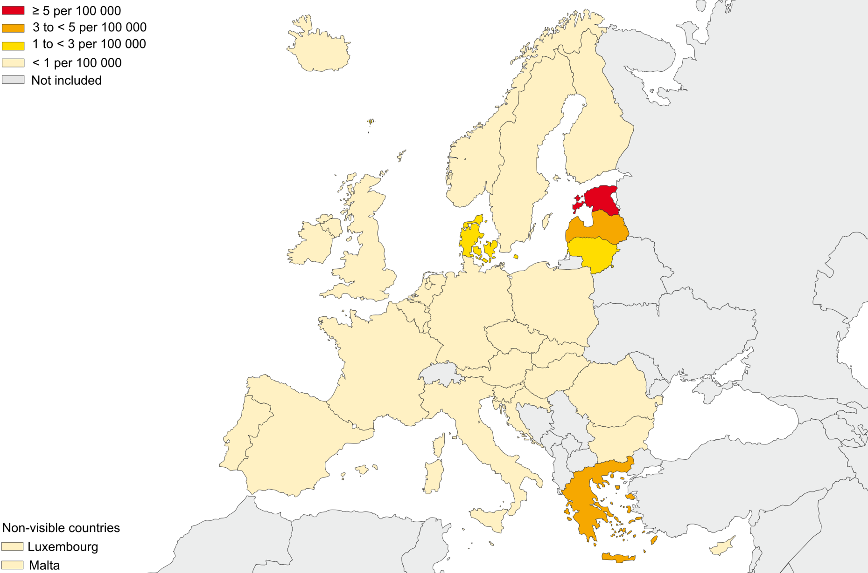
HIV infections diagnosed and reported, 2012 Injecting drug use, EU/EEA
Source: ECDC/WHO. HIV/AIDS Surveillance in Europe, 2012

Slide 7
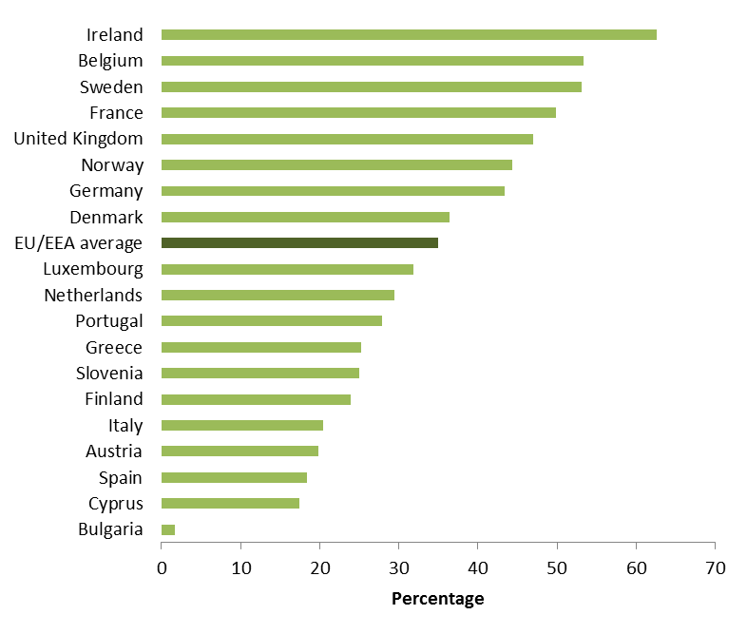
HIV diagnoses in persons originating from countries with a generalised epidemic among all the heterosexually acquired infections, 2012 (n=9 944)
Source: ECDC/WHO. HIV/AIDS Surveillance in Europe, 2012

Slide 8
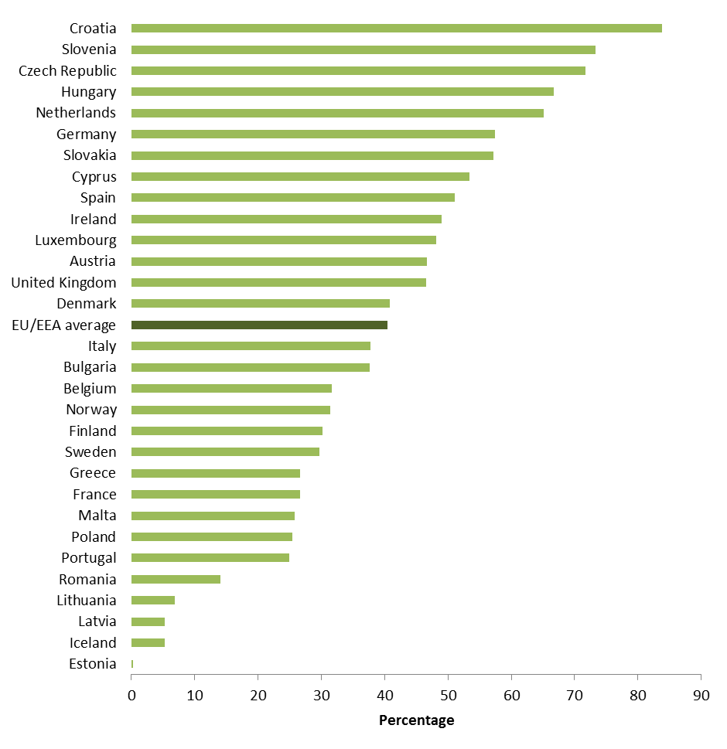
HIV diagnoses in MSM among all reported HIV cases, by country, EU/EEA, 2012 (n=29 381)
Source: ECDC/WHO. HIV/AIDS Surveillance in Europe, 2012

Slide 9
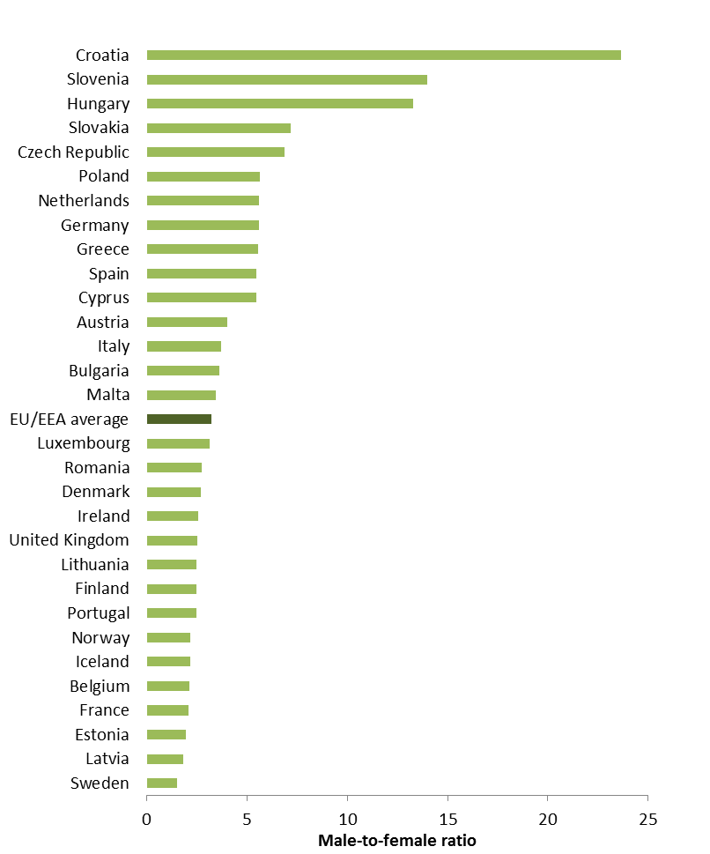
Male-to-female ratio of HIV infections, by country, EU/EEA, 2012 (n=29 327)
Source: ECDC/WHO. HIV/AIDS Surveillance in Europe, 2012

Slide 10
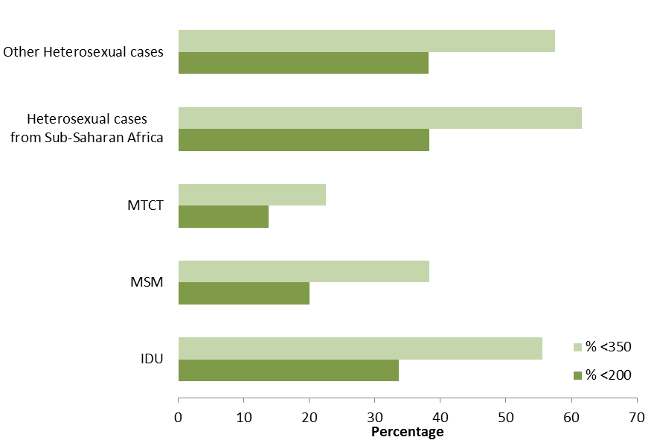
Percentage of cases presenting with CD4 cell count <350/mm³ and <200/mm³, by mode of transmission, EU/EEA, 2012 (n=16 150)
Source: ECDC/WHO. HIV/AIDS Surveillance in Europe, 2012

Slide 11
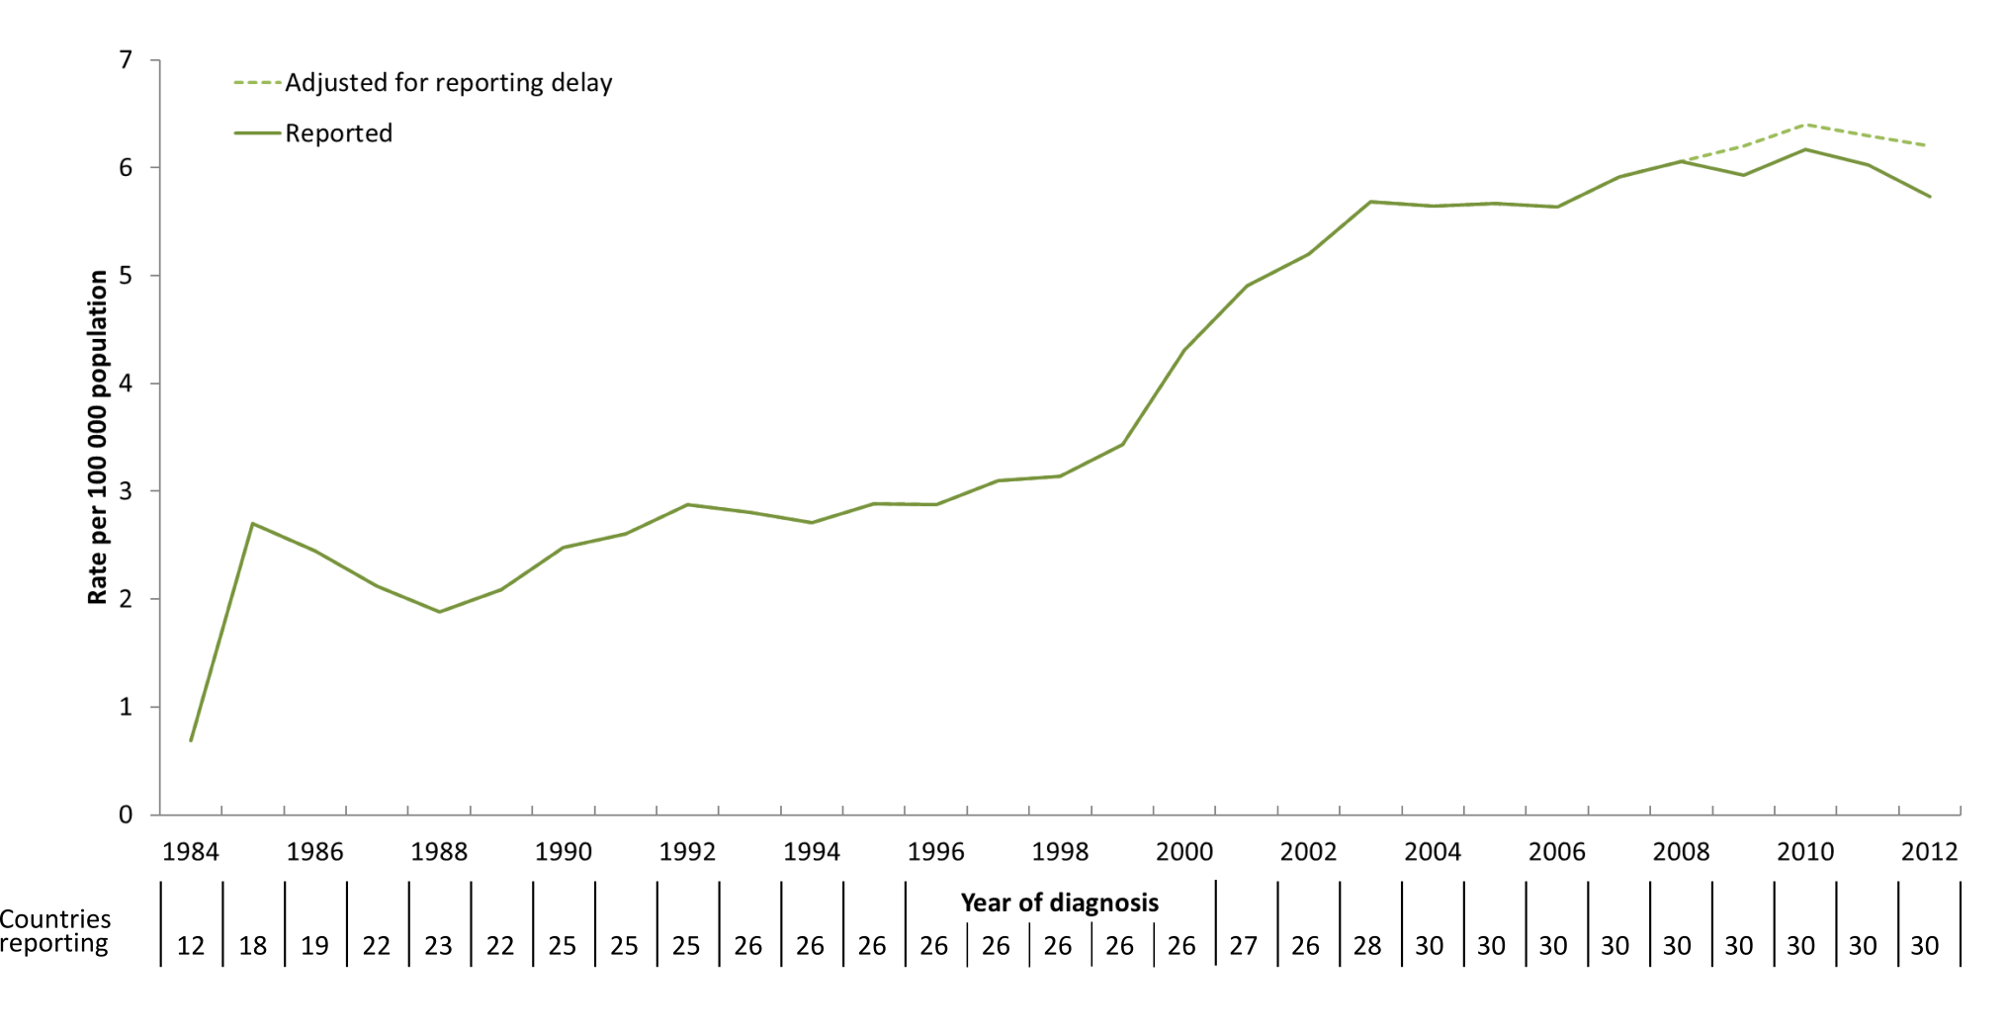
Rate of reported HIV diagnoses, by year of diagnosis, in the EU/EEA, 1984–2012
Source: ECDC/WHO. HIV/AIDS Surveillance in Europe, 2012

Slide 12
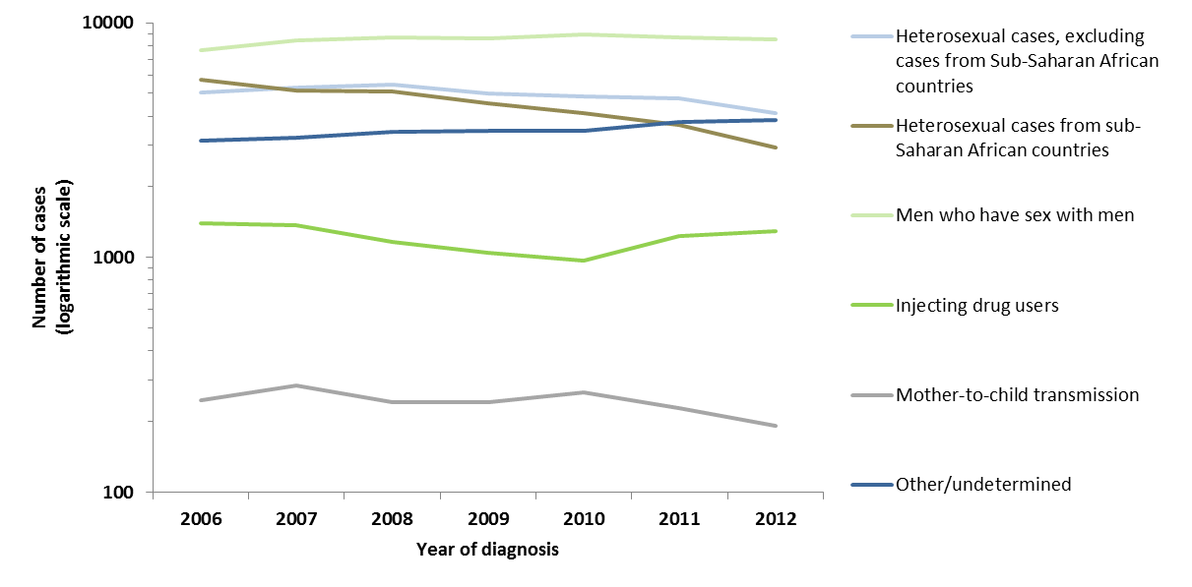
HIV infections reported, 2006-2012 Transmission mode and origin, adjusted for reporting delay
Predominant transmission mode: men who have sex with men
Data were not included or not available from Estonia, Poland, Spain, Italy.
Source: ECDC/WHO. HIV/AIDS Surveillance in Europe, 2012

Slide 13
Conclusions (1)
HIV infection is of major public health importance in Europe, with evidence of continuing transmission in specific populations with no clear signs of overall decrease.
Half of the HIV infections were diagnosed as late presenters with CD4 cell counts less than 350/mm³ blood.
Heterogeneity exists in HIV epidemics in the EU/EEA:
Men who have sex with men accounted for majority of cases;
One third of heterosexual cases have direct links to sub-Saharan Africa (areas with a generalised epidemic);
Despite low levels of HIV reported in IDU, increases continue in Greece and Romania.
Source: ECDC/WHO. HIV/AIDS Surveillance in Europe, 2012

Slide 14
Conclusions (2)
Interventions should be based on evidence and tailored to the local epidemiological situation and vulnerable populations such as MSM, IDU and migrant populations.
Wider access and uptake of HIV counselling and testing is needed to ensure earlier diagnosis and access to treatment – both to improve the longer term treatment outcomes for the individuals but also to prevent or reduce further transmission in the community.
Source: ECDC/WHO. HIV/AIDS Surveillance in Europe, 2012

Slide 15
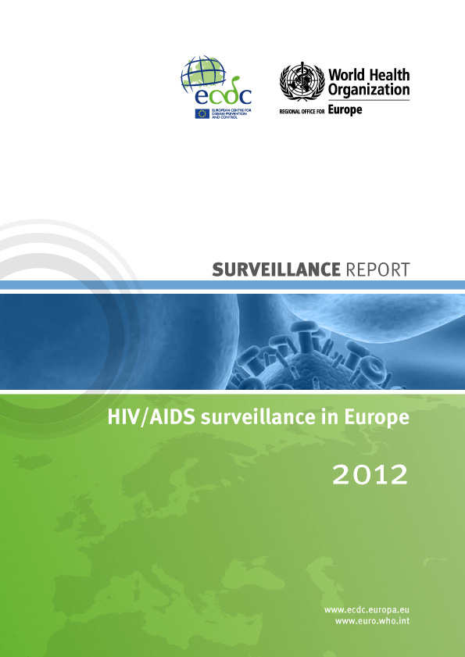
Report is available from:
www.ecdc.europa.eu

