Slide 1
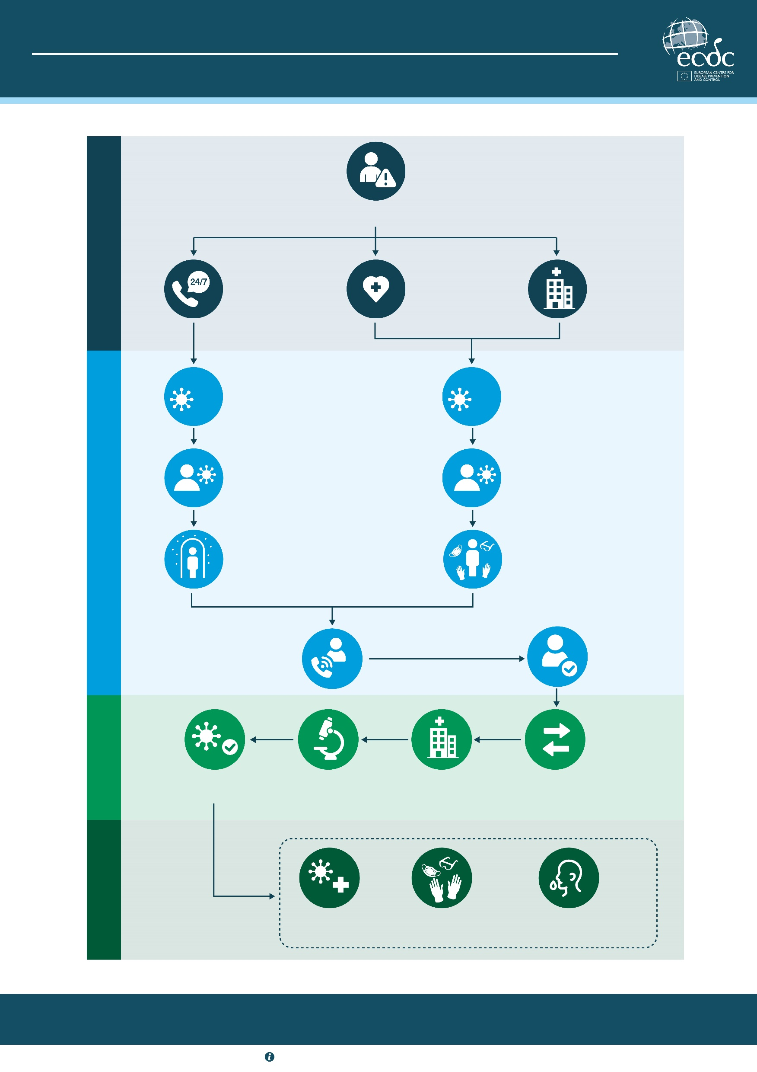
EBOLA DISEASE AND HEALTHCARE SETTINGS
PATIENT MANAGEMENT PATHWAY
Person with
symptoms
INITIAL CONTACT
Phone contact
with 24/7 public
phone service or
primary care
Outpatient
medical
office visit
Hospital
emergency
department visit
?
Conduct clinical
and epidemiological
assessment
?
Conduct clinical
and epidemiological
assessment
If Ebola disease
is suspected, advise
patient to self-isolate
If Ebola disease is
suspected, immediately
isolate the patient
RISK MANAGEMENT
Self-isolate
Use personal
protective equipment
immediately
Contact public
health authorities
Validate
symptoms
DIAGNOSIS
Confirm Ebola
disease case
Conduct laboratory
investigation
Admit patient into
designated hospital
Arrange safe
transfer
MANAGEMENT
Clinical
management
Infection prevention
and control
In case of death, handle
human remains appropriately
Follow national procedures. Early identification, rapid reporting and safe management are essential to reducing the risk of transmission.
For more information, visit ecdc.europa.eu

