Slide 1
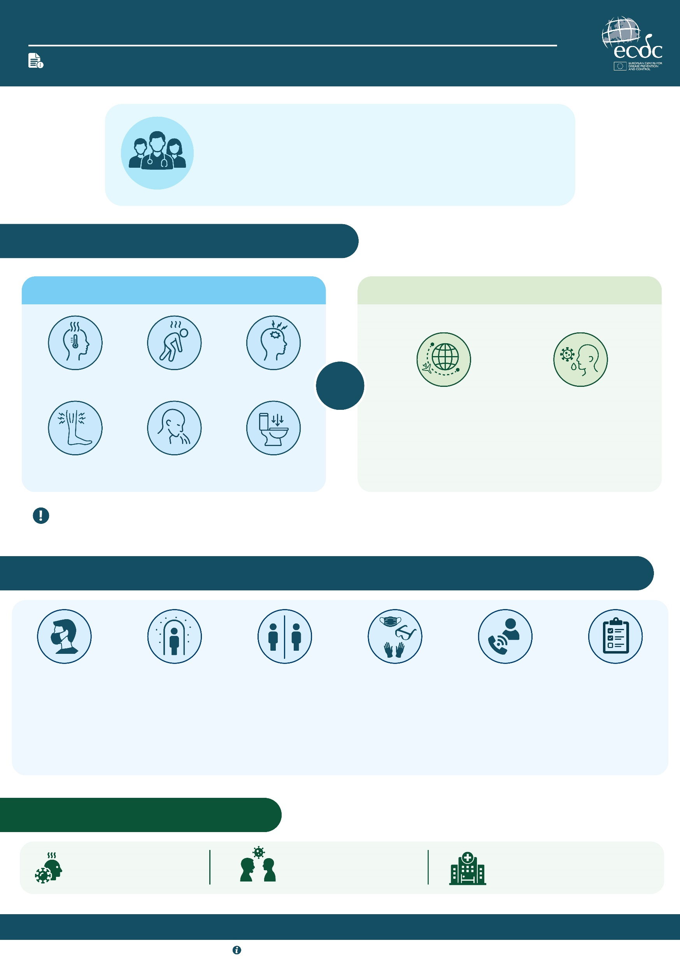
EBOLA DISEASE AND HEALTHCARE SETTINGS
GUIDE FOR HEALTHCARE PROFESSIONALS
Healthcare professionals play a critical role in the early identification and safe management of suspected Ebola disease cases.
Imported cases in Europe are expected to be very rare. However, awareness of the current outbreak is important to ensure early recognition of potential cases.
When recommended infection prevention and control measures are followed, the risk to healthcare workers and other patients is very low.
1. WHEN COULD IT BE EBOLA DISEASE?
SYMPTOMS
RELEVANT TRAVEL OR EXPOSURE HISTORY
Sudden onset of fever
Weakness
Headache
AND
Possible exposure to someone with suspected or confirmed Ebola disease, their bodily fluids, or funeral or burial practices.
Travel to the Democratic Republic of the Congo or Uganda.
Muscle or joint pain
Nausea, vomiting
Diarrhoea
A more severe stage of the disease includes symptoms such as bleeding from the nose, gums and skin, and bloody vomiting and stools.
2. WHAT SHOULD YOU DO IF YOU SUSPECT SOMEONE WITH EBOLA DISEASE?
If tolerated, ask the patient to wear a fluid-resistant surgical facemask (type IIR).
Place the patient in a single room with a separate toilet, if available, and away from other patients and healthcare workers.
Limit contact with the patient to essential staff only.
Use appropriate personal protective equipment in line with protocols and the level of risk.
Notify the relevant public health or emergency coordination service immediately for guidance on patient management.
Follow national procedures for laboratory testing, patient transfer, and infection prevention and control measures.
3. EBOLA DISEASE: KEY FACTS
People usually cannot transmit the virus before symptoms occur.
The risk of transmission increases with the severity of illness.
Healthcare settings can remain safe with the right infection prevention and control measures.
Stay informed. Protect yourself. Protect your patients. Protect your community.
For more information, visit ecdc.europa.eu

