Slide 1
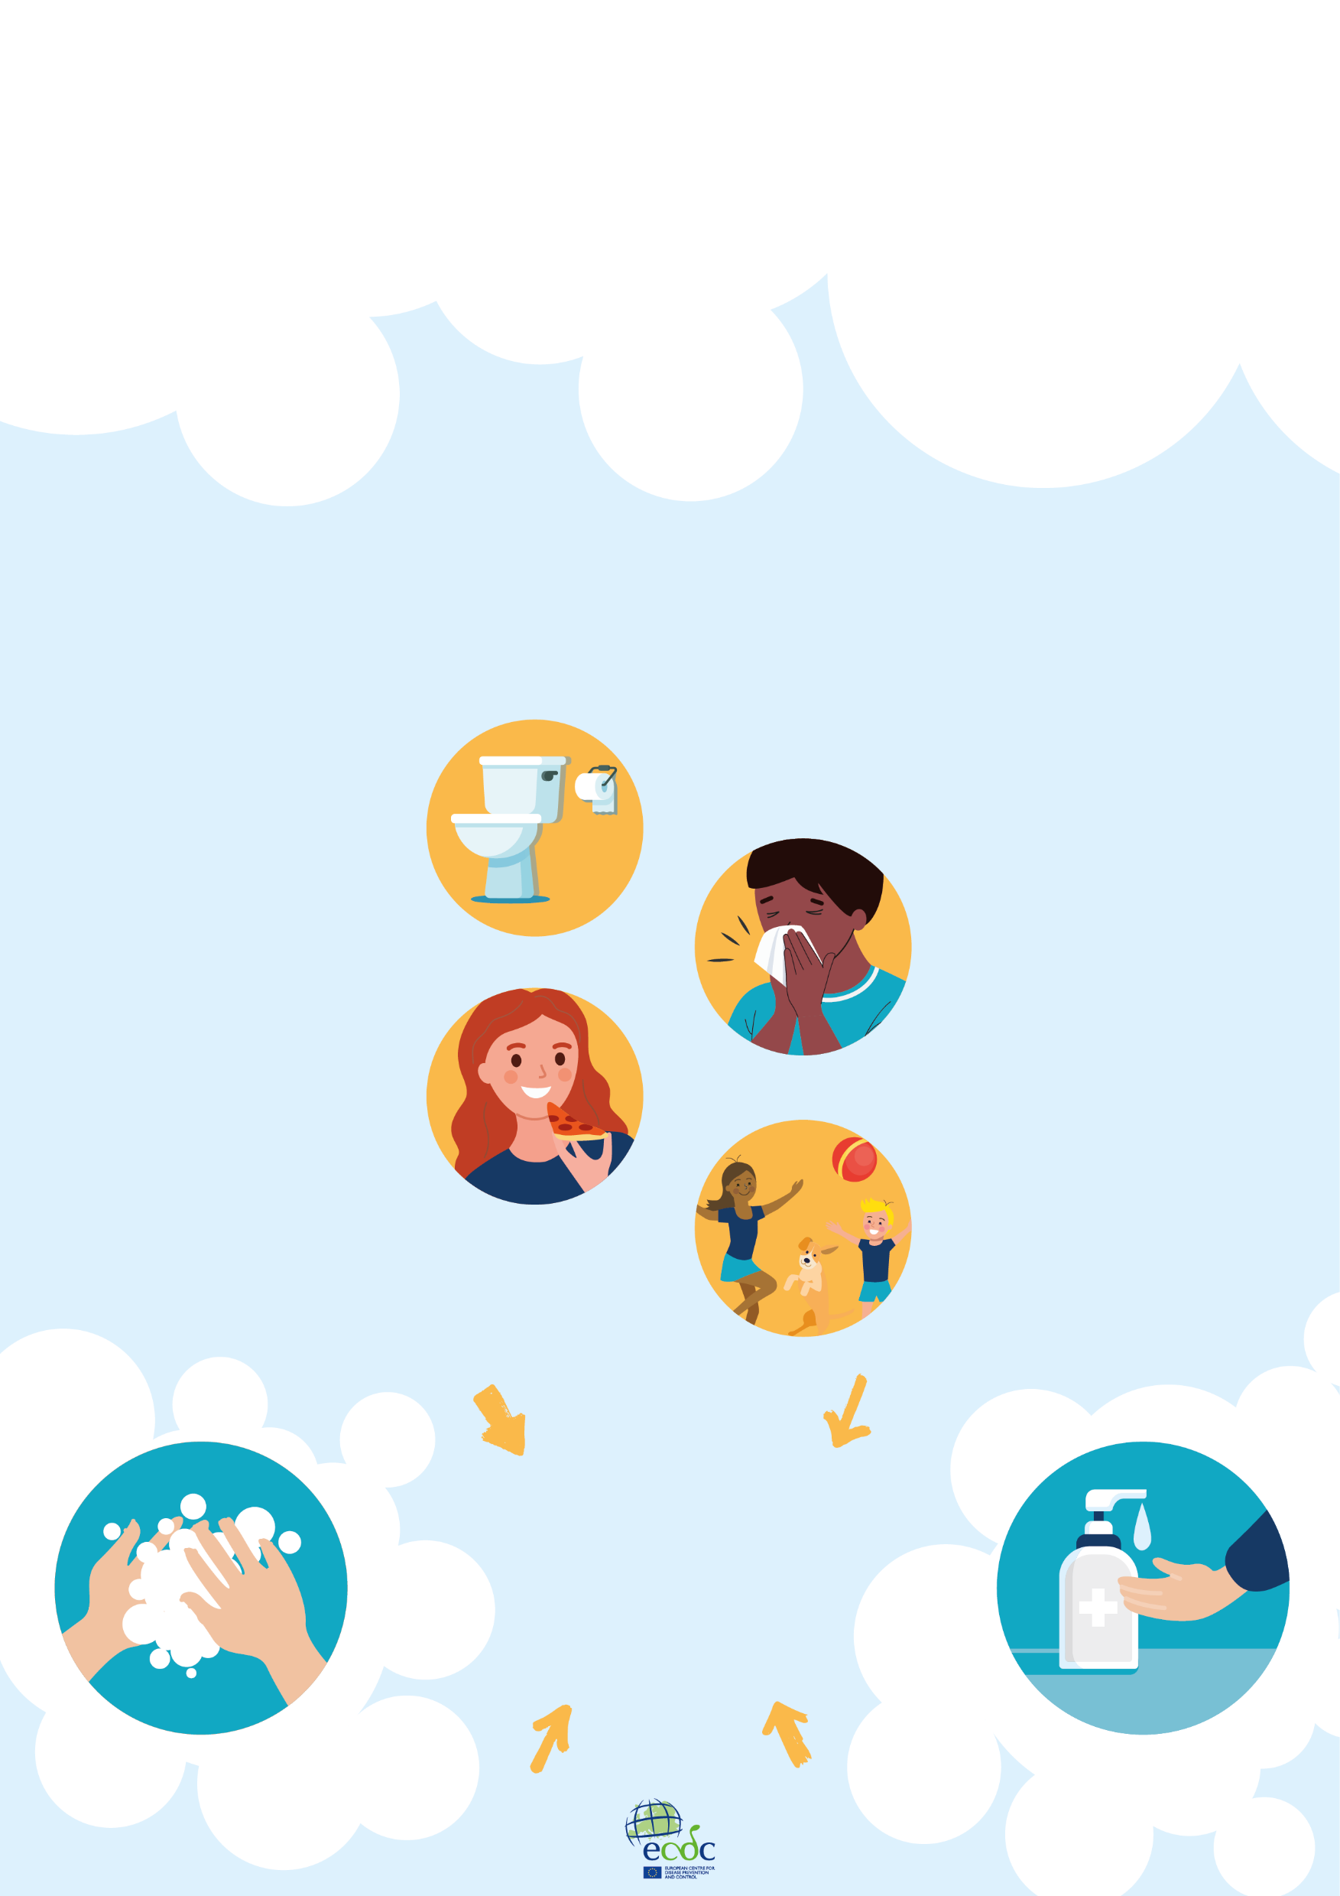
CATCH FRIENDS,
NOT INFECTIONS!
LEARN WHEN TO CLEAN
YOUR HANDS TO STAY HEALTHY!
After using the toilet
After coughing, sneezing or blowing your nose
Before and after eating
After having been outside/playing
CLEAN YOUR HANDS
WITH SOAP AND WATER OR WITH HAND SANITISER

