Slide 1
World Tuberculosis Day 2017
Tuberculosis situation in the EU/EEA, 2015
Findings from the joint Tuberculosis surveillance and monitoring in Europe, 2017 report by ECDC and WHO Regional Office for Europe
ECDC TB Team European Centre for Disease Prevention and Control
Stockholm, 24 March 2017

Slide 2
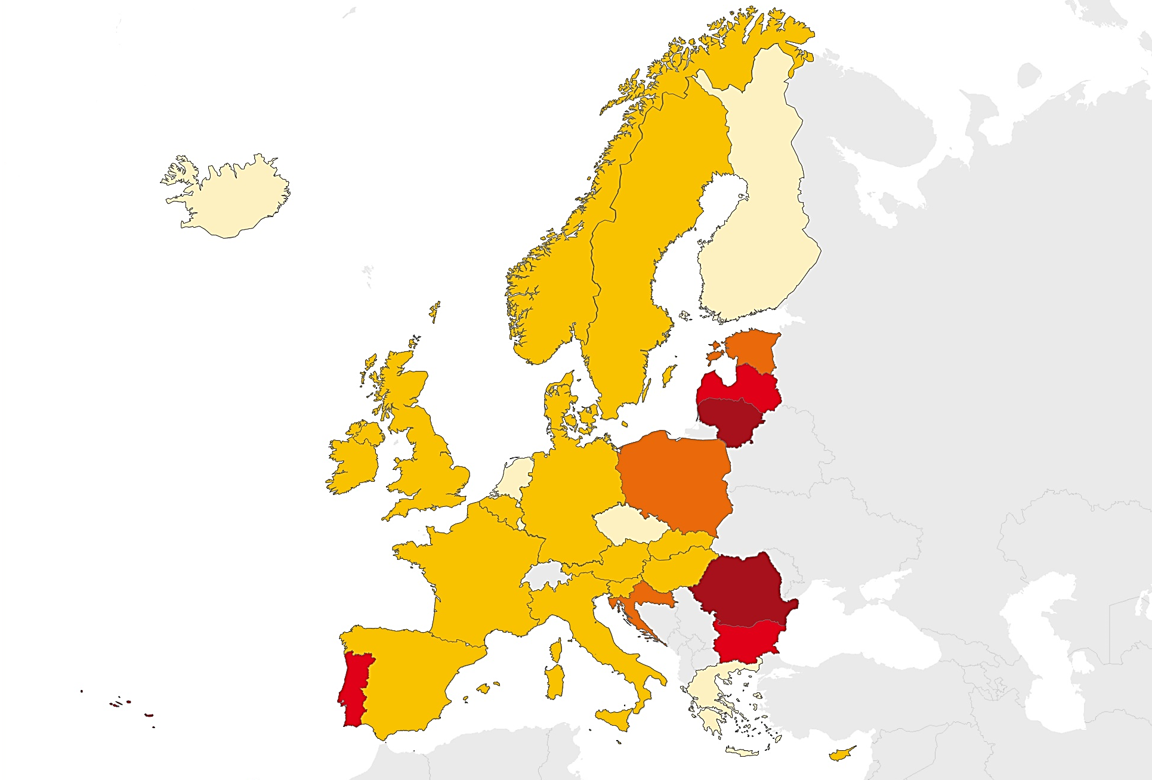
TB notifications, EU/EEA, 2015
60 195 TB cases in 30 EU/EEA countries
Notification rate of 11.7 per 100 000 population (range 2.1–76.5)
Cases per
100 000 population
< 5
5 to 9
10 to 19
20 to 49
≥ 50
Not reporting
Source: European Centre for Disease Prevention and Control/WHO Regional Office for Europe. Tuberculosis surveillance and monitoring in Europe 2017

Slide 3
TB notifications, EU/EEA, 2006-2015
Steady decline between 2006 and 2015:
number of TB cases decreased by 30%
notification rate decreased by 37%
Source: European Centre for Disease Prevention and Control/WHO Regional Office for Europe. TB surveillance and monitoring in Europe, 2017

Slide 4
TB notification rate by sex and age group, EU/EEA, 2015
The highest notification rate was observed in the age group 25–44 years, (14.4 per 100 000). Males were over-represented in all age groups except children under 15 years.
Source: European Centre for Disease Prevention and Control/WHO Regional Office for Europe. TB surveillance and monitoring in Europe, 2017

Slide 5
TB notification rate by age group, EU/EEA, 2006–2015
Decreased by 2-5% annually in all age groups
Source: European Centre for Disease Prevention and Control/WHO Regional Office for Europe. Tuberculosis surveillance and monitoring in Europe 2017

Slide 6
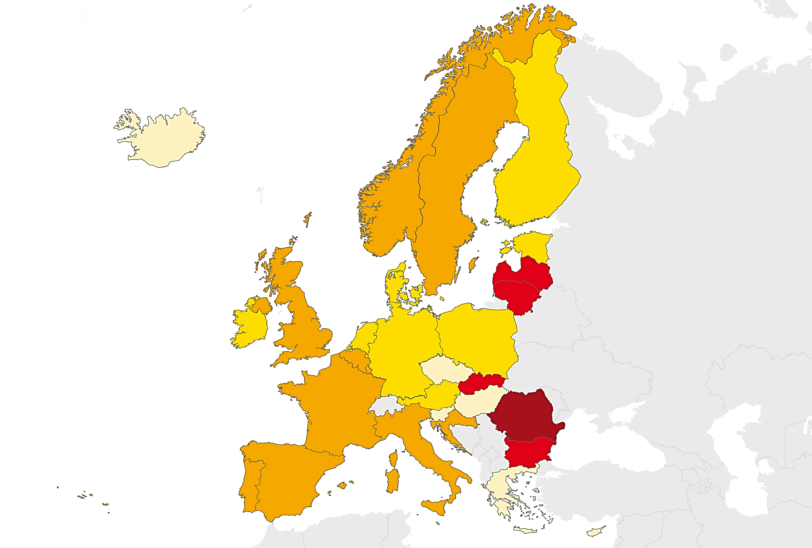
TB in children under 15 years, EU/EEA, 2015
2 444 TB cases reported in children under 15 years
4.1% of all TB cases (range 0-21.1%)
3.0 notifications per 100 000 child population (range 0–21.3)
Cases per
100 000 children
< 1
1 to 1.9
2 to 3.9
4 to 9.9
≥ 10
Not reporting
Source: European Centre for Disease Prevention and Control/WHO Regional Office for Europe. Tuberculosis surveillance and monitoring in Europe 2017
Notes:
Added: Notified

Slide 7
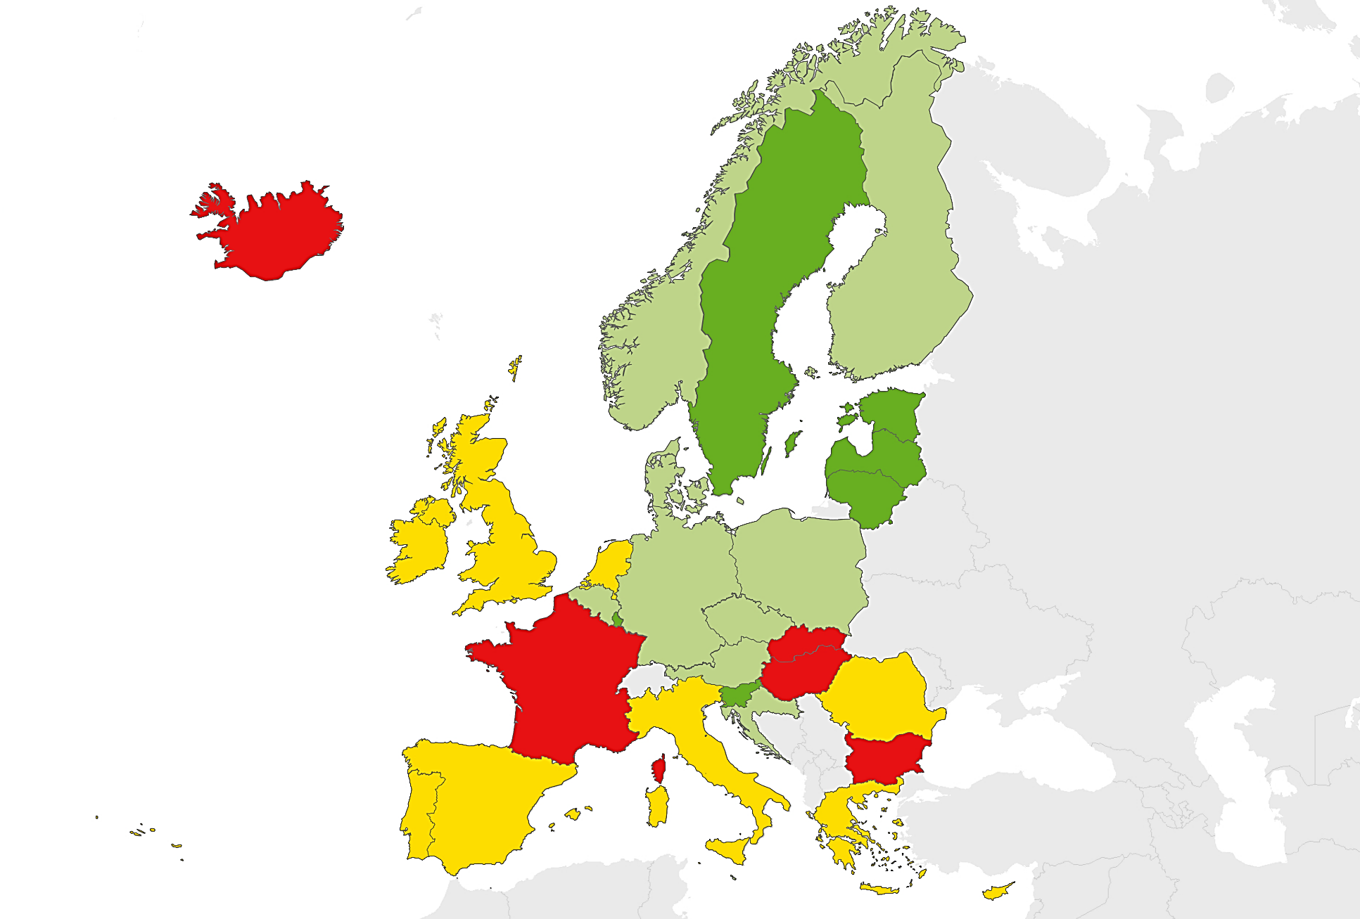
Confirmed TB cases*, EU/EEA, 2015
66.9% of TB cases were laboratory-confirmed (range 42.9–91.5%)
Proportion of confirmed cases
< 60%
60 to 69%
70 to 79%
≥ 80%
Not reporting
Source: European Centre for Disease Prevention and Control/WHO Regional Office for Europe. TB surveillance and monitoring in Europe, 2017
* Confirmation by culture or by both sputum microscopy and Mycobacterium tuberculosis nucleic acid amplification test

Slide 8
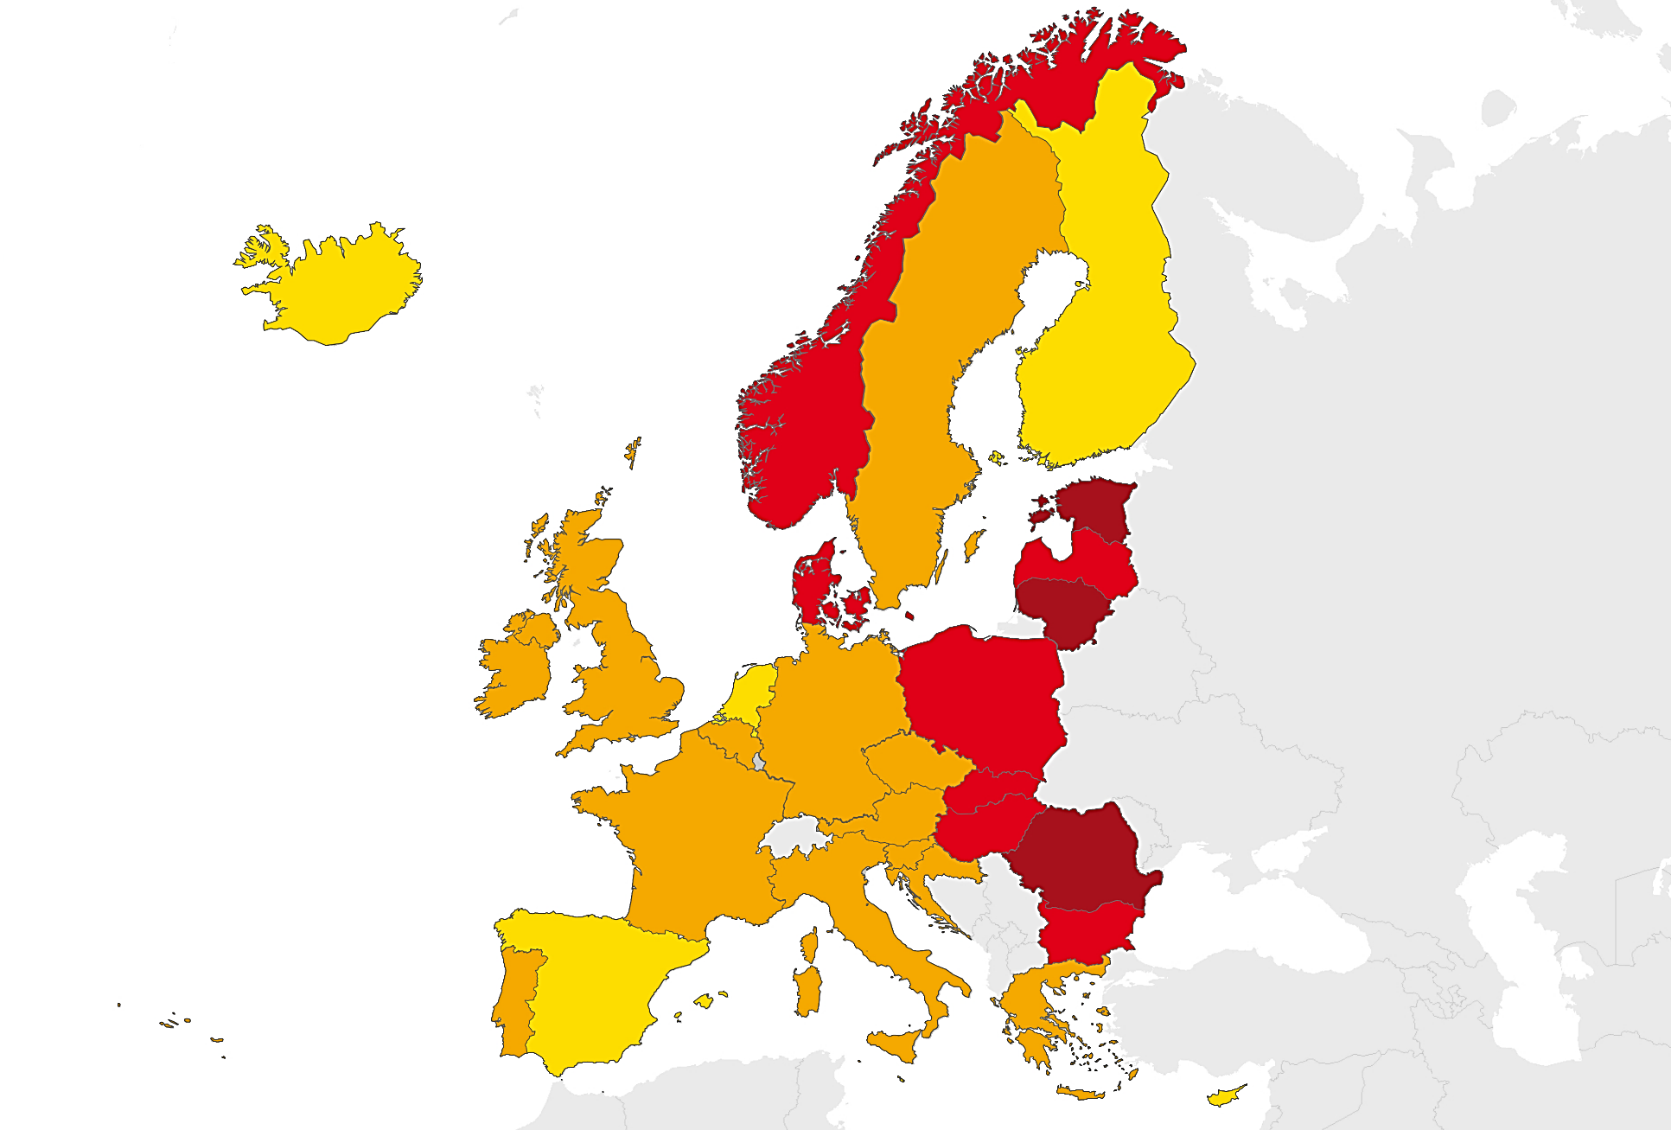
Previously treated TB cases, EU/EEA, 2015
11.1% of reported cases had been previously treated (range 0–21.7%)
Proportion of previously treated cases
< 5%
5 to 9.9%
10 to 14.9%
≥ 15%
Not reporting
Source: European Centre for Disease Prevention and Control/WHO Regional Office for Europe. TB surveillance and monitoring in Europe, 2017

Slide 9
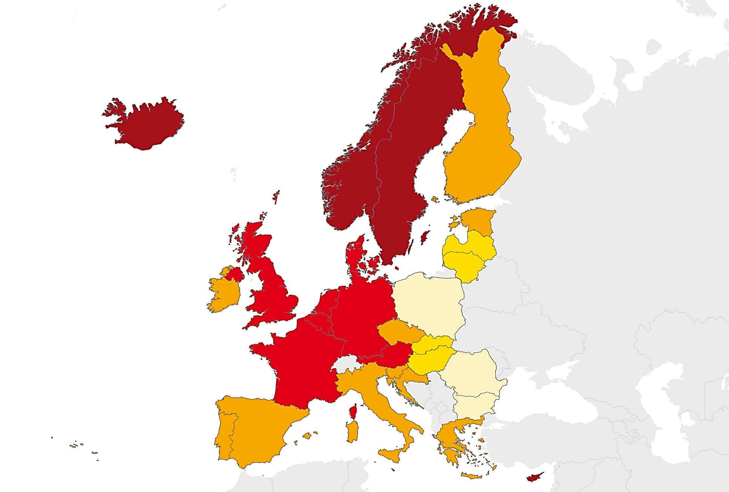
TB cases in persons of foreign origin, EU/EEA, 2015
29.8% of TB cases occurred in persons of foreign origin (range 0.2–89.5%)
Proportion of cases
< 1%
1 to 9.9%
10 to 49.9%
50 to 74.9%
≥ 75%
Not reporting
Source: European Centre for Disease Prevention and Control/WHO Regional Office for Europe. Tuberculosis surveillance and monitoring in Europe 2017
Notes:
Added: Notified

Slide 10
TB cases in persons of foreign origin, EU/EEA, 2006–2015
Percentage of cases in persons of foreign origin increased from 17.6% in 2006 to 29.8% in 2015
Rate per 100 000 total population stable between 3.1 and 3.5
Source: European Centre for Disease Prevention and Control/WHO Regional Office for Europe. TB surveillance and monitoring in Europe, 2017

Slide 11
TB notification rates by origin, EU/EEA, 2010–2015
3.7% annual decline of notification rate in foreign population
7.0% annual decline of notification rate in native population
Source: Hollo V, Beauté J, Ködmön C, van der Werf MJ. TB notification rate decreases faster in residents of native origin than in residents of foreign origin in the EU/EEA. (Eurosurveillance, March 2017).

Slide 12
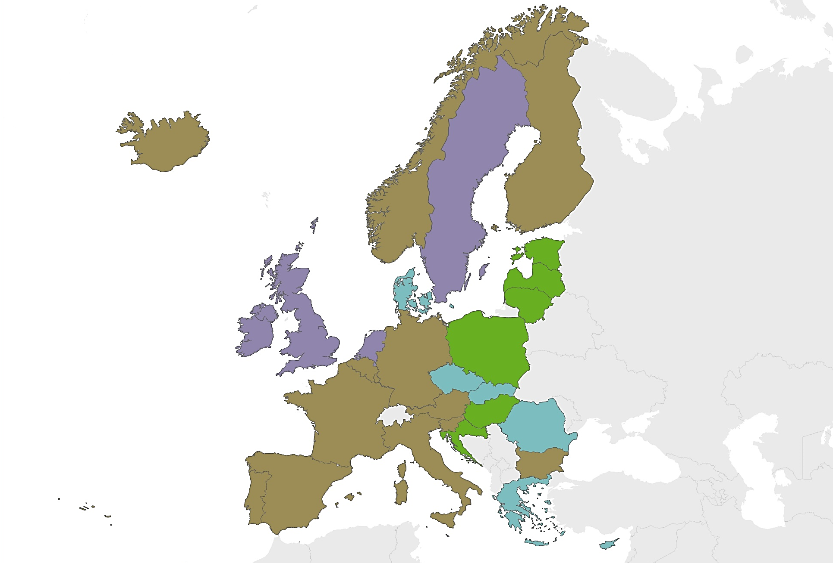
Extrapulmonary TB cases, EU/EEA, 2015
22.2% of TB cases had extrapulmonary TB (range 2.8–46.4%)
Proportion of extrapulmonary cases
0 to 9.9%
10 to 19.9%
20 to 29.9%
≥ 30%
Not reporting
Source: European Centre for Disease Prevention and Control/WHO Regional Office for Europe. Tuberculosis surveillance and monitoring in Europe 2017
Notes:
Added: Notified

Slide 13
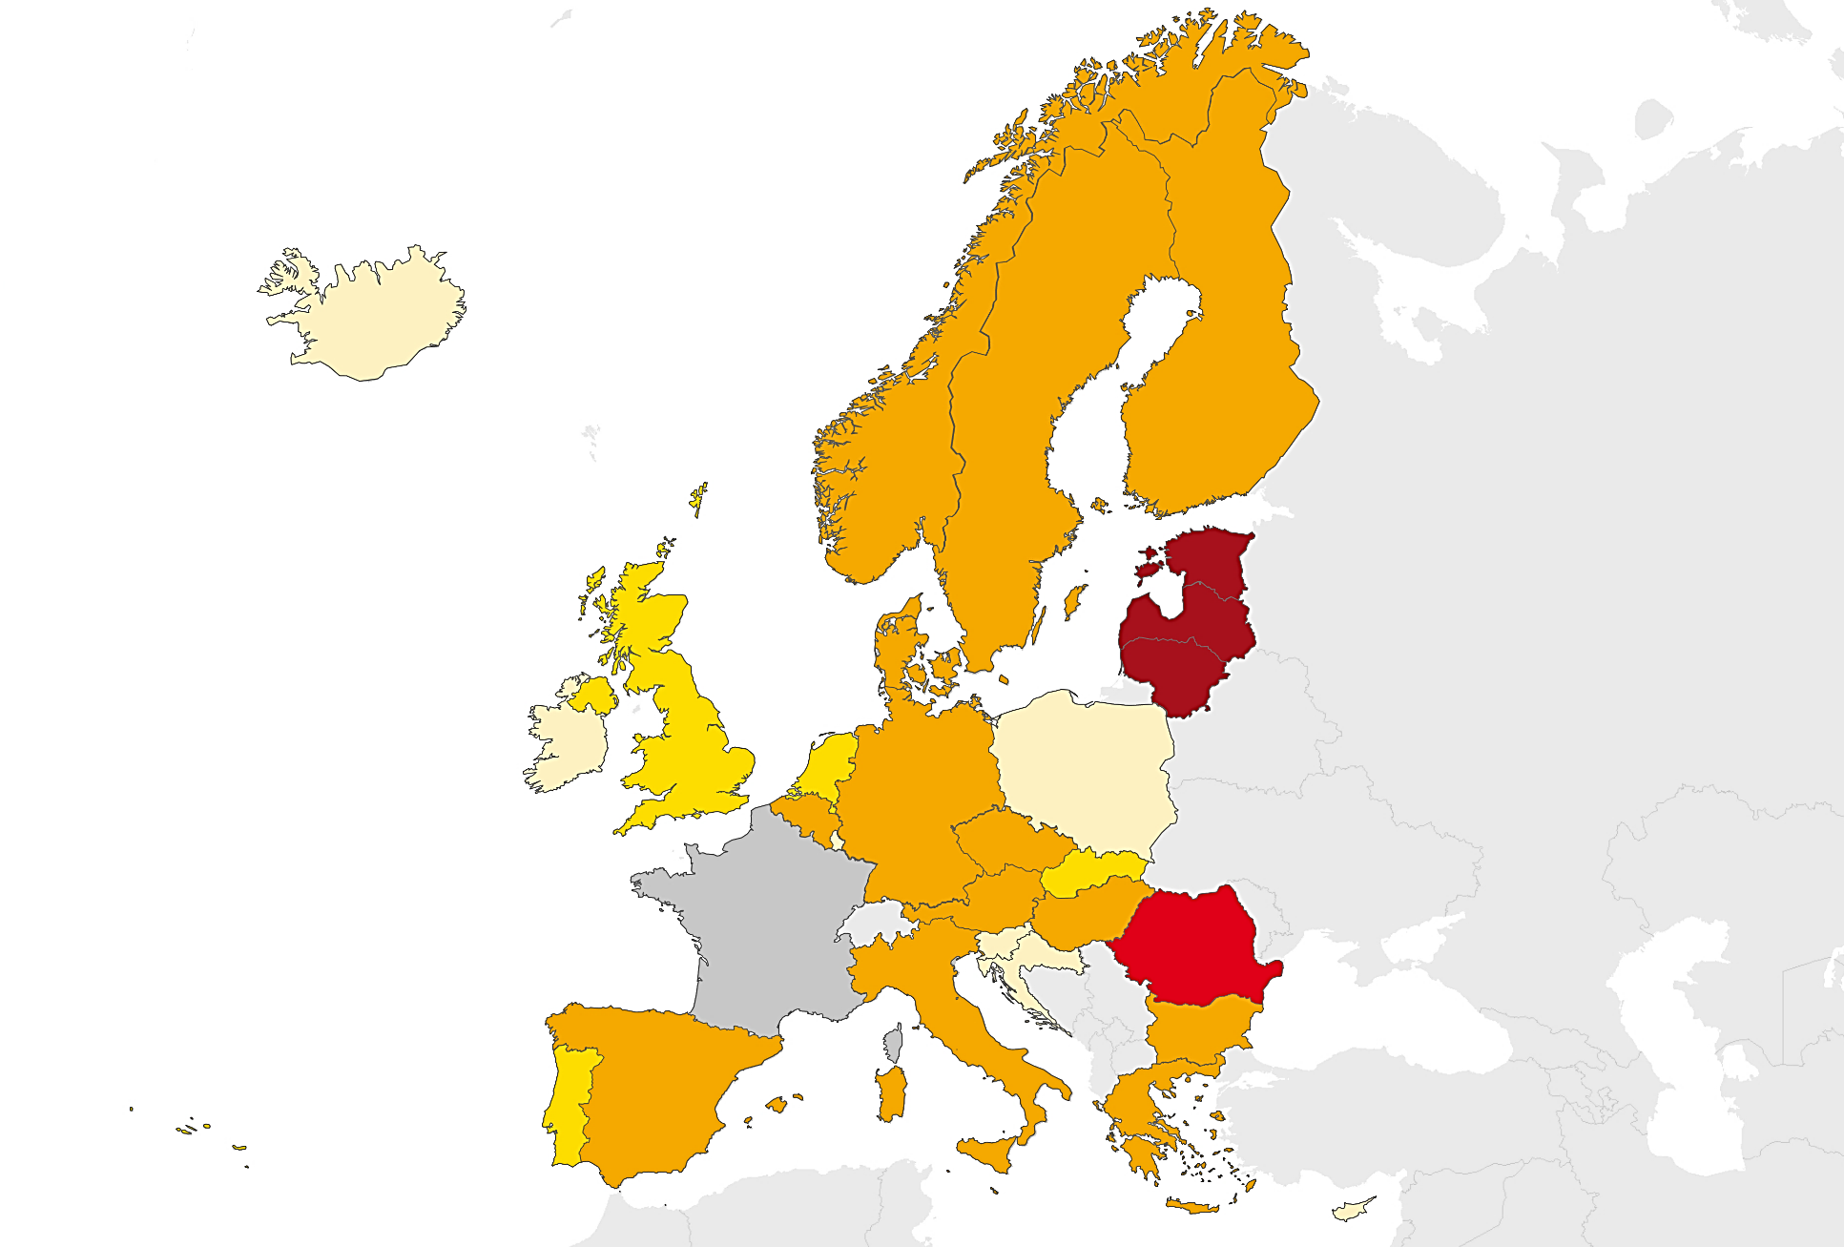
Multidrug-resistant TB (MDR TB), EU/EEA, 2015
4.1% of TB cases with DST* results were multidrug-resistant (range 0–21.2%)
Proportion of cases
< 1%
1 to 1.9%
2 to 4.9%
5 to 9.9%
≥ 10%
Not reporting
Source: European Centre for Disease Prevention and Control/WHO Regional Office for Europe. TB surveillance and monitoring in Europe, 2017
* DST – drug susceptibility results reported for at least isoniazid and rifampicin

Slide 14
MDR TB notification rate, EU/EEA, 2011– 2015
Rate was stable at 0.3 per 100 000 population between 2011 and 2015
Source: European Centre for Disease Prevention and Control/WHO Regional Office for Europe. Tuberculosis surveillance and monitoring in Europe 2017

Slide 15
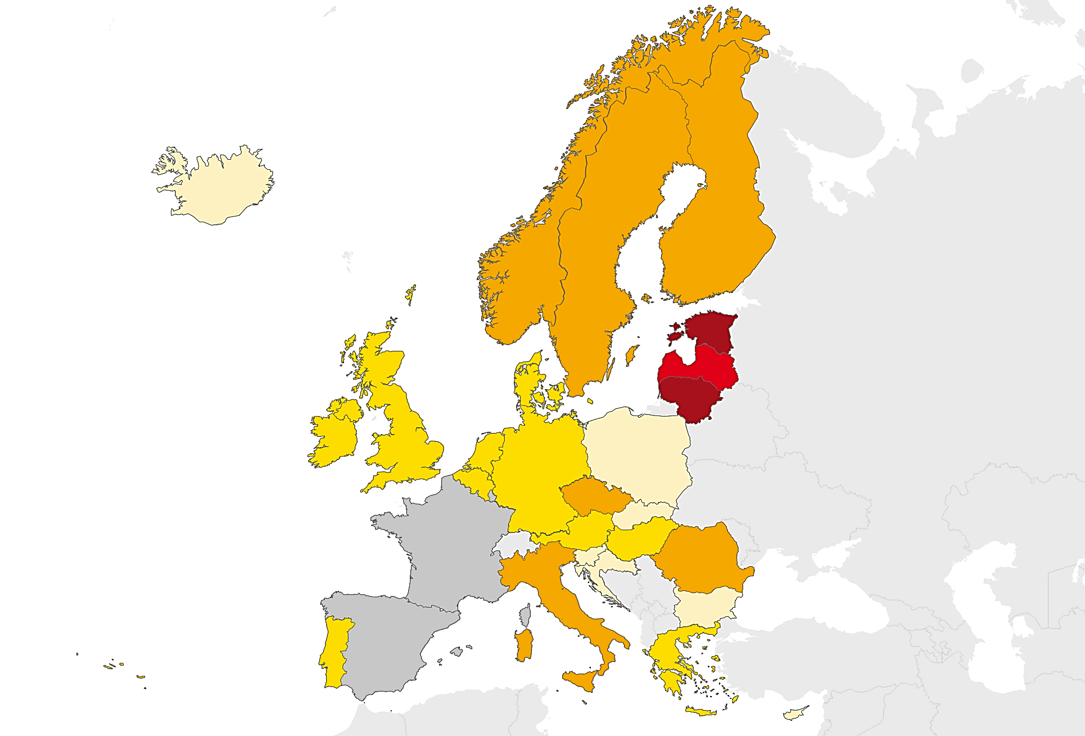
Multidrug resistance among new pulmonary TB cases, EU/EEA, 2015
2.2% of new pulmonary TB cases with DST* results had MDR TB (range 0–13.5%)
Proportion of cases
< 1%
1 to 1.9%
2 to 4.9%
5 to 9.9%
≥ 10%
Not reporting
Source: European Centre for Disease Prevention and Control/WHO Regional Office for Europe. TB surveillance and monitoring in Europe, 2017
* DST – drug susceptibility results reported for at least isoniazid and
rifampicin

Slide 16
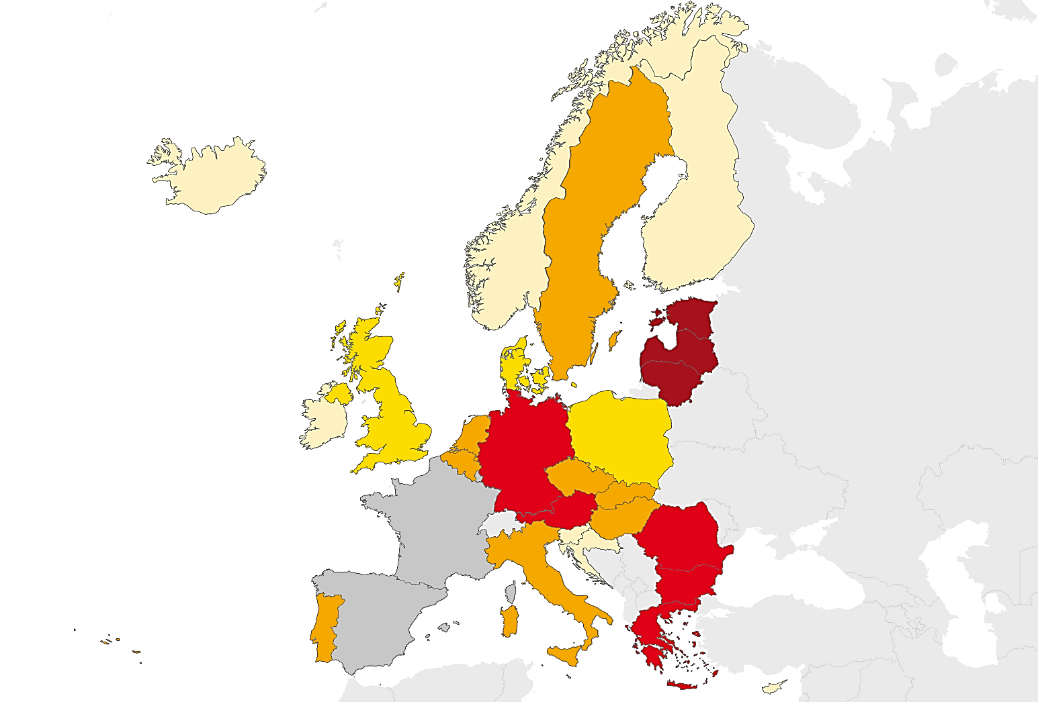
Multidrug resistance among previously treated pulmonary TB cases, EU/EEA, 2015
17.2% (range 0–51.4%) of previously treated pulmonary TB cases with DST* results had MDR TB
Proportion of cases
< 1%
1 to 4.9%
5 to 14.9%
15 to 24.9%
≥ 25%
Not reporting
Source: European Centre for Disease Prevention and Control/WHO Regional Office for Europe. TB surveillance and monitoring in Europe, 2017
* DST – drug susceptibility results reported for at least isoniazid and
rifampicin

Slide 17
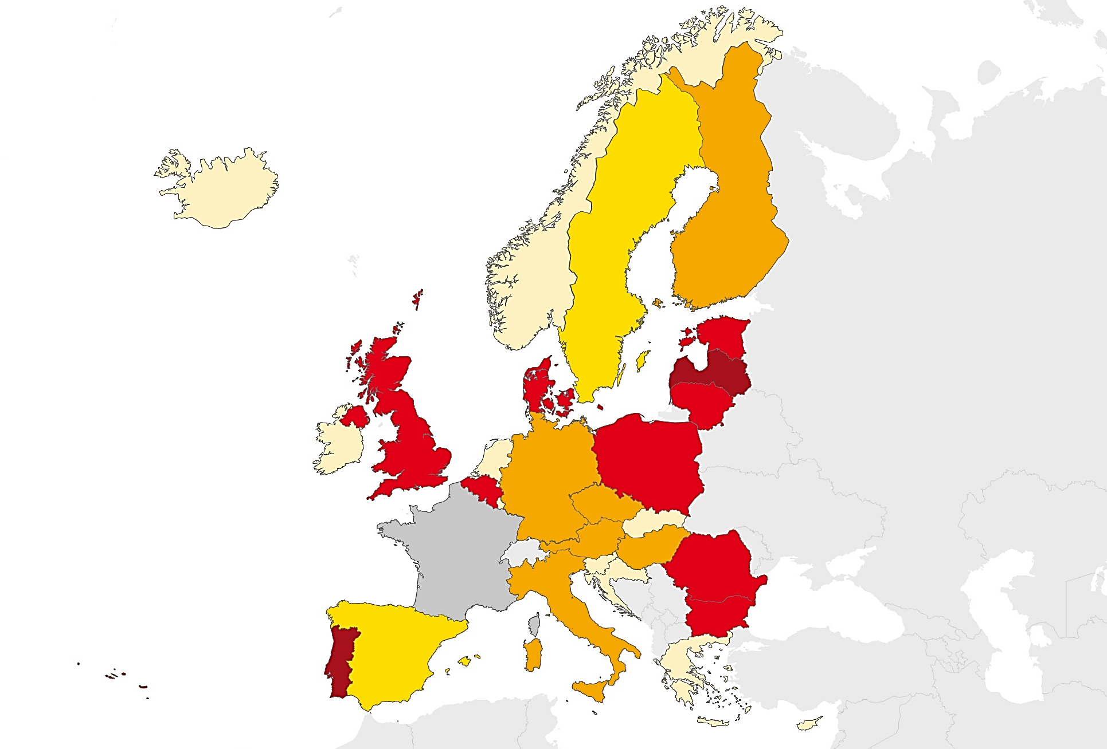
Extensively drug-resistant TB (XDR TB), EU/EEA, 2015
19.7% of MDR TB cases with second line DST* were extensively drug-resistant (range 0–30.0% and 13.0–25.4% for countries reporting more than five cases)
Proportion of cases
< 1%
1 to 9.9%
10 to 14.9%
15 to 24.9%
≥ 25%
Not reporting
Source: European Centre for Disease Prevention and Control/WHO Regional Office for Europe. Tuberculosis surveillance and monitoring in Europe 2017
* DST – drug susceptibility test

Slide 18
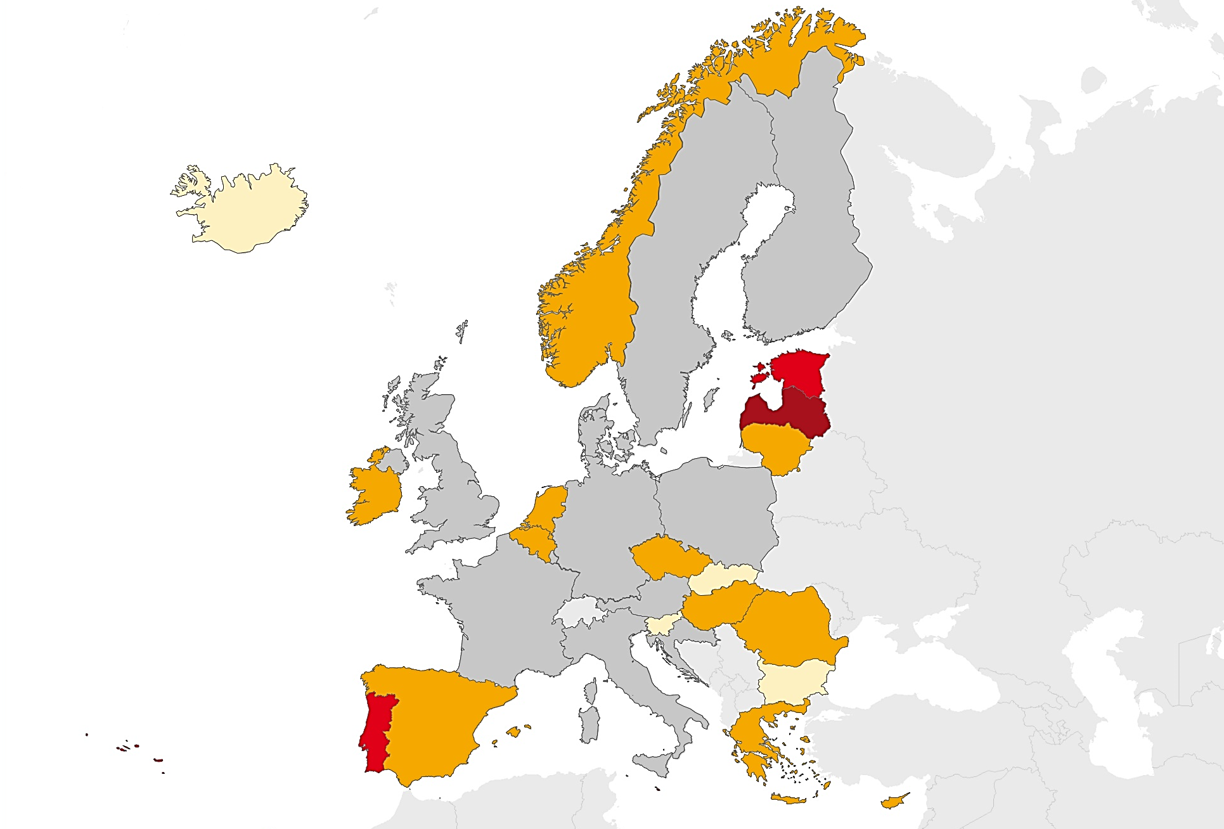
TB/HIV co-infection, EU/EEA, 2015
4.6% of TB cases with known HIV status* were HIV positive (range 0–17.4%)
Proportion of confirmed cases
< 1%
1 to 9.9%
10 to 14.9%
≥ 15%
Not reporting
Source: European Centre for Disease Prevention and Control/WHO Regional Office for Europe. Tuberculosis surveillance and monitoring in Europe 2017
* Among countries reporting HIV status for at least 50% of TB cases
Notes:
Added: Notified

Slide 19
Treatment success of all TB cases notified in 2014, EU/EEA, 2015
72.0% of all TB cases* had a successful treatment outcome after 12 months (range 43.3–88.9%)
Source: European Centre for Disease Prevention and Control/WHO Regional Office for Europe. TB surveillance and monitoring in Europe, 2017
* Six EU/EEA Member States did not report treatment outcome data
Notes:
72.0 of all TB cases were reported as successfully treated by 25 MSs

Slide 20
Treatment success of all notified TB cases, 2005–2014, EU/EEA
Proportion of successfully treated cases is stable (range 72–75%)
Source: European Centre for Disease Prevention and Control/WHO Regional Office for Europe. Tuberculosis surveillance and monitoring in Europe 2017

Slide 21
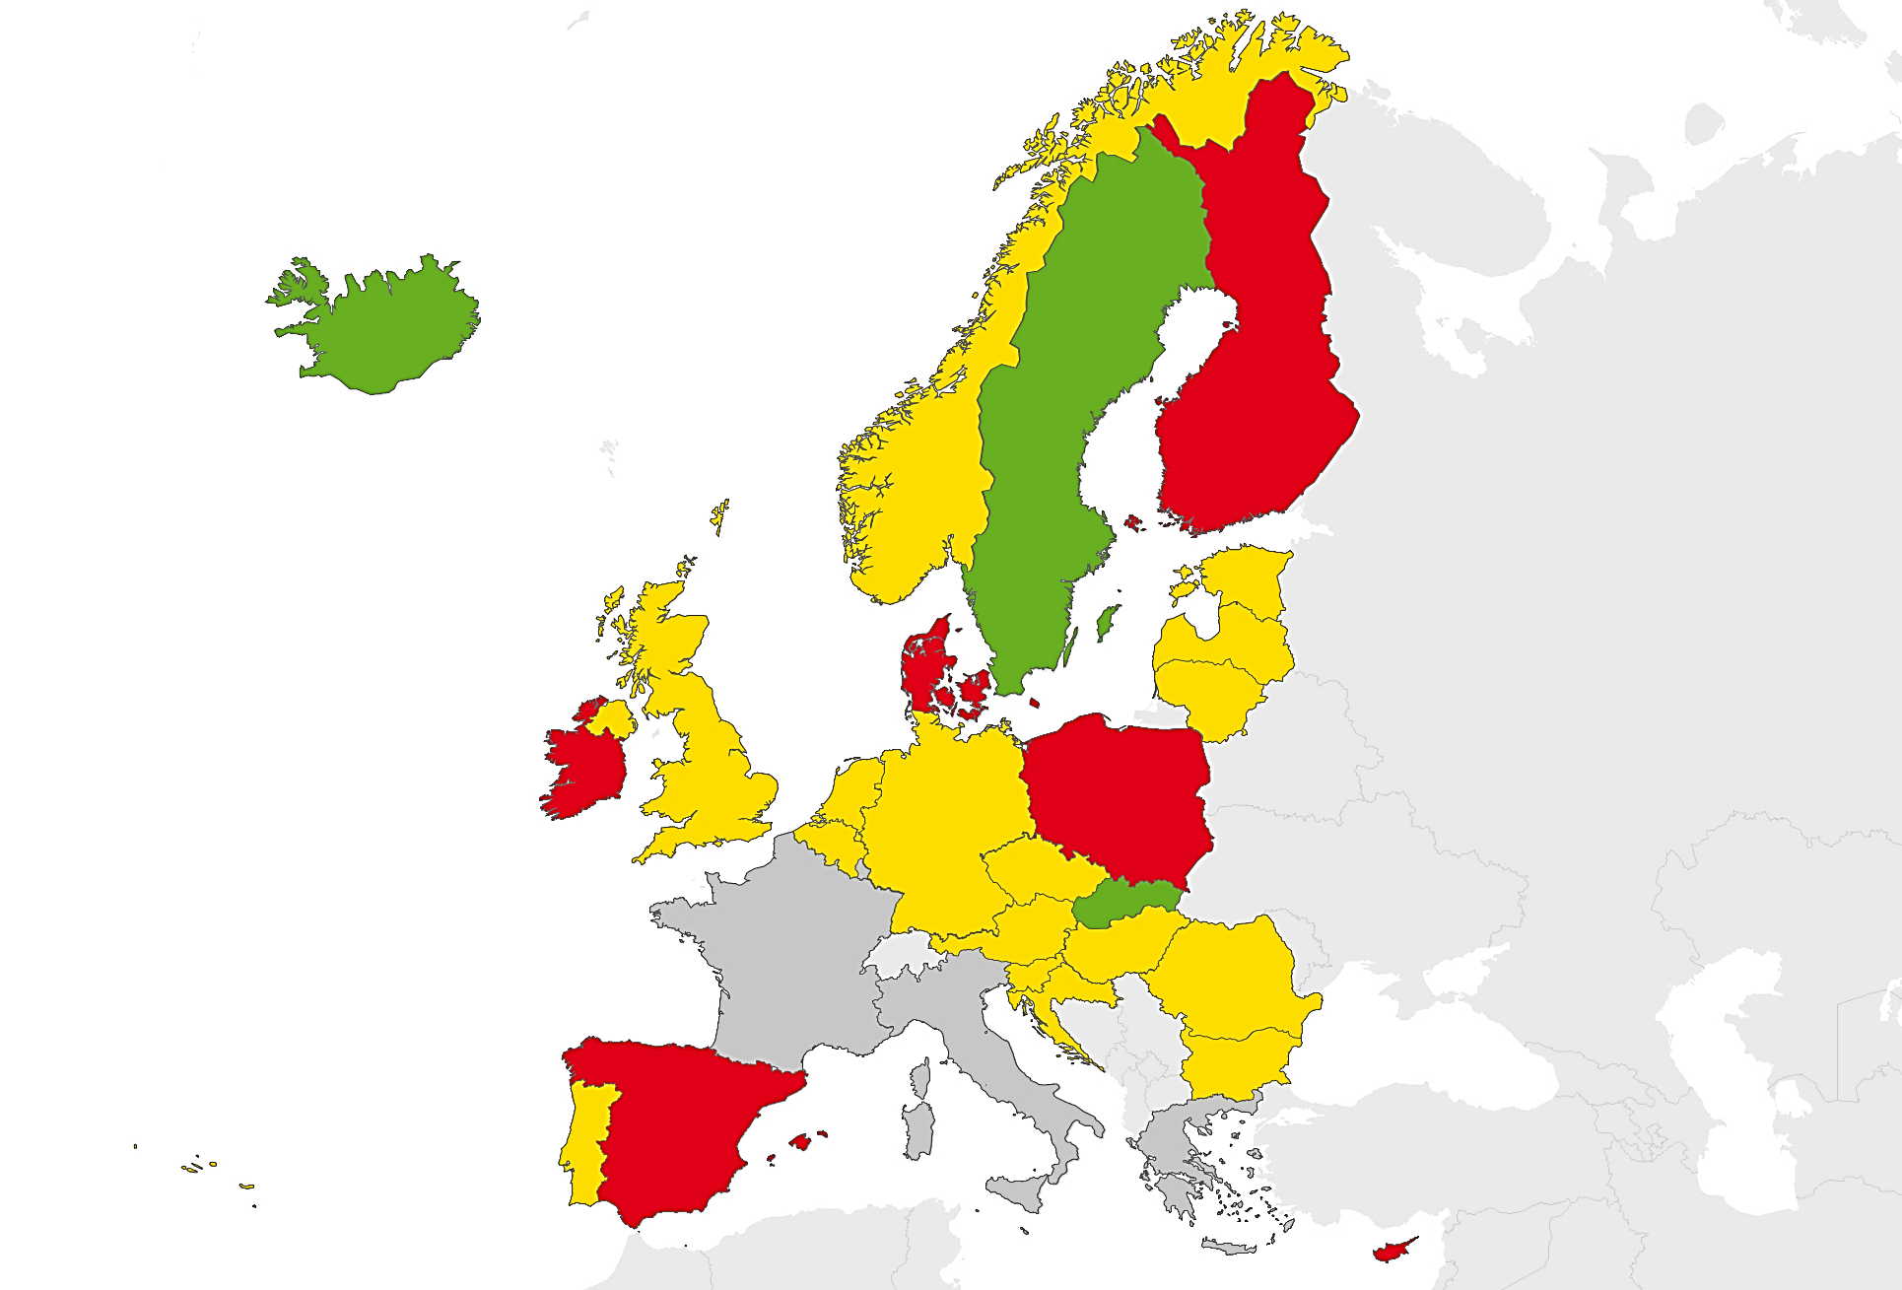
Treatment success, EU/EEA, 2015*
72.0% of all TB cases* had a successful treatment outcome after 12 months (range 43.3–88.9%)
Proportion of treatment success
< 60%
60 to 84.9%
≥ 85%
Not reporting
Source: European Centre for Disease Prevention and Control/WHO Regional Office for Europe. Tuberculosis surveillance and monitoring in Europe 2017
* Six EU/EEA Member States did not report treatment outcome data

Slide 22
Treatment success in new confirmed TB cases and relapses, started on treatment in 2014*, EU/EEA, 2015
74.4% of new confirmed cases and relapses had a successful treatment outcome (range 44.8–88.9%)
Source: European Centre for Disease Prevention and Control/WHO Regional Office for Europe. TB surveillance and monitoring in Europe, 2017
* Cases started on second line treatment are excluded

Slide 23
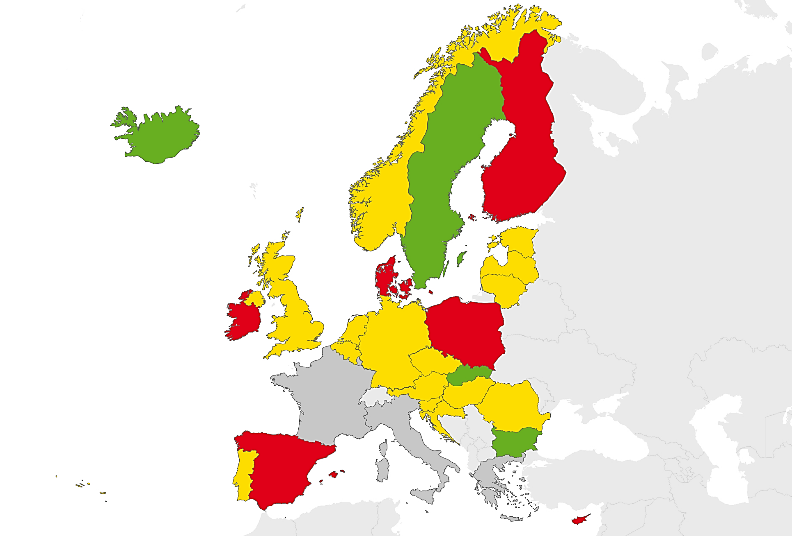
Treatment success in new confirmed TB cases and relapses notified in 2014*, EU/EEA, 2015
74.4% of new confirmed TB cases and relapses had a successful treatment outcome (range 44.8–88.9%)
Proportion of treatment success
< 60%
60 to 84.9%
≥ 85%
Not reporting
Source: European Centre for Disease Prevention and Control/WHO Regional Office for Europe. TB surveillance and monitoring in Europe, 2017
* Six EU/EEA Member States did not report treatment outcome data

Slide 24
Treatment success in MDR TB*, EU/EEA, 2015
40.4% of all MDR TB cases notified in 2013 were successfully treated (range 0–93.8%)
Source: European Centre for Disease Prevention and Control/WHO Regional Office for Europe. Tuberculosis surveillance and monitoring in Europe 2017
* Croatia, Czech Republic, Iceland and Slovenia reported zero MDR TB cases in 2013

Slide 25
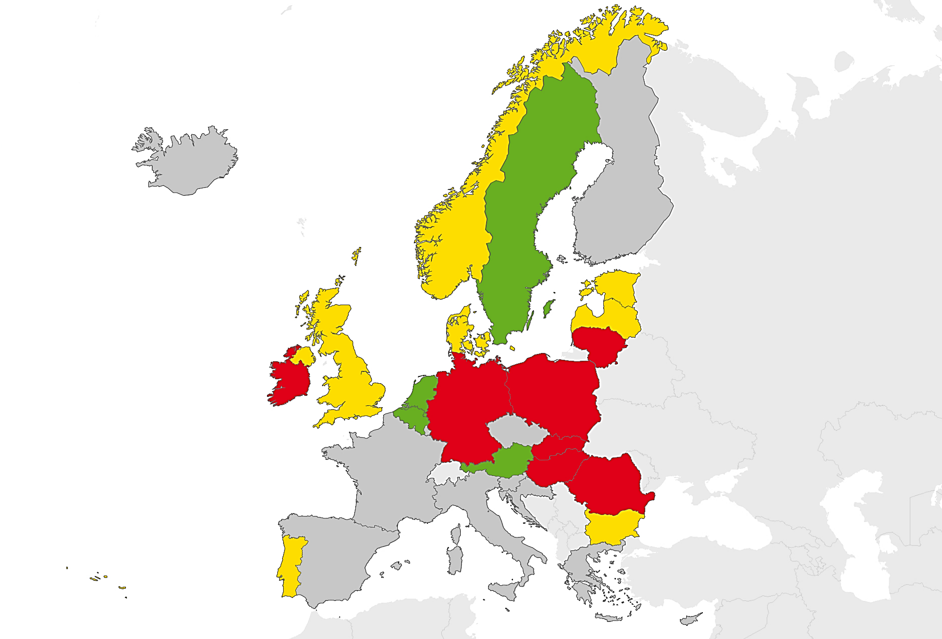
Treatment success in all cases with MDR TB*, EU/EEA, 2015
40.4% of all MDR TB cases notified in 2013 was successfully treated (range 0–93.8%)
Proportion of treatment success
< 40%
40 to 69.9%
≥ 70%
Not reporting
Source: European Centre for Disease Prevention and Control/WHO Regional Office for Europe. TB surveillance and monitoring in Europe, 2017
* Croatia, Czech Republic, Iceland and Slovenia reported zero MDR TB cases in 2013,
nine Member States did not report treatment outcome data for MDR TB cases

Slide 26
Treatment outcomes of MDR TB cases notified in 2011–2013, EU/EEA, 2015
Treatment success rates remained stable at 38-40% in the 2011, 2012 and 2013 cohorts
Source: European Centre for Disease Prevention and Control/WHO Regional Office for Europe. TB surveillance and monitoring in Europe, 2017

Slide 27
Treatment success in XDR TB cases, EU/EEA, 2015
24.3% of the XDR TB cases notified in 2012 were treated successfully (range 0–100%)
Source: European Centre for Disease Prevention and Control/WHO Regional Office for Europe. TB surveillance and monitoring in Europe, 2017
* Cyprus, Ireland, Netherlands, Norway and Slovakia reported zero XDR TB cases in 2012. 13 countries did not report second line drug susceptibility testing results or XDR TB treatment outcome data
27
Notes:
TOM results reported for 140 XDR TB cases notified in 2012

