Slide 1
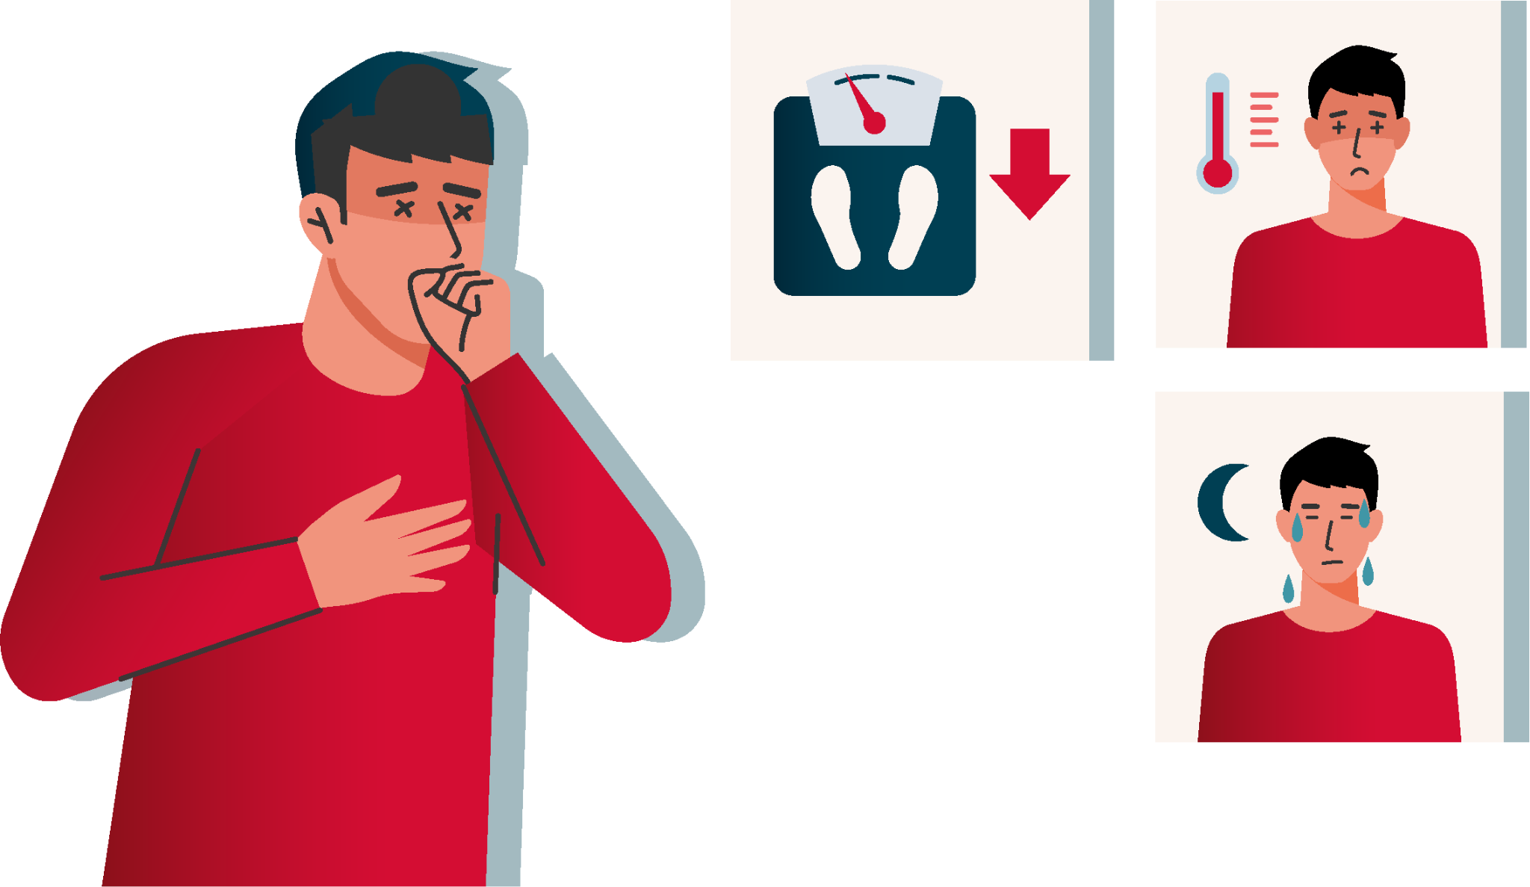
Coughing for over 2 weeks?
Losing weight without trying?
Fever and night sweats?
Know
the
symptoms
Take charge of Your Health!
Seek medical care early!

Slide 2
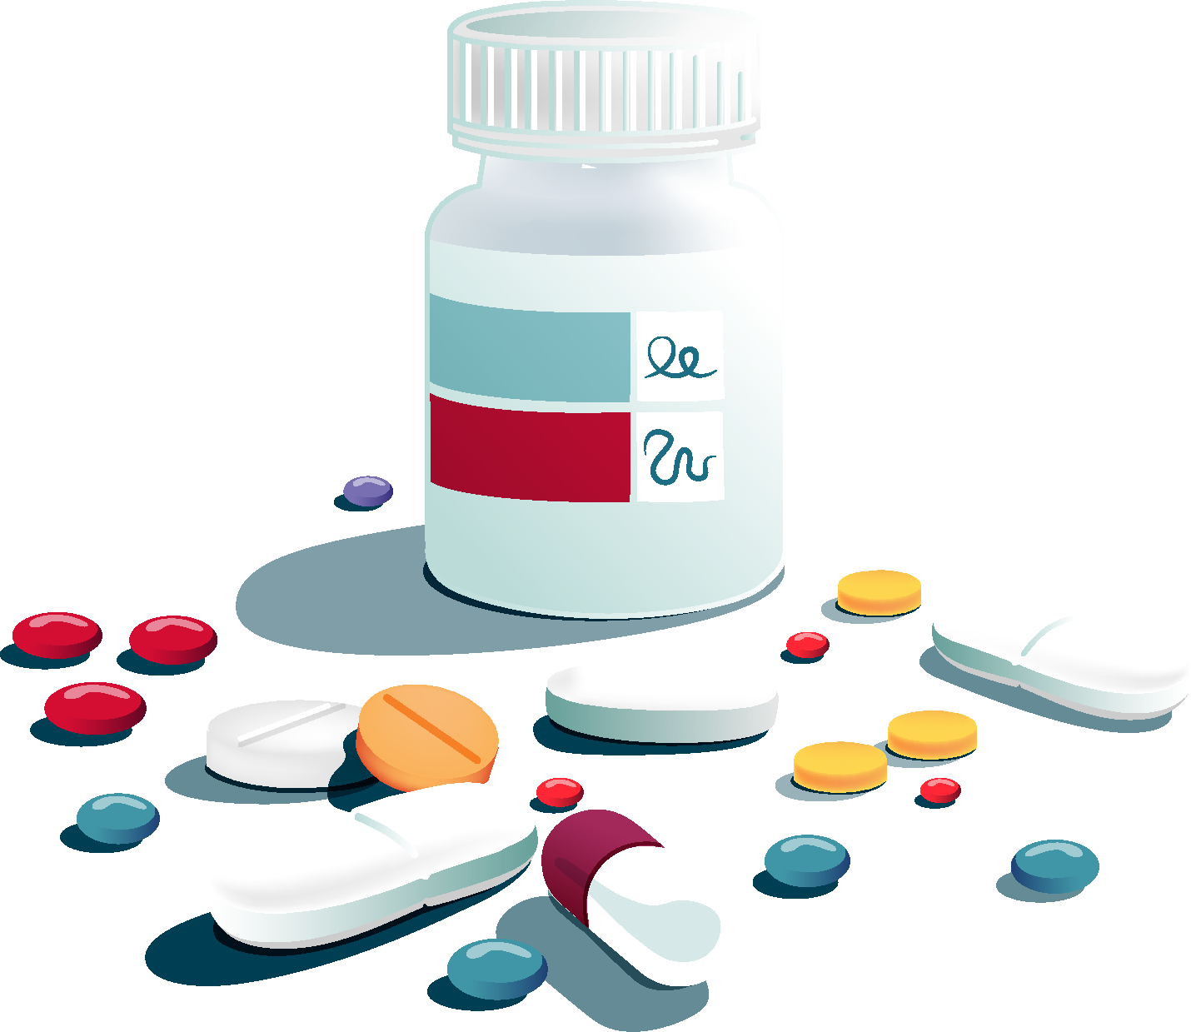
Stopping your TB treatment early
can cause
drug resistance.
Always
follow your doctor's advice.

Slide 3
TB is treatable,
not a death sentence
Stigma stops people
from getting help —
let's support and stand
by those affected.

Slide 4
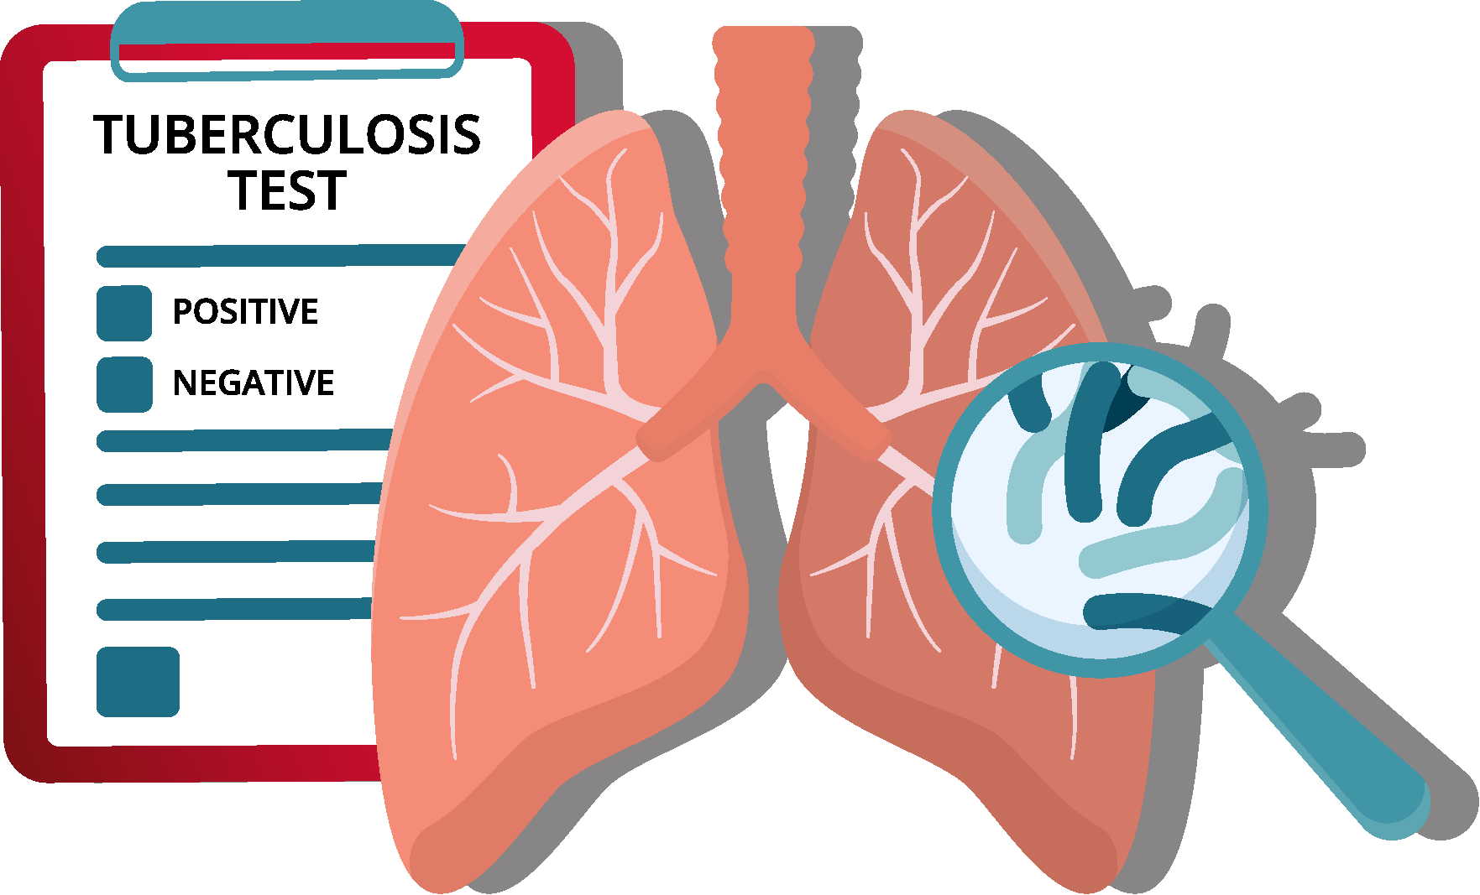
Have you been in close contact with someone who has TB?
Get tested—especially if you:
• live or work in crowded conditions
• have diabetes or HIV
• are a healthcare worker

Slide 5
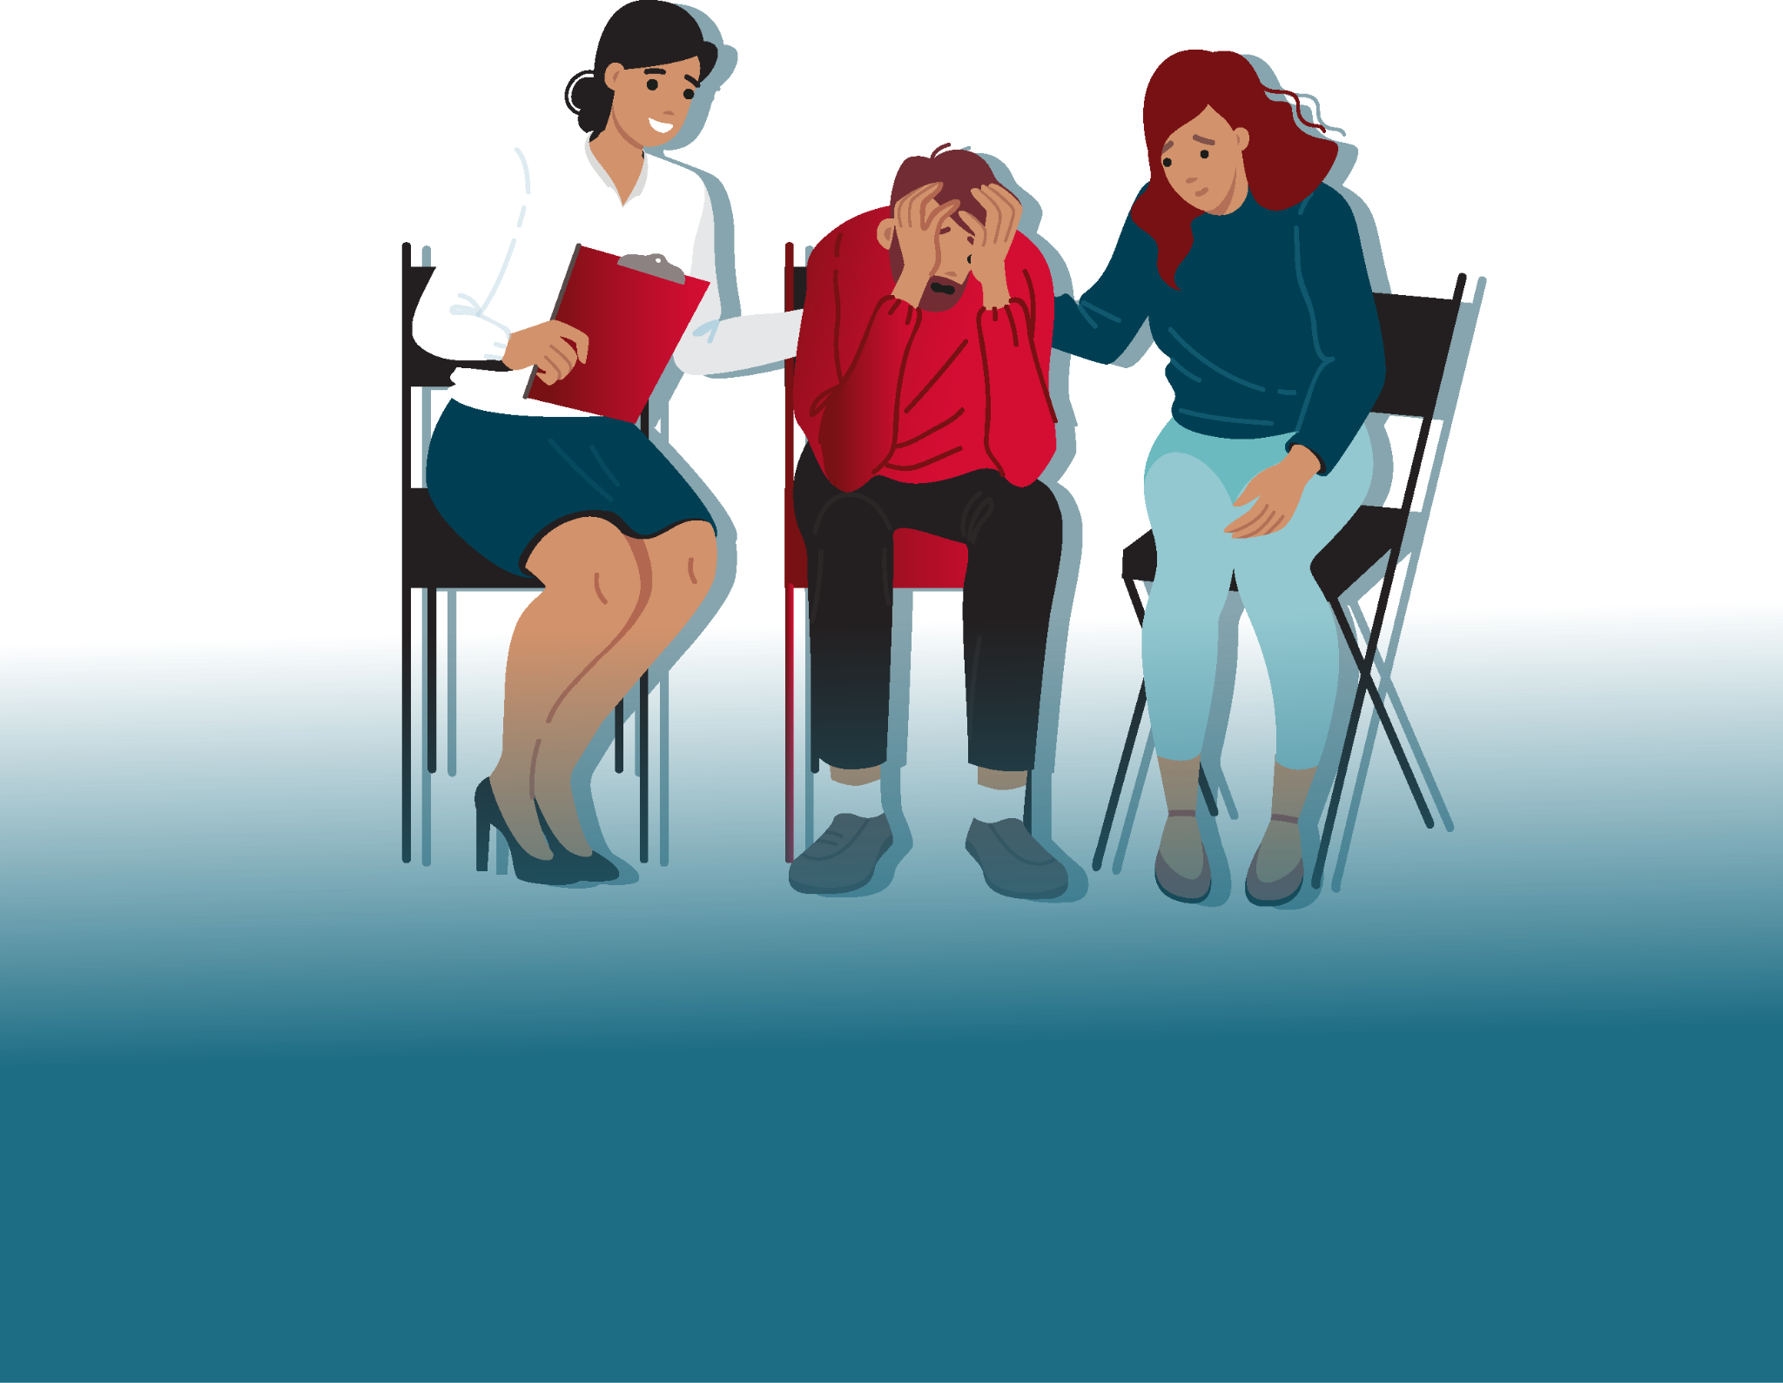
Support
makes a big difference!
TB treatment can be tough and lengthy.
Completing treatment is key to recovery.

