Slide 1
Surveillance of hepatitis B and C in the EU/EEA – 2021 data
Section for STIs, blood-borne viruses and TB

Slide 2
Surveillance of hepatitis B and C – principles
Surveillance programme coordinated by ECDC
Data on new hepatitis B and C cases diagnosed in EU/EEA countries are uploaded annually into the European Surveillance System (TESSy) – a purpose-built web-based system for data collection
Case-based and aggregate reporting possible
Countries requested to follow the EU 2018 case definitions, differentiating between acute and newly diagnosed chronic infections
Data validated by Member States

Slide 3
Hepatitis B data and trends

Slide 4
Hepatitis B data: reporting countries and case definitions used
30 countries provided hepatitis B data for 2021
Three countries could only provide data on acute cases
Case definitions varied:
22 countries used the EU 2012 or 2018 case definitions*
Four countries used the EU 2008 case definition
Four countries used national case definitions
Aggregate data from two countries (Belgium, Bulgaria)
*The 2012 and 2018 case definitions are essentially identical, except that the 2018 definition explicitly states that countries should differentiate between acute and chronic cases according to ECDC requirements
2018: https://eur-lex.europa.eu/legal-content/EN/TXT/PDF/?uri=CELEX:32018D0945&from=EN#page=22
2012: https://eur-lex.europa.eu/LexUriServ/LexUriServ.do?uri=OJ:L:2012:262:0001:0057:EN:PDF
2008: https://ec.europa.eu/health/ph_threats/com/docs/1589_2008_en.pdf

Slide 5
Hepatitis B data: distribution by disease status, EU/EEA, 2021
16 187 cases reported in 2021
Acute: 1 142 (7%)
Chronic: 6 998 (43%)
Unknown: 6 935 (43%)*
Overall rate (excluding three countries that only report acute cases): 4.7 per 100 000
*An additional 1 112 (7%) could not be classified by disease status due to incompatible format of the data provided

Slide 6
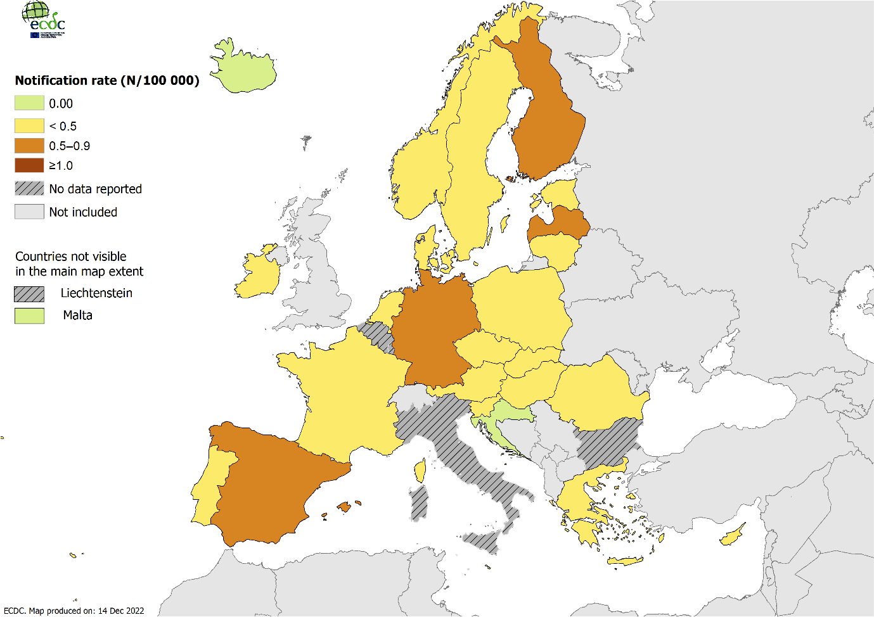
Notification rate of acute hepatitis B cases per 100 000 population by country, EU/EEA, 2021
Belgium and Bulgaria submitted aggregate data which does not differentiate between acute and chronic cases
National data submitted by Italy does not differentiate between acute and chronic cases

Slide 7
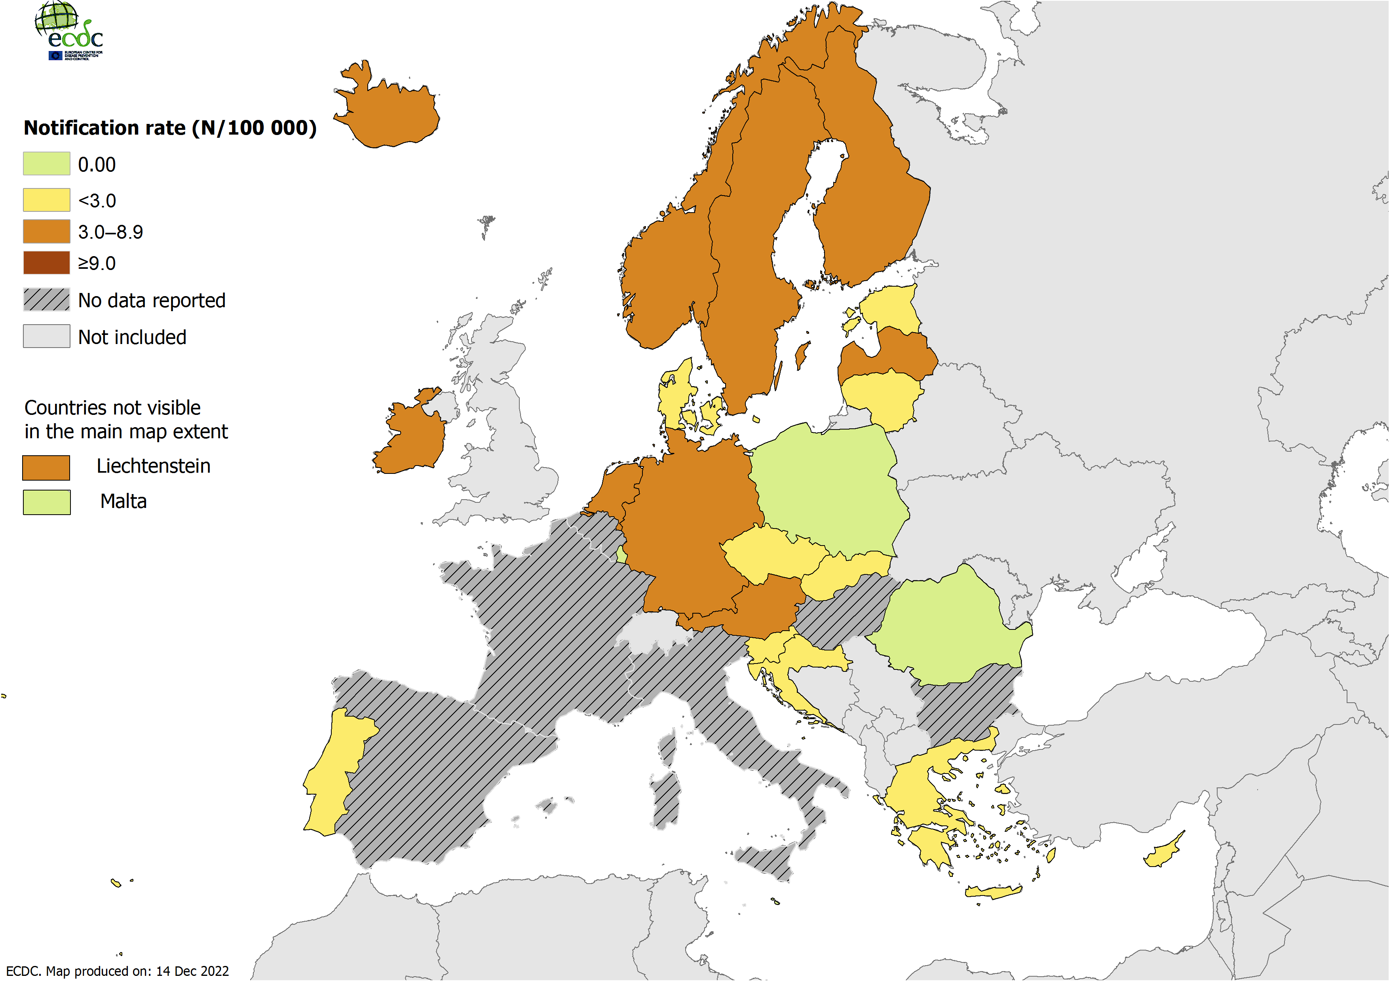
Notification rate of chronic hepatitis B cases per 100 000 population by country, EU/EEA, 2021
Belgium and Bulgaria submitted aggregate data which does not differentiate between acute and chronic cases
National data submitted by Italy does not differentiate between acute and chronic cases
France, Hungary and Spain only submit data on acute cases

Slide 8
Notification rates of acute and chronic hepatitis B per 100 000 population by year in EU/EEA countries reporting consistently, 2012–2021
Acute cases: Country reports from Austria, Cyprus, Czechia, Denmark, Estonia, Finland, France, Germany, Greece, Hungary, Iceland, Ireland, Latvia, Lithuania, Malta, the Netherlands, Norway, Poland, Romania, Slovakia, Slovenia, Spain, Sweden.
Chronic cases: Country reports from Austria, Cyprus, Denmark, Estonia, Finland, Ireland, Latvia, Malta, the Netherlands, Norway, Portugal, Romania, Slovakia, Slovenia and Sweden.
Note that even though Germany has reported consistently, data on chronic cases is excluded as there was a change in case definition and reporting in 2019 which resulted in a large number of chronic cases in that year.

Slide 9
Hepatitis B data: distribution by age, transmission and importation status, 2021
11% of acute cases and 6% of chronic cases aged under 25
Male-to-female rate ratio: 1.4 to 1
Transmission mode (25% complete for acute cases, 15% for chronic):
Most common acute: Heterosexual transmission (30%); transmission due to sex between men 16%); nosocomial (12%);
Most common chronic: mother-to-child transmission (50%).
Migration variables poorly reported but 40% of cases with complete information were classified as ‘imported’; 93% of ‘imported’ infections were chronic

Slide 10
Rate of reported hepatitis B cases per 100 000 by age and disease status, 2021
Source: Acute cases – Austria, Croatia, Cyprus, Czechia, Denmark, Estonia, Finland, France, Germany, Greece, Hungary, Iceland, Ireland, Latvia, Lithuania, Malta, the Netherlands, Norway, Poland, Portugal, Romania, Slovakia, Slovenia, Spain and Sweden.
Chronic cases – Austria, Croatia, Cyprus, Czechia, Denmark, Estonia, Finland, Germany, Greece, Iceland, Ireland, Latvia, Liechtenstein, Lithuania, Luxembourg, Malta, the Netherlands, Norway, Poland, Portugal, Romania, Slovakia, Slovenia and Sweden.

Slide 11
Reported transmission category for acute and chronic hepatitis B cases, 2021
Cases with known transmission status.
*: Nosocomial transmission includes hospitals, nursing homes, psychiatric institutions and dental services. This category refers mainly to patients exposed through healthcare settings, distinct from ’needle-stick and other occupational exposure’, which refers to staff.
**: ‘Non-occupational injuries’ include needle sticks that occur outside a health care setting, bites, tattoos, piercings.
***: ‘Needle-stick and other occupational exposure’ refers to occupational injuries.
Source: Acute reports from Austria, Denmark, Finland, France, Germany, Ireland, Italy, Latvia, the Netherlands, Norway, Poland, Portugal, Romania, Slovakia, Spain and Sweden.
Chronic reports from Austria, Croatia, Denmark, Estonia, Finland, Germany, Ireland, the Netherlands, Norway, Portugal, Slovakia and Sweden.

Slide 12
Hepatitis C data and trends

Slide 13
Hepatitis C data: reporting countries and case definitions used
29 countries provided hepatitis C data for 2021
One country could only provide data on acute cases
Case definitions varied
21 countries used the revised EU 2012 case definition
Three countries used the EU 2008 case definition
Five countries used national case definitions
Aggregate data from two countries (Belgium, Bulgaria)
*The 2012 and 2018 case definitions are essentially identical, except that the 2018 definition explicitly states that countries should differentiate between acute and chronic cases according to ECDC requirements
2018: https://eur-lex.europa.eu/legal-content/EN/TXT/PDF/?uri=CELEX:32018D0945&from=EN#page=22
2012: https://eur-lex.europa.eu/LexUriServ/LexUriServ.do?uri=OJ:L:2012:262:0001:0057:EN:PDF
2008: https://ec.europa.eu/health/ph_threats/com/docs/1589_2008_en.pdf

Slide 14
Hepatitis C data: distribution by disease status, EU/EEA, 2021
14 560 cases reported in 2021
Acute: 987 (7%)
Chronic: 5 029 (35%)
Unknown: 8 051 (55%)*
As acute hepatitis C is difficult to diagnose clinically or serologically, most ‘unknown’ cases are likely to be chronic infections.
Overall rate (excluding Hungary that only reports acute cases): 4.1 per 100 000.
* 493 cases (3%) could not be classified by disease status due to incompatible format of the data provided

Slide 15
Rate of all reported hepatitis C cases across EU/EEA countries, 2012-2021
Source: Country reports from Austria, Bulgaria, Croatia, Cyprus, Czechia, Denmark, Estonia, Finland, Germany, Greece, Iceland, Ireland, Italy, Latvia, Luxembourg, Malta, Norway, Poland, Portugal, Slovakia, Slovenia, and Sweden.

Slide 16
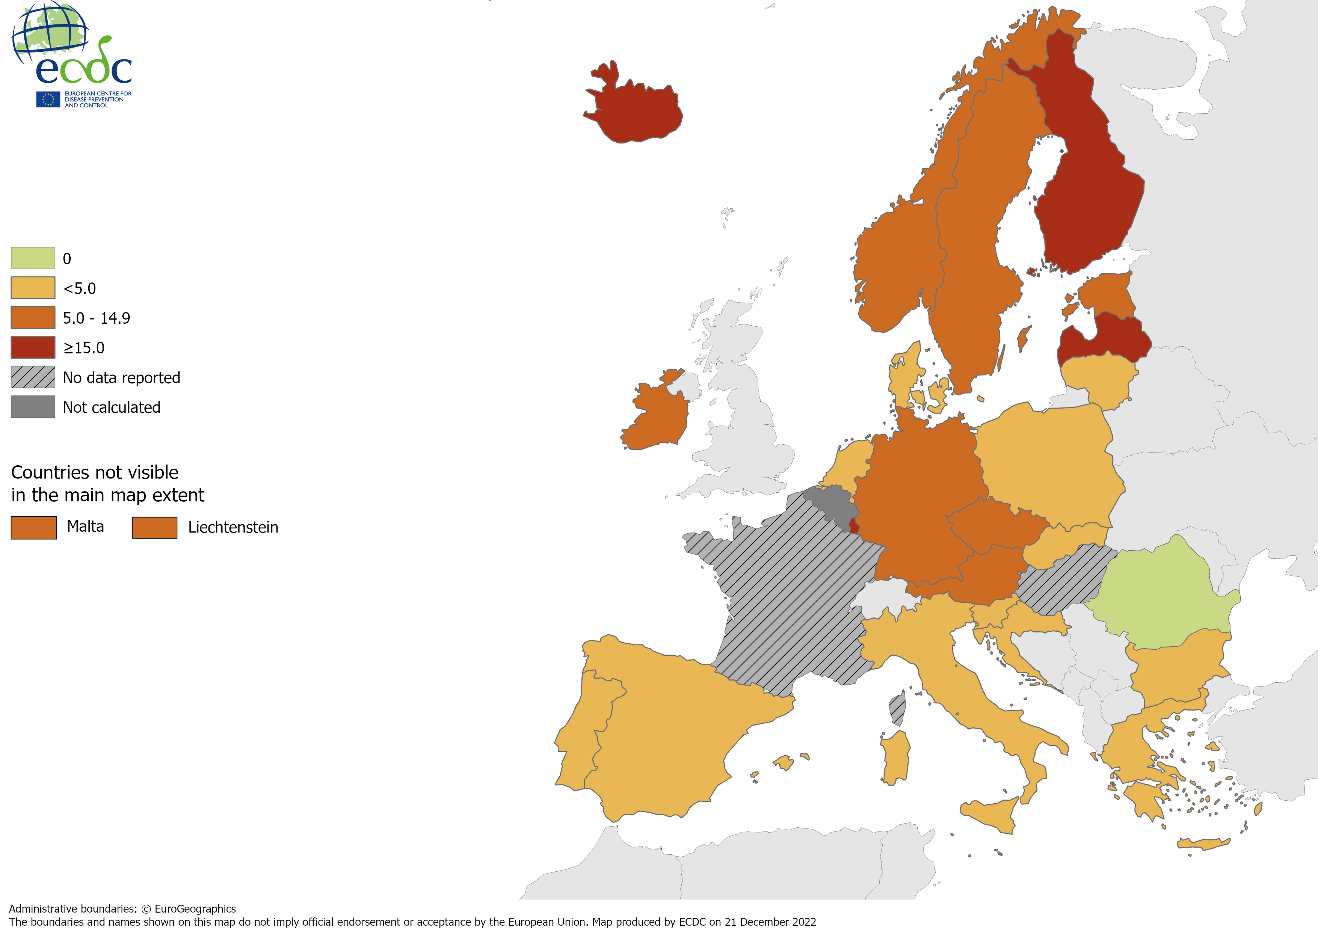
Distribution of newly diagnosed hepatitis C cases per 100 000 population by country*, EU/EEA, 2021

Slide 17
Hepatitis C: distribution by age, transmission and importation status, 2021
The most affected group was males from 35 to 44
6% were aged under 25
The overall male-to-female rate ratio was 2 to 1
Transmission mode (32% complete):
Most common acute: injecting drug use (61%), sex between men (13%);
Most common chronic: injecting drug use (70%)
14% of cases with complete information were classified as ‘imported’

Slide 18
Notification rate of newly diagnosed hepatitis C cases per 100 000 population by age and sex, EU/EEA, 2021
Source: Country reports from Austria, Croatia, Cyprus, Czechia, Denmark, Estonia, Finland, Germany, Greece, Iceland, Ireland, Italy, Latvia, Liechtenstein, Lithuania, Luxembourg, Malta, the Netherlands, Norway, Poland, Portugal, Romania, Slovakia, Slovenia, Spain and Sweden.

Slide 19
Transmission category of hepatitis C cases by acute and chronic disease status, EU/EEA, 2021
Cases with known transmission status.
*: ‘Nosocomial transmission’ includes hospital, nursing home, psychiatric institutions and dental. This category refers mainly to patients exposed through healthcare settings, distinct from ‘needle-stick and other occupational exposure’, which refers to staff.
**: ‘Non-occupational injuries’ include needle-sticks that occur outside a healthcare setting, bites, tattoos and piercings.
***: ‘Needle-stick and other occupational exposure’ refers to occupational injuries.
Source: Acute reports from Austria, Croatia, Denmark, Estonia, Germany, Hungary, Ireland, Italy, Latvia, the Netherlands, Poland, Portugal, Slovakia, Spain, and Sweden.
Chronic reports from Austria, Croatia, Denmark, Estonia, Germany, Ireland, Latvia, Portugal, Slovakia, Slovenia, Spain and Sweden.

Slide 20
Conclusions

Slide 21
Summary of key findings
High numbers of newly diagnosed hepatitis B and C cases notified across Europe
Chronic cases dominate across both diseases
Marked variation between countries
Decrease in reported cases during COVID-19 pandemic
Likely due to reduction in healthcare seeking behaviour, testing availability and (for acute cases) sexual risk behaviour
Gentle increase in acute and chronic rates in 2021 compared to 2020 likely due to behaviours and testing practices returning to pre-pandemic levels
Hepatitis C: strong north-south geographical trend
Transmission routes for hepatitis B differ from hepatitis C, and for hepatitis B these routes vary by disease status (acute vs chronic)
A substantial proportion of cases, especially for hepatitis B, are imported

Slide 22
Key limitations of the data
Due to the largely asymptomatic nature of hepatitis infections, data are strongly influenced by local testing practices
Challenges relating to the case definitions:
Different definitions used by countries
Some countries only report acute hepatitis cases
High proportion of cases coded as unknown – in particular of hepatitis C where due to challenges in differentiating acute from chronic cases
Data completeness low for certain variables:
Transmission, Imported
Underreporting major issue reported by some countries

Slide 23
Other information

Slide 24
Surveillance of hepatitis B and C – epidemiological objectives
1. To monitor the incidence and routes of transmission of newly diagnosed cases of hepatitis B and C in the general and vulnerable populations
2. To monitor the prevalence of chronic hepatitis B and C virus infection to determine burden of infection (and estimate the proportion undiagnosed) in the general and vulnerable populations
3. To monitor the proportion of chronic cases that are engaged in care (continuum of care)
4. To monitor the proportion of newly diagnosed chronic cases presenting late
5. To determine genotype and sequence distributions of newly acquired infections to better follow transmission patterns, the emergence of resistance and vaccine escape mutants and potentially more virulent virus strains (priority on hepatitis C infections)
6. To determine and describe the proportion of co-infections (HIV/HBV/HCV/HDV)
7. To determine the proportion of HCV re-infections (especially among key risk groups with high incidence e.g. PWIDs)

Slide 25
Hepatitis B case definition
Hepatitis B | EU 2008 Case definition | EU 2012/2018 case definition
Clinical criteria | Any person with a discrete onset of symptoms (e.g. fatigue, abdominal pain, loss of appetite, intermittent nausea and vomiting) AND At least on of the following three: Fever Jaundice Elevated serum aminotransferase levels | Not relevant for surveillance purposes
Laboratory criteria | Hepatitis B virus core IgM antigen specific antibody response Laboratory results need to be interpreted according to vaccination status | Positive results of at least one or more of the following tests or combination of tests: IgM hepatitis B core antibody (anti-HBc IgM) Hepatitis B surface antigen (HBsAg) Hepatitis B e antigen (HBeAg) Hepatitis B nucleic acid (HBV-DNA)
Epidemiological criteria | An epidemiological link by human to human transmission (e.g. sexual contact, vertical transmission or blood transmission) | N/A
Case definition – possible | N/A | N/A
Case definition – probable | Any person meeting the clinical criteria and with an epidemiological link | N/A
Case definition – confirmed | Any person meeting the clinical and laboratory criteria | Any person meeting the laboratory criteria

Slide 26
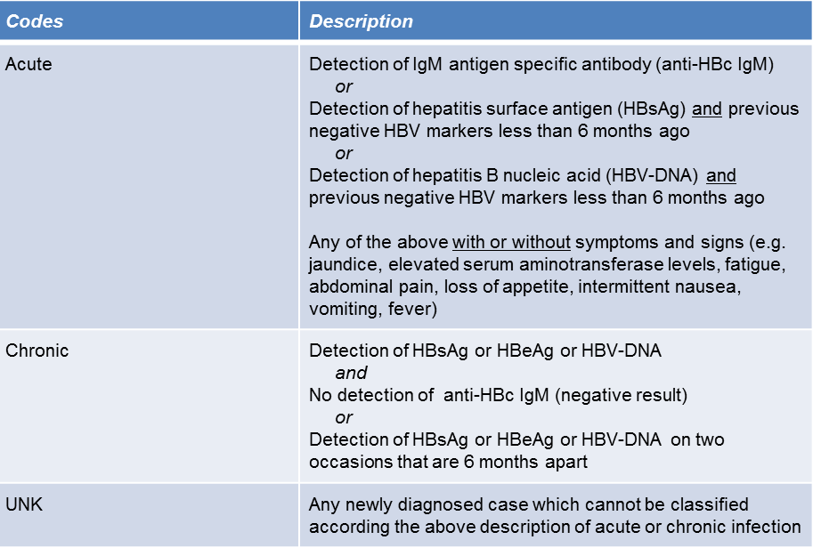
Differentiation of hepatitis B by stage of infection

Slide 27
Hepatitis C case definition
Hepatitis C | EU 2008 Case definition | EU 2012/2018 case definition
Clinical criteria | Not relevant for surveillance purposes | Not relevant for surveillance purposes
Laboratory criteria | At least one of the following two: Detection of hepatitis C virus nucleic acid in serum Hepatitis C specific antibody response confirmed by a different antibody test | At least one of the following three: Detection of hepatitis C virus nucleic acid (HCV RNA) Detection of hepatitis C virus specific antigen (HCV-core) Hepatitis C virus specific antibody (anti-HCV) response confirmed by a confirmatory (e.g. immunoblot) antibody test in persons older than 18 months without evidence of resolved infection
Epidemiological criteria | N/A | N/A
Case definition - Possible | N/A | N/A
Case definition - Probable | N/A | N/A
Case definition - Confirmed | Any person meeting the clinical and laboratory criteria | Any person meeting the laboratory criteria
The following combination of lab tests shall not be included or reported:
Resolved infection: Detection of hepatitis C virus antibody and no detection of hepatitis C virus nucleic acid (HCV RNA negative result) or hepatitis C virus core antigen (HCV‐core negative result) in serum/plasma.

Slide 28
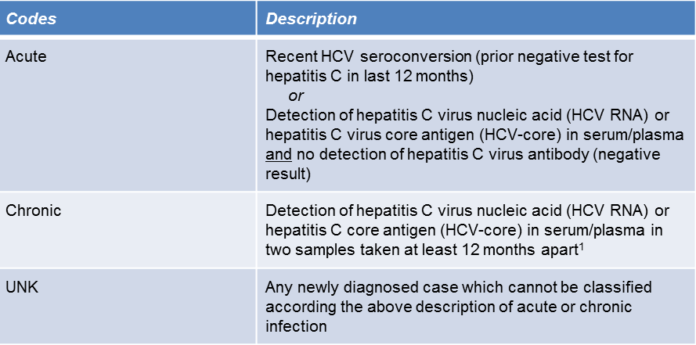
Differentiation of hepatitis C by stage of infection
¹ In the event that the case was not notified the first time

Slide 29
Surveillance of hepatitis B and C: data completeness in 2019

Slide 30
Acknowledgements
The EU/EEA Hepatitis B and C Disease Network
ECDC: Lina Nerlander, Erika Duffell, Julien Beauté, Catia Cunha, Alexandru Sache, Hector Hornubia
Contact: stihivhep@ecdc.europa.eu

