Slide 1
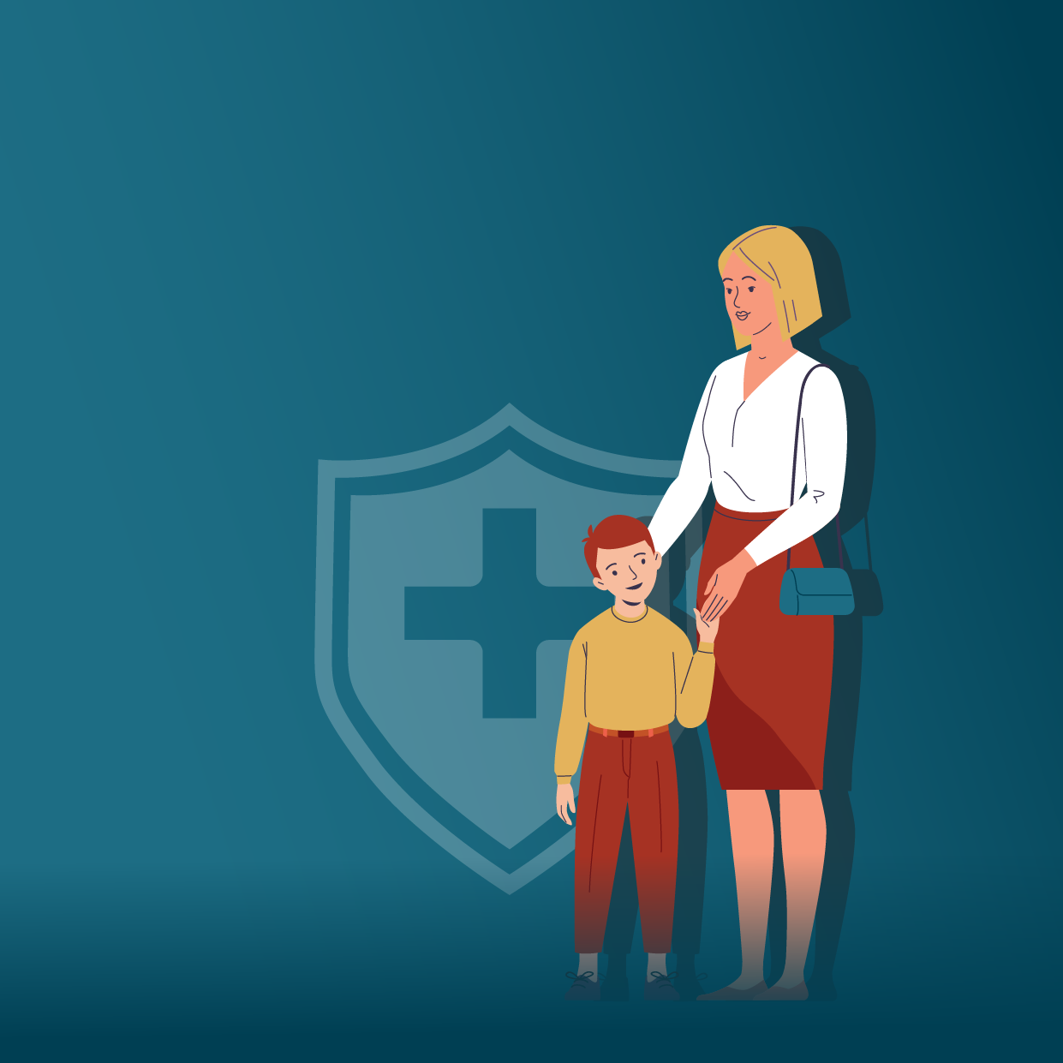

Each year vaccination prevents 3.5 - 5 million deaths worldwide from diseases like:
whooping cough
measles
diphtheria
tetanus
or flu
Stay informed, get vaccinated!

Slide 2
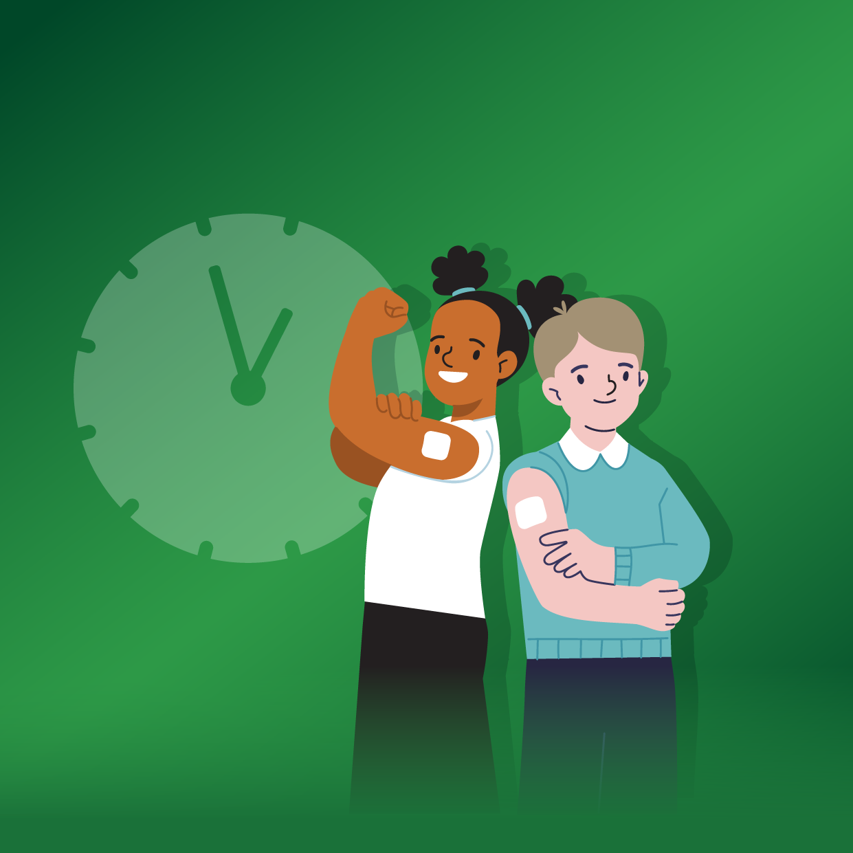
Missed a vaccine dose?
Talk to your doctor and get your child vaccinated as soon as possible
Stay informed, keep your child safe!

Slide 3
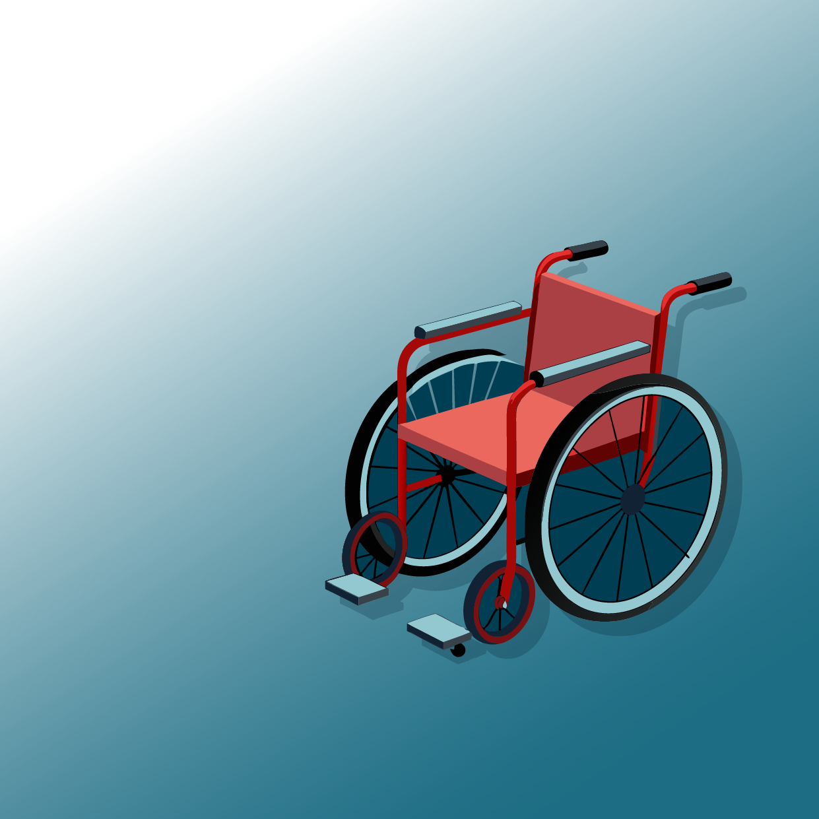
Europe has been polio-free since 2002,
but as long as polio is not eradicated worldwide,
the risk of outbreaks remains.
Stay informed, get vaccinated!

Slide 4
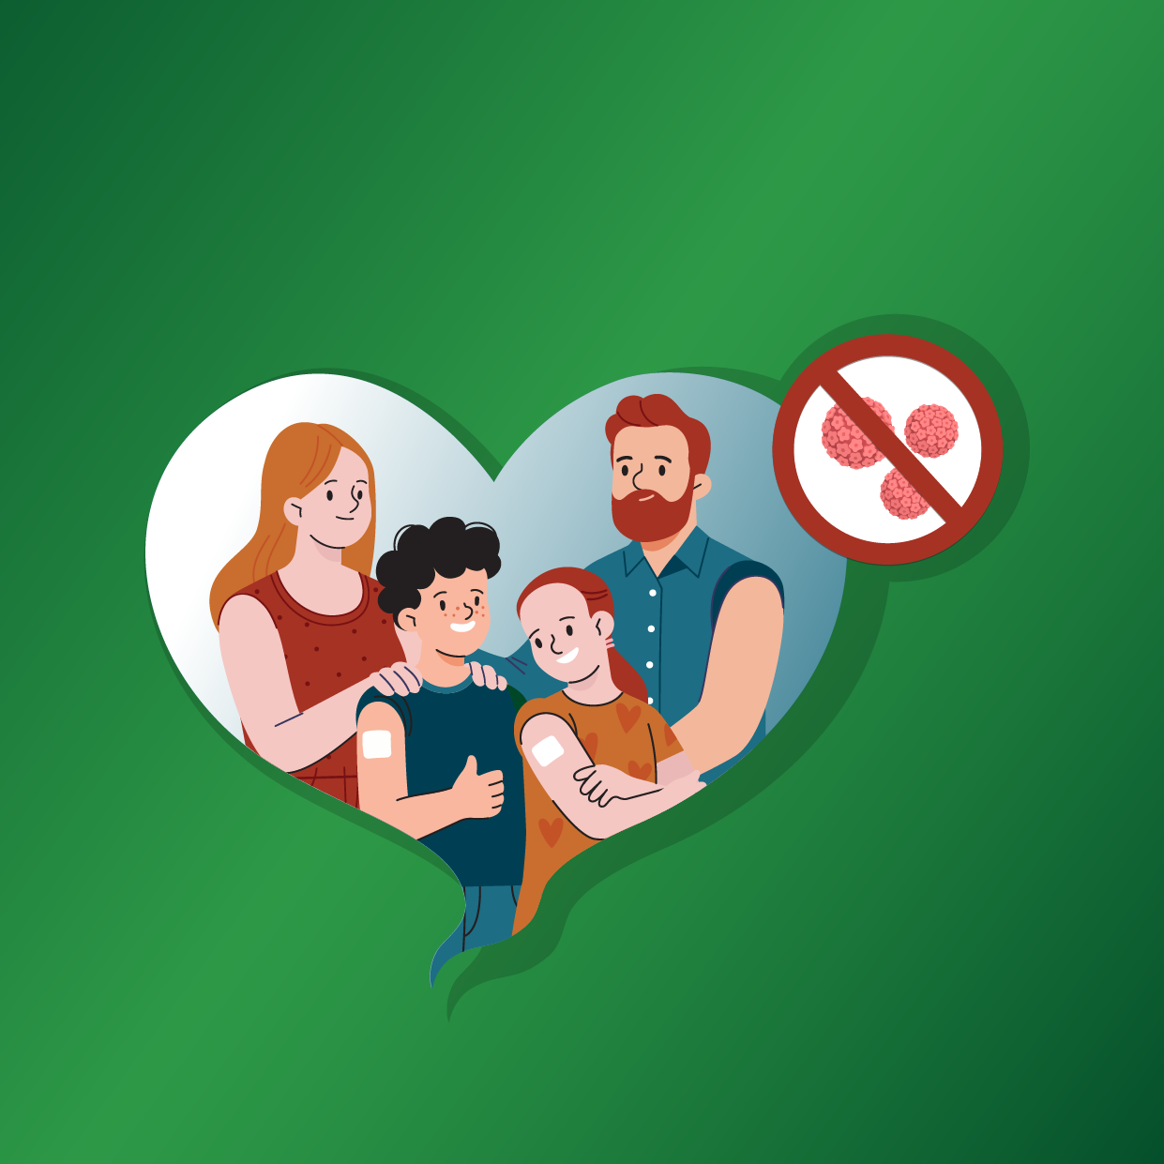
Vaccination of girls and boys against human papillomavirus can prevent HPV-related cancers in both men and women.
Get informed,
get vaccinated!

Slide 5
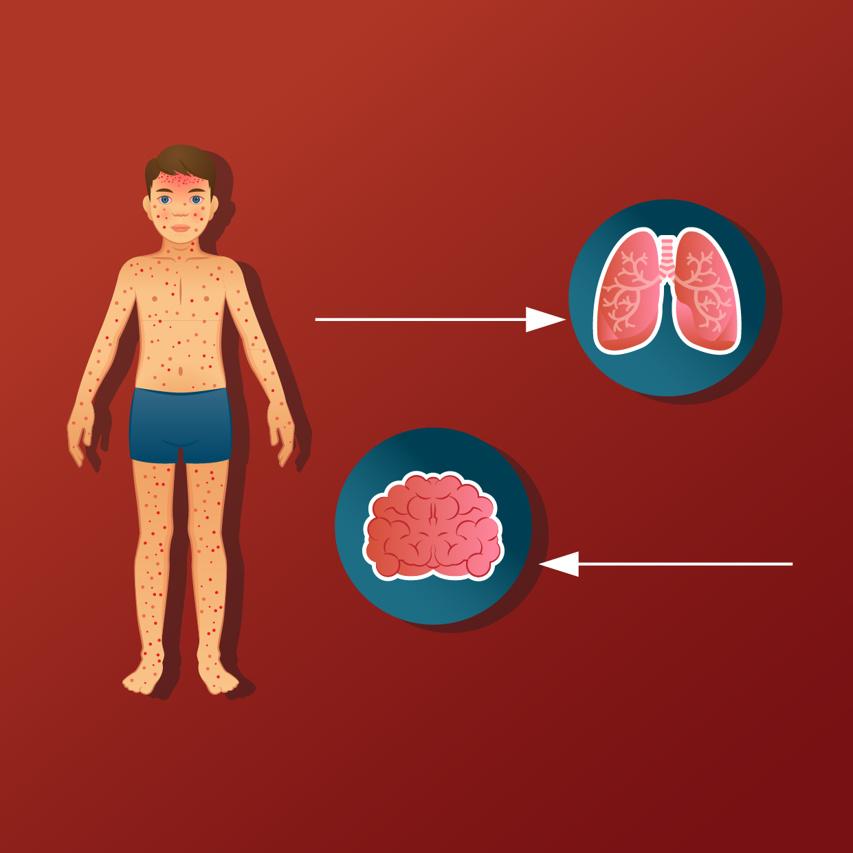
Measles affects people of all ages and can cause serious complications, such as:
pneumonia
encephalitis
Protect your family and contribute to collective immunity!

Slide 6
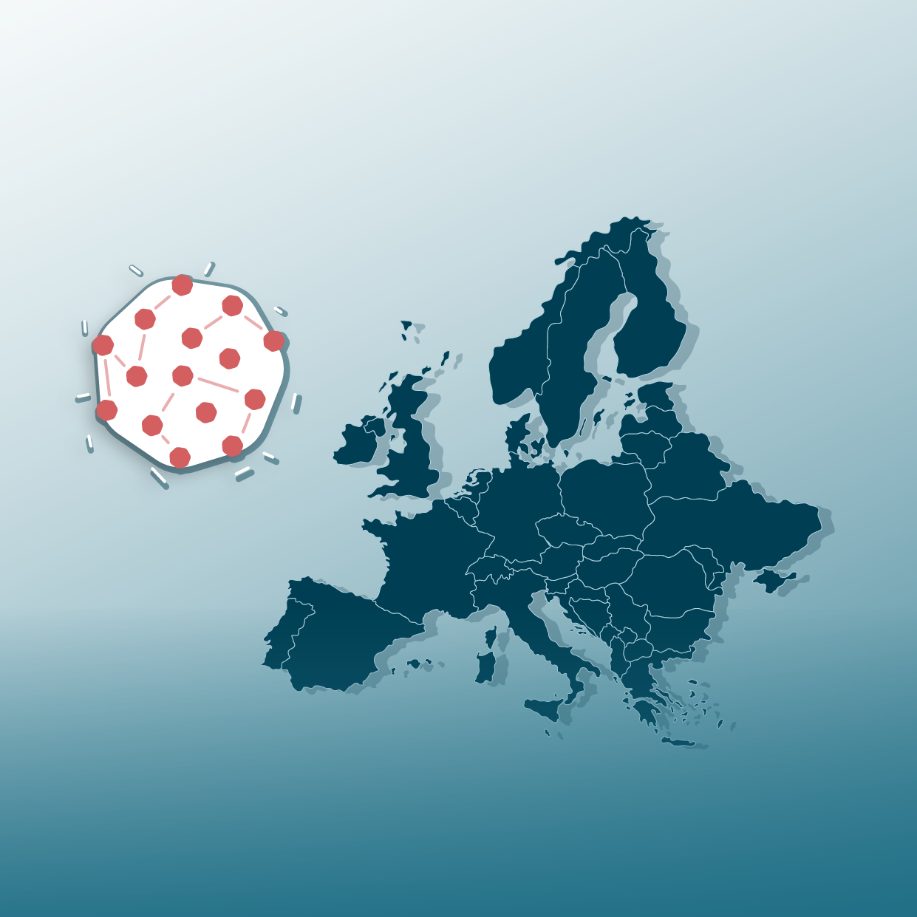
In 2024 , more than 35 000 people were diagnosed with measles across the EU.
23 people died.
Vaccines save lives.
Protect yourself and others

Slide 7
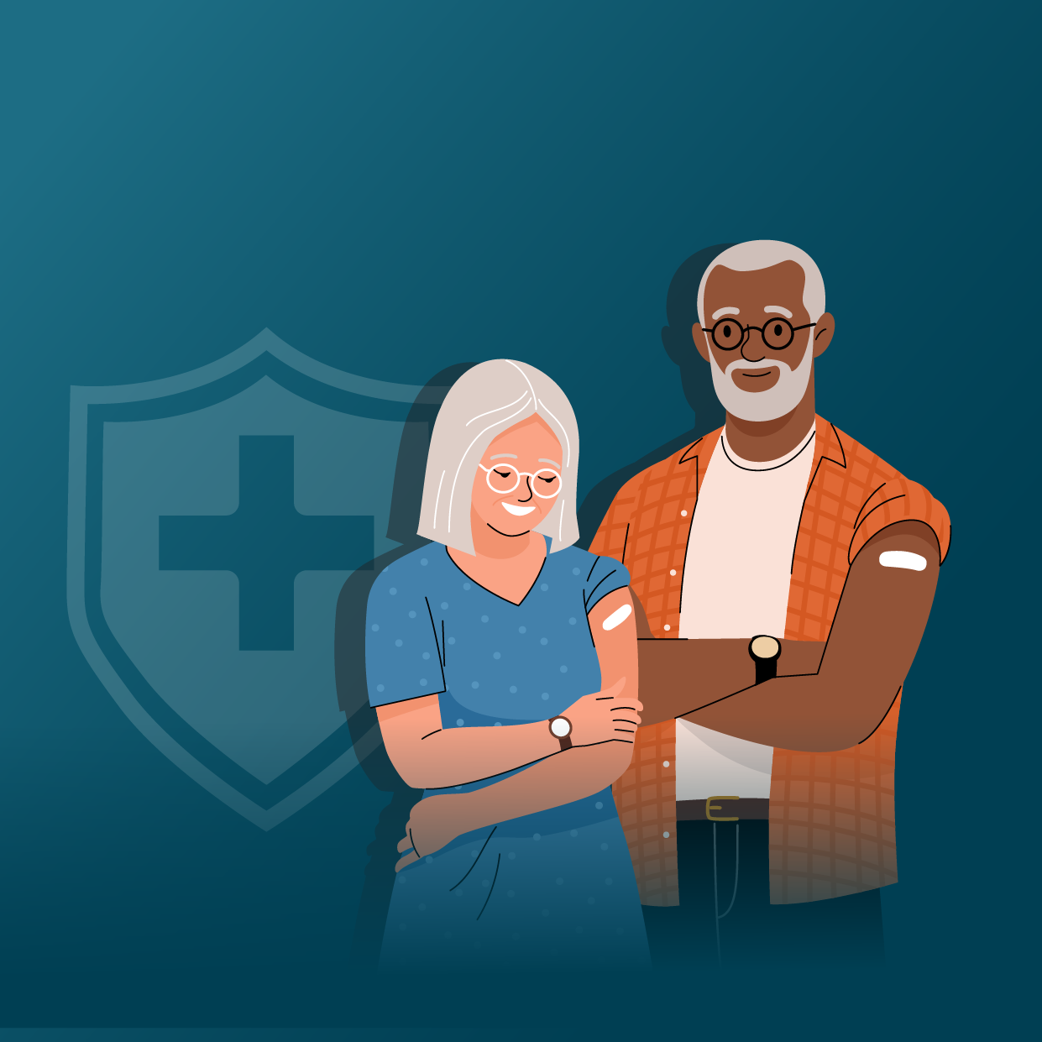
With age, comes wisdom!
Be wise, talk to your doctor
and check the national vaccination recommendations
for your age.
Stay informed, get vaccinated!

Slide 8
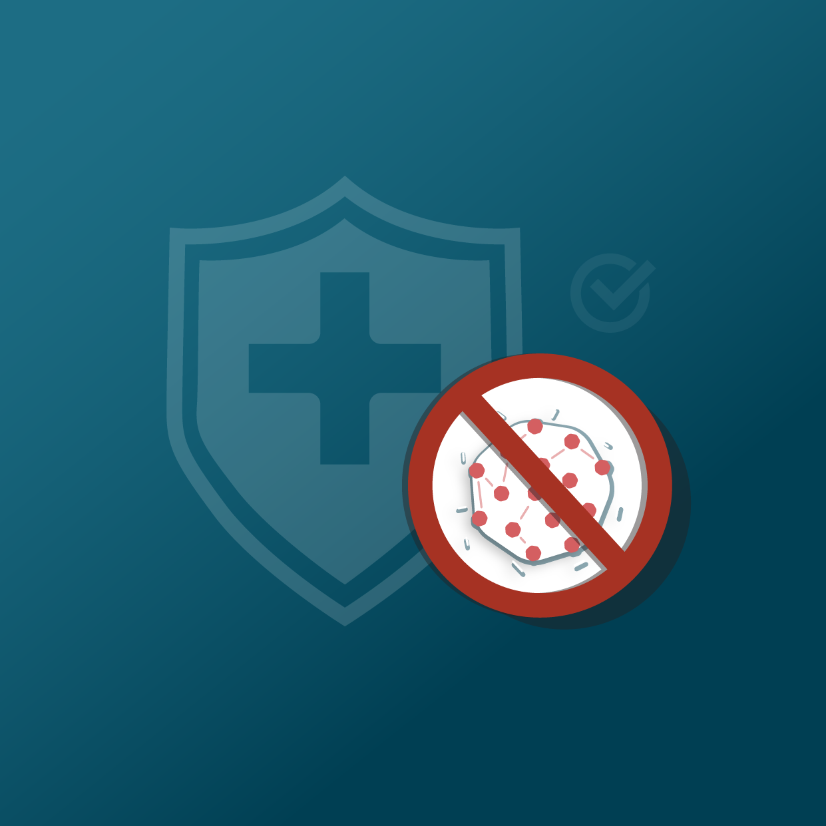
Vaccination is the only way to avoid measles.
Stay informed, keep yourself and others safe!

