Slide 1
Annual Epidemiological Report for 2017 Sexually Transmitted Diseases - chlamydia - gonorrhoea - lymphogranuloma venereum - (congenital) syphilis

Slide 2
Chlamydia
For 2017, 26 EU/EEA Member States reported 409 646 cases of chlamydia infection.
The crude notification rate was 146 cases per 100 000 population.
Notification rates of chlamydia infection varied considerably across Europe, with the highest country-specific rates more than 5 000 times higher than the lowest rates. This is believed to be mainly a reflection of the differences in chlamydia testing, case finding and reporting rather than indicative of actual differences in chlamydia prevalence.
Notification rates continue to be highest among young adult women and heterosexuals.
The overall trend appears stable over recent years, but there are variations at country level.

Slide 3
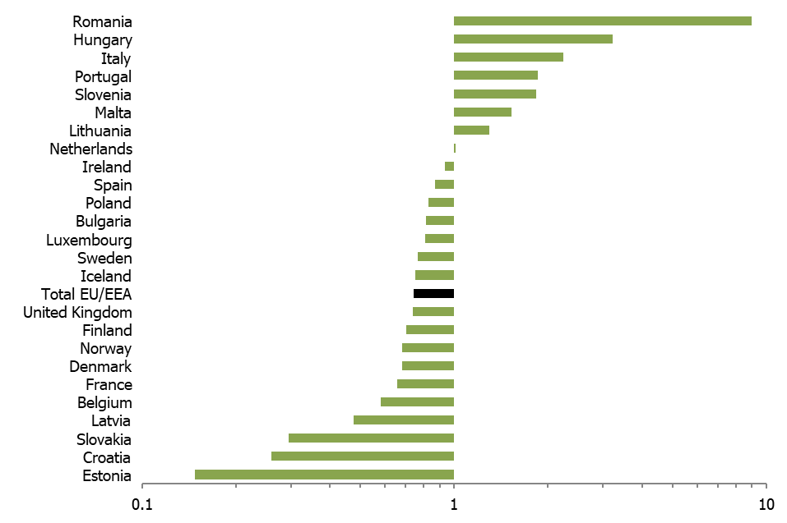
Chlamydia male-to-female ratio, 25 EU/EEA countries, 2017

Slide 4
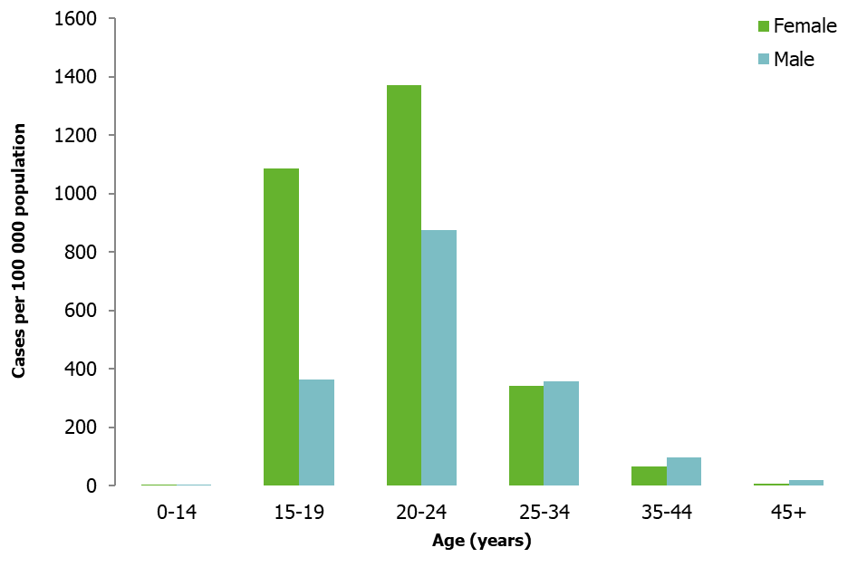
Chlamydia cases per 100 000 population, by age group and gender, EU/EEA, 2017
Source: Country reports from Bulgaria, Croatia, Cyprus, Denmark, Estonia, Finland, Hungary, Iceland, Ireland, Latvia, Lithuania, Luxembourg, Malta, Norway, Portugal, Romania, Slovakia, Slovenia, Spain, Sweden and the United Kingdom.

Slide 5
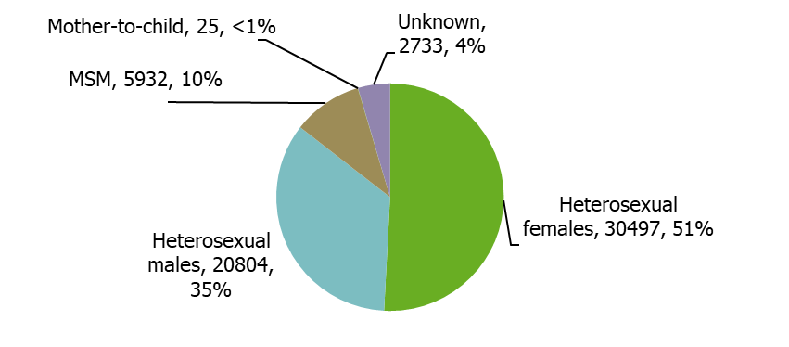
Chlamydia infections by transmission category and gender (n=59 991), EU/EEA, 2017
Note: EU/EEA countries with ≥60% completeness in transmission category
Data from Hungary, Italy, Latvia, Lithuania, Malta, the Netherlands, Portugal, Romania, Slovakia, Slovenia and Sweden.

Slide 6
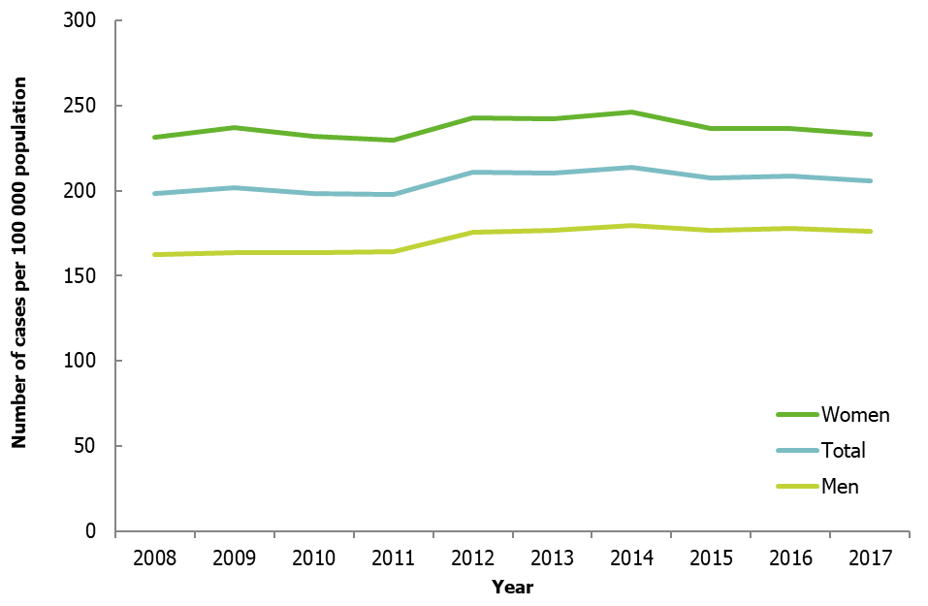
Confirmed chlamydia cases per 100 000 population by year, EU/EEA countries reporting consistently, 2008−2017
Source: Country reports from Cyprus, Denmark, Estonia, Finland, Iceland, Ireland, Latvia, Lithuania, Luxembourg, Malta, Norway, Poland, Romania, Slovakia, Slovenia, Sweden and the United Kingdom.
Notes:
Note: In 2008, the United Kingdom started including data from a screening programme targeted at 15–24-year-olds in England. This programme offers community-based testing services outside of STI clinics and resulted in a large increase of chlamydia diagnoses from 2008 onwards.

Slide 7
Lymphogranuloma venereum
Lymphogranuloma venereum (LGV) is a systemic STI caused by Chlamydia trachomatis serovars L1, L2, or L3.
In 2017, 1 989 cases of LGV were reported in 24 countries.
Four countries (France, the Netherlands, Spain and the United Kingdom) accounted for 86% of all notified cases.
Almost all cases in 2017 were reported among men who have sex with men; among the cases with known HIV status, 64% were HIV-positive.
The number of reported cases decreased compared to 2016. This was the first reduction in the number of reported cases since 2009.

Slide 8
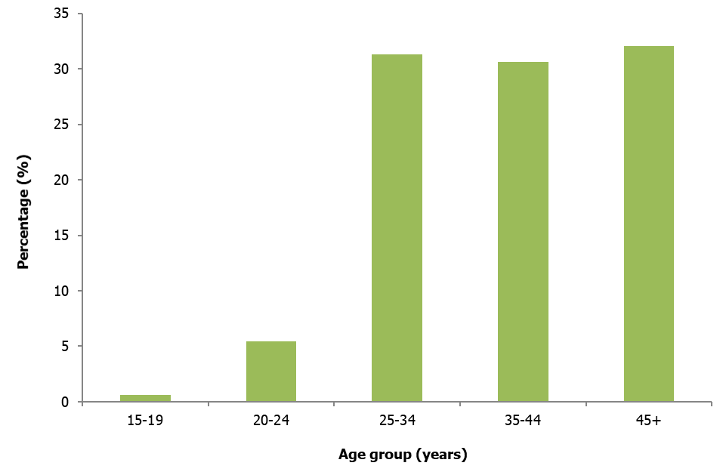
Age distribution of confirmed LGV cases, EU/EEA, 2017
Source: Country reports from Croatia, Cyprus, Czech Republic, Denmark, Estonia, Finland, France, Hungary, Iceland, Ireland, Italy, Latvia, Lithuania, Luxembourg, Malta, the Netherlands, Norway, Poland, Portugal, Slovenia, Sweden and the United Kingdom.

Slide 9
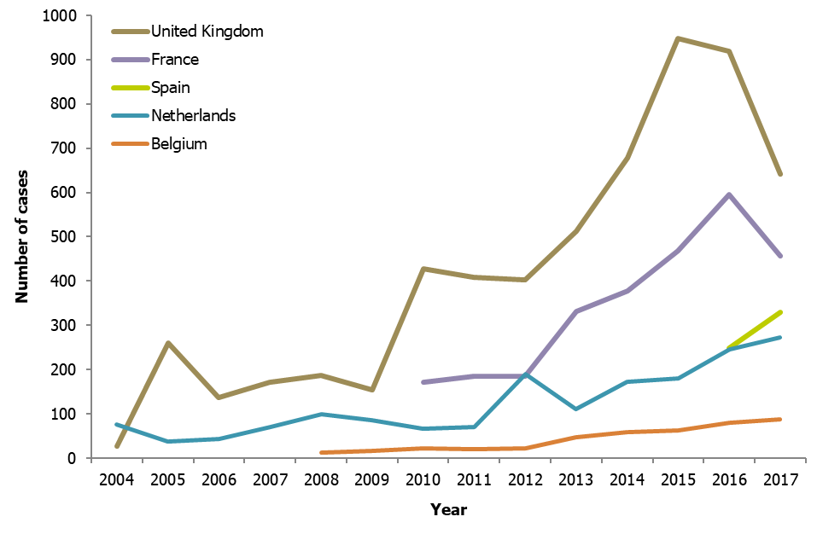
Confirmed LGV cases among the five EU/EEA Member States reporting the largest number of cases in 2017, 2007–2017

Slide 10
Gonorrhoea
A total of 89 239 cases of gonococcal infection were reported by 27 EU/EEA Member States for 2017.
The overall crude notification rate was 22.2 cases per 100 000 population.
Rates of reported gonococcal infection vary considerably across Europe, with higher rates reported in northern Europe.
Men who have sex with men (MSM) accounted for almost half of the reported cases (47%) in 2017.
The overall notification rate increased in 2017 following the slight reduction seen in 2016.

Slide 11
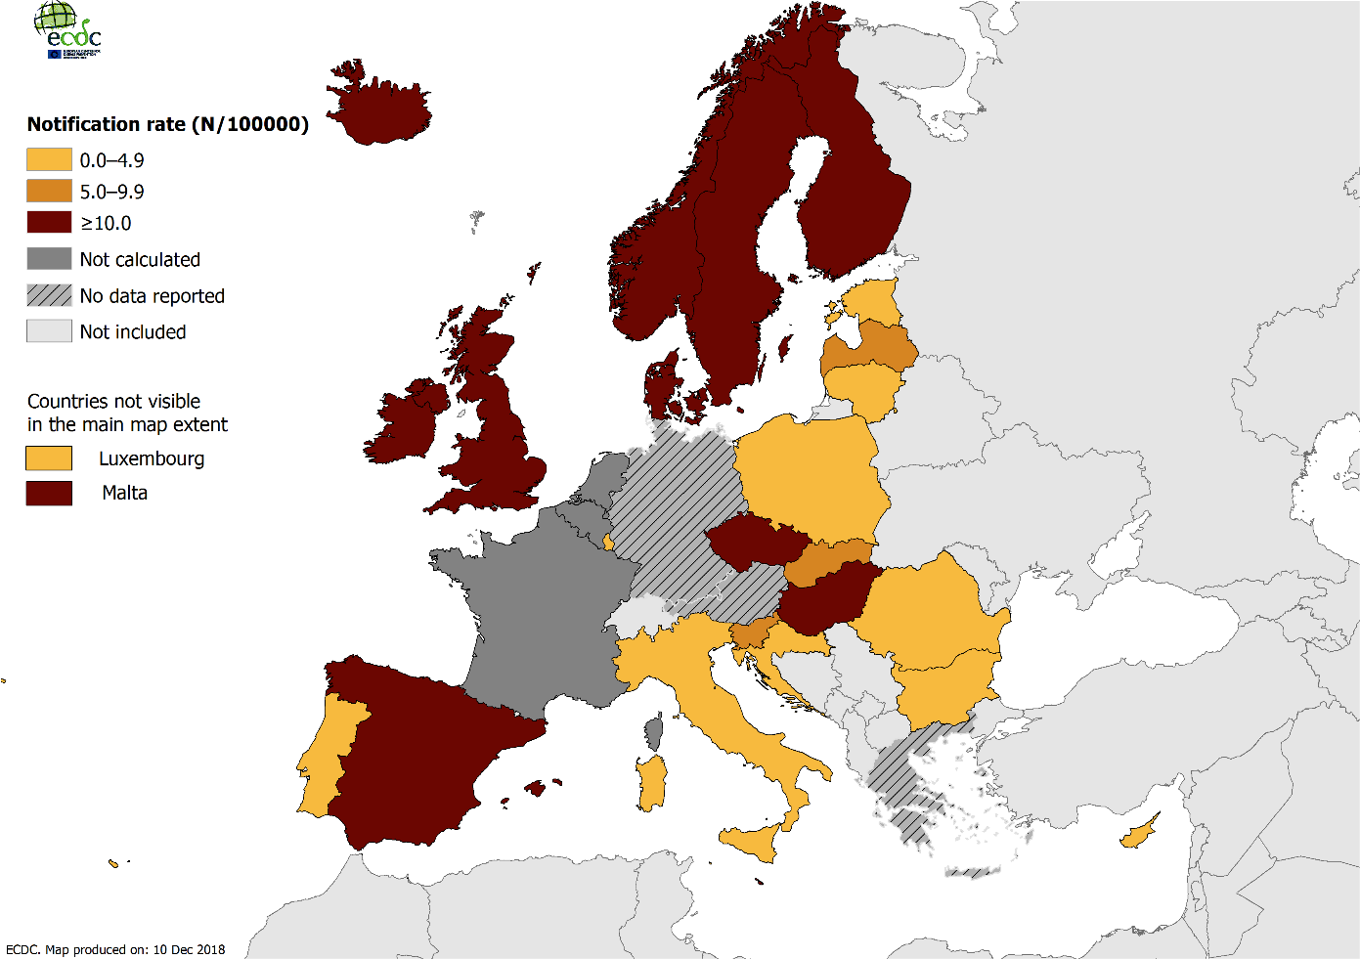
Rate of confirmed gonorrhoea cases per 100 000 population by country, EU/EEA, 2017

Slide 12
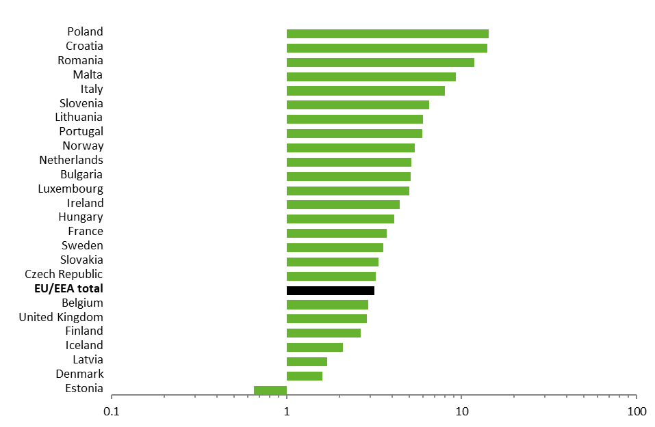
Gonorrhoea male-to-female ratio in 25 EU/EEA countries, 2017

Slide 13
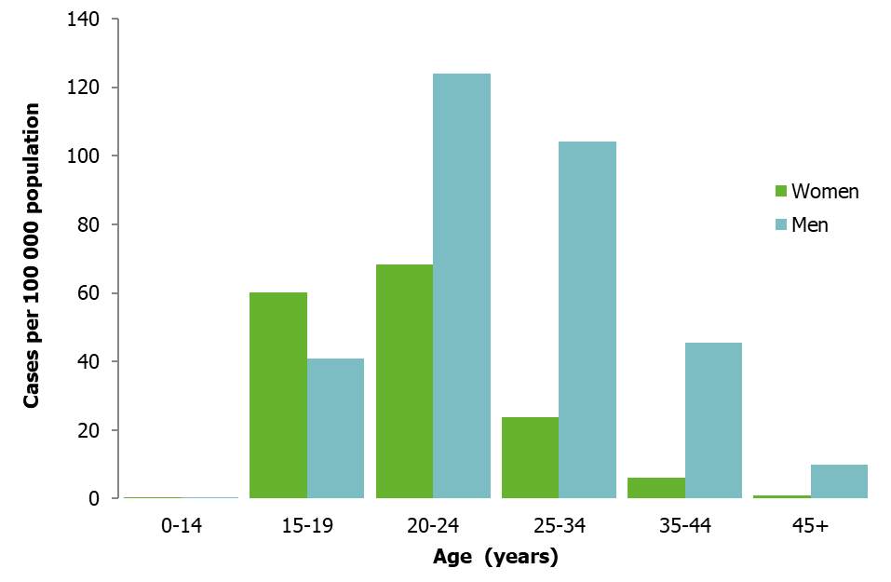
Rate of confirmed gonorrhoea cases per 100 000 population, by age and gender, EU/EEA, 2017
Source: Country reports from Cyprus, Croatia, the Czech Republic, Denmark, Estonia, Finland, Hungary, Iceland, Ireland, Italy, Latvia, Lithuania, Luxembourg, Malta, Norway, Portugal, Romania, Slovakia, Slovenia, Sweden and the United Kingdom.

Slide 14
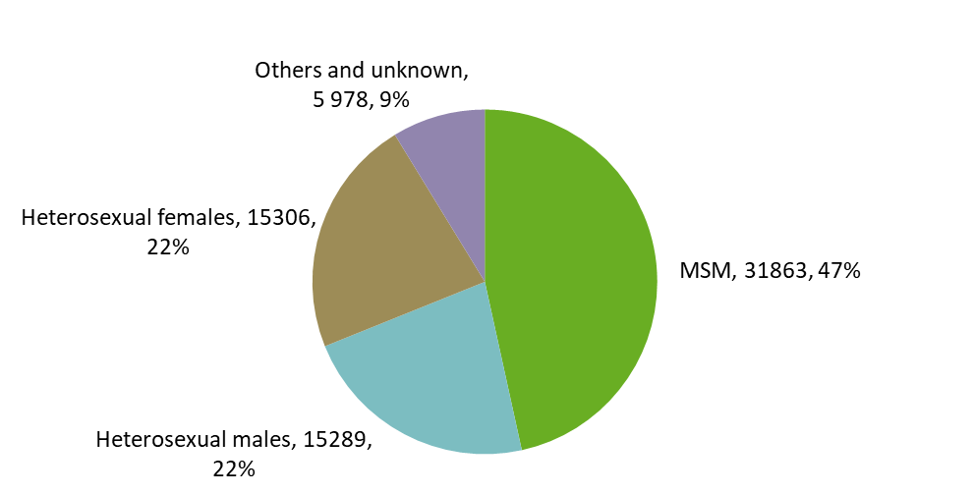
Percentage of gonorrhoea infections by transmission category and gender (n=68 436), EU/EEA, 2017
Source: Country reports from the Czech Republic, Denmark, Finland, Hungary, Iceland, Ireland, Latvia, Lithuania, Malta, the Netherlands, Norway, Portugal, Romania, Slovakia, Slovenia, Sweden and the United Kingdom.

Slide 15
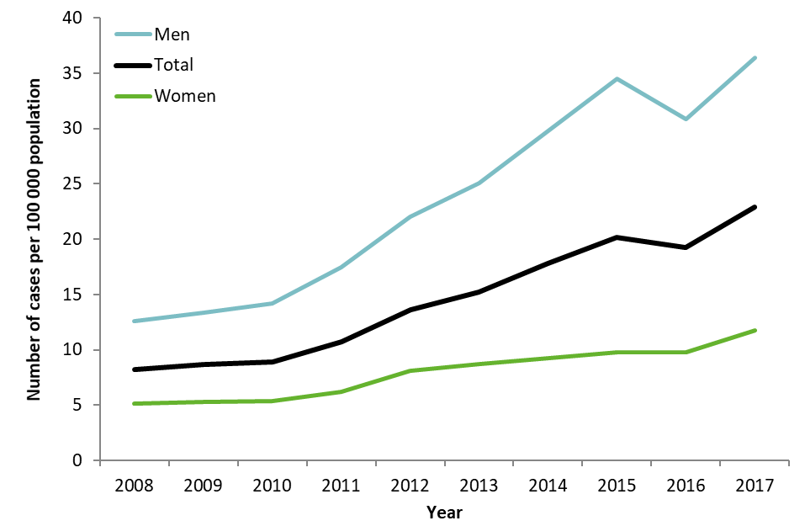
Rate of confirmed gonorrhoea cases per 100 000 population by year, EU/EEA countries reporting consistently, 2008−2017
Source: Country reports from Bulgaria, Cyprus, the Czech Republic, Denmark, Estonia, Finland, Iceland, Ireland, Italy, Latvia, Lithuania, Luxembourg, Malta, Norway, Poland, Portugal, Romania, Slovakia, Slovenia, Spain, Sweden and the United Kingdom.

Slide 16
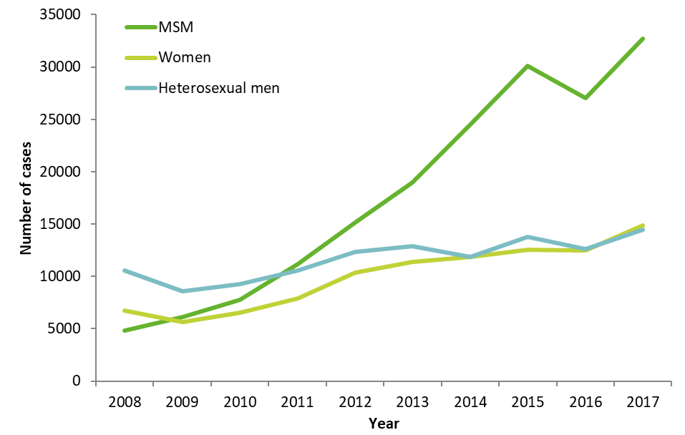
Number of confirmed gonorrhoea cases by gender, transmission category and year, EU/EEA countries reporting consistently, EU/EEA, 2008−2017
Source: Country reports from Cyprus, the Czech Republic, Denmark, France, Latvia, Lithuania, Malta, the Netherlands, Norway, Romania, Slovenia, Sweden and the United Kingdom.

Slide 17
Syphilis
In 2017, 33 189 confirmed syphilis cases were reported in 28 EU/EEA Member States; the notification rate was 7.1 cases per 100 000 population.
Reported syphilis rates were nine times higher in men than in women and peaked among 25–34-year-old men (28 cases per 100 000 population).
Two-thirds (67%) of the syphilis cases with information on transmission category were reported in men who have sex with men (MSM).
The trend in syphilis rates has been on the rise since 2011, particularly among men, mainly due to an increase in the number of cases among MSM.
The slight increase of syphilis rates among women that started in 2016 continued in 2017.

Slide 18
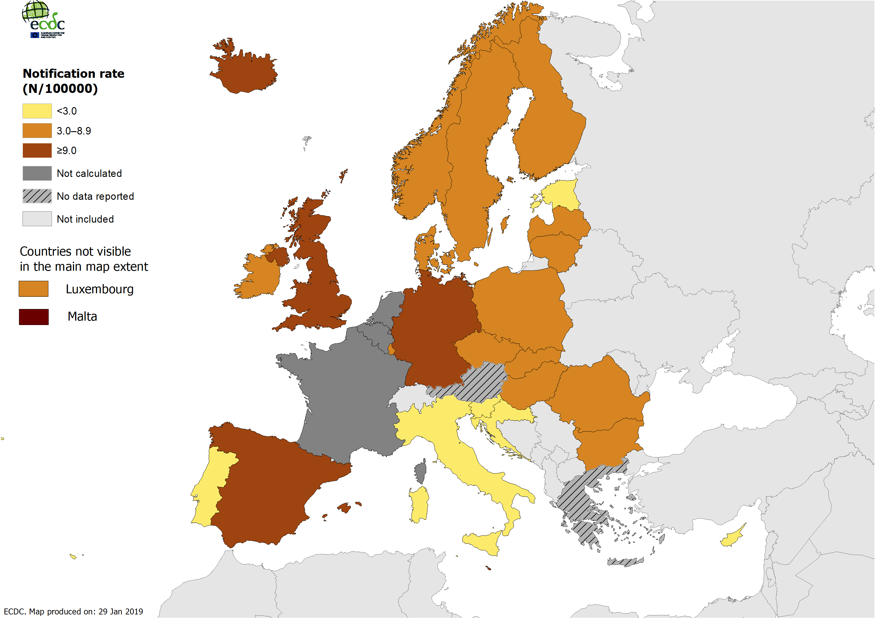
Rate of confirmed syphilis cases per 100 000 population by country, EU/EEA, 2017

Slide 19
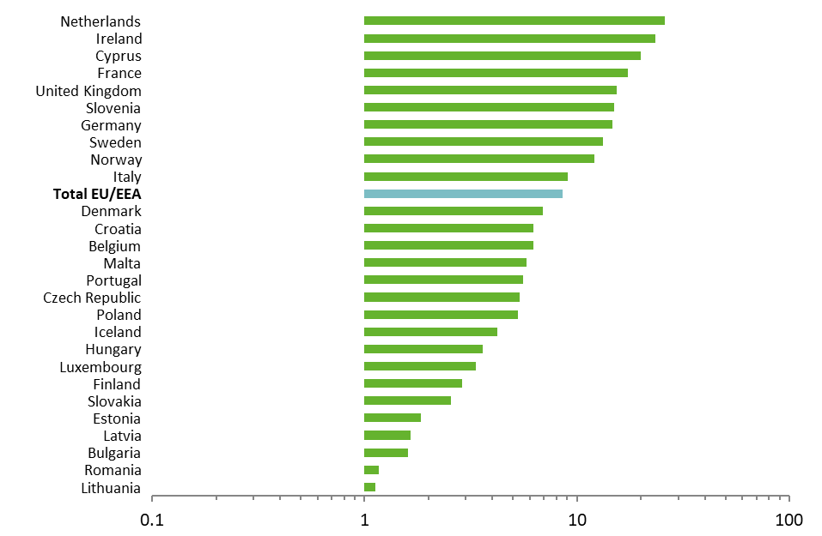
Syphilis male-to-female ratio in 27 EU/EEA countries, 2017

Slide 20
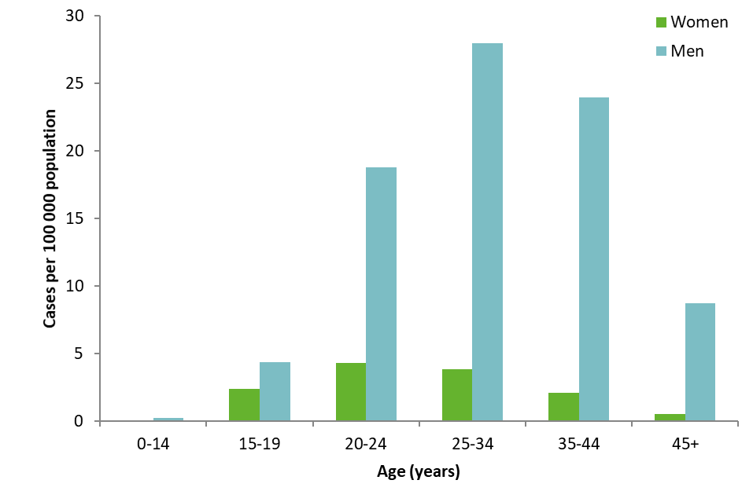
Rate of confirmed syphilis cases per 100 000 population, by age and gender, EU/EEA, 2017
Source: Country reports from Croatia, Cyprus, the Czech Republic, Denmark, Estonia, Finland, Germany, Hungary, Iceland, Ireland, Italy, Latvia, Lithuania, Luxembourg, Malta, Norway, Portugal, Romania, Slovakia, Slovenia, Sweden and the United Kingdom.

Slide 21
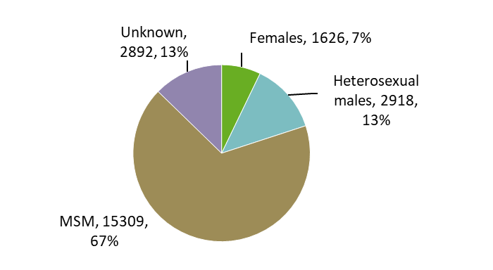
Percentage of syphilis infections by transmission category and gender (n=22 745), EU/EEA, 2017
Data from countries reporting transmission category for more than 60% of cases: the Czech Republic, Denmark, Finland, France, Germany, Hungary, Ireland, Latvia, Malta, the Netherlands, Norway, Romania, Slovakia, Slovenia, Sweden and the United Kingdom..

Slide 22
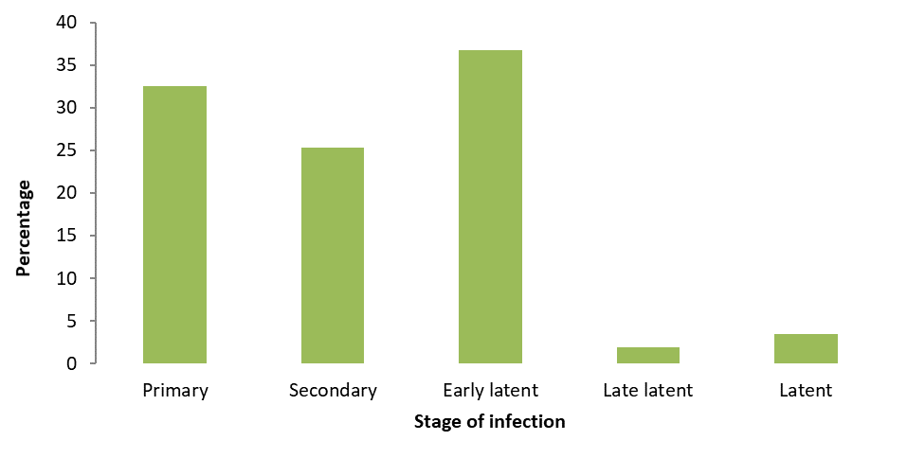
Distribution of reported syphilis infection stages, EU/EEA, 2017
Source: Country reports from the Czech Republic, Estonia, France, Hungary, Iceland, Ireland, Latvia, Lithuania, Malta, the Netherlands, Norway, Romania, Slovakia, Slovenia and the United Kingdom.

Slide 23
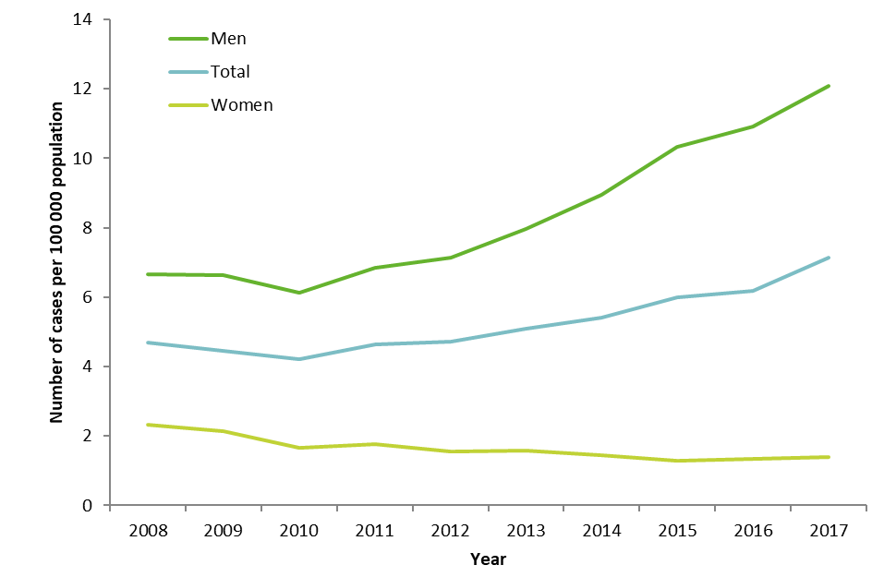
Rate of confirmed syphilis cases per 100 000 population by year, EU/EEA countries reporting consistently, 2008−2017
Source: Country reports from the Bulgaria, Cyprus, Czech Republic, Denmark, Estonia, Finland, Germany, Ireland, Italy, Latvia, Lithuania, Luxembourg, Malta, Norway, Poland, Portugal, Romania, Slovakia, Slovenia, Sweden and the United Kingdom.

Slide 24
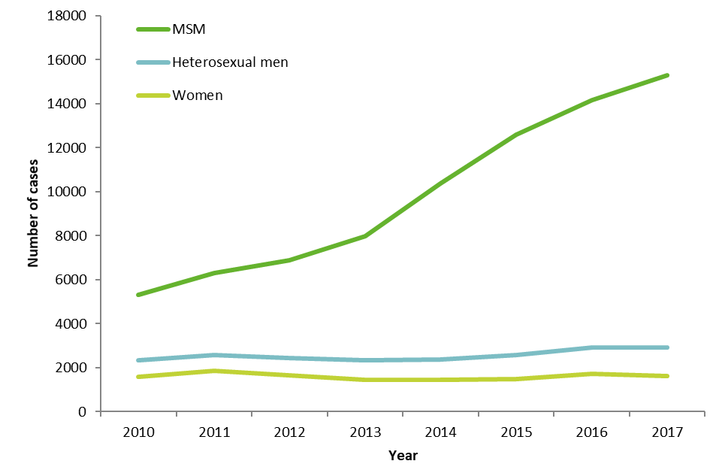
Number of confirmed syphilis cases by gender, transmission category and year, EU/EEA countries reporting consistently, EU/EEA, 2010−2017
Source: Country reports from the Czech Republic, Denmark, Finland, France, Germany, Hungary, Iceland, Ireland, Latvia, Lithuania, Malta, the Netherlands, Norway, Portugal, Romania, Slovakia, Slovenia, Sweden and the United Kingdom.

Slide 25
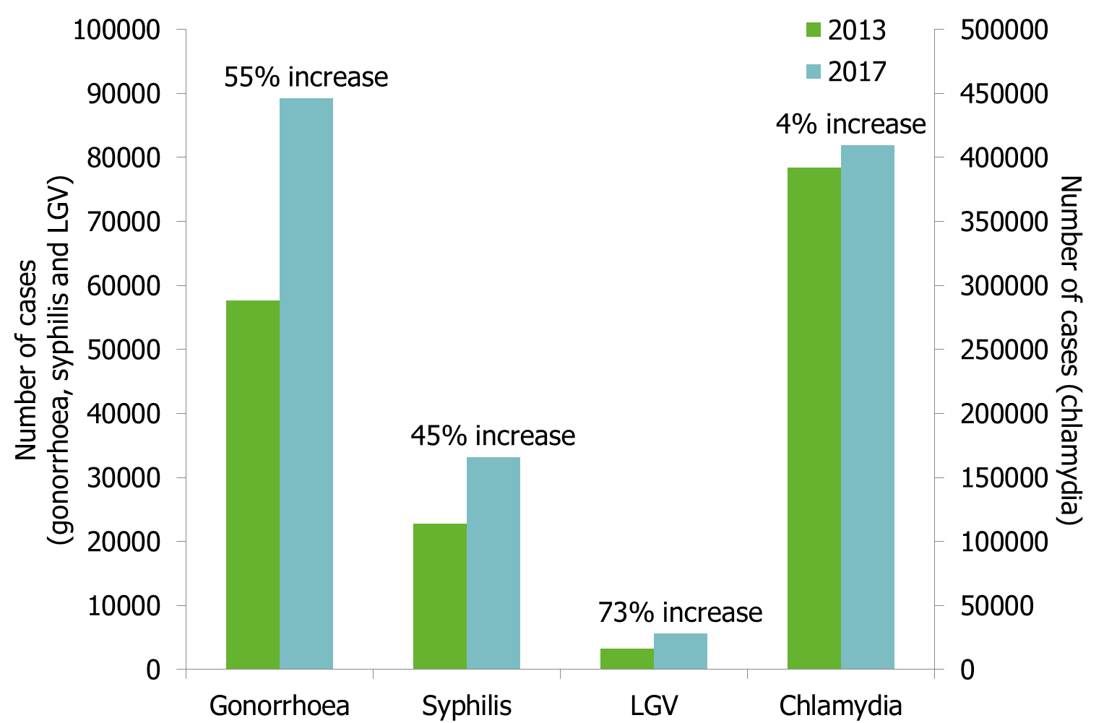
Change in number of reported confirmed cases of gonorrhoea, syphilis and LGV, EU/EEA, 2013-2017
Source: Countries reporting both in 2013 and 2017. Country reports from Belgium, Bulgaria (not LGV), Croatia, Cyprus, Czech Republic, Denmark, Estonia, Finland, France, Germany (syphilis only), Hungary, Iceland, Ireland, Italy (not LGV), Latvia, Lithuania, Luxembourg, Malta, Netherlands, Norway, Poland, Portugal, Romania (not LGV), Slovakia (not LGV), Slovenia, Spain (not LGV), Sweden and the United Kingdom.

Slide 26
Congenital syphilis
In 2017, 36 congenital syphilis cases were reported in 23 EU/EEA Member States, at a crude rate of 1.1 cases per 100 000 live births.
The trend for reported congenital syphilis cases has remained stable in recent years.
There may be some underreporting: seven countries did not contribute to the reporting of congenital syphilis and a further 13 reported no cases for 2017.
The low rates of congenital syphilis and decreasing rates of reported syphilis among women suggest that most Member States have effective programmes for elimination of congenital syphilis. Better indicator data are needed to assess the effectiveness of antenatal screening programmes in all EU/EEA countries.

Slide 27
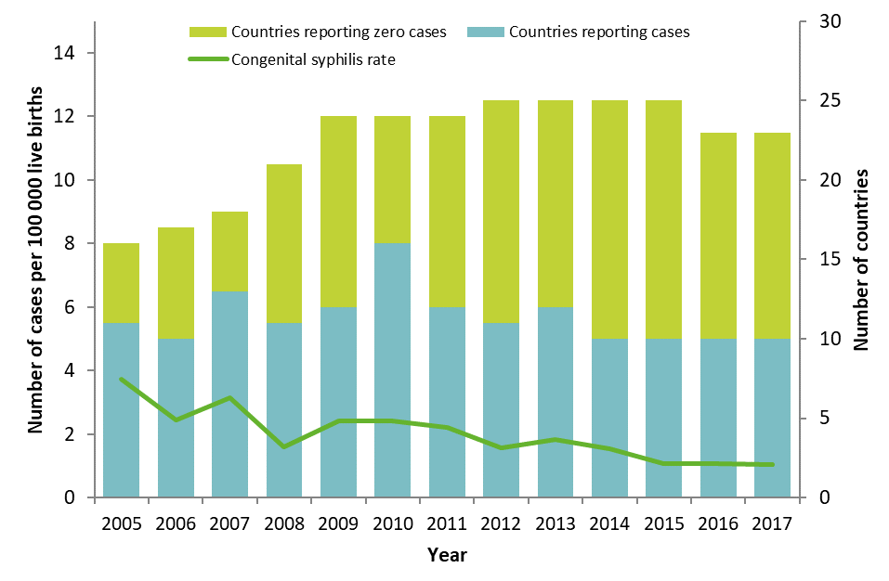
Number of confirmed congenital syphilis cases per 100 000 live births; number of countries reporting congenital syphilis data, by year, 25 EU/EEA countries, 2005–2017
Source: Country reports from Bulgaria, Croatia, Cyprus, the Czech Republic, Denmark, Estonia, Germany, Greece, Hungary, Iceland, Ireland, Italy, Latvia, Lithuania, Luxembourg, Malta, Norway, Poland, Portugal, Romania, Slovakia, Slovenia, Spain, Sweden and the United Kingdom.

Slide 28
Thank you Follow us on @ECDC_EU or @ECDC_HIVAIDS

