Slide 1
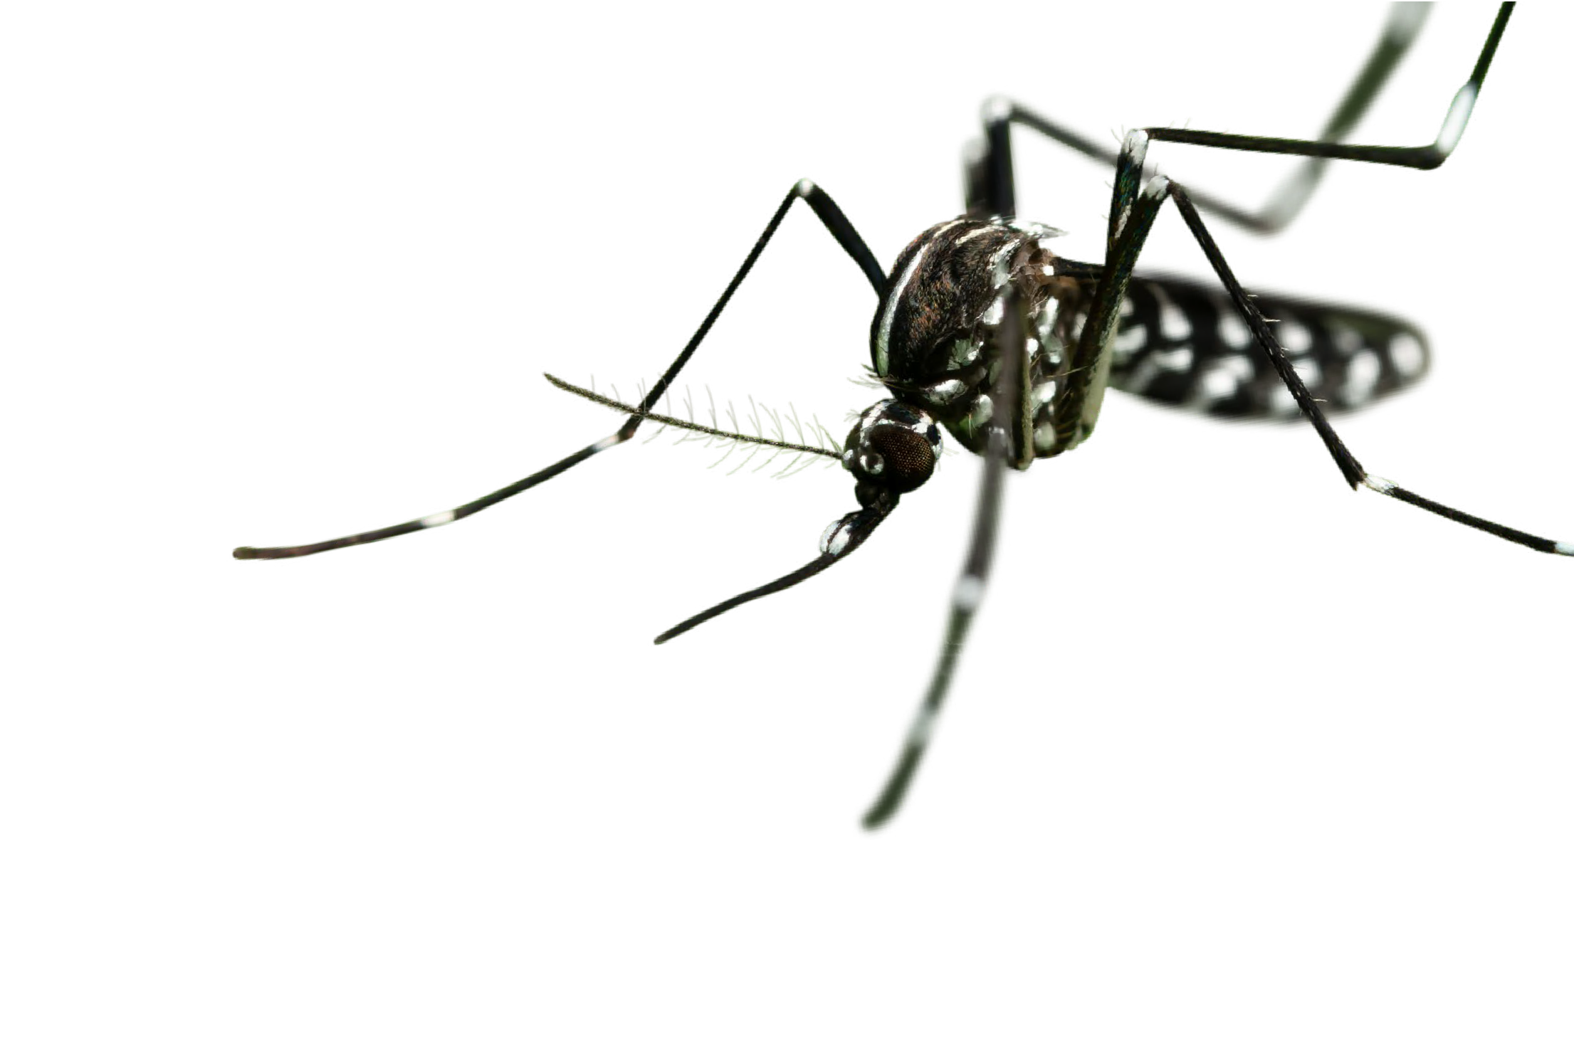



‘Reverse’ identification key for mosquito species
More and more people are getting involved in the surveillance of invasive mosquito species in the EU/EEA, not just professionals with formal training in entomology. There are many taxonomic keys available for identifying mosquitoes of medical and veterinary importance, but they are almost all designed for professionally trained entomologists.
The current identification key aims to provide non-specialists with a simple mosquito recognition tool for distinguishing between invasive mosquito species and native ones. On the overview displays (p. 4, 5 and 6) you can select the species that best resembles your specimen. On the species-specific pages you will find additional information on those species that can easily be confused with that selected, so you can check these additional pages as well.
This key provides the non-specialist with reference material to help recognise an invasive mosquito species and gives details on the morphology (in the species-specific pages) to help with verification and the compiling of a final list of candidates. The key displays six invasive/ exotic mosquito species that are present in the EU/EEA or have been intercepted in the past. It also contains 16 native species. The native species have been selected (1) based on their morphological similarity with the invasive species; (2) on the likelihood of encountering them; and (3) to include representatives of all mosquito genera present in Europe.
If you want to further develop your identification skills, you can consult ‘Mosquitoes - Identification, Ecology and Control. Third Edition’ [1] or identification tools available online, such as MosKeyTool: https://www.medilabsecure.com/moskeytool.html.
Different scientific names are available for the species included in this key. Table 1 provides an overview of the scientific names used in the key [2] and names based on the revisions made by Reinert and colleagues [3-7] that can be found in scientific literature. We hope that this will aid communication between health professionals and scientists.
Species name used in the key | Synonyms currently in use | Common name
Aedes aegypti | Stegomyia aegypti | Yellow fever mosquito
Aedes albopictus | Stegomyia albopicta | Asian tiger mosquito
Aedes atropalpus | Georgecraigius atropalpus | American rock pool mosquito
Aedes japonicus japonicus | Hulecoeteomyia japonica japonica | Asian bush or rock pool mosquito
Aedes koreicus | Hulecoeteomyia koreica
Aedes triseriatus
Ochlerotatus triseriatus
American Eastern tree hole mosquito
Aedes cantans
Ochlerotatus cantans
Aedes caspius
Ochlerotatus caspius
Salt marsh mosquito
Aedes communis
Ochlerotatus communis
Snowpool mosquito
Aedes cretinus
Stegomyia cretina
Aedes geniculatus
Dahliana geniculata
Aedes pulcritarsis
Ochlerotatus pulchritarsis
Aedes vexans
Aedimorphus vexans
Aedes vittatus
Fredwardsius vittatus
Aedes zammitii
Acartomyia zammitii
Anopheles plumbeus
Coquillettidia richiardii
Culex pipiens
(Northern) house mosquito
Culiseta annulata
Culiseta longiareolata Orthopodomyia pulcripalpis Uranotaenia unguiculata
Note: Aedes above dashed line are invasive /exotic species; Aedes below dashed line are native Aedes species. The solid lines separate the genera.
1

Slide 2
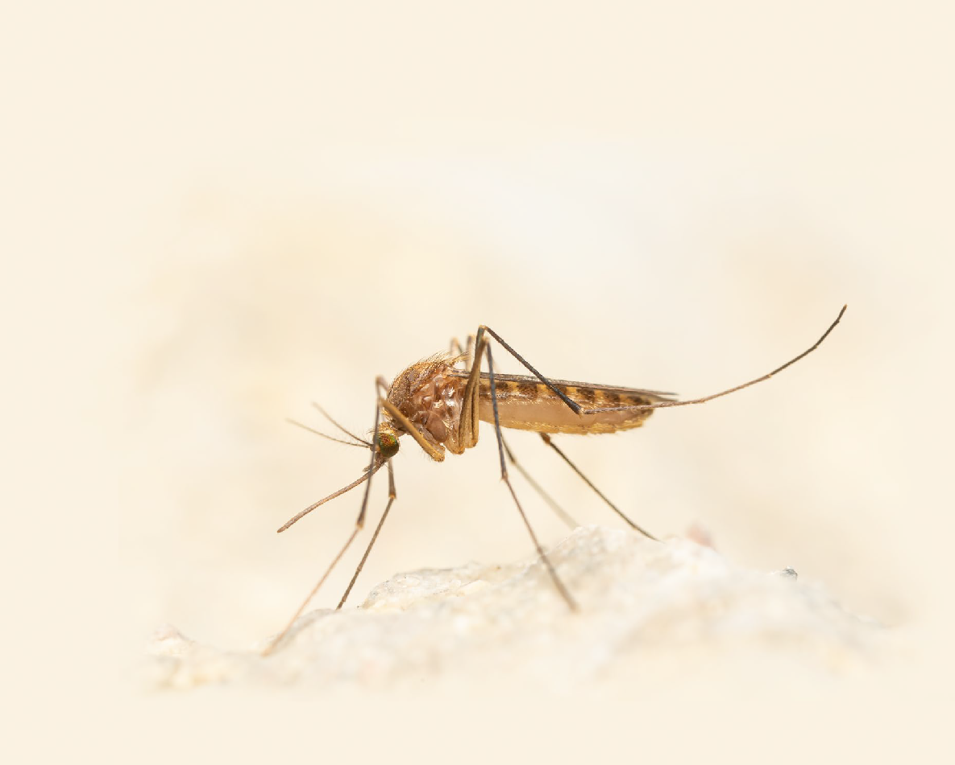
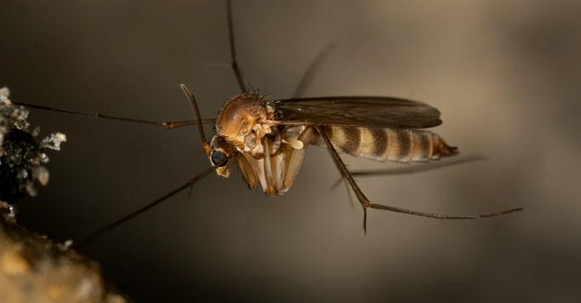
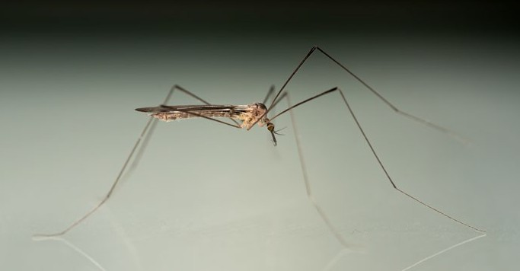
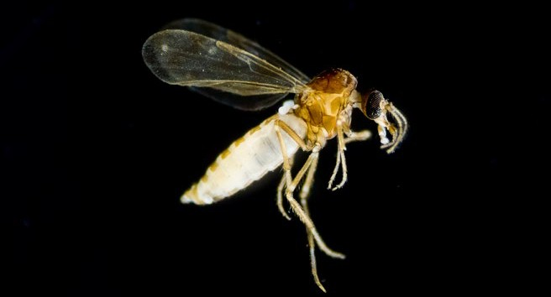
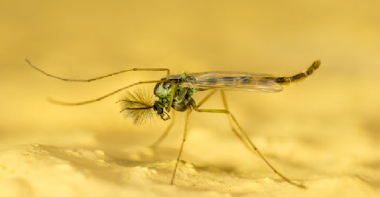
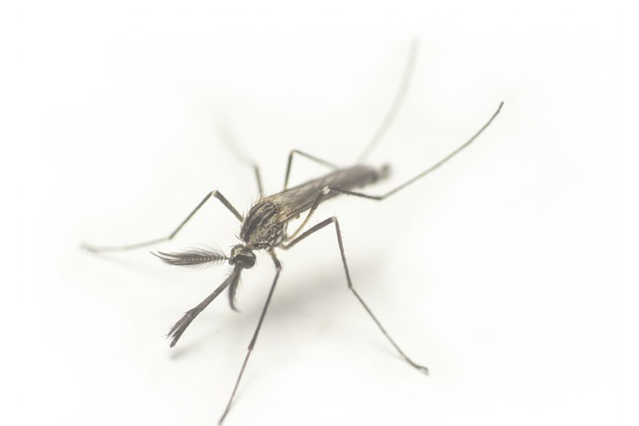
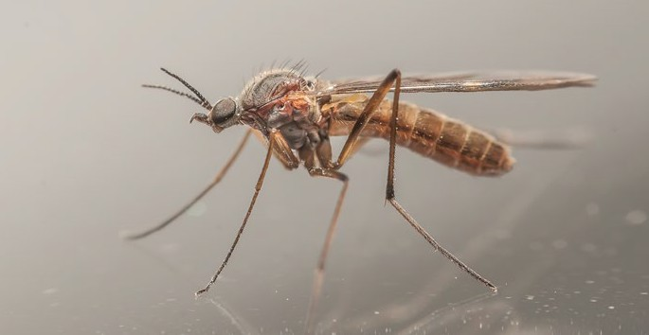
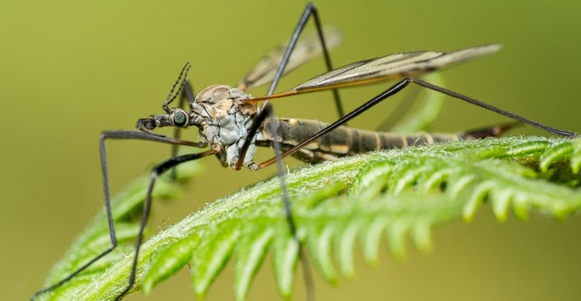
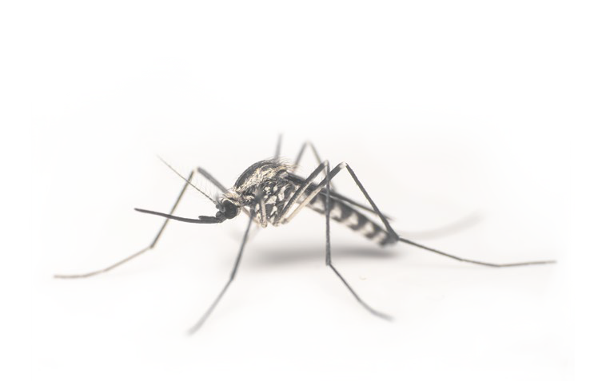
What is/is not a mosquito?
Scientific classification of mosquitoes
Diptera that look similar to Culicidae
Kingdom | Phylum | Class | Order | Suborder | Family | Genus | Species
Animalia | Arthropoda | Insecta | Diptera | Nematocera | Culicidae | e.g Aedes | e.g albopictus
2
2
3
© Anders Lindström/SVA
© Anders Lindström/SVA
Body structures
Head
1
1
Thorax
Scutum
Abdomen
Tarsomeres (tarsal segments) of hindleg
Mycetophilidae or Fungus gnats
Short mouth parts (1); markedly humped thorax [2]; 2–14mm
Limoniidae or Limonid crane flies
Short mouth parts [1]; very long legs [2]; slender body [3]; 2–11mm
Tibia of hindleg
5
4
Antennae
3
1
2
3
2
1
Palps
Tarsus of hindleg
3
© Anders Lindström/SVA
© Anders Lindström/SVA
Proboscis
Femur
2
1
1
Ceratopogonidae or Biting midges
Short proboscis, not needle-like [1]; hooped thorax [2]; wing without scales [3]; 1–3mm
Chironomidae or Chironomids or
Non-biting midges
Short mouth parts [1]; no scales on wing [2]; shape of thorax, ‘hooped’ [3]; ~10mm
Culicidae or True (biting) mosquitoes (Culex pipiens female)
Females with elongated ‘needle-like’ mouth parts [1]; wings with scales;
long legs; size of mosquito 3–6mm;
Female vs male mosquitoes
2
Not feathery antenna
1
© Anders Lindström/SVA
© Anders Lindström/SVA
Feathery antenna
1
Anisopodidae or Wood gnats
Short mouth parts [1]; ~4–12 mm
Tipulidae or Crane flies
No needle-like proboscis; looks like an oversized mosquito; slender body [1]; long legs [2]; wing span 1–6.5 cm
Female
Male
2

Slide 3
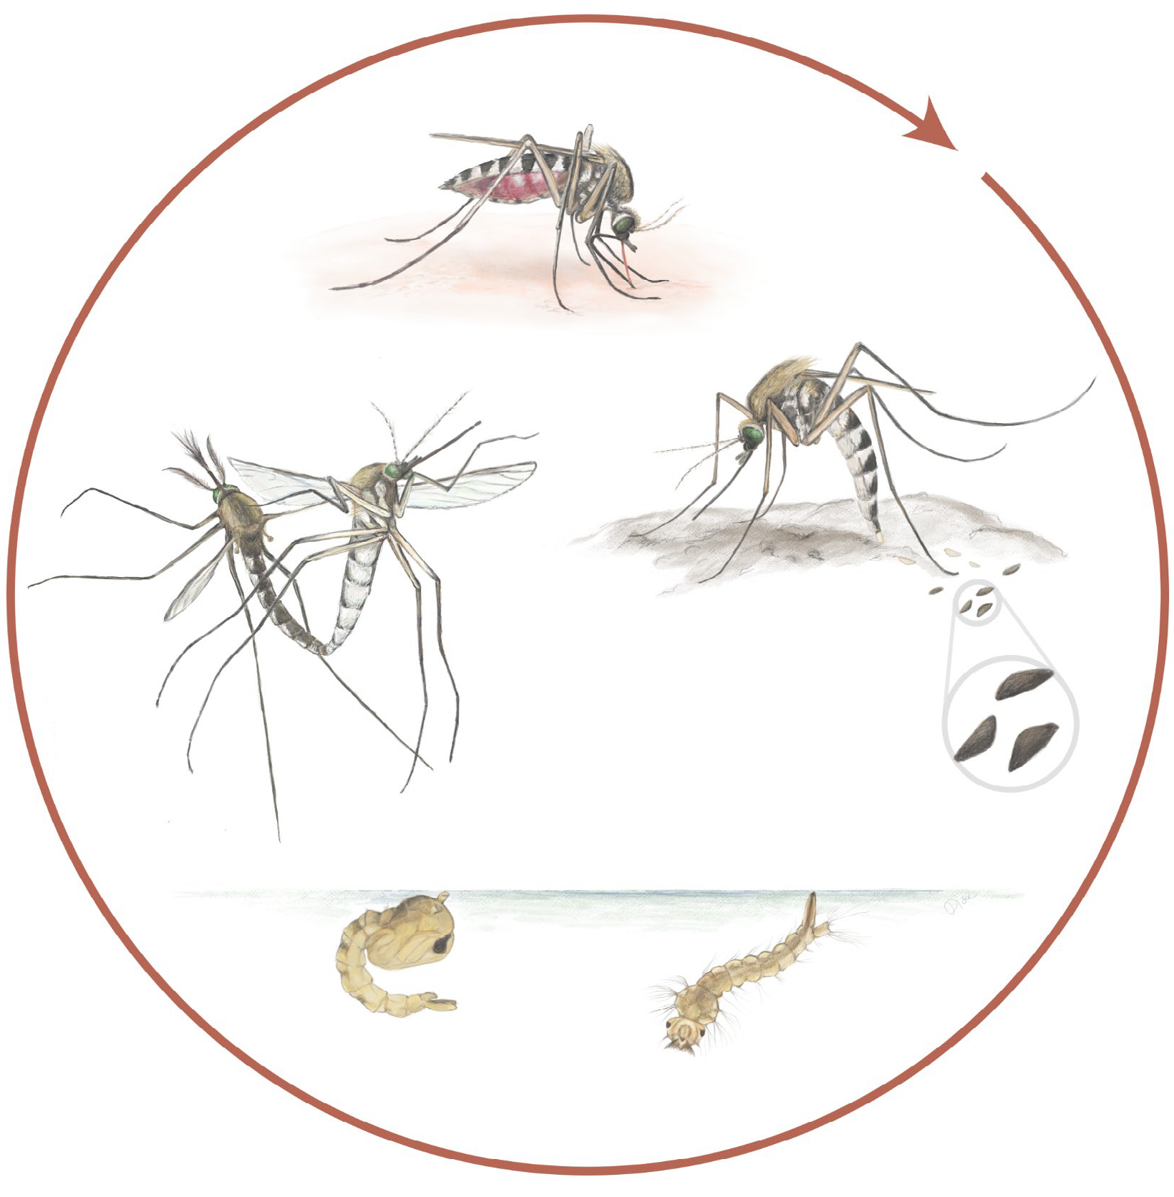
Life cycle of a floodwater Aedes mosquito
Female taking blood meal
Adult
Adults mating
Female laying eggs on the ground
♀
♂
Eggs
Pupa
Larva
© Disa Eklöf/SVA
3

Slide 4
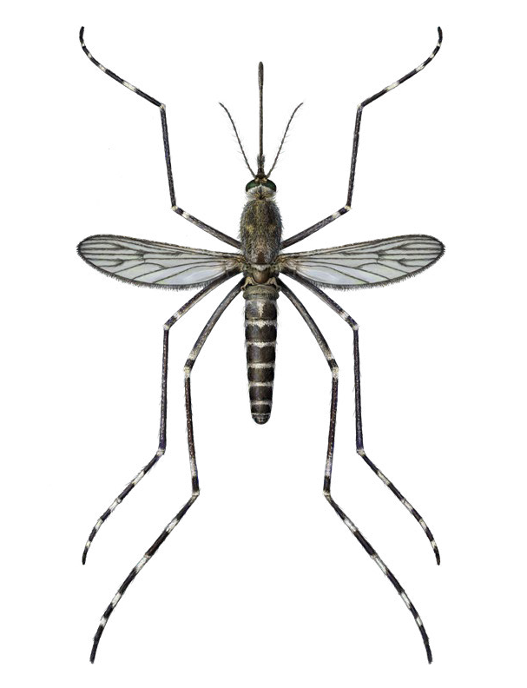
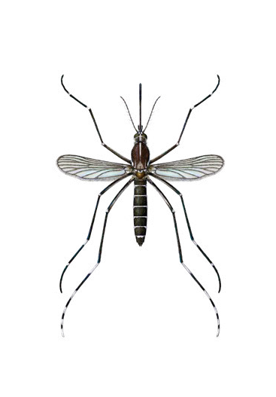
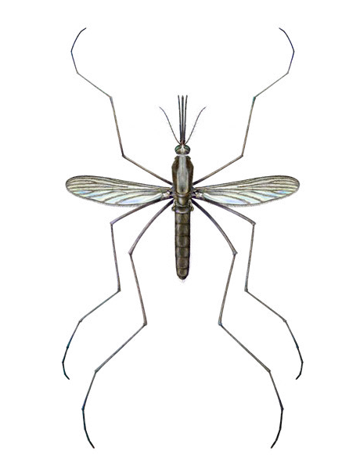
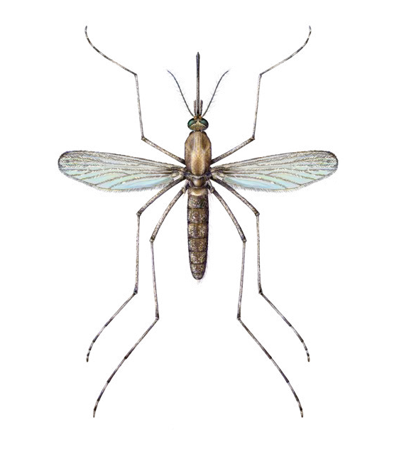
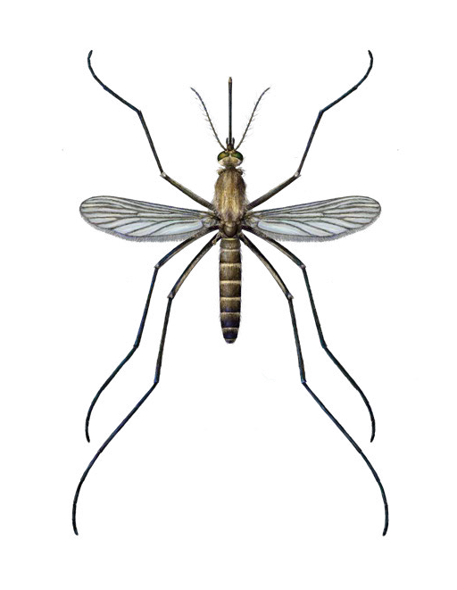
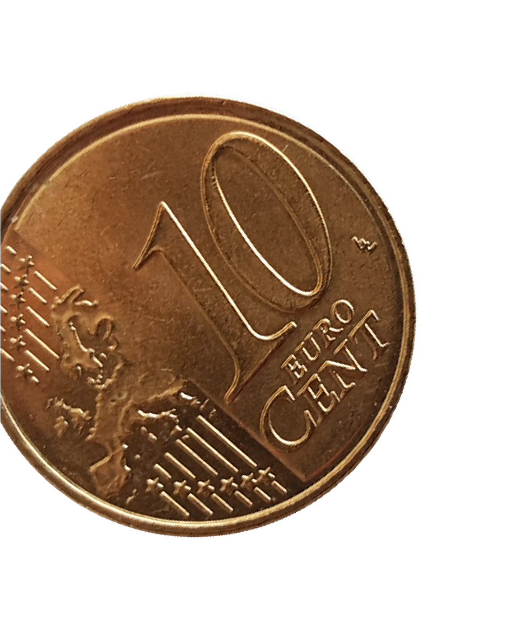
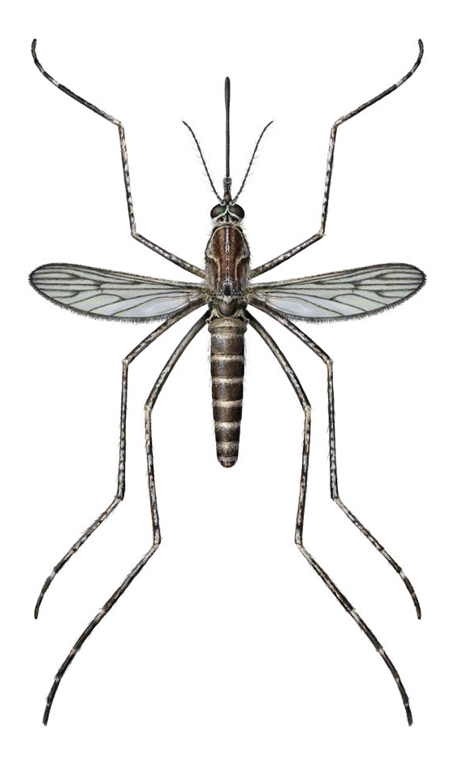
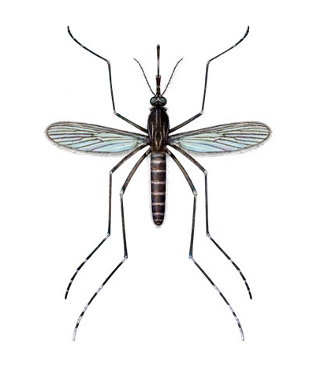
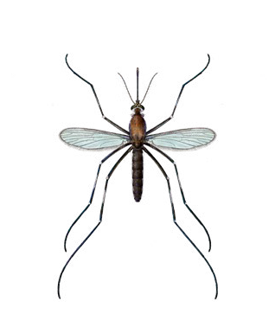
Female mosquitoes
Representatives of the seven mosquito genera present in Europe
Aedes albopictus
p.8
Anopheles plumbeus
p.22
Coquillettidia richiardii
p.23
Culex pipiens
p.24
Culiseta annulata
p.25
© Disa Eklöf/SVA
Culiseta longiareolata
p.26
Orthopodomyia pulcripalpis
p.27
Uranotaenia unguiculata
p.28
0 2.5 5 mm
Invasive Native
© Disa Eklöf/SVA
4

Slide 5
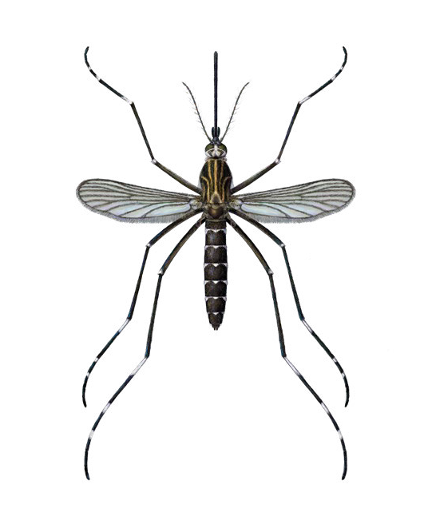
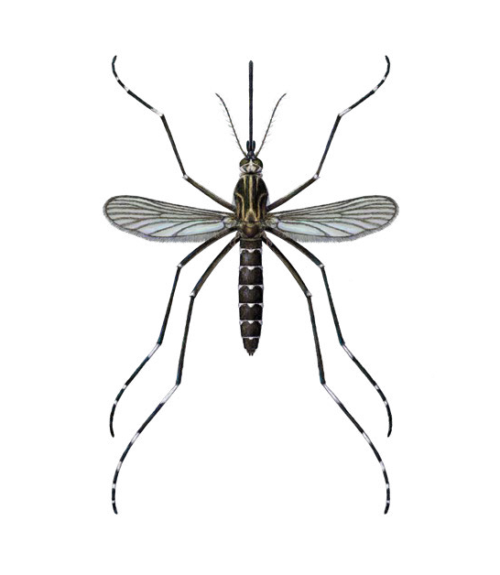
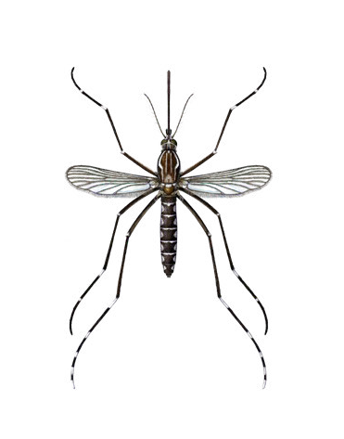
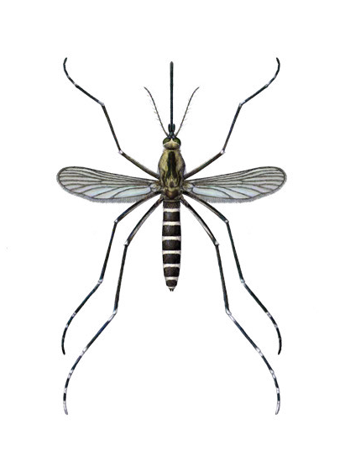
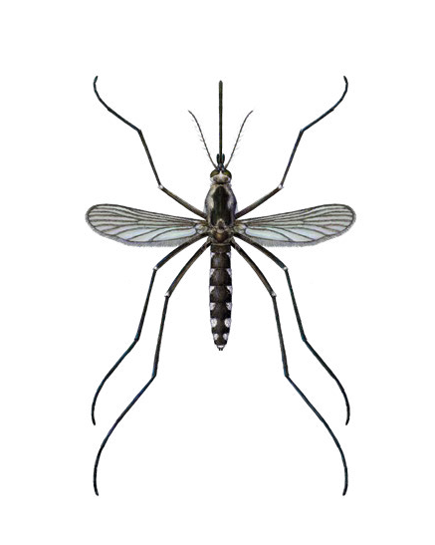
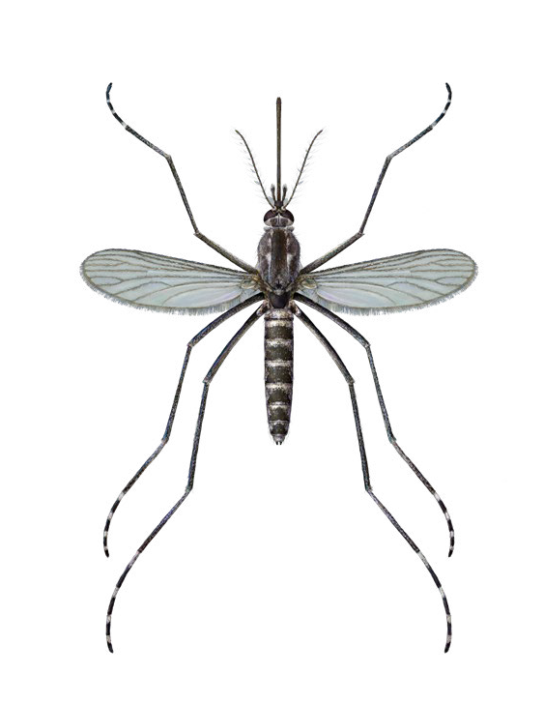
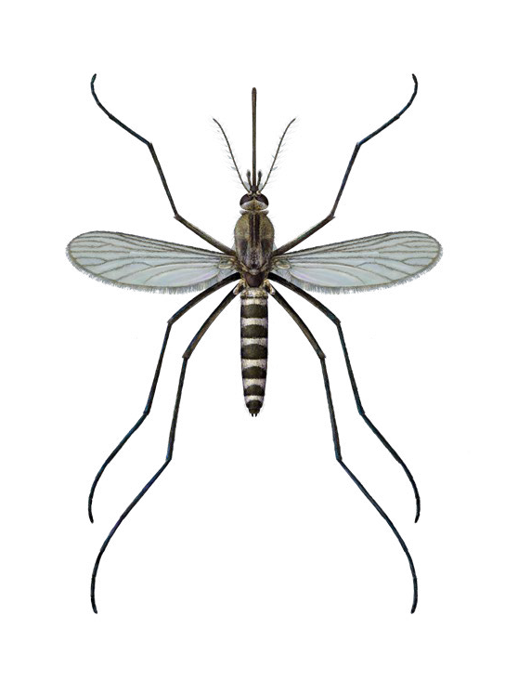
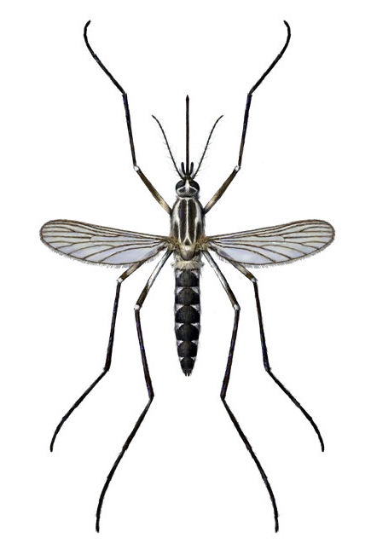
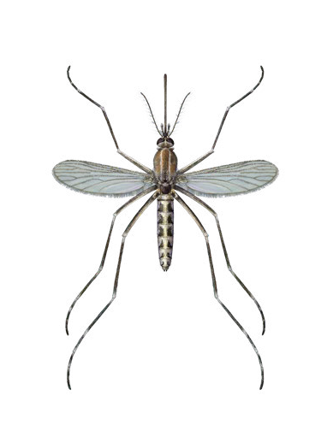
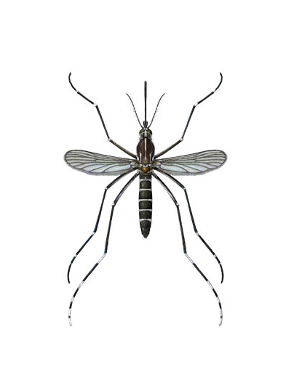
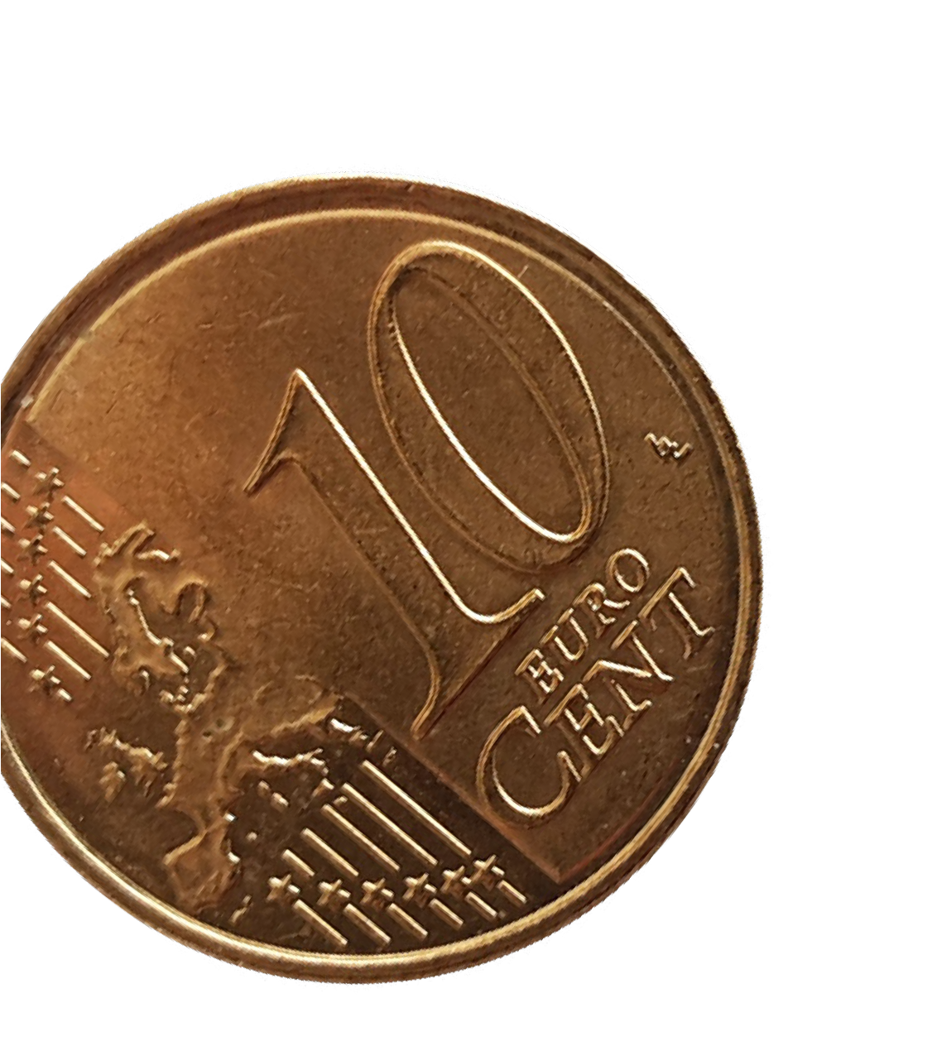
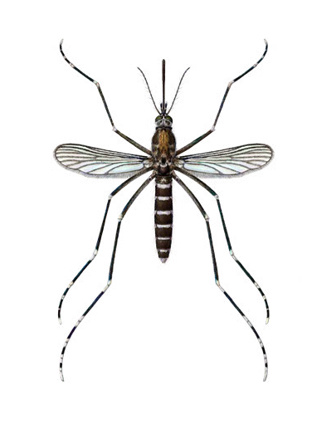
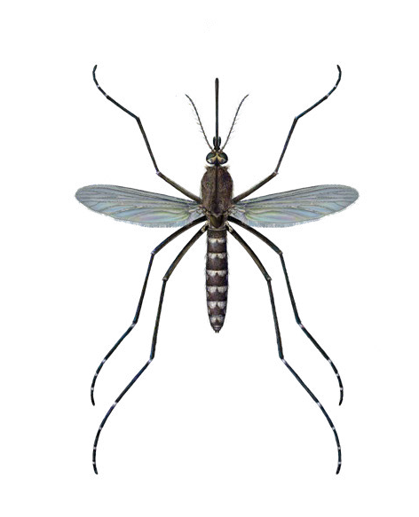
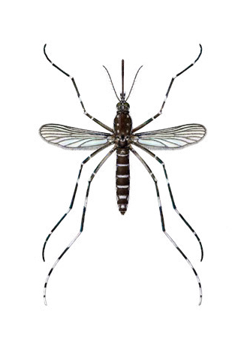
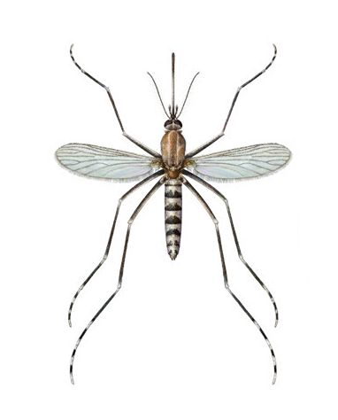
Female Aedes mosquitoes
Aedes aegypti
p.7
Aedes albopictus
p.8
Aedes atropalpus
p.9
Aedes japonicus
p.10
Aedes koreicus
p.11
© Disa Eklöf/SVA
Aedes triseriatus
p.12
Aedes cantans
p.14
Aedes caspius
p.15
Aedes communis
p.16
Aedes cretinus
p.13
Aedes geniculatus
p.17
Aedes pulcritarsis
p.18
Aedes vexans
p.19
Aedes vittatus
p.20
Aedes zammitii
p.21
0 2.5 5 mm
Invasive Exotic Native
5
© Disa Eklöf/SVA

Slide 6
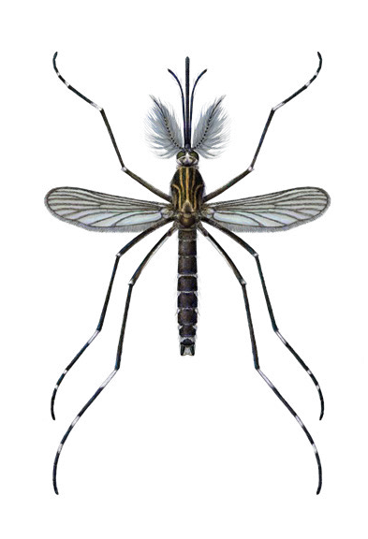
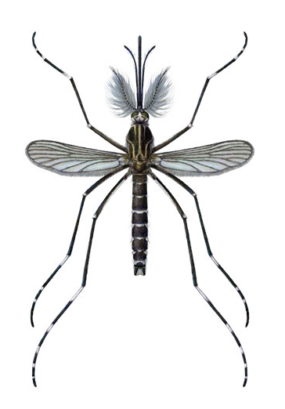
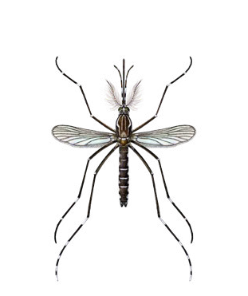
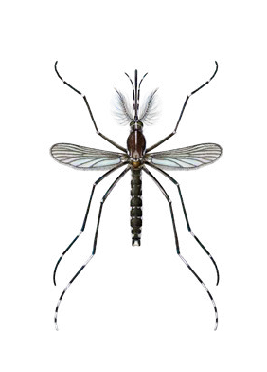

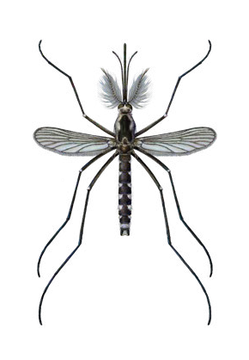
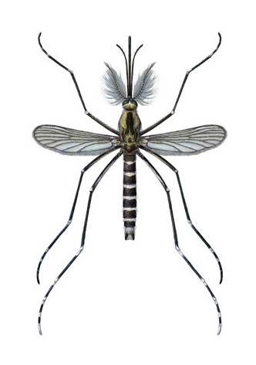
Male invasive Aedes mosquitoes
Aedes aegypti
p.7
Aedes albopictus
p.8
Aedes japonicus
p.10
Aedes koreicus
p.11
© Disa Eklöf/SVA
Aedes triseriatus
p.12
Aedes atropalpus
p.9
0 2.5 5 mm
Invasive Exotic Native
6

Slide 7
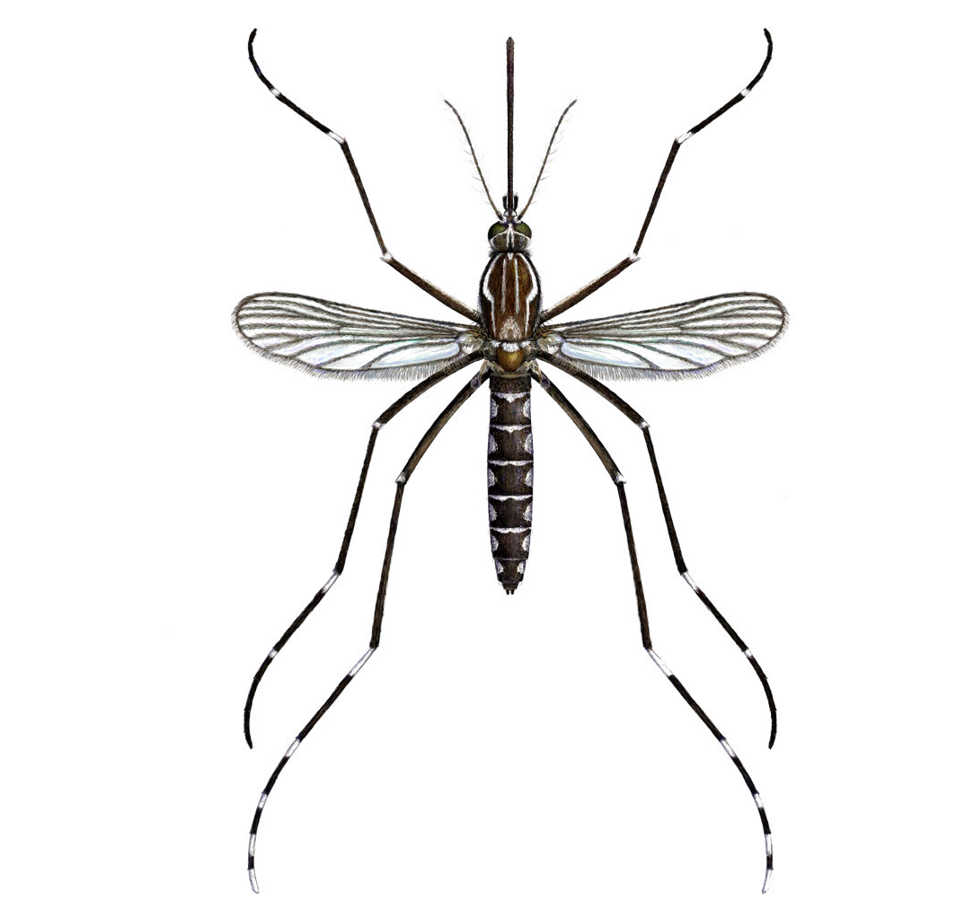
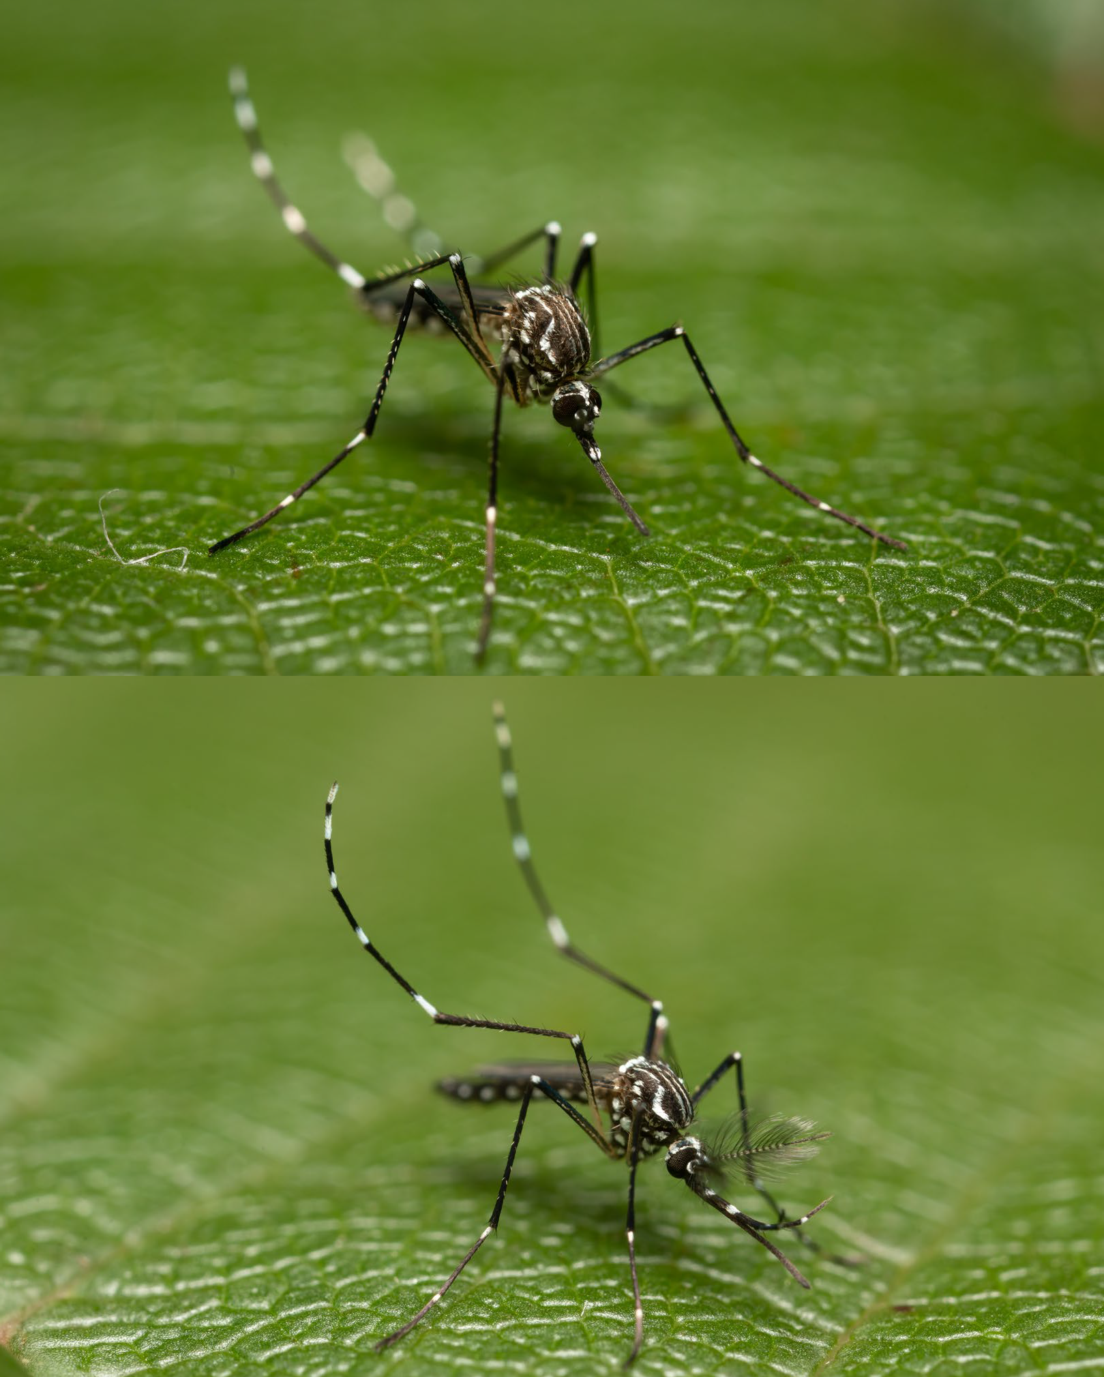

Aedes aegypti
Yellow fever mosquito
© Disa Eklöf/SVA
2
Stegomyia aegypti
Morphological characteristics
The genus Aedes has a pointy abdomen
Scutum (dorsal part of the thorax) has silver scales in the shape of a lyre on a black background.
Small size.
Contrasting black-and-white colouration.
Silvery-white markings on legs and abdomen.
Invasive
4
5
1
© Anders Lindström/SVA
Easily-confused species
Aedes albopictus; Aedes cretinus
In Europe, female Aedes aegypti will lay their eggs in artificial water containers, much like Aedes albopictus. Suitable habitats include earthenware pots and water tanks, uncovered cisterns, empty cans, flower pots or dishes, broken bottles or discarded tyres.
On the island of Madeira, Aedes aegypti is active throughout the year, with a peak in abundance from August to October.
The eggs are resistant to desiccation. Unlike Aedes albopictus, Aedes aegypti cannot produce diapausing eggs resistant to frost.
♀
Status in Europe
Exotic, invasive
Origin: Tropical Africa
Distribution
https://bit.ly/ 3MAZ3un
Likely point of entry
International trade and travel, airports.
Biting habits
Human, occasionally other mammals.
The females feed predominantly during the day in shaded places and only occasionally during the night.
Females can feed multiple times between egg laying.
Ecology (habitat, breeding sites)
Originally Aedes aegypti was found in forested areas, using tree holes as habitats. The species is now commonly found in tropical and sub-tropical areas, in close proximity to humans. It thrives well in urban and peri-urban environments.
© Anders Lindström/SVA
♂
7

Slide 8
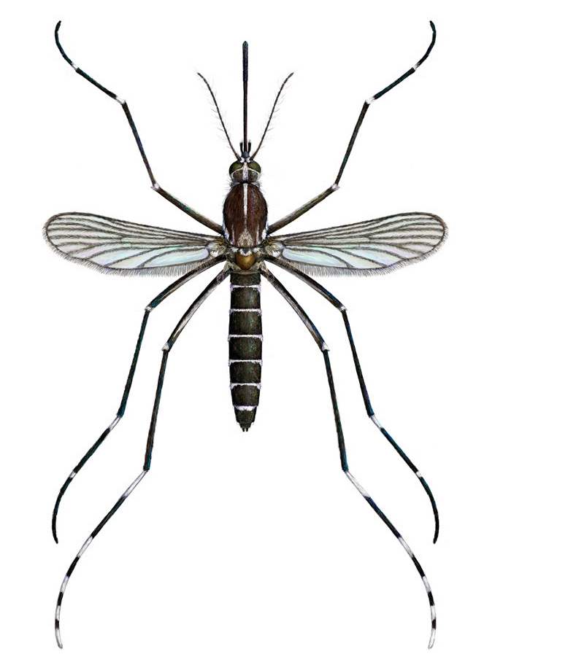
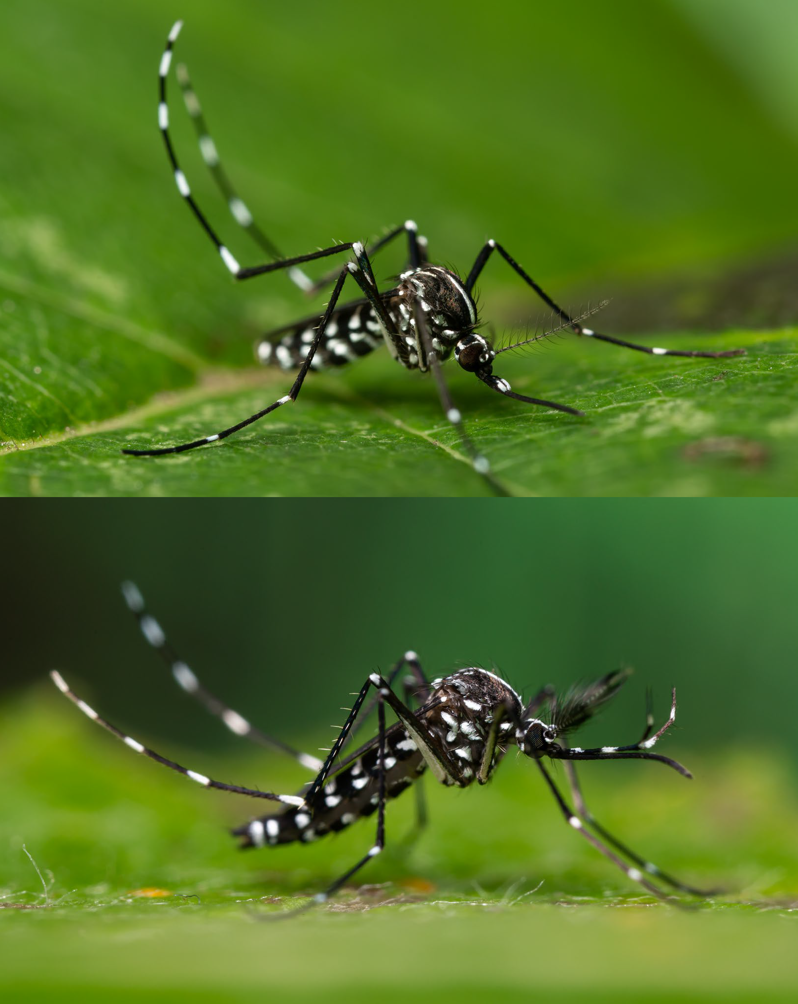

Aedes albopictus
(Asian) tiger mosquito
© Disa Eklöf/SVA
1
Stegomyia albopicta
Morphological characteristics
Scutum (dorsal part of the thorax) with a median silver-scale line on a black background.
Medium size.
White stripes beside and posterior to the median white line on the scutum do not reach the middle of the scutum.
Mid leg: white basal bands only on tarsomere 1 and 2.
Invasive
4
Easily-confused species
Aedes cretinus; Aedes aegypti
Status in Europe
Exotic, invasive
Origin: Asia
Distribution
https://bit.ly/ 3MAZ3un
In a temperate climate Aedes albopictus has been shown to be most active during the period May-September.
Adult Aedes albopictus females can produce eggs able to survive periods of frost during the winter (diapausing eggs).
Diapausing eggs of European Aedes albopictus have been shown to be able to survive a cold spell of -10°C, whereas eggs of tropical Aedes albopictus can only survive -2°C.
Larvae develop in natural or artificial water containers. Artificial aquatic habitats include tyres, barrels, rainwater gulley catch basins and flower pot dishes.
Biting habits
Adult females bite aggressively, usually during the day outdoors, but also during the night indoors.
Aedes albopictus feeds on humans, domestic and wild animals, reptiles, birds and amphi- bians, depending on host availability.
© Anders Lindström/SVA
♀
Likely point of entry
Eggs of Aedes albopictus are often imported in used tyres or hydroponic plant containers. Other ways of introduction include vehicles in which adult Aedes albopictus individuals can ‘hitchhike’ across borders.
Ecology (habitat, breeding sites)
In Europe Aedes albopictus prefers urban and suburban habitats.
© Anders Lindström/SVA
♂
8

Slide 9
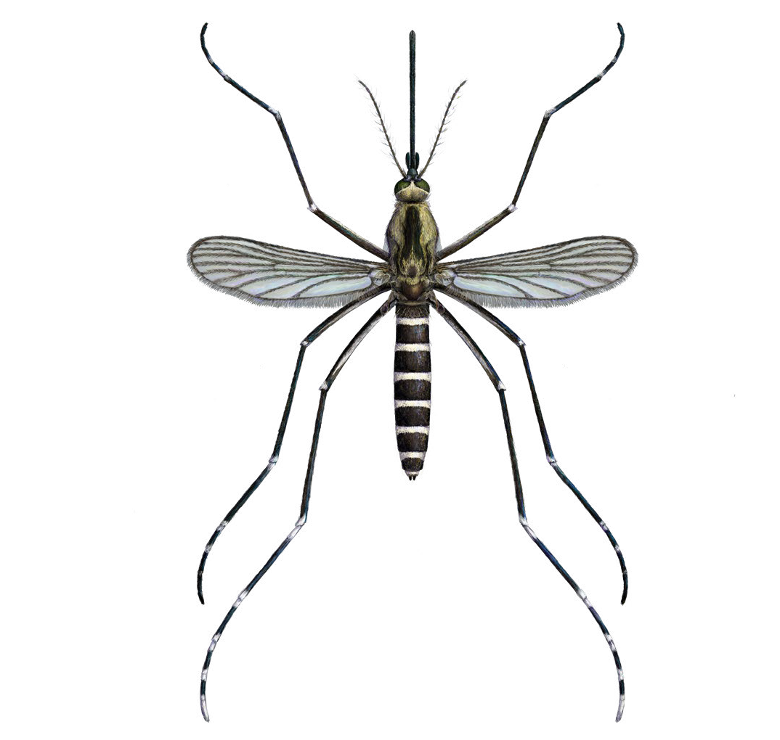
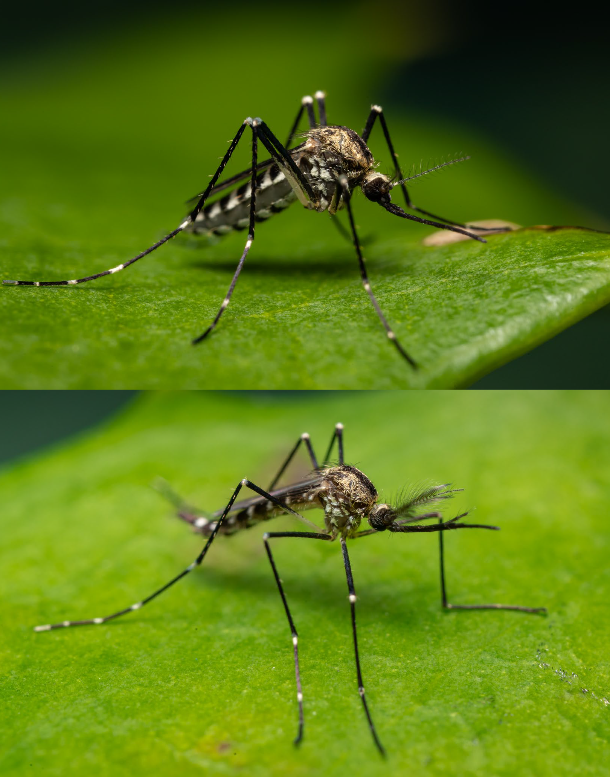
Aedes atropalpus
American rock pool mosquito
© Disa Eklöf/SVA
1
Georgecraigius atropalpus
Morphological characteristics
Presence of two lateral lines of pale scales on a black background on the scutum (dorsal part of the thorax).
Legs have inter-articular pale rings.
Wings have a patch or short line of pale scales at the base of the first principal longitudinal vein of the wing (costa).
Dorsal plates of abdomen with regular pale basal bands
3
Exotic
4
2
© Anders Lindström/SVA
Easily-confused species
Aedes caspius; Aedes pulcritarsis
The species is also known to breed in a variety of artificial containers, especially discarded tyres and other man-made water collectors such as concrete septic tanks.
Eggs are desiccation-resistant and can there- fore survive outside of water until conditions are suitable for them to hatch.
Biting habits
Aedes atropalpus will readily bite humans and the species has a preference for mammalian hosts.
Females bite at night and during the day and are known to be a pest in the vicinity of aquatic habitats.
♀
Status in Europe
Exotic
Origin: North and Central America
Distribution
https://bit.ly/ 3MAZ3un
Likely point of entry
International used tyre trade.
Ecology (habitat, breeding sites)
Aedes atropalpus appear early in the season.
Females can lay their first eggs without taking a bloodmeal (autogenous egg production).
Aedes atropalpus larvae are most often associated with soft water rock pool habitats along mountain streams in North America.
© Anders Lindström/SVA
♂
9

Slide 10
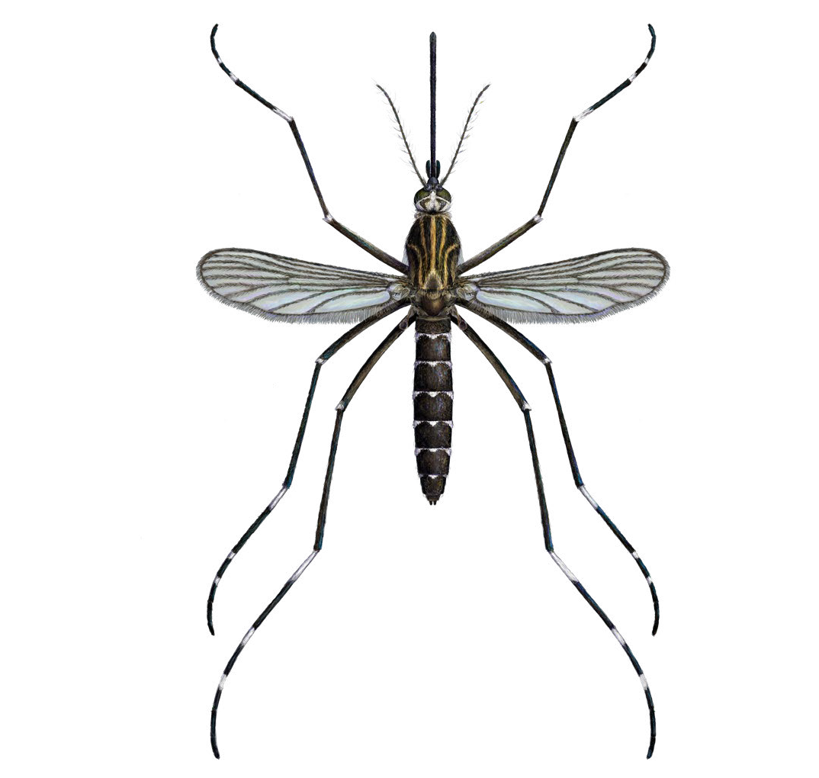
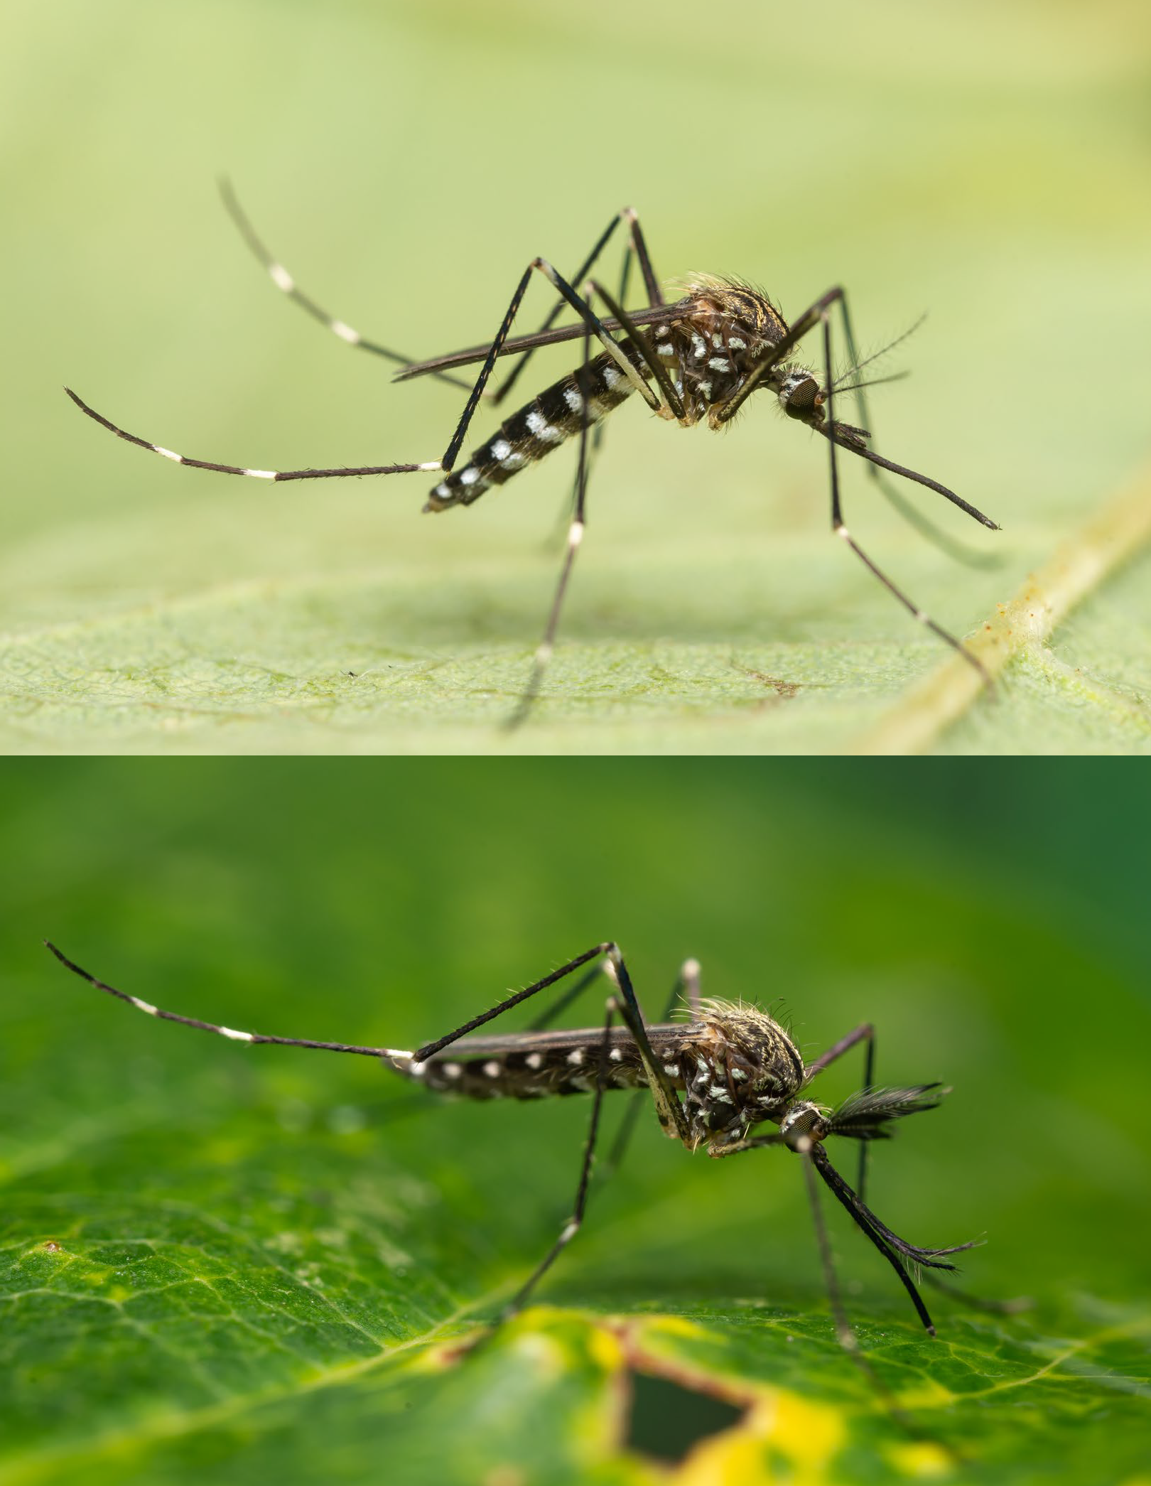
Aedes japonicus japonicus
Asian bush or rock pool mosquito
© Disa Eklöf/SVA
Morphological characteristics
Scutum (dorsal part of the thorax) with several lines of yellowish scales on a black background.
Relatively large.
White scale patches on black legs.
Tarsomeres 4 and 5 of hind leg almost entirely dark (different from Aedes koreicus).
Dorsal plates of the abdomen with lateral and median pale patches at the base of each segment that do not form complete bands.
1
Ochlerotatus japonicus japonicus, Hulecoeteomyia japonica japonica
Invasive
3
5
4
© Anders Lindström/SVA
Easily-confused species
Aedes koreicus
Ecology (habitat, breeding sites)
Adults are often found in forested areas.
Aedes japonicus prefers to lay eggs in shady rock holes but exploits also a large range of both habitats including tree holes, tyres, bird baths, and all breeding sites rich in
organic matter.
Aedes japonicus can produce frost- and desiccation-resistant diapausing eggs that can remain dormant over winter and hatch once environmental conditions become favourable.
Aedes japonicus can also overwinter as larva.
Biting habits
Aedes japonicus females feed mainly on mammals.
Female Aedes japonicus feed during the day. This species is an aggressive biter and will readily bite humans outside —mainly in forested areas, but occasionally also inside houses.
♀
Status in Europe
Exotic, invasive
Origin: Asia
Distribution
https://bit.ly/ 3MAZ3un
Likely point of entry
Can be imported by international tyre trade.
© Anders Lindström/SVA
♂
10

Slide 11

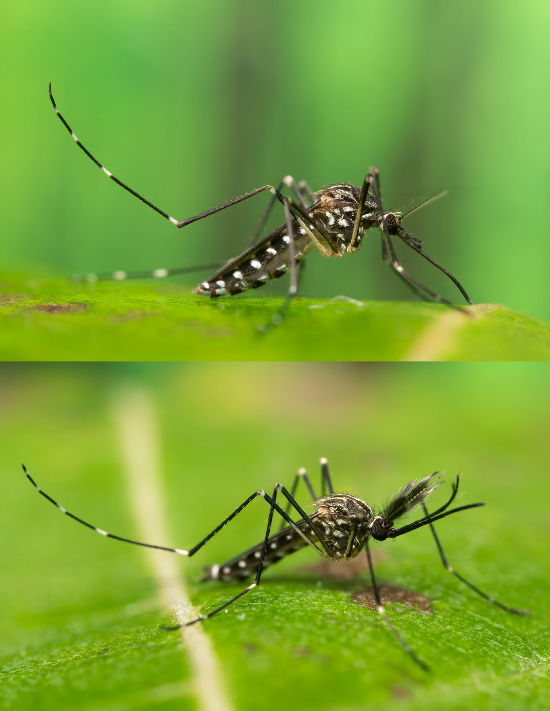
Aedes koreicus
© Disa Eklöf/SVA
1
Ochlerotatus koreicus, Hulecoeteomia koreica
Morphological characteristics
Strongly resembles Aedes japonicus in that it also has clear longitudinal lines on the scutum (dorsal part of the thorax).
Relatively large.
The presence of a complete 4th basal band on hind-tarsomere distinguishes the species from Aedes japonicus.
Can have an incomplete pale band at the base of hind tarsomere 5.
Invasive
3
4
© Anders Lindström/SVA
Easily-confused species
Aedes japonicus
Ecology (habitat, breeding sites)
Aedes koreicus overwinters as eggs which hatch during spring. Adults are most active between May and October.
The species survives in the same manner as Aedes japonicus - frost- and desiccation-re- sistant eggs that are dormant during winter and hatch once environmental conditions become favourable.
Larvae of Aedes koreicus can be found in both natural and artificial water containers such as garden ponds, water drums and other vessels and unused metal construction equipment. Natural sites include tree holes and stone cavities containing rain water and decaying tree leaves.
Biting habits
Aedes koreicus bites humans both during the day and at night.
Hosts are humans and mammals.
♀
Status in Europe
Exotic, invasive
Origin: Asia
Distribution
https://bit.ly/ 3MAZ3un
Likely point of entry
International trade routes, although for several established populations in Europe the intro- duction pathway is not clear.
© Anders Lindström/SVA
♂
11

Slide 12


Aedes triseriatus
American Eastern tree hole mosquito
© Disa Eklöf/SVA
1
Ochlerotatus triseriatus
Morphological characteristics
Presence of two pale-scaled stripes on the sides of the scutum (dorsal part of the thorax).
Absence of pale bands on the legs.
Dorsal plates of abdomen with baso-lateral pale patches.
Exotic
3
2
© Anders Lindström/SVA
Easily-confused species
Aedes geniculatus
Hatching is thought to be dependent upon flooding and may be staggered, resulting in only a proportion of an egg batch hatching in response to a particular flooding event at a certain time. This allows Aedes triseriatus to survive in a variety of environments across its range.
Eggs can survive prolonged periods without water. The species overwinters by diapausing eggs.
♀
Status in Europe
Exotic
Origin: North America
Distribution
Not introduced into Europe in the last five years.
Biting habits
Aedes triseriatus feeds on a multitude of hosts (birds, mammals, reptiles) and readily bites humans.
Females mostly bite during the day in shaded areas.
Likely point of entry
International tyre trade.
Ecology (habitat, breeding sites)
In its native range of North America, Aedes triseriatus is widely distributed. Aedes triseriatus breeds in tree-holes, tyres and other artificial containers. Adults are commonly encountered in forested areas.
© Anders Lindström/SVA
♂
12

Slide 13



Aedes cretinus
© Disa Eklöf/SVA
1
Ochlerotatus cretinus, Stegomyia cretina
Morphological characteristics
Scutum (dorsal part of the thorax) has a central narrow white stripe which forks at the end.
The scutum is bordered by a fine line of white scales, with a minute break at the scutal angle.
Resembles Aedes albopictus but differs through the longer lateral white lines on the scutum.
Hind tarsi with basal white rings; fifth tarsomere entirelly white.
Small size.
3
Native
4
Easily-confused species
Aedes albopictus; Aedes aegypti
Status in Europe
Native
Distribution
Aedes cretinus is found in Cyprus, Greece and Turkey.
Ecology (habitat, breeding sites)
Larvae can be found in tree holes and used tyres but also in small ground pools with thick vegetation which is not typical for container breeding mosquitoes.
Biting habits
Females are aggressive human biters during the day, both in shaded and open places.
© Disa Eklöf/SVA
♀
13

Slide 14


Aedes cantans
4
© Disa Eklöf/SVA
2
Ochlerotatus cantans
Morphological characteristics
Dark blackish-brown scaling with scattered white or yellow scales on body and wings.
Scutum covered with dark-brown or bronze- brown scales and the lateral parts with greyish-white or creamy scales.
Tarsomere 1 (tarsomere is the individual sub-segment of a tarsus) of all the legs has more or less mixed scales.
Tarsomeres 2–5 have moderately broad white basal rings, except for Tarsomere 5 of the forelegs which is entirely dark-scaled.
Native
1
3
Easily-confused species
Aedes cantans is part of the annulipes group: This group includes Aedes annulipes, Aedes behningi, Aedes cantans, Aedes cyprius, Aedes euedes, Aedes excrucians, Aedes flavescens, Aedes mercurator, Aedes riparius and Aedes surcoufi.
This species is generally not confused with any of the current invasive mosquito species in Europe.
Status in Europe
Native
Distribution
The species is widespread in Europe.
Ecology (habitat, breeding sites)
Aedes cantans produces only one generation (or in some cases two) per year. After this the species hibernates as diapausing eggs.
The larval habitat of Aedes cantans is meadow or forest pools without much vegetation but with a layer of organic material at the bottom.
Biting habits
Females feed on mammals and occasionally on birds.
© Anders Lindström/SVA
♀
14

Slide 15



Aedes caspius
Salt marsh mosquito
1
Morphological characteristics
Scutum (dorsal part of thorax) is covered with golden scales and has two dorsocentral white stripes.
Legs have inter-articular pale rings.
Dorsal plates of the abdomen have golden bands at the base and end of each plate and these are widest in the middle.
Small size.
3
2
© Disa Eklöf/SVA
Ochlerotatus caspius
Native
Easily-confused species
Aedes atropalpus
Aedes caspius is part of the caspius group. Members of this group are difficult to distinguish based on morphology. Species included in this group are Aedes berlandi, Aedes caspius, Aedes dorsalis, Aedes mariae, Aedes phoeniciae, Aedes pulcritarsis and Aedes zammitii.
Status in Europe
Native
Distribution
https://bit.ly/ 3MAZ3un
Ecology (habitat, breeding sites)
Adult Aedes caspius can be found in many habitats since they disperse over long distances from their larval hatching sites.
Larvae develop mainly in coastal marshes (brackish water) with temporary flooding. They can also be found in rice fields or meadows flooded with fresh water. They can withstand substantial salt concentrations of up to 150g/L.
The species overwinters as diapausing eggs.
Biting habits
Females feed mostly outside, but can be found indoors if there are large numbers. They feed both during the day and at night and are most active around dusk.
Hosts are both humans and animals.
© Anders Lindström/SVA
♀
15

Slide 16


Aedes communis
Snowpool mosquito
© Disa Eklöf/SVA
3
Ochlerotatus communis
Morphological characteristics
Medium size.
Dark-scaled tarsi.
Scutum (dorsal part of thorax) has yellow or golden scales.
Dorsal plates of abdomen with large pale basal bands.
Native
4
2
© Anders Lindström/SVA
Easily-confused species
This species is part of the communis group. The members of this group are morphologi- cally difficult to distinguish. The most common species in this group are Aedes cataphylla, Aedes detritus, Aedes punctor and Aedes sticticus.
This species is generally not confused with any of the current invasive mosquito species in Europe.
Status in Europe
Native
Distribution
In Europe the species is found from the northern European region to the Mediterranean.
Ecology (habitat, breeding sites)
Aedes communis only completes one genera- tion per year and is mainly found in swampy forests. The species prefers breeding in acid waterbodies, filled with water from melting snow or spring rainfall.
Larvae can be found in small water bodies without vegetation, but with a dense layer of dead leaves. They can be found in strongly acidic waters with a pH as low as three.
Aedes communis larvae can hatch in temperatures of little more than 0°C.
♀
Biting habits
Hosts are warm-blooded forest inhabitants.
Females are most active during the twilight period.
© Anders Lindström/SVA
♂
16

Slide 17


Aedes geniculatus
© Disa Eklöf/SVA
Dahliana geniculata
Morphological characteristics
Large mosquito
Conspicuous white knee spots.
Scutum has two central black stripes, sometimes fused into one, otherwise completely separated by a pale medio-dorsal stripe.
Tibiae and tarsi are entirely black-scaled.
Dorsal plates of abdomen with baso-lateral pale triangular patches
3
Native
2
5
4
© Anders Lindström/SVA
Easily-confused species
Aedes triseriatus
This species can be confused with the closely related species Aedes echinus and Aedes gilcolladoi (occurring in southern Europe only; not represented in this key).
Status in Europe
Native
Eggs are resistant to both frost and desiccation. Aedes geniculatus hibernates as eggs in northern climates and as larvae in southern climates.
♀
Biting habits
Feeds on various mammals, including humans and cattle, but also on birds and reptiles.
Females bite during daytime and during twilight hours. In south-eastern Europe, the species can be a nuisance for humans in forested areas.
The species is also found in peri-urban sites.
Distribution
Europe
Ecology (habitat, breeding sites)
Adult Aedes geniculatus are mainly found in deciduous or mixed forests, rarely in conifer forests. Although they can be a nuisance to humans they rarely enter urban areas.
The species mainly lays eggs in tree holes and open tree stumps, but can also colonise artificial containers, such as tyres. Breeding sites are usually rich in organic matter and tannins.
© Anders Lindström/SVA
♂
17

Slide 18


Aedes pulcritarsis
2
5
Morphological characteristics
Medium sized.
Dark palps with white tips.
Silvery-white inter-articular bands on tarsi.
Tarsomere 5 entirely white.
Scutum (dorsal part of the thorax) with large anterior yellow-brown patch and white posterior dots.
3
4
© Disa Eklöf/SVA
Ochlerotatus pulchritarsis
Native
Easily-confused species
Aedes atropalpus
This species can be confused with the closely related species Aedes berlandi
(not represented in this key).
Status in Europe
Native
Ecology (habitat, breeding sites)
This species hibernates during the egg stage and has one to two generations per year.
The larvae are mostly found in tree holes of deciduous and olive trees. Larval development can last up to two months. A suitable breeding site has a water temperature which never exceeds 21°C.
In the absence of woodland areas, adult mosquitoes are often found near stables or in villages.
Biting habits
Anthropophilic mosquitoes that bite outdoors and mainly during the daytime.
Distribution
Principally distributed in the Mediterranean region but found as far north as the Czech Republic. The species is also present in Central and South East Asia.
© Anders Lindström/SVA
♀
18

Slide 19



Aedes vexans
1
Morphological characteristics
Scutum has an indefinite pattern with yellowy- cream-coloured scales.
Tarsi have narrow pale basal rings.
Dorsal plates of the abdomen have pale bi-lobed basal bands.
Small-to-medium sized.
3
2
© Disa Eklöf/SVA
Aedimorphus vexans
Native
© Anders Lindström/SVA
Easily-confused species
This species is generally not confused with any of the current invasive mosquito species in Europe.
Status in Europe
Native
Ecology (habitat, breeding sites)
Adults can migrate long distances from breeding sites, up to 15 km, entering human settlements in large numbers.
This species breeds mostly on flood plains, exhibiting fast larval development. It is often found in flooded areas and around the margins of lakes with fluctuating water levels.
Biting habits
Feeds aggressively on humans and cattle during the daytime.
♀
Distribution
https://bit.ly/ 3MAZ3un
© Anders Lindström/SVA
♂
19

Slide 20


Aedes vittatus
© Disa Eklöf/SVA
Fredwardsius vittatus
2
1
Morphological characteristics
Palps with white apex and a few white scales in the middle.
Scutum (dorsal part of thorax) blackish brown with six silvery white spots arranged in three pairs.
White knee spots on all legs.
Hind leg with white rings on tarsomeres 1–4; Tarsomere 5 entirely white.
Native
3
4
Easily-confused species
This species is generally not confused with any of the current invasive mosquito species in Europe.
Ecology (habitat, breeding sites)
Aedes vittatus larvae are found in rock pools containing clear water, with mud and organic material on the bottom. Other breeding sites are gardening utensils, boats, wells or tree holes.
Aedes vittatus eggs can withstand desiccation and are laid above the water level.
Status in Europe
Native
Distribution
This species is present in the Mediterranean sub region and the Afrotropical and Oriental regions. Its distribution is probably limited by the low temperature in more northern areas.
Biting habits
This species bites both indoors and outdoors, Aedes vittatus females can sometimes attack people in large numbers. Biting activity occurs mainly during the twilight period.
© Anders Lindström/SVA
♀
20

Slide 21


Aedes zammitii
© Disa Eklöf/SVA
1
Acartomyia zammitii
Morphological characteristics
Scutum (dorsal part of the thorax) covered with rust-brown to gold scales.
Scutellum with three groups of white sickle-shaped scales and golden-brown or dark setae.
Ventral surface of femora is white scaled.
Anterior surface of tibia is black scaled with speckled white scales.
Native
2
3
4
© Anders Lindström/SVA
Easily-confused species
Aedes caspius
This species is hardly distinguishable from the closely related species Aedes mariae and
Aedes phoeniciae (not represented in this key).
This species is generally not confused with any of the current invasive mosquito species in Europe.
Status in Europe
Native
Distribution
Coastal areas of the Mediterranean region.
Ecology (habitat, breeding sites)
The eggs enter diapause at temperatures below 16°C and during short-day photope- riods.
Larvae are found in rock pools along the Mediterranean seashore with concentrations of up to 20% of salt.
Aedes zammitii produces multiple generations per year and can often be a nuisance in rocky coastal areas.
Biting habits
Readily bites humans.
♀
© Anders Lindström/SVA
♂
21

Slide 22


Anopheles plumbeus
1
© Disa Eklöf/SVA
Morphological characteristics
Palps of the female mosquitoes from the genus Anopheles are the same length as the proboscis.
Global dark appearance.
Black proboscis and palps.
Vertex (dorsal part of the head) with a tuft of white scales and yellowish setae.
Pale / ash-grey median part of the scutum (dorsal part of the thorax).
5
4
Native
© Anders Lindström/SVA
Easily-confused species
Anopheles claviger (not shown in this key).
This species is generally not confused with any of the current invasive mosquito species in Europe.
Status in Europe
Native
Distribution
Widely distributed throughout Europe. It can also be found in the northern Caucasus, the Middle East south to Iran, Iraq and North Africa.
Ecology (habitat, breeding sites)
Breeding sites are tree holes with decom- posing organic matter. Other breeding sites can be artificial containers such as water catch basins and tyres. or unused stable slurry pits.
Eggs are laid slightly above the water surface on the side of the of breedings sites and only
♀
hatch when the breeding site is flooded.
Anopheles plumbeus overwinters as egg or
larvae. Larvae can survive periods during which water surfaces are frozen.
Biting habits
Females are most active during twilight and prefer to feed on mammalian blood, however they also feed on birds and reptiles. Some populations have a strong preference for human hosts.
© Anders Lindström/SVA
♂
22

Slide 23


Coquillettidia richiardii
5
3
© Disa Eklöf/SVA
Morphological characteristics
The scales on the wings of this genus are broad and clearly visible.
Wing veins covered with broad, intermixed yellowish and brown scales.
Apex of the proboscis slightly broader and darker than the preceding part.
Pale ring in the middle of tarsomere 1 of all legs (sometimes hardly visible).
Broad pale basal rings usually present on all tarsomeres.
2
Native
1
4
Easily-confused species
This species is generally not confused with any of the current invasive mosquito species in Europe. There is only one other species of this genus present in Europe: Coquillettidia buxtoni.
Status in Europe
Native
Distribution
Common species in the western Palearctic region.
Ecology (habitat, breeding sites)
Coquillettidia richiardii has one to three generations per season. The larvae obtain oxygen from the air channels of aquatic plants by attaching themselves to the plants' roots.
Breeding sites are various freshwater or slightly saline permanent water bodies such as marshes, lakes, riverbeds and estuaries.
Biting habits
Mostly feed on mammals but also birds and amphibians.
Females are mostly active around the breeding sites but can fly a few kilometers to villages. where they can be a severe nuisance.
Bite after sunset, at night, and just after sunrise.
© Anders Lindström/SVA
♀
23

Slide 24




Culex pipiens
House mosquito, Northern house mosquito
2
© Disa Eklöf/SVA
Morphological characteristics
The genus Culex has a rounded abdomen end whereas the genus Aedes has a pointy abdomen.
Brownish-yellow, with no pattern on scutum.
Abdominal dorsal plates bearing yellowish basal bands.
Native
3
1
Easily-confused species
Culex pipiens is part of a group of species which are very hard to distinguish based on morphological characteristics. For more information see
Culex pipiens is hard to confuse with any of the current invasive mosquito species in Europe.
Status in Europe
Native
Females lay their eggs on water surfaces in batches as egg rafts of around 200 eggs. These eggs are non-dormant and the larvae hatch rapidly as soon as the embryonic development is completed (around 24 hours).
Larvae can be found from mid-spring until the first frosts. In summer and autumn Culex pipiens can be found in abundance.
For more information see fact sheet:
https://bit.ly/ 3LmZQ1L
© Anders Lindström/SVA
♀
Distribution
https://bit.ly/ 3MAZ3un
Biting habits
Females of the Culex pipiens form pipiens mainly bite birds (ornithophilic), feed outdoors (exophagic) and rest outdoors (exophilic).
The Culex pipiens form molestus is charac- terised by females that mainly bite humans and other mammals indoors (endophagic) or occasionally outdoors. They frequently rest indoors (endophilic). They can lay a batch of eggs without a bloodmeal (autogenous).
They are most active after dusk and before dawn.
Ecology (habitat, breeding sites)
Culex pipiens can inhabit nearly every type of water source. They can breed in clear water but also in water highly polluted with organic matter, and can even tolerate a small amount of salinity (e.g. coastal marshes or rock pools).
Females overwinter in frost-free shelters, such as cellars, caves, bunkers, or ground burrows.
© Anders Lindström/SVA
♂
24

Slide 25


Culiseta annulata
© Disa Eklöf/SVA
Morphological characteristics
The genus Culiseta has a rounded abdomen whereas the genus Aedes has a pointy abdomen.
Generally large mosquitoes
Dark brown with whitish markings.
Tarsomere I (the individual sub-segment of a tarsus) with a noticeable white ring in the middle and white rings at the bases of Tarsomeres 2–4.
Tarsomeres 5 of all legs entirely dark-scaled.
Wings largely covered with scales, some of which clustered, forming distinct dark spots.
Dorsal plates of the abdomen with whitish basal bands.
Native
6
7
1
5
4
© Anders Lindström/SVA
♀
Easily-confused species
Culiseta longiareolata; Culiseta subochrea; Culiseta alaskaensis.
Status in Europe
Native
Distribution
Occurs throughout Europe, but is more common in the North than in the South, where it is largely replaced by Culiseta longiareolata.
Eggs are laid on water surfaces in stagnant pools, ponds, ditches, water troughs and other artificial containers, such as rainwater collection barrels. Manure basins can also act as a larval habitat. The larvae can even survive in water with a high level of salinity.
Eggs are laid in rafts, like Culex pipiens.
Adults can be encountered from early spring, with the population peak occurring in September.
Biting habits
Females bite humans, indoors and outdoors.
Also bites birds occasionally.
They are active during the night.
Ecology (habitat, breeding sites)
This species hibernates at the adult stage in the cellars or attics of dwellings or in domestic animal sheds, where it can be a nuisance even during the winter.
© Anders Lindström/SVA
♂
25

Slide 26


Culiseta longiareolata
© Disa Eklöf/SVA
3
Morphological characteristics
The genus Culiseta has a rounded abdomen, whereas the genus Aedes has a pointy abdomen.
Very large size.
Lines on scutum.
White spots on legs.
Wing veins covered with dark scales, some of which clustered, forming dark spots which are less distinct than in Culiseta annulata.
Native
5
4
1
Easily-confused species
Culiseta annulata; Culiseta subochrea, (not shown in this key); Culiseta alaskaensis (not shown in this key)
Status in Europe
Native
Ecology (habitat, breeding sites)
Breeding occurs in rock holes, wooden barrels, concrete tanks, wells and other artificial containers.
Larvae are rarely found in natural water bodies such as ditches or drain canals. Larvae are able to survive in conditions of high salinity and polluted waters.
Hibernation takes place during the larval stage.
Biting habits
Culiseta longiareolata do not enter human dwellings and rarely bite humans.
Culiseta longiareolata prefer feeding on birds.
Distribution
In Europe the species is widely distributed in the Mediterranean region.
© Anders Lindström/SVA
♀
26

Slide 27


Orthopodomyia pulcripalpis
3
© Disa Eklöf/SVA
Morphological characteristics
Typical for this genus: length of tarsomere 1 of the foreleg longer than tarsomeres 2 to 5 together and tarsomere 4 of forelegs is shorter.
Palps nearly half as long as the proboscis.
White ring on apical half of the proboscis.
Scutum with three pairs of narrow white stripes.
Legs covered in black scales with a metallic shine. Has white spots on the joint between femur and tibia.
Dark brown scales on the wing veins.
2
4
Native
6
5
Easily-confused species
This species is generally not confused with any of the current invasive mosquito species in Europe.
This is the only species of this genus present in Europe.
Status in Europe
Native
Distribution
Palearctic, mostly present around the Mediterranean area. The only species of this genus present in Europe.
Ecology (habitat, breeding sites)
The species is closely associated with forest.
Larvae breed in tree holes and holes in tree roots. The species prefers large tree holes with water permanently present (e.g. Platanus spp.).
The species overwinter in the larval stage and can survive when water surfaces freeze.
Biting habits
Females are mainly ornithophilic and rarely bite humans; they are most active during the day in shaded places.
© Anders Lindström/SVA
♀
27

Slide 28


Uranotaenia unguiculata
2
© Disa Eklöf/SVA
3
Morphological characteristics
Genus characterised by the anal vein which is sharply bent at the end.
Proboscis swollen at the apex.
Dark head with silver line along the eye margins.
Silvery white line running across the lateral margin of the scutum (see photograph).
White scales on the tip of femur and tibia.
Pale longitudinal stripe on the anterior surface of the femora.
Terga covered with dark-brown iridescent scales.
Very small size.
4
Native
1
6
5
7
© Anders Lindström/SVA
Easily-confused species
This species is generally not confused with any of the current invasive mosquito species in Europe.
Ecology (habitat, breeding sites)
Preferred breeding sites of this species are pools, ditches, canals or shallow shores of lakes with stagnant or slow running water that are rich in aquatic vegetation. Larvae prefer fresh water.
The adults are most abundant in late summer.
The species overwinters as adults in shelters, caves, piles of cut reeds, or dense vegetation.
Biting habits
Feeds on amphibians and rarely bites humans or mammals.
♀
Status in Europe
Native
Distribution
Mediterranean region and as far north as Luxembourg.
There are only three species of Uranotaenia present in the western Palearctic region: Uranotaenia balfouri is present in Morocco and Uranotaenia mashonaensis in Israel. Uranotaenia unguiculata is present all around the Mediterranean.
© Anders Lindström/SVA
♂
28

Slide 29

References
Becker N, Petric D, Zgomba M, Boase C, Madon MB, Dahl C, et al. Mosquitoes. Identification, Ecology and Control: Springer Nature Switzerland AG 2020; p. 570.
Wilkerson RC, Linton YM, Fonseca DM, Schultz TR, Price DC, Strickman DA. Making Mosquito Taxonomy Useful: A Stable Classification of Tribe Aedini that Balances Utility with Current Knowledge of Evolutionary Relationships. PLoS One. 2015;10(7):e0133602.
Reinert JF. New classification for the composite genus Aedes (Diptera : Culicidae : Aedini), elevation of subgenus Ochlerotatus to generic rank, reclassification of the other subgenera, and notes on certain subgenera and species. J Am Mosquito Contr. 2000;16(3):175-88.
Reinert JF, Harbach RE, Kitching IJ. Phylogeny and classification of Aedini (Diptera: Culicidae), based on morphological characters of all life stages. Zoological Journal of the Linnean Society. 2004;142(3):289-368.
Reinert JF, Harbach RE, Kitching IJ. Phylogeny and classification of Finlaya and allied taxa (Diptera: Culicidae: Aedini) based on morphological data from all life stages. Zoological Journal of the Linnean Society. 2006;148(1):1-101.
Reinert JF, Harbach RE, Kitching IJ. Phylogeny and classification of Finlaya and allied taxa (Diptera: Culicidae: Aedini) based on morphological data from all life stages. Zoological Journal of the Linnean Society. 2008;148:1-101.
Reinert JF, Harbach RE, Kitching IJ. Phylogeny and classification of tribe Aedini (Diptera: Culicidae). Zoological Journal of the Linnean Society. 2009;157(4):700-94.
Further reading. Wilkerson RC, Linton YM, Stricker D. Mosquitoes of the world: Johns Hopkins University Press; 2021.
This report was commissioned by the European Centre for Disease Prevention and Control (ECDC) Specific contract No 2 ECD.10468 and No 3 ECD.11885 implementing inter-agency framework contract for services No ECDC/2019/020 (VectorNet). The report was coordinated by Olivier Briët, and produced with contri- butions from Anders Lindström, Disa Eklöf, Nick Van Hul, Marieta Braks, Arjan Stroo, Dušan Petrić, Francis Schaffner and Wim Van Bortel.
The key is based on illustrations made by Disa Eklöf and photos by Anders Lindström from the National Veterinary Institute/SVA. Anders Lindström owns the copyright of all photographs and Disa Eklöf owns the copyright of all illustrations. These photographs and illustrations are public and may be reproduced,
adapted and/or distributed, totally or in part, irrespective of the means and/or the formats used, provided that the copyright owners are always acknowledged as the original source of the material. Such acknow- ledgement must be included in each copy of the material.
29

