Slide 1
Reusable maps and graphs from ECDC Communicable Disease Threats Report Week 39, 2022
You are encouraged to reuse our maps and graphs for your own purposes and are free to translate them, provided the content is not altered and the source is acknowledged.

Slide 2
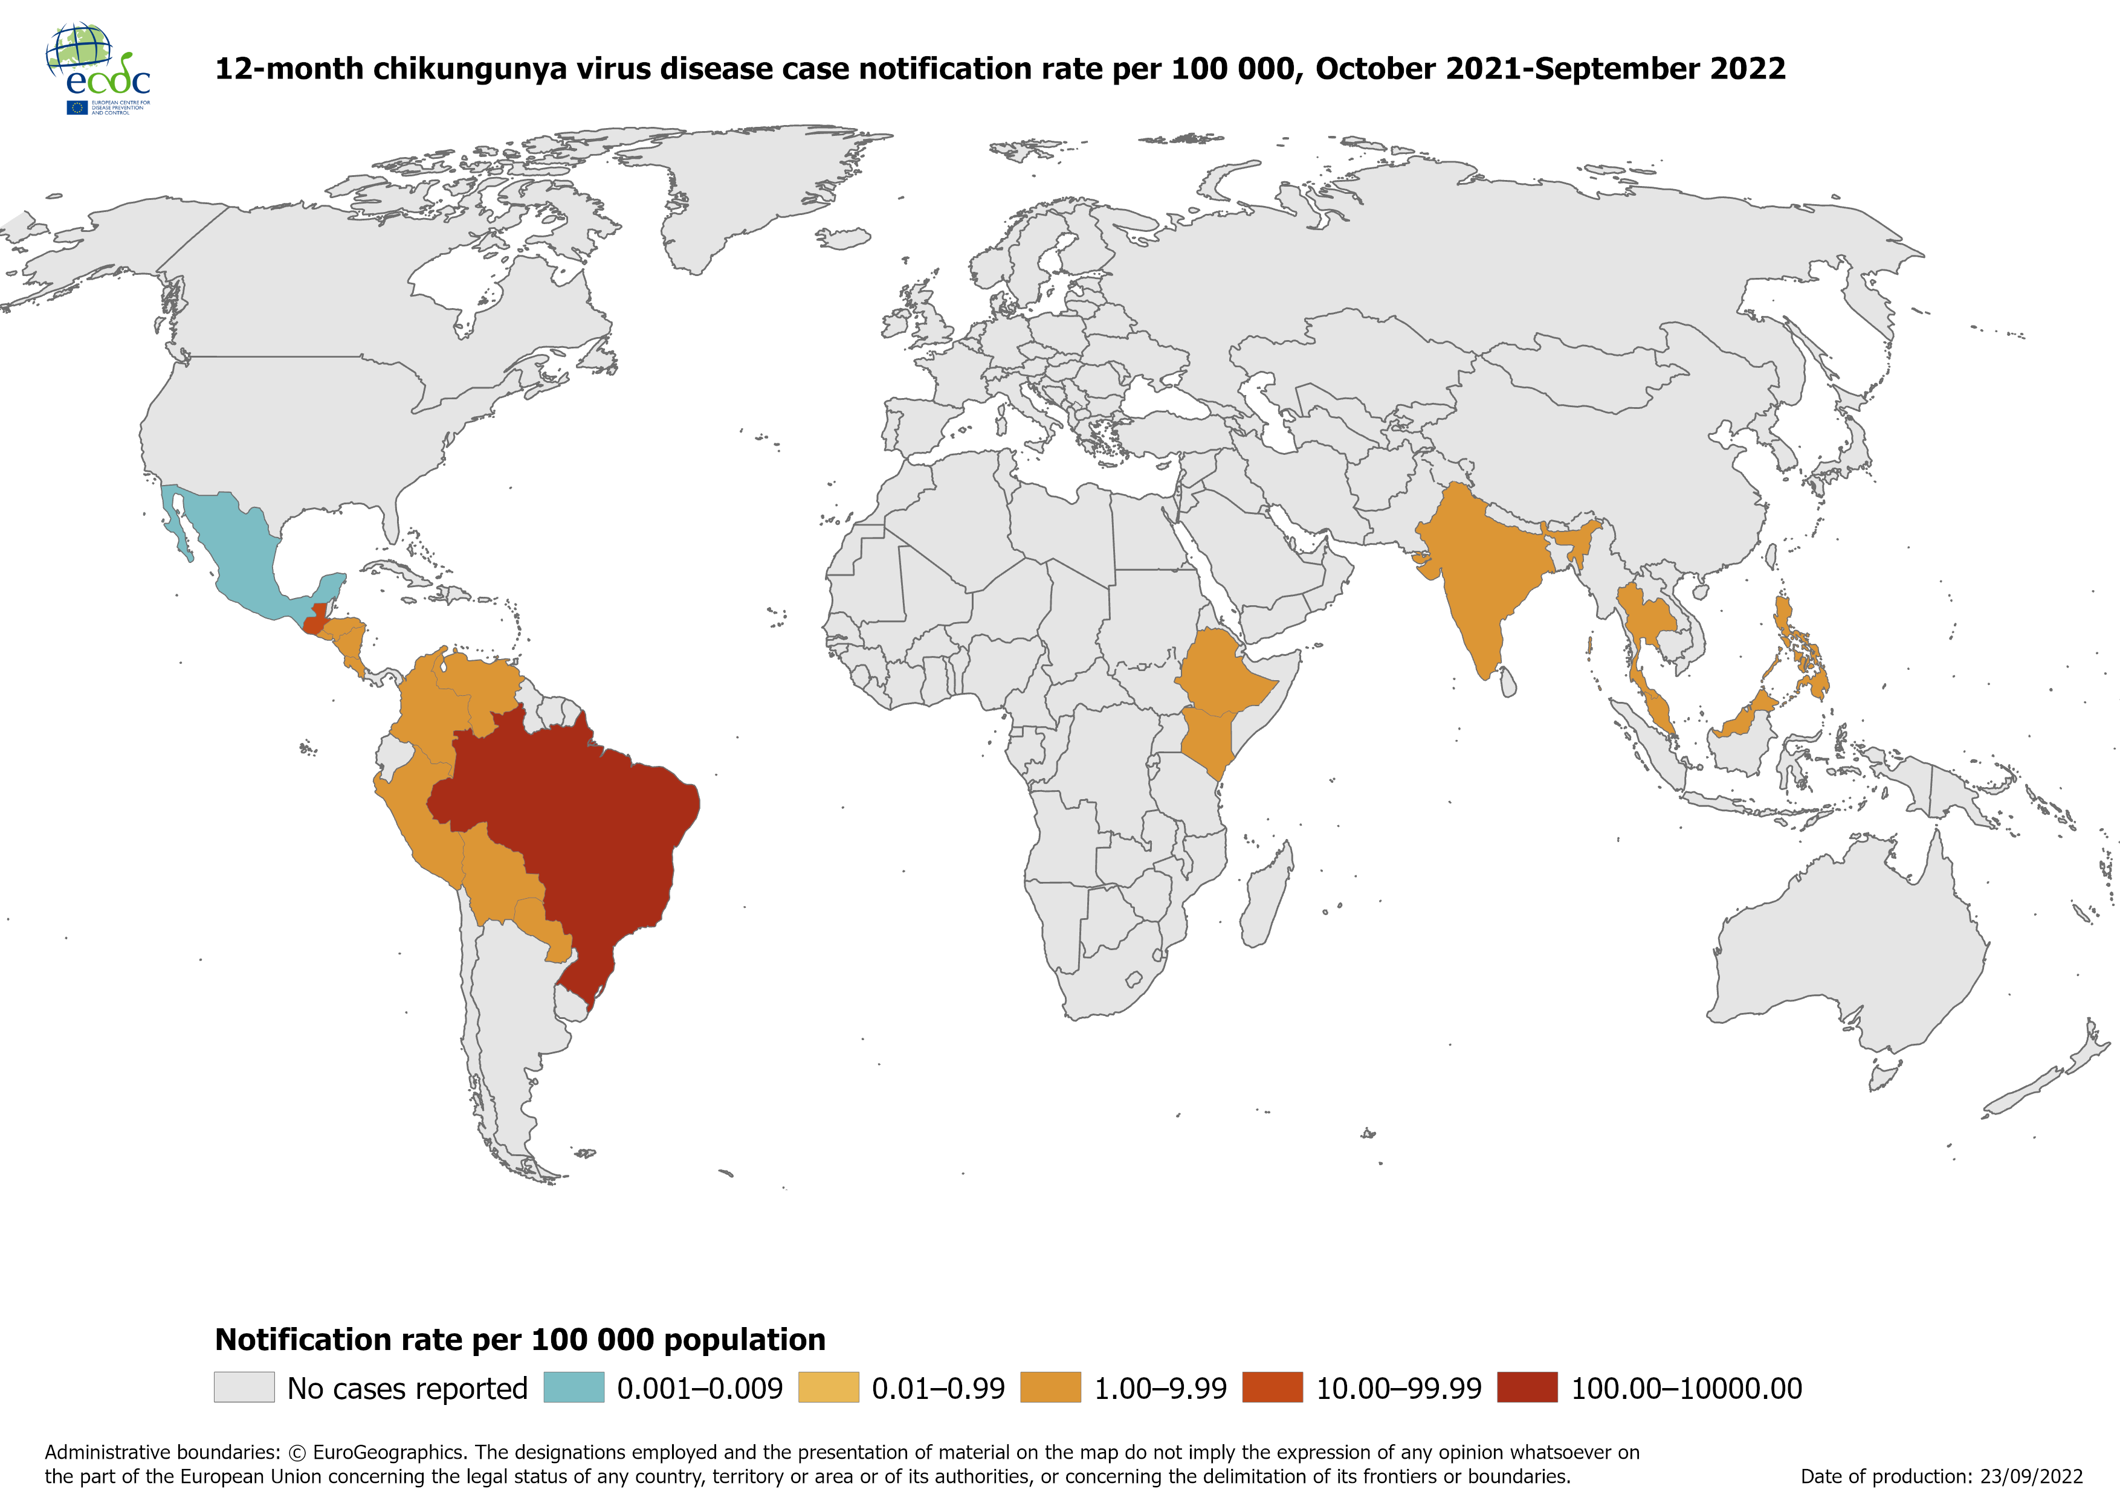
Notification rate of chikungunya cases reported worldwide, October 2021 to September 2022

Slide 3
Notification rate of chikungunya cases reported worldwide, July to September 2022

Slide 4
Notification rate of dengue cases reported worldwide, October 2021 to September 2022

Slide 5
Notification rate of dengue cases reported worldwide, July 2021 to September 2022

Slide 6
Distribution of confirmed human cases of avian influenza A(H9N2) virus infection by year of onset and country, 1998-2022 (updated on 26 September, n=114)

Slide 7
Distribution of confirmed human cases of avian influenza A(H5N6) virus infection by year of onset and country, 2014-2022 (n=81)

