Slide 1
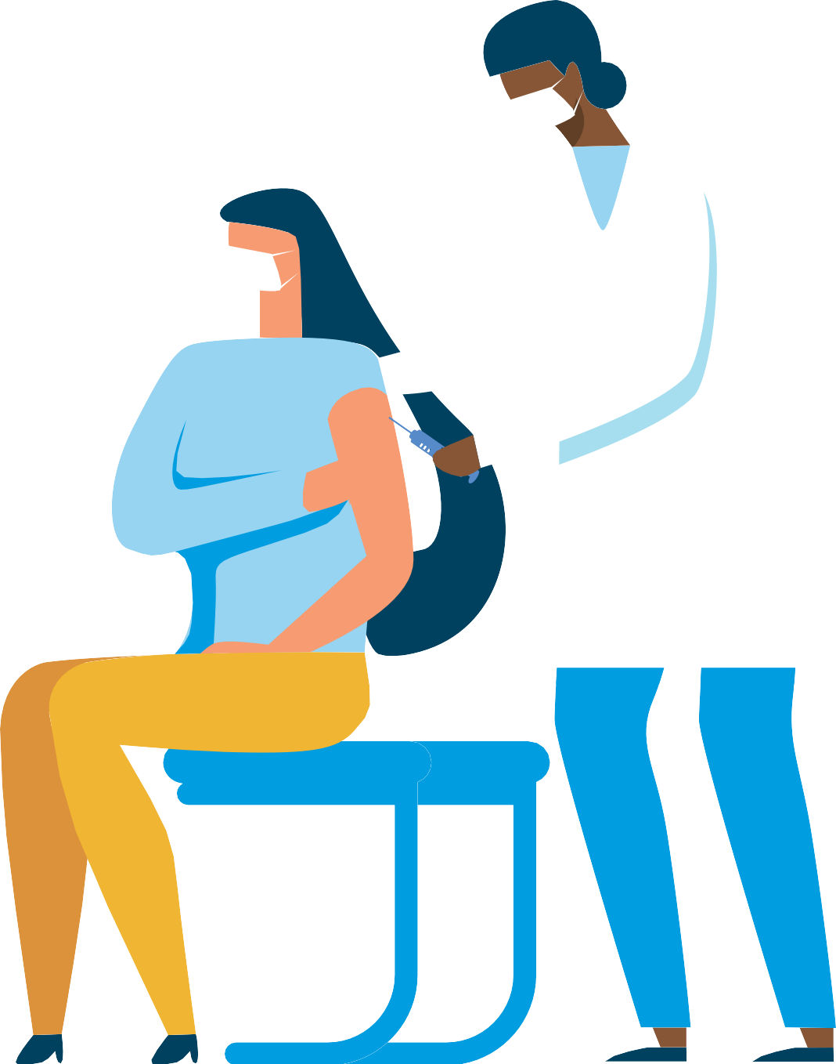

Influenza
during the COVID-19 pandemic
How do I protect myself and others from COVID-19 during influenza vaccination?
Don’t come for a vaccination if you are ill or have had close contact with a COVID-19 case in the past two weeks.
Keep a distance of at least one metre (ideally two) to other people, except for the vaccinator, in the facility.
Schedule your vaccination during less busy times when there are no queues.
Use a surgical face mask or a textile mask to protect against droplets.
Wash your hands with soap and water before and after being in the facility for vaccinations. Alternatively, use alcohol-based disinfectant.
Avoid touching surfaces with bare hands, or shaking hands with anyone in the facility.

Slide 2

Influenza
during the COVID-19 pandemic
Why is it important to get vaccinated against influenza during the COVID-19 pandemic?
By getting vaccinated, you help protect the vulnerable, such as the elderly and those with chronic underlying medical conditions. These are people who are at increased risk of severe outcomes such as respiratory difficulties or death.
Both influenza and COVID-19 can cause severe disease, but note that the influenza vaccine only protects against influenza.
Dual infection with COVID-19 and influenza is likely to cause more severe outcomes.
Both COVID-19 and influenza can disrupt healthcare services and the functioning of nursing homes. It is especially important this year that healthcare staff get vaccinated against influenza and that healthcare services keep running.

