Slide 1
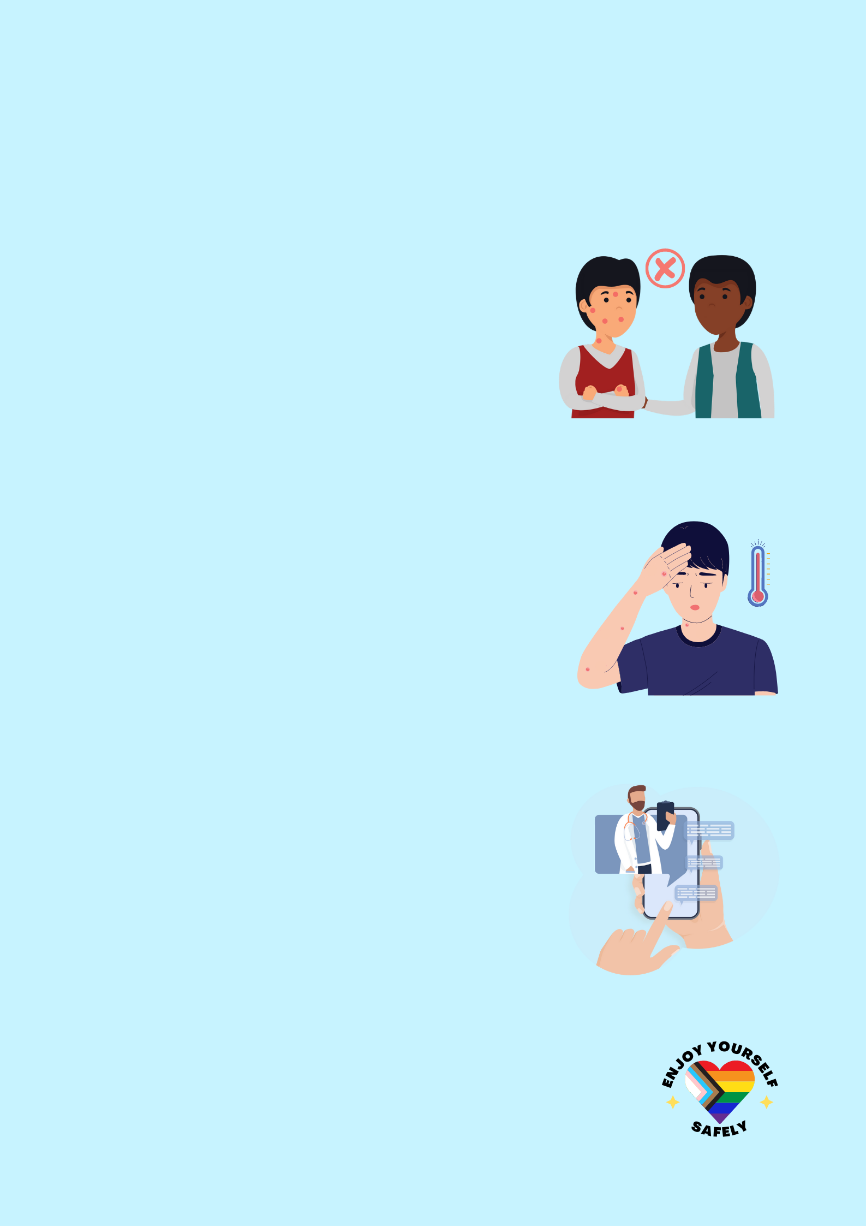
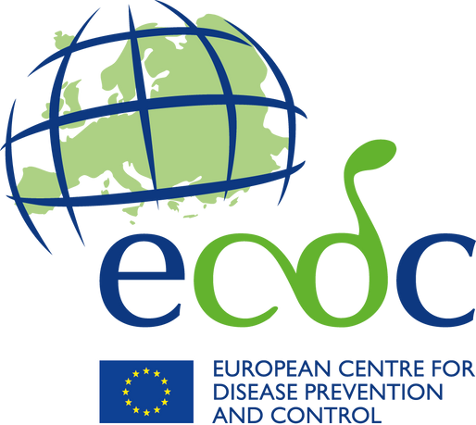
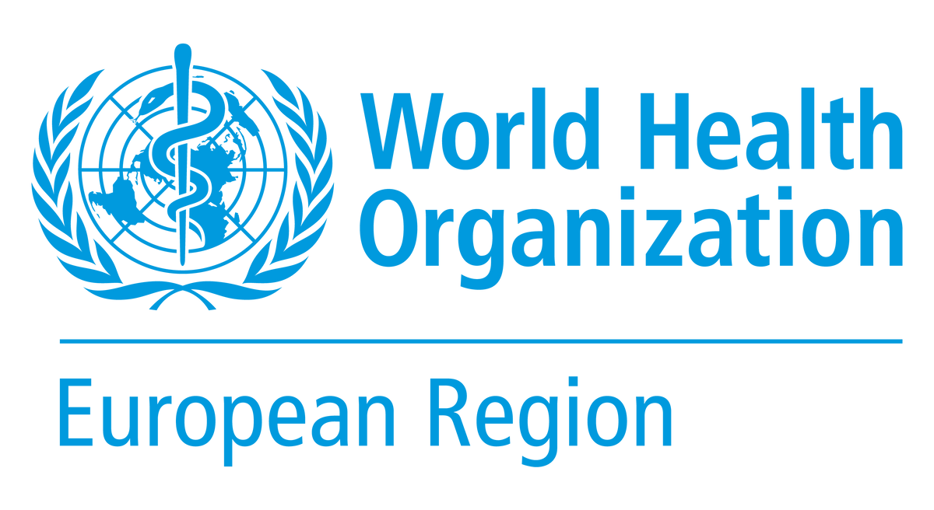
MPOX
Learning about mpox can help you protect yourself and your community.
Updated 17 May 2023
HOW CAN I PROTECT MYSELF?
To catch mpox, you need skin-to-skin contact, including during sex, with someone who has mpox or through contact with their contaminated belongings.
To reduce the risk of contracting mpox:
Practice safer sex.
Keep your hands clean.
Talk to your healthcare provider about getting vaccinated.
WHAT ARE THE SYMPTOMS I SHOULD LOOK OUT FOR?
Rash with blisters on any part of the body (starting on mouth, anus or the genitals).
Inflammation and pain in the rectum.
Swollen lymph nodes.
Fever.
These symptoms can be accompanied by headaches, muscle aches, and low energy.
WHAT SHOULD I DO IF I SUSPECT I HAVE MPOX?
Seek medical advice and get tested.
If possible, avoid close physical contact or ensure lesions are covered when in close proximity to others.
Take a break from sex.
Ask close contacts and sexual partners if they have similar symptoms.
Keep good hand hygiene.
If you have been exposed to someone with mpox, seek medical advice even if you don’t have symptoms. You may be eligible for vaccination that will lower the risk of infection and developing severe disease.
Follow the advice of health authorities and trusted international organizations.
Things are not always what they seem online: scan the QR code to access reliable information from a trusted source.
© World Health Organization Regional office for Europe and the European Centre for Disease Prevention and Control, 2023 Some rights reserved. This work is available under the Creative Commons Attribution- 3.0 IGO licence (CC BY-3.0 IGO; Creative Commons — Attribution 3.0 IGO — CC BY 3.0 IGO).

