Slide 1



MPOX: WHAT
YOU NEED TO KNOW
Swipe right to learn about MPOX and get health advice to protect yourself and others.
Updated 17 May 2023

Slide 2
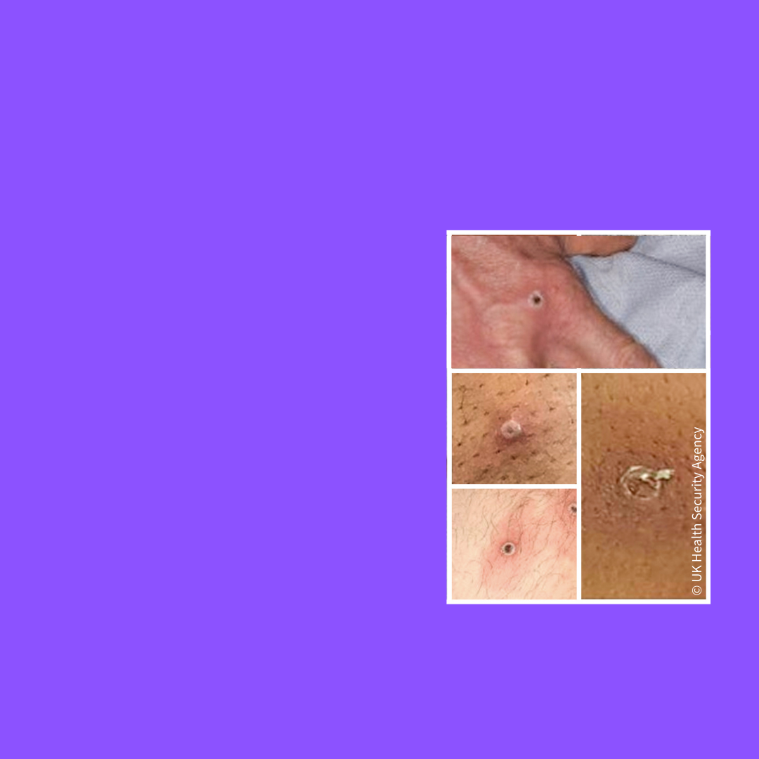
What are the mpox symptoms I should look out for?
The most common symptoms include:
Rash
Swollen lymph nodes
Fever
Headache
Muscle aches
Back and rectal pain
Low energy
Updated 17 May 2023

Slide 3

How is mpox spread?
You can get mpox if you have close contact with someone who has mpox, or with a contaminated object.
Mpox spreads most easily during direct skin-to-skin contact, including during sex.
Updated 17 May 2023

Slide 4

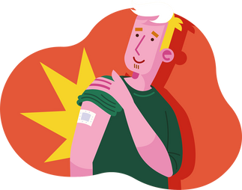
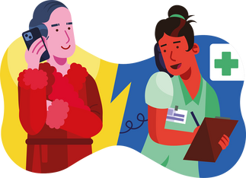

How can I protect myself and my community?
Keep having conversations with peers and sexual partners about mpox, and stay up-to-date with the latest information.
If you have or suspect having mpox, take a break from sexual activities until scabs are no longer present.
If vaccination is available to you, get vaccinated.
If you have or suspect you may have mpox, contact your health provider or sexual health clinic.
Keep your hands clean, using soap and water, or an alcohol-based sanitizer.
Updated 17 May 2023

Slide 5
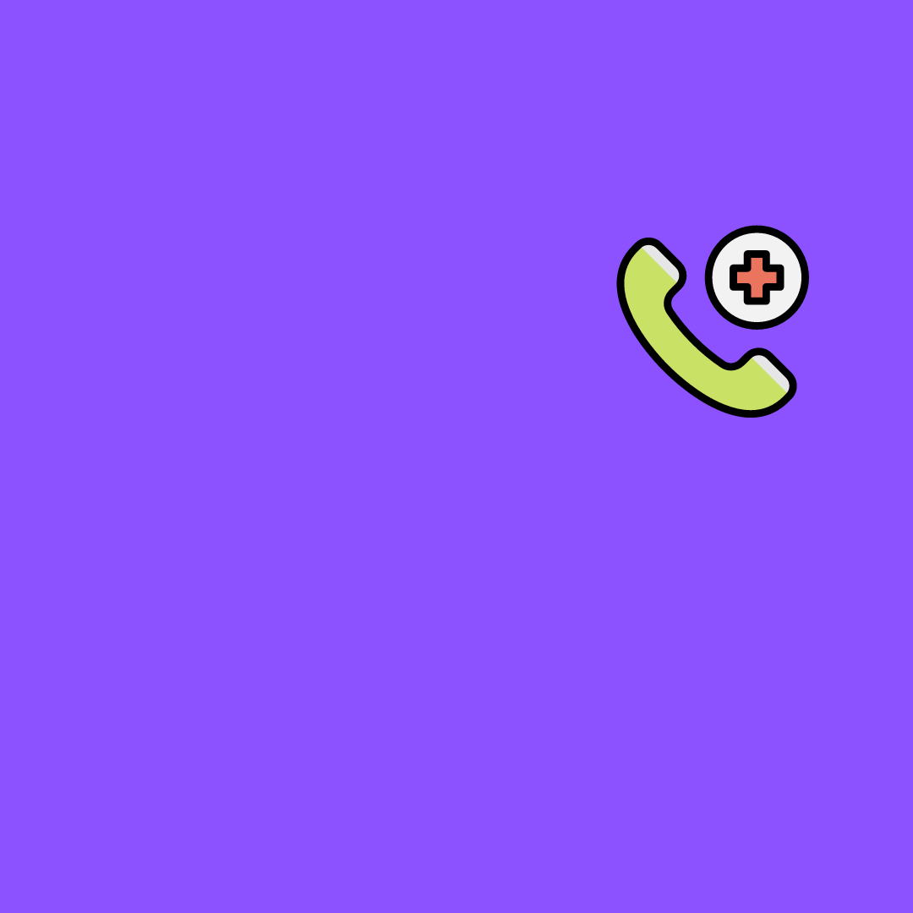
What to do if I suspect I have mpox?
Seek medical advice by contacting your health care provider.
Get tested.
If possible, self-isolate and avoid close contact with others.
If self-isolation is not possible and you have lesions, ensure they are covered when in close proximity to others.
Take a break from sexual activities until you have a negative test result.
Ask your close contacts and sexual partners if they have similar symptoms.
Updated 17 May 2023

Slide 6

What to do if I have mpox?
If possible, self-isolate and follow the advice of health authorities.
If self-isolation is not possible and you have lesions, ensure they are covered when in close proximity to others.
Avoid contact with pregnant women, young children, and immunocompromised people until you have recovered.
Take a break from sexual activity until scabs are no longer present.
Share details of close and sexual contacts with health authorities or inform your contacts yourself.
Updated 17 May 2023

