Slide 1
HIV and AIDS Surveillance 2025 2024 data
In the EU/EEA region
Findings from the joint report HIV and AIDS surveillance Europe by ECDC and WHO Regional Office for Europe
Stockholm, 28 November 2025

Slide 2
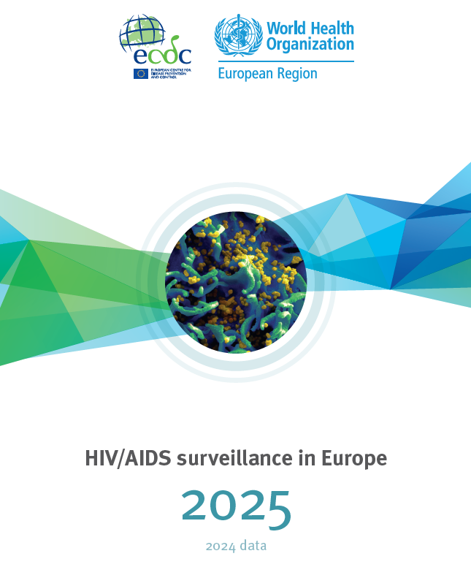
Reported HIV diagnoses, EU/EEA, 2024
Reported HIV diagnoses
Reporting countries/number of countries | 30/30
Number of new HIV diagnoses | 24 164
Rate of HIV diagnoses per 100 000 population | 5.3
Male-to-female ratio | 2.8
Percentage new HIV diagnoses CD4 < 350 cells/mm³ | 48.0
Percentage of migrants | 47.2
Reported transmission mode, when mode of transmission was known (%)
Sex between men | 48.3
Heterosexual transmission (men) | 21.8
Heterosexual transmission (women) | 23.8
Injecting drug use | 4.7
Mother-to-child transmission | 1.1
Source: ECDC/WHO (2025). HIV/AIDS Surveillance in Europe 2025–2024 data. https://www.ecdc.europa.eu/en/publications-data/hivaids-surveillance-europe-2025-2024-data

Slide 3
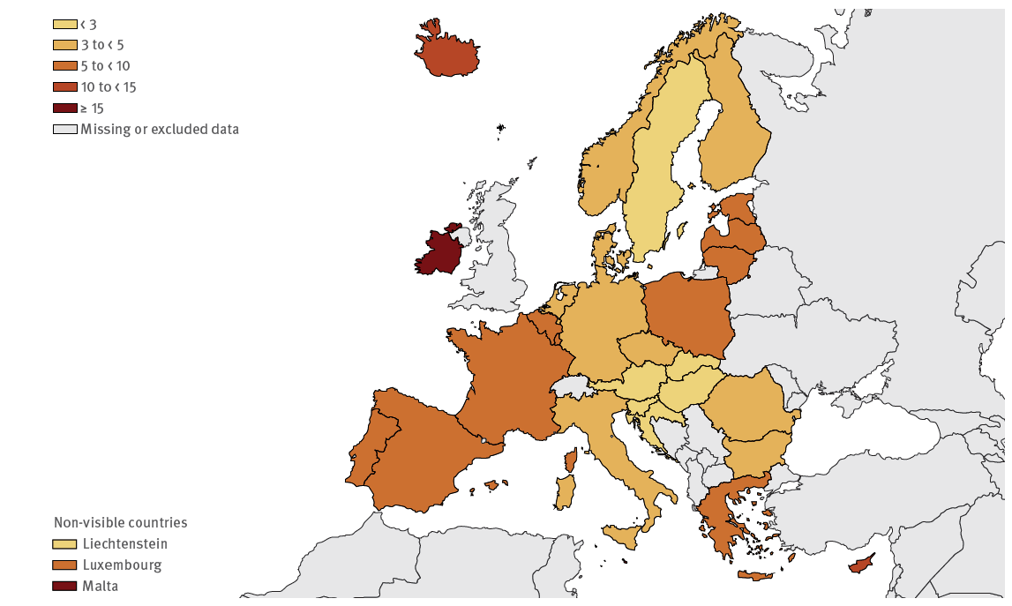
HIV diagnoses per 100 000 population EU/EEA, 2024
Rate: 5.3 per 100 000 (EU/EEA)
Source: ECDC/WHO (2025). HIV/AIDS Surveillance in Europe 2025–2024 data. https://www.ecdc.europa.eu/en/publications-data/hivaids-surveillance-europe-2025-2024-data

Slide 4
Estimated HIV infections and reported new HIV diagnoses in the EU/EEA, 2015 – 2024
The number of diagnoses reported is higher than the number of estimated infections, suggesting improved detection.
There is a decreasing trend in the number of estimated infections which could indicate control of HIV transmission.
Source: ECDC/WHO (2025). HIV/AIDS Surveillance in Europe 2025–2024 data. https://www.ecdc.europa.eu/en/publications-data/hivaids-surveillance-europe-2025-2024-data

Slide 5
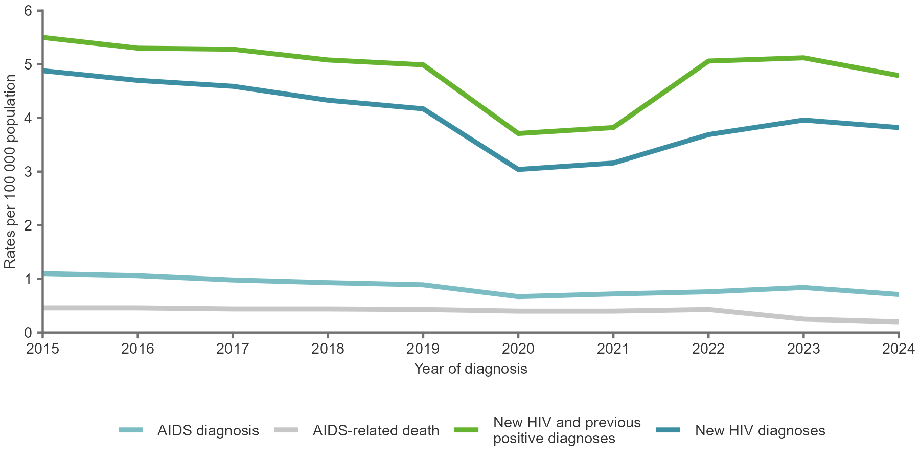
HIV diagnoses per 100 000 population EU/EEA, 2015 – 2024
In 2024, 24 164 HIV diagnoses were reported in 30 EU/EEA countries, a rate of 5.3 per 100 000—a 14.5% decline since 2015.
When excluding previously positive known diagnoses and analysing data from 20 countries, the 2024 rate was 3.8 per 100 000, representing a 22.4% decrease compared with 2015 (4.9 per 100 000).
Note: This figure includes data on HIV cases reported between 2015 and 2024 from the following EU/EEA countries: Austria, Belgium, Croatia, Cyprus, Czechia, Denmark, Estonia, France, Germany, Greece, Iceland, Ireland, Italy, Latvia, Liechtenstein, Luxembourg, Malta, Netherlands, Norway, Portugal, Slovakia, Slovenia, Sweden. Data from Bulgaria, Finland, Hungary, Lithuania, Poland, Romania and Spain were excluded as more than 50% of the HIV status variable data were classified as unknown. AIDS and deaths rates were not impacted by previous positive known diagnoses, and these rates are not adjusted.
Previous positive diagnoses are defined as an HIV diagnosis made either abroad or in another setting within the reporting country on any occasion before the current year of reporting. Some countries report previous positive HIV cases as they enter, re-enter or re-engage with the care system in the reporting country. The variable identifying the HIV status as a previous positive or first-time diagnosis had a completeness of 66.2 %.
Source: ECDC/WHO (2025). HIV/AIDS Surveillance in Europe 2025–2024 data. https://www.ecdc.europa.eu/en/publications-data/hivaids-surveillance-europe-2025-2024-data

Slide 6
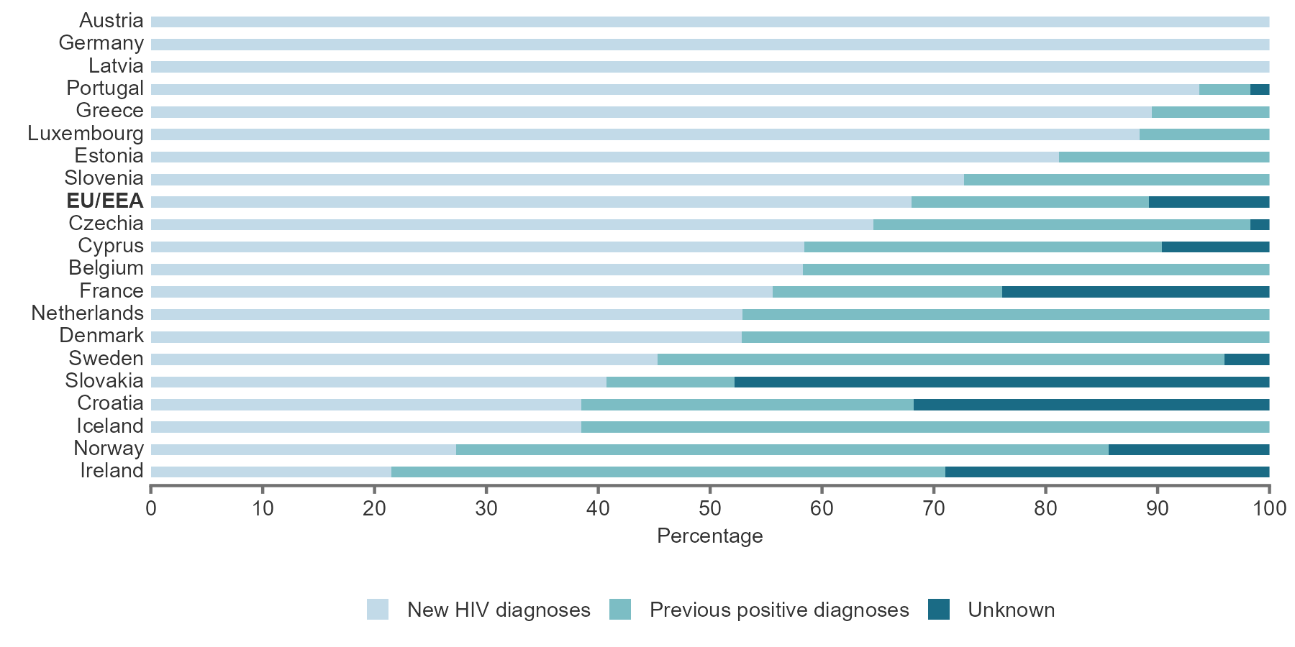
Previously positive known diagnoses and new HIV diagnoses by country of report, EU/EEA, 2024 (n=14 745)
In countries reporting information about HIV status (new diagnoses vs. previously positive known diagnoses), 21.2% were previous positive diagnoses
Note: Countries with more than 50% unknown for the variable identifying the HIV status as a previous positive or first-time diagnosis are excluded from the figure.
Source: ECDC/WHO (2025). HIV/AIDS Surveillance in Europe 2025–2024 data. https://www.ecdc.europa.eu/en/publications-data/hivaids-surveillance-europe-2025-2024-data

Slide 7
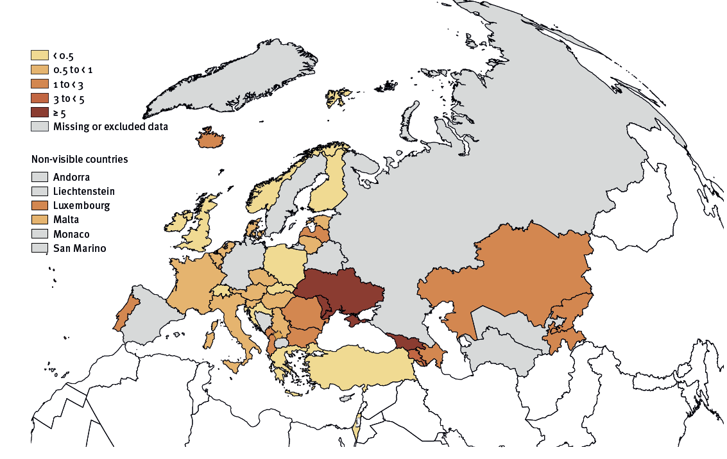
AIDS diagnoses EU/EEA and WHO European Region, 2024
Rate: 0.7 per 100 000 (EU/EEA)
Source: ECDC/WHO (2025). HIV/AIDS Surveillance in Europe 2025–2024 data. https://www.ecdc.europa.eu/en/publications-data/hivaids-surveillance-europe-2025-2024-data

Slide 8
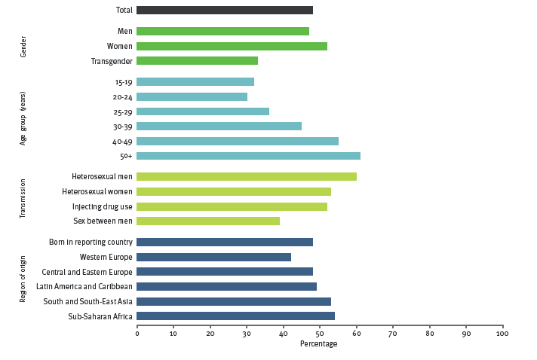
Late HIV diagnosis remains a challenge
Among those diagnosed in 2024 in the EU/EEA, 48% were diagnosed late.
Late diagnosis highest in people over age 50, in those who likely acquired HIV through heterosexual transmission, and those originating from South and Southeast Asia and Sub-Saharan Africa
Note: This figure excludes cases with an unknown CD4 cell count per mm³, people with acute infection, those classified as previous positives cases, children younger than 15 years old and cases reported by countries that did not report CD4 cell counts per mm³.
Source: ECDC/WHO (2025). HIV/AIDS Surveillance in Europe 2025–2024 data. https://www.ecdc.europa.eu/en/publications-data/hivaids-surveillance-europe-2025-2024-data

Slide 9
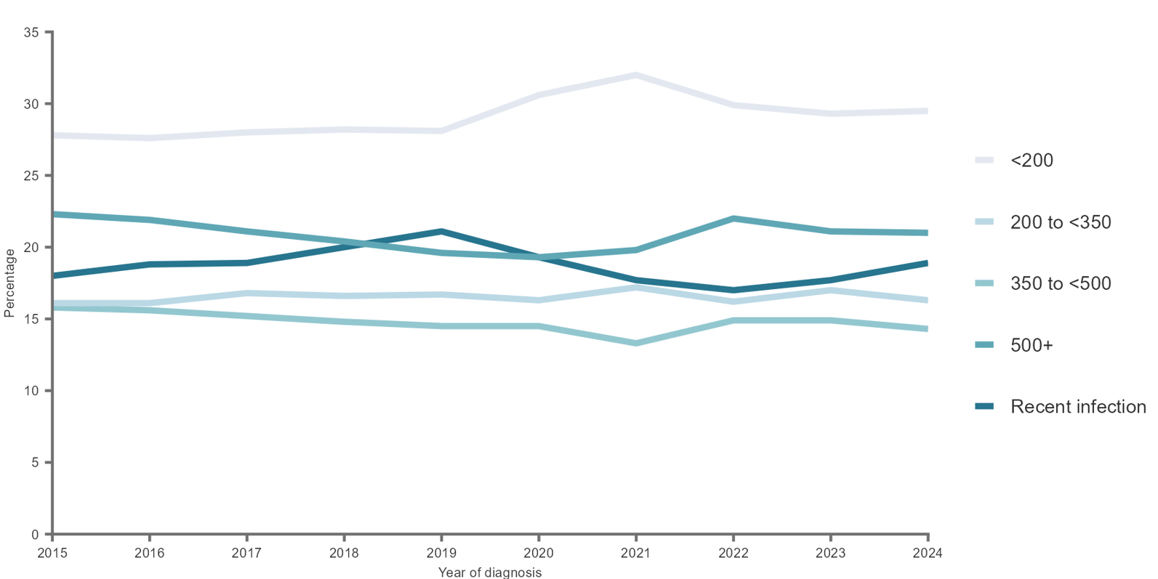
Recent infection or CD4 count at diagnosis, EU/EEA, 2015 - 2024
The proportion of newly diagnosed cases with recent infection has risen since 2022; however, it had been higher in 2019
Note: Bulgaria, Finland, Hungary, Lithuania, Poland, Romania and Spain were excluded from this figure as more than 50% of their cases had unknown values in the HIV status variables. Additionally, previously positive cases were excluded from the countries included in the figure, along with children under 15 years old. Only individuals with CD4 cell count per mm³ recorded at the time of diagnosis were included.
Source: ECDC/WHO (2025). HIV/AIDS Surveillance in Europe 2025–2024 data. https://www.ecdc.europa.eu/en/publications-data/hivaids-surveillance-europe-2025-2024-data

Slide 10
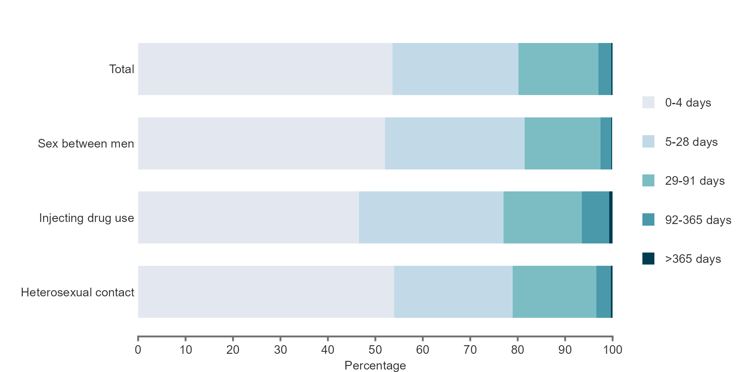
Linkage to care following HIV diagnosis, EU/EEA, 2024
53.6% linked to care within 4 days after diagnosis 97.0% linked within 3 months
Note: Cases with no data or missing data on CD4 cell count or date of diagnosis, previous positive cases and those who died within 91 days of diagnosis are excluded from this figure.
Source: ECDC/WHO (2025). HIV/AIDS Surveillance in Europe 2025–2024 data. https://www.ecdc.europa.eu/en/publications-data/hivaids-surveillance-europe-2025-2024-data

Slide 11
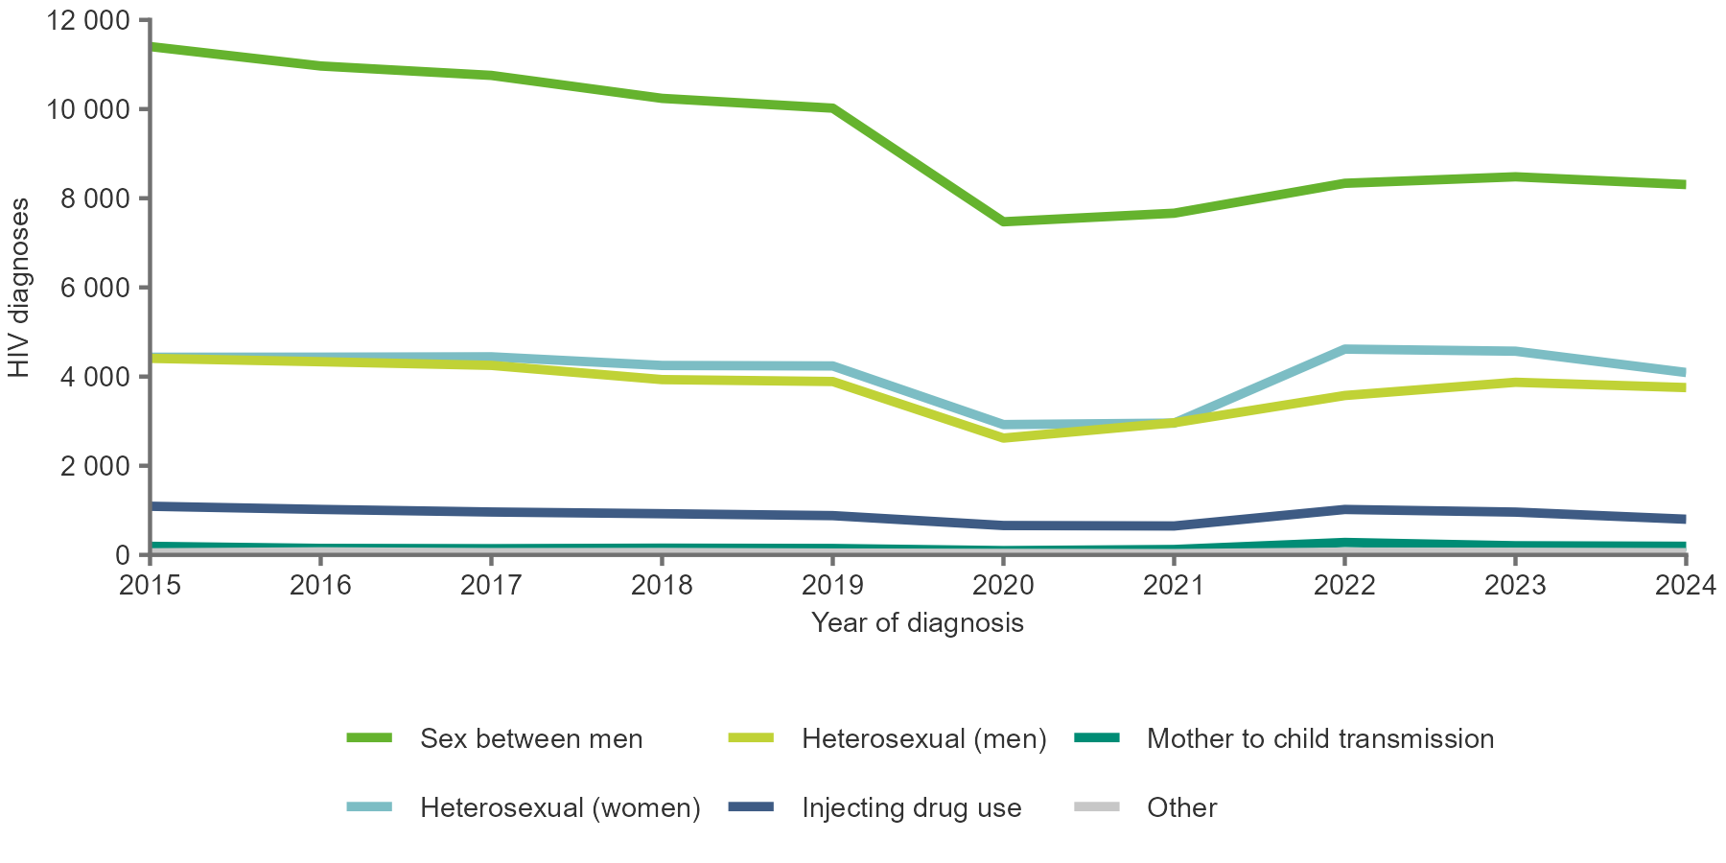
HIV diagnoses, by transmission mode EU/EEA, 2015 - 2024
The HIV epidemic is predominantly driven by sexual transmission, accounting for 94% of diagnoses where route of transmission is known
Note: Diagnoses reported by Estonia, Latvia, Poland were excluded due to incomplete reporting on transmission mode during a portion of the previous decade.
Source: ECDC/WHO (2025). HIV/AIDS Surveillance in Europe 2025–2024 data. https://www.ecdc.europa.eu/en/publications-data/hivaids-surveillance-europe-2025-2024-data

Slide 12
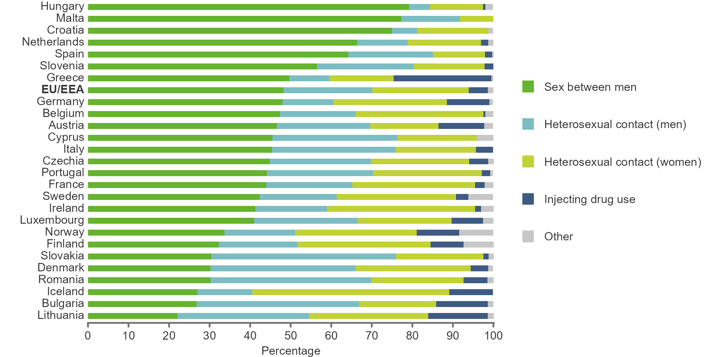
Heterosexual transmission is becoming a key mode of HIV transmission in the EU/EEA, 2024
Among diagnoses with known mode of transmission:
Sex between men accounts for 48.3% and exceeds 50% in six countries
Heterosexual transmission accounts for 45.7% and exceeds 50% in 13 countries
Injecting drug use accounts for 4.7%
Source: ECDC/WHO (2025). HIV/AIDS Surveillance in Europe 2025–2024 data. https://www.ecdc.europa.eu/en/publications-data/hivaids-surveillance-europe-2025-2024-data

Slide 13
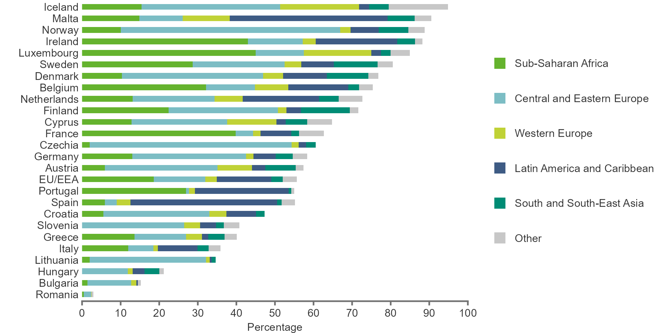
Increasingly diverse region of origin among those diagnosed with HIV in the EU/EEA, 2024
32.2% Sub-Saharan Africa
26.4% Central and Eastern Europe
24.4% Latin America and the Caribbean
5.3% South and South-East Asia
5.2% Western Europe
6.5% Other regions
55.7% of those with known origin information were migrants
Source: ECDC/WHO (2025). HIV/AIDS Surveillance in Europe 2025–2024 data. https://www.ecdc.europa.eu/en/publications-data/hivaids-surveillance-europe-2025-2024-data

