Slide 1
HIV/AIDS Surveillance 2018 2017 data
European Centre for Disease Prevention and Control
WHO Regional Office for Europe

Slide 2
European Union/ European Economic Area (EU/EEA)

Slide 3
New HIV diagnoses in the EU/EEA
2017
Reporting countries/number of countries* | 30/31
Number of HIV diagnoses | 25 353
Rate per 100 000 population (adjusted for reporting delay) | 6.2
Male-to-female ratio | 3.1
Percentage of new diagnoses CD4<350 cells/mm³ | 49%
Transmission mode (%)
Sex between men | 38
Heterosexual transmission (men) | 17
Heterosexual transmission (women) | 16
Injecting drug use | 4
Vertical transmission | <1
Unknown | 24
* Due to technical issues no 2017 data were received from Germany
Source: ECDC/WHO (2018). HIV/AIDS Surveillance in Europe 2018– 2017 data

Slide 4
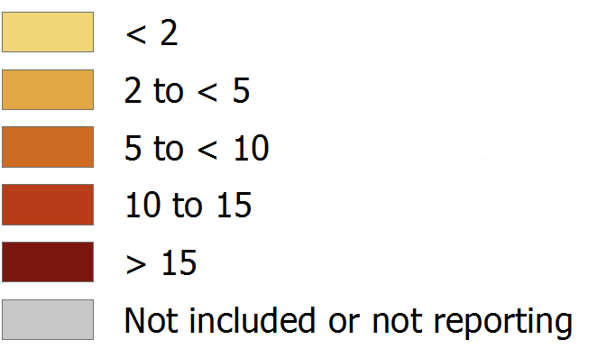
New HIV diagnoses, 2017, EU/EEA
Rate per 100 000 population
EU/EEA rate: 6.2 per 100 000
adjusted for reporting delay
Non-visible countries
Source: ECDC/WHO (2018). HIV/AIDS Surveillance in Europe 2018– 2017 data

Slide 5
New HIV diagnoses in men, 2017, EU/EEA
Rate per 100 000 male population
EU/EEA rate: 9.0 per 100 000
Non-visible countries
Source: ECDC/WHO (2018). HIV/AIDS Surveillance in Europe 2018– 2017 data

Slide 6
New HIV diagnoses in women, 2017, EU/EEA
Rate per 100 000 female population
EU/EEA rate: 2.8 per 100 000
Non-visible countries
Source: ECDC/WHO (2018). HIV/AIDS Surveillance in Europe 2018– 2017 data

Slide 7
New HIV diagnoses attributed to sex between men, 2017, EU/EEA
Rate per 100 000 male population
Non-visible countries
Source: ECDC/WHO (2018). HIV/AIDS Surveillance in Europe 2018– 2017 data

Slide 8
New HIV diagnoses attributed to heterosexual transmission, 2017, EU/EEA
Rate per 100 000 population
Non-visible countries
Source: ECDC/WHO (2018). HIV/AIDS Surveillance in Europe 2018– 2017 data

Slide 9
New HIV diagnoses attributed to injecting drug use, 2017, EU/EEA
Rate per 100 000 population
Non-visible countries
Source: ECDC/WHO (2018). HIV/AIDS Surveillance in Europe 2018– 2017 data

Slide 10
AIDS diagnoses, 2017, EU/EEA
Rate per 100 000 population
EU/EEA rate: 0.7 per 100 000
Non-visible countries
Source: ECDC/WHO (2018). HIV/AIDS Surveillance in Europe 2018– 2017 data

Slide 11
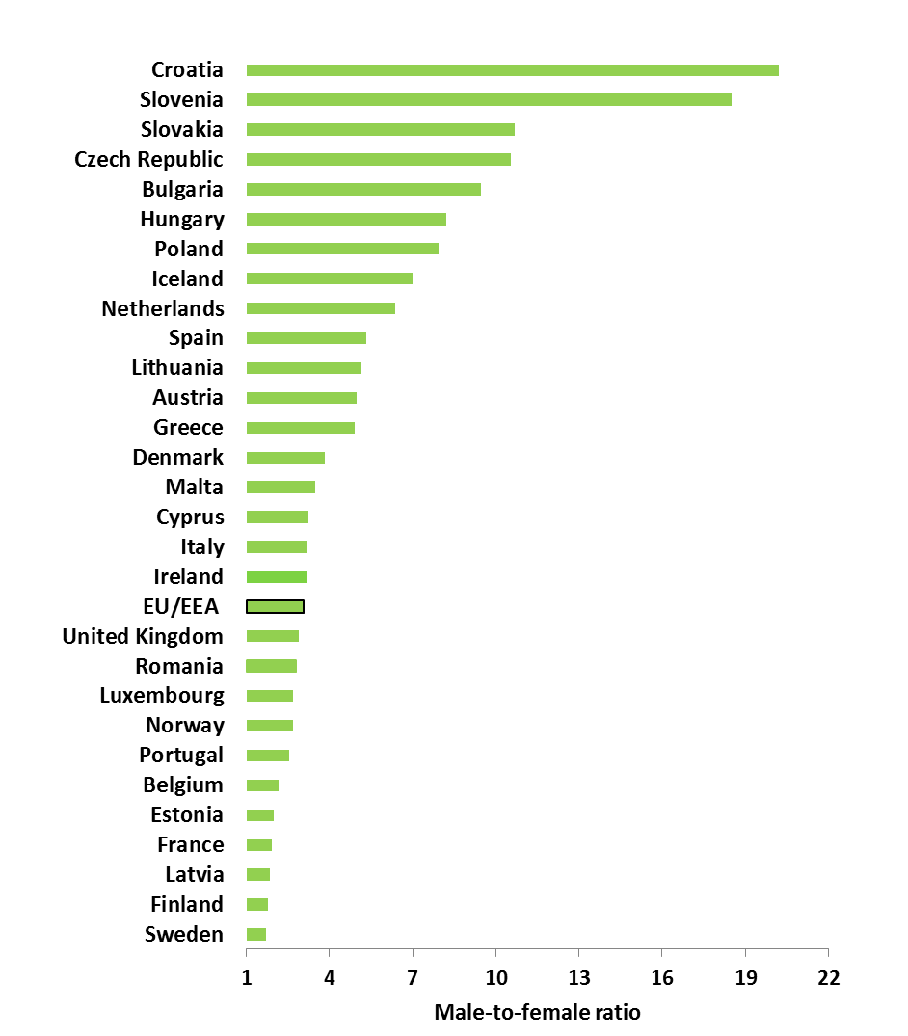
Male-to-female ratio in new HIV diagnoses, by country, EU/EEA, 2017
EU/EEA male-to-female ratio: 3.1
Source: ECDC/WHO (2018). HIV/AIDS Surveillance in Europe 2018– 2017 data

Slide 12
Age- and gender-specific rates of HIV diagnoses per 100 000 population, EU/EEA, 2017
Women
Men
Source: ECDC/WHO (2018). HIV/AIDS Surveillance in Europe 2018– 2017 data

Slide 13
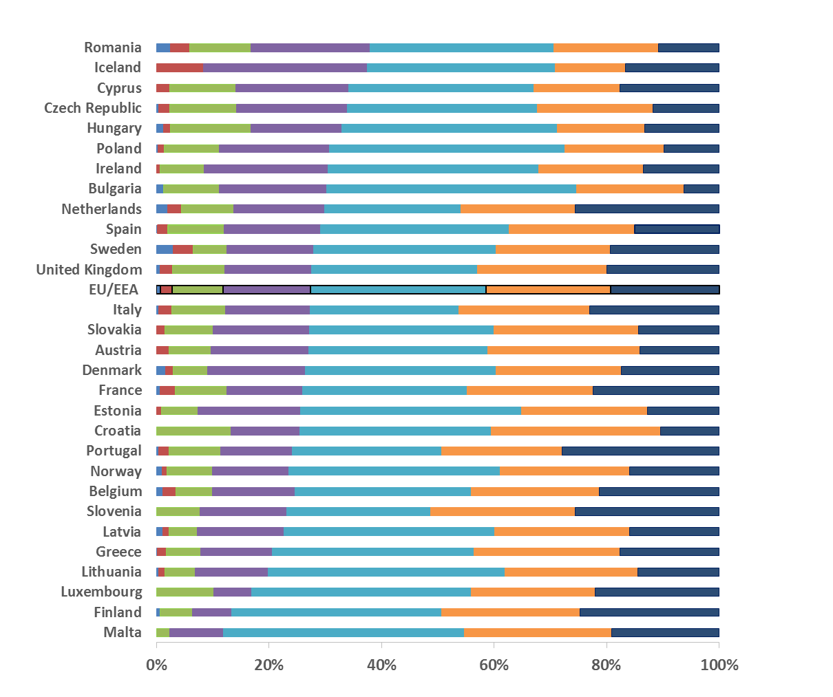
Percentage of new HIV diagnoses, by country and age group, EU/EEA, 2017
<15 years
15-19 years
20-24 years
25-29 years
30-39 years
40-49 years
50+ years
Note: Germany did not report data for 2017, 0 cases were reported by Liechtenstein
Source: ECDC/WHO (2018). HIV/AIDS Surveillance in Europe 2018– 2017 data

Slide 14
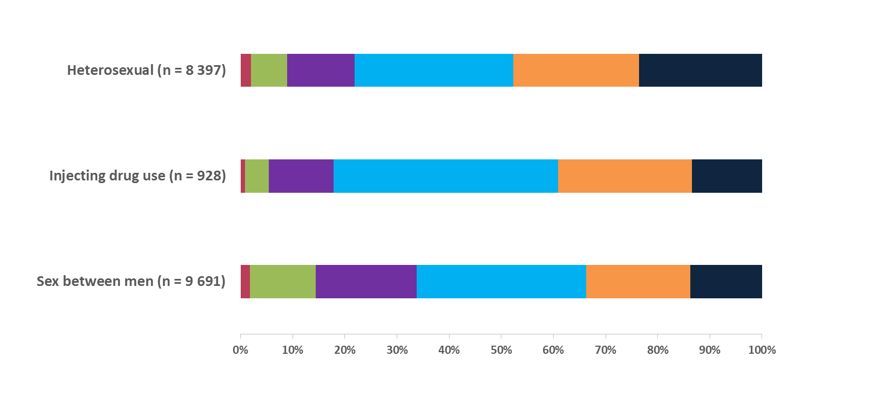
New HIV diagnoses, by transmission mode and age group, EU/EEA, 2017
15-19 years
20-24 years
25-29 years
30-39 years
40-49 years
50+ years
Source: ECDC/WHO (2018). HIV/AIDS Surveillance in Europe 2018– 2017 data

Slide 15
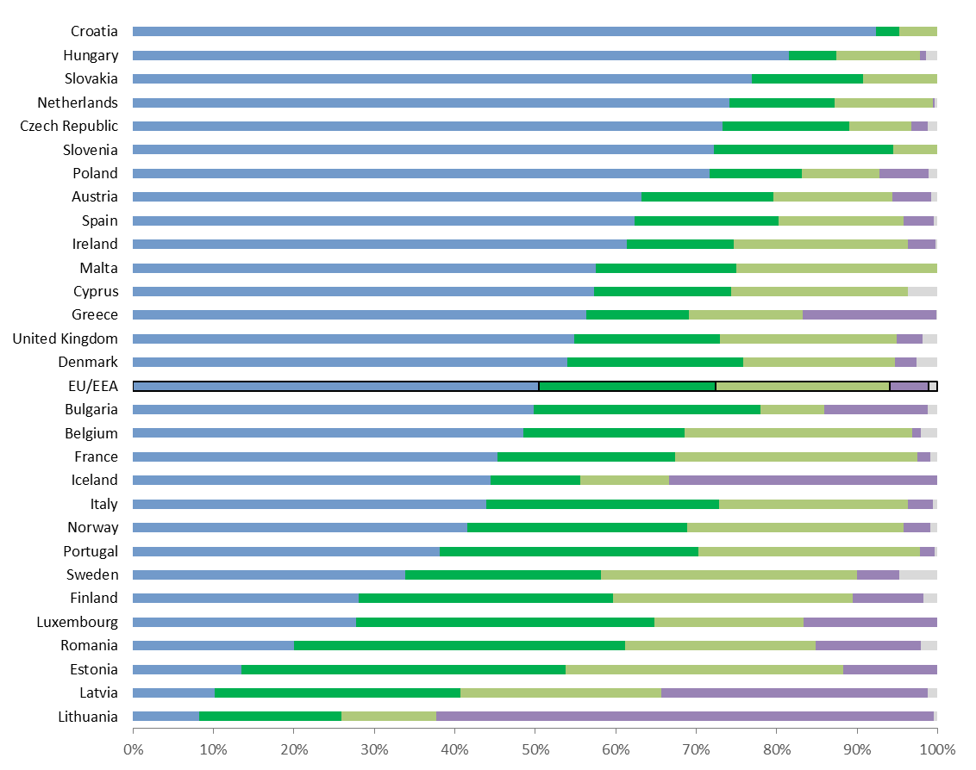
Proportion of new HIV diagnoses, by country and transmission, EU/EEA, 2017
Sex between men
Heterosexual contact (males)
Heterosexual contact (females)
Injecting
drug use
Other/
undetermined
Note: Germany did not report data for 2017, 0 cases were reported by Liechtenstein
Source: ECDC/WHO (2018). HIV/AIDS Surveillance in Europe 2018– 2017 data

Slide 16
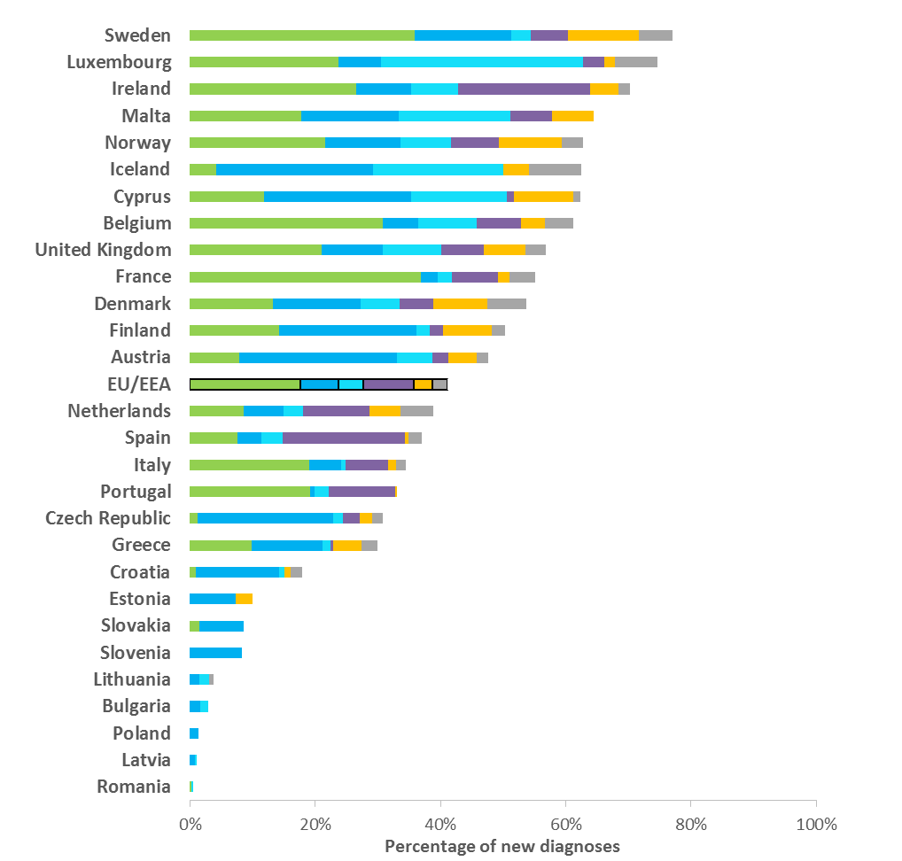
Proportion HIV diagnoses in migrants* by country of report and region of origin, EU/EEA 2017
Sub-Saharan Africa
Central and Eastern Europe
Western Europe
Latin American and Caribbean
South and Southeast Asia
Other
* Migrants include all persons born outside of the country in which the diagnosis was made.
EU/EEA: 41% diagnosed in 2017 were born abroad
Data include only cases with known region of origin;
No data were reported by Germany in 2017 and zero cases were reported among migrants in Hungary or Liechtenstein
Source: ECDC/WHO (2018). HIV/AIDS Surveillance in Europe 2018– 2017 data

Slide 17
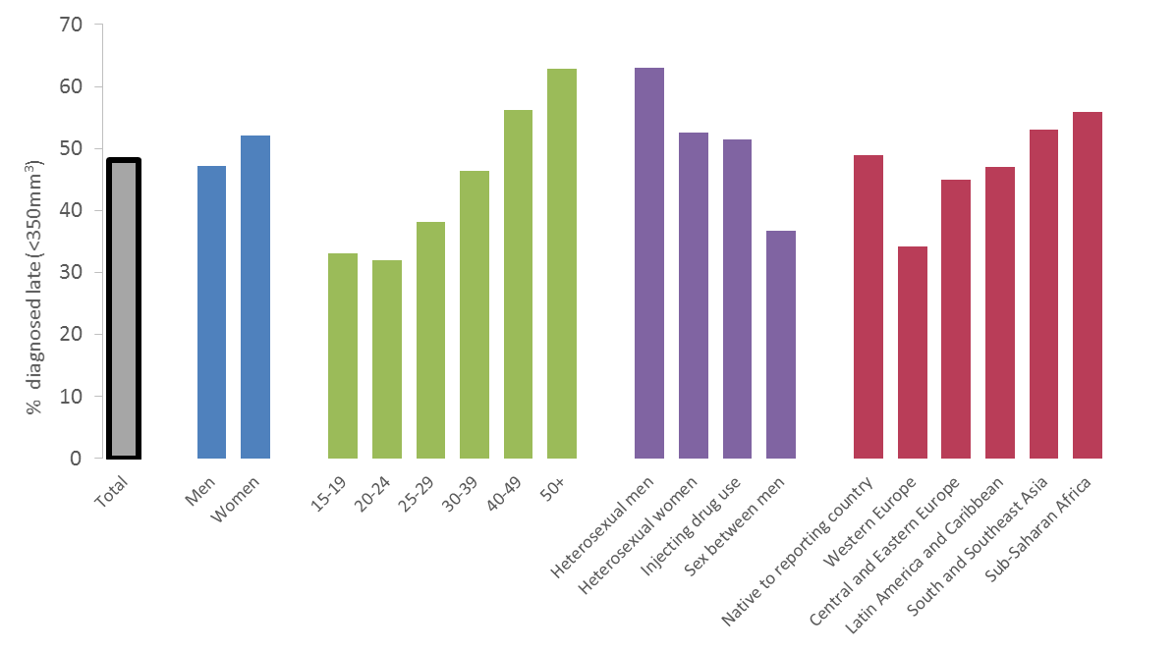
Proportion of persons diagnosed late* with HIV by demographic, EU/EEA, 2017
Gender
Age group (years)
Transmission
Region of origin
*Diagnosed late=CD4<350 cells/mm³ at diagnosis
Source: ECDC/WHO (2018). HIV/AIDS Surveillance in Europe 2018– 2017 data

Slide 18
Proportion of HIV cases diagnosed late, 2017, EU/EEA
% persons with CD4
<350 cells/mm³ at HIV diagnosis
EU/EEA average: 49%
Non-visible countries
Source: ECDC/WHO (2018). HIV/AIDS Surveillance in Europe 2018– 2017 data

Slide 19
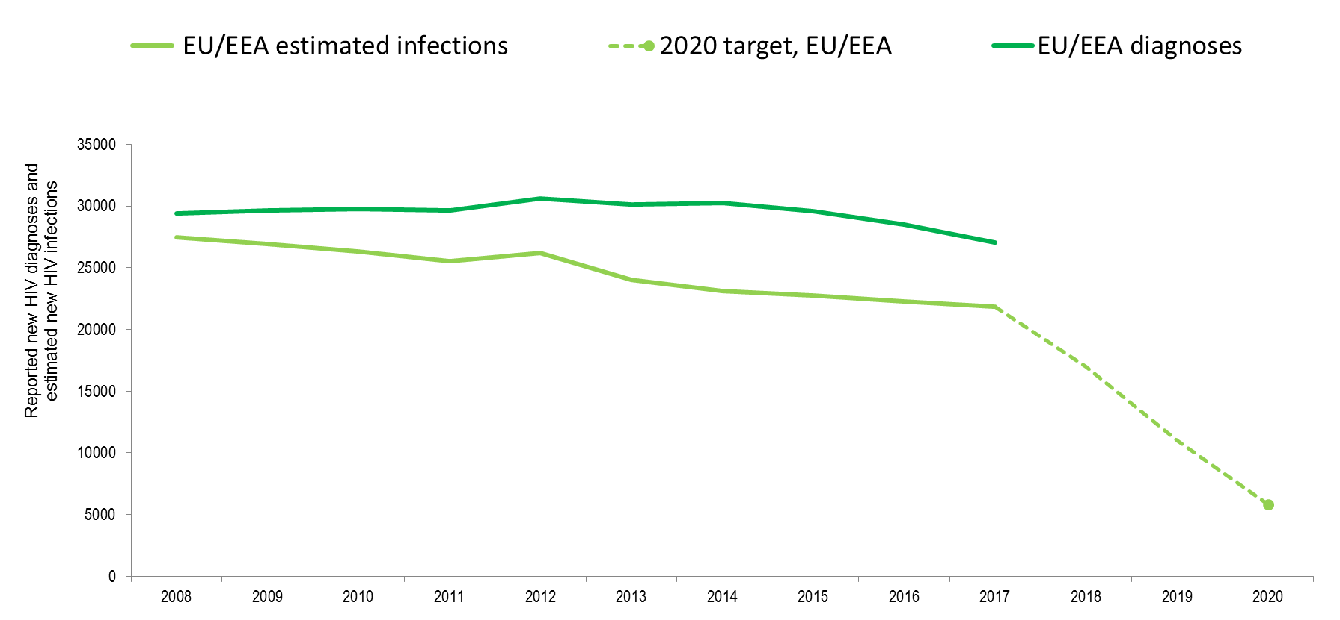
New reported HIV diagnosis and estimated infections, EU/EEA, 2008-2017
Source: Estimates from UNAIDS, 2018; ECDC/WHO (2018). HIV/AIDS Surveillance in Europe 2018– 2017 data

Slide 20
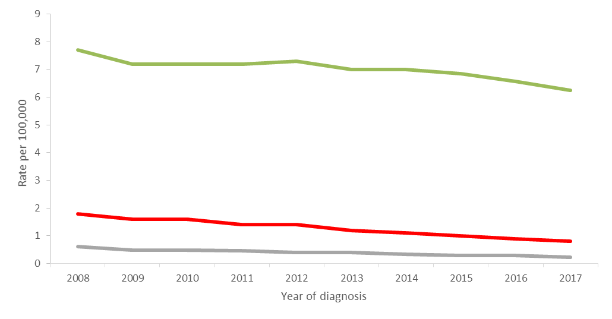
HIV diagnoses, AIDS diagnoses and AIDS-related deaths per 100 000 population, EU-EEA, 2008-2017
HIV
AIDS
AIDS-related deaths
Note: HIV rate is adjusted for reporting delay. Deaths rate exclude countries not reporting deaths consistently over the period (Belgium, Germany, Italy, Sweden)
Source: ECDC/WHO (2018). HIV/AIDS Surveillance in Europe 2018– 2017 data

Slide 21
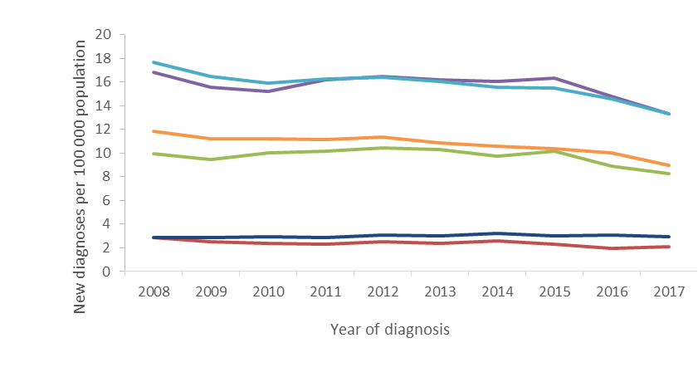
New HIV diagnoses, by age group, EU-EEA, 2008-2017
15-19 years
20-24 years
25-29 years
30-39 years
40-49 years
50+ years
Source: ECDC/WHO (2018). HIV/AIDS Surveillance in Europe 2018– 2017 data

Slide 22
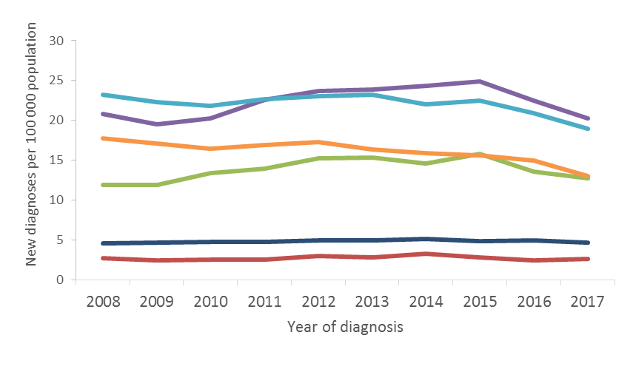
New HIV diagnoses in men, by age group, EU-EEA, 2008-2017
15-19 years
20-24 years
25-29 years
30-39 years
40-49 years
50+ years
Source: ECDC/WHO (2018). HIV/AIDS Surveillance in Europe 2018– 2017 data

Slide 23
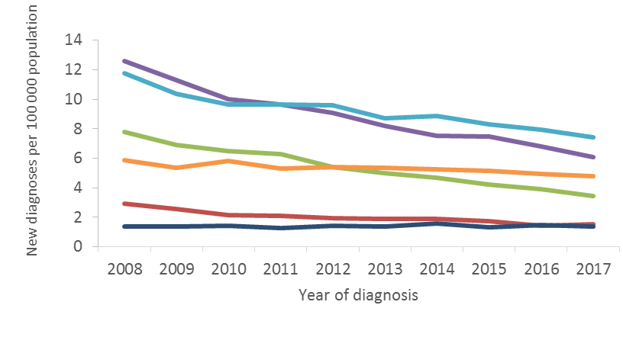
New HIV diagnoses in women, by age group, EU-EEA, 2008-2017
15-19 years
20-24 years
25-29 years
30-39 years
40-49 years
50+ years
Source: ECDC/WHO (2018). HIV/AIDS Surveillance in Europe 2018– 2017 data

Slide 24
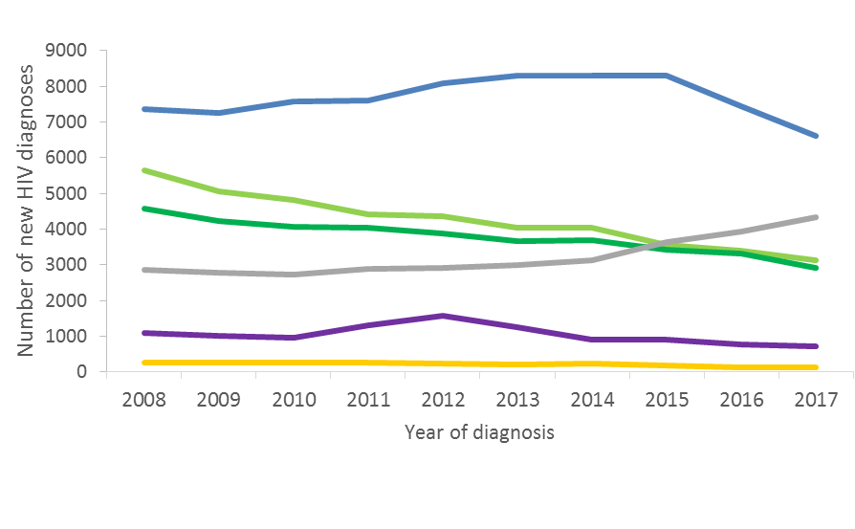
HIV diagnoses, by route of
transmission, 2008-2017, EU/EEA
Sex between men
Other/
undetermined
Heterosexual (women)
Heterosexual
(men)
Injecting drug use
Vertical transmission
Data are adjusted for reporting delay. HIV diagnoses reported by Estonia and Poland excluded due to incomplete reporting on transmission mode during some years of the period; diagnoses reported by Germany, Italy and Spain excluded due to incomplete reporting during a portion of the period.
Source: ECDC/WHO (2018). HIV/AIDS Surveillance in Europe 2018– 2017 data

Slide 25
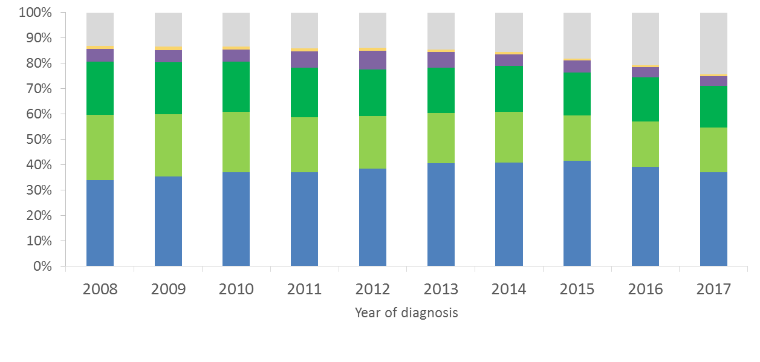
Proportion of HIV diagnoses,
by route of transmission,
2008-2017, EU/EEA
Other/
unknown
Vertical transmission
Injecting
drug use
Heterosexual
(men)
Heterosexual (women)
Sex between
men
Data are adjusted for reporting delay. HIV diagnoses reported by Estonia and Poland excluded due to incomplete reporting on transmission mode during some years of the period; diagnoses reported by Germany, Italy and Spain excluded due to incomplete reporting during a portion of the period.
Source: ECDC/WHO (2018). HIV/AIDS Surveillance in Europe 2018– 2017 data

Slide 26
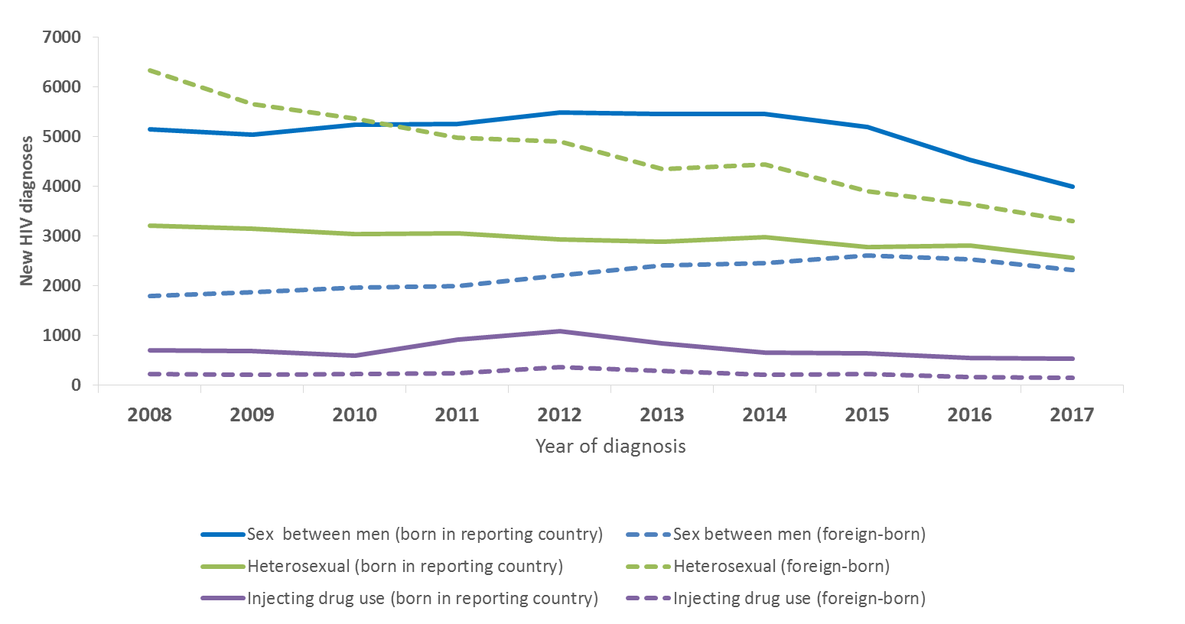
New HIV diagnoses, by year of diagnosis, transmission route and migration status, EU/EEA, 2008-2017
Data are adjusted for reporting delay. HIV diagnoses reported by Estonia and Poland excluded due to incomplete reporting on transmission mode during some years of the period; diagnoses reported by Germany, Italy and Spain excluded due to incomplete reporting during a portion of the period.
Source: ECDC/WHO (2018). HIV/AIDS Surveillance in Europe 2018– 2017 data

Slide 27
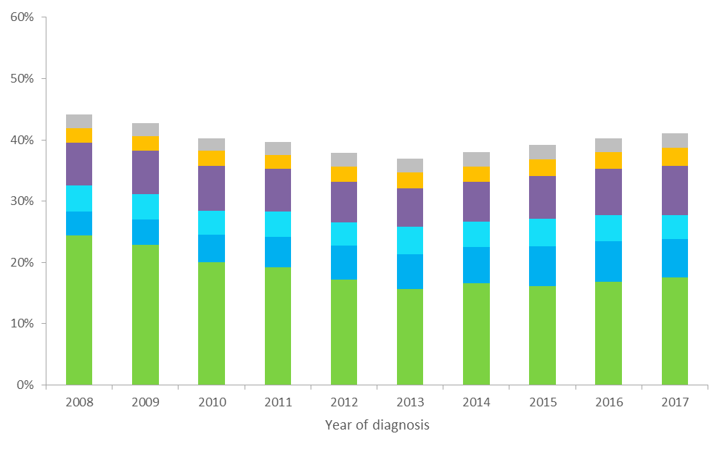
Proportion of HIV diagnoses in migrants, by region of origin,
2008-2017, EU/EEA
Other
South and Southeast Asia
Latin American and Caribbean
Western Europe
Central and Eastern Europe
Sub-Saharan Africa
* Migrants include all persons born outside of the reporting country
Data are adjusted for reporting delay. HIV diagnoses reported by Estonia and Poland excluded due to incomplete reporting on transmission mode during some years of the period; diagnoses reported by Germany, Italy and Spain excluded due to incomplete reporting during a portion of the period.
Source: ECDC/WHO (2018). HIV/AIDS Surveillance in Europe 2018– 2017 data

Slide 28
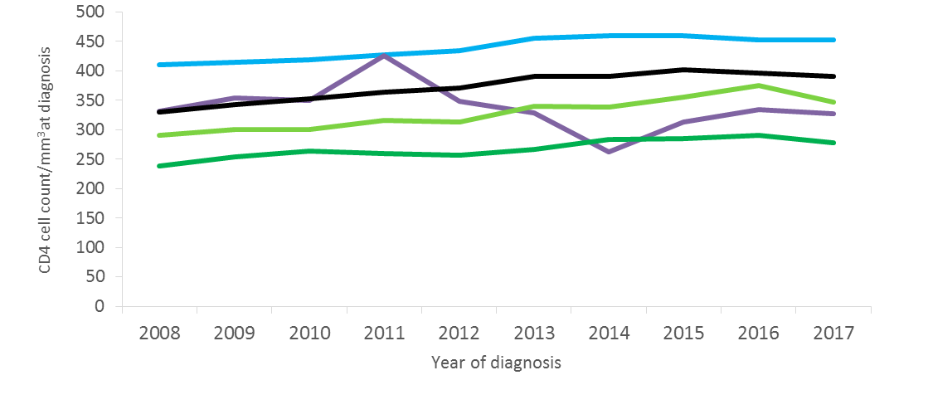
Median CD4 cell count per mm³ at HIV diagnosis, overall and by route of HIV transmission, EU/EEA, 2008-2017
Sex between men
All new diagnoses
Heterosexual (women)
Heterosexual
(men)
Injecting drug use
Note: Excludes countries with >60% incomplete data on CD4 cell count during any year over the period (Bulgaria, Croatia, Estonia, Germany, Hungary, Italy, Ireland, Latvia, Lithuania, Malta, Norway, Poland, Portugal, Sweden). Acute infections are excluded from this analysis.
Source: ECDC/WHO (2018). HIV/AIDS Surveillance in Europe 2018– 2017 data

Slide 29
Time to linkage to care after HIV diagnosis, by route of transmission, EU/EEA, 2017
Note: Data presented here exclude individuals who did not have a CD4 count reported after diagnosis
Source: ECDC/WHO (2018). HIV/AIDS Surveillance in Europe 2018– 2017 data

Slide 30
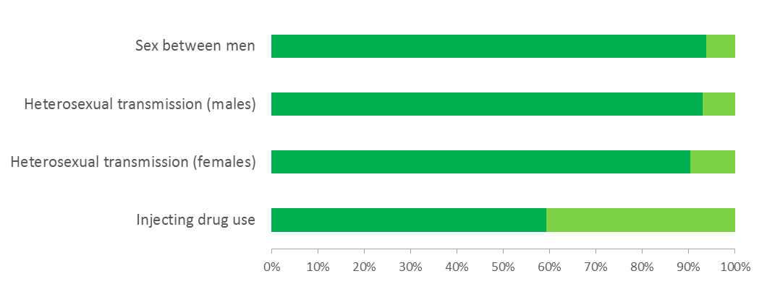
Proportion of AIDS diagnoses within 90 days of HIV diagnosis, by route of HIV transmission, EU/EEA, 2017
AIDS < 90 days of HIV diagnosis
AIDS > 90 days after HIV diagnosis
Source: ECDC/WHO (2018). HIV/AIDS Surveillance in Europe 2018– 2017 data

Slide 31
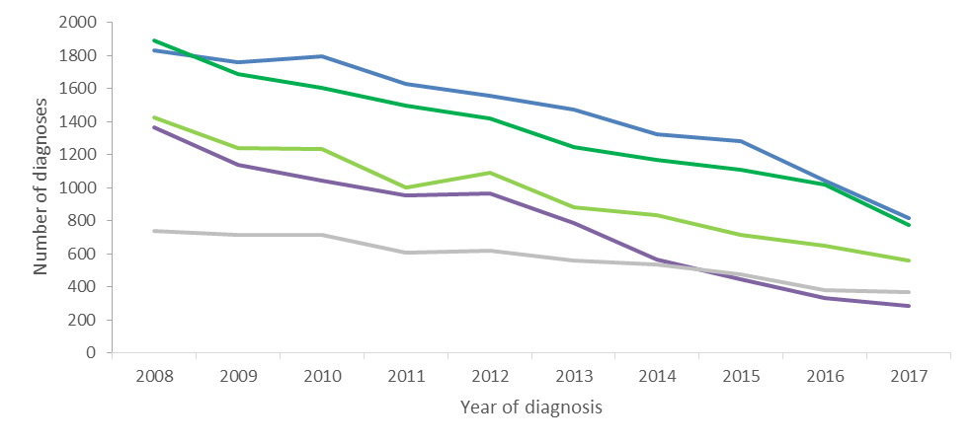
AIDS diagnoses, by route of HIV transmission, EU/EEA, 2008-2017
Sex between men
Heterosexual
(Men)
Heterosexual (women)
Other/
unknown
Injecting drug use
Note: Data from Germany, Belgium and Sweden excluded due to inconsistent reporting during the period
Source: ECDC/WHO (2018). HIV/AIDS Surveillance in Europe 2018– 2017 data

Slide 32
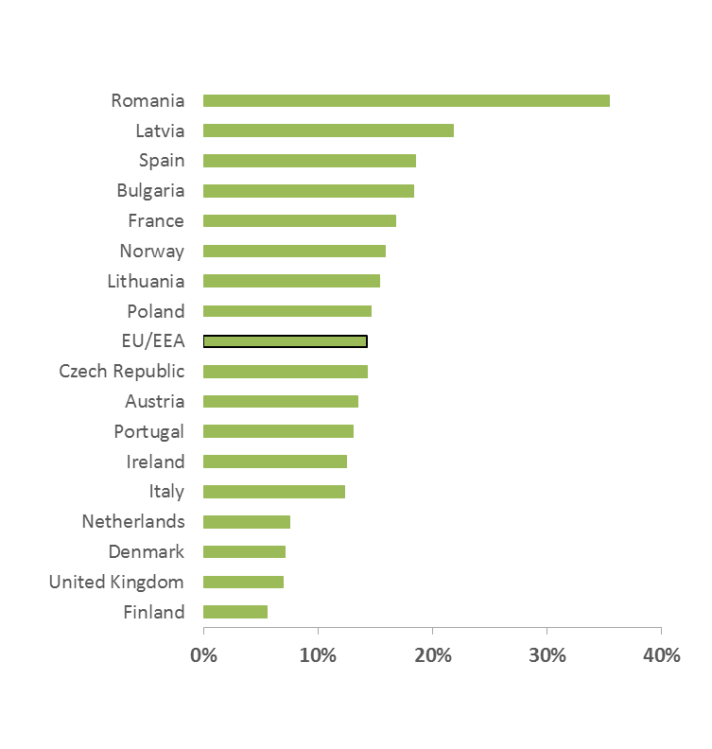
Proportion of persons diagnosed with AIDS with tuberculosis as an AIDS-defining illness, EU/EEA, 2017
EU/EEA average: 14%
Countries that did not report AIDS (Belgium, Germany and Sweden) or reported no cases of TB as an AIDS-defining illness (Croatia, Cyprus, Estonia, Greece, Hungary, Iceland, Ireland, Luxembourg, Norway, Slovakia, and Slovenia) are excluded
Source: ECDC/WHO (2018). HIV/AIDS Surveillance in Europe 2018– 2017 data

Slide 33
Conclusions: EU/EEA (1)
Although preventable through effective public health measures, significant HIV transmission continues in the EU/EEA
Key findings on HIV in EU/EEA countries
Sex between men accounted for the largest proportion of cases diagnosed (38%),
41% of new HIV diagnoses were among people originating from outside of the reporting country,
There is evidence of a decline in the rate of new HIV diagnoses in the EU/EEA as a whole.
Despite the overall decline, HIV rates continue to increase in one-third of EU/EEA countries.
Nearly half (49%) of people were diagnosed late, with a CD4 cell count of <350/mm³ at diagnosis.
Source: ECDC/WHO (2016). HIV/AIDS Surveillance in Europe, 2015

Slide 34
Conclusions: EU/EEA (2)
Evidence-based HIV prevention interventions tailored to the local epidemiological context and targeted at those most at risk should be sustained and scaled up.
Expansion of HIV testing and linkage to care will ensure early diagnosis and access to treatment; this will reduce the number of late presenters and improve treatment outcomes.
Programmes for men who have sex with men should be a cornerstone of HIV prevention in all EU/EEA countries
Given the high proportion of HIV cases among migrants in many EU/EEA countries, and evidence of post-migration HIV acquisition, migrant-sensitive prevention services are crucial
Adequate harm reduction levels will continue to prevent HIV among people who inject drugs
Source: ECDC/WHO (2016). HIV/AIDS Surveillance in Europe, 2015

Slide 35
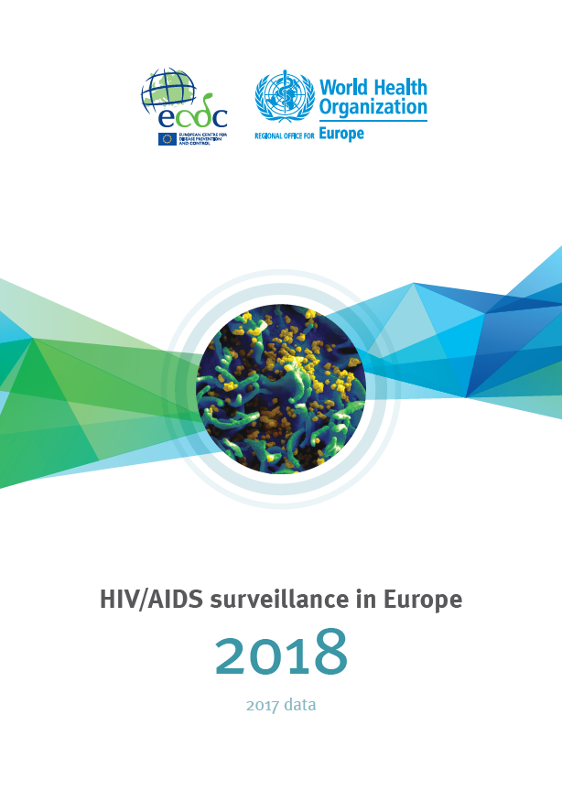
Full report is
available at
www.ecdc.europa.eu
and
http://bit.ly/HIVsur_18
Questions
STIHIVHEP@ecdc.europa.eu

