Slide 1
Tackling antimicrobial resistance – what is the current situation in Europe?
Dr Andrea Ammon, ECDC Director,
27 June 2017, European Parliament

Slide 2
Human mortality, United States, 1900−2000
1918 Influenza pandemic
1000
1924 Plague: last human-to-human transmission
800
600
1940 First use of penicillin
Deaths per 100,000 population/year
400
1955 Salk vaccine introduced
200
0
1900
1920
1940
1960
1980
2000
Adapted from: Aiello AE, Larson EL. Lancet Infect Dis 2002;2:103-10.

Slide 3


Modern medicine: not possible without effective antibiotics
Hip / knee replacement
Organ transplant
Cancer chemotherapy
Intensive care
Care of preterm babies

Slide 4
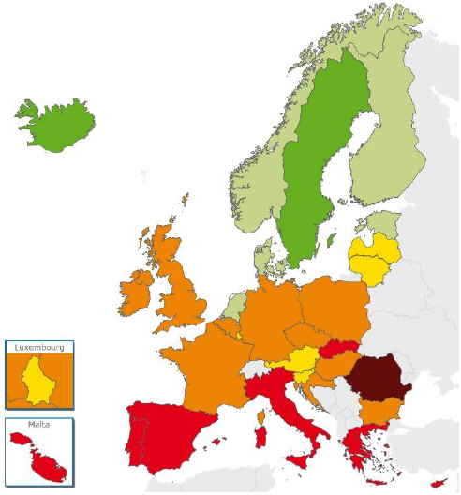
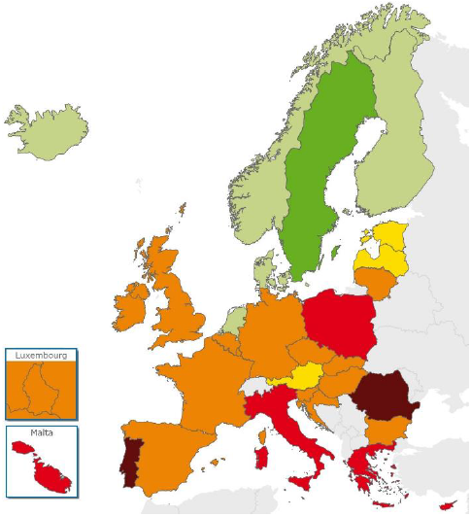
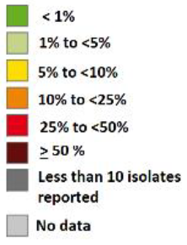
Staphylococcus aureus: % of invasive isolates with resistance to meticillin (MRSA), EU/EEA, 2012 & 2015
2012
2015
⬇
⬇
⬇
⬇
⬆
⬇
⬇
Source: EARS-Net, 2016.
The symbols ⬆ and ⬇ indicate a significant increasing or decreasing trend for the period 2012-2015, respectively. These trends were calculated on laboratories that consistently reported during this period.

Slide 5
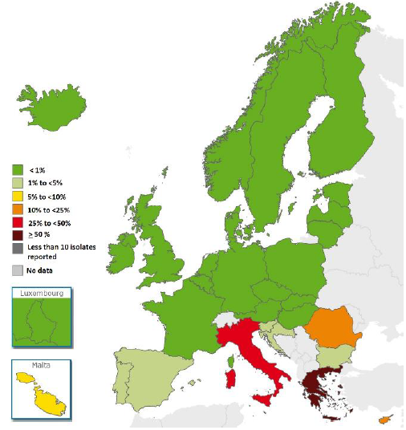
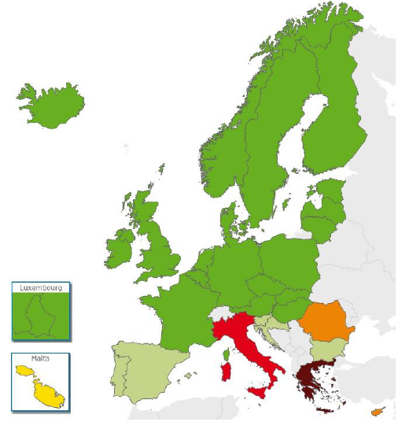
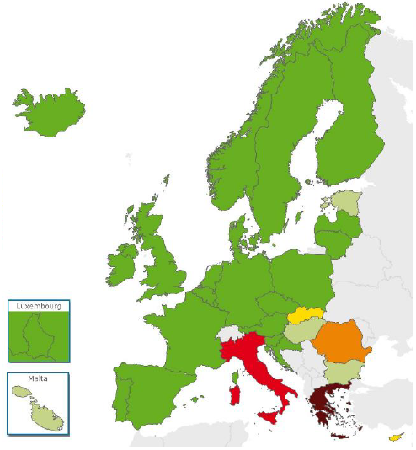
Klebsiella pneumoniae: % of invasive isolates with resistance to carbapenems, EU/EEA, 2012 & 2015
2012
2015
⬇
⬆
⬆
⬆
Source: EARS-Net, 2016.
The symbols ⬆ and ⬇ indicate a significant increasing or decreasing trend for the period 2012-2015, respectively. These trends were calculated on laboratories that consistently reported during this period.

Slide 6
Actions to control outbreaks in hospitals of carbapenem-resistant infections
Active surveillance
Screening of patients on admission and isolation
Staff specialised in infection control
By a separate, dedicated staff and equipment
Hygiene precautions
Enforced hand hygiene, contact precautions
Prudent antibiotic use
Restriction of certain antibiotics, e.g. carbapenems

Slide 7

International collaboration on AMR
Transatlantic Task Force on Antimicrobial Resistance (TATFAR)
e.g. Action 1.2: Review of antibiotic reduction goals in human medicine from TATFAR partner countries (jointly with US CDC, Public Health Agency of Canada, Norwegian Institute of Public Health)
WHO
Global Antimicrobial Resistance Surveillance System (GLASS)
WHO Global surveillance of antimcirobial consumption
World Antibiotic Awareness Week

Slide 8
A forward look
2nd Joint Interagency Antimicrobial Consumption and Resistance Analysis (JIACRA) report, jointly with EFSA and EMA (will be delivered to the Commission on 30 June 2017)
Annual update on AMR and antimicrobial consumption in humans in the EU/EEA (November 2017)
ECDC point prevalence surveys of HAIs, AMR and antimicrobial use in European acute care hospitals and in long-term care facilities, 2016-2017 (ECDC publications, November 2018)

Slide 9
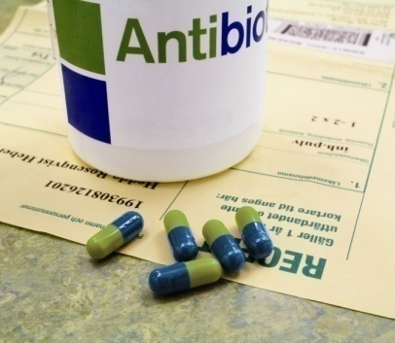
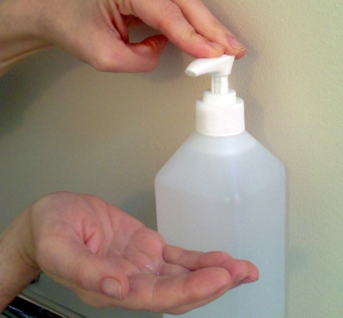
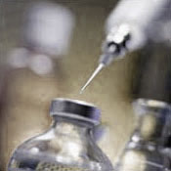
Main actions to prevent and control antimicrobial resistance (AMR)
Prudent use of antimicrobial agents (only when needed, correct dose, correct dose intervals, correct duration)
Infection prevention and control (hand hygiene, screening, isolation)
New antimicrobial agents (with a novel mechanism of action, research, development)

Slide 10

Humans + Animals = One Health
Prudent use of antibiotics. Everyone is responsible!

Slide 11
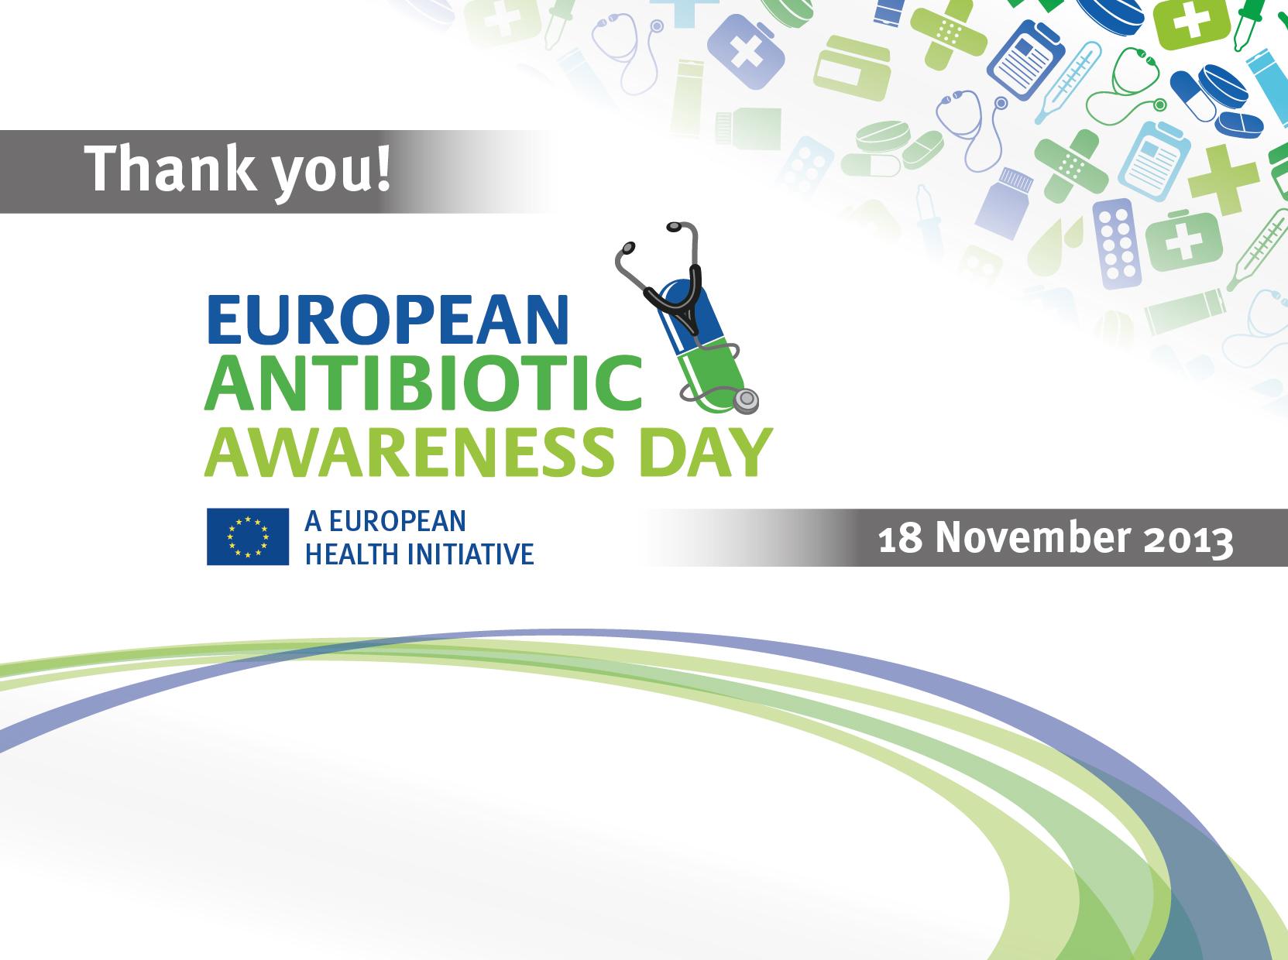

Annual event around 18 November

