Slide 1


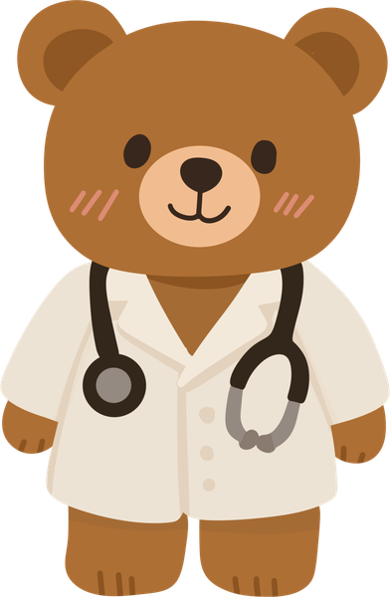
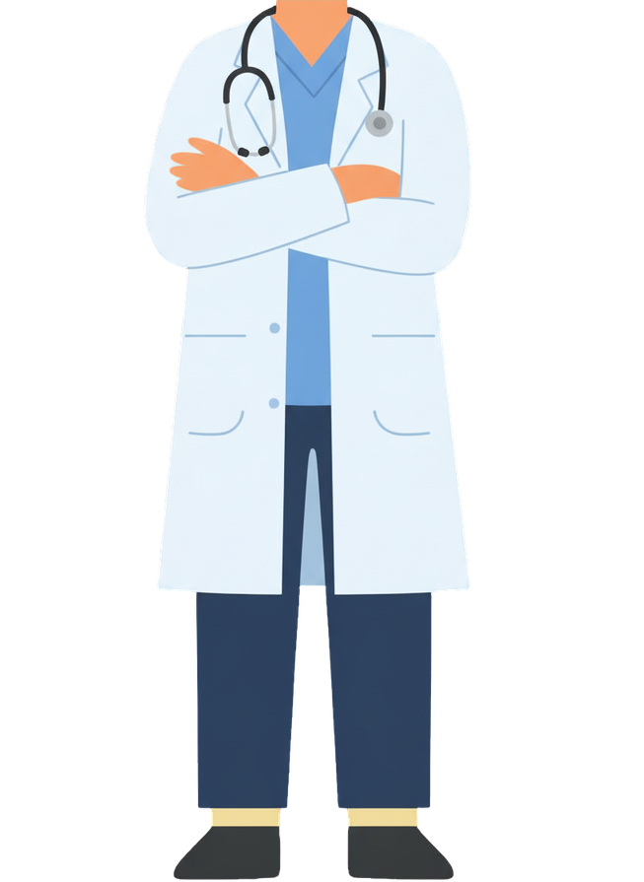

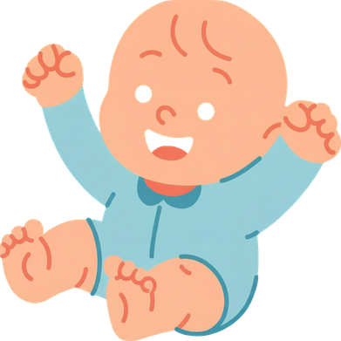
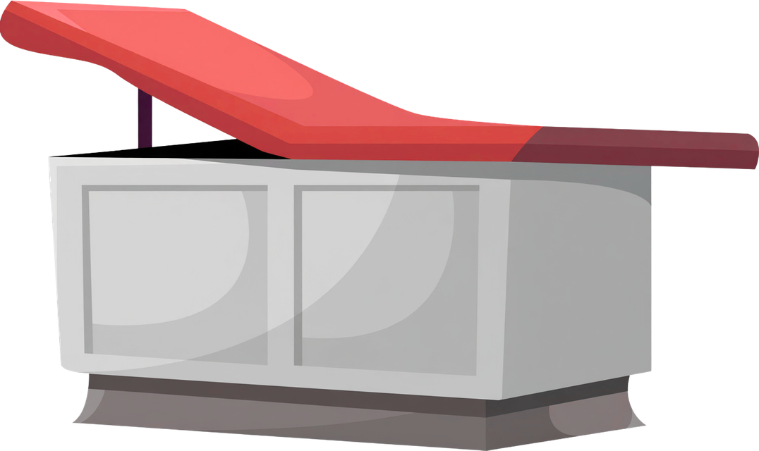

#EIW2026
vaccination-info.eu
FOR EVERY GENERATION, VACCINES WORK.
Vaccination Calendar
Did your child miss a vaccine dose?
Talk to your doctor or health provider about catching up as soon as possible.
Completing the recommended vaccination schedule helps give your child the best protection.

Slide 2



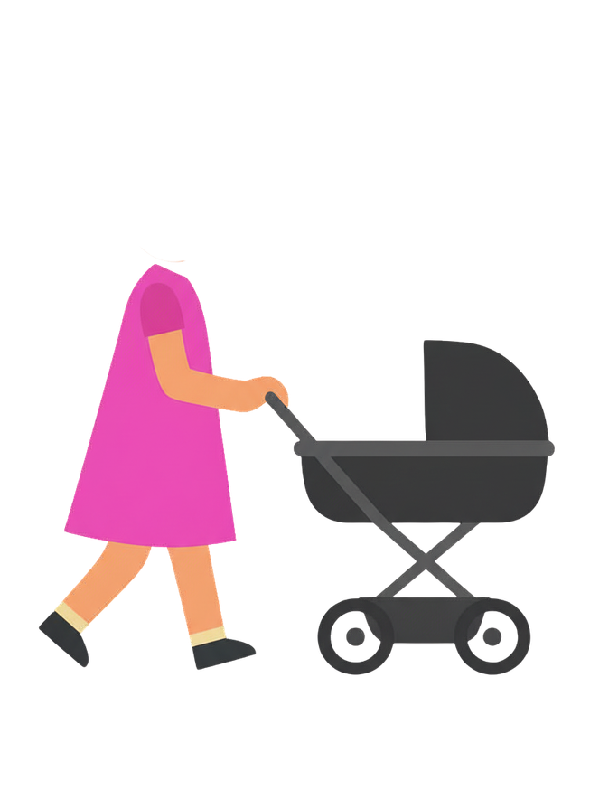

#EIW2026
vaccination-info.eu
FOR EVERY GENERATION, VACCINES WORK.
Measles can affect people of any age, but babies who are too young to be vaccinated are especially vulnerable.
On time vaccination helps protect your child, your family and those who cannot yet be vaccinated.

Slide 3
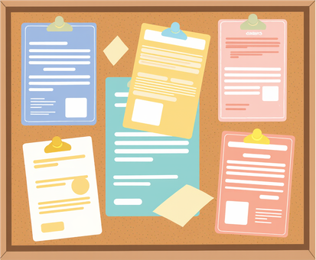

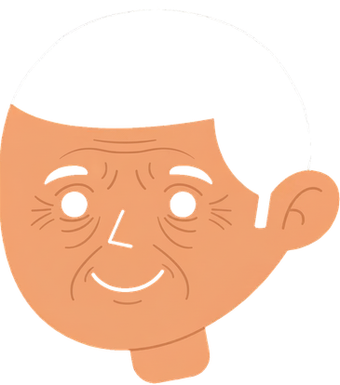
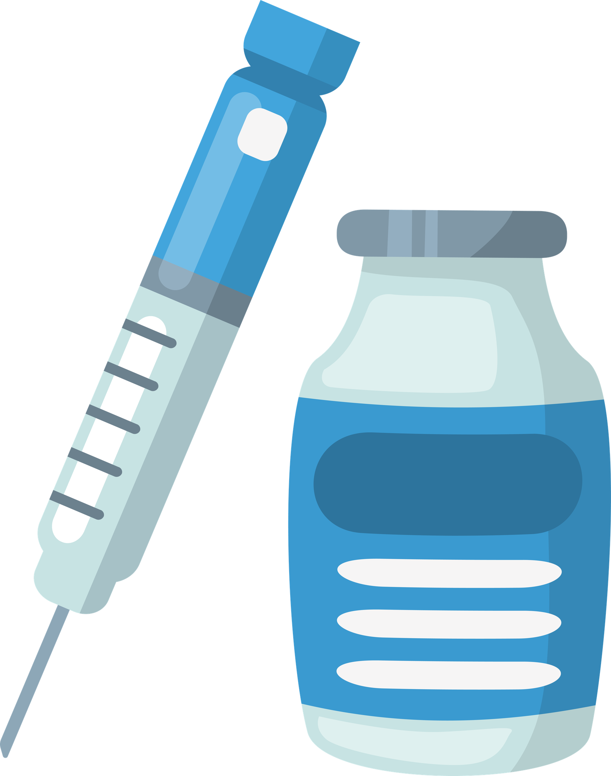

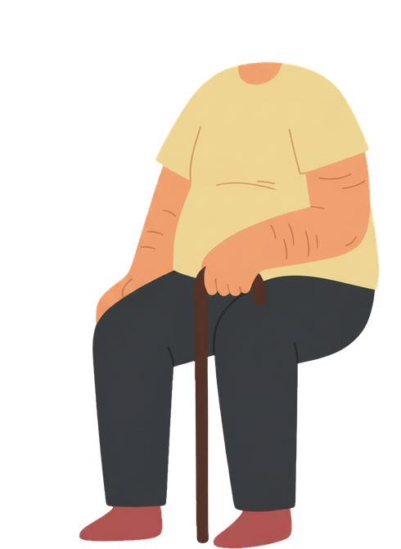
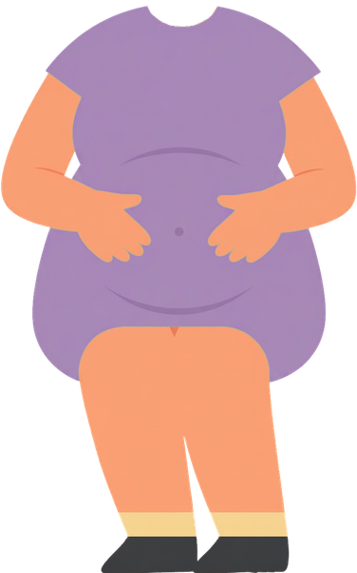
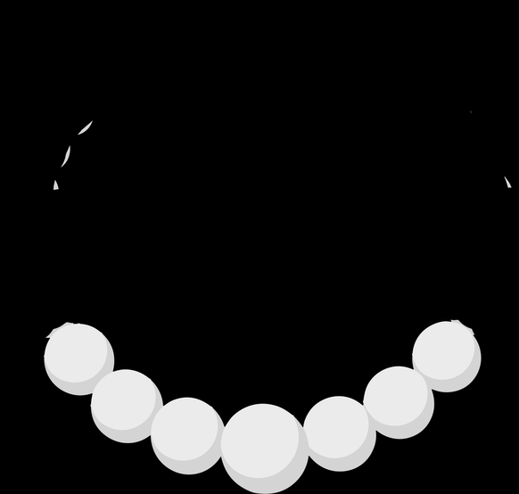
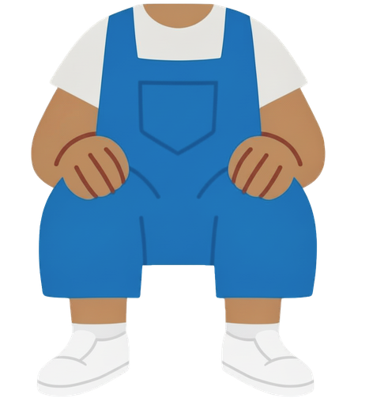




#EIW2026
vaccination-info.eu
FOR EVERY GENERATION, VACCINES WORK.
Vaccines protect everyone:
children, adolescents, adults and older people.
Staying up to date with vaccination protects you, your family and your community.

Slide 4


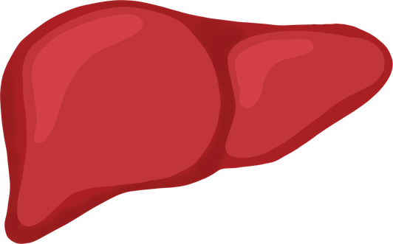
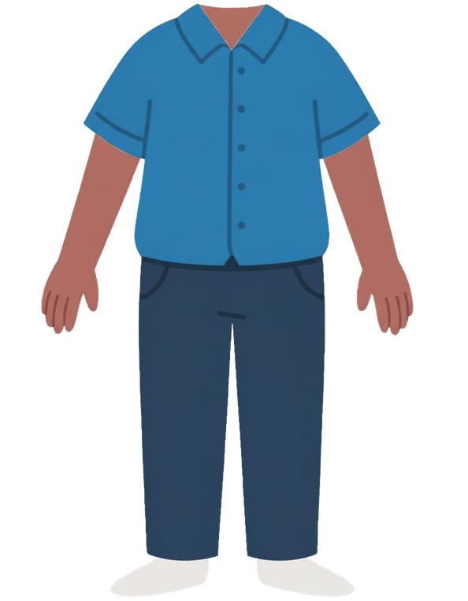

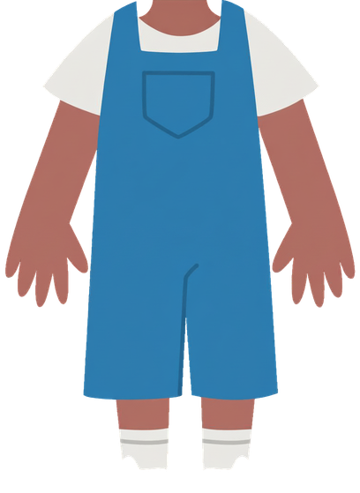

#EIW2026
vaccination-info.eu
FOR EVERY GENERATION, VACCINES WORK.
Hepatitis B can cause serious liver disease, including liver cancer.
Vaccination helps protect you and your family.
Speak to your healthcare provider to make sure you are up to date on recommended vaccines.

Slide 5



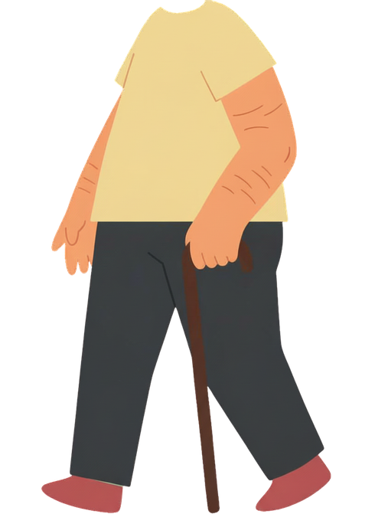
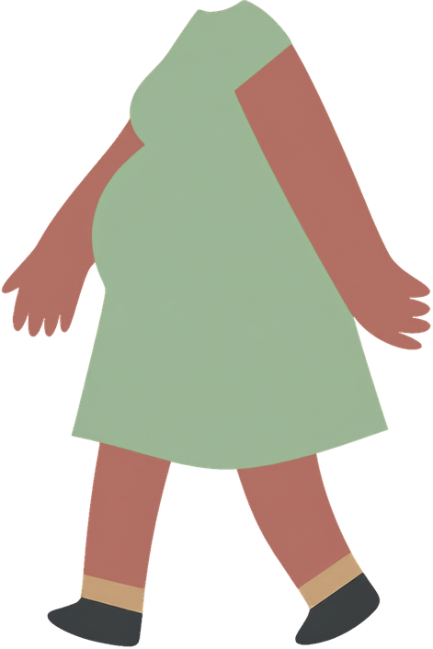


#EIW2026
vaccination-info.eu
FOR EVERY GENERATION, VACCINES WORK.
From infancy to our senior years, vaccines help protect us throughout our lives.
They have worked for generations before us, and they continue to work today.

Slide 6
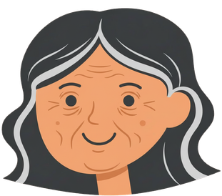
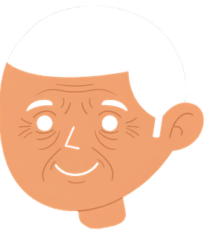

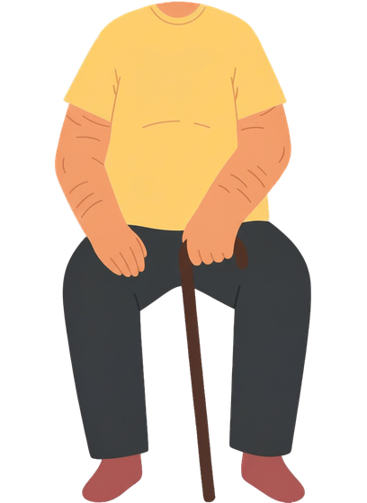
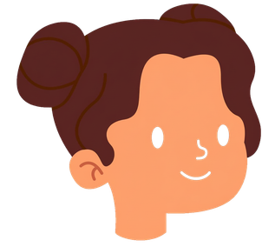

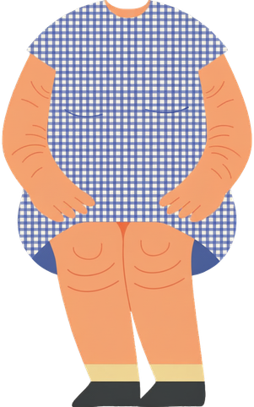

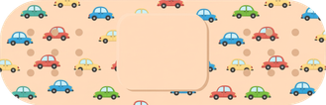

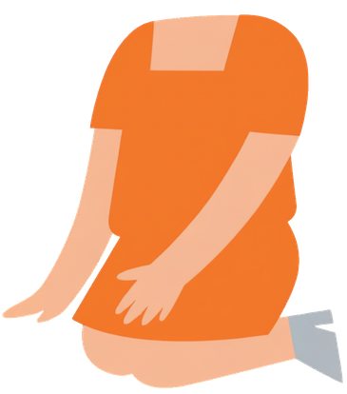
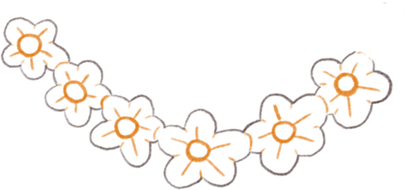
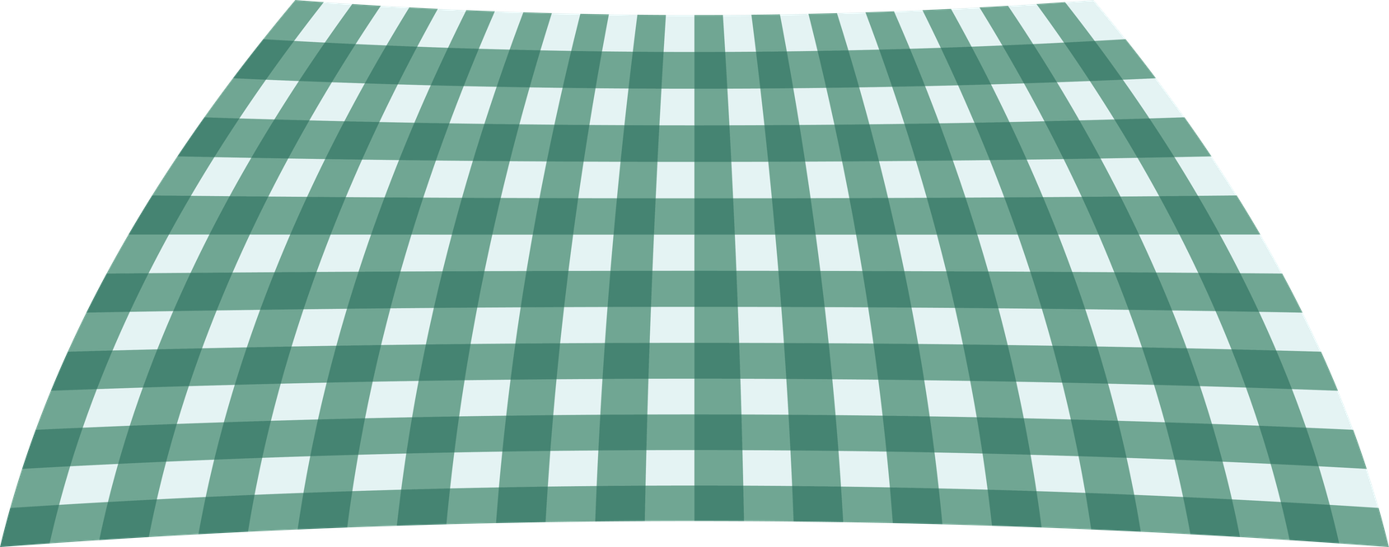
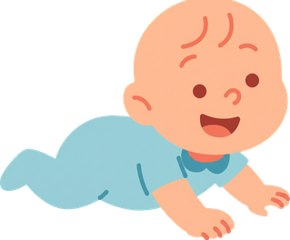
#EIW2026
vaccination-info.eu
FOR EVERY GENERATION, VACCINES WORK.
For over 50 years, vaccination has improved lives in Europe.
Vaccines have protected generations, saved millions of lives, and continue to safeguard our future.

Slide 7
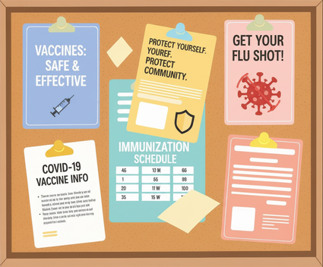

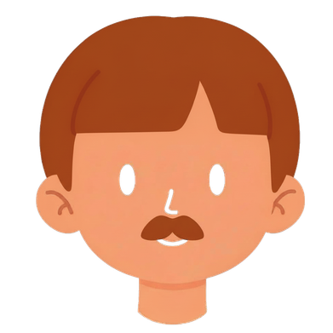

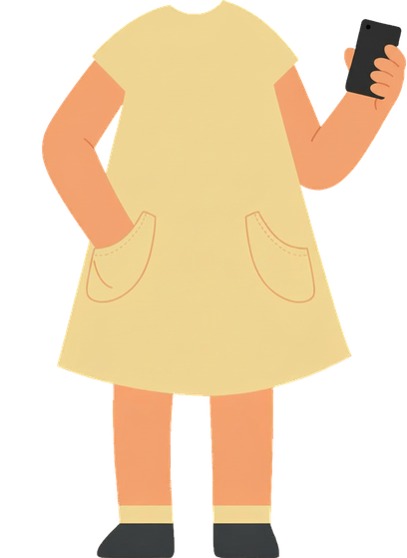
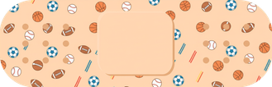
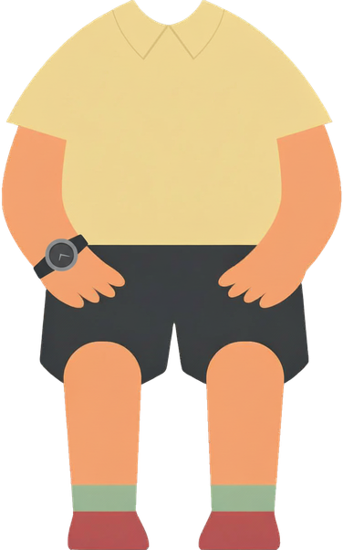

#EIW2026
vaccination-info.eu
FOR EVERY GENERATION, VACCINES WORK.
Vaccines are not just for children.
Many vaccines and boosters are important in adolescence, adulthood and later in life too.
Get informed, stay protected!

Slide 8
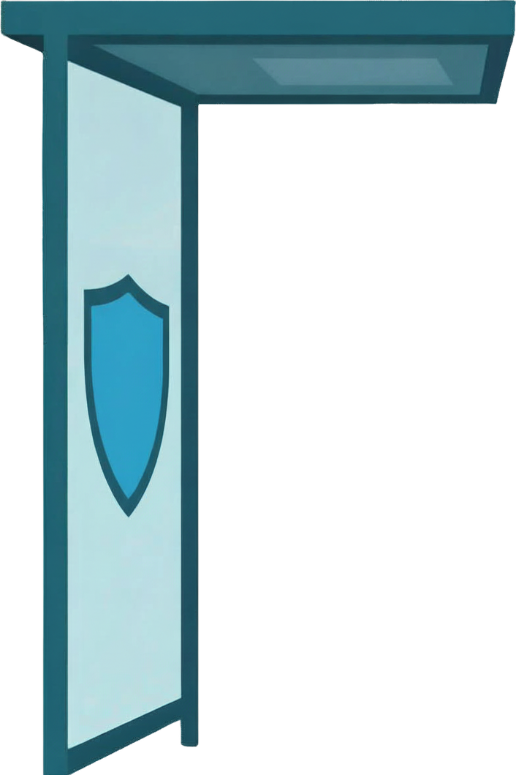


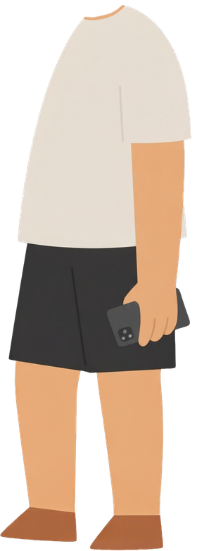
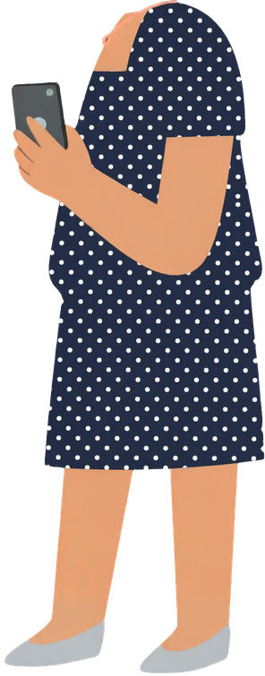

#EIW2026
vaccination-info.eu
FOR EVERY GENERATION, VACCINES WORK.
Vaccination can help prevent HPV, a very common infection that can lead to several types of cancer in both women and men.
Get informed, stay protected!

Slide 9

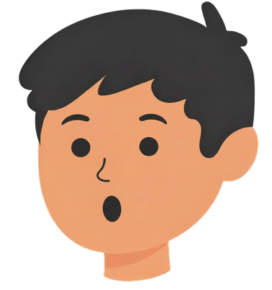
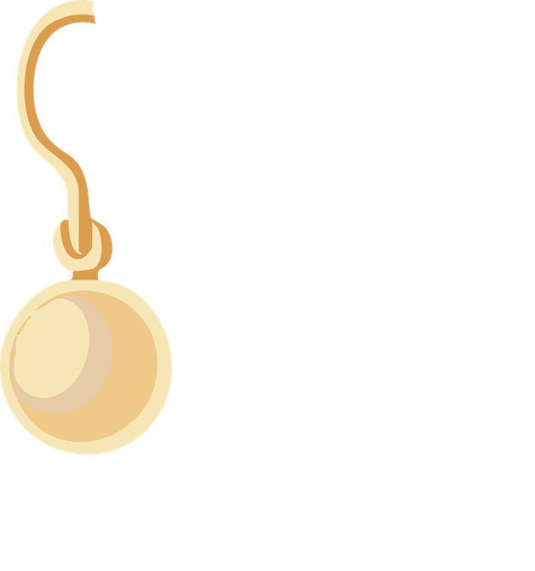
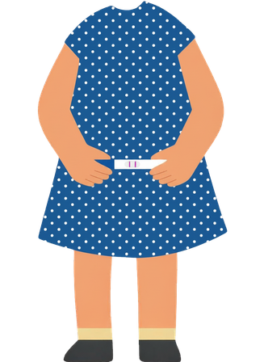
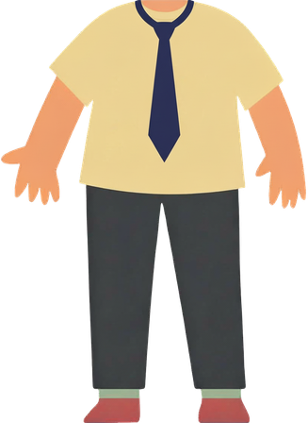


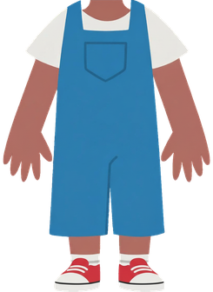
#EIW2026
vaccination-info.eu
FOR EVERY GENERATION, VACCINES WORK.
Immunization protects not only the individuals.
It also protects families, strengthens communities and safeguards future generations.
That is why vaccines work for everyone.

