Slide 1
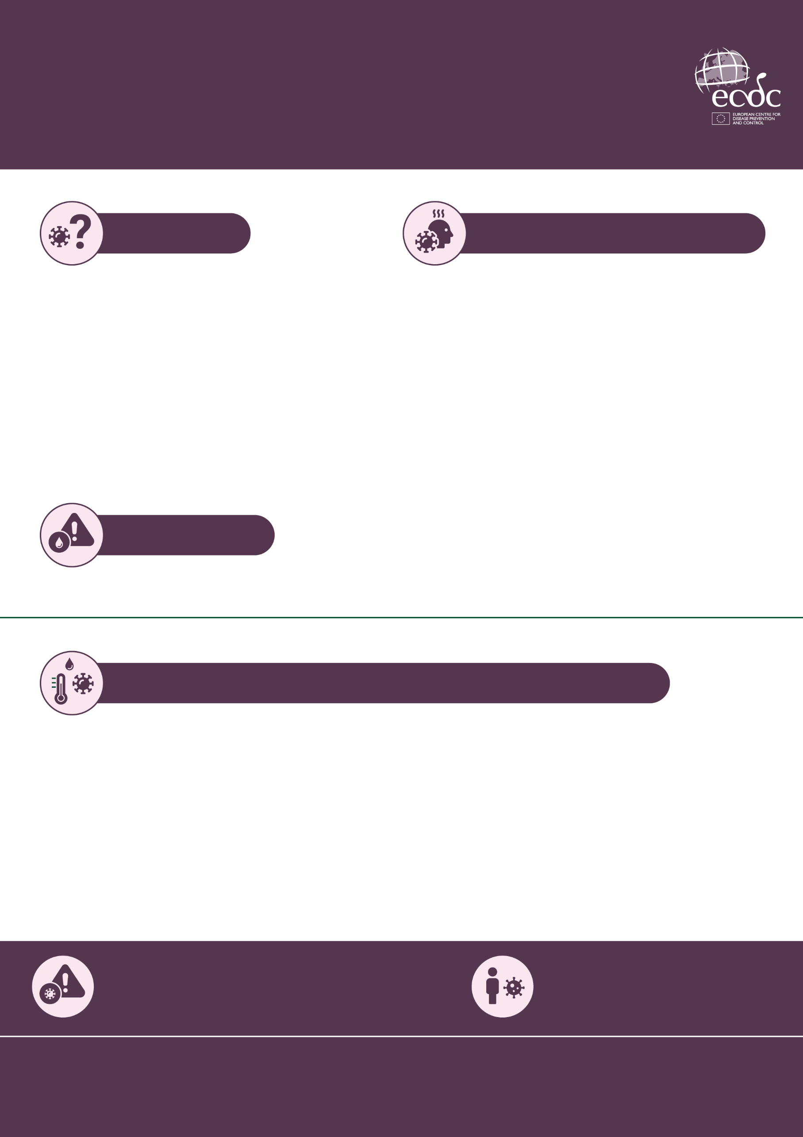
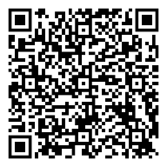
Ebola outbreak 2026
Ebola disease:
what you need to know
Information for you and your family
What is it?
What are the symptoms?
Ebola disease is a rare but serious disease.
This outbreak was first identified in the Democratic Republic of the Congo (DRC) where most cases have so far been diagnosed.
The current outbreak is caused by the Bundibugyo species, for which there is no approved vaccine or targeted treatment.
This virus occurs naturally in certain wild animals, including bats, monkeys, and antelopes.
It can take between 2 and 21 days after a person is infected before they become ill.
Symptoms often begin with fever, headache, and joint or muscle pain.
As the disease progresses, people may also develop a sore throat, nausea, vomiting, diarrhoea, and internal or external bleeding.
Am I at risk?
You can only become infected through contact with the blood or other bodily fluids of a person or animal with an infection (whether living or dead).
The virus is NOT spread through the air and is also generally not transmitted by coughing or sneezing.
What to do if someone you know has symptoms?
If you believe someone has symptoms, you should encourage them to contact a doctor or emergency health service provider by phone immediately.
They should not visit a healthcare provider in person.
Make sure they mention:
            their exact symptoms
            their recent travel history
            They should self-isolate if they develop symptoms.
            If not treated, Ebola disease can be fatal.
The risk to the general population in Europe from the current Ebola disease outbreak in DRC and Uganda remains very low.
A person with Ebola disease only becomes infectious from when they start showing symptoms.
Find out more from your national health
authorities and on the ECDC website:
www.ecdc.europa.eu

