Slide 1
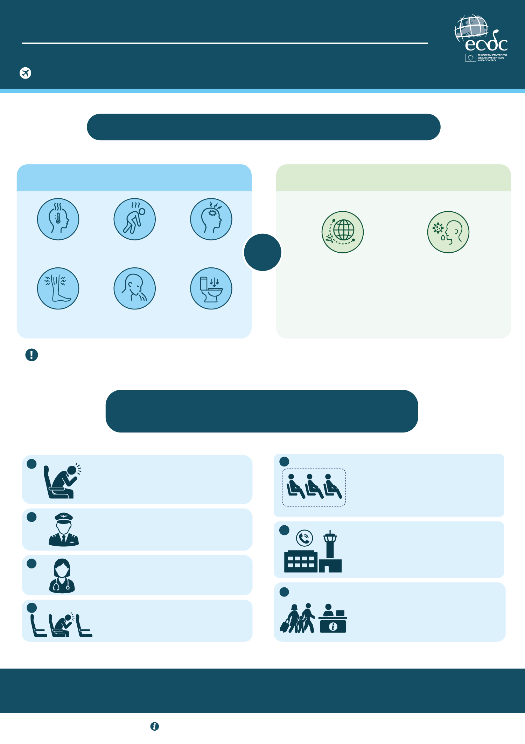
EBOLA DISEASE AND AIR TRAVEL
A PASSENGER DEVELOPS SYMPTOMS: WHAT HAPPENS NEXT?
Actions for cabin crew and airlines
WHEN SHOULD EBOLA DISEASE BE CONSIDERED?
COMPATIBLE SYMPTOMS
RELEVANT TRAVEL OR EXPOSURE HISTORY
Sudden onset of fever
Weakness
Headache
AND
Travel to the Democratic Republic of the Congo or Uganda.
Possible exposure to a suspected or confirmed Ebola disease case, their bodily fluids, or funeral or burial practices.
Muscle or joint pain
Nausea, vomiting
Diarrhoea
A more severe stage of the disease includes symptoms such as bleeding from the nose, gums and skin, and bloody vomiting and stools.
WHAT SHOULD THE CABIN CREW DO IF
A PASSENGER DEVELOPS SYMPTOMS?
1
ASSESS THE SITUATION
5
PROTECT NEARBY PASSENGERS AND CREW
Assess the passenger’s symptoms
Ask about travel to affected areas and possible exposure.
Limit contact. Provide adequate personal protective equipment to passengers seated next to the ill passanger if isolation is not possible.
2
INFORM THE CAPTAIN
Advise the captain of the situation as soon as possible.
6
NOTIFY BEFORE ARRIVAL
The captain must report any suspected case to the destination airport and public health authorities before arrival.
3
FOLLOW MEDICAL ADVICE
Liaise with medical support (ground or onboard) and follow their advice.
7
FOLLOW PROCEDURES ON ARRIVAL
4
ISOLATE THE PASSENGER
Passengers and crew should follow the advice of airport and public health authorities. The cleaning crew should perform appropriate cleaning of the aircraft.
Move the passanger to a separate area if possible (empty row near lavatory).
Ebola disease is transmitted by people with symptoms.
Early actions help protect passengers, the crew and the community.
For more information, visit ecdc.europa.eu

