Slide 1
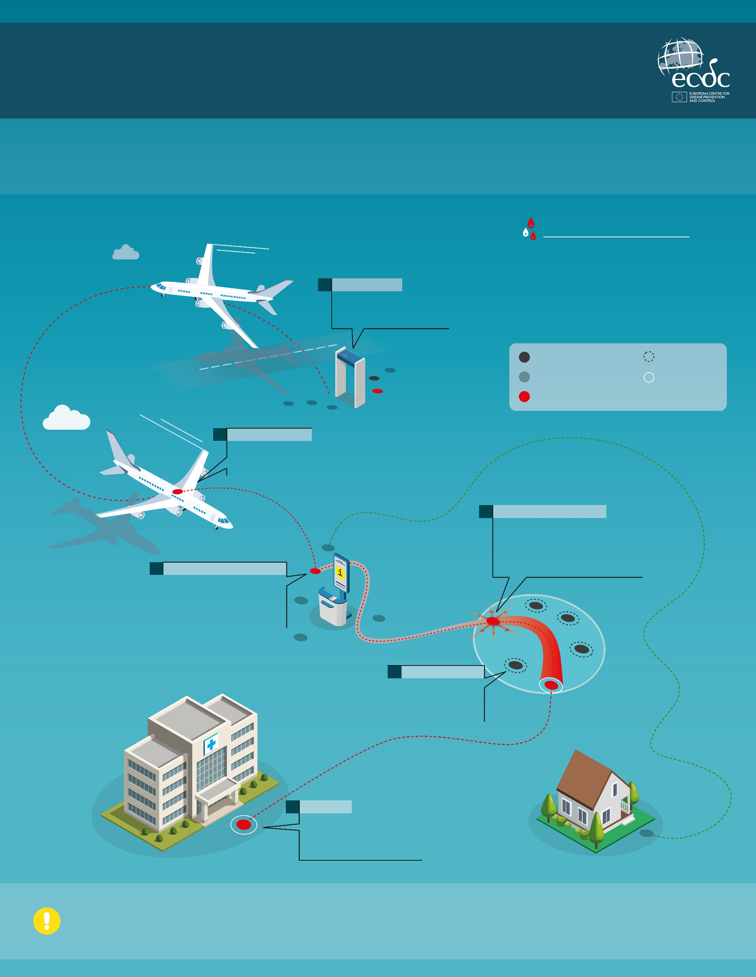
EBOLA DISEASE: REDUCING THE RISK
Experience from previous outbreaks shows that while Ebola disease cases can occur in Europe, they remain rare. The following measures will help rapidly detect cases and reduce the risk of further spread.
RECOGNISING SYMPTOMS
Early symptoms can include headaches, fever, nausea, vomiting, diarrhoea and weakness, which can appear between 2 and 21 days after infection. More severe symptoms include bleeding from the nose, gums and skin, and bloody vomiting and stools.
People are generally not contagious before symptoms begin. The Ebola virus spreads through direct contact with infected blood or other bodily fluids.
1.
EXIT SCREENING
Screening travellers leaving affected areas for symptoms before boarding flights is a vital first step.
Person at risk
Contact tracing
Person not at risk
Isolation
Person with the infection
2.
WHILE TRAVELLING
If symptoms develop while travelling, passengers should inform the cabin crew for them to take immediate action.
4.
IDENTIFYING AN INFECTION
While caring for patients, healthcare workers need to ask them about their recent travel. People with a suspected infection should be rapidly isolated and assessed.
3.
INFORMATION ON ARRIVAL
Travellers arriving from affected areas should receive information from public health authorities about where to seek care if symptoms develop.
5.
CONTACT TRACING
Public health authorities will monitor anyone in contact with people who are infected to help prevent further spread.
6.
HOSPITALS
Patients displaying symptoms are isolated and cared for using strict infection prevention and control measures.
The risk to the general population in Europe from the current Ebola disease outbreak in DRC and Uganda remains very low.

