Slide 1
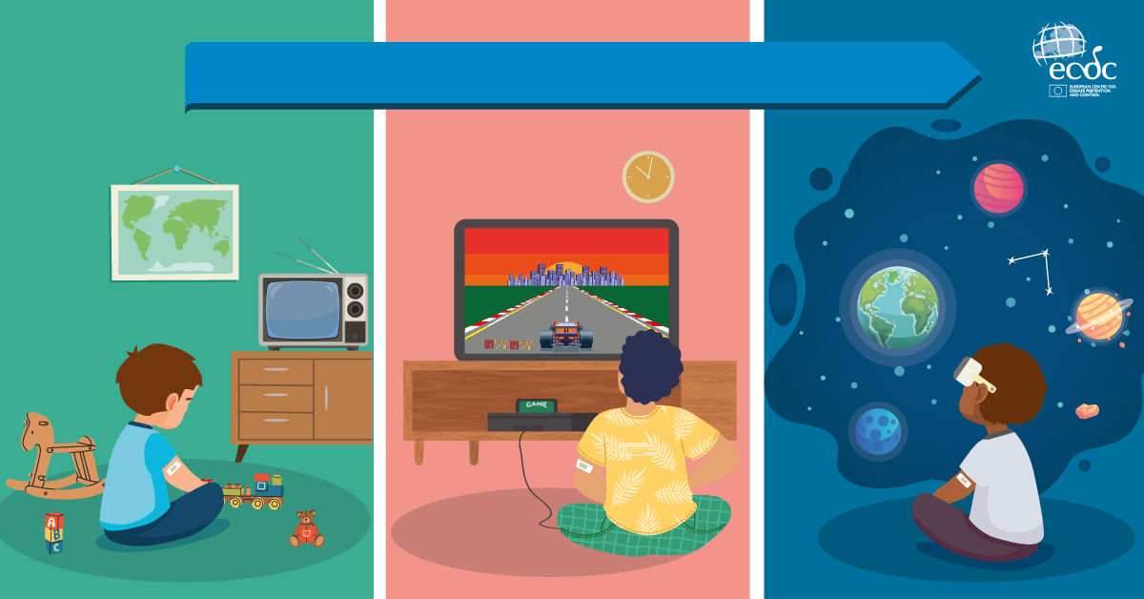
Vaccines, protecting generations

