Slide 1


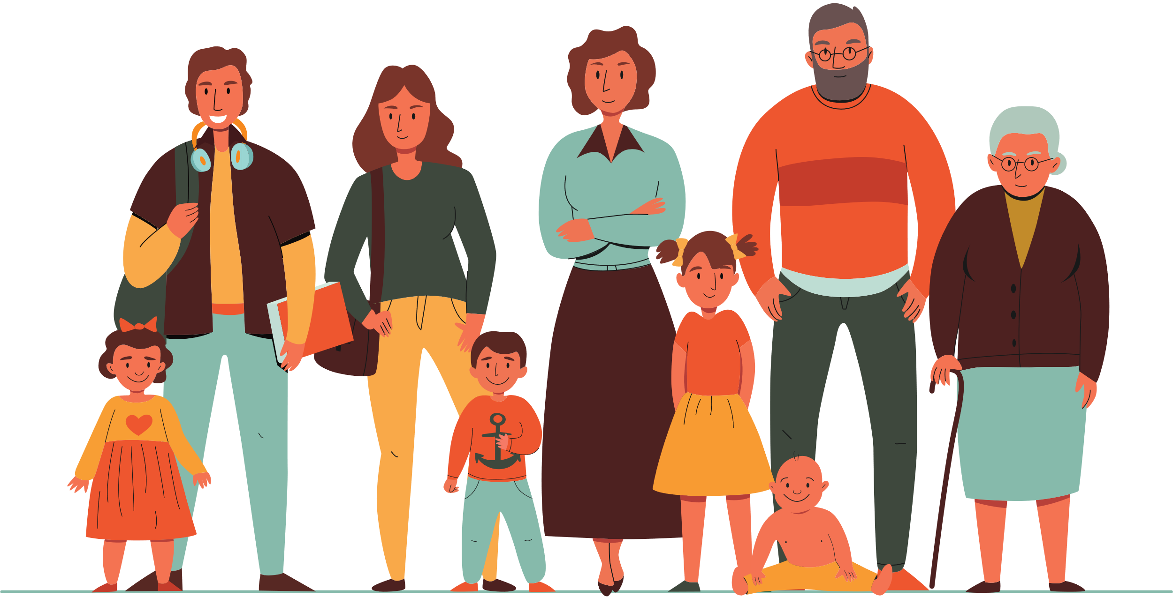

In Europe, routine vaccinations have been part of our lives for over 50 years.
They have protected generations of people and saved millions of lives.
Vaccines save lives.
#ProtectingGenerations #UnitedInProtection #EIW2024

Slide 2

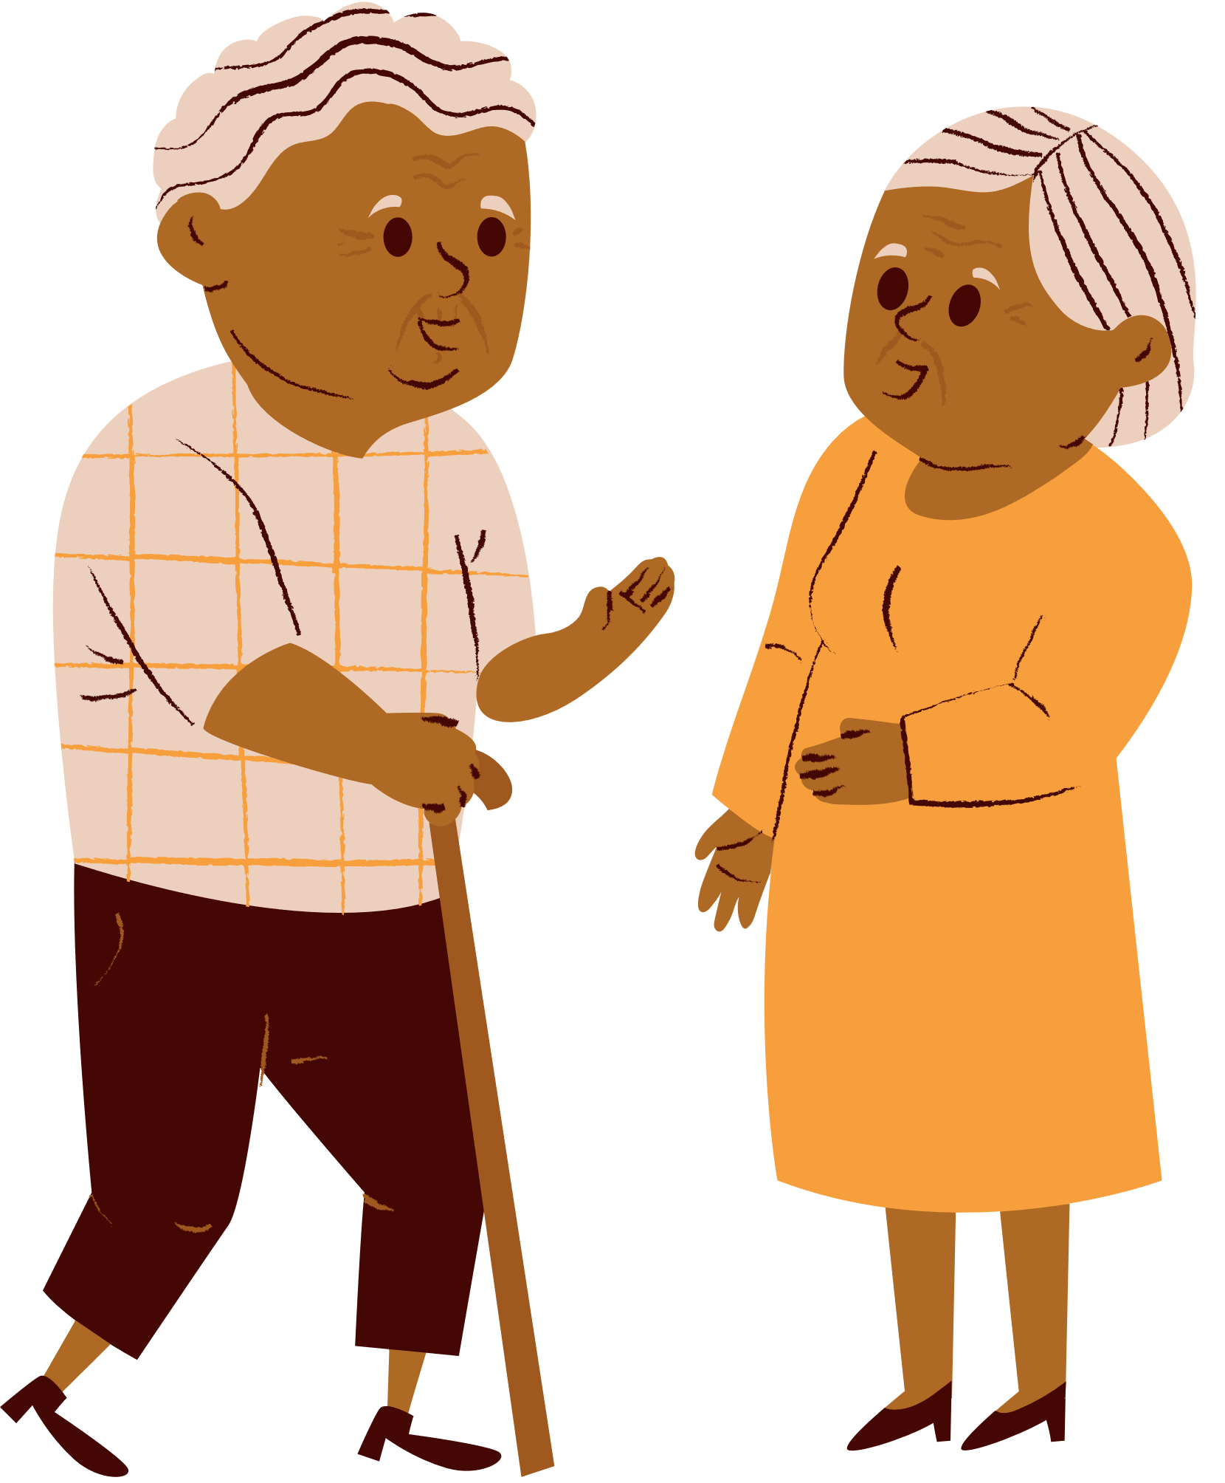
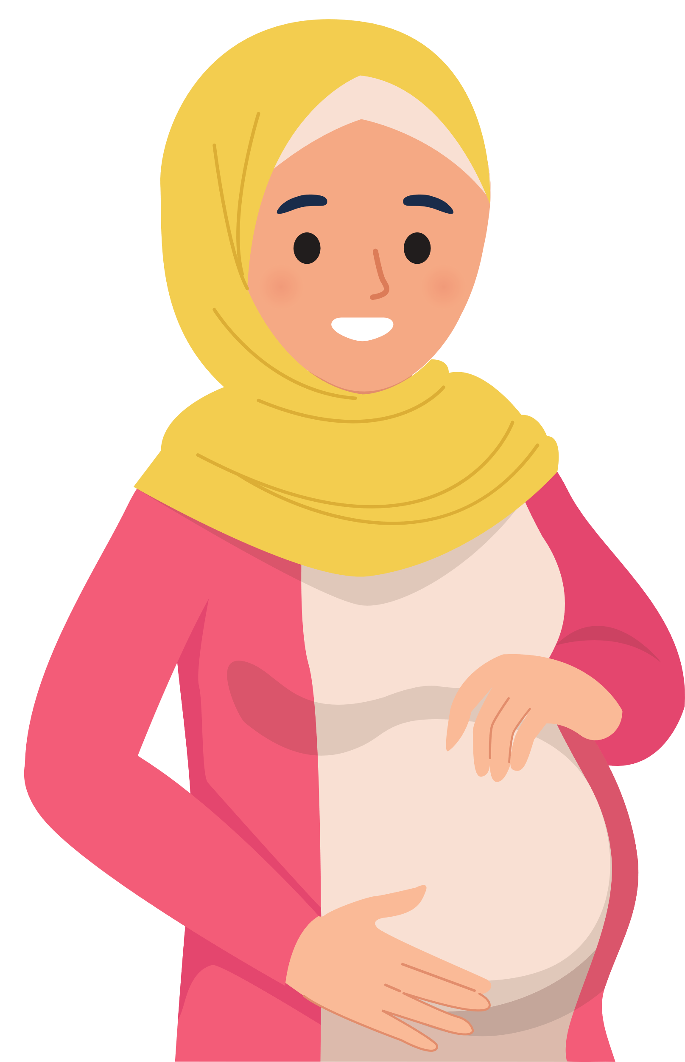
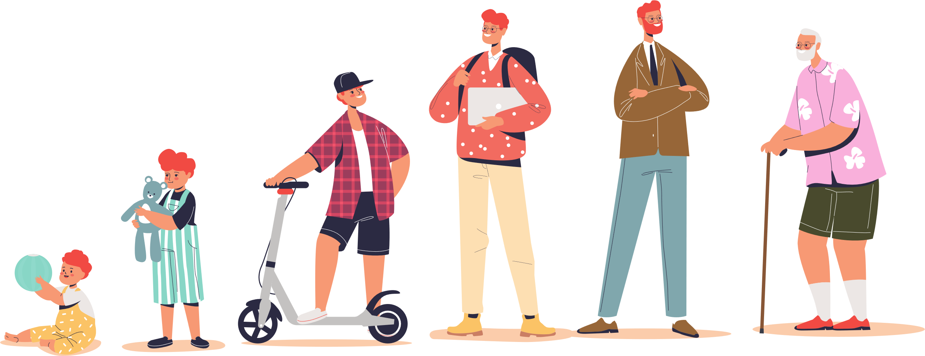
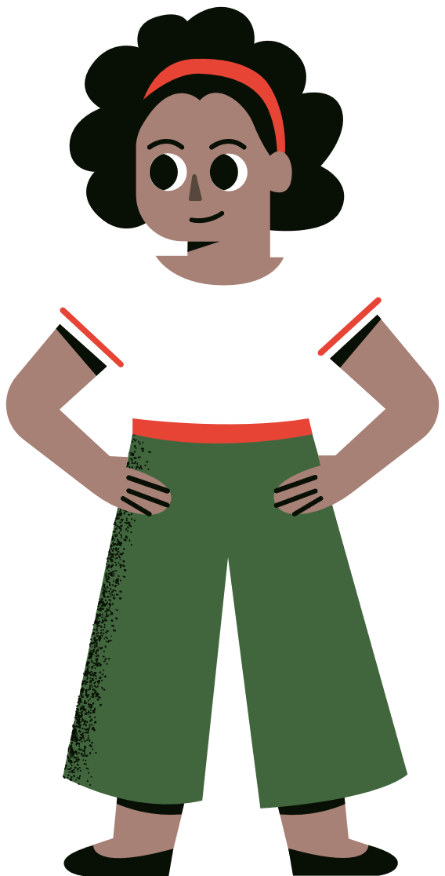
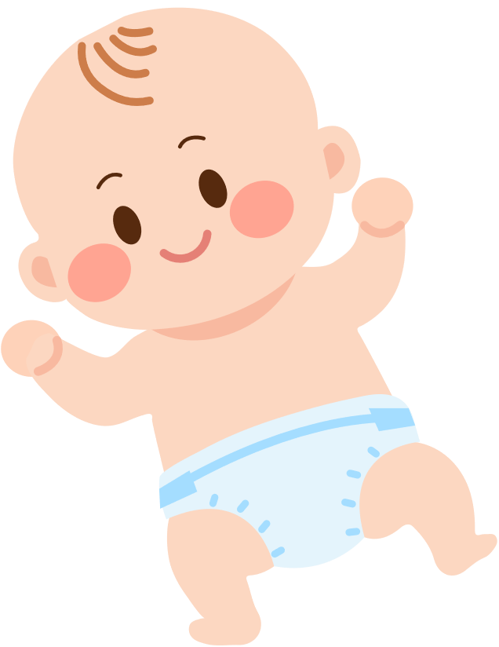

Vaccines protect everyone:
Children, adolescents, adults and the elderly.
Protect yourself, your family and your community by being up-to-date with your vaccines.
#ProtectingGenerations #UnitedInProtection #EIW2024

Slide 3
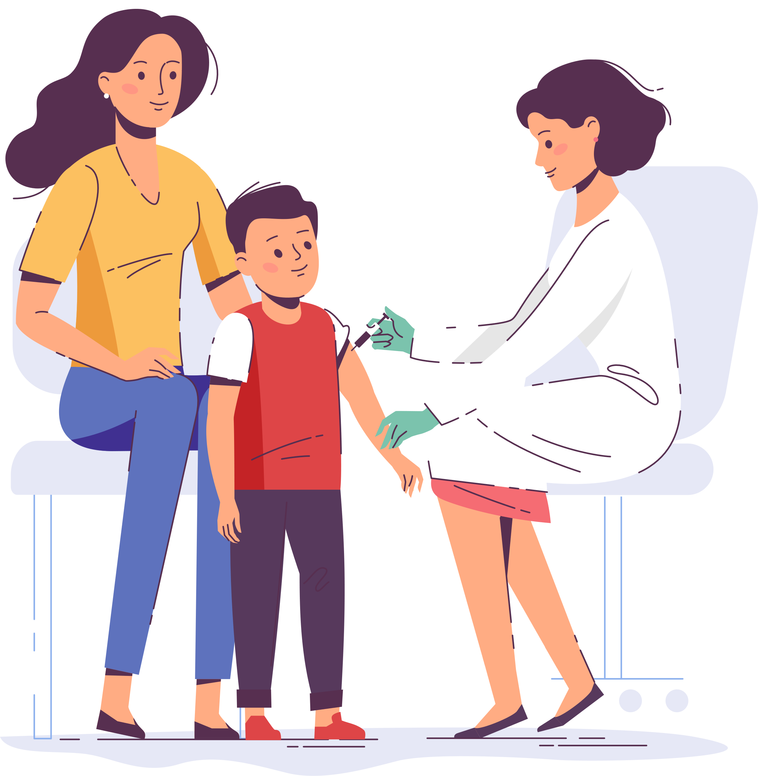
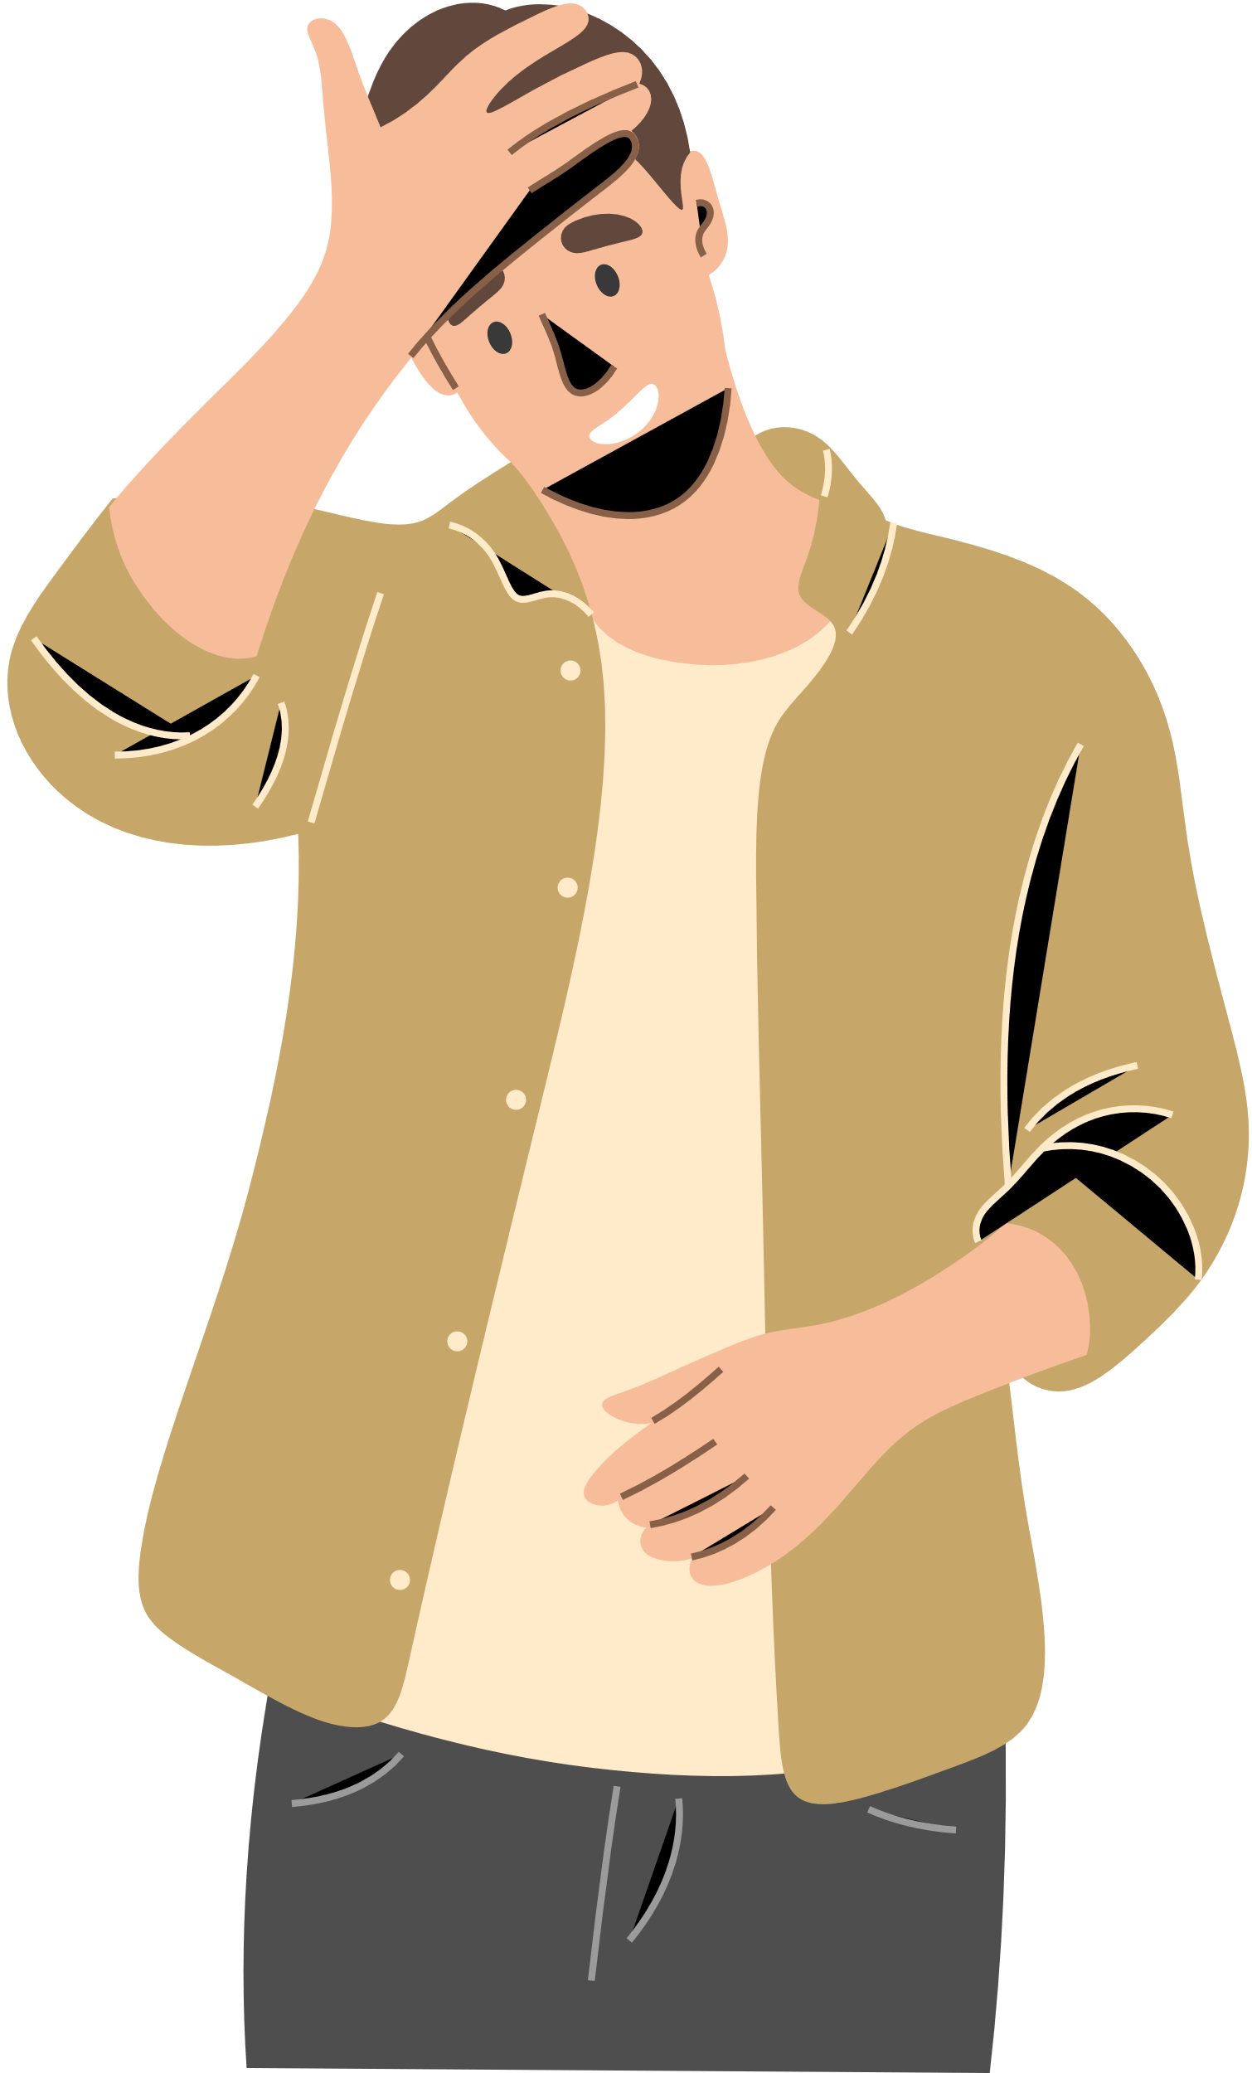




Did your child miss a
vaccine dose?
Talk to your doctor and get your child vaccinated as soon as possible to complete the recommended vaccination course!
#ProtectingGenerations #UnitedInProtection #EIW2024

Slide 4
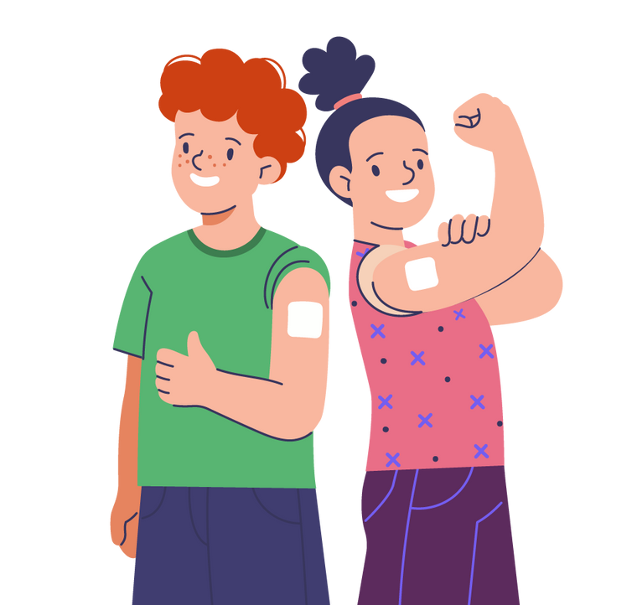
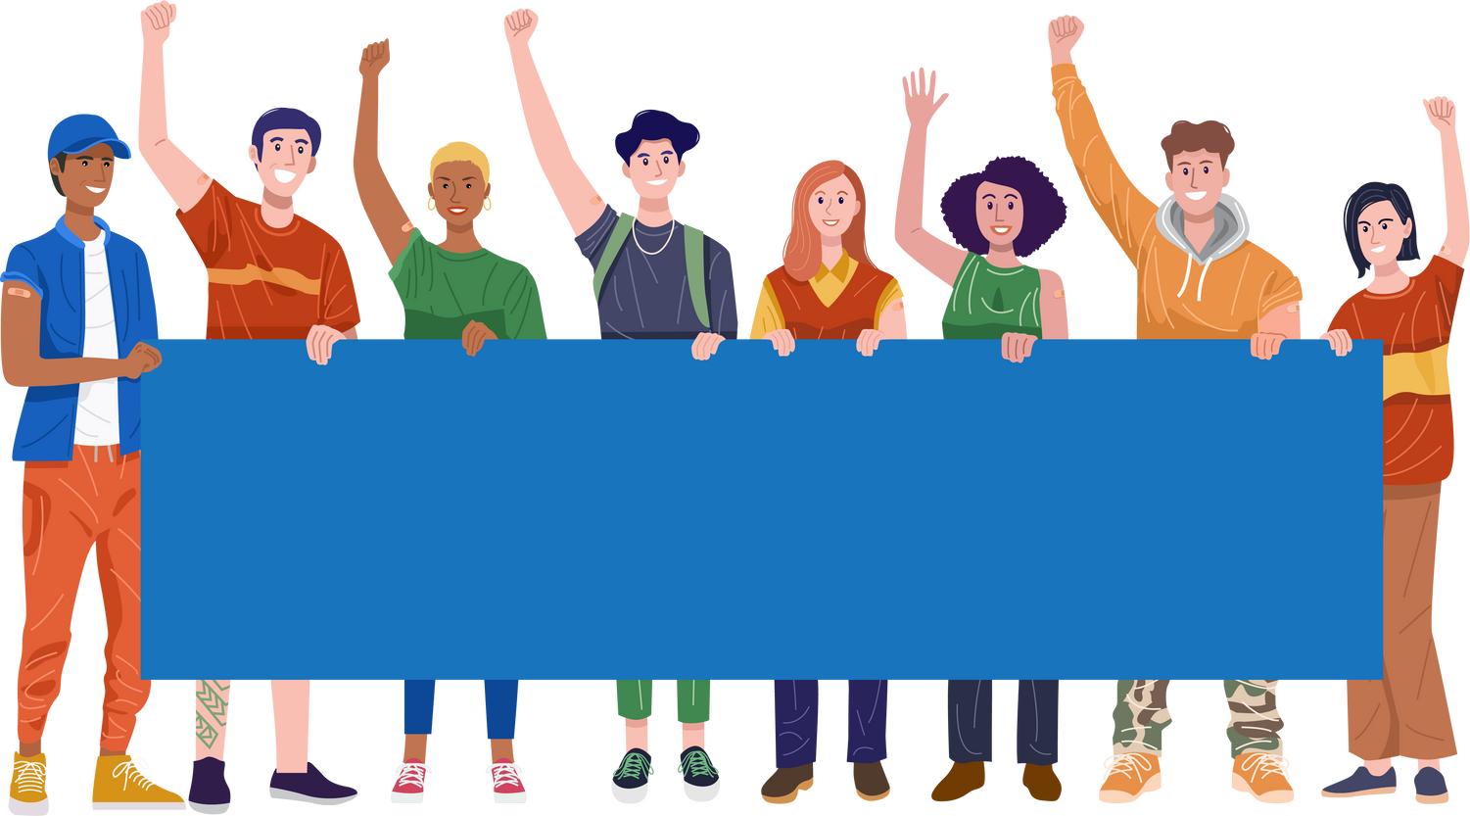
Get informed,
Get vaccinated!
Vaccination can prevent HPV, the most common sexually transmitted infection.
HPV can lead to cancer in both men and women.
#ProtectingGenerations #UnitedInProtection #EIW2024

Slide 5
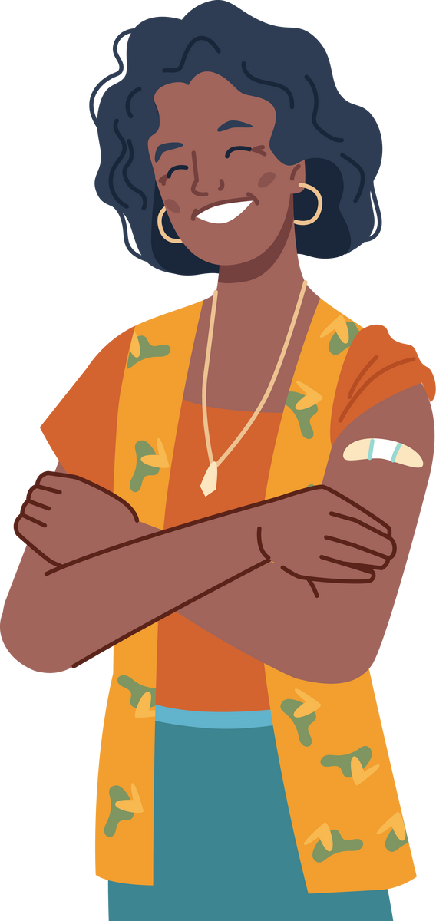

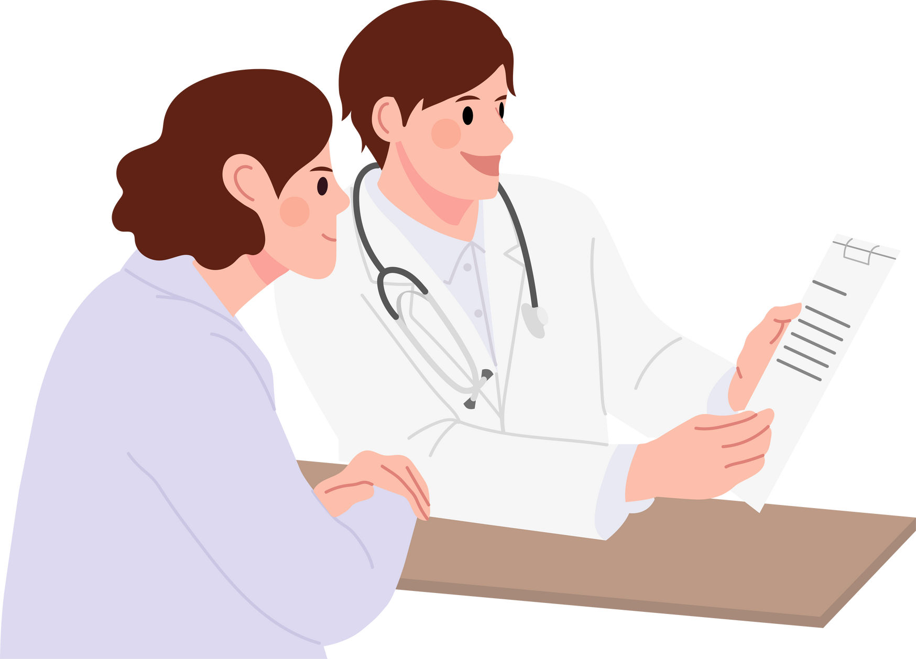
Vaccines aren’t just for children.
Many countries recommend vaccines or boosters during adulthood.
Check the recommendations in your country and speak to your doctor.
Vaccines save lives!
#ProtectingGenerations #UnitedInProtection #EIW2024

Slide 6
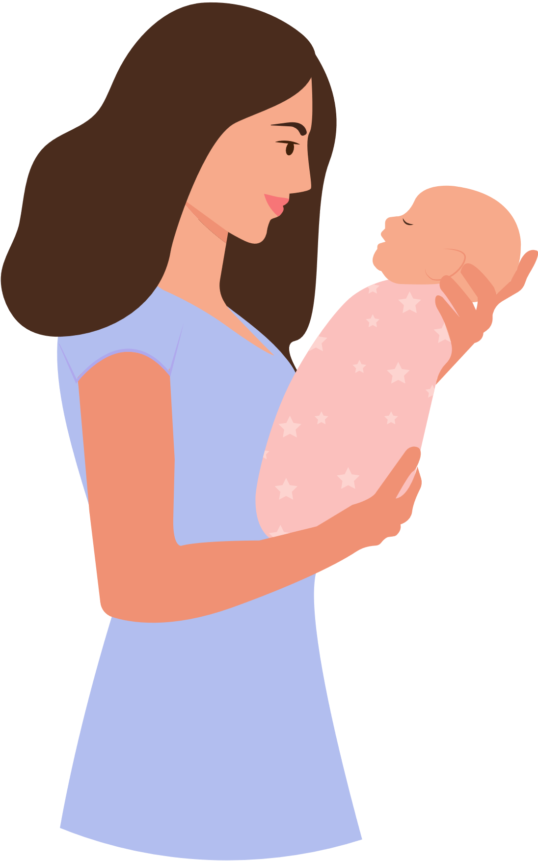
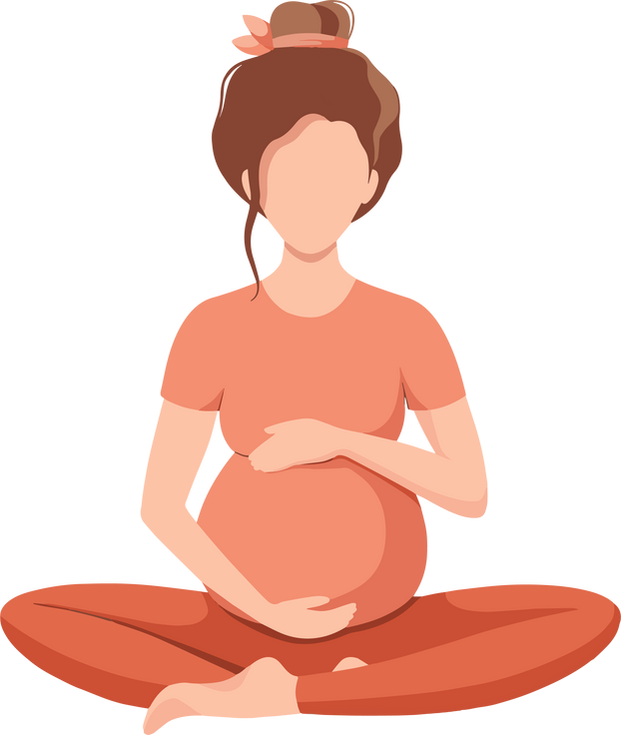
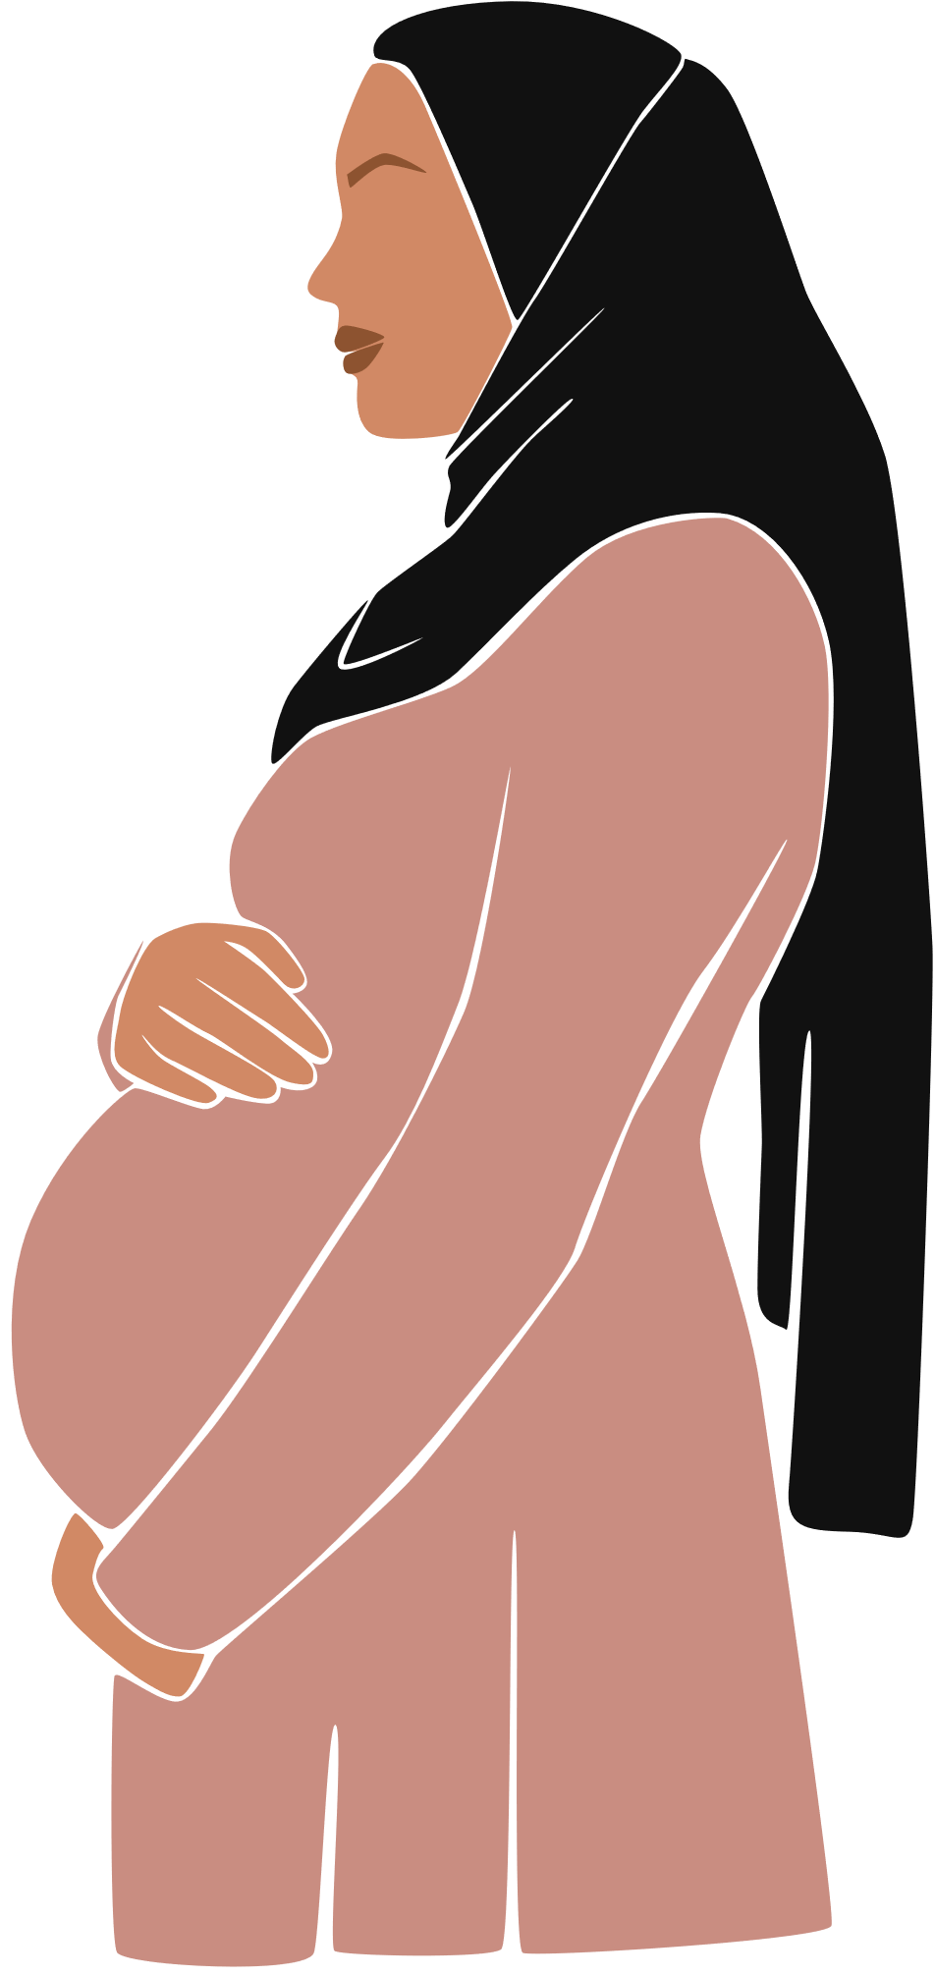
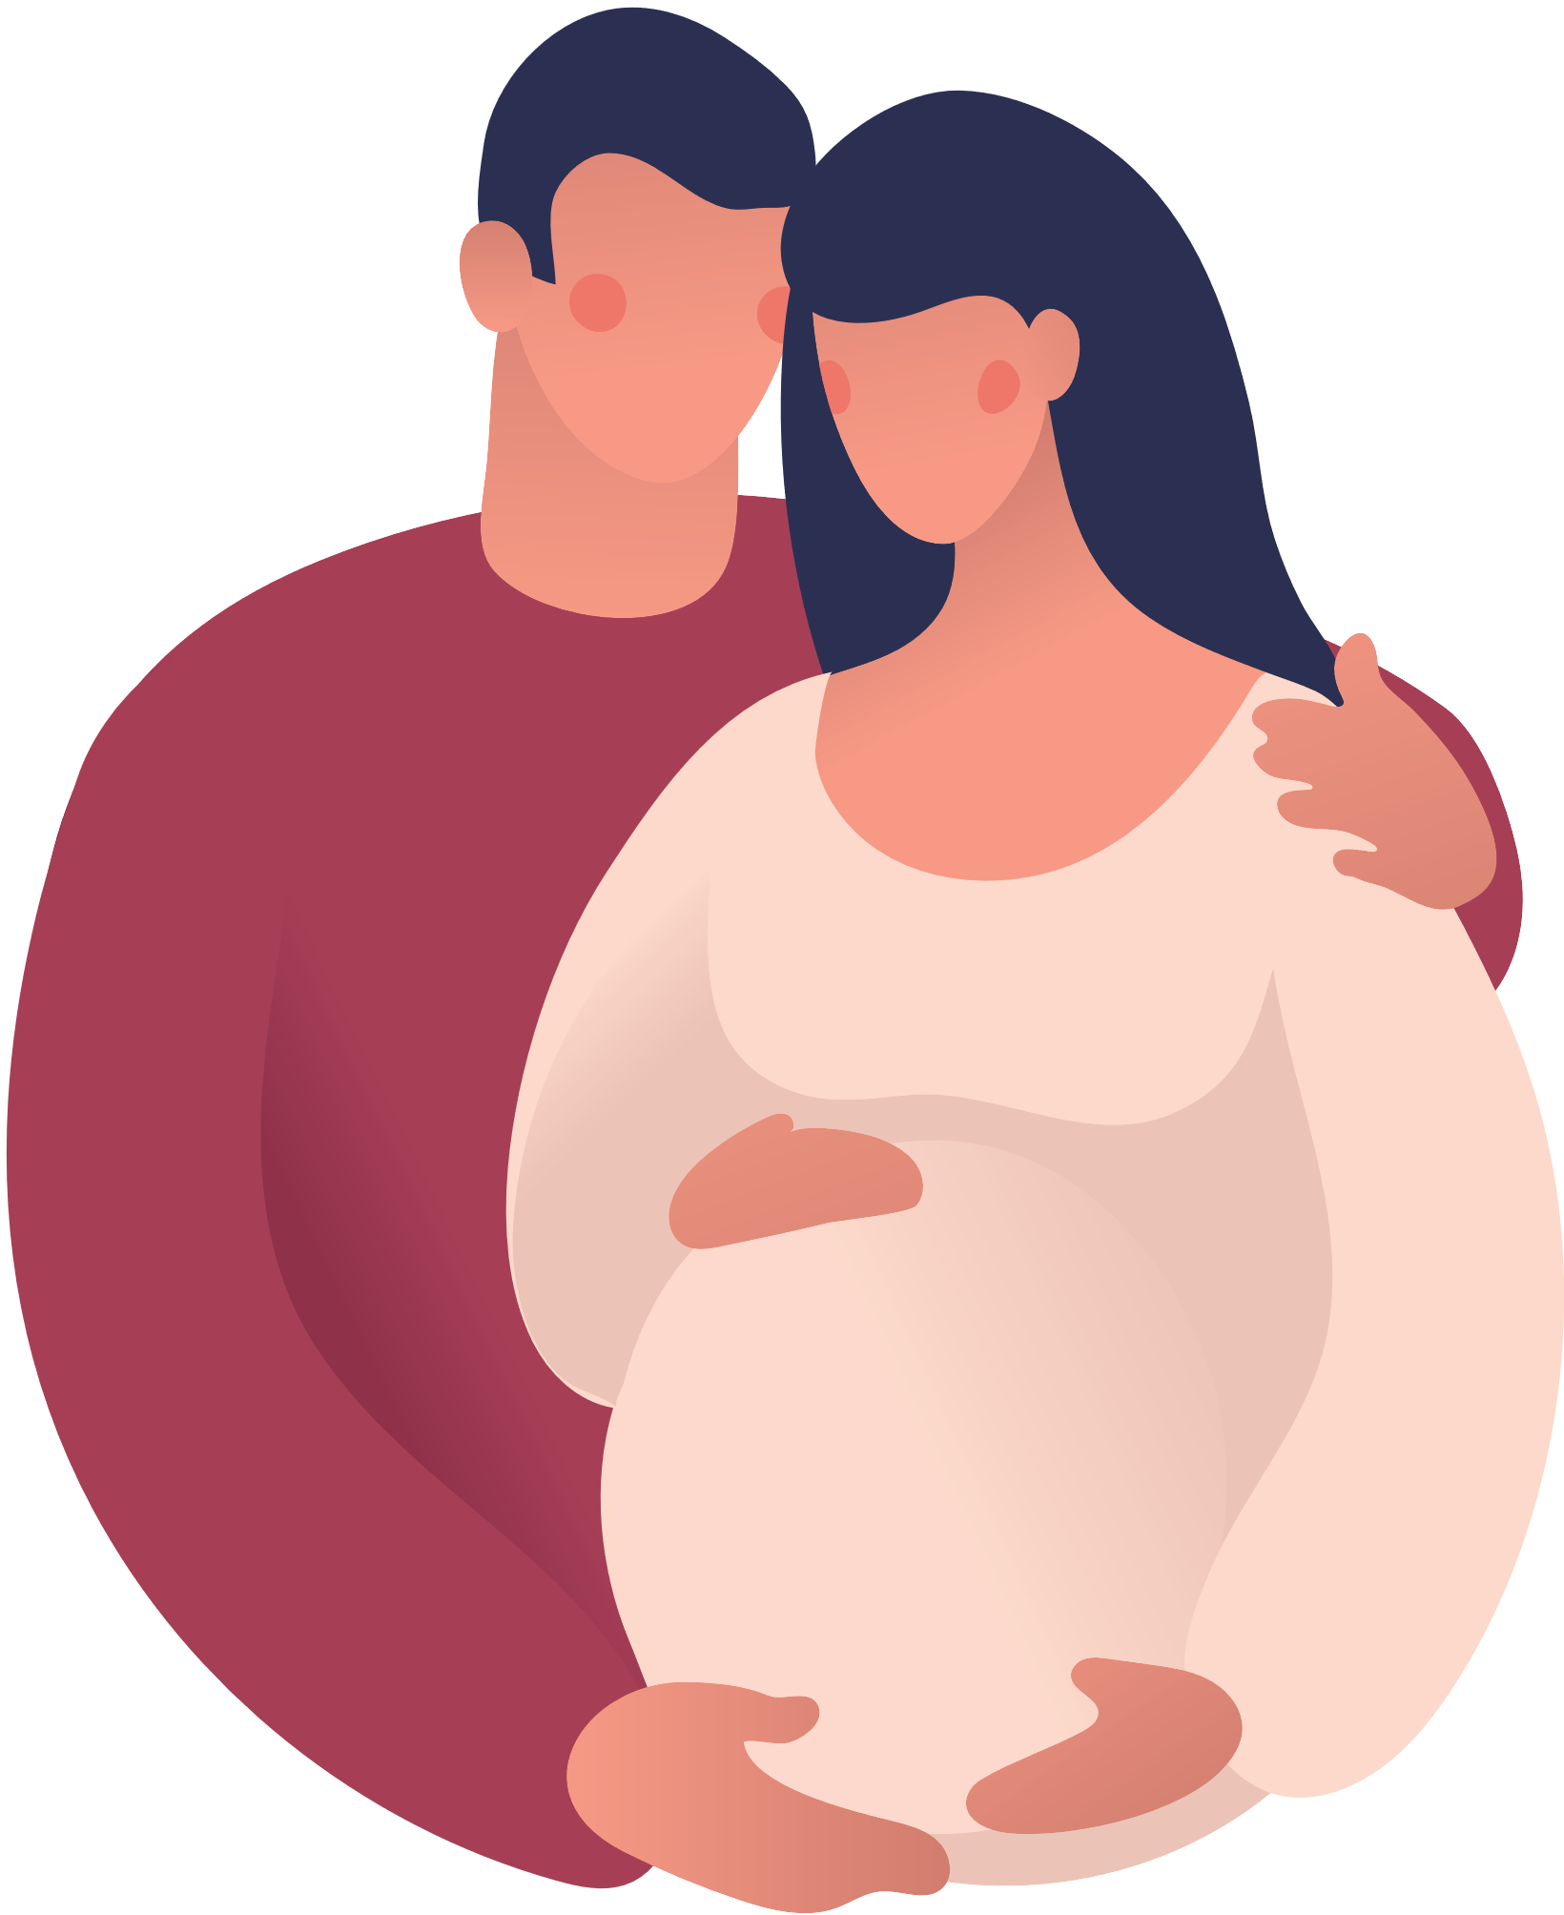

Unvaccinated women who get rubella during pregnancy are at increased risk of miscarriage or severe health problems for the child.
Protect yourself and your baby, ensure you are up-to-date on recommended vaccines well before pregnancy!
Vaccines save lives.
#ProtectingGenerations #UnitedInProtection #EIW2024

Slide 7
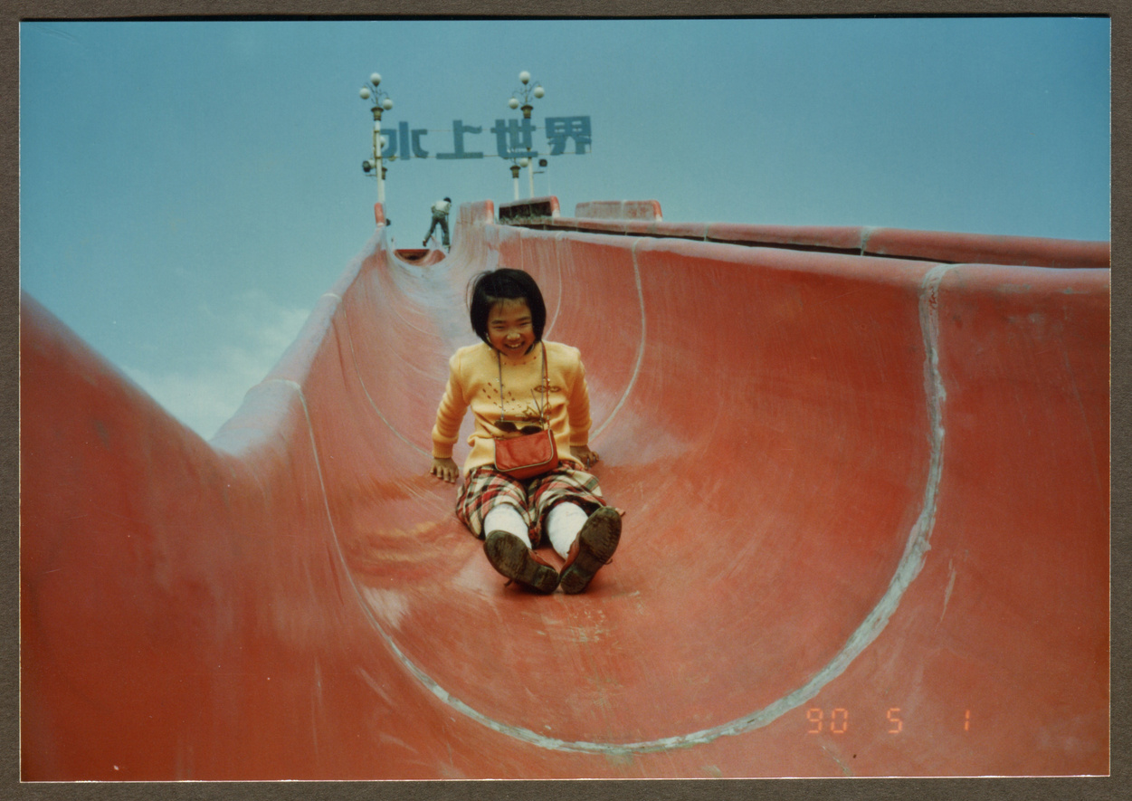




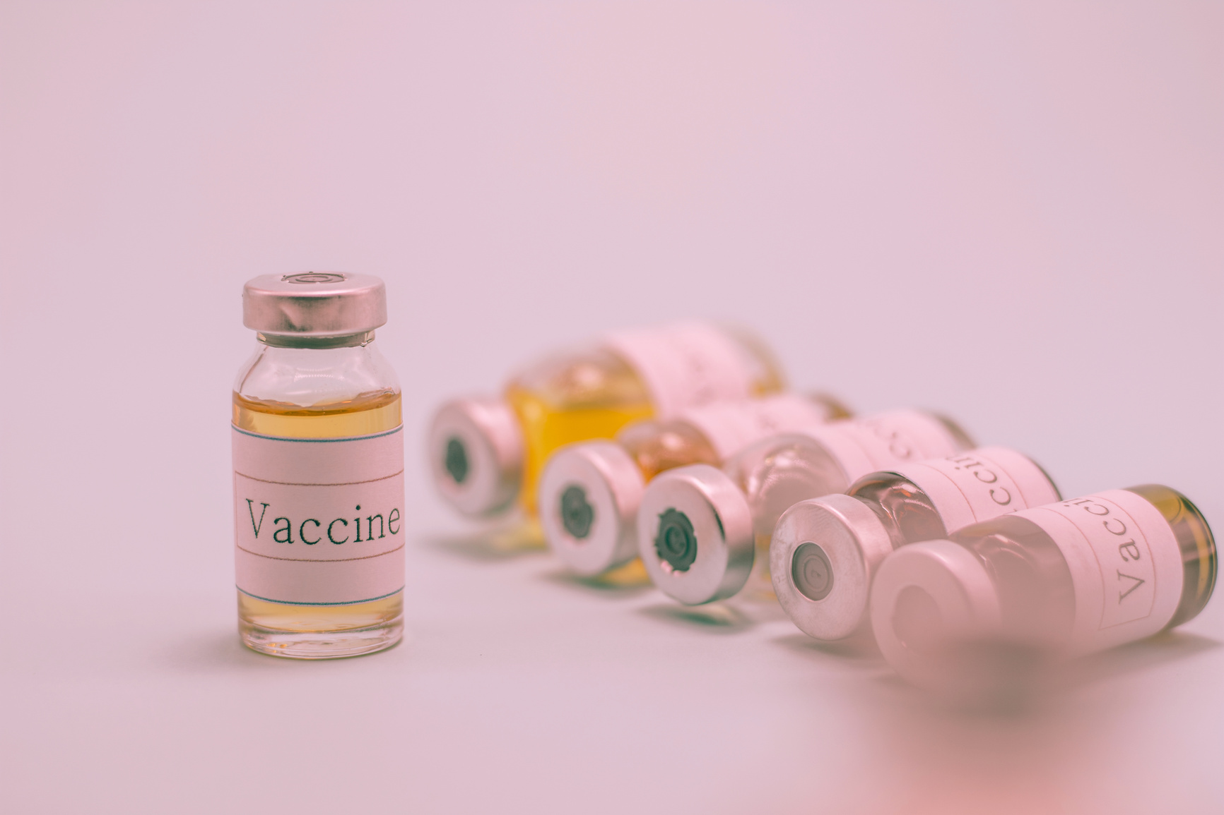

1971
1995
2024
1984
2012
Times change, the importance of vaccination doesn’t.
Vaccines save lives.
#ProtectingGenerations #UnitedInProtection #EIW2024

Slide 8
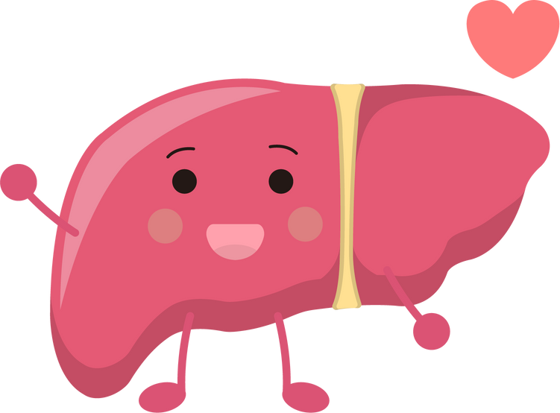
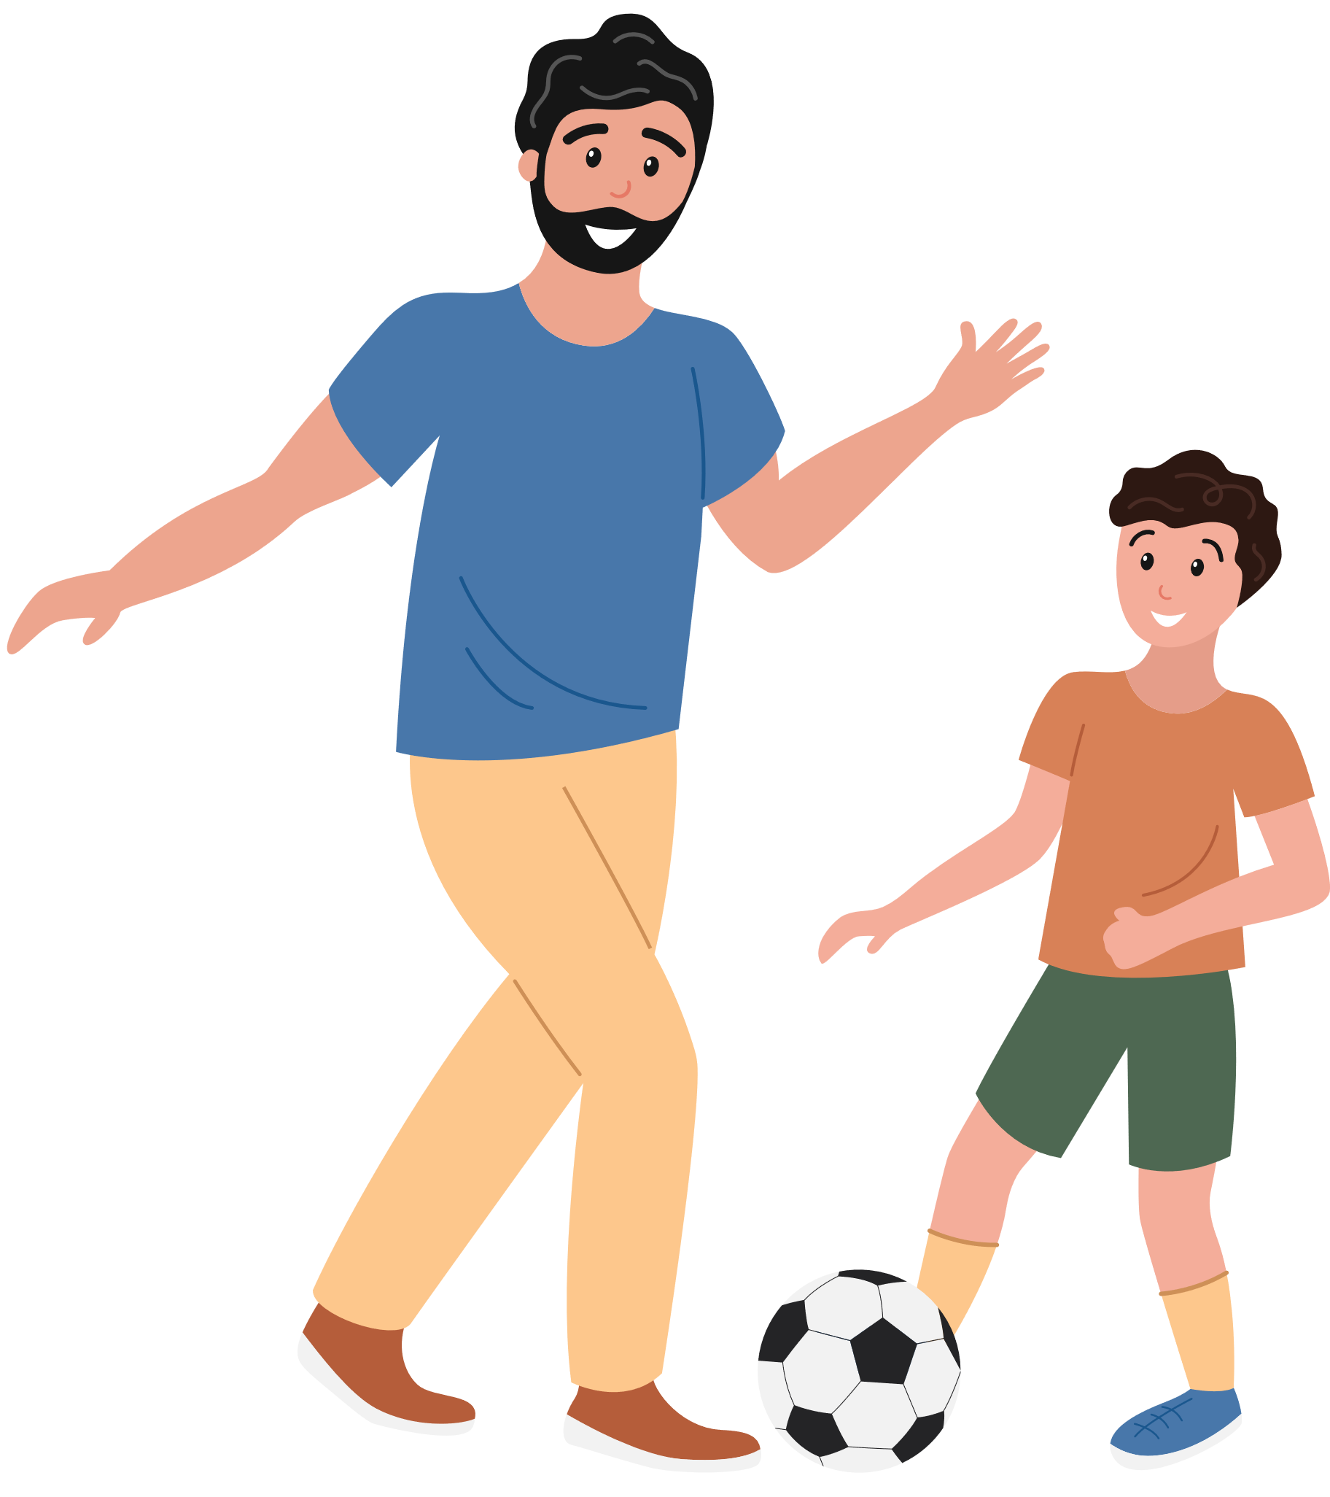
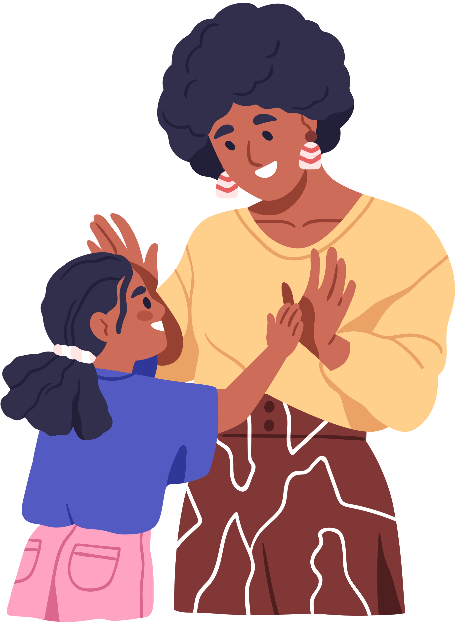
Hepatitis B can lead to liver cancer.
Get yourself and your family vaccinated against Hepatitis B:
Speak with your doctor to make sure you are up-to-date on your vaccines.
Vaccines save lives.
#ProtectingGenerations #UnitedInProtection #EIW2024

Slide 9

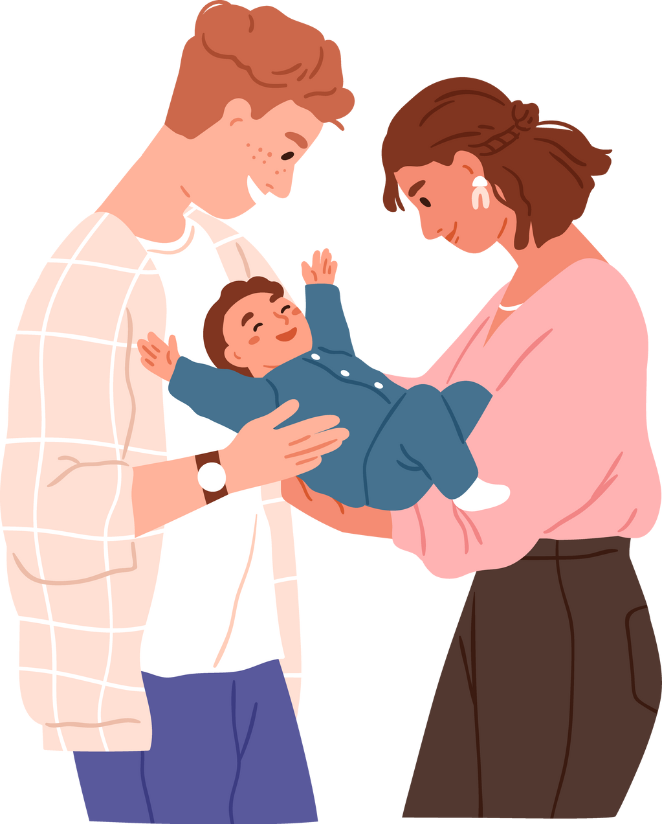
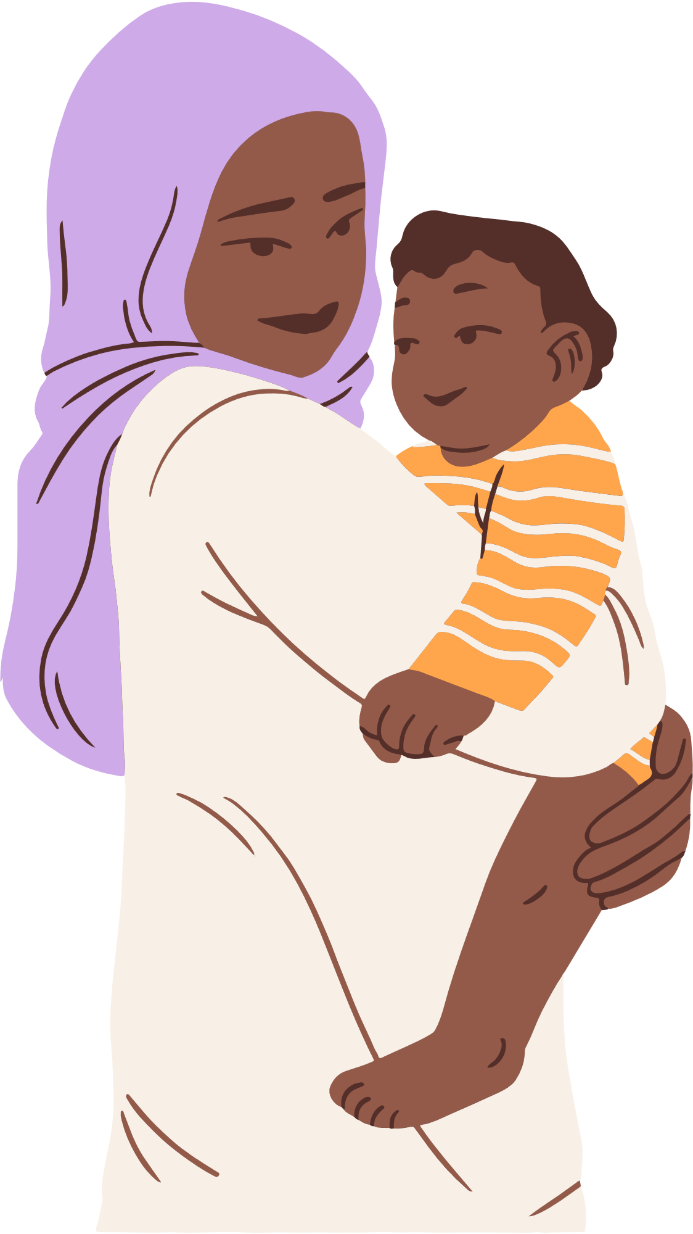
Measles can affect people of all ages, but children under 12 months old, who are too young to be vaccinated, are especially vulnerable.
Vaccinate your child at the right time, protect your family and contribute to collective immunity!
Vaccines save lives.
#ProtectingGenerations #UnitedInProtection #EIW2024

