Slide 1
HIV/AIDS Surveillance 2017 2016 data
European Centre for Disease Prevention and Control
WHO Regional Office for Europe

Slide 2
European Union/ European Economic Area (EU/EEA)

Slide 3
New HIV diagnoses in the EU/EEA
2016
Reporting countries/Number of countries | 31/31
Number of HIV diagnoses | 29 444
Rate per 100 000 population (adjusted rate*) | 5.9
Male-to-female ratio | 3.2
Percentage new diagnoses CD4<350 cells/mm³ | 48%
Transmission mode (%)
Sex between men | 40
Heterosexual | 32
Injecting drug use | 4
Mother to child transmission | <1
Unknown | 23
Source: ECDC/WHO (2017). HIV/AIDS Surveillance in Europe 2017– 2016 data

Slide 4
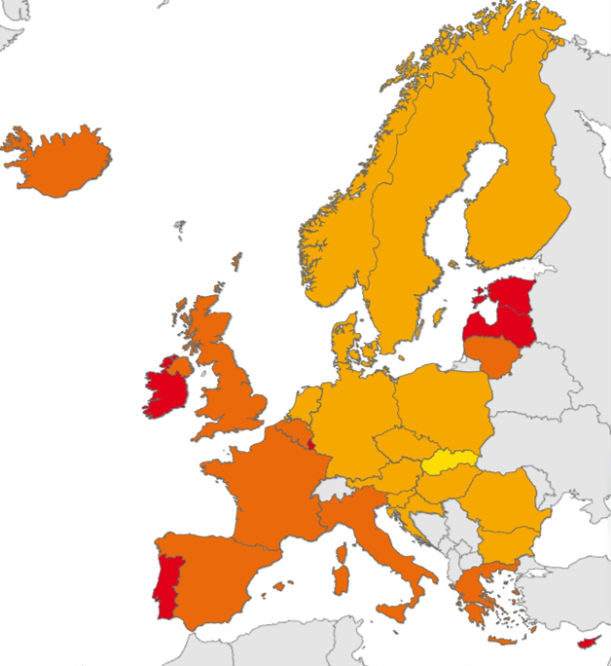
New HIV diagnoses, 2016, EU/EEA
Rate per 100 000 population
< 2
2 to <5
5 to <10
10 to 20
Not included or
not reporting
EU/EEA rate: 5.9 per 100 000*
Non-visible countries
Liechtenstein
Luxembourg
Malta
Source: ECDC/WHO (2017). HIV/AIDS Surveillance in Europe 2017– 2016 data
* adjusted for reporting delay

Slide 5
Male-to-female ratio in new HIV diagnoses, by country, EU/EEA, 2016
EU/EEA
Male-Female ratio: 3.2
Source: ECDC/WHO (2017). HIV/AIDS Surveillance in Europe 2017– 2016 data

Slide 6
Age- and gender-specific rates of HIV diagnoses per 100 000 population, EU/EEA, 2016
Women
Men
Source: ECDC/WHO (2017). HIV/AIDS Surveillance in Europe 2017– 2016 data

Slide 7
New HIV diagnoses, by transmission mode and age group, EU/EEA, 2016
15-19 years
20-24 years
25-29 years
30-39 years
40-49 years
50+ years
Source: ECDC/WHO (2017). HIV/AIDS Surveillance in Europe 2017– 2016 data

Slide 8
Percentage of new HIV diagnoses, by country and age group, EU/EEA, 2016
<15 years
15-19 years
20-24 years
25-29 years
30-39 years
40-49 years
50+ years
Source: ECDC/WHO (2017). HIV/AIDS Surveillance in Europe 2017– 2016 data

Slide 9
Percentage of new HIV diagnoses, by transmission and country, EU/EEA, 2016
Sex between men
Injecting
drug use
Heterosexual
Other/
undetermined
Source: ECDC/WHO (2017). HIV/AIDS Surveillance in Europe 2017– 2016 data

Slide 10
Reported HIV transmission modes in the EU/EEA, 2016
Unknown mode of transmission is excluded from proportions presented here.

Slide 11
Proportion HIV diagnoses in migrants* by country of report, EU/EEA 2016
New diagnoses in migrants from high-endemic countries
New diagnoses in migrants from other countries
EU/EEA: 40% diagnosed in 2016 were born abroad
* Migrants are all persons born outside of the country in which the diagnosis was made.
Data include only cases with known region of origin;
One or no cases were reported among migrants in Hungary or Liechtenstein
Source: ECDC/WHO (2017). HIV/AIDS Surveillance in Europe 2017– 2016 data

Slide 12
Proportion of persons diagnosed late* by demographic, EU/EEA, 2016
*Diagnosed late=CD4<350 cells/mm³ at diagnosis
Gender
Age group (years)
Transmission
Region of origin
Source: ECDC/WHO (2017). HIV/AIDS Surveillance in Europe 2017– 2016 data

Slide 13
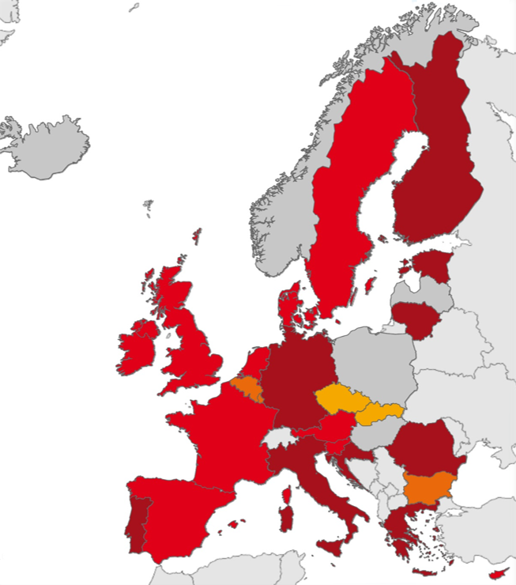
Late diagnosis, 2016, EU/EEA
% persons with CD4
<350 cells/mm³ at HIV diagnosis
<30%
30 to <40%
40 to <50%
>50%
Missing data or did not report
EU/EEA Average: 48%
Non-visible countries
Luxembourg
Malta
Source: ECDC/WHO (2017). HIV/AIDS Surveillance in Europe 2017– 2016 data

Slide 14
HIV diagnoses, AIDS diagnoses and AIDS-related deaths per 100 000 population, EU-EEA, 2007-2016
HIV
AIDS
AIDS-related deaths
Deaths rates exclude countries not reporting deaths consistently over the period (Italy, Sweden)
Source: ECDC/WHO (2017). HIV/AIDS Surveillance in Europe 2017– 2016 data

Slide 15
New HIV diagnoses in men, by age group, EU-EEA, 2007-2016
15-19 years
20-24 years
25-29 years
30-39 years
40-49 years
50+ years
Data is adjusted for reporting delay
Source: ECDC/WHO (2017). HIV/AIDS Surveillance in Europe 2017– 2016 data

Slide 16
New HIV diagnoses in women, by age group, EU-EEA, 2007-2016
15-19 years
20-24 years
25-29 years
30-39 years
40-49 years
50+ years
Data is adjusted for reporting delay
Source: ECDC/WHO (2017). HIV/AIDS Surveillance in Europe 2017– 2016 data

Slide 17
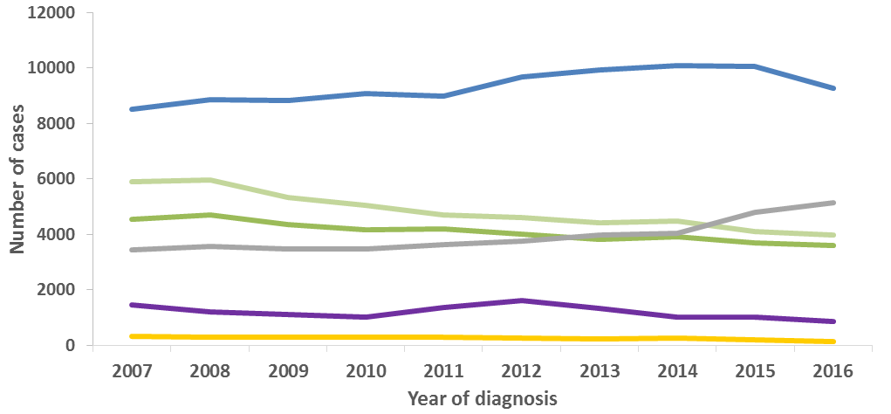
HIV diagnoses, by mode of
transmission, 2007-2016, EU/EEA
Sex between men
Other/
undetermined
Heterosexual (women)
Heterosexual
(men)
Injecting drug use
Mother-to-child transmission
Data is adjusted for reporting delay. Cases from Estonia and Poland excluded due to incomplete reporting on transmission mode during the period; cases from Italy and Spain excluded due to increasing national coverage over the period.
Source: ECDC/WHO (2017). HIV/AIDS Surveillance in Europe 2017– 2016 data

Slide 18
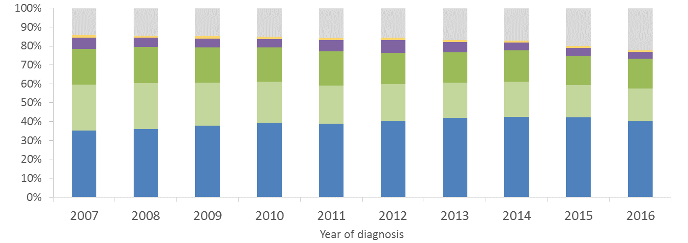
Proportion of HIV diagnoses,
by mode of transmission,
2007-2016, EU/EEA
Other/
undetermined
Mother-to-child transmission
Injecting
drug use
Heterosexual
(Men)
Heterosexual (women)
Sex between
men
Data is adjusted for reporting delay. Cases from Estonia and Poland excluded due to incomplete reporting on transmission mode during the period; cases from Italy and Spain excluded due to increasing national coverage over the period.
Source: ECDC/WHO (2017). HIV/AIDS Surveillance in Europe 2017– 2016 data

Slide 19
New HIV diagnoses, by year of diagnosis, transmission and migration status, EU/EEA, 2007-2016
Data is adjusted for reporting delay
Source: ECDC/WHO (2017). HIV/AIDS Surveillance in Europe 2017– 2016 data

Slide 20
Median CD4 cell count per mm³ at HIV diagnosis, by transmission group, EU/EEA, 2007-2016
Sex between men
All new diagnoses
Heterosexual
Injecting drug use
Excludes countries with >60% incomplete data on CD4 cell count during any year over the period (Bulgaria, Croatia, Estonia, Germany, Hungary, Italy, Ireland,
Latvia, Lithuania, Malta, Norway, Poland, Portugal, Sweden)
Source: ECDC/WHO (2017). HIV/AIDS Surveillance in Europe 2017– 2016 data

Slide 21
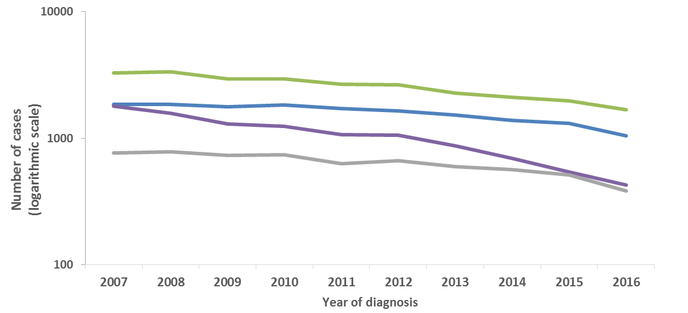
AIDS diagnoses, by transmission mode, EU/EEA, 2007-2016
Heterosexual
Sex between men
Injecting drug use
Other/
undetermined
Source: ECDC/WHO (2017). HIV/AIDS Surveillance in Europe 2017– 2016 data

Slide 22
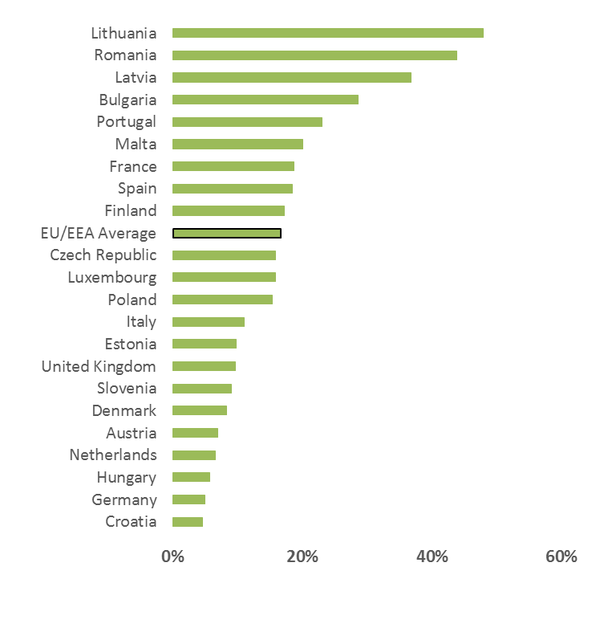
Proportion of persons diagnosed with AIDS with tuberculosis as an AIDS-defining illness, EU/EEA, 2016
EU/EEA Average: 17%
Source: ECDC/WHO (2017).
HIV/AIDS Surveillance in Europe 2017– 2016 data
Countries that did not report AIDS (Sweden and Belgium) or reported no cases of TB as an AIDS-defining illness (Cyprus, Estonia, Hungary, Ireland, Iceland, Luxembourg, Norway, Slovakia) or did not report AIDS-defining illnesses at all (Greece) are excluded

Slide 23
Conclusions: EU/EEA (1)
Although preventable through effective public health measures, significant HIV transmission continues in the EU/EEA
2016 HIV surveillance data from EU/EEA countries indicates that:
sex between men accounted for the largest proportion of cases diagnosed in 2016 (40%).
40% of HIV diagnoses in 2016 were among people originating from outside the reporting country.
there is evidence of a decline in the rate of new HIV diagnoses in the region as a whole.
despite the overall decline, HIV rates continue to increase in 11/31 EU/EEA countries.
Nearly half (48%) of those diagnosed in 2016 were diagnosed late (CD4 cell count of <350/mm³ at diagnosis).
Source: ECDC/WHO (2016). HIV/AIDS Surveillance in Europe, 2015

Slide 24
Conclusions: EU/EEA (2)
Evidence-based HIV prevention interventions tailored to the local epidemiological context and targeted at those most at risk should be sustained and scaled-up.
Programmes for men who have sex with men should be a cornerstone of HIV prevention in all EU/EEA countries
Given the high proportion of HIV cases among migrants in many EU/EEA countries, and evidence of post-migration HIV-acquisition, migrant-sensitive prevention services are crucial
Adequate harm reduction levels will continue to prevent HIV among people who inject drugs
Expansion of HIV testing and linkage to care will ensure early diagnosis and access to treatment; this will reduce the number of late presenters and improve treatment outcomes.
Source: ECDC/WHO (2016). HIV/AIDS Surveillance in Europe, 2015

Slide 25
WHO European Region

Slide 26
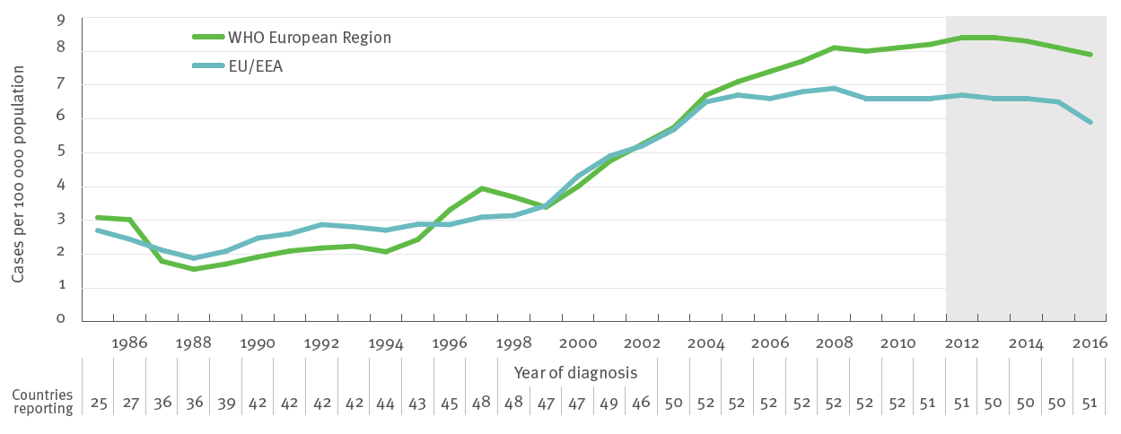
Rate of new HIV diagnoses per 100 000 population, by year of diagnosis, EU/EEA and the WHO European Region*, 1985-2016
*Data are adjusted for reporting delay; data from Russia are not included
Source: ECDC/WHO (2017). HIV/AIDS Surveillance in Europe 2017– 2016 data

Slide 27
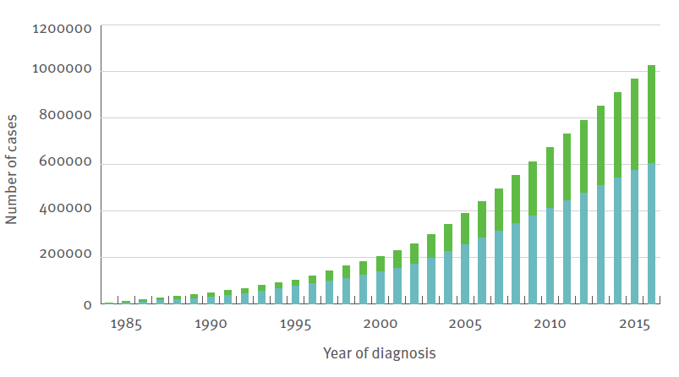
Cumulative number of new HIV diagnoses in the EU/EEA and other countries of the WHO European Region*, 1984-2016
EU/EEA
Other countries of the WHO European Region
* Data from Russia not included
Source: ECDC/WHO (2017). HIV/AIDS Surveillance in Europe 2017– 2016 data

Slide 28
New HIV diagnoses per 100 000 population, 2016
New diagnoses per 100 000 population
Source: ECDC/WHO (2017). HIV/AIDS Surveillance in Europe 2017– 2016 data

Slide 29
New HIV diagnoses in men per 100 000 male population, 2016
New diagnoses per 100 000 population
Source: ECDC/WHO (2017). HIV/AIDS Surveillance in Europe 2017– 2016 data

Slide 30
New HIV diagnoses in women per 100 000 female population, 2016
New diagnoses per 100 000 population
Data is adjusted for reporting delay
Source: ECDC/WHO (2017). HIV/AIDS Surveillance in Europe 2017– 2016 data

Slide 31
Proportion of persons diagnosed late*, by demographic, WHO European Region, 2016
*Diagnosed late=CD4<350 cells/mm³ at diagnosis
Source: ECDC/WHO (2017). HIV/AIDS Surveillance in Europe 2017– 2016 data

Slide 32
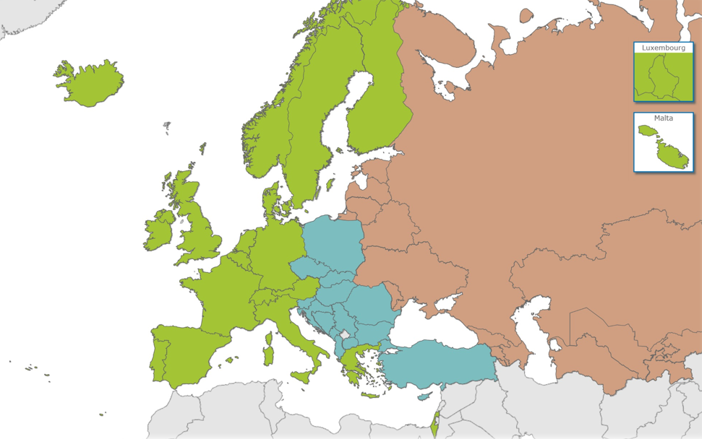
WHO European Region
Source: ECDC/WHO (2017). HIV/AIDS Surveillance in Europe 2017– 2016 data

Slide 33
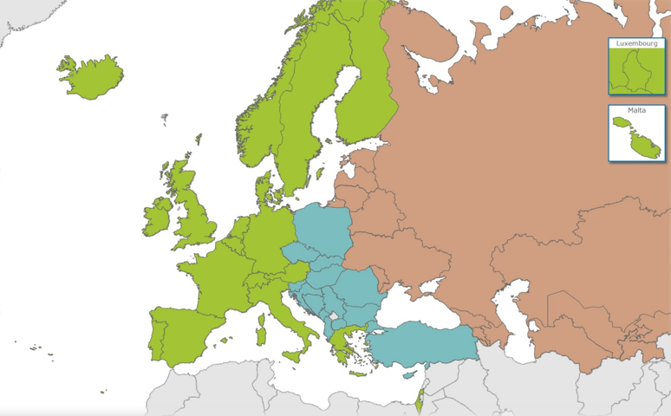
New HIV diagnoses, WHO European Region, 2016
160 453 new HIV diagnoses in the European Region
(18.2 per 100 000 population)
6.2 per 100 000;
17% of new diagnoses
2.9 per 100 000;
4% of new diagnoses
50.2 per 100 000;
80% of new diagnoses
West
Centre
East
Source: ECDC/WHO (2017). HIV/AIDS Surveillance in Europe 2017– 2016 data

Slide 34
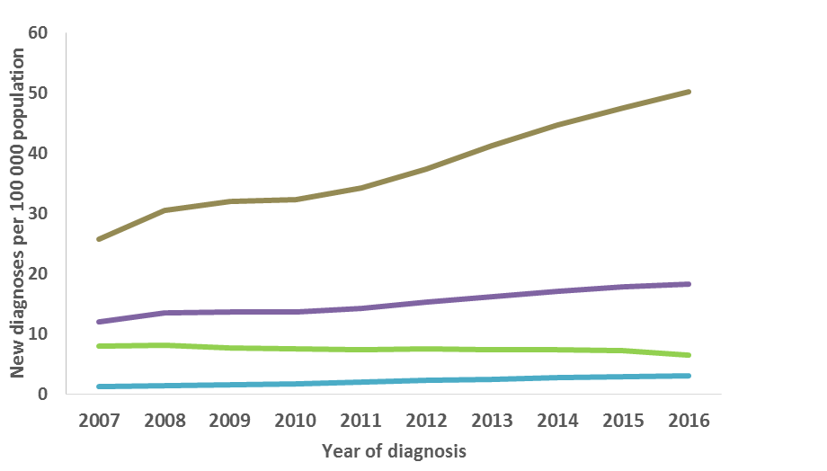
Rate of new HIV diagnoses, by year of diagnosis, WHO European Region*, 2007-2016
East
WHO European Region
West
Centre
* Data for Russia were obtained through the Russian Federal Scientific and Methodological Center for Prevention and Control of AIDS; Sprakva; 2017
Source: ECDC/WHO (2017). HIV/AIDS Surveillance in Europe 2017– 2016 data

Slide 35
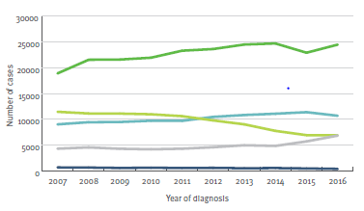
New HIV diagnoses, by transmission mode and year of diagnosis, WHO European Region, 2007-2016
Heterosexual
Sex between men
Injecting drug use
Other/
undetermined
Mother-to-child transmission
Data from Russia, Turkmenistan and Uzbekistan excluded due to inconsistent reporting during the period; data from Estonia, Poland and Turkey excluded due to incomplete reporting on transmission mode during the period; data from Italy and Spain excluded due to increasing coverage of national surveillance during the period.
Source: ECDC/WHO (2017). HIV/AIDS Surveillance in Europe 2017– 2016 data

Slide 36
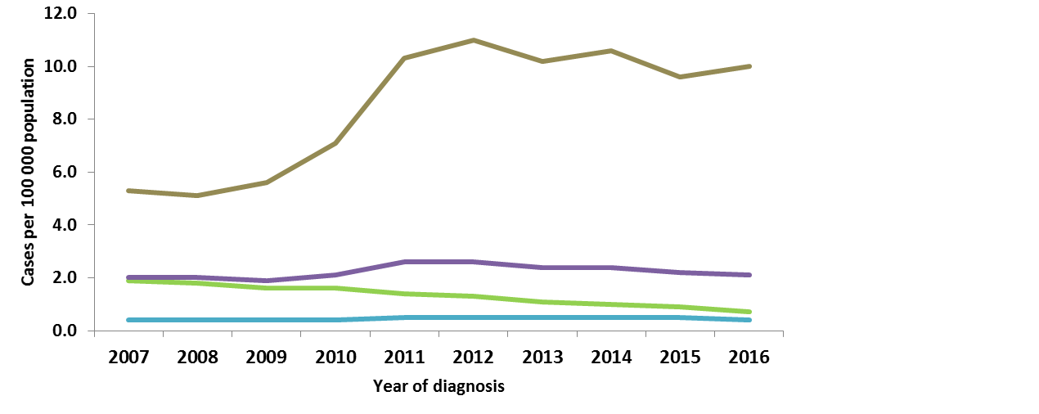
Rate of new AIDS diagnoses, by year of diagnosis, WHO European Region, 2007-2016
East
WHO European Region
West
Centre
Source: ECDC/WHO (2017). HIV/AIDS Surveillance in Europe 2017– 2016 data

Slide 37
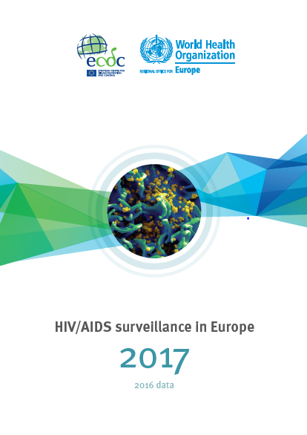
Full report can be
downloaded at:
www.ecdc.europa.eu
http://bit.ly/HIVAIDS_17

