Slide 1
HIV/AIDS Surveillance 2019 2018 data
European Centre for Disease Prevention and Control
WHO Regional Office for Europe

Slide 2
New HIV diagnoses in the EU/EEA, 2018
Reporting countries/number of countries | 31/31
Number of HIV diagnoses | 26 164
Rate per 100 000 population (adjusted rate*) | 5.6
Male-to-female ratio | 3.1
Percentage new diagnoses CD4<350 cells/mm³ | 49%
Transmission mode (%)
Sex between men | 40
Heterosexual transmission (men) | 16
Heterosexual transmission (women) | 17
Injecting drug use | 4
Mother to child transmission | <1
Unknown | 23
* Adjusted for reporting delay
Source: ECDC/WHO (2019). HIV/AIDS Surveillance in Europe 2019– 2018 data

Slide 3
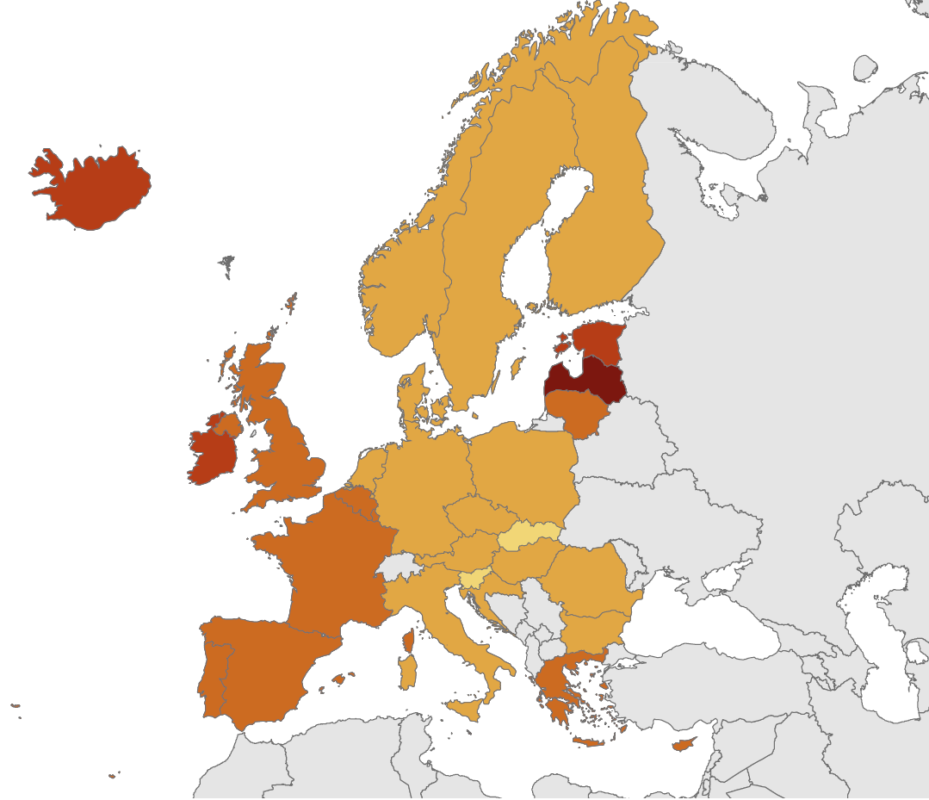
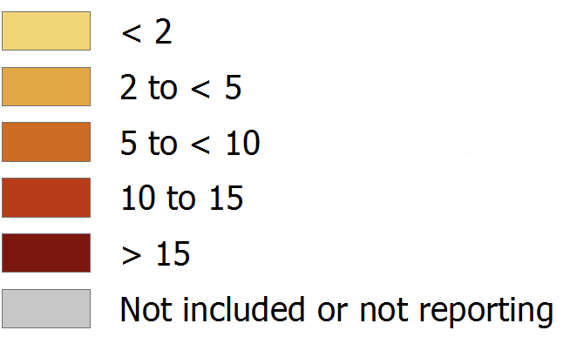
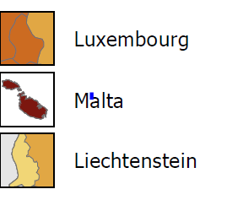
New HIV diagnoses, 2018, EU/EEA
Rate per 100 000 population
EU/EEA rate: 5.6 per 100 000
adjusted for reporting delay
Non-visible countries
Source: ECDC/WHO (2019). HIV/AIDS Surveillance in Europe 2019– 2018 data

Slide 4
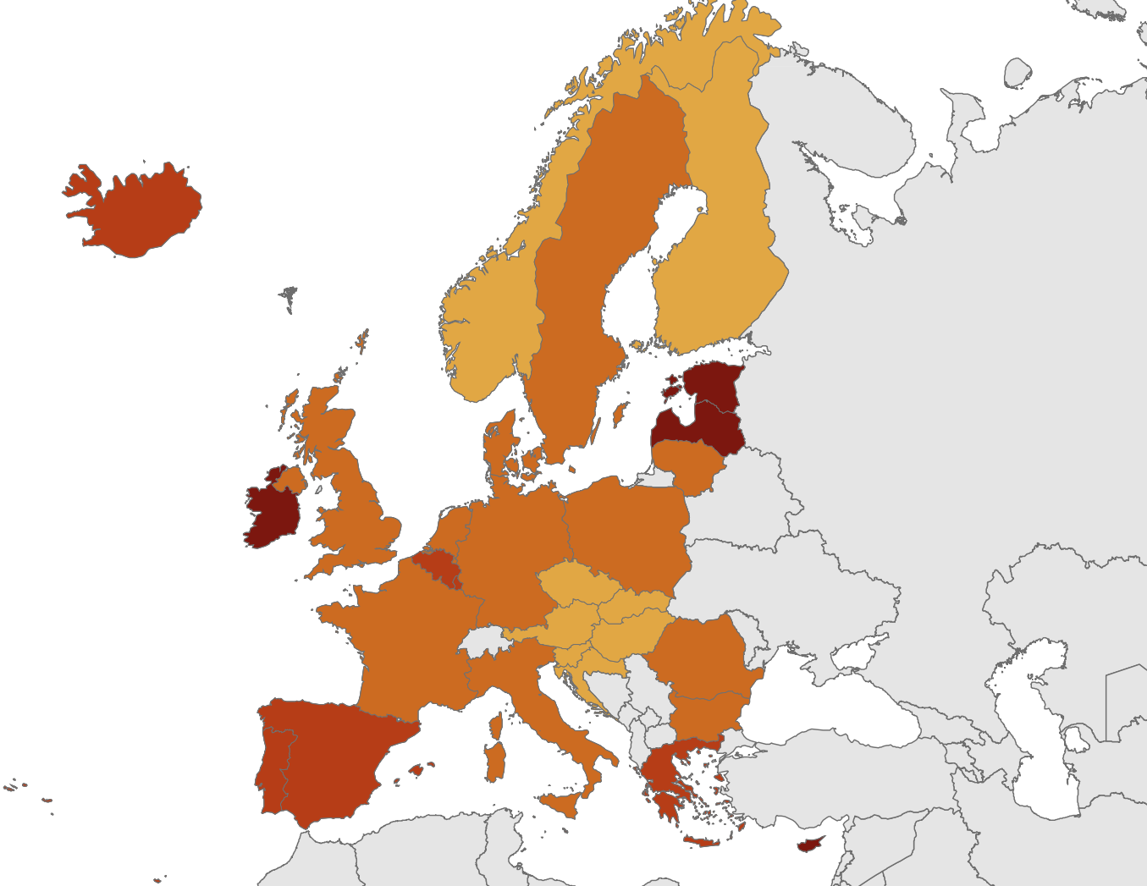
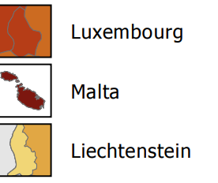
New HIV diagnoses in men, 2018, EU/EEA
Rate per 100 000 male population
EU/EEA rate: 7.9 per 100 000
Non-visible countries
Source: ECDC/WHO (2019). HIV/AIDS Surveillance in Europe 2019– 2018 data

Slide 5
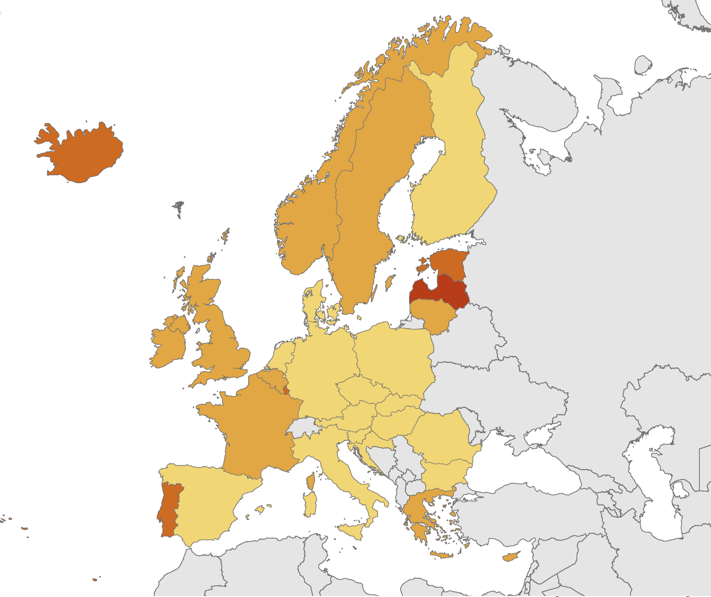
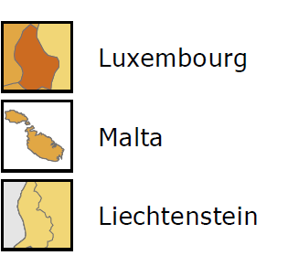
New HIV diagnoses in women, 2018, EU/EEA
Rate per 100 000 female population
EU/EEA rate: 2.4 per 100 000
Non-visible countries
Source: ECDC/WHO (2018). HIV/AIDS Surveillance in Europe 2019– 2018 data

Slide 6
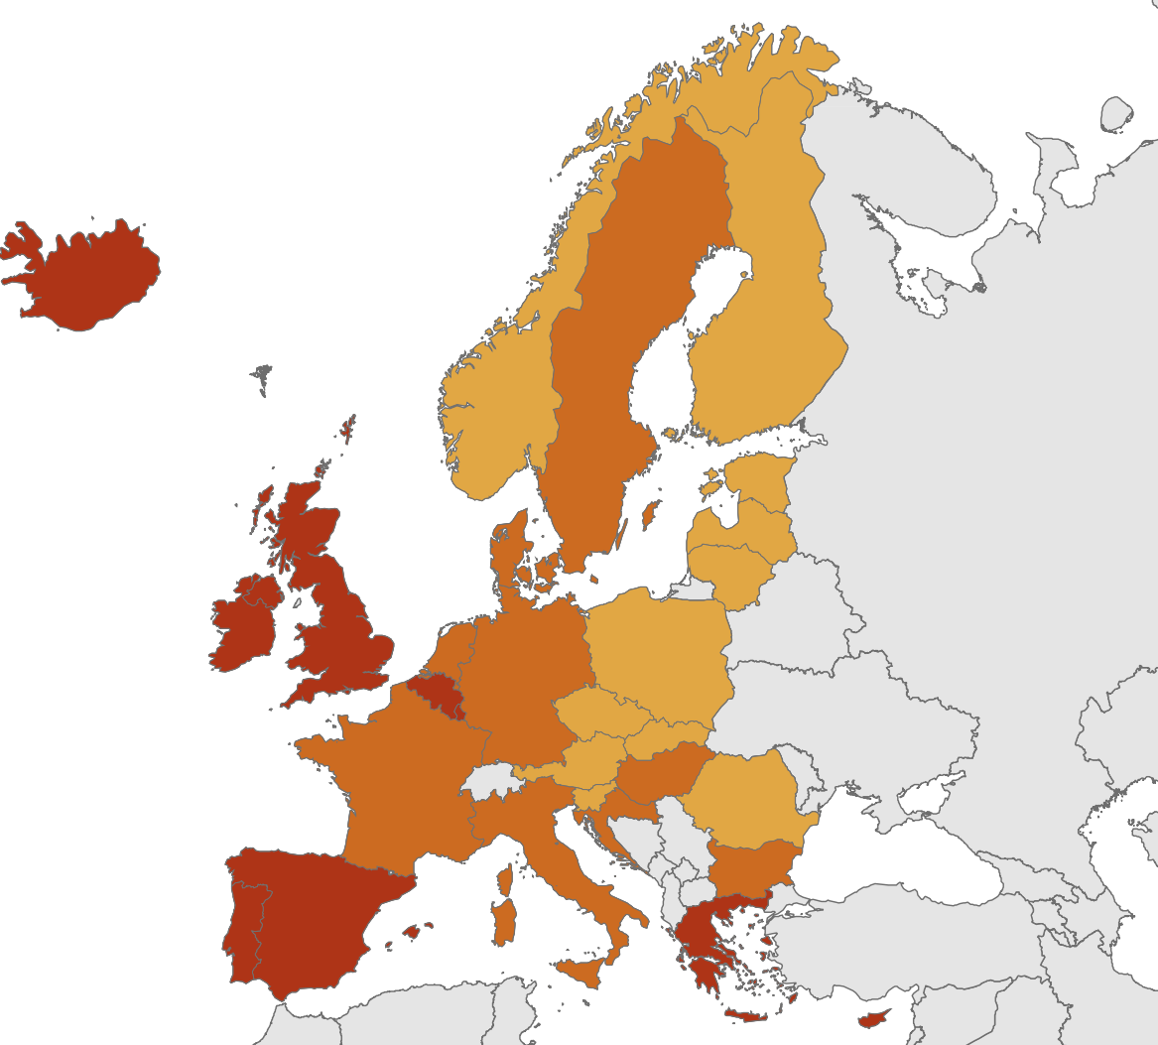
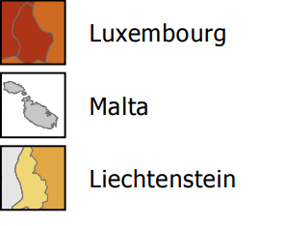
New HIV diagnoses attributed to sex between men, 2018, EU/EEA
Rate per 100 000 male population
EU/EEA rate: 4.2 per 100 000
Non-visible countries
Source: ECDC/WHO (2019). HIV/AIDS Surveillance in Europe 2019– 2018 data

Slide 7
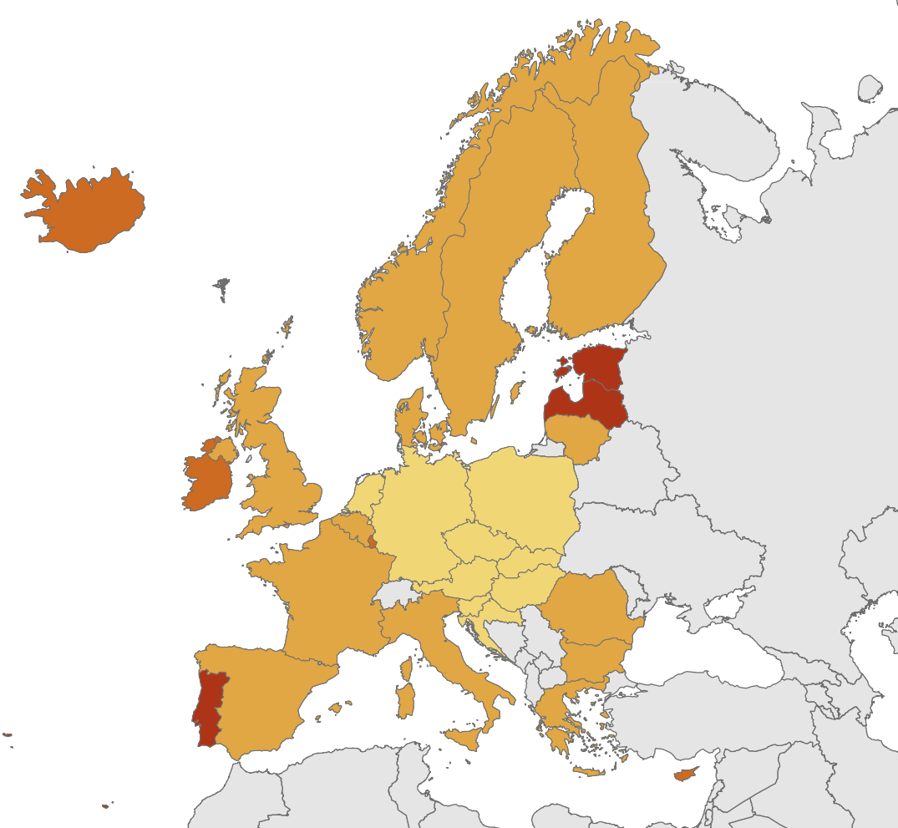
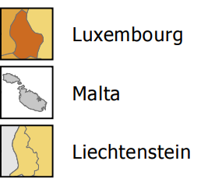
New HIV diagnoses attributed to heterosexual transmission, 2018, EU/EEA
Rate per 100 000 population
EU/EEA rate: 1.7 per 100 000
Non-visible countries
Source: ECDC/WHO (2019). HIV/AIDS Surveillance in Europe 2019– 2018 data

Slide 8
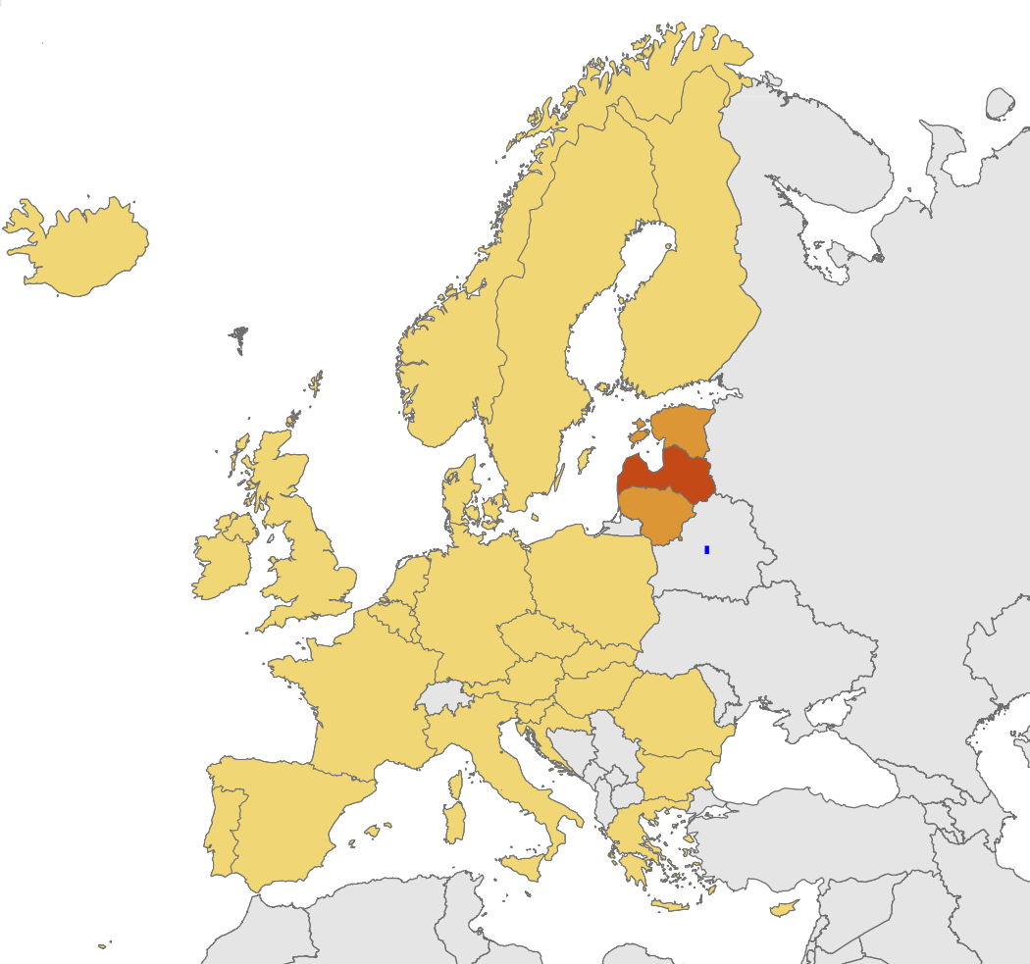
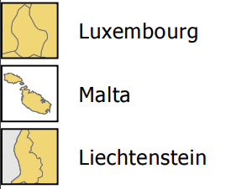
New HIV diagnoses attributed to
injecting drug use, 2018, EU/EEA
Rate per 100 000 population
EU/EEA rate: 0.2 per 100 000
Non-visible countries
Source: ECDC/WHO (2019). HIV/AIDS Surveillance in Europe 2019– 2018 data

Slide 9
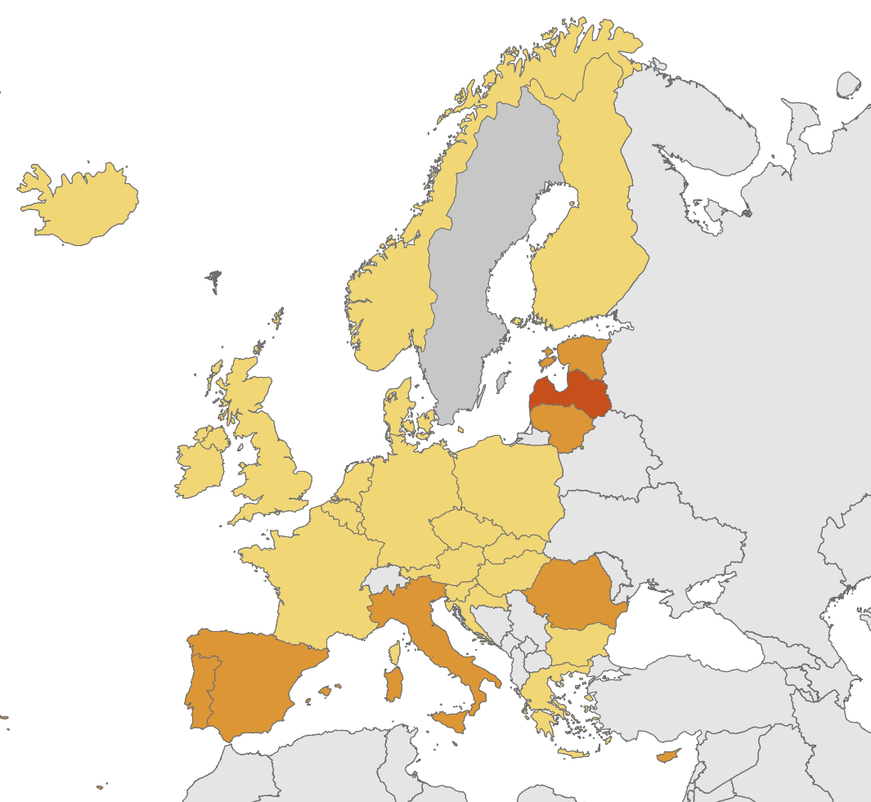
AIDS diagnoses, 2018, EU/EEA
Rate per 100 000 population
EU/EEA rate: 0.6 per 100 000
Non-visible countries
Source: ECDC/WHO (2019). HIV/AIDS Surveillance in Europe 2019– 2018 data

Slide 10
Age- and gender-specific rates of HIV diagnoses per 100 000 population, EU/EEA, 2018
Women
Men
Source: ECDC/WHO (2019). HIV/AIDS Surveillance in Europe 2019– 2018 data

Slide 11
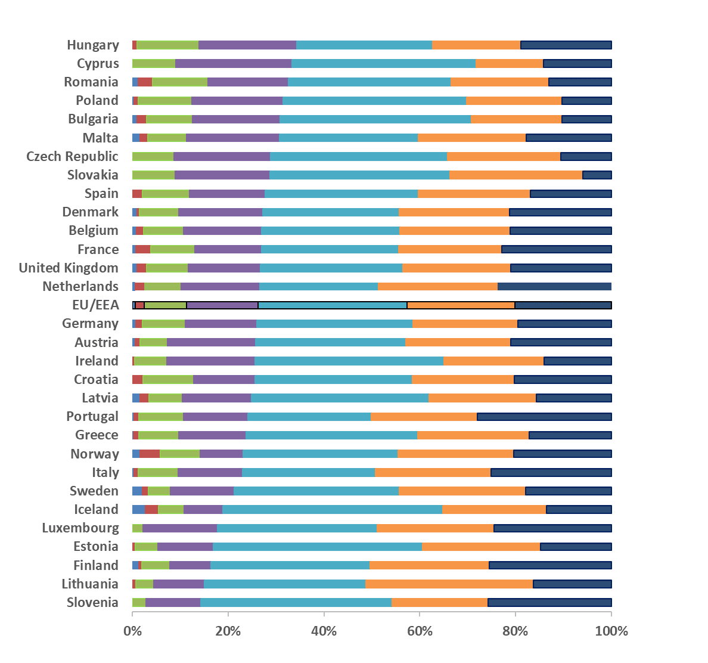
Percentage of new HIV diagnoses, by country and age group, EU/EEA, 2018
<15 years
15-19 years
20-24 years
25-29 years
30-39 years
40-49 years
50+ years
Source: ECDC/WHO (2019). HIV/AIDS Surveillance in Europe 2019– 2018 data

Slide 12
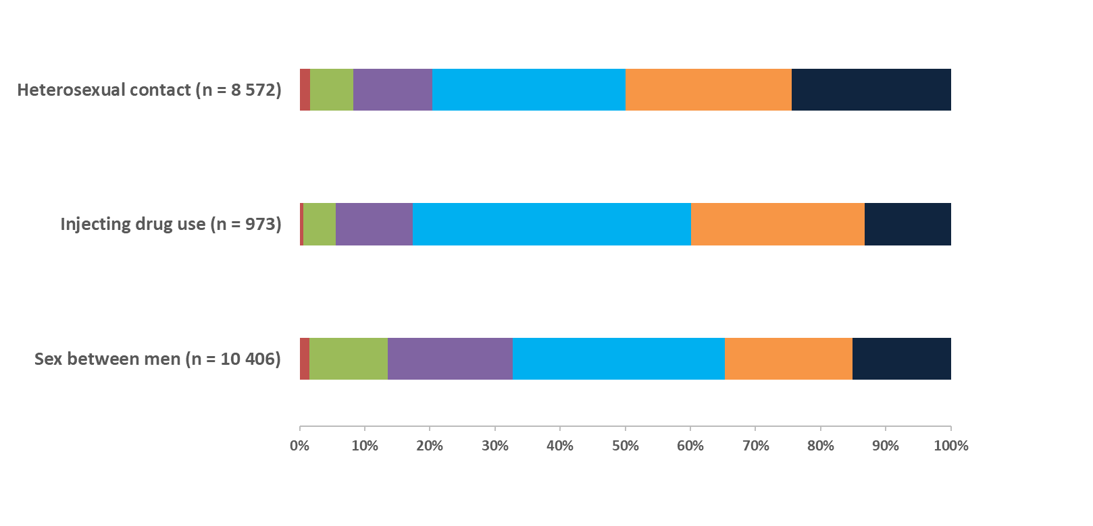
New HIV diagnoses, by transmission mode and age group, EU/EEA, 2018
15-19 years
20-24 years
25-29 years
30-39 years
40-49 years
50+ years
Source: ECDC/WHO (2019). HIV/AIDS Surveillance in Europe 2019– 2018 data

Slide 13
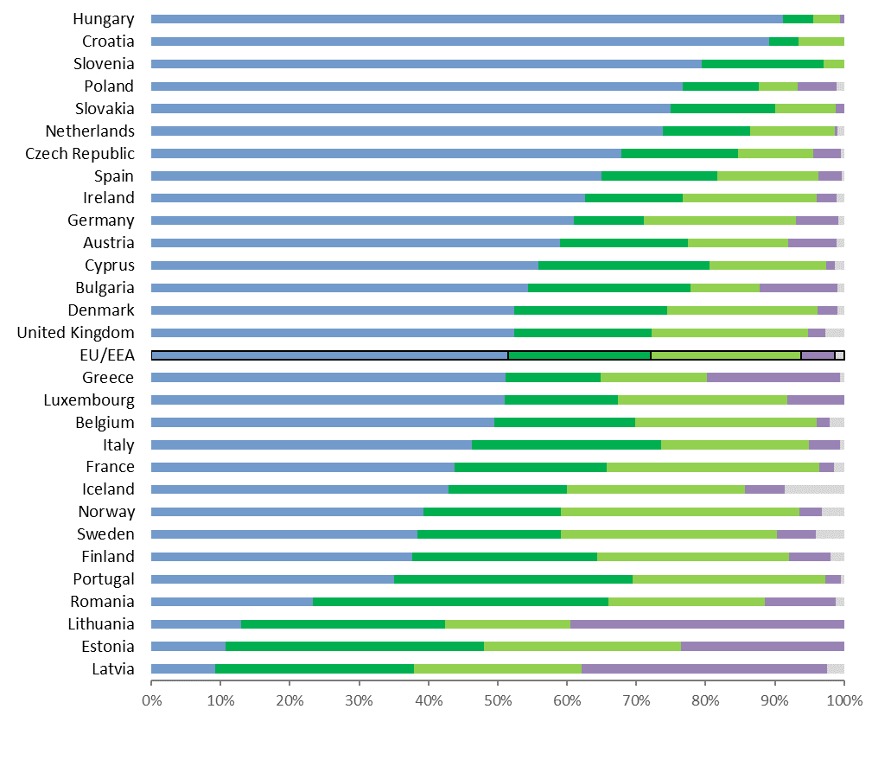
Percentage of new HIV diagnoses, by transmission and country, EU/EEA, 2018
Sex between men
Heterosexual contact (males)
Heterosexual contact (females)
Injecting
drug use
Other/
undetermined
Note: Zero cases were reported by Liechtenstein and Malta did not report transmission route in 2018
Source: ECDC/WHO (2019). HIV/AIDS Surveillance in Europe 2019– 2018 data

Slide 15
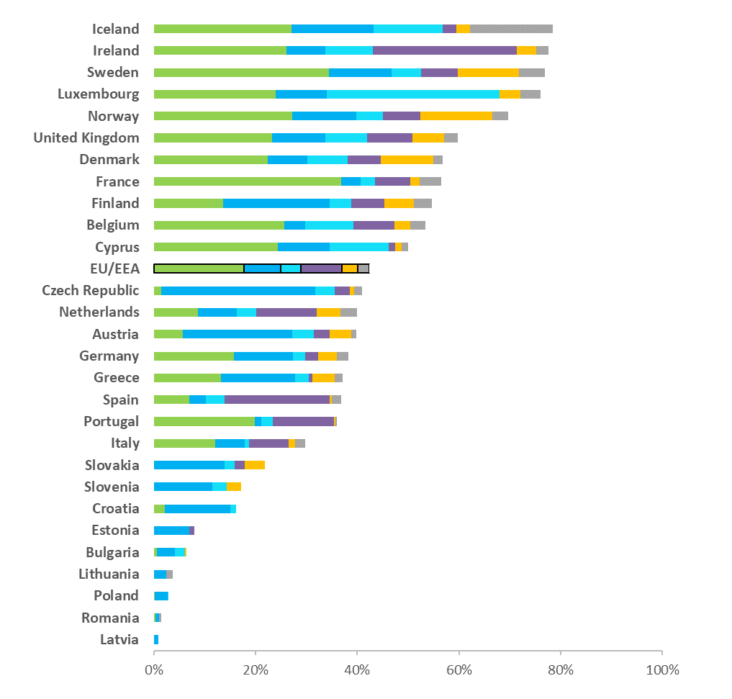
Proportion HIV diagnoses in migrants* by region of origin and country of report, EU/EEA 2018
Sub-Saharan Africa
Central and Eastern Europe
Western Europe
Latin American and Caribbean
South and Southeast Asia
Other
* Migrants include all persons born outside of the country in which the diagnosis was made.
EU/EEA: 42% diagnosed in 2018 were born abroad
Data include only cases with known region of origin;
Hungary and Malta did not report data on country of birth or region of origin
Source: ECDC/WHO (2019). HIV/AIDS Surveillance in Europe 2019– 2018 data

Slide 16
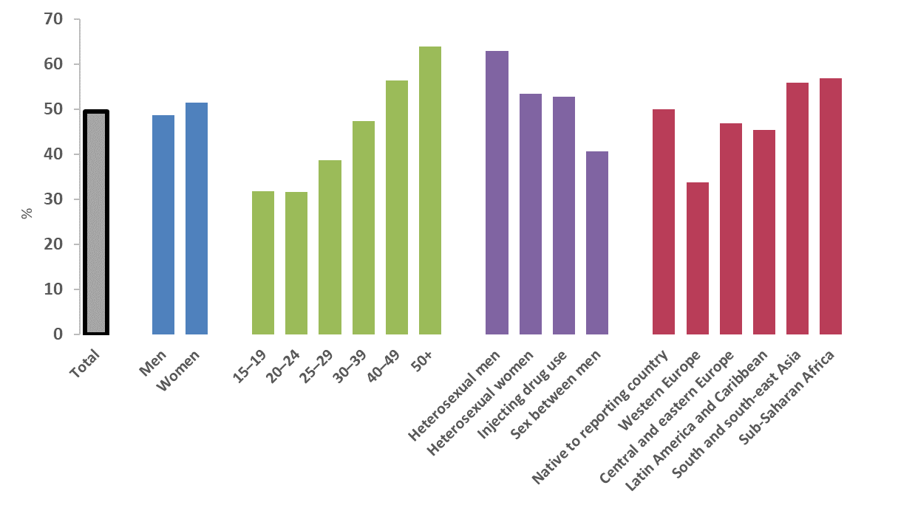
Proportion of persons diagnosed late* by demographic, EU/EEA, 2018
*Diagnosed late=CD4<350 cells/mm³ at diagnosis
Gender
Age group (years)
Transmission
Region of origin
Source: ECDC/WHO (2019). HIV/AIDS Surveillance in Europe 2019– 2018 data

Slide 17
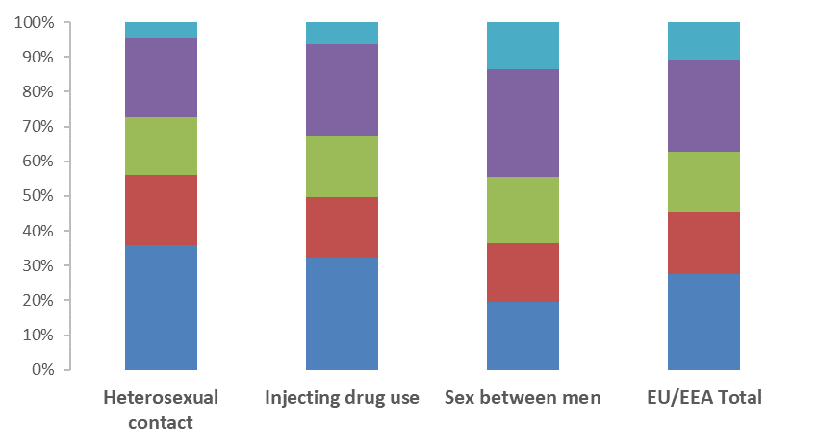
Acute infection or CD4 cell count per mm³ at HIV diagnosis, overall and by transmission group, EU/EEA, 2018
Acute Infection
500+
350 to <500
200 to <350
<200
Source: ECDC/WHO (2019). HIV/AIDS Surveillance in Europe 2019– 2018 data

Slide 18
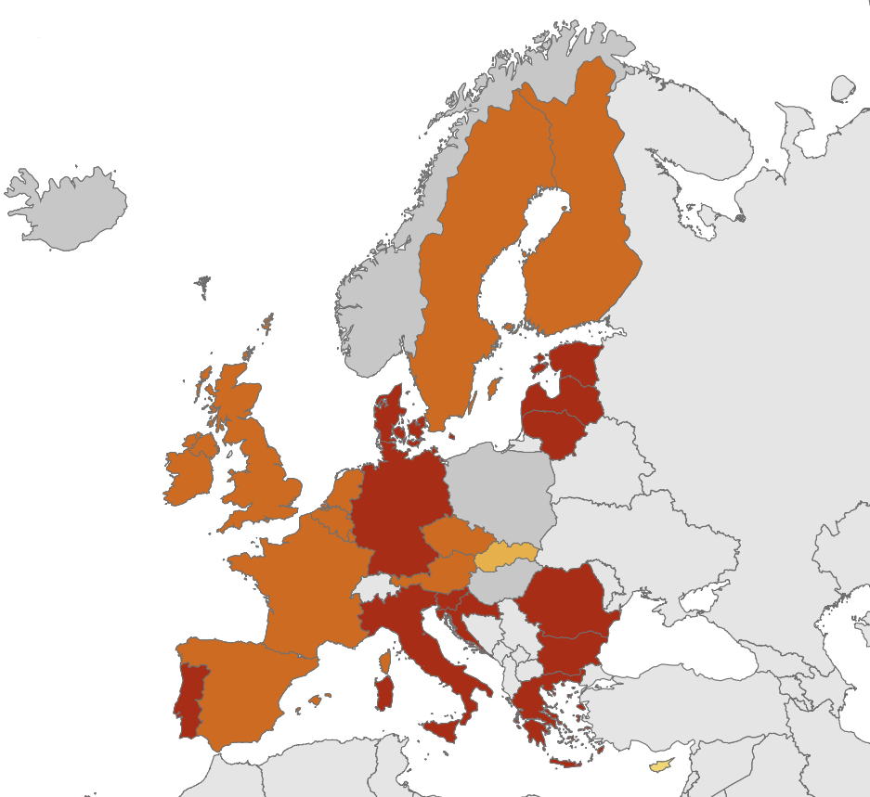
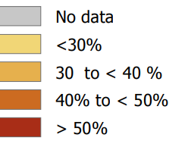
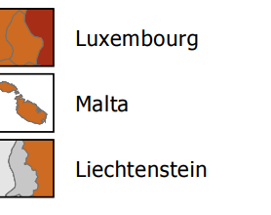
Late diagnosis, 2018, EU/EEA
% persons with CD4
<350 cells/mm³ at HIV diagnosis
EU/EEA average: 49%
Non-visible countries
Source: ECDC/WHO (2019). HIV/AIDS Surveillance in Europe 2019– 2018 data

Slide 19
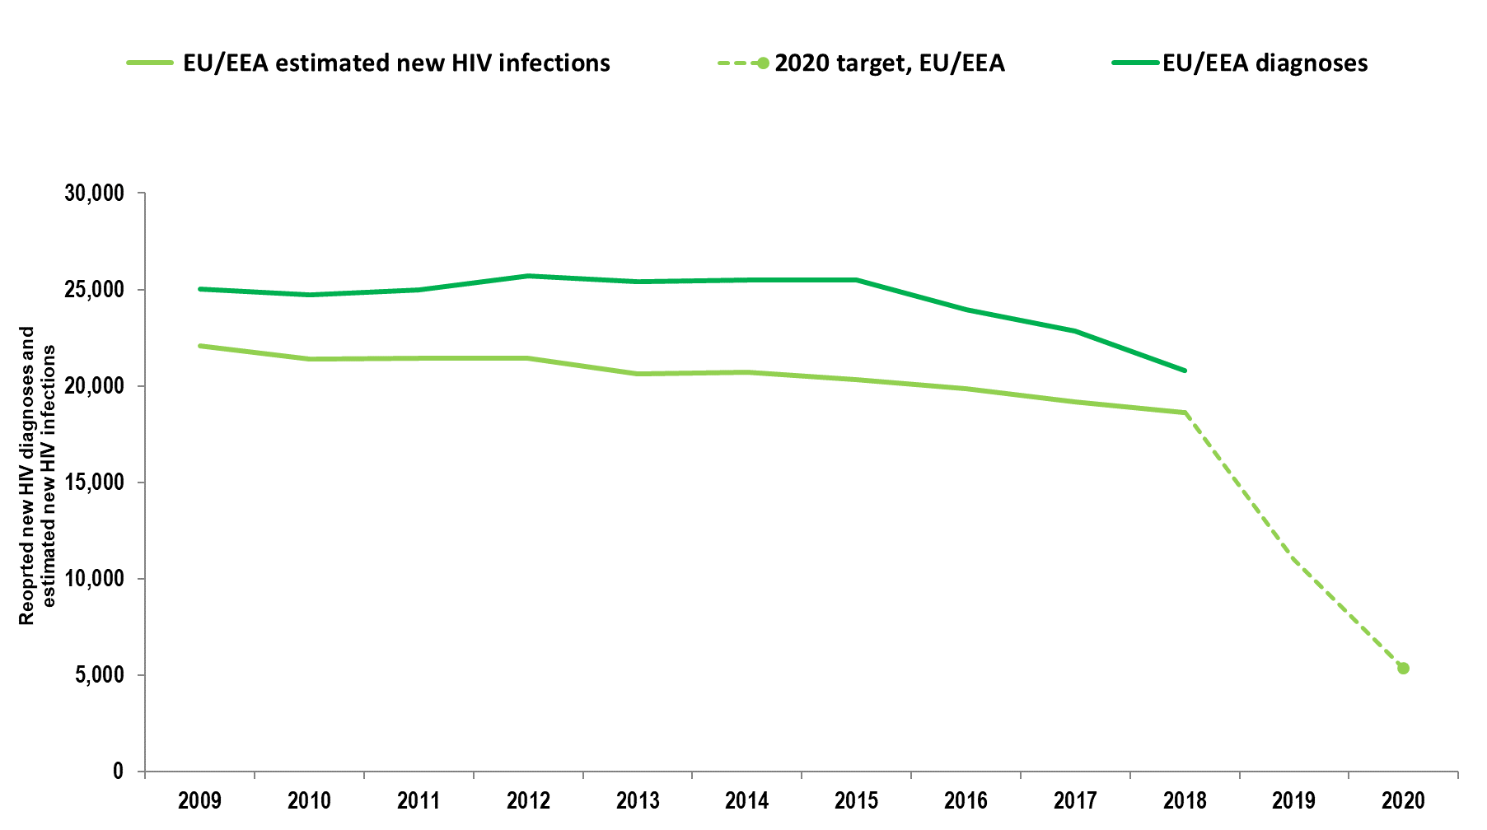
Estimated new HIV infections and reported diagnoses, EU/EEA, 2018
Source: ECDC/WHO (2019). HIV/AIDS Surveillance in Europe 2019– 2018 data

Slide 20
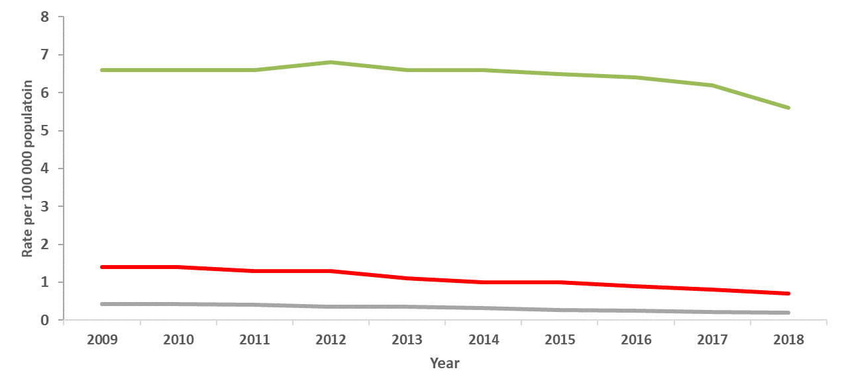
HIV diagnoses, AIDS diagnoses and AIDS-related deaths per 100 000 population, EU-EEA, 2009-2018
HIV
AIDS
AIDS-related deaths
Note: HIV rate is adjusted for reporting delay. Rates exclude countries not reporting consistently over the period: Sweden (AIDS and AIDS-deaths), Italy and Denmark (AIDS deaths)
Source: ECDC/WHO (2019). HIV/AIDS Surveillance in Europe 2019– 2018 data

Slide 21
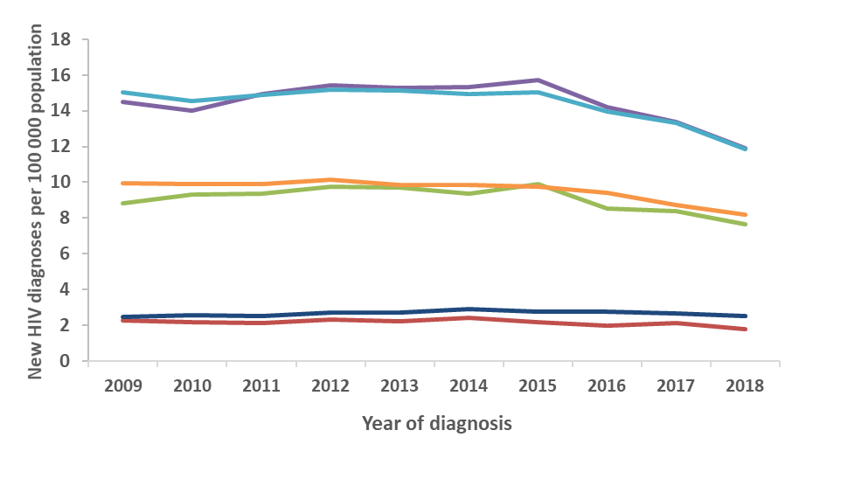
New HIV diagnoses, by age group, EU-EEA, 2009-2018
15-19 years
20-24 years
25-29 years
30-39 years
40-49 years
50+ years
Source: ECDC/WHO (2019). HIV/AIDS Surveillance in Europe 2019– 2018 data

Slide 22
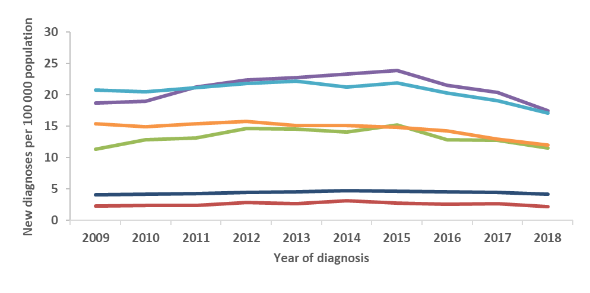
New HIV diagnoses in men, by age group, EU-EEA, 2009-2018
15-19 years
20-24 years
25-29 years
30-39 years
40-49 years
50+ years
Source: ECDC/WHO (2019). HIV/AIDS Surveillance in Europe 2019– 2018 data

Slide 23
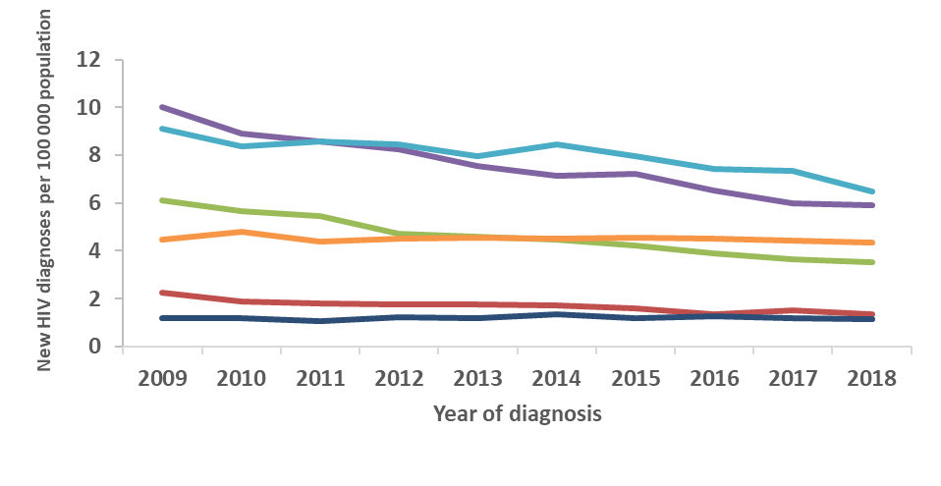
New HIV diagnoses in women, by age group, EU-EEA, 2009-2018
15-19 years
20-24 years
25-29 years
30-39 years
40-49 years
50+ years
Source: ECDC/WHO (2019). HIV/AIDS Surveillance in Europe 2019– 2018 data

Slide 24
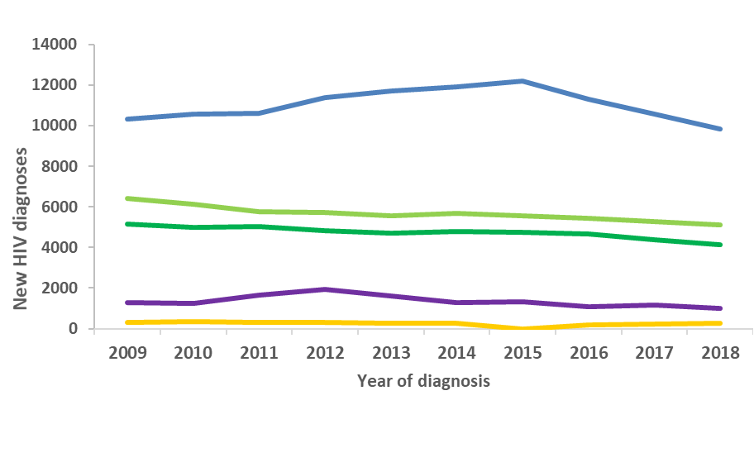
HIV diagnoses, by route of transmission,
2009-2018, EU/EEA
Sex between men
Heterosexual (women)
Heterosexual
(men)
Injecting drug use
Vertical transmission
Data is adjusted for reporting delay. Data for missing transmission is imputed. HIV diagnoses reported by Estonia, Malta and Poland excluded due to incomplete reporting on transmission mode for during some years of the period; diagnoses reported by Italy and Spain excluded due to incomplete reporting during a portion of the period.
Source: ECDC/WHO (2019). HIV/AIDS Surveillance in Europe 2019– 2018 data

Slide 25
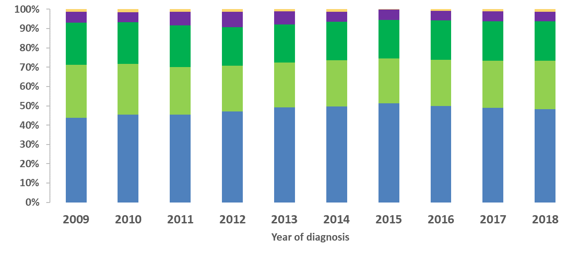
Proportion of HIV diagnoses,
by route of transmission, 2009-2018, EU/EEA
Vertical transmission
Injecting
drug use
Heterosexual
(men)
Heterosexual (women)
Sex between
men
Data is adjusted for reporting delay. Data for missing transmission is imputed. HIV diagnoses reported by Estonia, Malta and Poland excluded due to incomplete reporting on transmission mode for during some years of the period; diagnoses reported by Italy and Spain excluded due to incomplete reporting during a portion of the period.
Source: ECDC/WHO (2019). HIV/AIDS Surveillance in Europe 2019– 2018 data

Slide 26
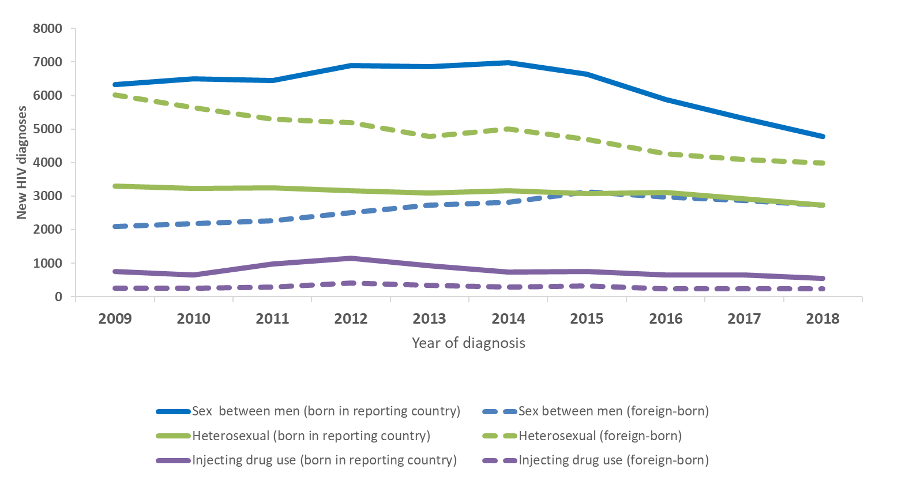
New HIV diagnoses, by year of diagnosis, transmission and migration status, EU/EEA, 2009-2018
HIV diagnoses reported by Estonia, Malta and Poland excluded due to incomplete reporting on transmission mode during some years of the period; diagnoses reported by Italy and Spain excluded due to incomplete reporting during a portion of the period.
Source: ECDC/WHO (2019). HIV/AIDS Surveillance in Europe 2019– 2018 data

Slide 27
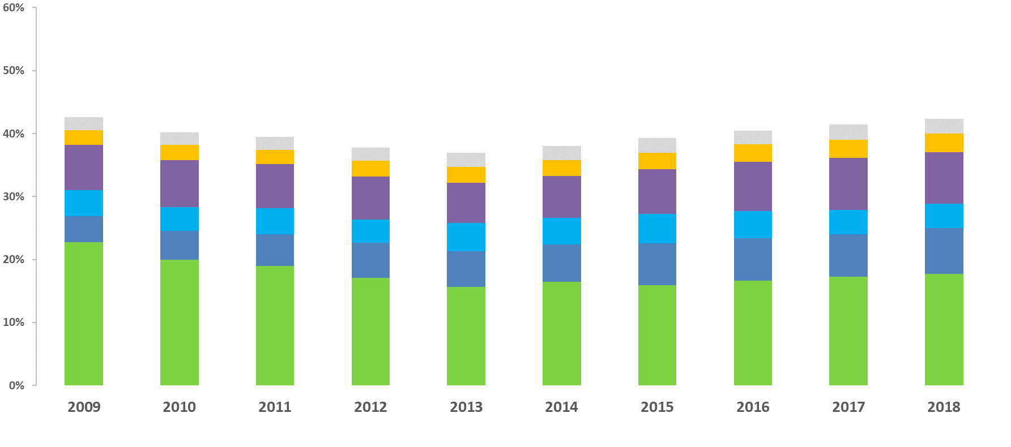
Proportion of HIV diagnoses in migrants, by region of origin, 2009-2018, EU/EEA
* Migrants include all persons born outside of the reporting country
Other
South and Southeast Asia
Latin American and Caribbean
Western Europe
Central and Eastern Europe
Sub-Saharan Africa
Data is adjusted for reporting delay. HIV diagnoses reported by Estonia and Poland excluded due to incomplete reporting on transmission mode during some years of the period; diagnoses reported by Italy and Spain excluded due to incomplete reporting during a portion of the period.
Source: ECDC/WHO (2019). HIV/AIDS Surveillance in Europe 2019– 2018 data

Slide 28
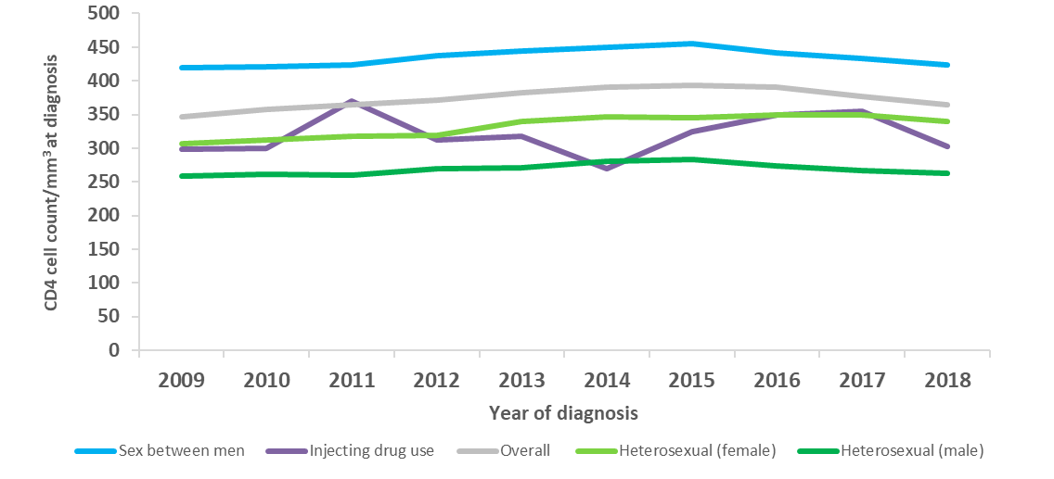
Median CD4 cell count per mm³ at HIV diagnosis, overall and by route of HIV transmission, EU/EEA, 2009-2018
Sex between men
All new diagnoses
Heterosexual (women)
Heterosexual
(men)
Injecting drug use
Note: Excludes countries with >60% incomplete data on CD4 cell count during any year over the period (Bulgaria, Croatia, Estonia, Germany, Hungary, Italy, Ireland, Latvia, Lithuania, Malta, Norway, Poland, Portugal, Sweden). Acute infections are excluded from this analysis.
Source: ECDC/WHO (2019). HIV/AIDS Surveillance in Europe 2019– 2018 data

Slide 29
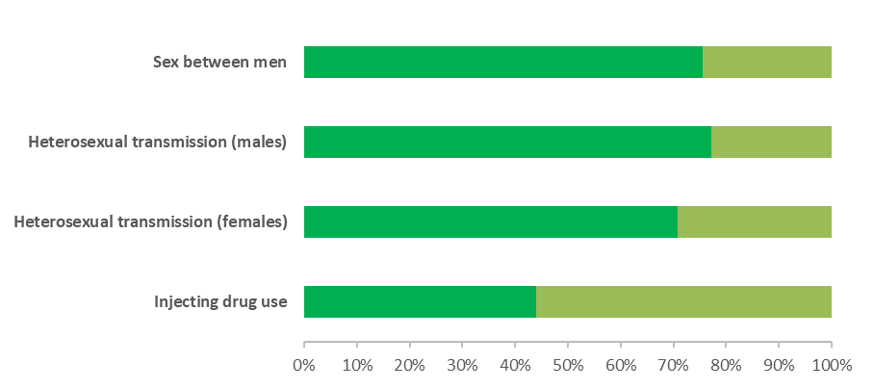
Proportion of AIDS diagnoses within 90 days of HIV diagnosis, by route of HIV transmission, EU/EEA, 2018
AIDS < 90 days of HIV diagnosis
AIDS > 90 days after HIV diagnosis
Source: ECDC/WHO (2019). HIV/AIDS Surveillance in Europe 2019– 2018 data

Slide 30
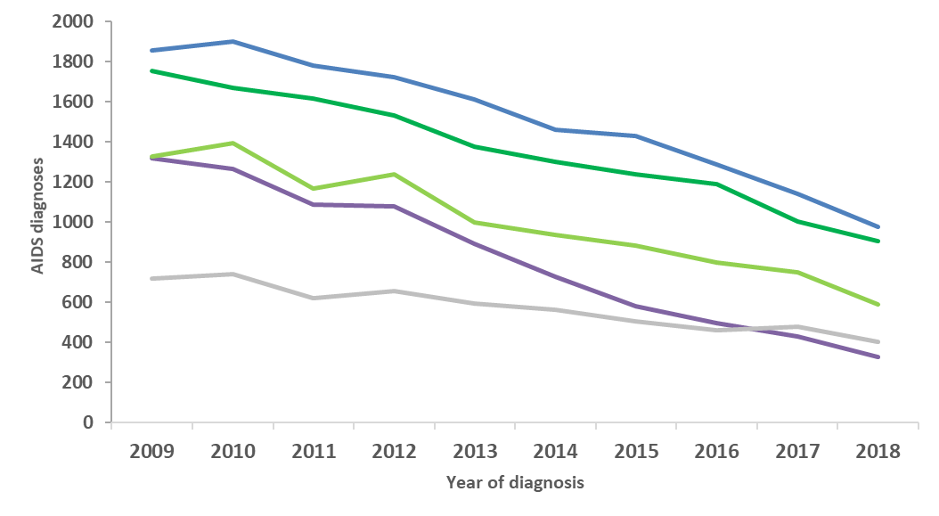
AIDS diagnoses, by route of HIV transmission, EU/EEA, 2009-2018
Sex between men
Heterosexual
(Men)
Heterosexual (women)
Other/
unknown
Injecting drug use
Note: Data from Sweden excluded due to inconsistent reporting during the period
Source: ECDC/WHO (2019). HIV/AIDS Surveillance in Europe 2019– 2018 data

Slide 31
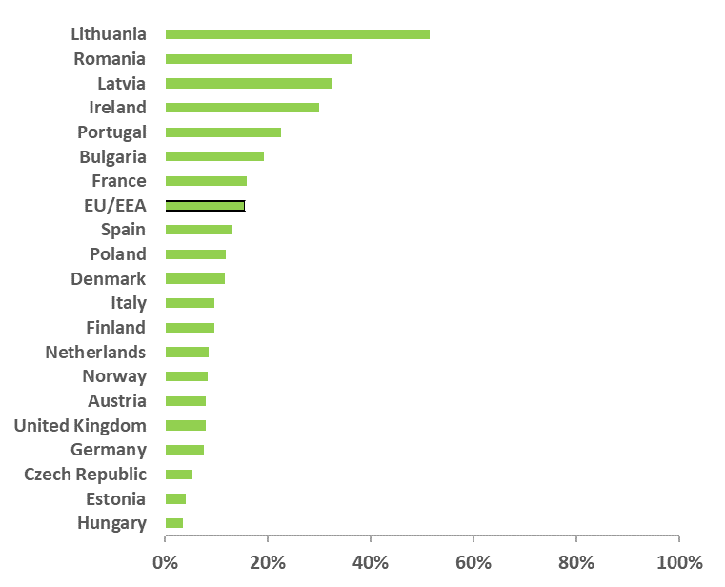
Proportion of people diagnosed with AIDS with tuberculosis as an AIDS-defining illness, EU/EEA, 2018
EU/EEA Average: 14%
Countries that did not report AIDS (Sweden) or reported no cases of TB as an AIDS-defining illness (Belgium, Croatia, Cyprus, Greece, Iceland, Luxembourg, Slovakia, Slovenia and Sweden) are excluded.
Source: ECDC/WHO (2019). HIV/AIDS Surveillance in Europe 2019– 2018 data

Slide 32
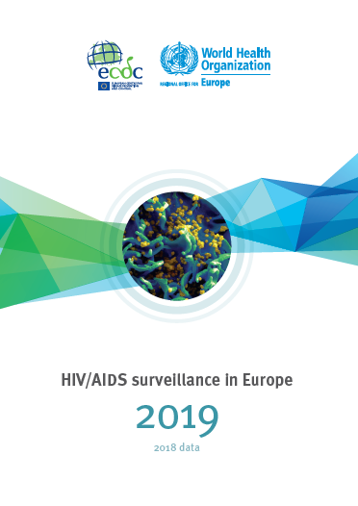
Full report can be
downloaded at
www.ecdc.europa.eu
Questions
STIHIVHEP@ecdc.europa.eu

