Slide 1
Tuberculosis situation in the EU/EEA, 2016
Findings from the joint report Tuberculosis surveillance and monitoring in Europe by ECDC and WHO Regional Office for Europe
Stockholm, 24 March 2018

Slide 2
Tuberculosis surveillance data, EU/EEA, 2016

Slide 3
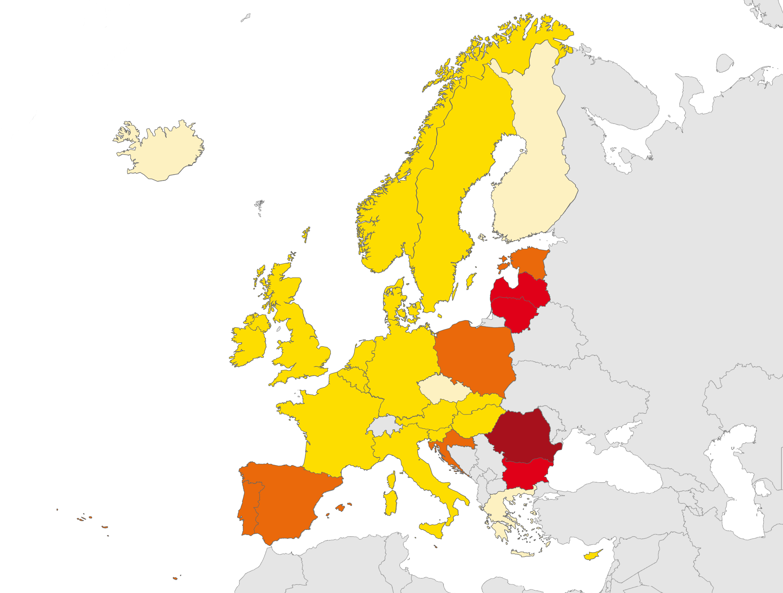
TB notifications, EU/EEA, 2016
58 994 TB cases notified in 30 EU/EEA countries
Notification rate of 11.4 per 100 000 population (range 1.8–68.9)
Cases per
100 000 population
< 5
5 to 9
10 to 19
20 to 49
≥ 50
Not reporting
Source: ECDC/WHO (2018). Tuberculosis surveillance and monitoring in Europe 2018–2016 data

Slide 4
Notified TB cases, EU/EEA, 2007–2016
Continuous decline between 2007 and 2016:
Number of TB cases decreased by 31%
Notification rate decreased by 32%
Year of reporting
Source: ECDC/WHO (2018). Tuberculosis surveillance and monitoring in Europe 2018–2016 data

Slide 5
TB notification rate by sex and age group, EU/EEA, 2016
The highest notification rate was observed in the age group 25–44 years (13.8 per 100 000)
Males were over-represented in all age groups > 14 years
Source: ECDC/WHO (2018). Tuberculosis surveillance and monitoring in Europe 2018–2016 data

Slide 6
TB notification rate by age group, EU/EEA, 2007–2016
Annual decrease by 2–4% in all age groups
Source: ECDC/WHO (2018). Tuberculosis surveillance and monitoring in Europe 2018–2016 data

Slide 7
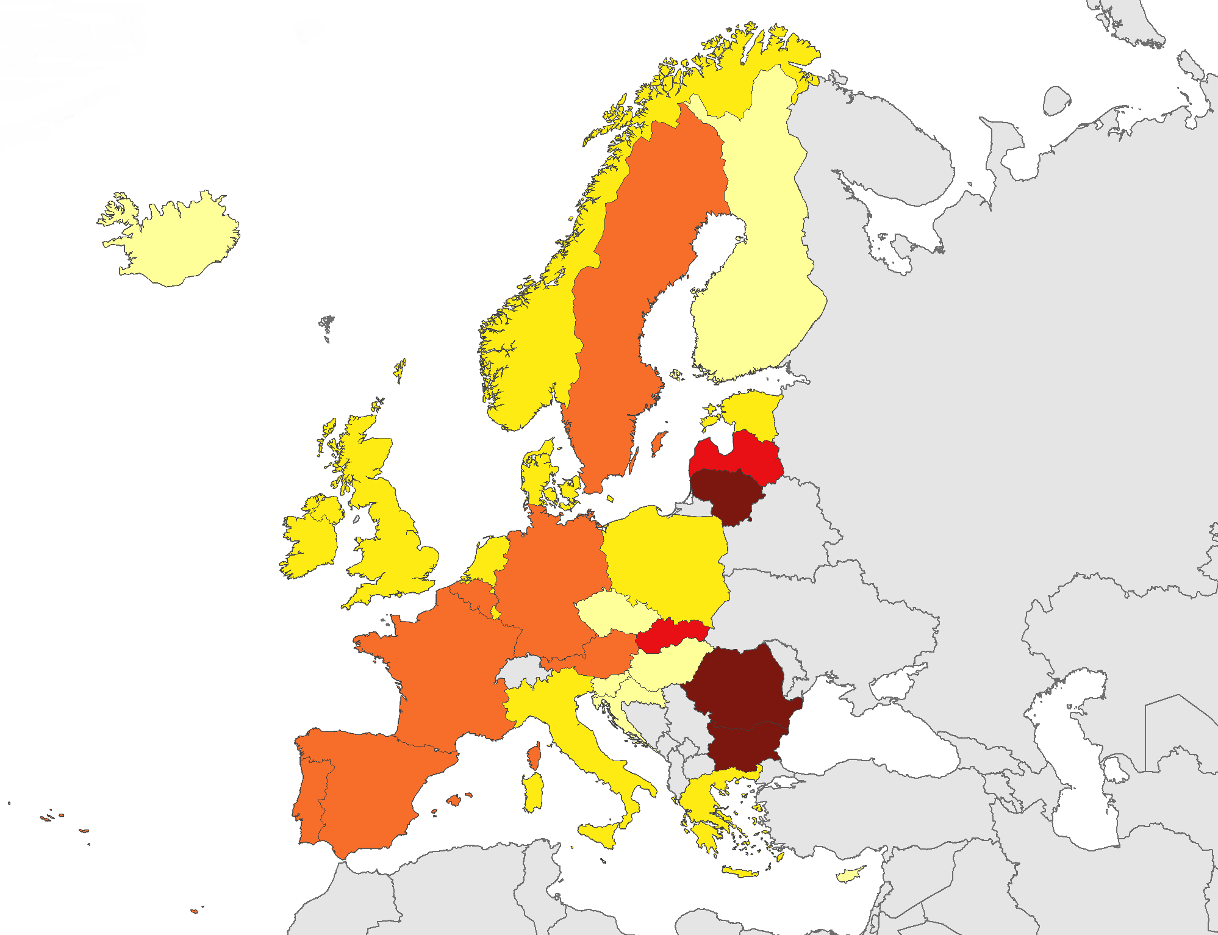
TB in children under 15 years, EU/EEA, 2016
2 447 TB cases notified in children under 15 years
4.1% of all TB cases (range 0–20.6%)
3.0 per 100 000 child population (range 0–19.4)
Cases per
100 000 children
< 1
1 to 1.9
2 to 3.9
4 to 9.9
≥ 10
Not reporting
Source: ECDC/WHO (2018). Tuberculosis surveillance and monitoring in Europe 2018–2016 data

Slide 8
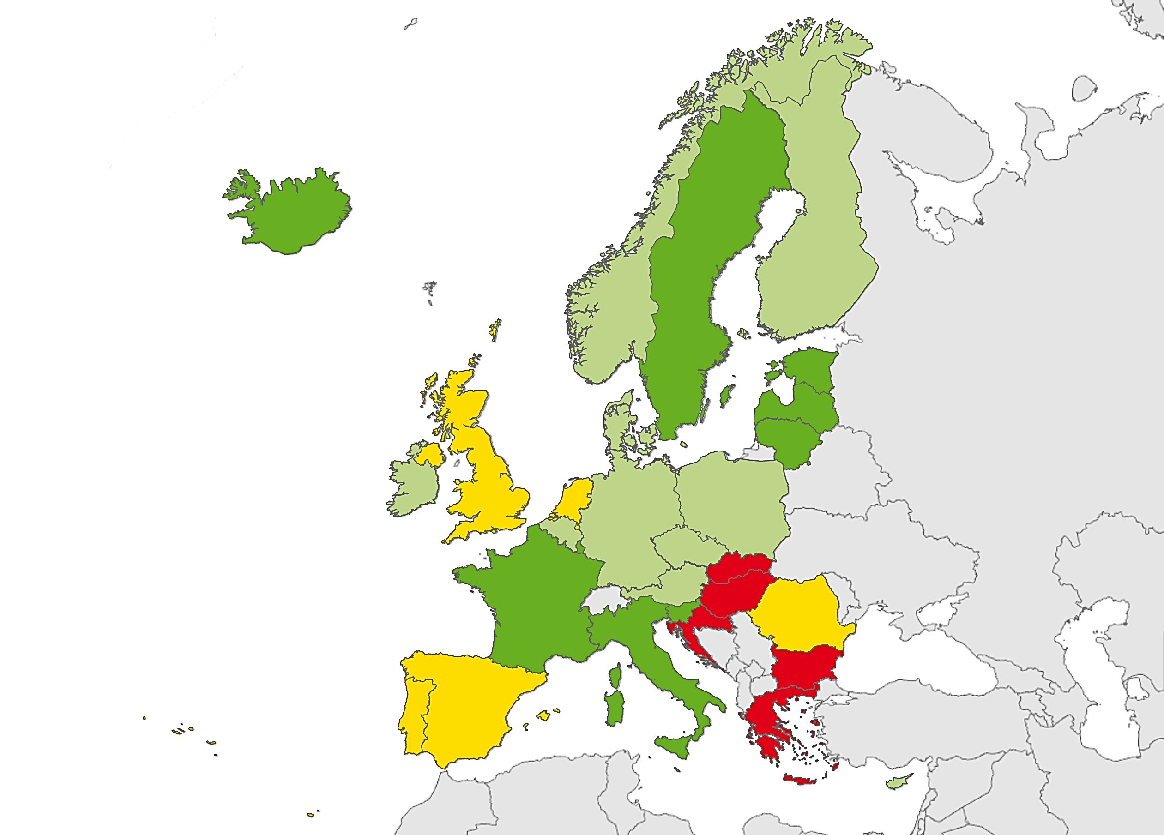
Confirmed TB cases*, EU/EEA, 2016
41 867 TB cases were notified as confirmed
71.0 % of all TB cases (range 39.5–92.4%)
Proportion of confirmed cases
< 60%
60 to 69%
70 to 79%
≥ 80%
Not reporting
* Confirmation by culture or by both sputum microscopy and Mycobacterium tuberculosis nucleic acid amplification test
Source: ECDC/WHO (2018). Tuberculosis surveillance and monitoring in Europe 2018–2016 data

Slide 9
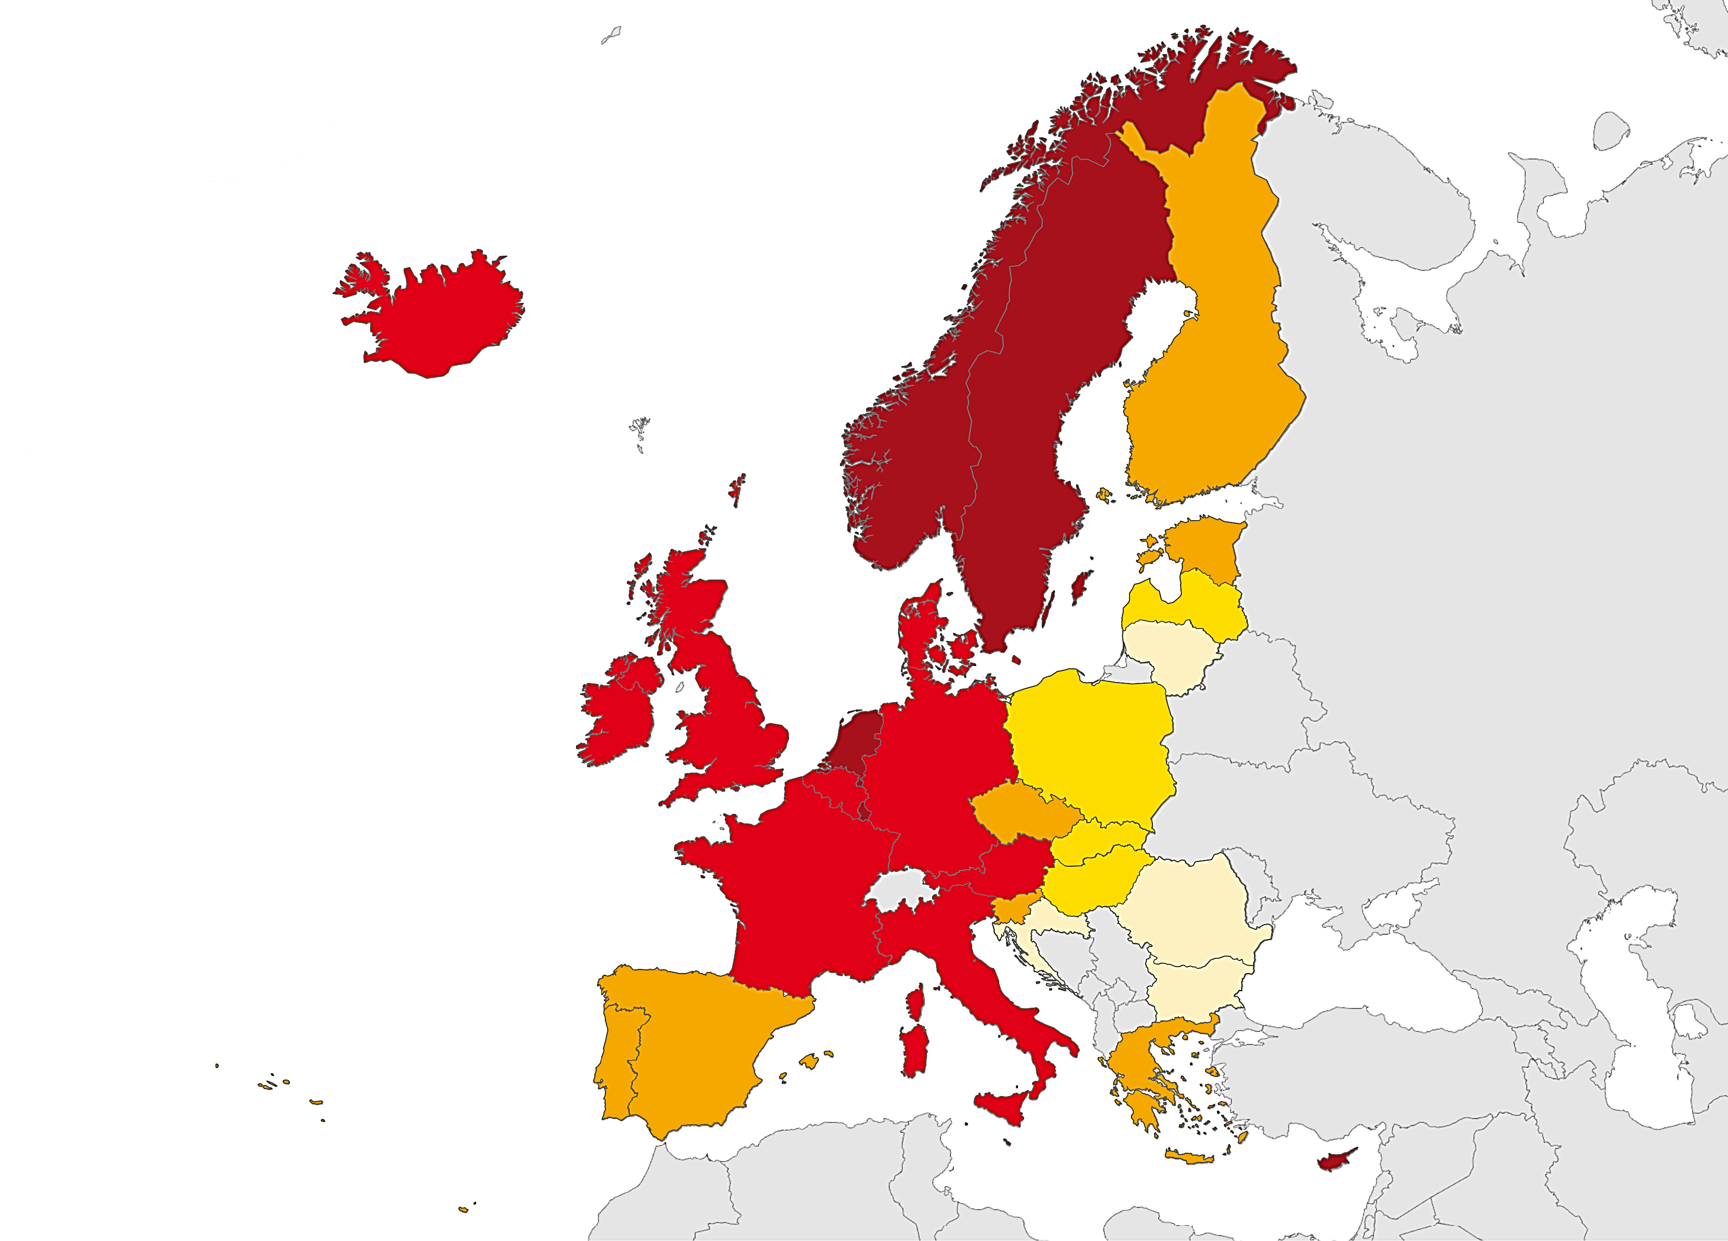
TB in persons of foreign origin, EU/EEA, 2016
19 312 TB cases were notified in persons originating from other countries than the reporting country
32.7% of all TB cases (range 0.2–96.0%)
Proportion of cases
< 1%
1 to 9.9%
10 to 49.9%
50 to 74.9%
≥ 75%
Not reporting
Source: ECDC/WHO (2018). Tuberculosis surveillance and monitoring in Europe 2018–2016 data

Slide 10
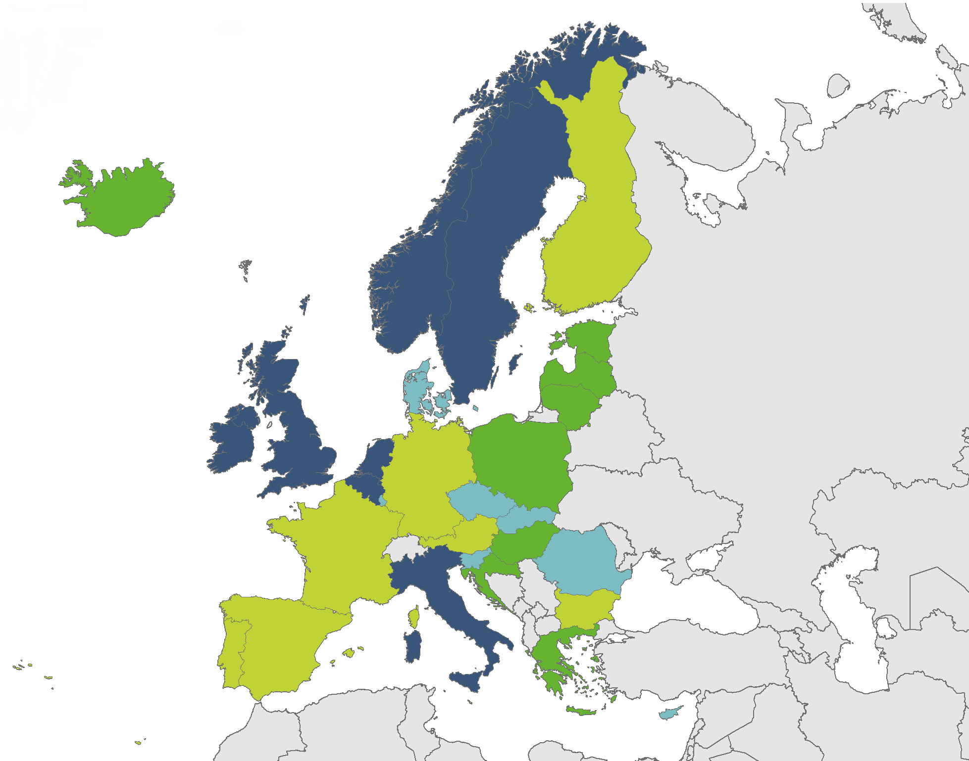
Extrapulmonary TB, EU/EEA, 2016
13 450 notified cases had extrapulmonary TB
22.8% of all TB cases (range 3.7–46.0%)
Proportion of extrapulmonary TB cases
0 to 9.9%
10 to 19.9%
20 to 29.9%
≥ 30%
Not reporting
Source: ECDC/WHO (2018). Tuberculosis surveillance and monitoring in Europe 2018–2016 data

Slide 11
TB cases in persons of foreign origin, EU/EEA, 2007–2016
The percentage of cases in persons of foreign origin increased from 21.0% in 2007 to 32.7% in 2016
Rate per 100 000 total population was stable between 3.4 and 3.7
Source: ECDC/WHO (2018). Tuberculosis surveillance and monitoring in Europe 2018–2016 data

Slide 12
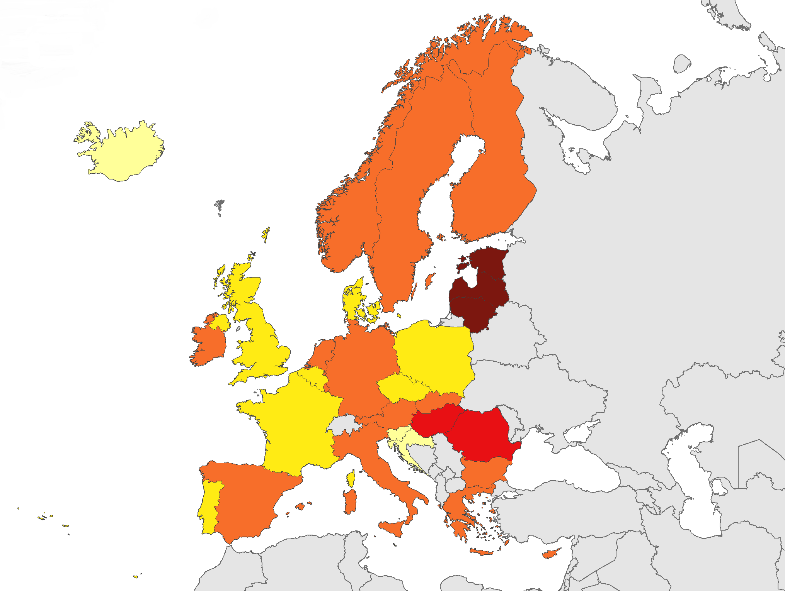
Multidrug-resistant TB (MDR TB), EU/EEA, 2016
1 322 MDR TB cases notified in 30 EU/EEA countries
3.7% of all TB cases (range 0–20.3%)
Proportion of cases
< 1%
1 to 1.9%
2 to 4.9%
5 to 9.9%
≥ 10%
Not reporting
Source: ECDC/WHO (2018). Tuberculosis surveillance and monitoring in Europe 2018–2016 data

Slide 13
Proportion of multidrug-resistant TB (MDR TB), EU/EEA, 2016*
1 322 MDR TB cases notified in 30 EU/EEA countries
3.7% of all TB cases (range 0–20.3%)
*Croatia, Iceland, Malta and Slovenia reported zero MDR TB cases for 2016
Source: ECDC/WHO (2018). Tuberculosis surveillance and monitoring in Europe 2018–2016 data

Slide 14
MDR TB cases and percentages of all TB cases tested for drug resistance, EU/EEA, 2007–2016
The total number of MDR TB cases decreased from 1 598 in 2007 to 1 322 in 2016
Proportion of MDR TB cases among all TB cases tested for drug resistance decreased from 5.2% in 2007 to 3.7% in 2016
Source: ECDC/WHO (2018). Tuberculosis surveillance and monitoring in Europe 2018–2016 data

Slide 15
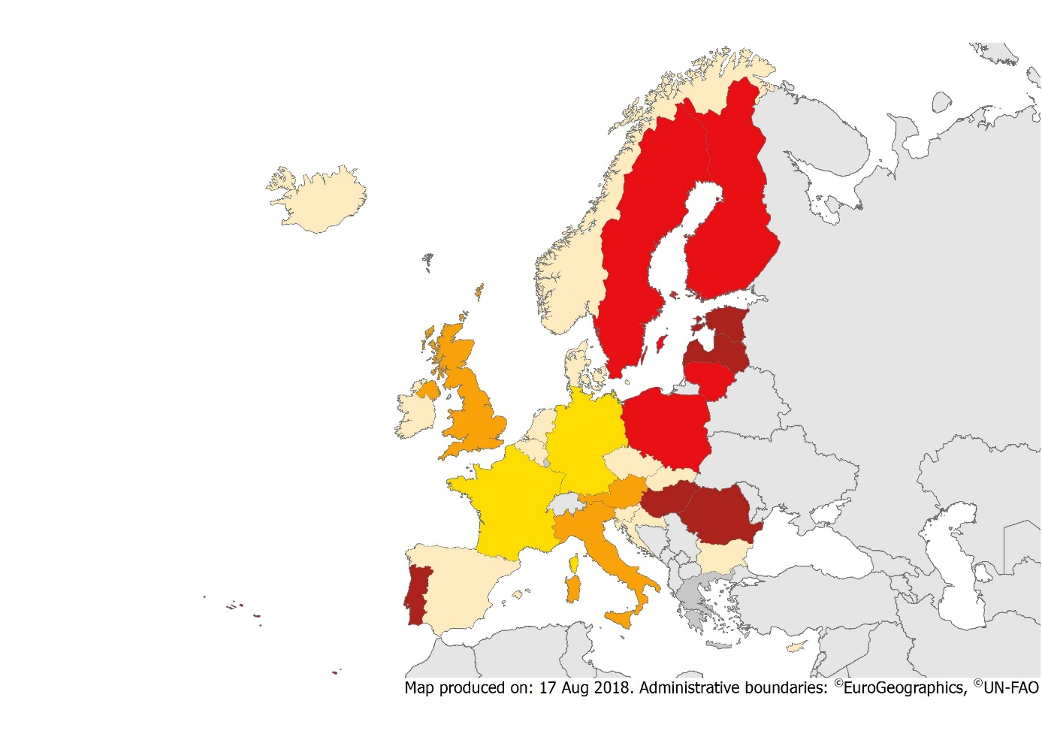
Extensively drug-resistant TB (XDR TB), EU/EEA, 2016
20.1% of MDR TB cases with second line DST* results were extensively drug-resistant (range 0–46.7% and 14.0–46.7% for countries reporting more than five XDR TB cases)
Proportion of MDR TB cases
< 1%
1 to 9.9%
10 to 14.9%
15 to 24.9%
≥ 25%
Not reporting
* DST – drug susceptibility test
Source: ECDC/WHO (2018). Tuberculosis surveillance and monitoring in Europe 2018–2016 data

Slide 16
Proportion of extensively drug-resistant TB (XDR TB), EU/EEA, 2016
198 XDR TB cases notified in 14 EU/EEA countries*
20.1% of all MDR TB cases (range 0–46.7%)
*Croatia, Iceland, Malta and Slovenia reported zero MDR TB cases and Belgium, Bulgaria, Cyprus, Czech Republic, Denmark, Ireland, Netherlands, Norway and Slovakia did not diagnose any XDR TB among MDR TB cases in 2016
Source: ECDC/WHO (2018). Tuberculosis surveillance and monitoring in Europe 2018–2016 data

Slide 17
Pulmonary XDR TB cases and percentages of all tested, EU/EEA, 2007–2016*
The total number of pulmonary XDR TB cases increased from 72 in 2009 to 185 in 2016
The proportion of pulmonary XDR TB cases among MDR TB increased from 10.7% in 2009 to 20.6% in 2016
* Number of reporting countries increased from 12 in 2007 to 26 in 2016
Source: ECDC/WHO (2018). Tuberculosis surveillance and monitoring in Europe 2018–2016 data

Slide 18
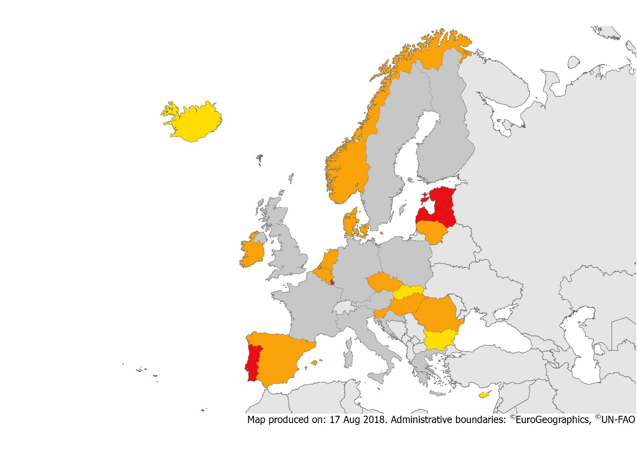
TB/HIV co-infection, EU/EEA, 2016
895 HIV-positive TB cases were notified by 20 EU/EEA countries in 2016
4.5% of TB cases with known HIV status were HIV-positive (range 0–17.4%*)
Proportion of co-infected cases
< 1%
1 to 9.9%
10 to 14.9%
≥ 15%
Not reporting
* Among countries reporting more than five TB cases with known HIV status
Source: ECDC/WHO (2018). Tuberculosis surveillance and monitoring in Europe 2018–2016 data

Slide 19
HIV-positive TB cases and percentages among all those tested, EU/EEA, 2007–2016*
The total number of HIV-positive TB cases decreased from 1 438 in 2007 to 895 in 2016
The proportion of HIV-positive TB cases among those tested decreased from 8.2% in 2009 to 4.5% in 2016
* Number of countries reporting HIV status increased from 14 in 2007 to 20 in 2016
Source: ECDC/WHO (2018). Tuberculosis surveillance and monitoring in Europe 2018–2016 data

Slide 20
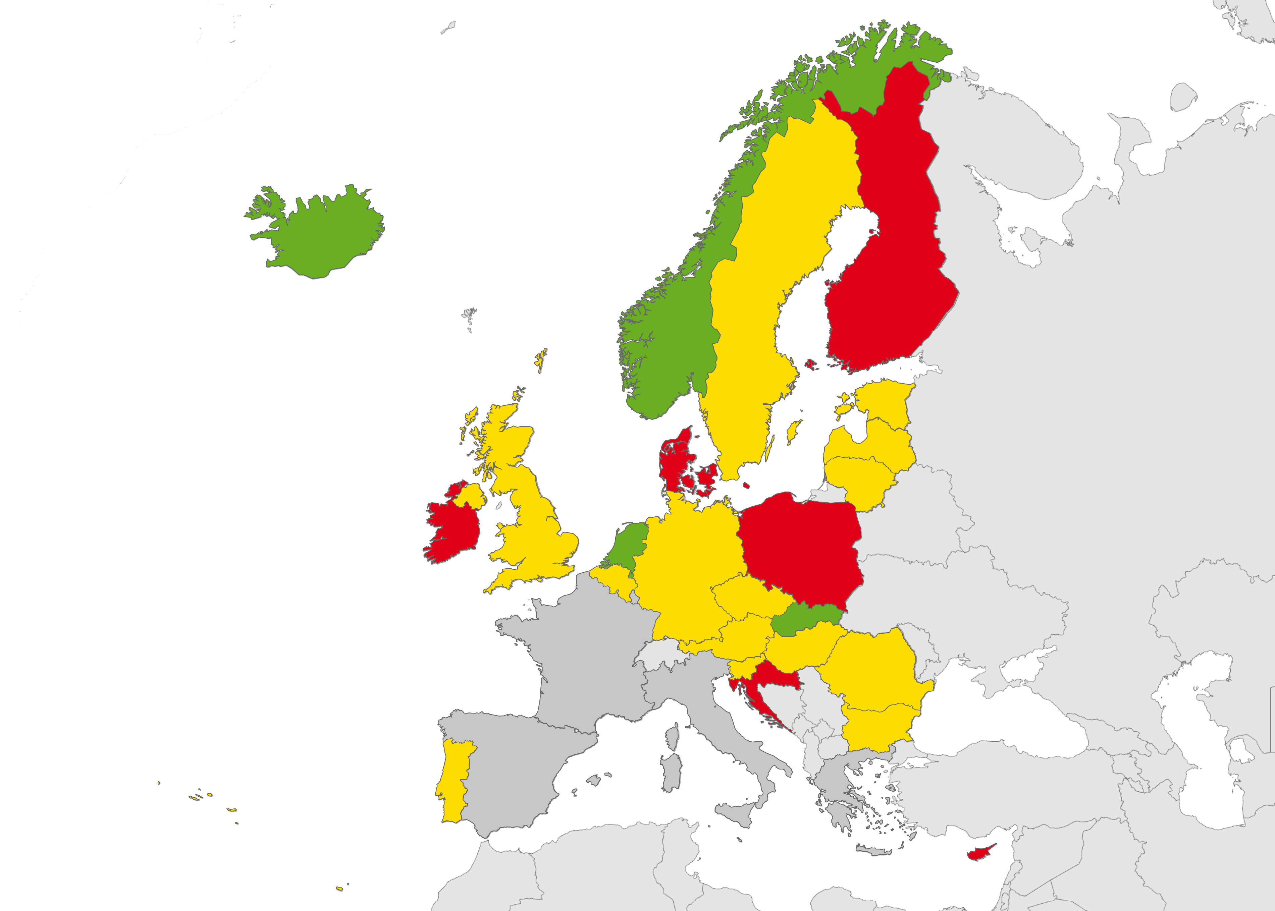
Treatment success, EU/EEA, 2016
71.5% of all TB cases* had a successful treatment outcome after 12 months (range 10.3–100%)
Proportion of treatment success
< 60%
60 to 84.9%
≥ 85%
Not reporting
* Six EU/EEA countries did not report treatment outcome data
Source: ECDC/WHO (2018). Tuberculosis surveillance and monitoring in Europe 2018–2016 data

Slide 21
Treatment success as of 2016 in all TB cases notified in 2015, EU/EEA
71.5% of all TB cases had a successful treatment outcome after 12 months (range 10.3–100%)
Source: ECDC/WHO (2018). Tuberculosis surveillance and monitoring in Europe 2018–2016 data

Slide 22
Treatment success of all notified TB cases, 2006–2015, EU/EEA
Proportion of successfully treated cases decreased from 75.5% in 2006 to 71.5% in 2015*
* Number of countries reporting treatment outcome data increased from 22 in 2006 to 24 in 2015
Source: ECDC/WHO (2018). Tuberculosis surveillance and monitoring in Europe 2018–2016 data

Slide 23
Treatment success as of 2016 for MDR TB cases reported in 2014*, EU/EEA
37.5% of all MDR TB cases notified in 2014 were successfully treated (range 0–86.7%)
* Cyprus, Iceland and Slovenia reported zero MDR TB cases in 2014
Source: ECDC/WHO (2018). Tuberculosis surveillance and monitoring in Europe 2018–2016 data

Slide 24
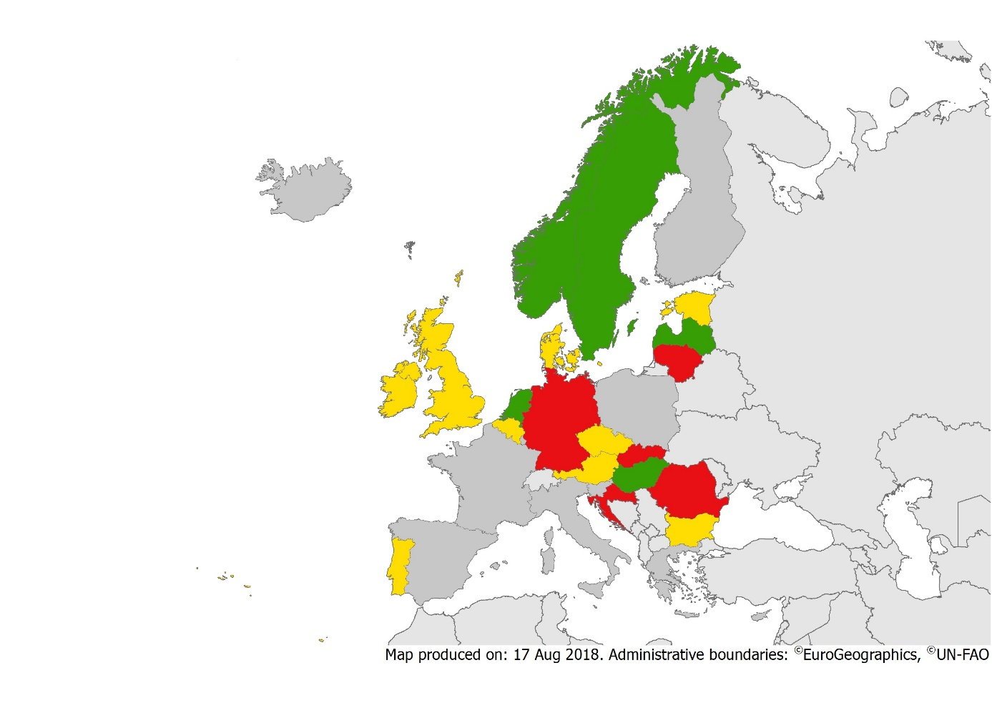
Treatment success as of 2016 in MDR TB cases notified in 2014*, EU/EEA
37.5% of all MDR TB cases notified in 2014 were successfully treated (range 0–86.7%)
Proportion of treatment success
< 40%
40 to 69.9%
≥ 70%
Not reporting/Zero reporting
* Slovenia reported zero MDR TB cases in 2014
Source: ECDC/WHO (2018). Tuberculosis surveillance and monitoring in Europe 2018–2016 data

Slide 25
Treatment outcomes of MDR TB cases notified in 2011–2014, EU/EEA, 2016
The treatment success rate has been stable between 37.5–40.5%
Source: ECDC/WHO (2018). Tuberculosis surveillance and monitoring in Europe 2018–2016 data

Slide 26
Treatment success in XDR TB cases, EU/EEA, 2016
33.8% of the XDR TB cases notified in 2013 were treated successfully (range 0–100%)*
* Belgium, Cyprus, Czech Republic, Netherlands, Slovenia and Slovakia reported zero XDR TB cases in 2013. Ten countries did not report second line drug susceptibility testing results or treatment outcome data for XDR TB cases.
Source: ECDC/WHO (2018). Tuberculosis surveillance and monitoring in Europe 2018– 2016 data

