Slide 1
Reusable maps and graphs from ECDC Communicable Disease Threats Report
Week 30, 2023
You are encouraged to reuse our maps and graphs for your own purposes and are free to translate them, provided the content is not altered and the source is acknowledged.

Slide 2
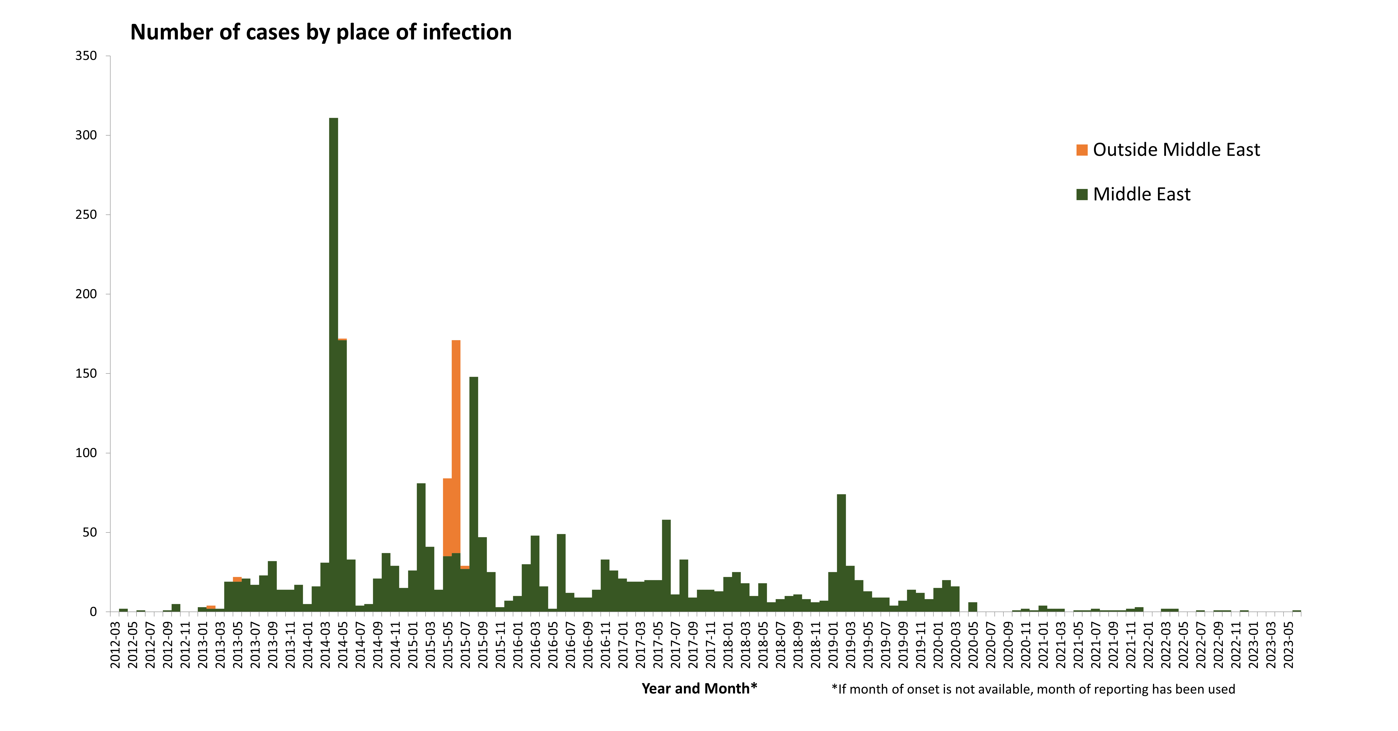
Distribution of confirmed MERS-CoV cases, by place of infection and month of onset, March 2012 – July 2023

Slide 3
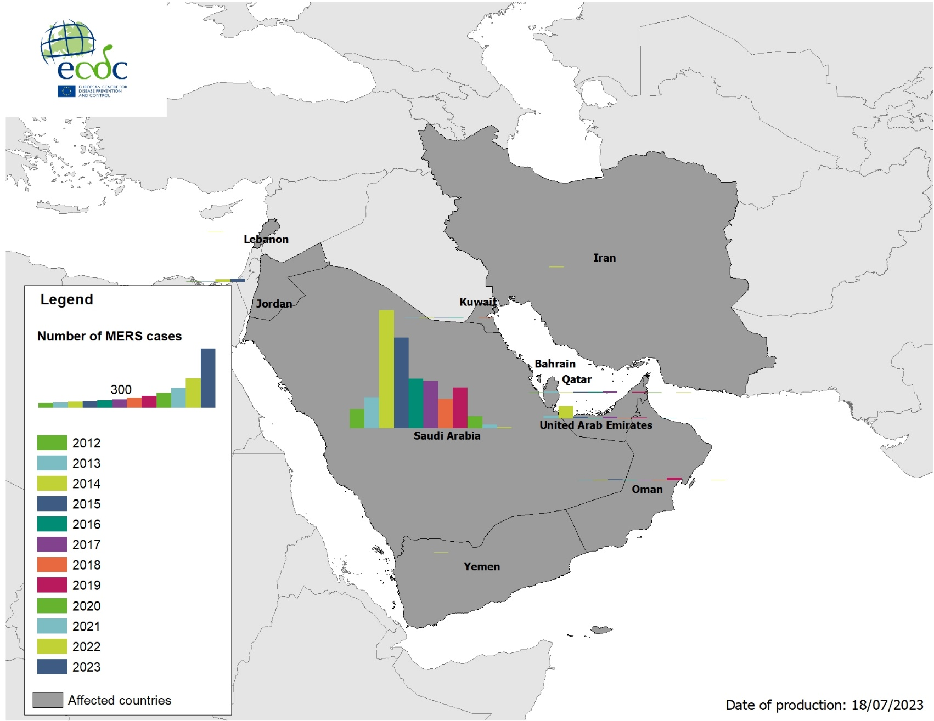
Geographical distribution of confirmed cases of MERS-CoV, by country of infection and year, from April 2012 to July 2023

Slide 4
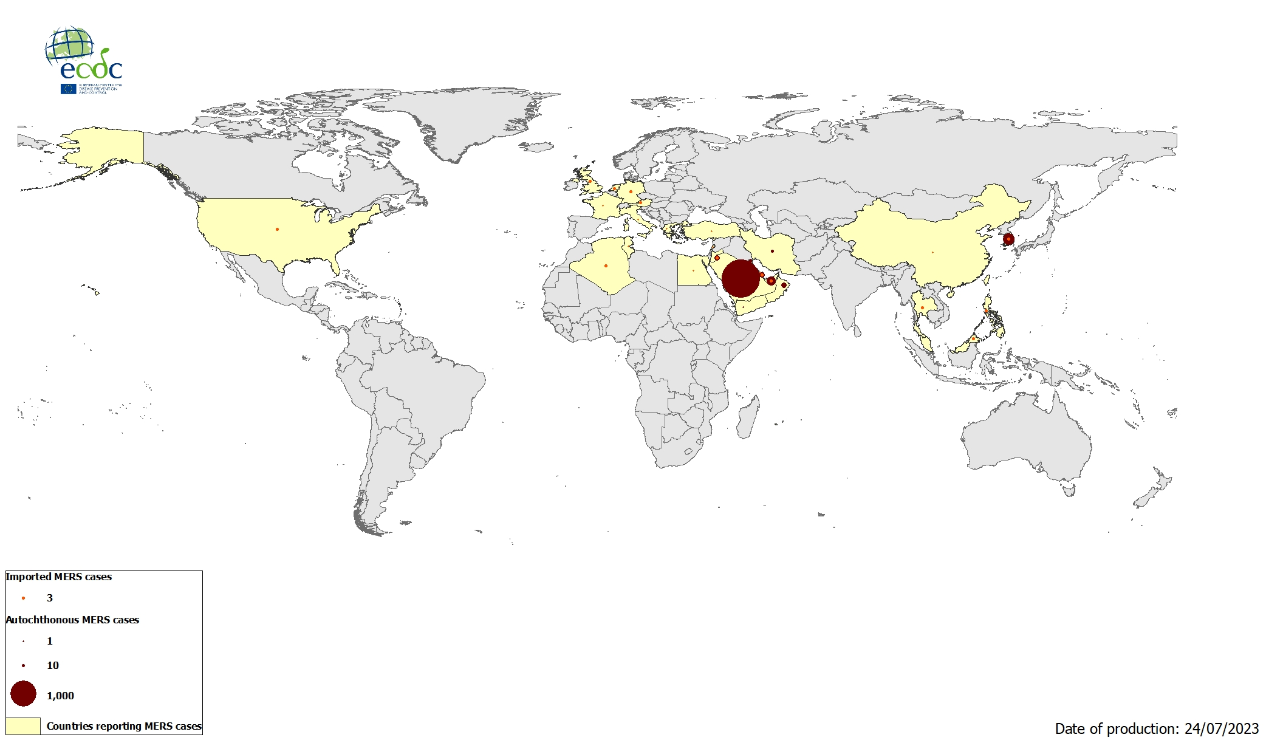
Geographical distribution of confirmed MERS-CoV cases, by reporting country, April 2012 – July 2023

Slide 5
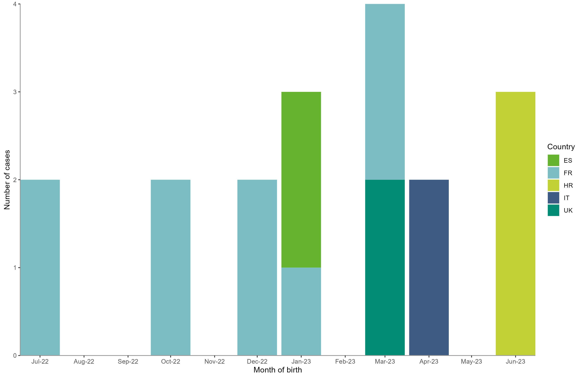
Distribution of confirmed and probable cases of severe neonatal Echovirus 11 infection in the EU/EEA and UK, as of 27 July 2023

Slide 6
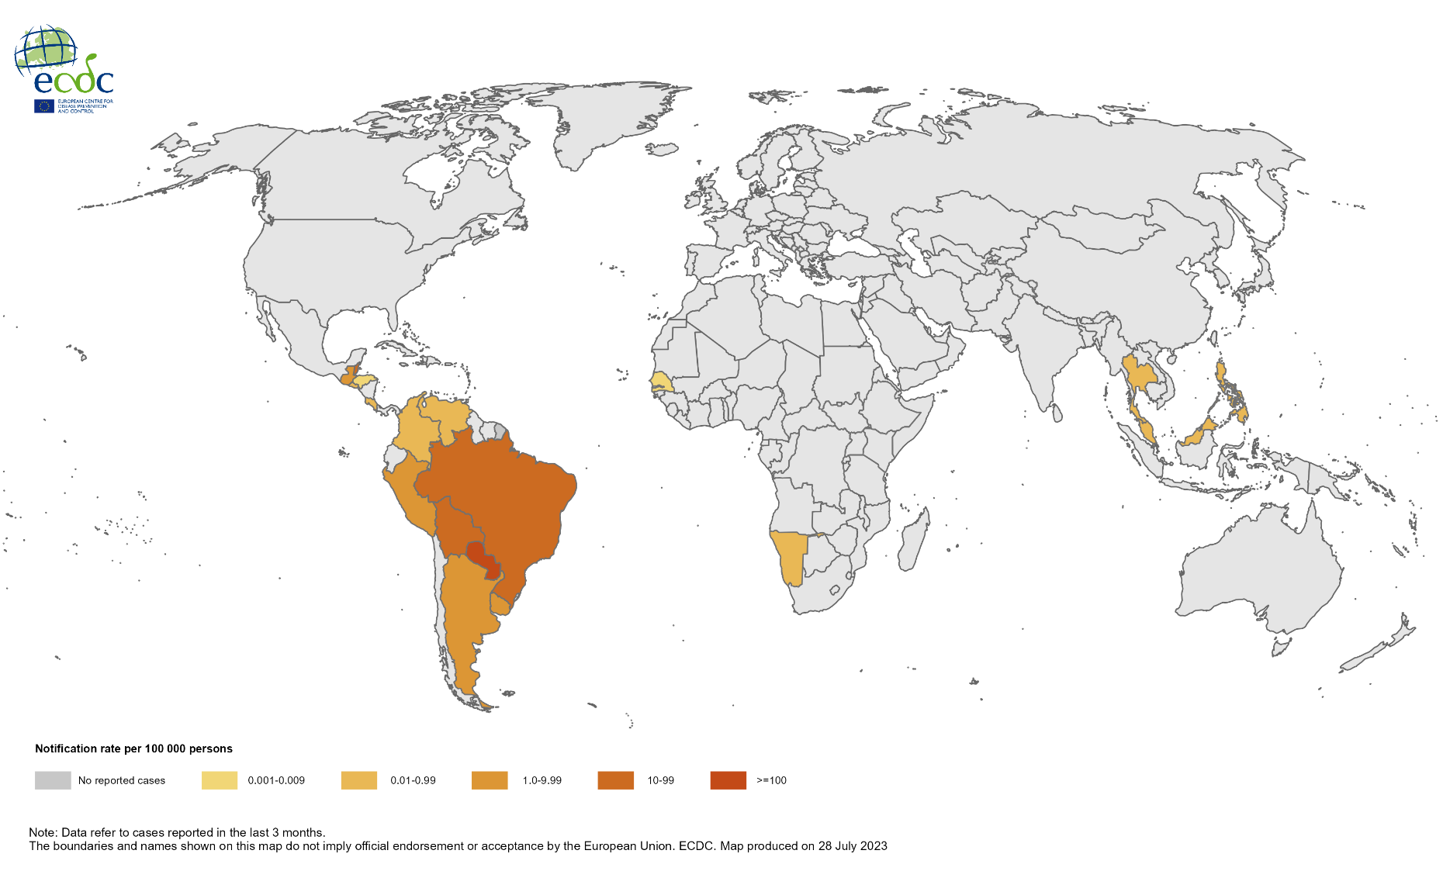
Three-month Chikungunya virus disease case notification rate per 100 000 population, April–June 2023

Slide 7
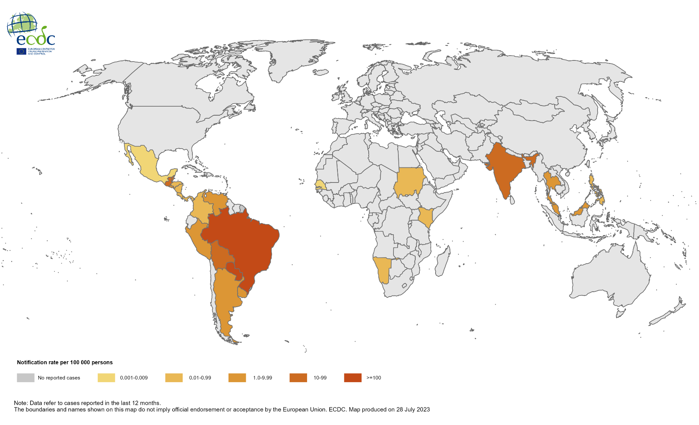
12-month Chikungunya virus disease case notification rate per 100 000 population, July 2022–June 2023

Slide 8
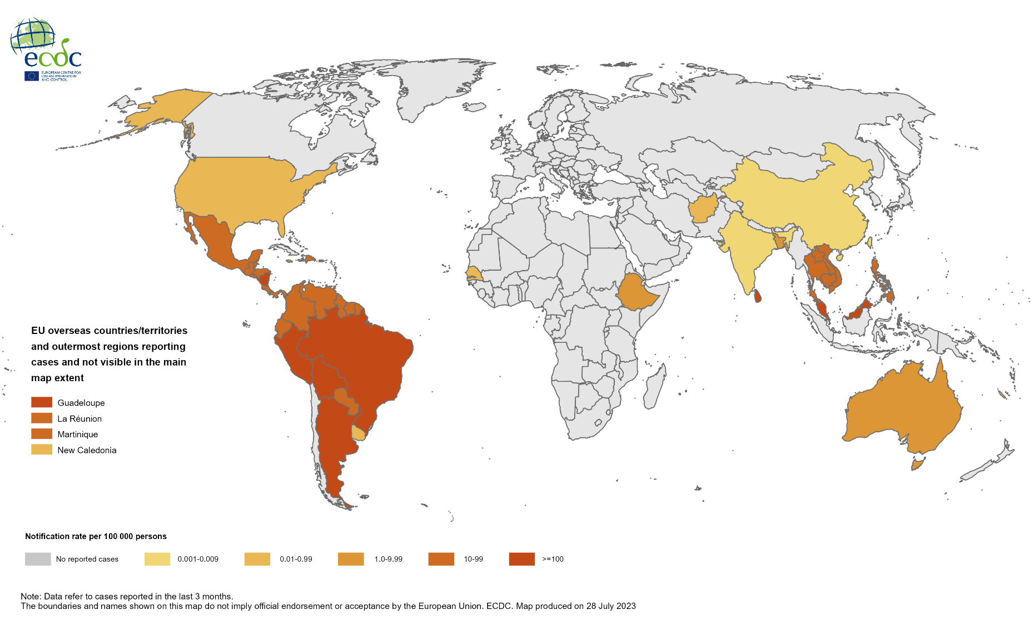
Three-month dengue virus disease case notification rate per 100 000 population, April–June 2023

Slide 9
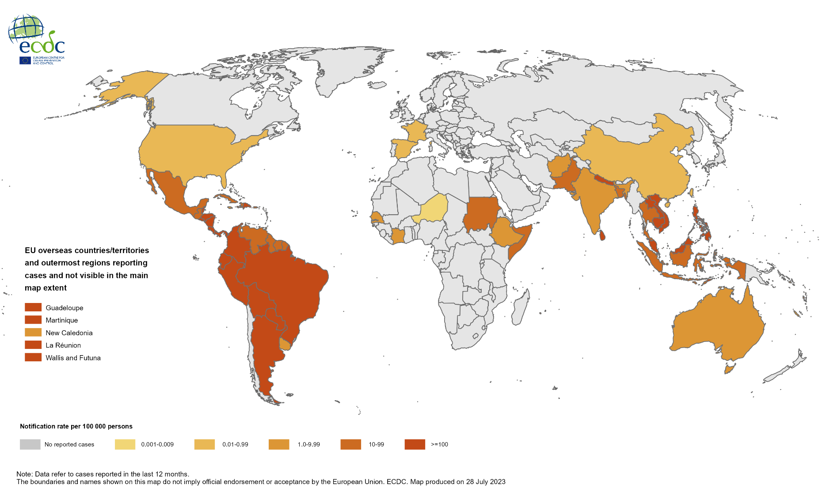
12-month dengue virus disease case notification rate per 100 000 population, July 2022–June 2023

Slide 10
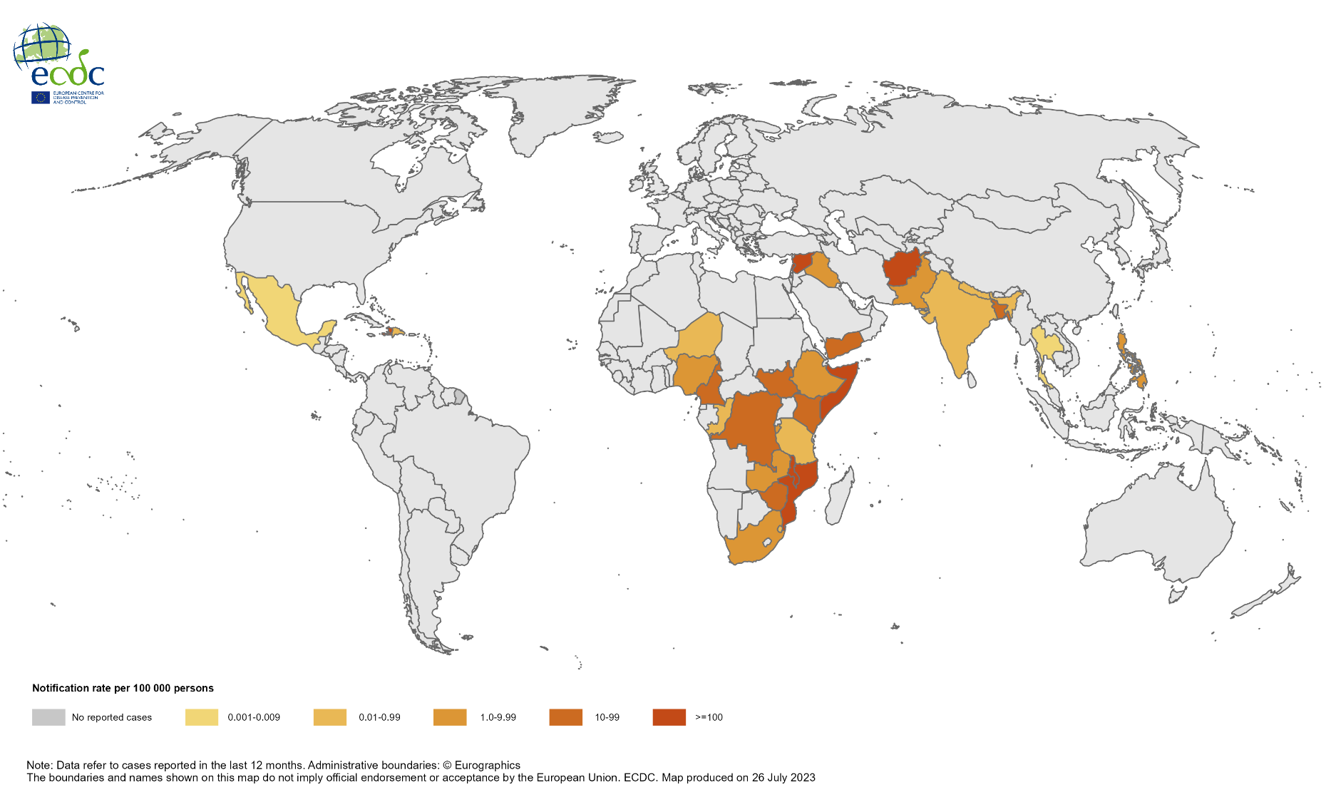
Geographical distribution of cholera cases reported worldwide, from August 2022 to July 2023

Slide 11
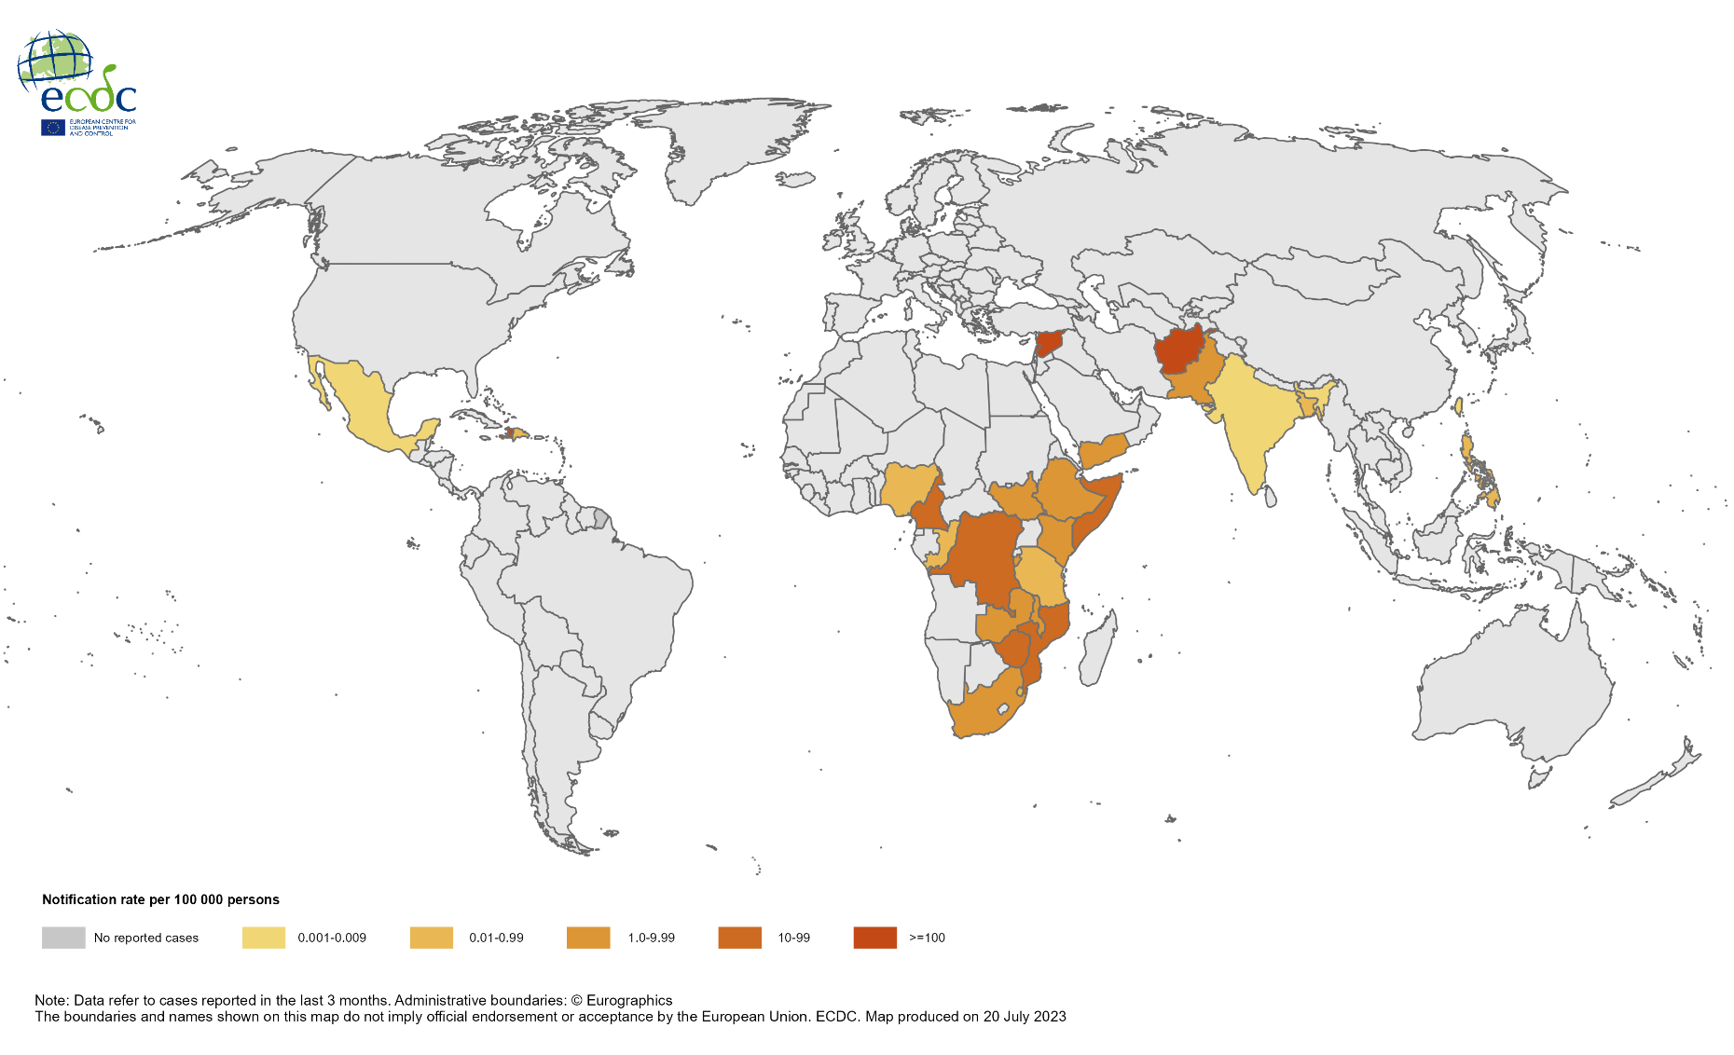
Geographical distribution of cholera cases reported worldwide, from May to July 2023

