Slide 1
Reusable maps and graphs from ECDC Communicable Disease Threats Report
Week 38, 2019
You are encouraged to reuse our maps and graphs for your own purposes and free to translate, provided the content is not altered and the source is acknowledged.

Slide 2
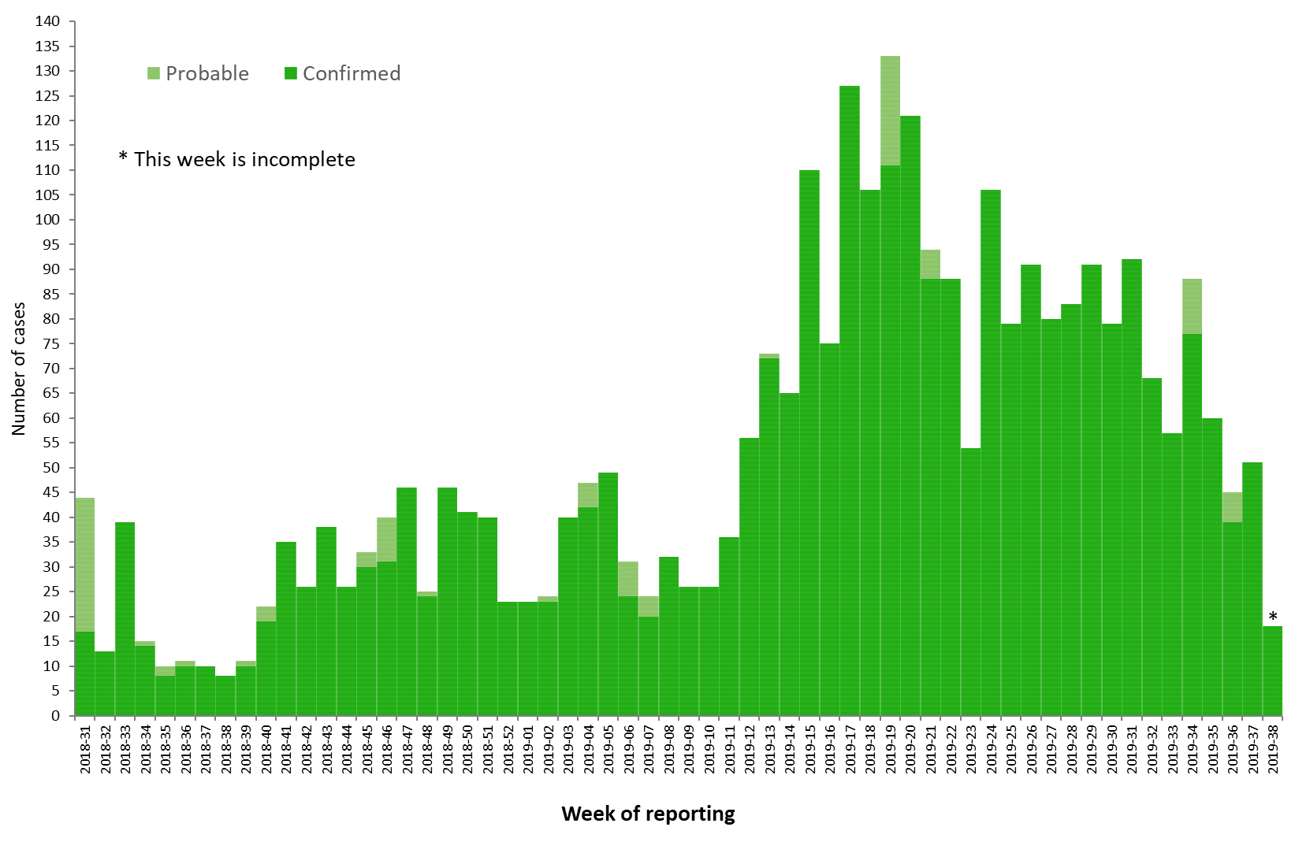
Distribution of confirmed and probable cases of Ebola virus disease by week of reporting, Democratic Republic of the Congo and Uganda, as of 18 September 2019

Slide 3
Ebola Virus Disease case distribution in DRC and Uganda as of 18 September 2019

Slide 4
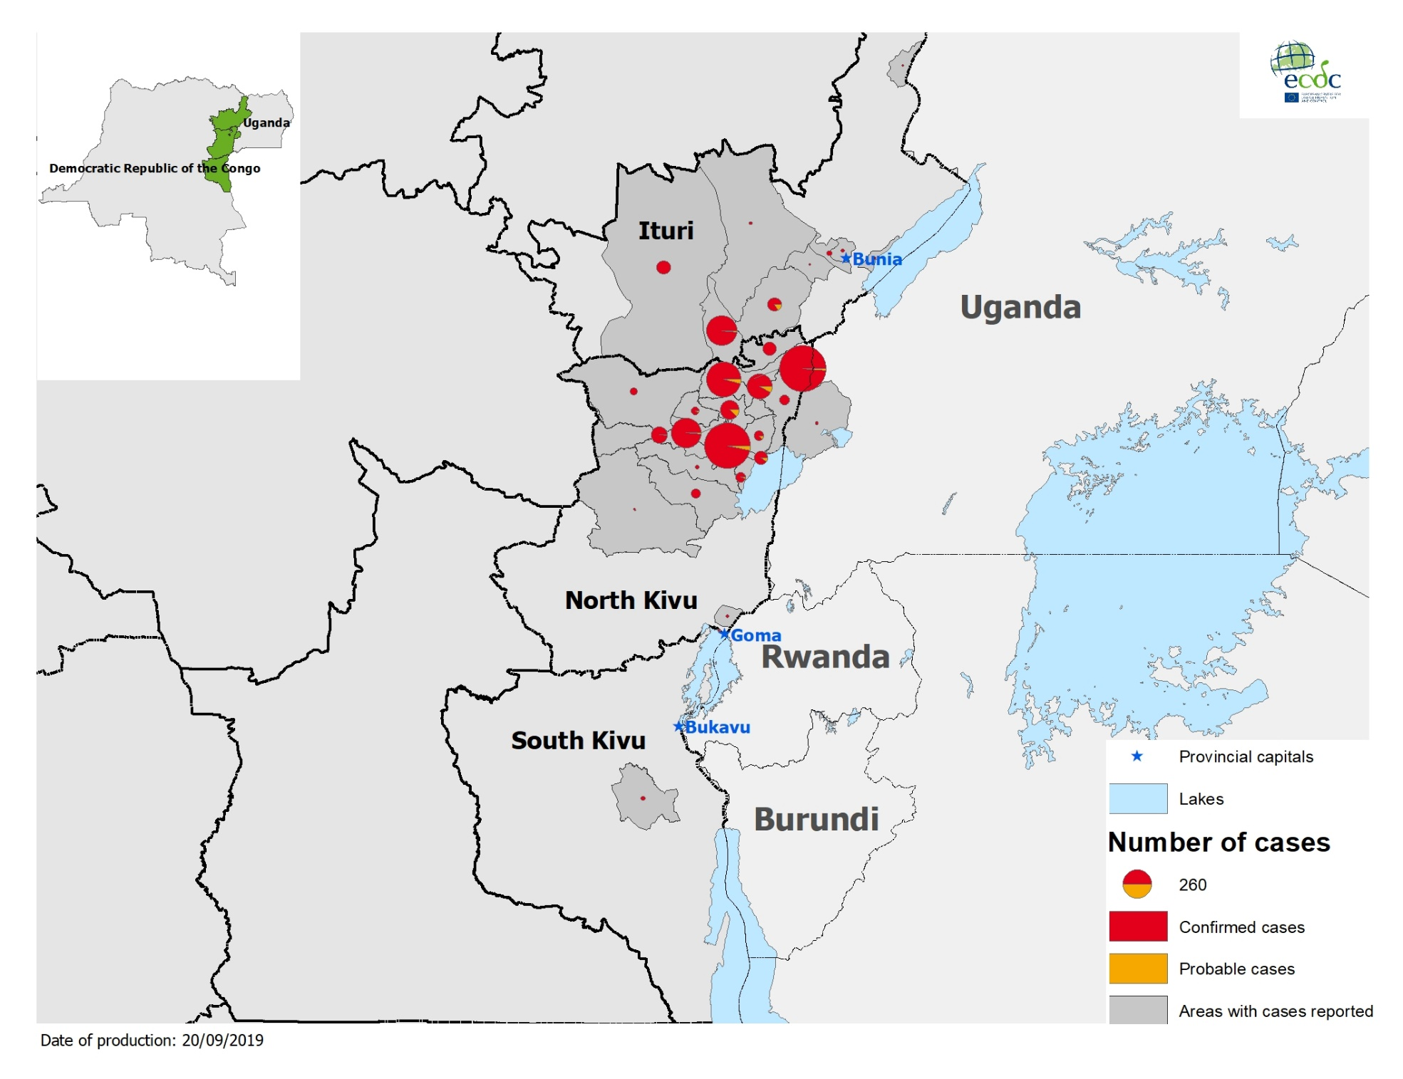
Geographical distribution of confirmed and probable cases of Ebola virus disease,
Democratic Republic of the Congo and Uganda as of 18 September 2019

Slide 5
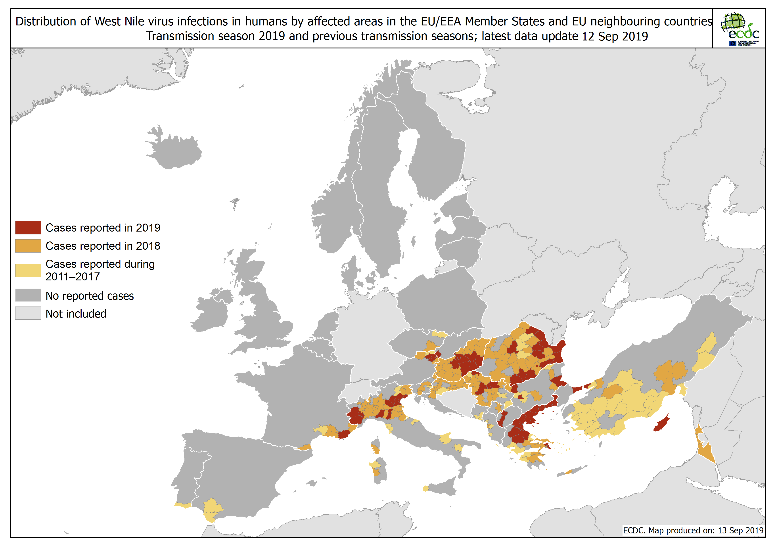
Distribution of West Nile virus in humans in affected areas in the EU/EEA Member States in 2019

Slide 6
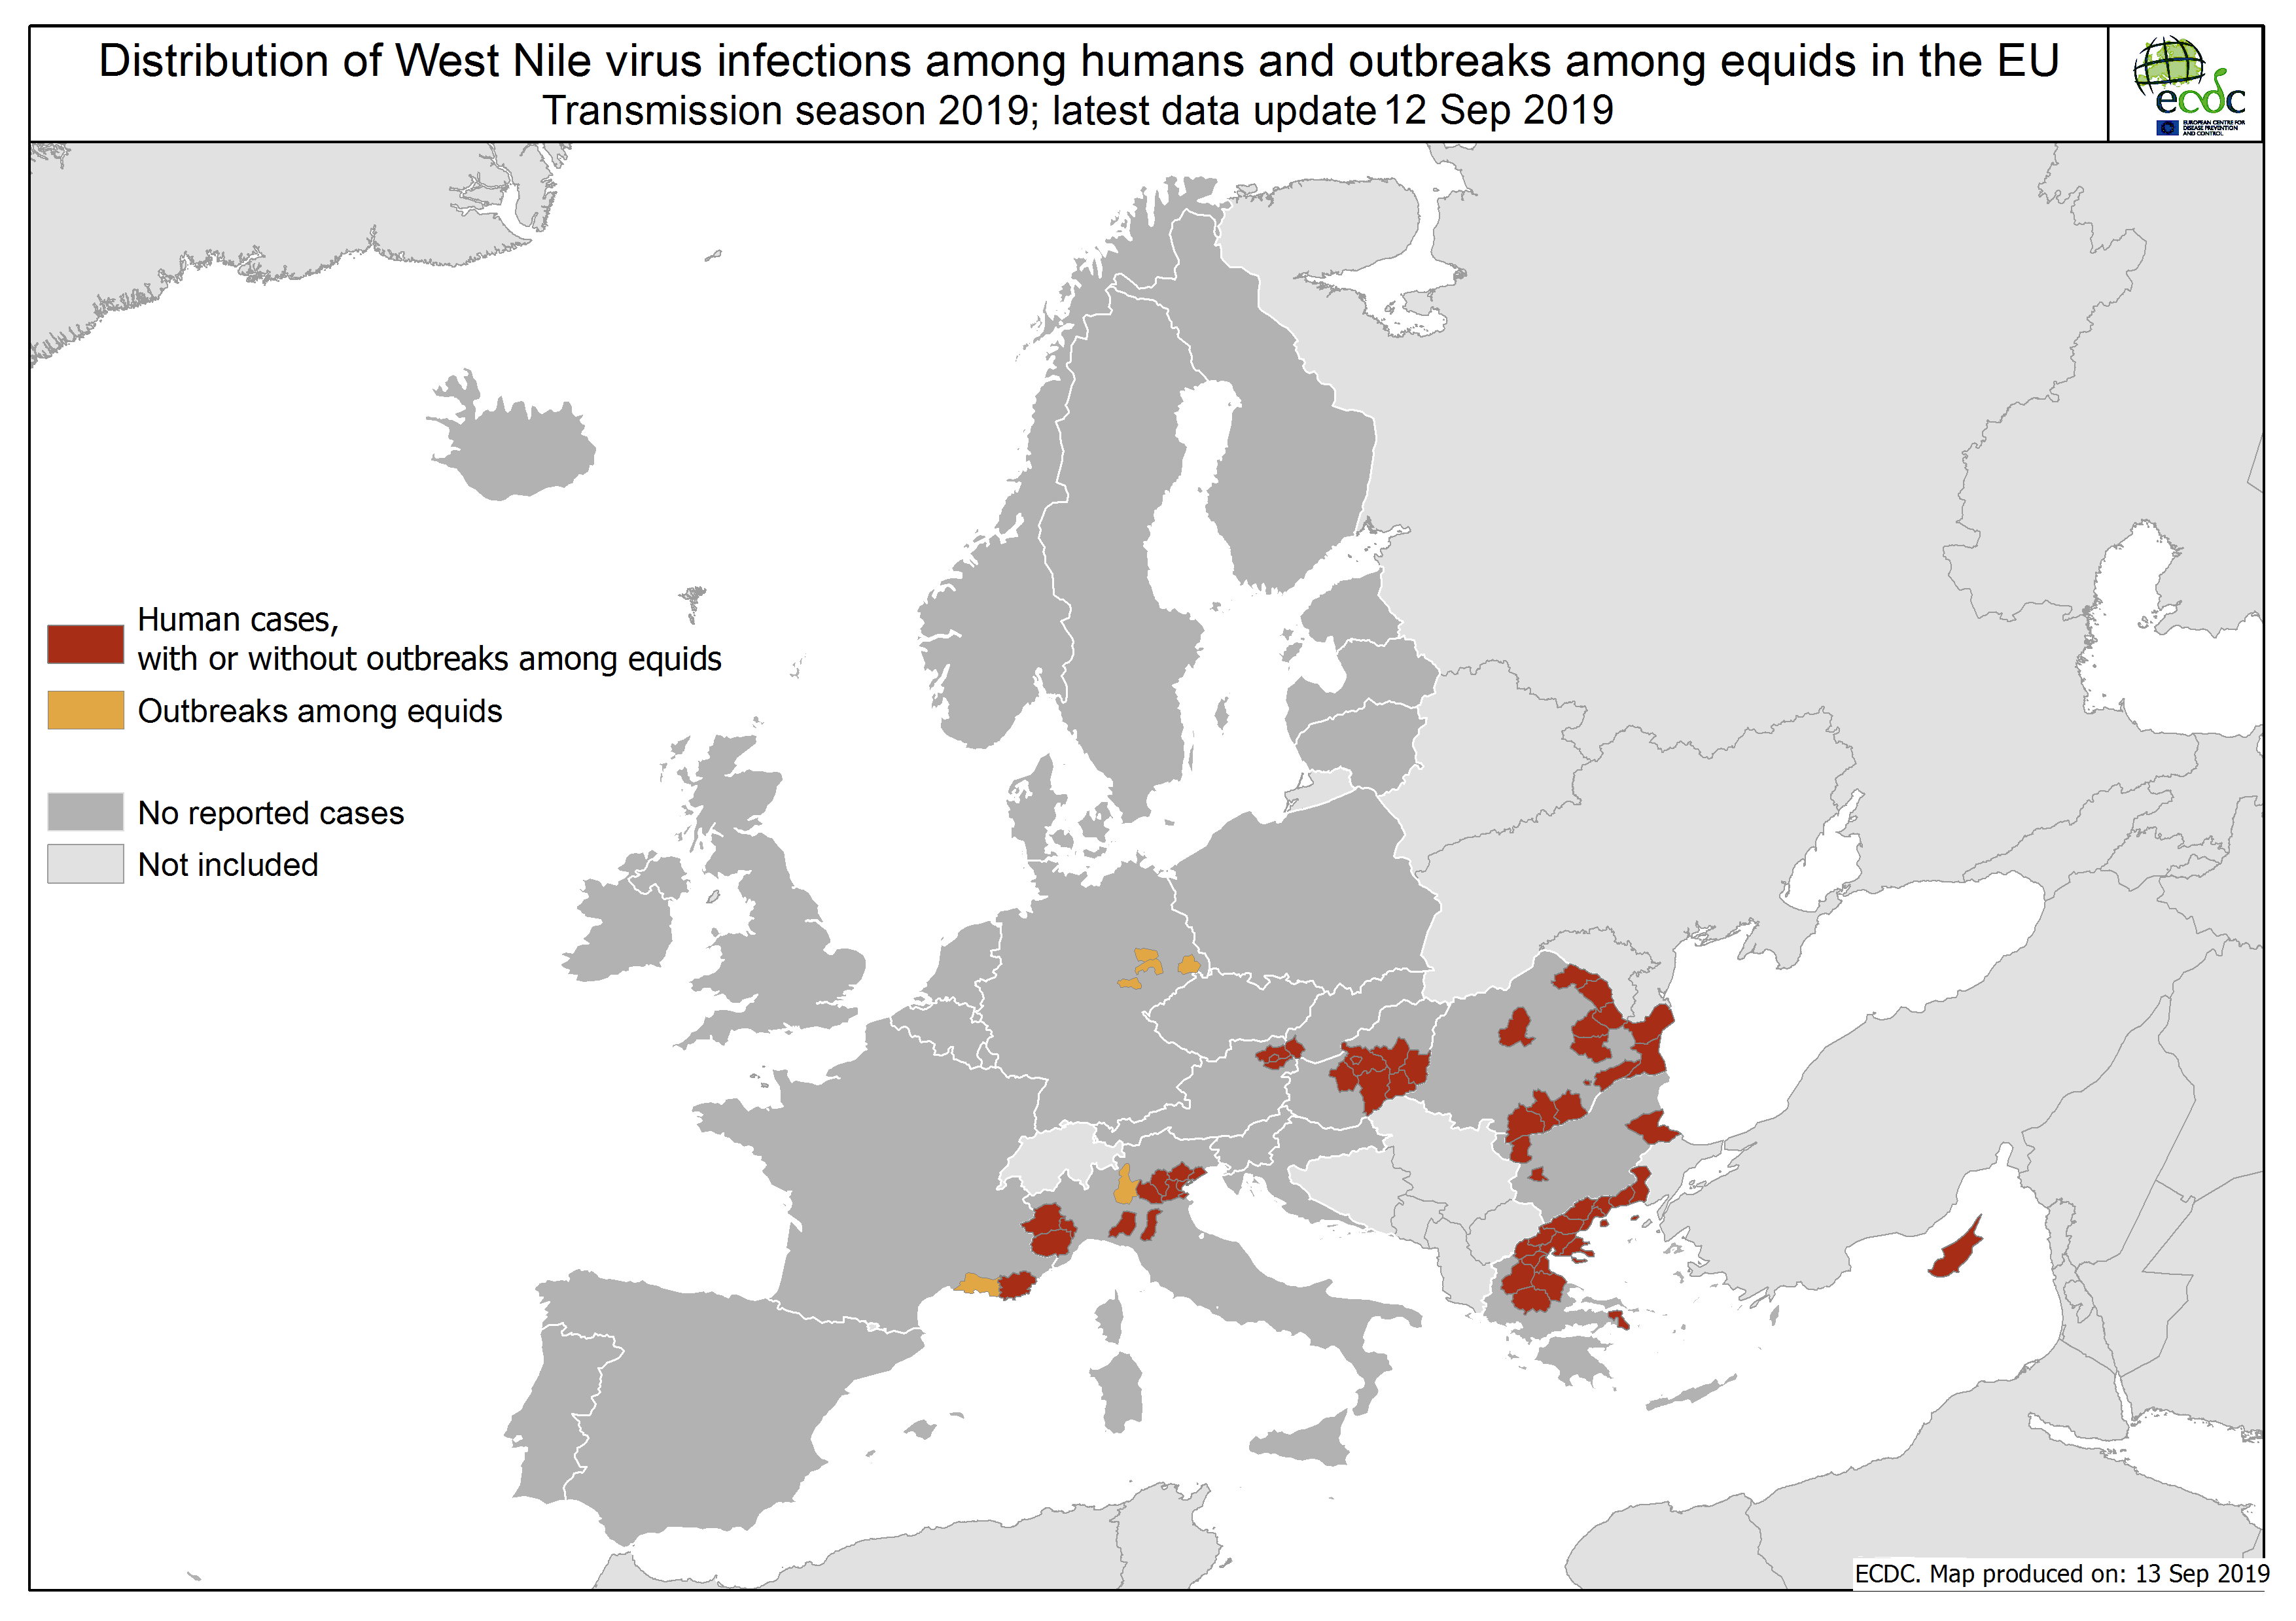

Slide 7
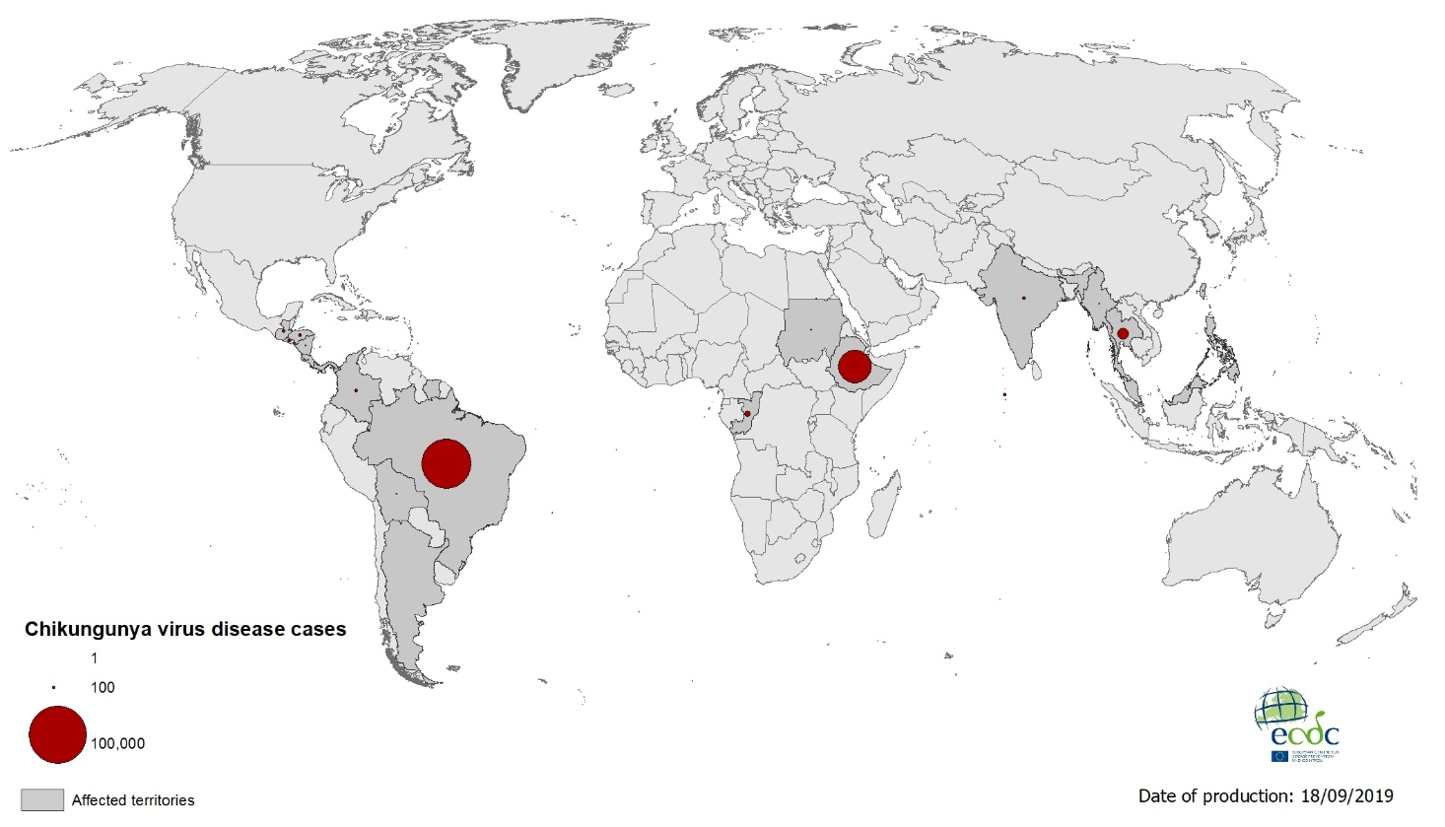
Geographical distribution of chikungunya virus disease cases reported worldwide, July–September 2019

Slide 8
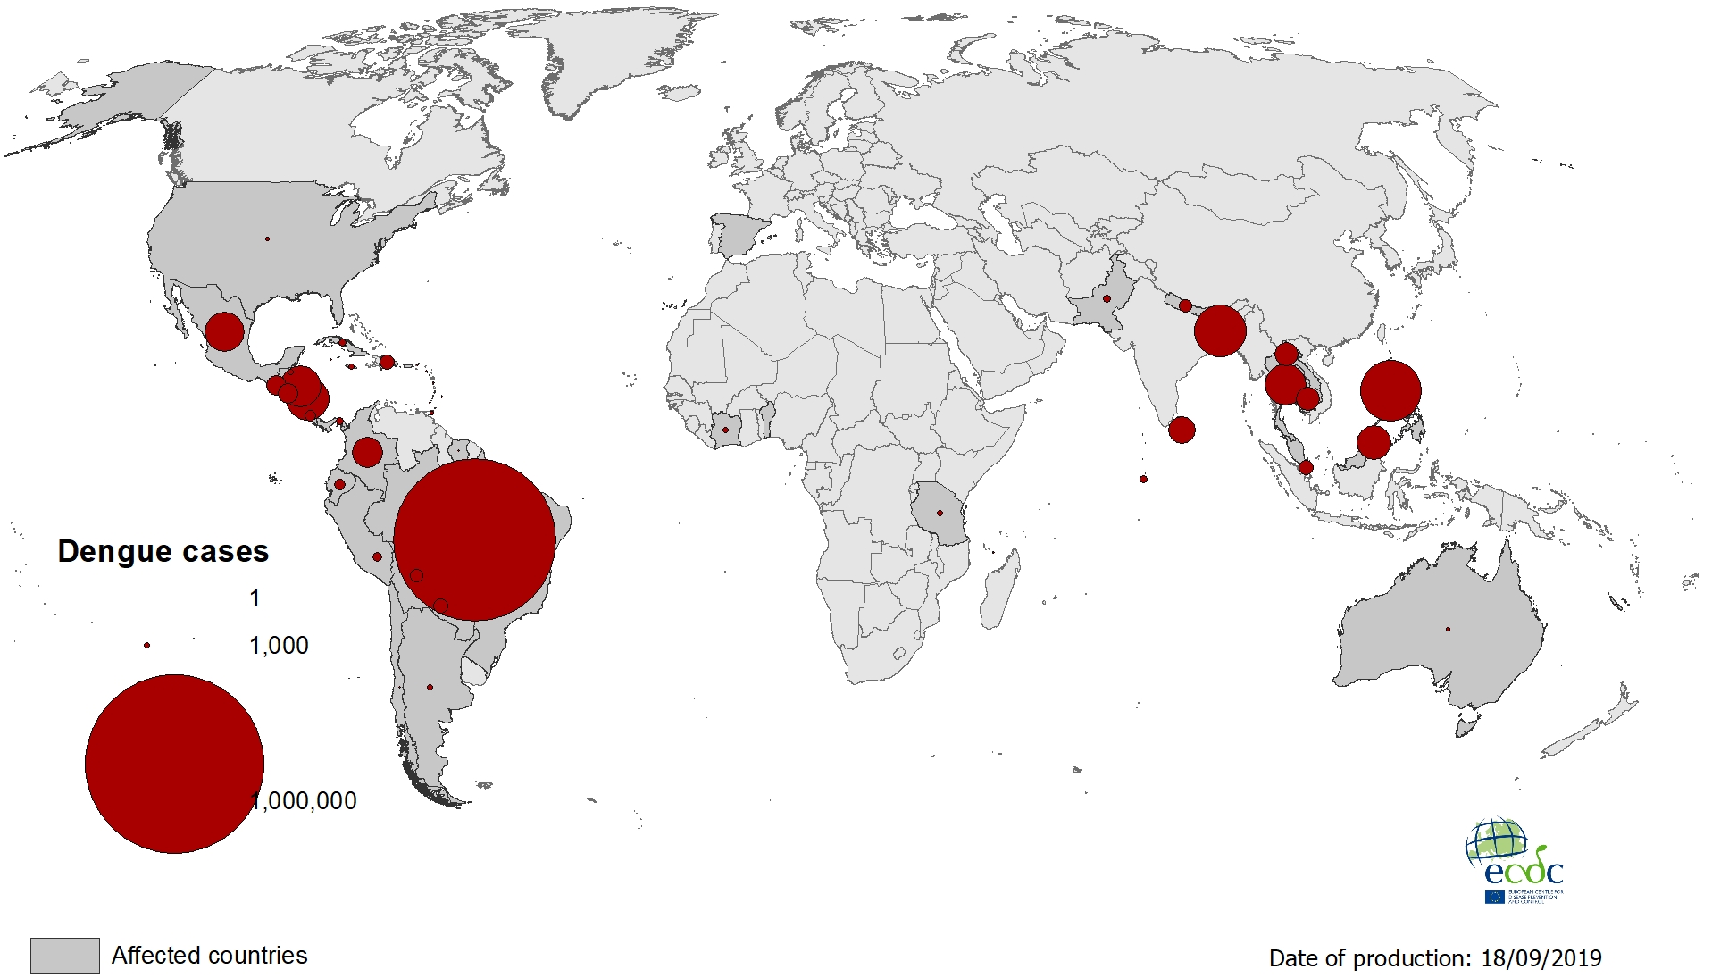
Geographical distribution of dengue cases reported worldwide, July–September 2019

