Slide 1
You are encouraged to reuse our maps and graphs for your own purposes and free to translate, provided the content is not altered and the source is acknowledged. Either copy the images from the following slides or download directly from: ecdc.europa.eu/en/publications/surveillance_reports/Communicable-Disease-Threats-Report/Pages/cdtr.aspx
European Centre for Disease Prevention and Control
Reusable maps and graphs from ECDC Communicable Disease Threats Report, week 35, 2017

Slide 2
New measles cases per week of reporting, week 2008-1 to 2017-34, Romania

Slide 3
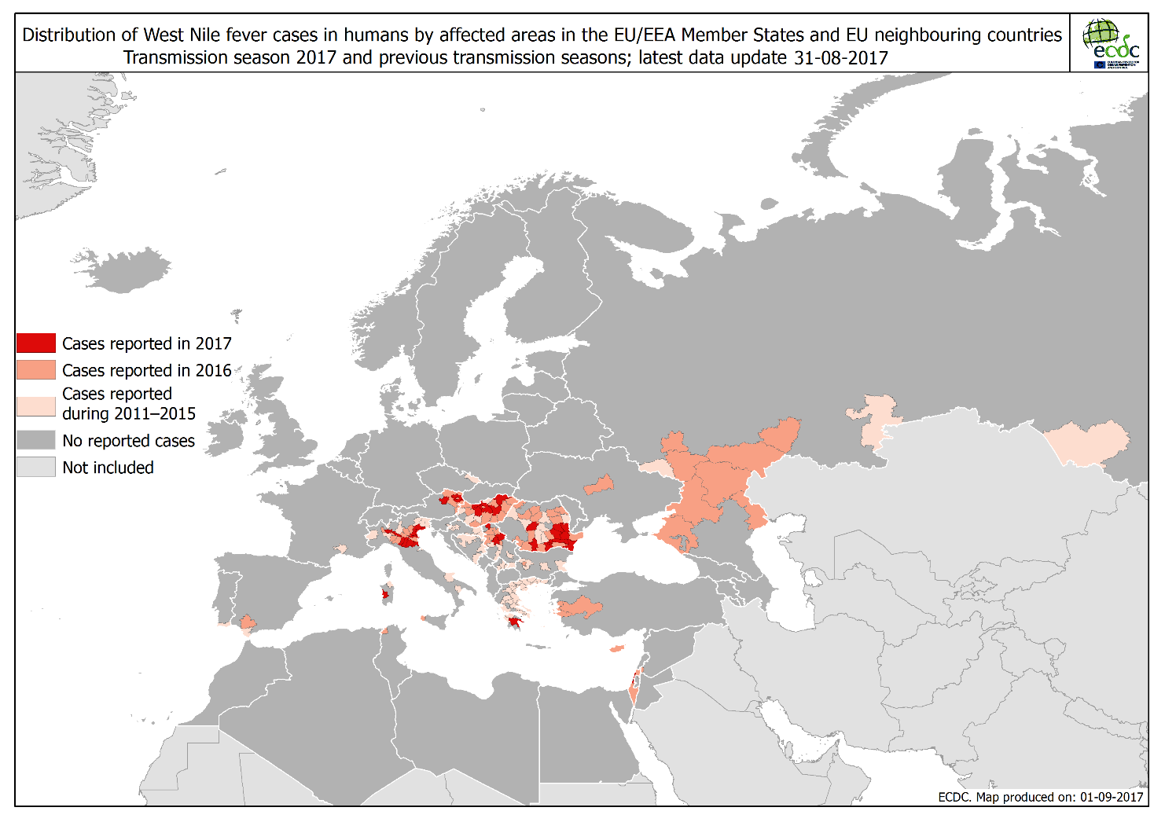

Slide 4
Distribution of confirmed cases of MERS-CoV by place of infection and month of onset,
March 2012 – 31 August 2017

Slide 5
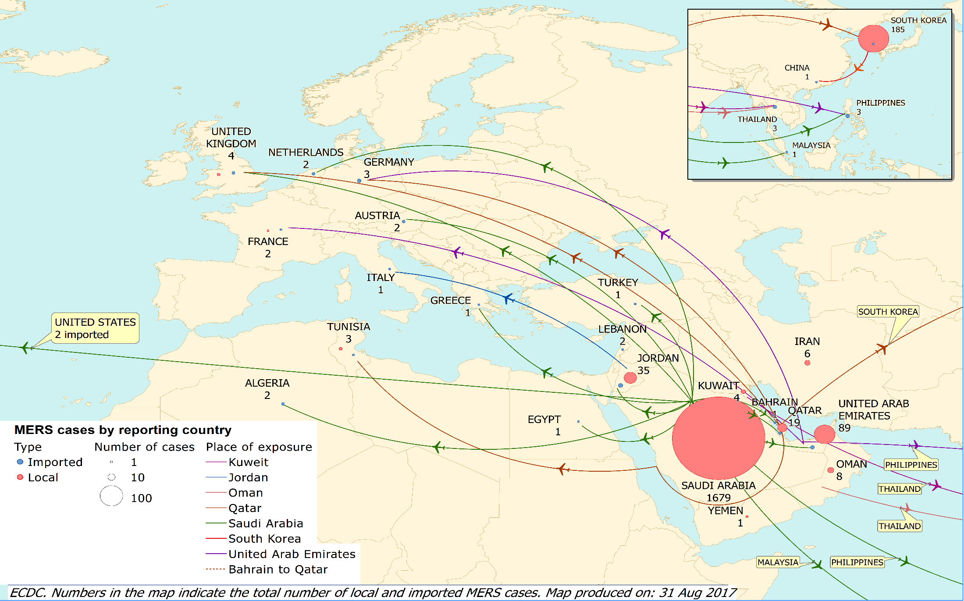
Distribution of confirmed cases of MERS-CoV by place of infection,
March 2012 – 31 August 2017

