Slide 1
You are encouraged to reuse our maps and graphs for your own purposes and free to translate, provided the content is not altered and the source is acknowledged.
Either copy the images from the following slides or download directly from: ecdc.europa.eu/en/publications/surveillance_reports/Communicable-Disease-Threats-Report/Pages/cdtr.aspx
European Centre for Disease Prevention and Control
Reusable maps and graphs from ECDC Communicable Disease Threats Report, week 22, 2018

Slide 2
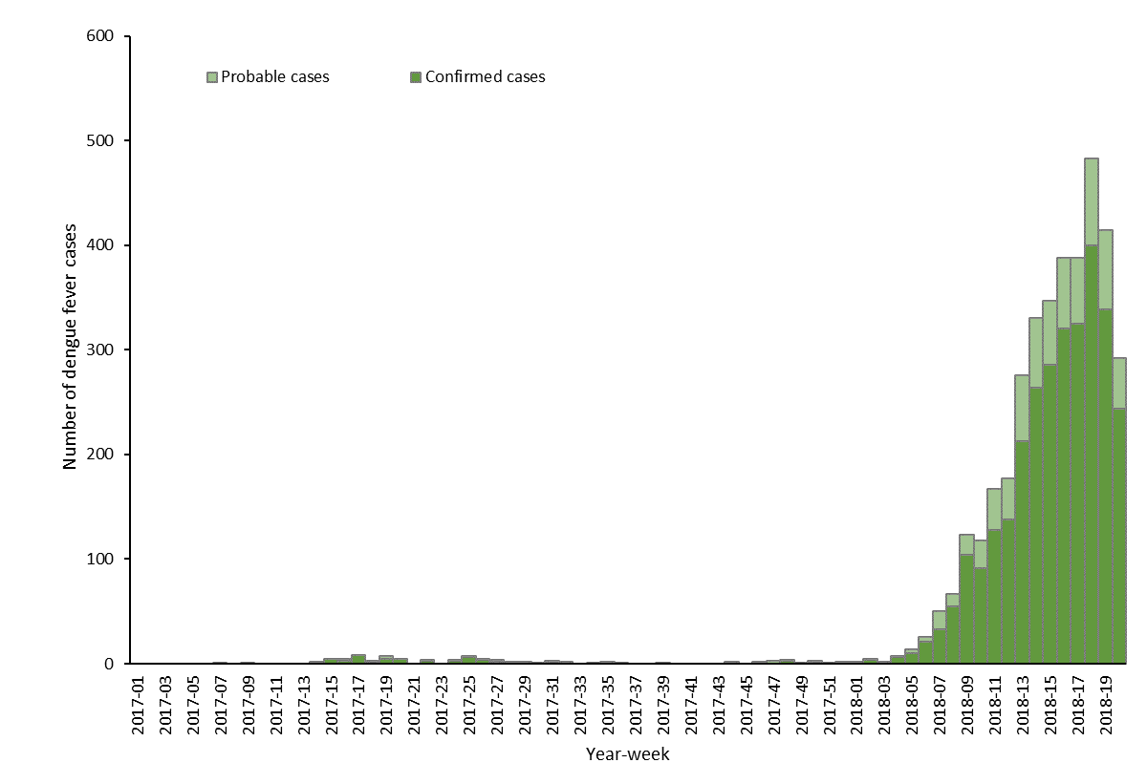
Distribution of autochthonous dengue cases by week of onset, week 1-2017 to week 20-2018, Réunion
Source: adapted from the MoH bulletin "Surveillance de la dengue à la Réunion. Point épidémiologique au 29 mai 2018”

Slide 3
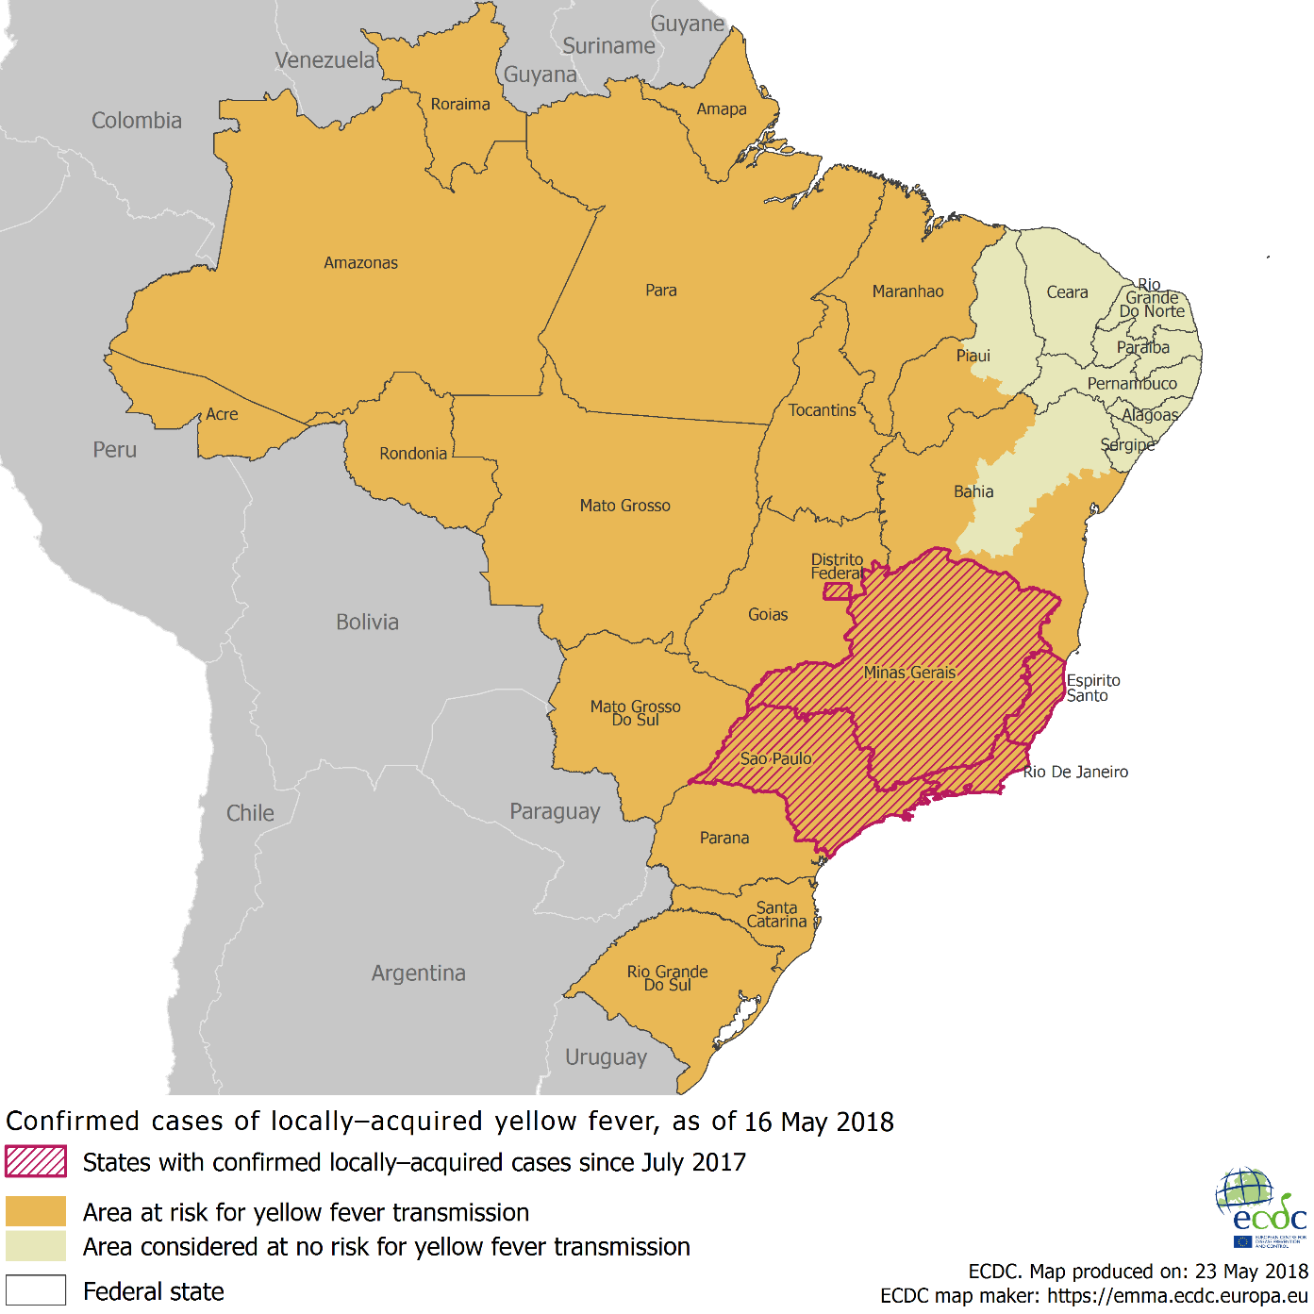
Distribution of confirmed yellow fever cases by state, Brazil, July 2017 – May 2018

Slide 4
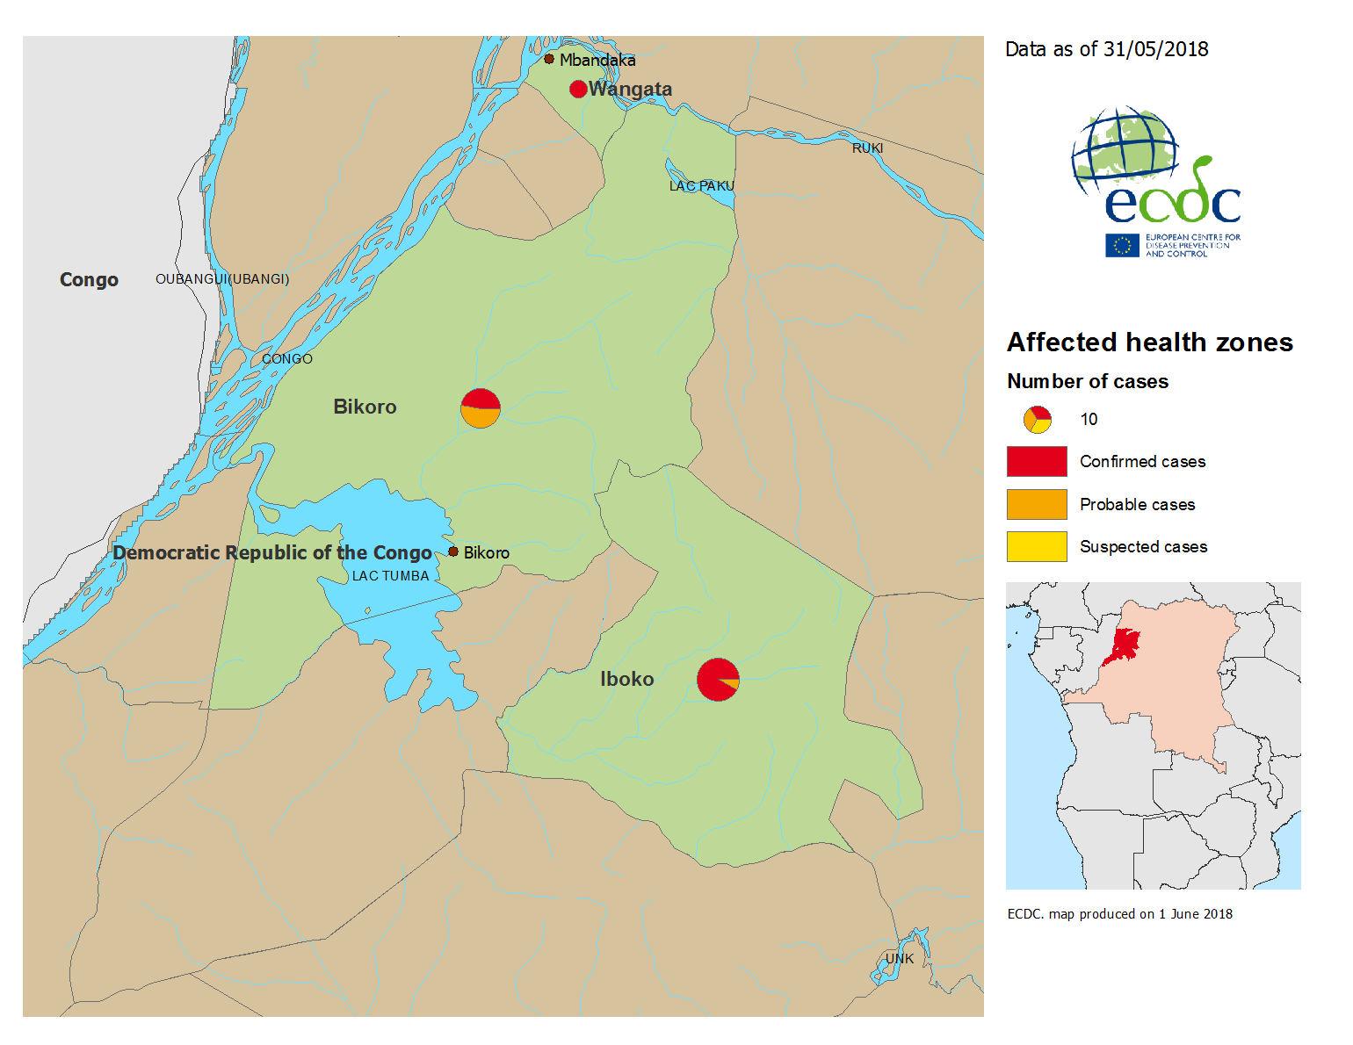
Geographical distribution of confirmed, probable and suspected cases of Ebola virus disease, Equateur Province, The Republic Democratic of Congo, as of 31 May 2018

Slide 5
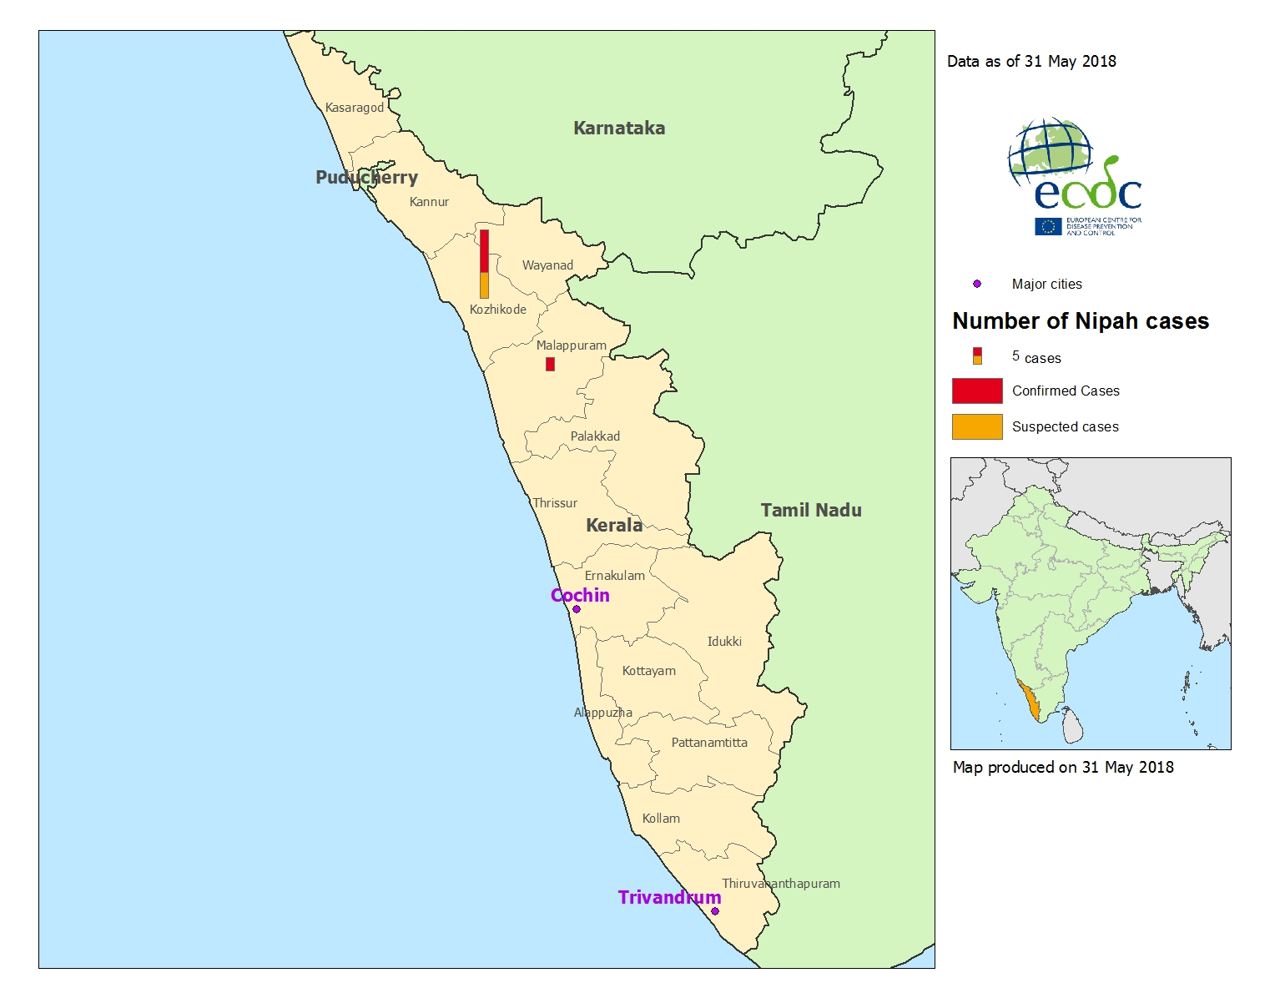
Distribution of Nipah virus cases, Kerala State, India, as of 31 May 2018

Slide 6
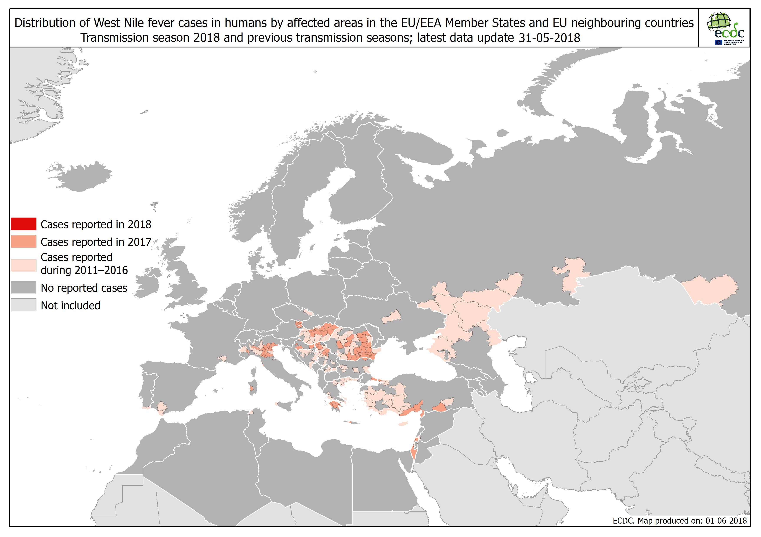

Slide 7
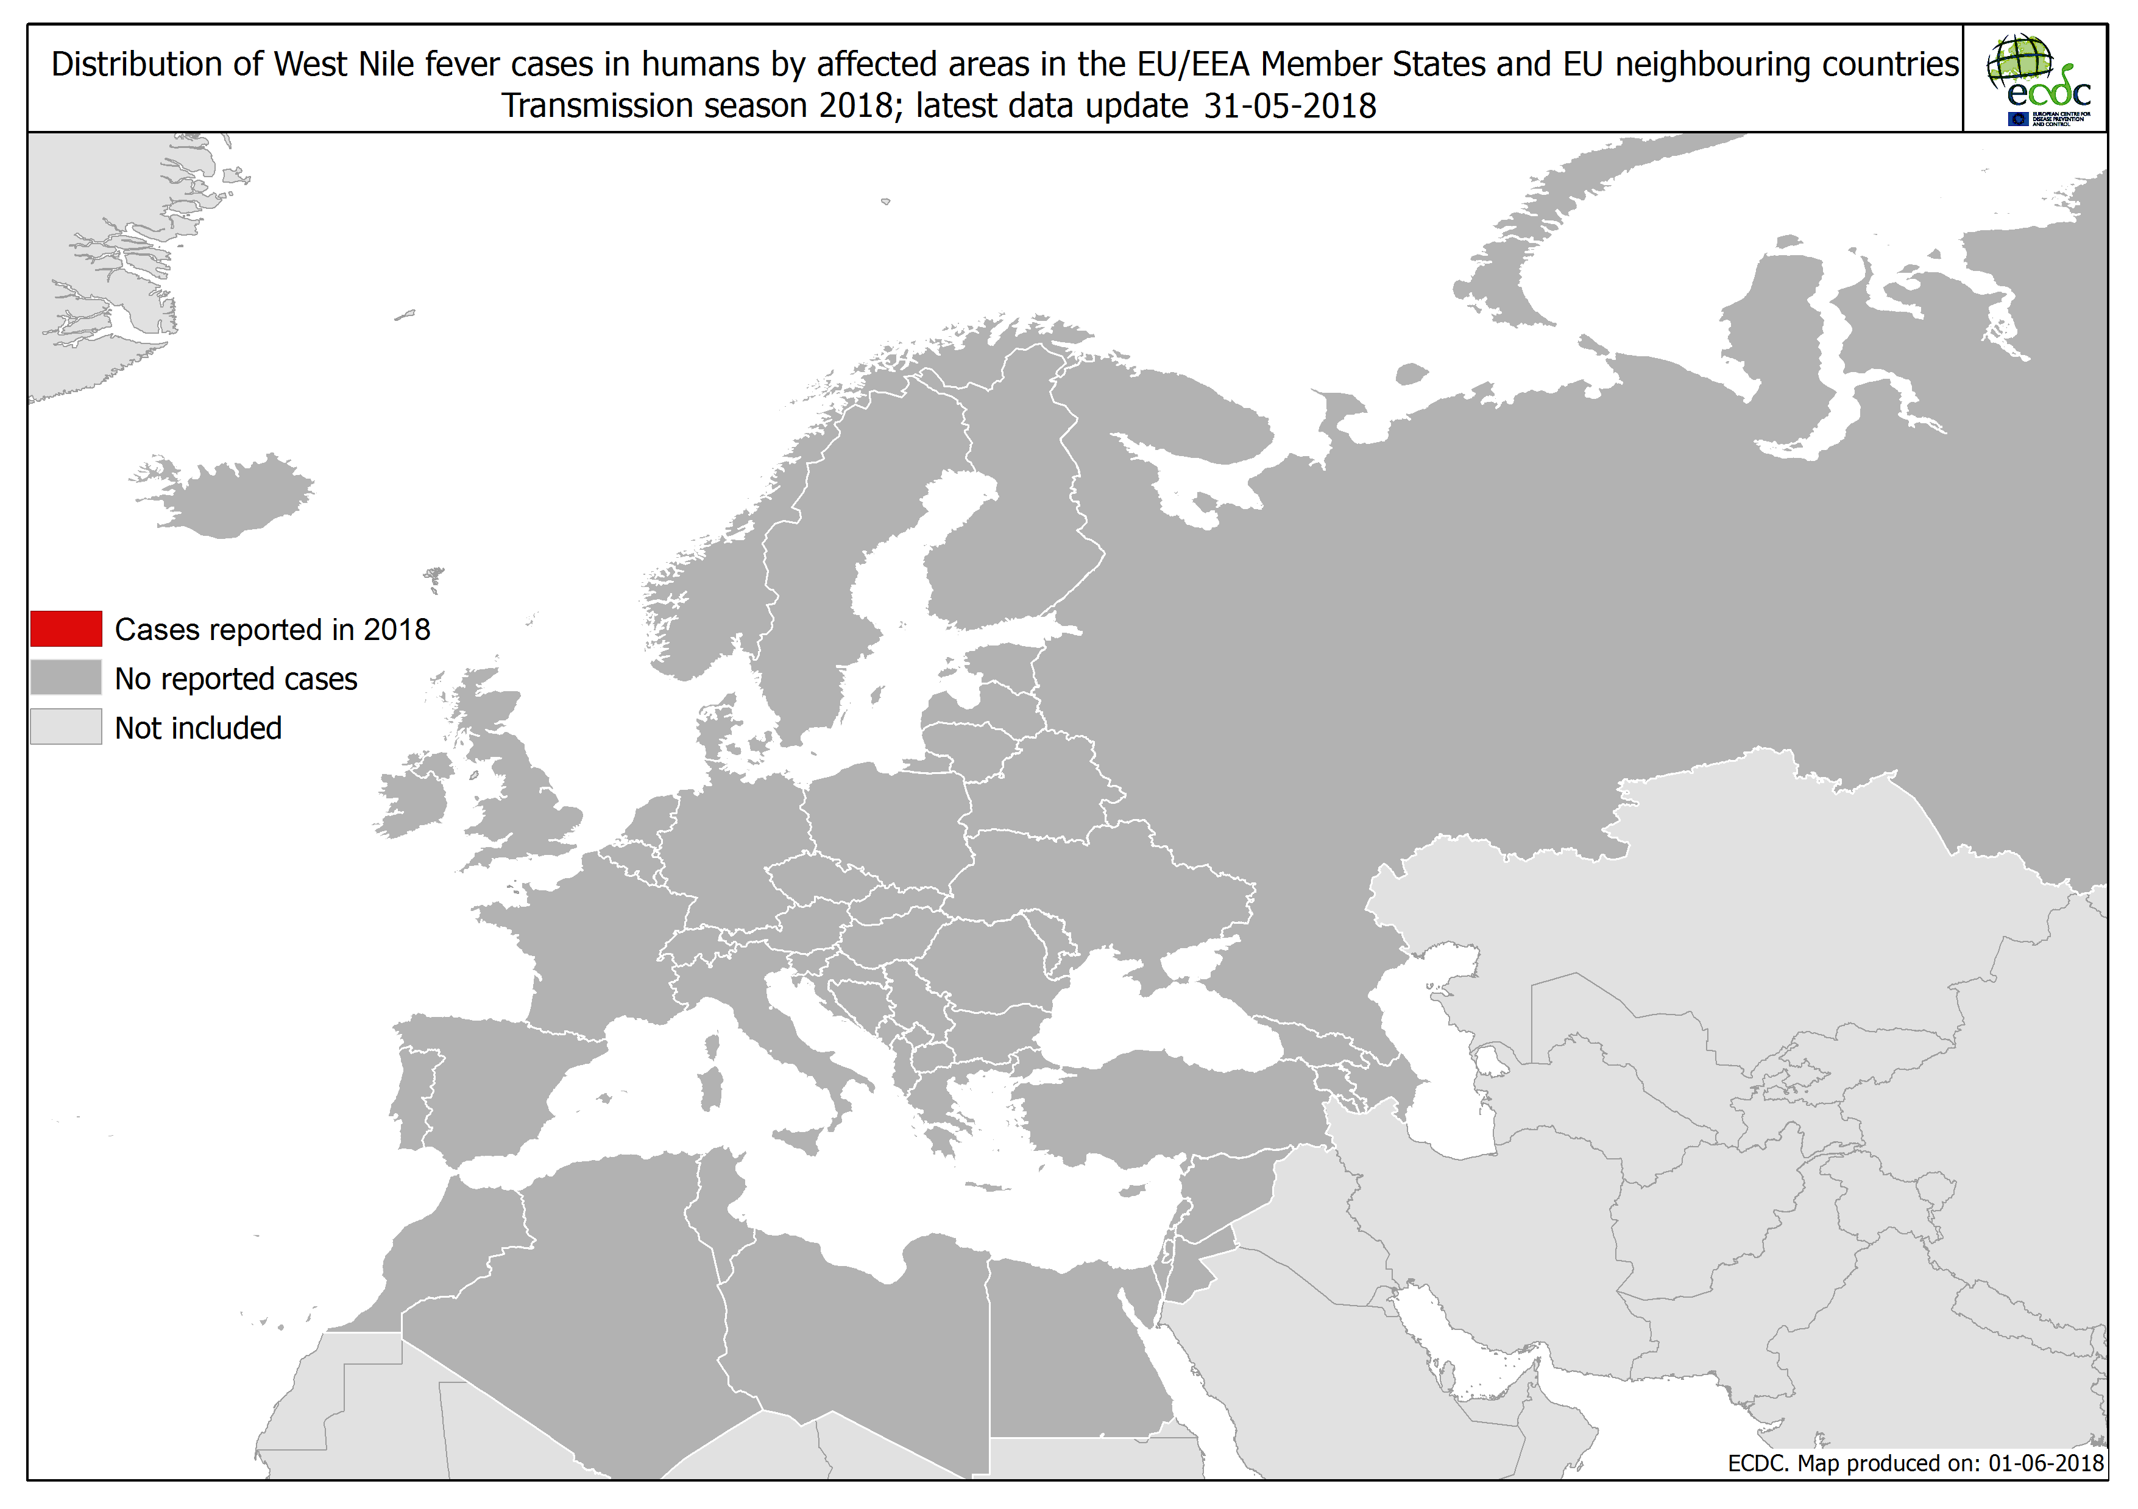

Slide 8
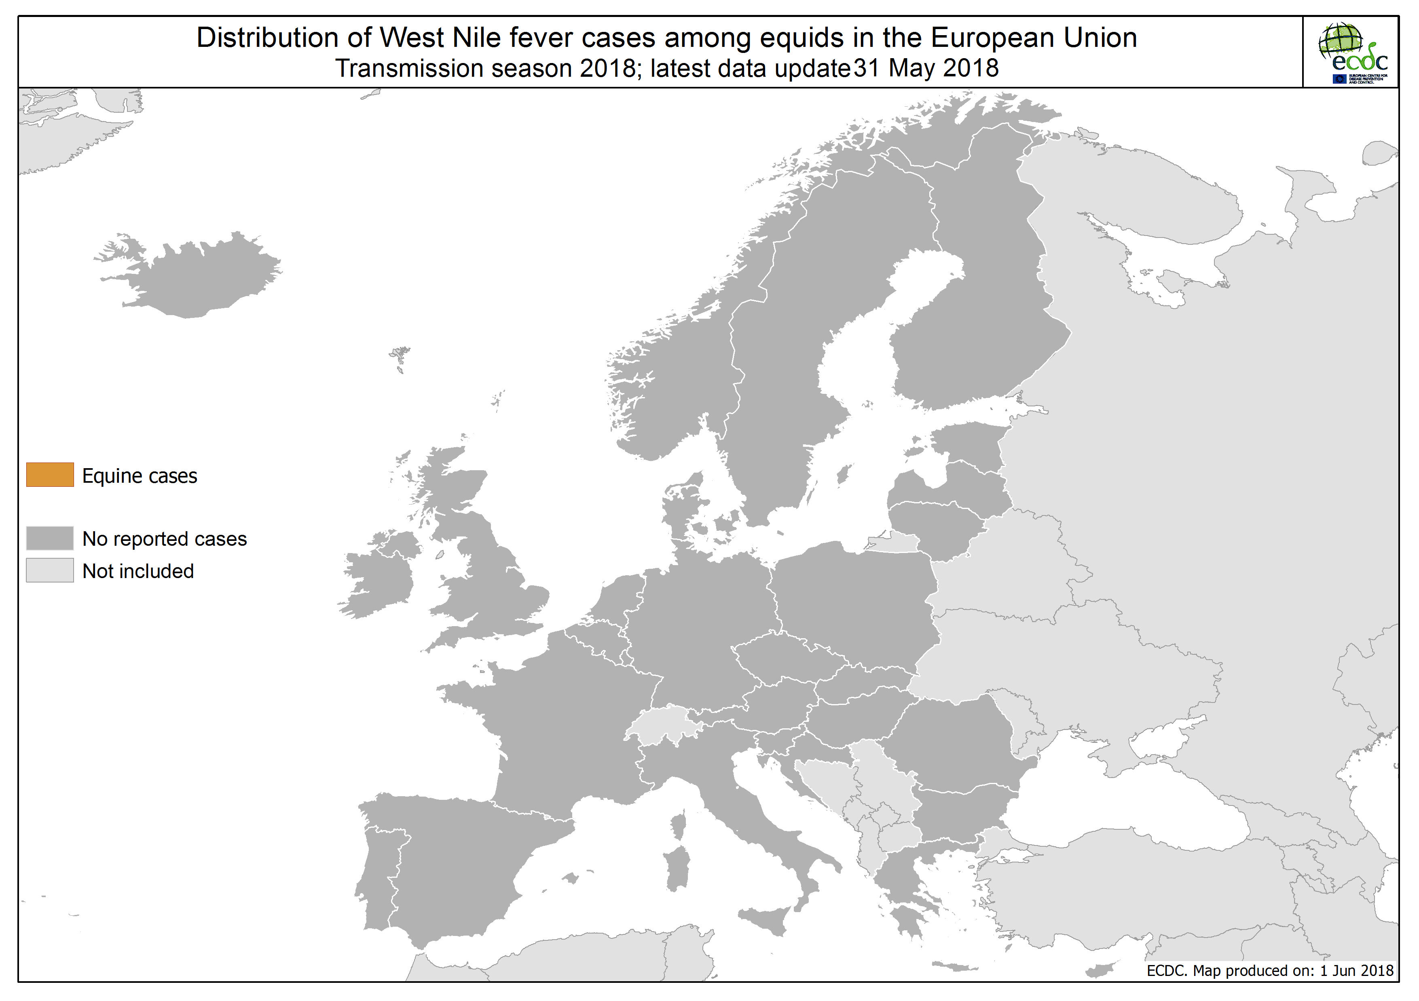

Slide 9
