Slide 1
Reusable maps and graphs from ECDC Communicable Disease Threats Report Week 16, 2023
You are encouraged to reuse our maps and graphs for your own purposes and are free to translate them, provided the content is not altered and the source is acknowledged.

Slide 2
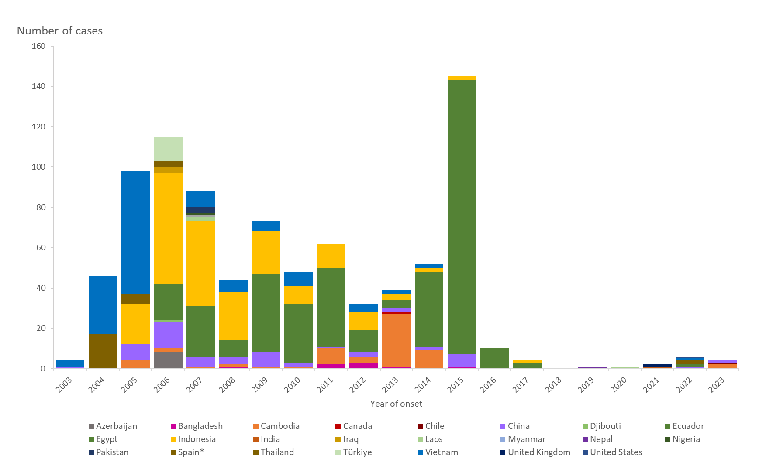
Distribution of confirmed human cases of avian influenza A(H5N1) virus infection by year of onset and country, 2003–2023 (updated on 19 April 2023, n=874)
Note: includes two asymptomatic cases reported in 2022 from Spain with suspected environmental contamination (Eurosurveillance, 2023)

