Slide 1
Reusable maps and graphs from ECDC Communicable Disease Threats Report
Week 8, 2024
You are encouraged to reuse our maps and graphs for your own purposes and are free to translate them, provided the content is not altered and the source is acknowledged.

Slide 2
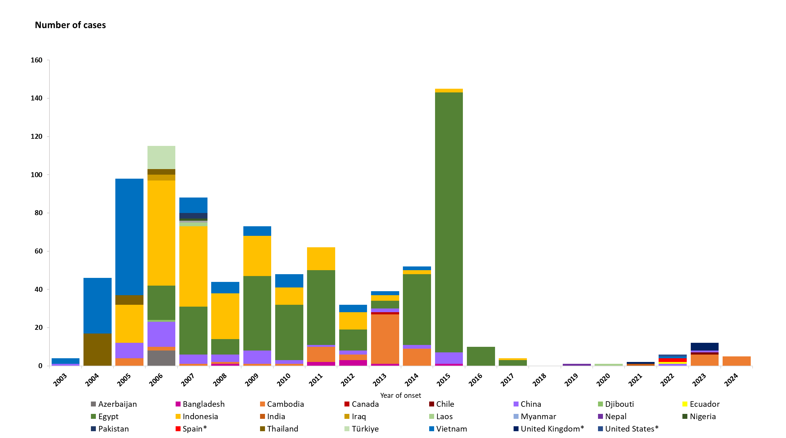
Distribution of confirmed human cases of avian influenza A(H5N1) virus infection by year of onset and country, 2003 to 22 Feb 2024 (n = 887)
*Note: this includes six detections due to suspected environmental contamination and no evidence of infection that were reported in 2022 by Spain (2 detections) and the United States (1), as well as in 2023 by the United Kingdom (3).

